Slide 1

Output Unit
Processing Unit
Pawan Mahadu Sarule
Class: FYBCA(Sci)

Slide 2
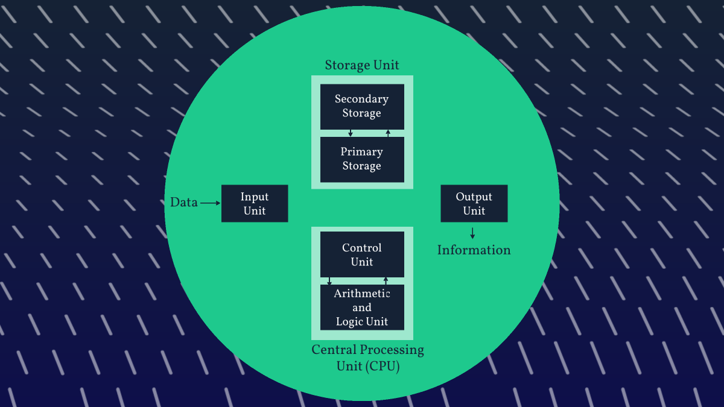
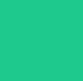
Storage Unit
Data
Information
Central Processing Unit (CPU)

Slide 3
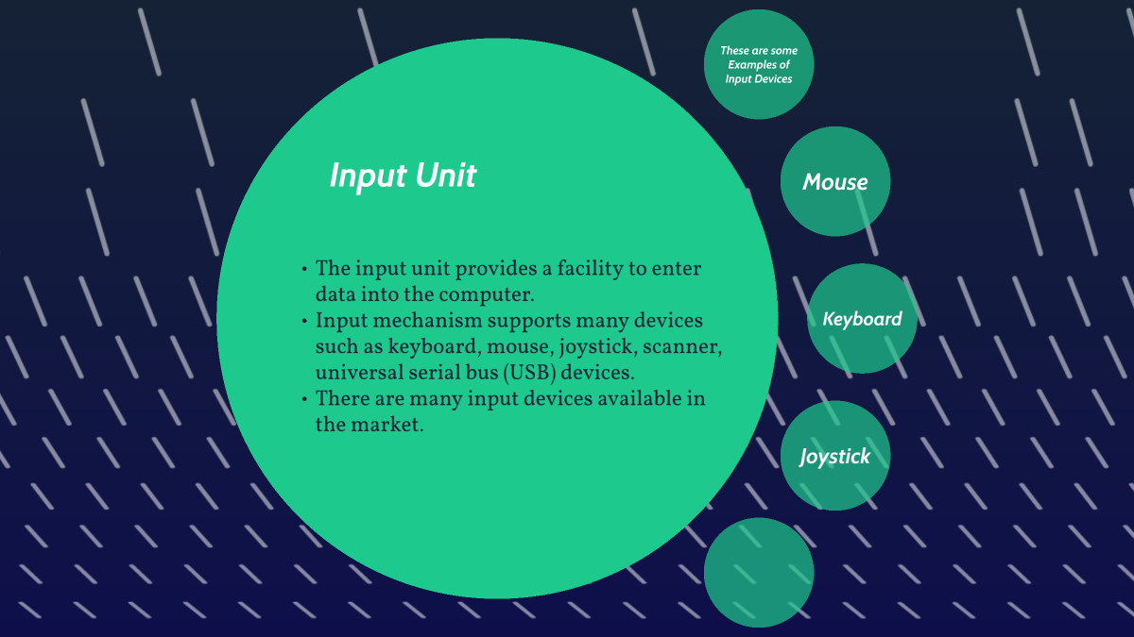
Input Unit
The input unit provides a facility to enter data into the computer.
Input mechanism supports many devices such as keyboard, mouse, joystick, scanner, universal serial bus (USB) devices.
There are many input devices available in the market.
Scanner

Slide 4



