Slide 1
Pawan Mahadu Sarule
Class: FYBCA (sci)

Slide 2
Index
1
Introduction
2
My Family
3
Education
4
All about me

Slide 3

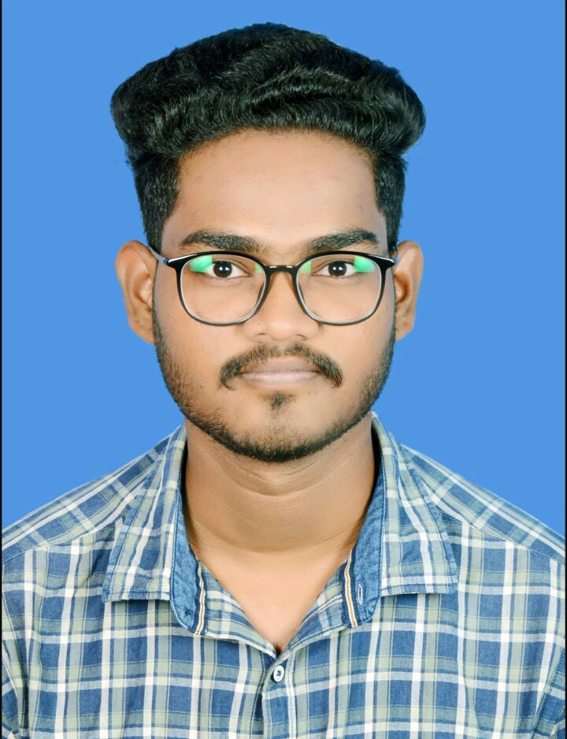
Its me !
Pawan Mahadu Sarule
FY BCA(Sci)

Slide 4
Introduction
Aim of Life
Born on
16Th Dec 2000
At
Sakhara, Hingoli, MH
I want to be the Data Scientist
Grow up at
Travel the world with my loved once.
Surat Gujarat
Now leave at
Live the life happily and peacefully .
Hinjewadi, Pune

Slide 5
My Family
01
Father
02
Mother
Mahadu Nayanu Sarule
Occupation : Cobbler
Vimala Mahadu Sarule
Occupation : House Wife
03
Brother
Arjun Mahadu Sarule
Occupation : Student

Slide 6
Education
Std. 1-3
Std 3-7
Std 8-10
Std 10-12
BCA (Sci)
Z. P School Sakhara,
Tq. Sengaon
Dist. Hingoli
H. B Hindi Vidyalaya,
Surat
Adarsh Hindi Vidyalaya,
Surat
Jai Hind Jr College,
Aurangabad
Dy Patil ACS,
Pimpari Pune

Slide 7
All about me !
1.Reading
2.Painting
3.Swimming
1. Shape of you
2. Bella Ciao
3. Despacito
Hobbies
Fav. Songs
01
02
1. Think and Grow Rich
2. The power of subconscious Mind
Books
1.Coffee
2.Biryani
3.Noodles
Food
06
03
1. Super 30
2. MS Dhoni
3. Dangal
Movie
Sports
1.Cricket
2.Basketball
3.Badminton
05
04

Slide 8
Thank You

