Slide 1

DR. D.Y. PATIL UNITECH SOCIETY'S
DR. D.Y. PATIL ARTS, COMMERCE & SCIENCE
COLLEGE
Pawan Mahadu Sarule
Class: FYBCA (sci)

Slide 2
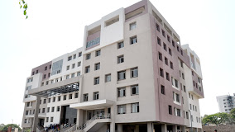

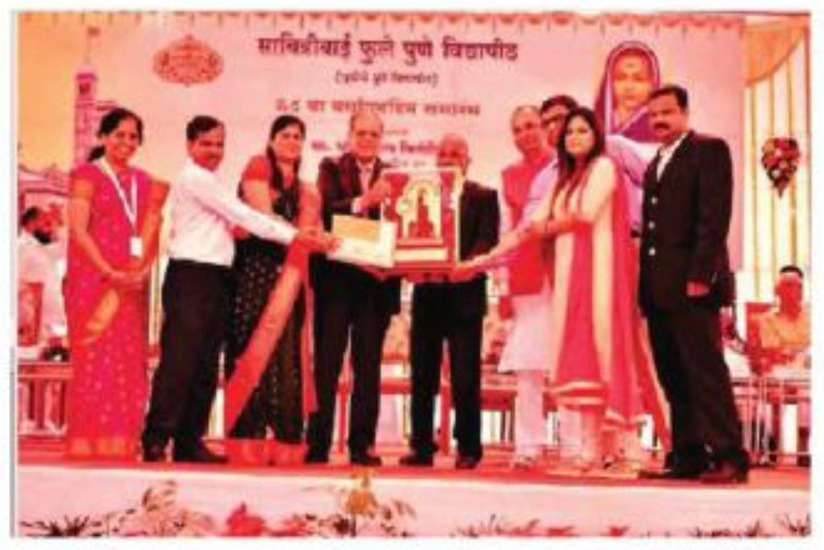
Dr. D.Y. Patil Arts, Commers And Science Collage Pimpari, Pune- 411018
College was established in the year 1995. it
runs both UG and PG Courses for arts students.
The College is affiliated to SPPU and is also NAAC Accredited with A grade with 3.28 CGPA. It has also received Best College Award from SPPU.

Slide 3
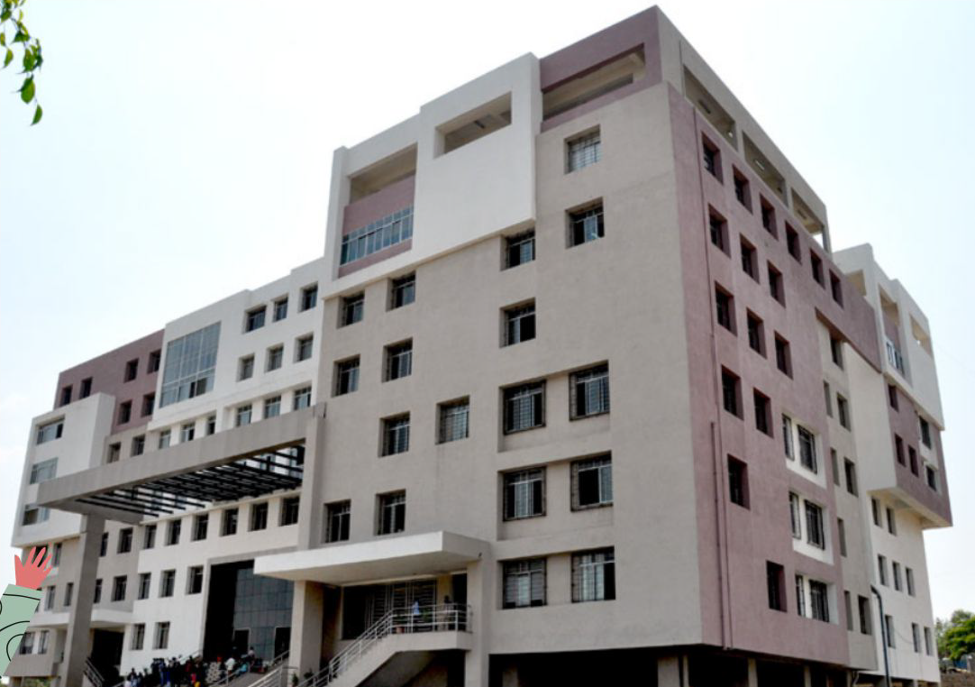
About us my college
Dr. D. Y. Patil Arts, Commerce & Science College was established in the year 1995 and it is a distinguished degree college affiliated to the University of Pune. Sheltered in huge well architecture premises along with multiple institutes, the college has a unique academic atmosphere chiefly characterized by interdisciplinary scholarly interaction and healthy competitive spirit and enthusiasm to excel in various curricular activities. The college has been Accredited by NAAC with A Grade.
The Unitech's Complex in Pune houses many prestigious institutions and colleges, imparting knowledge and learning in various disciplines to meet global challenges of 21 century. Within a very short span of time the college has gained recognition for preparing and grooming the students at under-graduate and post-graduate level into academically meritorious students and professionally efficient scholars. The highly qualified staff, well-equipped laboratories and well-stocked library in the college premises have yielded positive and encouraging results in enabling the students to excel in academics as well as extra-curricular activities.
THANK YOU

Slide 4
Vision To be a national model of academic excellence aspiring for promoting advance knowledge, highest morals & values for the well being of the society.
Mission
To provide traditional, conventional and innovative educational environment for creating global competencies and to
bring awareness of our rich and varied heritage to develop social responsibility amongst the students from all
backgrounds.
Goals and Objectives
To provide opportunities of education and skills through varied branches of knowledge of Arts, Commerce and Science.
To enhance employability of the students through innovative educational environment.
To enable students to develop a sense of culture and morality. To develop a spirit of social commitent.
To give edge to the global competence of the students through well equipped infrastructure and technical based education.
To encourage students to exhibit their artistic talent & skills through extracurricular activities.
THANK YOU

Slide 5
Our Faculty
Dr. P. D. Patil
Dr. Ranjit Patil
Chairman
Principal
THANK YOU
Dr. P. D. Patil is the architect of Pune’s academic complex of the Pratisthan and has transformed the vision of Padmashree Dr. D. Y. Patil into reality by establishing many quality institutions within a short span of time.
Dr. Ranjit D. Patil, MCS, M.Phil, NET and PhD. in the field of computer science. Currently he is working as Vice-Principal and HOD of computer Science department. He is recognized PhD and MPhil .

Slide 6
Thank You

