Slide 1
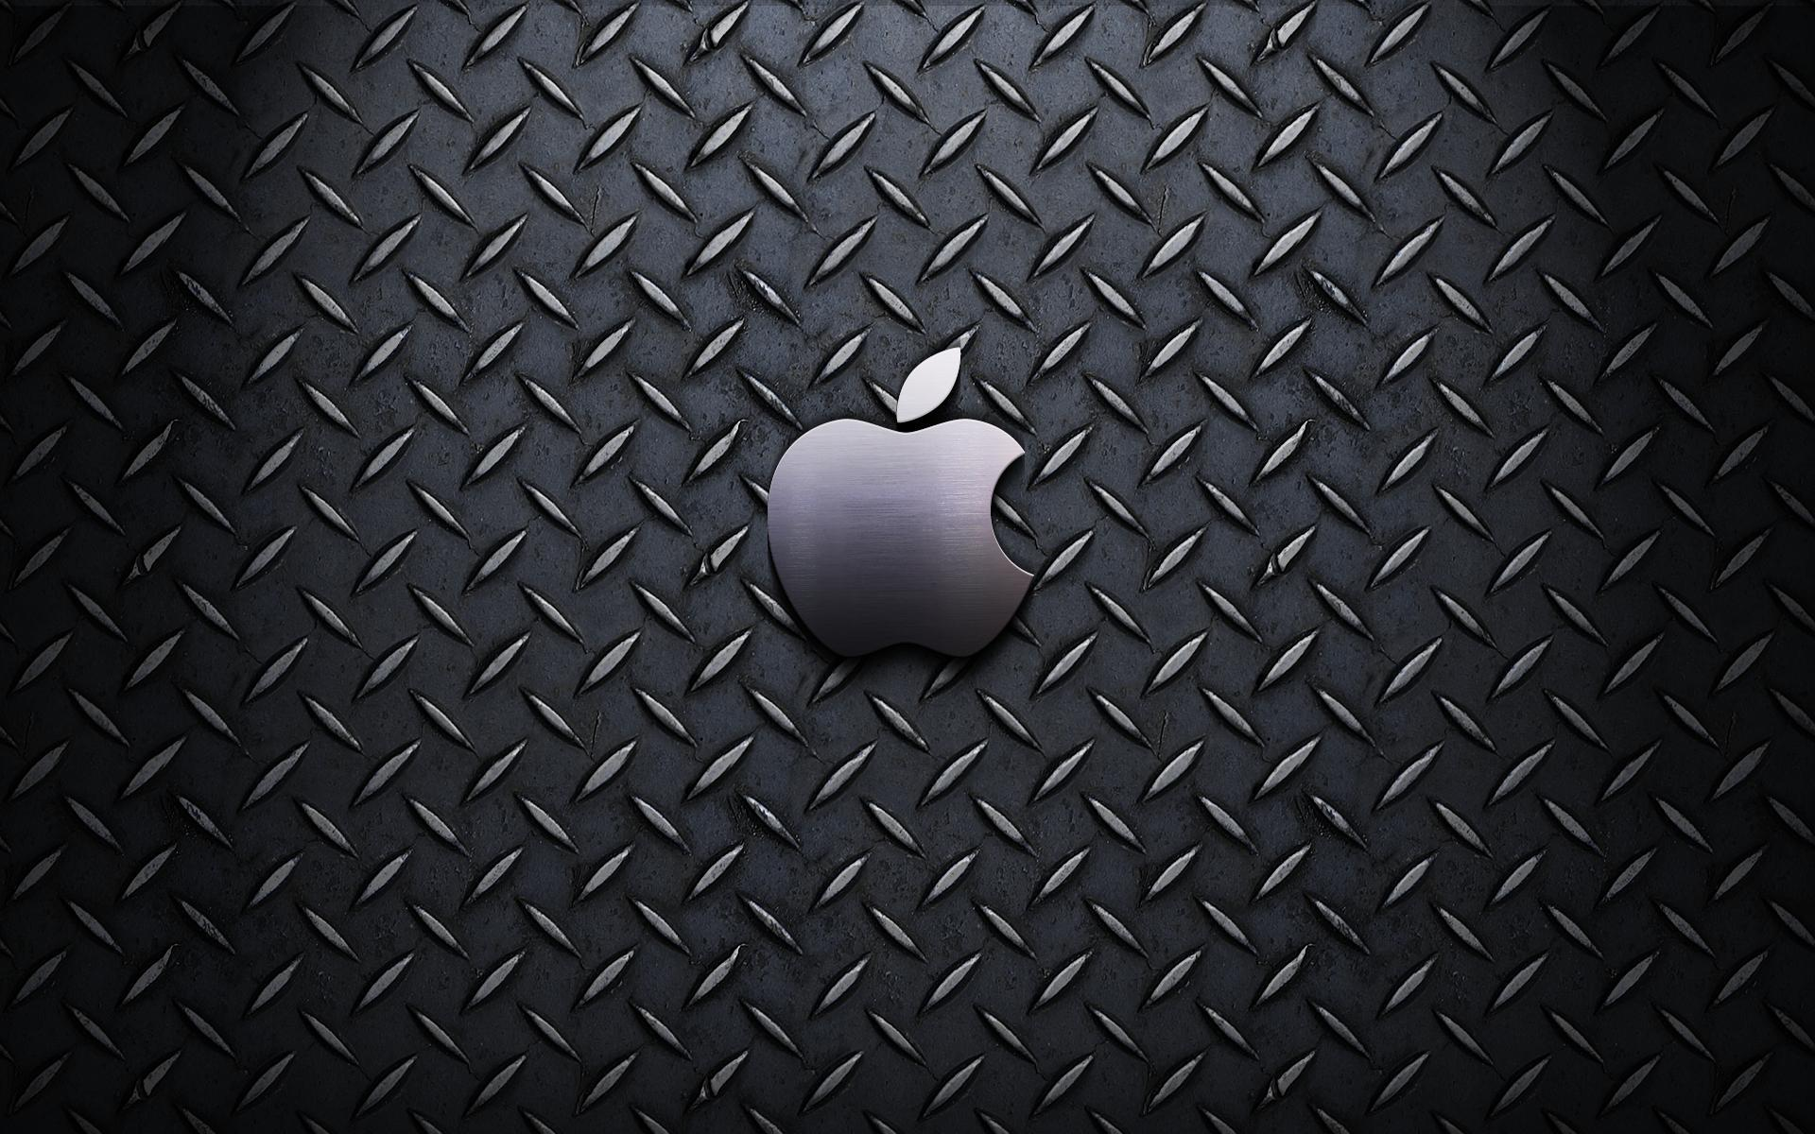
Pawan Mahadu Sarule
Class :FYBCA(Sci)

Slide 2

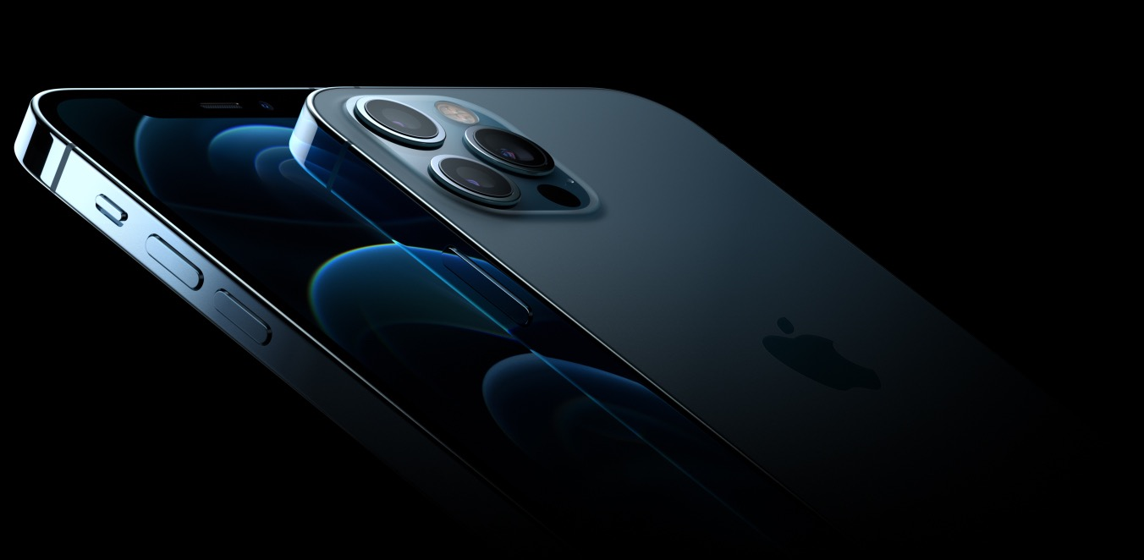

Slide 3
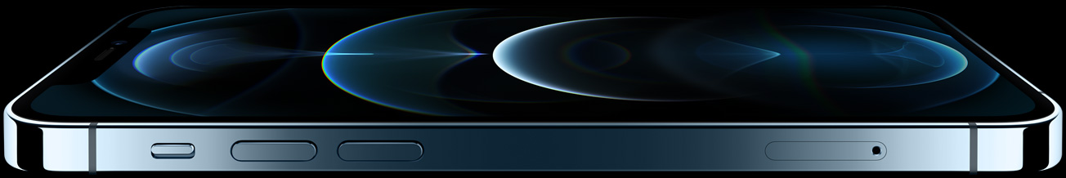
Ceramic Shield, tougher than any smartphone glass
Kicks glass

Slide 4
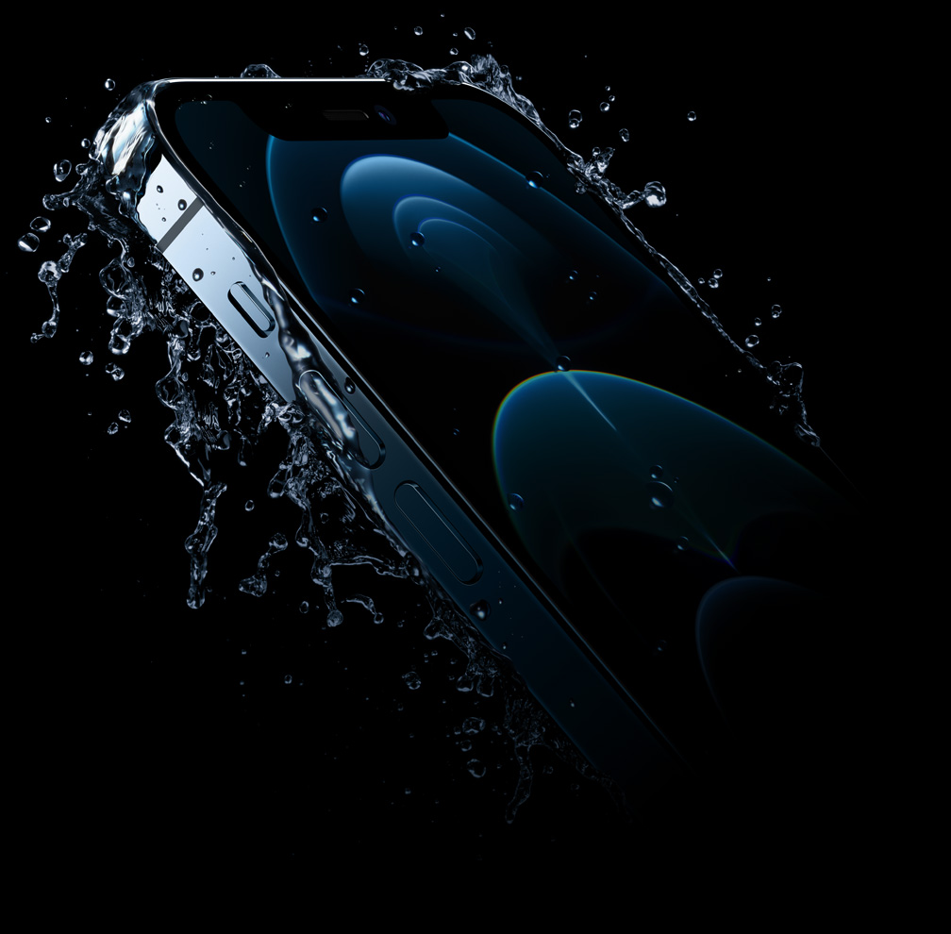
Blows other phones out of the water.
Industry‑leading IP68 water resistance

Slide 5
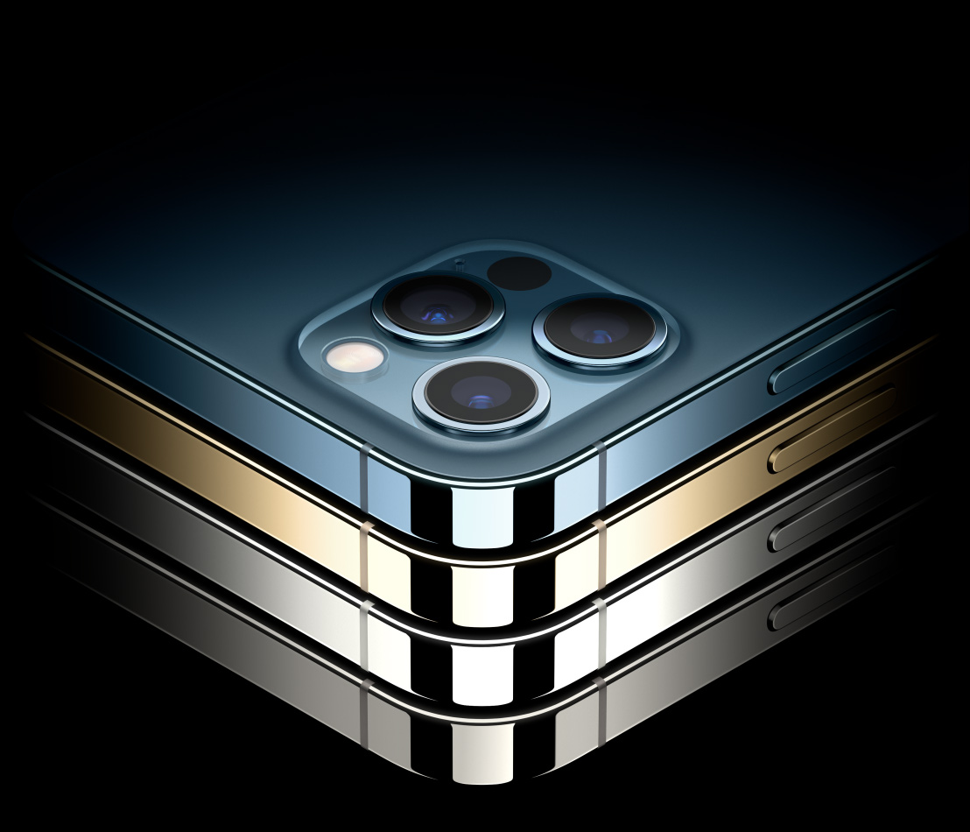
Four finishing touches.
Pacific Blue
Gold
Silver
Graphite

Slide 6
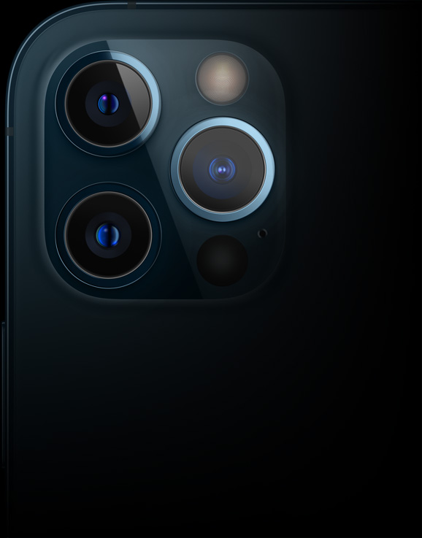
A snapshot of each camera.
iPhone 12 Pro
26mm focal length
1.4 µm pixels
ƒ/1.6 aperture
100% Focus Pixels
7-element lens
OIS

Slide 7
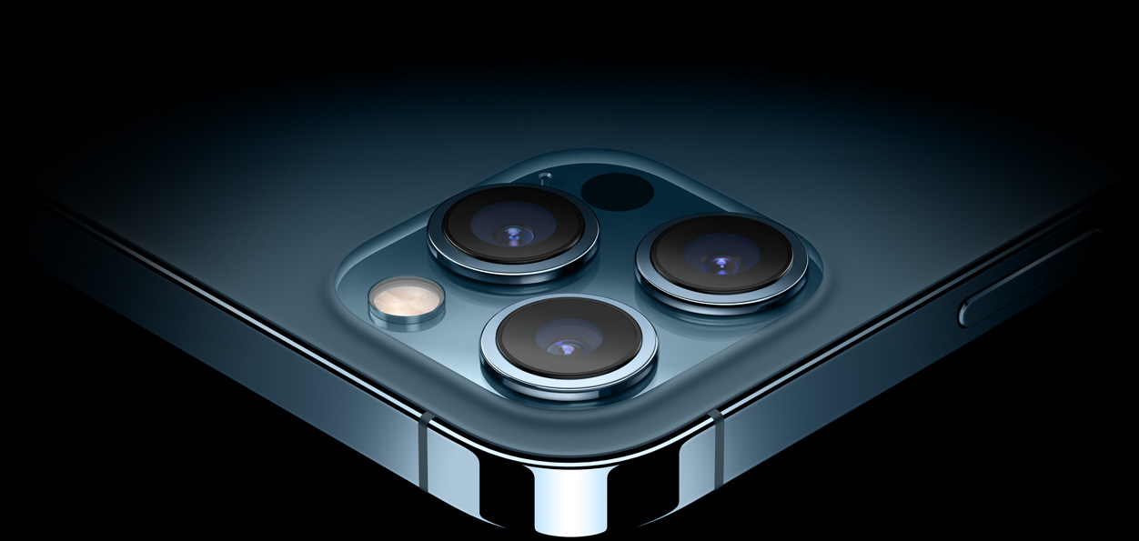
Pro camera system
A new day for Night mode.
Wide camera with ƒ/1.6 aperture captures 27% more light
New 7‑element Wide lens for edge‑to‑edge sharpness
New OIS makes 5,000 adjustments per second
LiDAR delivers up to 6x faster autofocus in low light

Slide 8
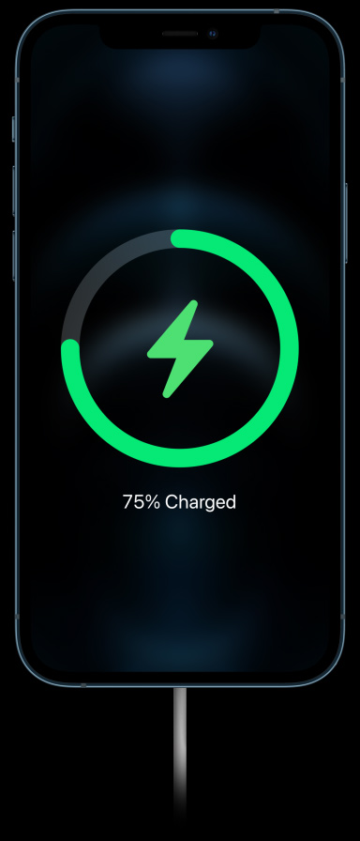
Turbo Chargeable.
Magnets align themselves perfectly every time for faster wireless charging.

Slide 9
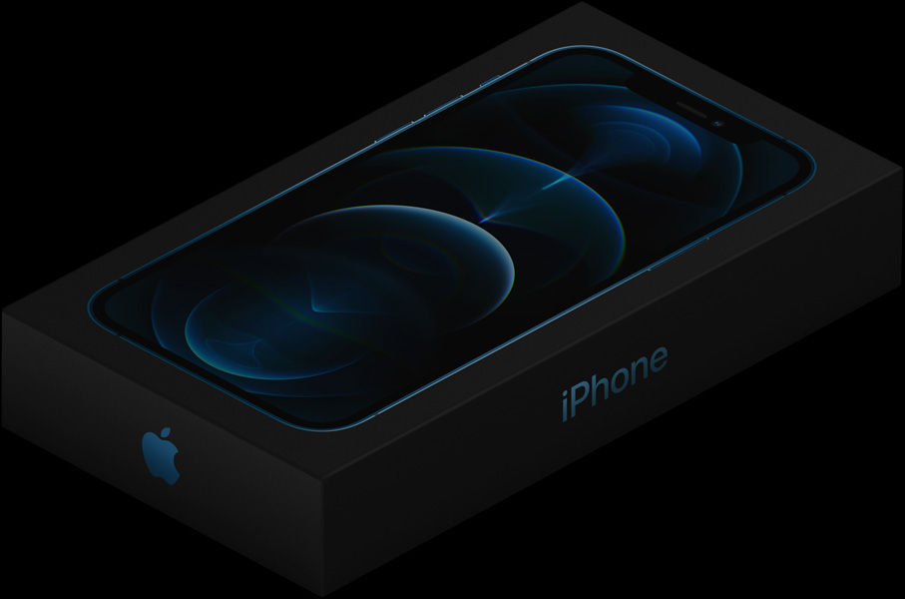
Thank
You

