Slide 1

By
Pawan Mahadu Sarule
Class: FYBCA(Sci)

Slide 2
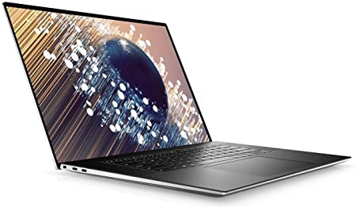
New XPS 17 9700 Laptop
10th Generation Intel® Core™ i7-10750H (12MB Cache, up to 5.0 GHz, 6 cores)
Windows 10 Pro (64bit) English
NVIDIA® GeForce® GTX 1650 Ti 4GB GDDR6
16GB DDR4-2933MHz, 2x8G
1TB M.2 PCIe NVMe Solid State Drive
CNC Machined Aluminum in Platinum Silver with Black Carbon Fiber Composite Palmrest
USB-C to USB-A v3.0 & HDMI v2.0 adapter ships standard

Slide 3
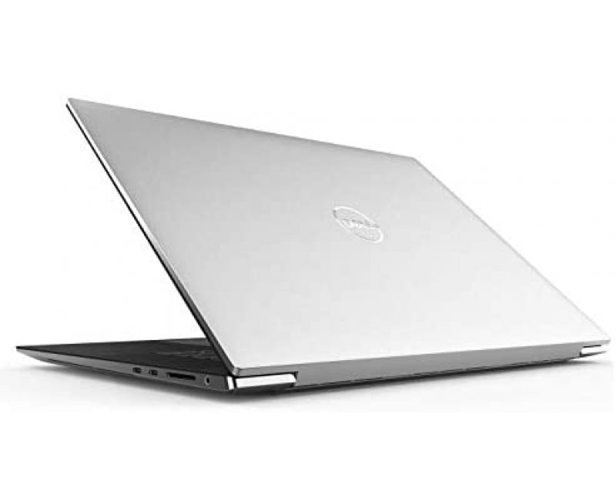
Create with colossal power
Feel the power: High-performance 10th Gen Intel® Core™ processors and powerful NVIDIA® graphics power the most intensive creative pursuits.
More creating, less waiting: GeForce® GTX 1650 Ti laptops are built with the breakthrough graphics performance of the award-winning GeForce GPUs. Dedicated GPU power accelerates the creative apps you use every day.
Speed and memory: Power through intense workloads with up to 32GB memory and up to 3x faster wireless with Killer™ AX1650 built on Intel WiFi6 Chipset.

Slide 4
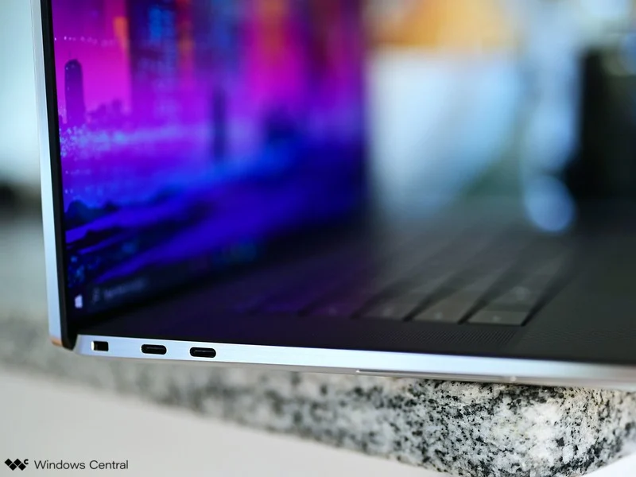
Ports & Slots
1. 2x Thunderbolt™ 3 with power delivery & DisplayPort | 2. Full-size SD card reader v6.0 | 3. 3.5mm headphone/microphone combo jack | 4. Wedge-shaped lock slot | 5. 2x Thunderbolt™ 3 with power delivery & DisplayPort
USB-C to USB-A v3.0 & HDMI v2.0 adapter ships standard

Slide 5

Thank
You

