Slide 1

Derivation of Vibrating String Equation Using Partial Differentiation
This presentation will guide you through the detailed derivation of the vibrating string equation using the powerful techniques of partial differentiation. We'll explore the underlying assumptions, the mathematical steps, and the physical interpretation of the resulting equation.

Slide 2

Introduction to Vibrating String Equation
1
Understanding Vibrations
2
Mathematical Modeling
3
Applications
This equation is a partial differential equation that captures the spatial and temporal variations of the string's displacement.
The vibrating string equation is fundamental in areas like acoustics, musical instrument design, and structural dynamics.
The vibrating string equation describes the motion of a taut string undergoing transverse vibrations.

Slide 3
Assumptions and Constraints
Uniform Tension
Small Deflections
Homogeneous Material
The string is assumed to have a constant tension along its length.
The string's transverse displacement is small compared to its length.
The string is made of a uniform, continuous material with no discontinuities.

Slide 4
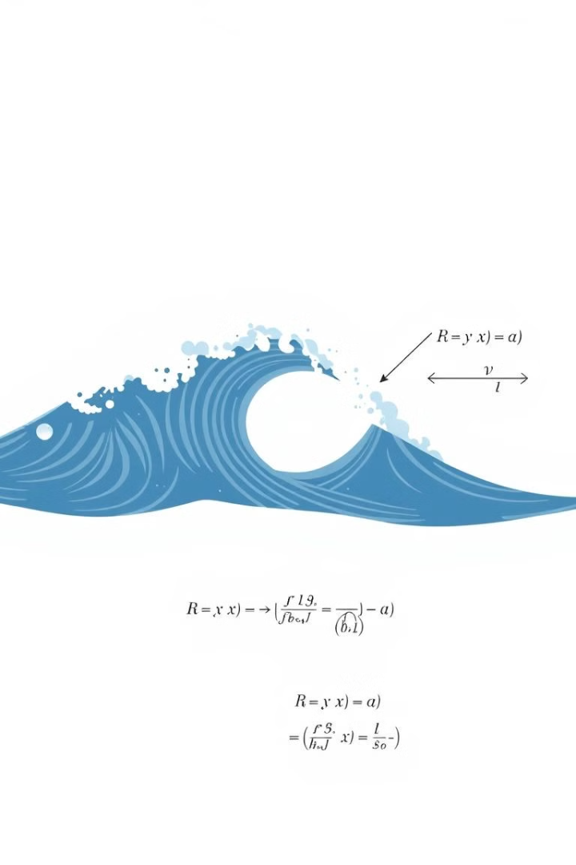
Derivation of Wave Equation
1
Force Balance
Apply Newton's second law to a small segment of the string to establish the force balance.
2
Spatial Derivatives
Introduce spatial derivatives to represent the tension and acceleration forces on the string.
3
Wave Equation
Simplify the expression to arrive at the canonical wave equation for the string's displacement.

Slide 5



Mathematical Equations for Vibrating Strings
Wave Equation
1
Describes the displacement of the string over time and space.
Partial Derivatives
2
Represent the spatial and temporal changes in the string's motion.
Force Balance
3
Applies Newton's laws to the forces acting on a string segment.
The derivation of the vibrating string equation involves a series of mathematical steps. First, we establish the wave equation that captures the displacement of the string over time and space. This requires taking partial derivatives to represent the spatial and temporal changes in the string's motion. Ultimately, we arrive at the equation of motion by performing a force balance on a small segment of the string.

Slide 6
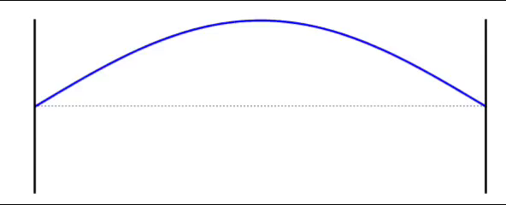

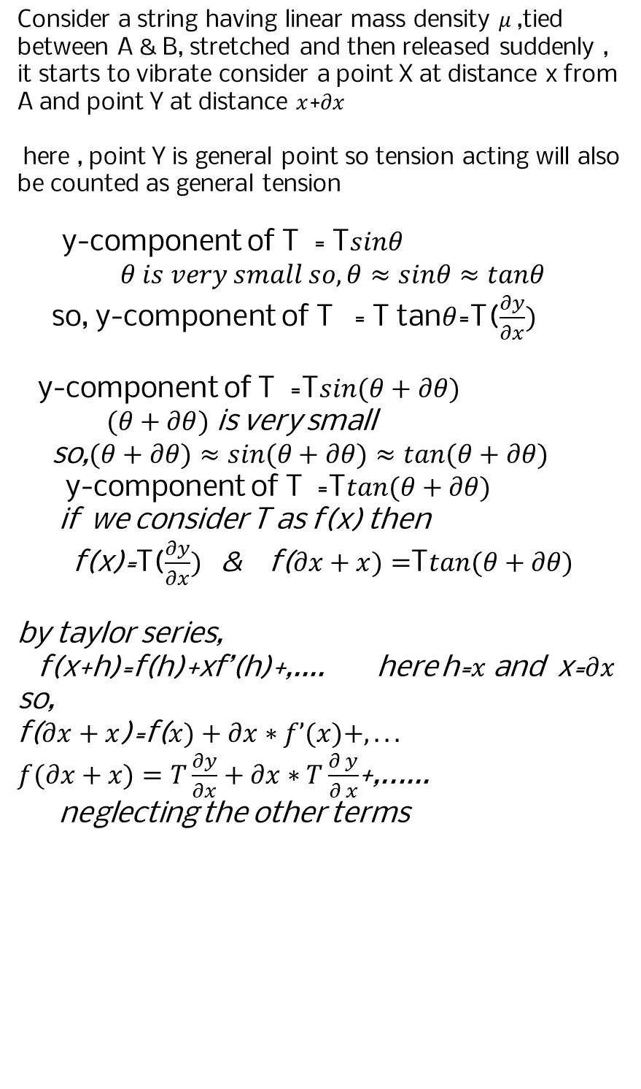
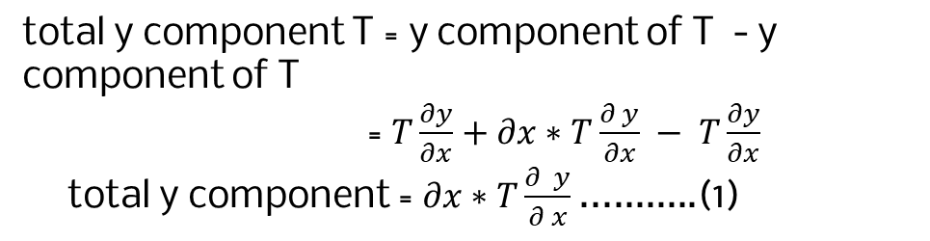



Mathematical Equations for Vibrating Strings
Consider a string having linear mass density $μ$,tied between A & B, stretched and then released suddenly , it starts to vibrate consider a point X at distance x from A and point Y at distance $x$+$∂x$
here , point Y is general point so tension acting will also be counted as general tension
y-component of T = T$sinθ$
$θ is very small so, θ≈sinθ≈tanθ$
so, y-component of T = T tan$θ$=T($\frac{∂y}{∂x})$
y-component of T =T$sin(θ+∂θ)$
$(θ+∂θ)$ is very small
so,$(θ+∂θ)≈sin(θ+∂θ)≈tan(θ+∂θ)$
y-component of T =T$tan(θ+∂θ)$
if we consider T as f(x) then
f(x)=T($\frac{∂y}{∂x})$ & f($∂x+x)=$T$tan(θ+∂θ)$
by taylor series,
f(x+h)=f(h)+xf’(h)+,.... here h=$x$ and x=$∂x$
so,
f($∂x+x$)=f($x)+∂x∗f’(x)+,...$
$f(∂x+x)=T\frac{∂y}{∂x}+∂x∗T\frac{∂ y}{∂ x}$+,......
neglecting the other terms
Y
X
A
$$xxxx$$
B
X
(0,0)
$$x \\ ∂x$$
X
T
Y
Y
Y
$$θ+δθ$$
X
$$θ$$
Since , tension in a string is same at every point so,
let , T at point X =T at point Y=T
T
X
total y component T = y component of T - y component of T
= $T\frac{∂y}{∂x}+∂x∗T\frac{∂ y}{∂x} − T\frac{∂y}{∂x}$
total y component = $∂x∗T\frac{∂ y}{∂ x}$...........(1)
2
2
2
2
2
2

Slide 7

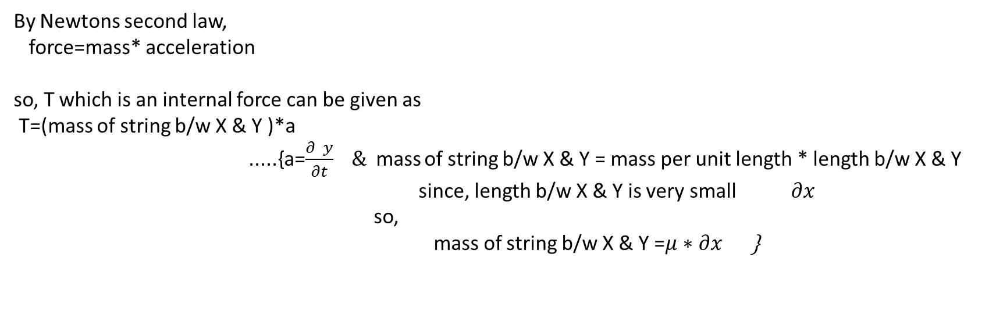
Mathematical Equations for Vibrating Strings
By Newtons second law,
force=mass* acceleration
so, T which is an internal force can be given as
T=(mass of string b/w X & Y )*a
.....{a=$\frac{∂ y}{∂t} \&$mass of string b/w X & Y = mass per unit length * length b/w X & Y
since, length b/w X & Y is very small $∂x$
so,
mass of string b/w X & Y =$μ∗∂x$ }
2
2
2
so, T =$μ∗∂x∗\frac{∂ y}{∂ t} ......(2)$
2
from equation (1) & (2),
T =$μ∗∂x∗\frac{∂ y }{∂ t}=∂x∗T∗\frac{∂ y}{∂ x}$
2
2
2
2
$$\frac{∂ y}{∂x}=\frac{μ}{T} ∗\frac{∂y}{∂t}$$
2
2
2
2

Slide 8

Partial Derivatives of Displacement
Spatial Derivative
Temporal Derivative
Second Derivatives
The partial derivative of displacement with respect to position represents the slope of the string.
The partial derivative of displacement with respect to time gives the velocity of the string's vibration.
Higher-order partial derivatives capture the acceleration and curvature of the vibrating string.

Slide 9




Translational and Vibrational Forces
Tension Force
Curvature
Equilibrium
The tension in the string acts in the tangential direction, causing translational acceleration.
The string's curvature results in a Vibrational force that contributes to the equation of motion.
The balance of these forces leads to the final form of the vibrating string equation.

Slide 10
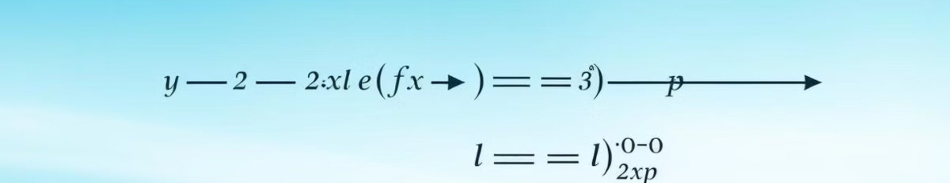




Equation of Motion for Vibrating String
Displacement
Time
Position
Parameters
The dependent variable is the transverse displacement of the string.
The independent variable is the time variable, capturing the temporal evolution of the vibration.
The other independent variable is the spatial position along the length of the string.
The equation also includes physical parameters like tension, density, and length of the string.

Slide 11
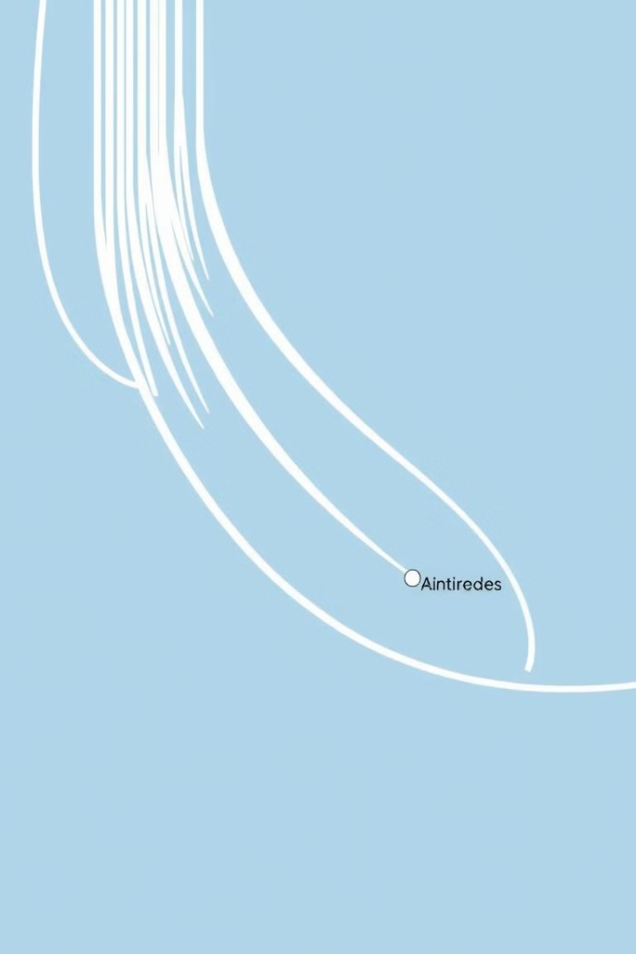
Boundary Conditions and Solution
Fixed Ends
The string is assumed to be fixed at both ends, with zero displacement at the boundaries.
Initial Conditions
The initial displacement and velocity of the string must be specified to fully determine the solution.
General Solution
The general solution to the vibrating string equation involves a superposition of sine and cosine functions.

Slide 12
Physical Interpretation of Variables
Displacement
Time
Position
The displacement variable represents the transverse motion of the string, perpendicular to its length.
The time variable captures the temporal evolution of the string's vibration, including frequency and period.
The spatial position variable describes the location along the length of the string, which affects the vibration patterns.

Slide 13

Applications and Examples
1
Musical Instruments
2
Structural Dynamics
3
Wave Propagation
The vibrating string equation is fundamental to the design and analysis of musical instruments like guitars, violins, and pianos.
The equation also applies to the vibrations of structures like bridges, buildings, and mechanical systems.
The vibrating string model can be extended to study the propagation of waves in various media, such as electromagnetic waves or sound waves.

