Slide 1
Chapter – VI
PHASE RULE

Slide 2
PHASE RULE
Dr. Jitendra B.Patil
Thakur college of Engineering & technology

Slide 3
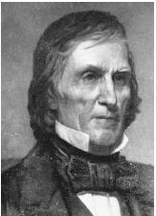
A system is divided in to two types; heterogeneous and homogeneous system.
Phase equilibrium is said to exist when two or more phases coexist in a heterogeneous system. Such a heterogeneous system is conveniently studied on the basis of thermodynamic considerations by a generalization of called as phase rule deduced by J. Willard Gibbs in 1876.
Willard Gibbs

Slide 4
INTRODUCTION
All the chemical reactions can be broadly classified into two types.
Irreversible reaction
Reversible reaction

Slide 5
1. Irreversible reaction:
Example:
Zn + H₂SO₄ −−−−−>ZnSO₄ + H₂↑

Slide 6
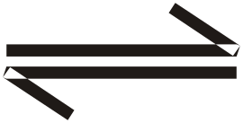
(ii) Reversible reaction
(a) Homogeneous reversible reaction
N₂(g) + 3H₂(g) 2NH₃(g)
(b) Heterogeneous reversible reaction
CaCO₃(s) CaO(s) + CO₂(g)

Slide 7
INTRODUCTION
The homogeneous reversible reactions can be studied using the law of mass action. But the heterogeneous systems require different methods.
The phase rule, given by Willard Gibbs (1874), is used to study the behavior of heterogeneous reversible reactions.

Slide 8
GIBB’S PHASE RULE
It states that in every heterogeneous system in equilibrium, the sum of the number of phases and degree of freedom is greater than the number of components by 2.
OR
P+F = C + 2
F = C − P + 2

Slide 9
F = C − P + 2
(F) number of degree of freedom
(C) number of components
(P) Number of phases.

Slide 10
Explanation (or) meanings of terms
1. Phase P
Phase is defined as, “any homogeneous physically distinct and mechanically separable portion of a system which is separated from other parts of the system by definite boundaries”
Gaseous phase
Liquid phase
Solid phase

Slide 11

(a) Gaseous phase
All gases are completely miscible and there is no boundary between one gas and the other.
1. Air : which is a mixture of O2, H2, N2, CO2 and water vapour, etc., constitutes a single phase.

Slide 12
(b) Liquid Phase
The number of liquid phases depends on the number of liquids present and their miscibilities.
(i) If two liquids are immiscible, they will form three separate phases two liquid phase and one vapour phase.
1.Benzene - Water.

Slide 13
(ii) If two liquids are completely miscible, they will form one liquid phase and one vapour phase.
Alcohol - Water.

Slide 14

(c) Solid Phase
Every solid constitutes a separate phase.
Decomposition of CaCO₃
CaCO3(s) CaO(s) + CO2(g)
It involves three phases, solid CaCO3, solid CaO and gaseous CO₂.

Slide 15
(d) Consider a water system
consisting of three phases.
Ice(s) Water(l) Vapour(g)
Each phase is physically distinct and homogeneous and there are definite boundaries between phases.
So this forms three phases.

Slide 16
(e) A solution of a substance in a
solvent consists of one phase only.
Sugar solution in water.
(f) An emulsion of oil in water forms two phases
(g) MgCO₃ (s) −−−−−> MgO(s) + CO₂ (g)
It involves solid MgCO3, solid MgO and gaseous CO2.
Three phases.

Slide 17
(h) Rhombic sulphur (s) −−−−> Monoclinic sulphur(s)
It forms two phases.
(i) Consider the following heterogeneous system.
CuSO₄(s) + 5H₂O(l) CuSO₄ - 5H₂O_{(s)}
Number of phase = 3; Number of component = 2

Slide 18
2. Component (C)
Component is defined as, “the smallest number of independently variable constituents, by means of which the composition of each phase can be expressed in the form of a chemical equation”.

Slide 19
Consider a water system
Ice(s) Water(l) Vapour(g)
The chemical composition of all the three phases is H₂O, but are in different physical form.
Hence the number of component is one and three phases.

Slide 20
(b) Sulphur exists in 4 phases namely rhombic, monoclinic, liquid and vapour, but the chemical composition is only sulphur. Hence it is a one component system.
(c) Thermal decomposition of CaCO3
CaCO₃(s) CaO(s) + CO_{2(g)}

Slide 21
The system consists of three phases namely, solid CaCO₃, solid CaO and gaseous CO₂.
But it is a two component system, because the composition of each of the above phases can be expressed in terms of any two of the three components present.
When CaCO₃ and CaO are considered as components.

Slide 22
Phase | Components
CaCO3 | CaCO₃ + 0CaO
CaO | 0CaCO₃ + CaO
CO2 | CaCO₃ − CaO

Slide 23
(d) PCl_{5(s)} −−−−−> PCl₃(l) + Cl₂(g)
This system has three phases, but the number of component is only two.
(e) An aqueous solution of NaCl is a two component system. The constituents are NaCl and H₂O.
(f) CuSO₄. 5H₂O(s) CuSO4 .3H₂O(s) + 2H₂O(g)
It is also a two component system.

Slide 24
(g) In the dissociation of NH4Cl, the following equilibrium occurs.
NH₄Cl_{(s)} NH_{3(g)} + HCl_{(g)}
The system consists of two phases namely solid NH₄Cl and the gaseous mixture containing NH3 + HCl. When NH₃ and HCl are present in equivalent quantities the composition of both the phases can be represented by the same chemical compound NH₄Cl and hence the system will be a one component system.

Slide 25
3.Degree of freedom(F)
Degree of freedom is defined as, “the minimum number of independent variable factors such as temperature, pressure and concentration, which must be fixed in order to define the system completely”.

Slide 26
A system having 1, 2, 3 or 0 degrees of freedom is called 1= univariant, 2= bivariant, 3= trivariant and 0= nonvariant respectively.
(a) Consider the following equilibrium
Ice(s) Water(l) Vapour(g)

Slide 27
Triple point: These three phases will be in equilibrium only at a particular temperature and pressure. Hence, this system does not have any degree of freedom, so it is non variant or zero variant.

Slide 28
(b) Consider the Following Equilibrium
Water(l) Water vapour(g)
Here liquid water is in equilibrium with water vapour. Hence any one of the degrees of freedom such as temperature or pressure has to be fixed to define the system. Therefore the
degree of freedom is one.

Slide 29
For a gaseous mixture of N₂ and H₂, we must state both the pressure and temperature.
Hence, the system is bivariant.

Slide 30
6.3 Phase Diagram
Phase diagram is a graph obtained by plotting one degree of freedom against another.

Slide 31
6.3.1 Types of Phase Diagrams
P-T diagram
T-C diagram

Slide 32
P-T Diagram
If the phase diagram is plotted between temperature against pressure, the diagram is called P − T diagram.
P − T diagram is used for one component system.

Slide 33
6.3.2 Uses of Phase Diagram
It is possible to predict from the phase diagrams whether an eutectic alloy or a solid solution is formed on cooling a homogeneous liquid containing mixture of two metals.
(ii) The phase diagrams are useful in understanding the properties of materials in the heterogeneous equilibrium system.
(iii) The study of low melting eutectic alloys, used in soldering, can be carried out using phase diagrams `

Slide 34
APPLICATIONS OF PHASE RULE TO ONE COMPONENT SYSTEM
example: The water system
Water exists in three possible phases namely solid, liquid and vapour. Hence, there can be three forms of equilibria.
Ice(s) Water(l) Vapour(g)

Slide 35
Solid Liquid
Liquid Vapour
Solid Vapour

Slide 36
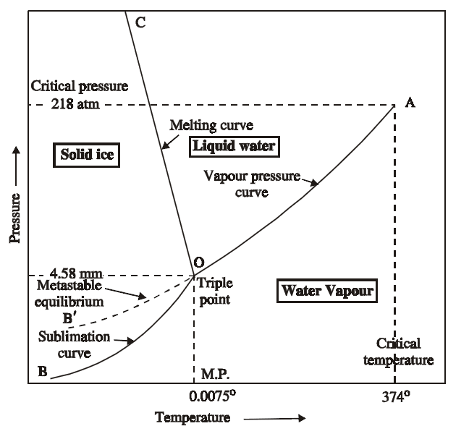
Phase diagram of One Component System

Slide 37
Each of the above equilibrium involves two phases. The phase diagram for the water system is shown in the Figure.
This phase diagram contains curves, areas, and triple point.

Slide 38
Curve OA
The curve OA is called vapourisation curve, it represents the equilibrium between water and vapour.
At any point on the curve the following equilibrium will exist.
Water Water vapour

Slide 39
The degree of freedom of the system is one,
i.e., univariant.
This is predicted by the phase rule.
F = C − P + 2; F = 1 − 2 + 2; F = 1

Slide 40
This equilibrium (i.e. line OA) will extend upto the critical temperature (374°C).
Beyond the critical temperature the equilibrium will disappear only water vapour will exist

Slide 41
(ii) Curve OB
The curve OB is called sublimation curve of ice, it represents the equilibrium between ice and vapour.
At any point on the curve the following equilibrium will exist.
Ice Vapour

Slide 42
The degree of freedom of the system is one, i.e.
Univariant. This is predicted by the phase rule.
F = C − P + 2; F = 1 − 2 + 2; F = 1

Slide 43
This equilibrium (line OB) will extend upto the absolute zero (− 273°C), where no vapour can be present and only ice will exist.

Slide 44
Curve OC
The curve OC is called melting point curve of ice, it represents the equilibrium between ice and water.
At any point on the curve the following equilibrium will exist.
Ice Water

Slide 45
The curve OC is slightly inclined towards pressure axis. This, shows that melting point of ice decreases with increase of pressure.
The degree of freedom of the system is one, i.e., univariant.

Slide 46
(iv) Point ‘O’ (Triple point)
The three curves OA, OB and OC meet at a point ‘O’, where three phases namely solid, liquid and vapour are simultaneously at equilibrium.
This point is called triple point, at this point the following equilibrium will exist
Ice(s) Water(l) Vapour(g)

Slide 47
The degree of freedom of the system is zero i.e., nonvariant. This is predicted by the phase rule.
F = C − P + 2; F = 1 − 3 + 2; F = 0
Temperature and pressure at the point ‘O’ are 0.0075°C and 4.58 mm respectively.

Slide 48
(v) Curve OB′: (Metastable Equilibrium)
The curve OB′ is called vapour pressure curve of the super-cool water or metastable equilibrium where the following equilibrium will exist.
Super−cool water Vapour

Slide 49
Sometimes water can be cooled below 0°C without the formation of ice, this water is called super-cooled water.
Super cooled water is unstable and it can be converted into solid by “seeding” or by slight disturbance.

Slide 50
(vi) Areas
Area AOC, BOC, AOB represents water, ice and vapour respectively. In order to define the system at any point in the areas, it is essential to specify both temperature and pressure.
The degree of freedom of the system is two. i.e., Bivariant.

Slide 51
This is predicted by the phase rule
F = C − P + 2; F = 1 − 1 + 2; F = 2

Slide 52
Eutectic system
Def:
A binary system consisting of two substances, which is miscible in all proportion is the liquid phase which does not react chemically is called Eutectic system.
E.g. Lead and silver comprises

Slide 53
Reduced Phase Rule (or) Condensed System
The maximum number of degree of freedom in a two component system will be three, when the system exists as a single phase.
P+F = C +1
OR
F= C − P + 1

Slide 54
In order to represent the conditions of equilibrium graphically, it requires three co-ordinates, namely P,T and C.
This requires three dimensional diagram, which cannot be conveniently represented on paper.
Therefore, any two of the three variables must be chosen for graphical representation.

Slide 55
Since the pressure is kept constant, the phase rule becomes
F′ = C − P + 1
This equation is called reduced phase rule or condensed phase rule.

Slide 56
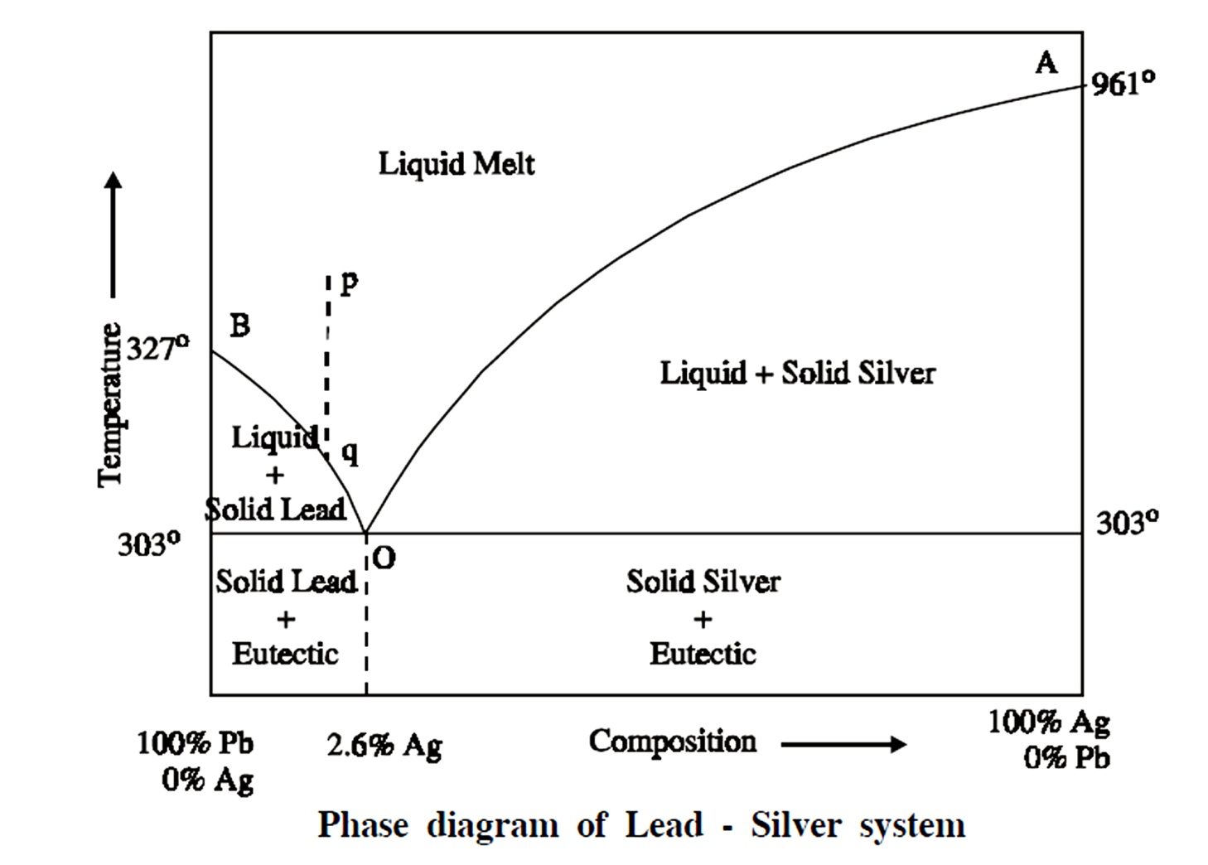
2.Phase Diagram of TWO COMPONENTSYSTEM
or
MULTI COMPONENT EQUILIBRIA
Eg. Lead-silver system.
Triple point: temp.303ºand composition: 97.4%Pb + 2.6%Ag

Slide 57
Classification of Two Component System
Based on the solubility and reactive ability,
the two component systems are classified into three types.
Simple eutectic formation.
(ii) (a) Formation of compound with congruent melting point.
(b) Formation of compound with incongruent melting point.
(iii) Formation of solid solution.

Slide 58
(i) Simple Eutectic system Formation
A binary system consisting of two substances, which are completely miscible in the liquid state, but completely immiscible in the solid state is known as eutectic (easy melt) system.
They do not react chemically. Of the different mixtures of two substances, the mixture having the lowest melting point is known as the eutectic mixture.

Slide 59
(ii)(a) Formation of compound with congruent melting point.
In this type of binary alloy system the two
substances form one or more compounds with definite proportions.
Of the compounds, a compound is said to possess congruent melting point, if it melts exactly at a constant temperature into liquid, having the same composition as that of the solid.

Slide 60
(ii)(b) Formation of compound with incongruent
melting point
Of the above compounds, a compound is said to possess incongruent melting point.
If it decomposes completely at a temperature below its melting point yielding a new solid phase with a composition different from that of the original.

Slide 61
(iii) Formation of solid solution
In this type when two substances, especially metals, are completely miscible in both the solid and liquid states.
They form solid solutions where mixing takes place in the atomic levels.
A condition for the formation of solid solution is, the two metals should not differ in atomic radius by more than 15%.

Slide 62
6.7 BINARY ALLOY SYSTEM
OR
THE SIMPLE
EUTECTIC SYSTEM

Slide 63
Example: The Lead-Silver System
Since the system is studied at constant pressure, the vapour phase is ignored and the condensed phase rule is used.
F′ = C − P + 1

Slide 64
2.Phase Diagram of TWO COMPONENTSYSTEM
or
MULTI COMPONENT EQUILIBRIA
Eg. Lead-silver system.
Triple point: temp.303ºand composition: 97.4%Pb + 2.6%Ag

Slide 65
(i) Curve AO
The curve AO is known as freezing point curve of silver. Point A is the melting point of pure Ag (961°C). The curve AO shows the melting point depression of Ag by the successive addition of Pb. Along this curve AO, solid Ag and the melt are in equilibrium.
Solid Ag Melt

Slide 66
According to reduced phase rule equation.
F′ = C − P + 1; F′ = 2 − 2 + 1; F′ = 1
The system is univariant.

Slide 67
(ii) Curve BO
The curve BO is known as freezing point curve of lead. Point B is the melting point of pure lead (327°C). The curve BO shows the melting point depression of ‘Pb’ by the successive addition of ‘Ag’. Along this curve ‘BO’, solid ‘Pb’ and the melt are in equilibrium.

Slide 68
Solid Pb Melt
According to reduced phase rule equation.
F′ = C − P + 1; F′ = 2 − 2 + 1; F′ = 1
The system is univariant

Slide 69
(iii) Point ‘O’ (Eutectic point)
The curves AO and BO meet at point ‘O’ at a temperature of 303°C, where three phases (solid Ag, solid Pb and their liquid melt) are in equilibrium.
Solid Pb + Solid Ag Melt

Slide 70
According to reduced phase rule equation.
F′ = C − P + 1; F′ = 2 − 3 + 1; F′ = 0
The system is non-variant.

Slide 71
The point ‘O’ is called eutectic point or eutectic temperature and its corresponding composition, 97.4%Pb + 2.6%Ag, is called eutectic composition.
Below this point the eutectic compound and the metal solidify.

Slide 72
(iv) Areas
The area above the line AOB has a single phase (molten Pb + Ag). According to reduced phase rule equation.
F′ = C − P + 1; F′ = 2 − 1 + 1; F′ = 2
The system is bivariant.

Slide 73
Both the temperature and composition have to be specified to define the system completely.
The area below the line AO (solid Ag + liquid melt), below the line BO (solid Pb + liquid melt) and below the point ‘O’ (Eutectic compound + solid Ag or solid Pb) have twophases and hence the system is univariant
F′ = C − P + 1; F′ = 2 − 2 + 1; F′ = 1.

Slide 74
Thus, the process of raising the relative proportion of Ag in the alloy is known as Pattinson’s process.
Uses of Eutectic system
1. Suitable alloy composition can be predicted with the help of eutectic systems.
2. Eutectic systems are used in preparing solders, used for joining two metal pieces together.

Slide 75
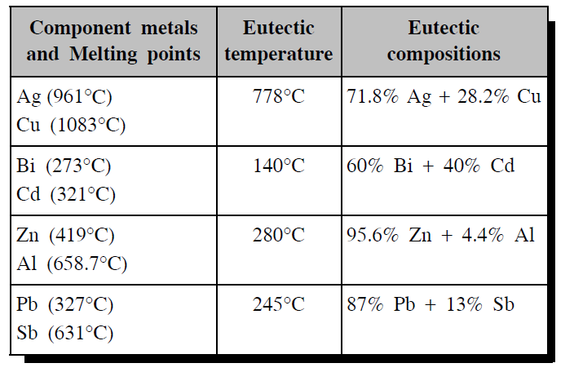
6.7.2 Eutectic Compositions and
Temperatures of Some Alloys

Slide 76
6.7.3 Differences between Melting point,
Eutectic point and Triple point
1. Melting Point
It is the temperature at which the solid and liquid phases, having the same composition, are in equilibrium.
Solid A Liquid A

Slide 77
Eutectic Point
It is the temperature at which two solids and a liquid phase are in equilibrium
Solid A + Solid B Liquid

Slide 78
3. Triple Point
It is the temperature at which three phases are in equilibrium.
Solid Liquid Vapour

Slide 79
All the eutectic points are melting points
All the melting points need not be eutectic points.
Similarly all the eutectic points are triple points, but all the triple points need not be eutectic points.

Slide 80
Uses or merits of phase rule
It is applicable to both physical and chemical equilibria.
2. It is a convenient method of classifying the equilibrium
states in terms of phases, components and degree of
freedom.
3. It indicates that the different systems having the same
degrees of freedom behave similarly.
4. It helps in deciding whether the given number of
substances remain in equilibrium or not.

Slide 81
Limitations of phase rule
1. Phase rule can be applied only for the systems in equilibrium.
2. Only three variables like P, T & C are considered, but not electrical, magnetic and gravitational forces.
3. All the phases of the system must be present under the same conditions of pressure and temperature.
4. Solid and liquid phases must not be in finely divided state, otherwise deviations occur.

Slide 82
Thanking You

Slide 83
Limitations OF PHASE RULE
(1) It applies to system in equilibrium and it is not much help in case of system which attain equilibrium very slowly.
(2)All the phases of the system must be present under the same condition of temperature , pressure and gravition force.
(3) It applies only to a single equilibrium state. It does not indicate the other possible equilibrium in the system
(4)The Solid and liquid phases should not be so finely subdivided to bring about deviation from their normal values of vapour pressure.

Slide 84
6.6 EXPERIMENTAL METHOD OF CONSTRUCTION OF A SIMPLE EUTECTIC PHASE DIAGE
6.6.1 Thermal analysis (or) cooling curve
Thermal analysis is a method involving a study of the cooling curves of various compositions of a system during solidification.
The shapes of the freezing point curves for any system (involving metals) can be determined by thermal analysis.
The form of the cooling curve indicates the composition of the solid.

Slide 85
Cooling Curves for a Pure Solid
A pure substance in the fused state is allowed to cool slowly and the temperature is noted at different time interval.
Then graph is plotted between temperature and time (Fig. 6.2).

Slide 86
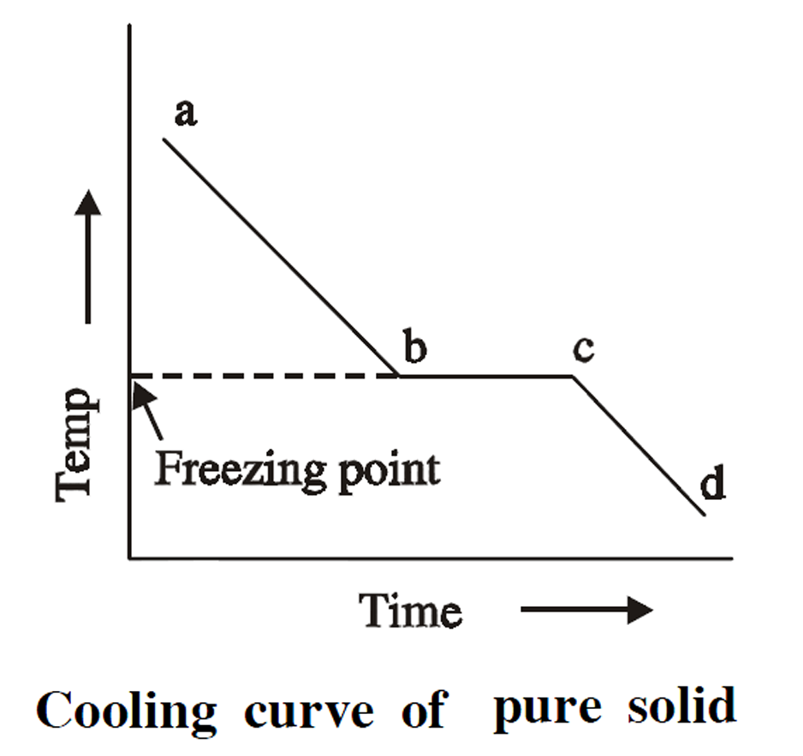
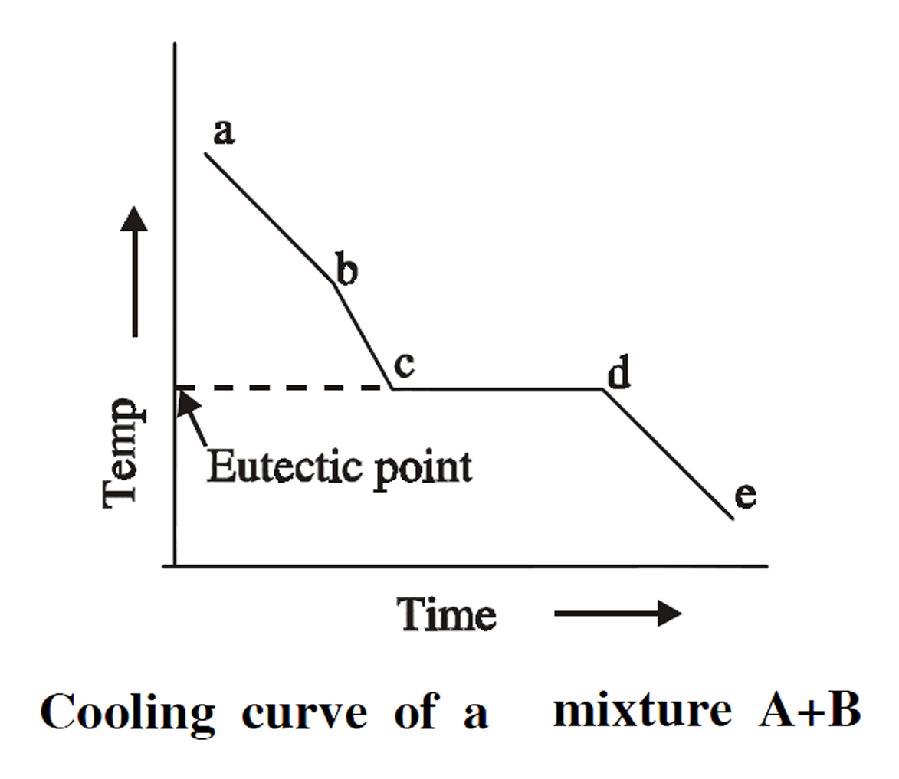

Slide 87
Initially the rate of cooling is continuous. When it reaches the point ‘b’ solid begins to appear, now the temperature remains constant until the liquid melt is completely solidified. Solidification completes at the point ‘c’.
The horizontal line ‘bc’ represents the equilibrium between the solid and liquid melt. After the point ‘c’, temperature of the solid begins to decrease along the curve ‘cd’.

Slide 88
Cooling Curves for a Mixture
If a mixture of two substances (say A and B) in the fused state is allowed to cool slowly, the cooling curve is obtained in a similar manner (Fig. 6.3).
Initially the rate of cooling is continuous. When it reaches the point ‘b’ one substance (either A or B) begins to solidify out of the melt.

Slide 89
Uses of Cooling Curves
1. Melting point and eutectic temperature can be noted from the cooling curve.
2. Percentage purity of the compounds can be noted from the cooling curve.
3. The behaviour of the compounds can be clearly understood from the cooling curve.

Slide 90
4. The composition corresponding to its freezing point yields the composition of the alloy.
5. The procedure of thermal analysis can be used to derive the phase diagram of any two component system.

Slide 91
calculate the number of phases, Component and Degree of freedom in the following system.
(i) MgCO3(s) MgO(s) +CO2(S)
(ii) CaCO3(s) CaO(s) +CO2(S)
(iii) NH4Cl(s) NH3(g) + HCl(g)
(iv) NaCl(s) NaCl(aq.)
(v) H2O(g) H2 (g) + H2O(g)

Slide 92


Slide 95


