Slide 1
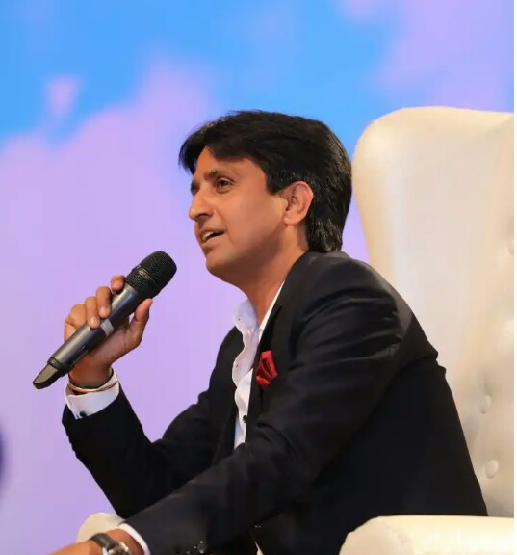
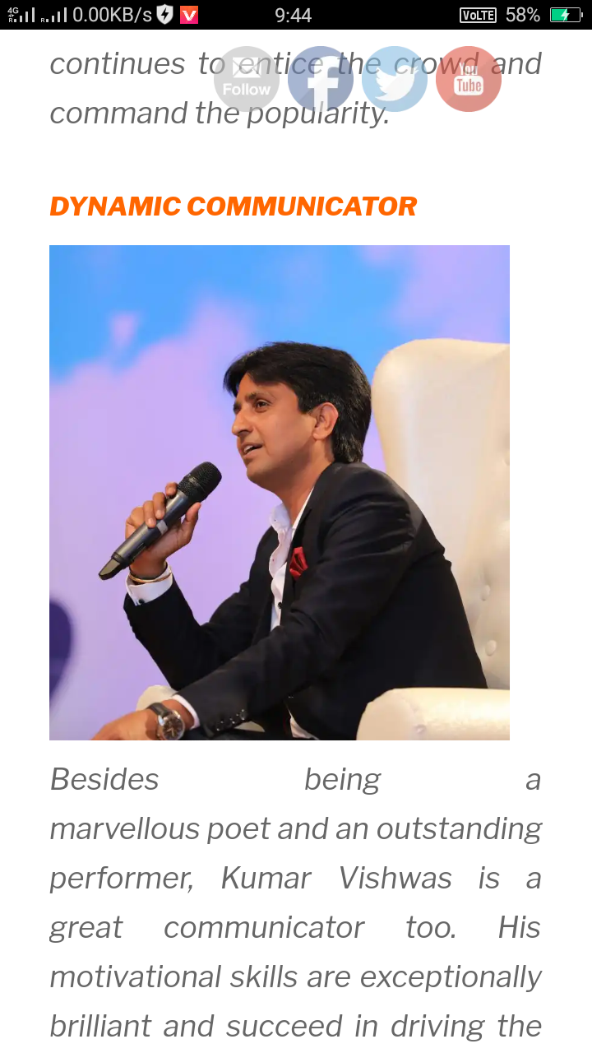
Dr. Kumar Vishwas
The marvellous poet and an outstanding performer
“creativity comes from thinking, there is no limit of thinking,nobody can stop your thinking so think more and more “

Slide 2
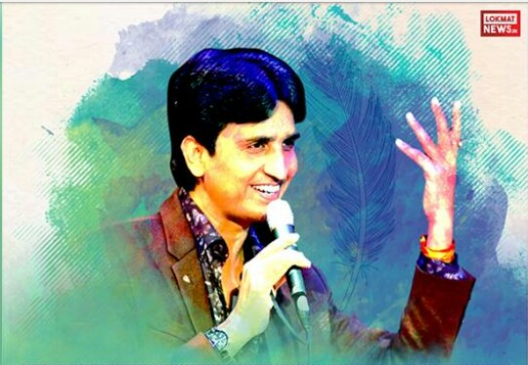
***Kumar Vishwas***
Personal Details in brief
D. O. B --- 10 Feb 1970
At Pikhuwa, Ghaziyabad
Uttar Pradesh
Schooling – La-la Ganga Sahay school,
Rajputana Regiment Inter college
Pikhuwa, Ghaziyabad
College - Meerut University ,Meerut(U.P)

Slide 3
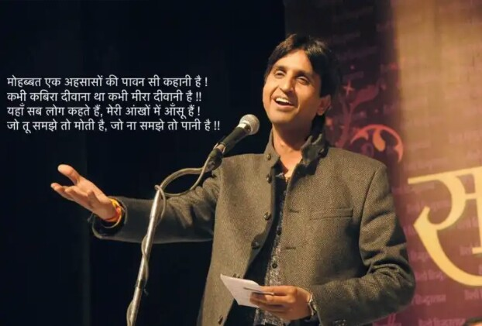
Edu. Qualification –Post Graduation Degree in Hindi
Ph.D in Hindi
Family.
Father-Dr.Chandra Pal Sharma(Lecturer)
Mother-Smt.Rama Sharma(Home maker)
Siblings -3
Spouse-Dr. Manju Sharma(Lecturer)
Daughters-Agrata Vishwas, Kuhu Vishwas
Profession- Performance Poet and an Indian Politician[AAP]
Fav. Politician – Arvind Kejriwal
Fav. Sports –Cricket
Fav. Poet –Ramadhari Singh Dinker

Slide 4
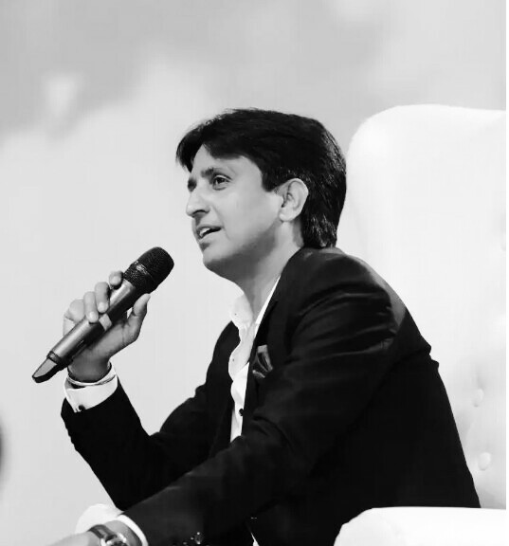
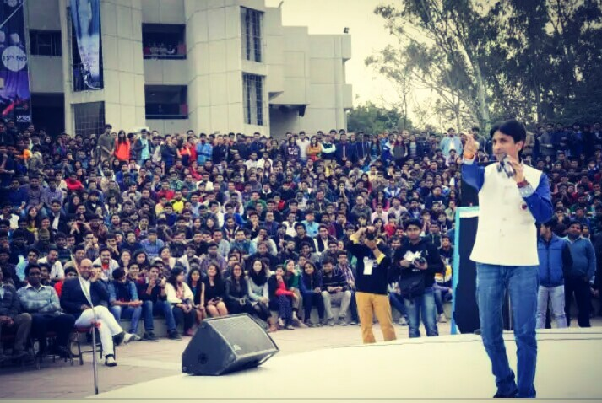
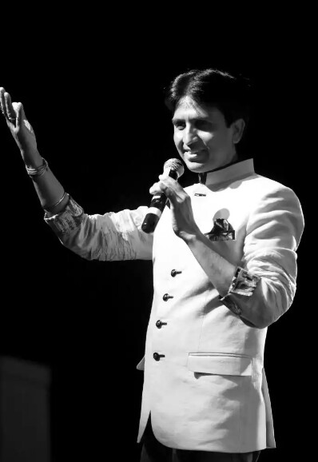
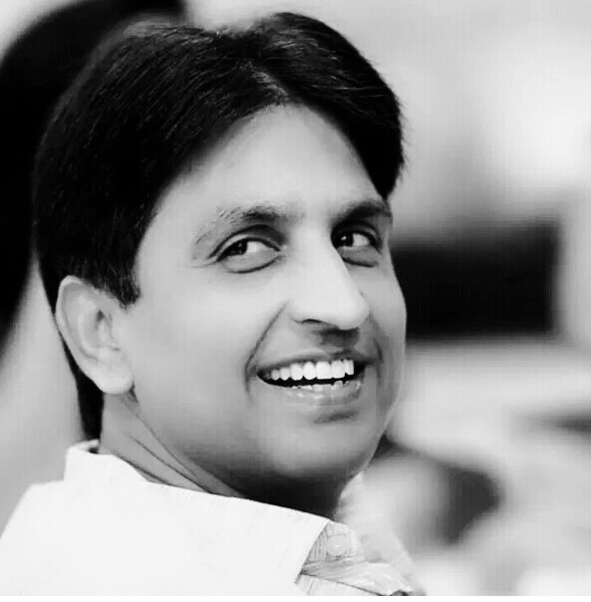
Life is dream for wise, a game for fool, comedy for rich and tragedy for poor. So never treat as fool or poor etc. Be Happy in your self

Slide 5
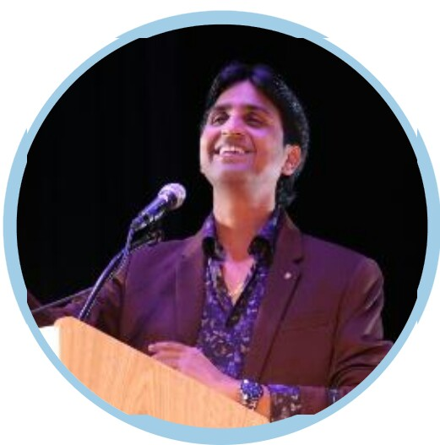
Starting journey of his carrier
In starting of carrier, Kumar Vishwas was passionate for his carrier
His father Dr. Chandra sharma a lecturer in college, he wanted to
Kumar Vishwas as a big service man however kumar Vishwas
for poetry led him to pursue a master’s Degree in Hindi Literature
******”Set a goal and for achieve, dedicated himself 100%”*******
After completing his Ph.D .He started working as a lecturer
in Rajasthan in the year 1994.
He has established himself as a poet.
He also writes lyrics for different title songs of TV serial .
“He writes a beautiful Nagma in recently releases movie Parmanu”
He also played a role of actor in “chaay garam”
He also supported the anti corruption movement led by Anna Hazare

Slide 6
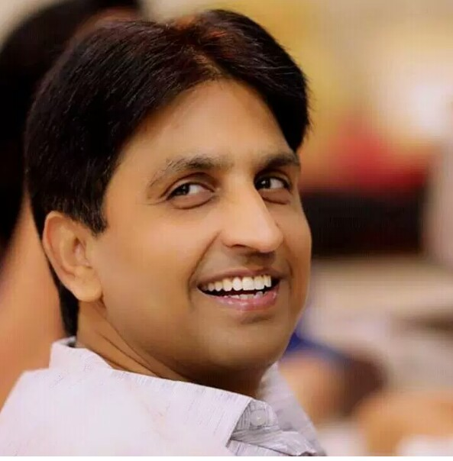
Achievements
In 1994 “Kavya Kumar Award“by purskar samiti
In 2004”Dr.Suman Alankaran” by sharda Bharti unnao
In 2006”Sahitya Shree”by Hindi Urdu purskar samiti
Also demanded as guest speaker Google HQ, California .
Stanford University, IIT’s and many other places.

Slide 7
As a dynamic communicator
Besides beings a marvellous poet and outstanding performer Kumar Vishwas
is a great communicator too.
His motivational skills are exceptionally brilliant and succeed in drive crowd
It is hard even for celebrities to hold the crowd for long hour over night inspites of all accessories back ups. Kumar Vishwas, has been doing this just with a mic and his poem wits in his soulful voice
He has written and sung many verses, yet “koi deewana kahta hai………”

Slide 8
Clarity of his words
The treasures that his pen has yielding cover wide range of notions viz. Social issues, Atrocities against women and women empowerment, philosophies of life and brimming with patriotic fervor.
Collectively speaking, “his poem are a mirror to the Society “

Slide 9
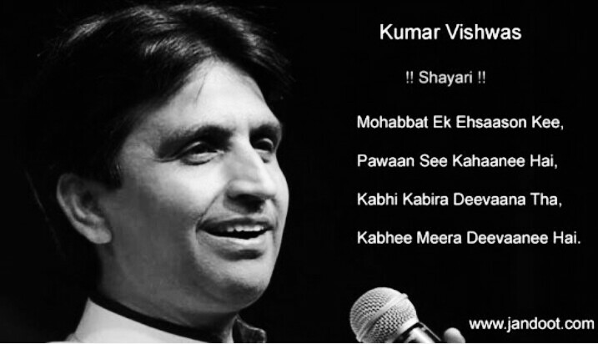
The words is too less to describe such a personality
Thank you………….
Made by :Pawan Kumar Singh, CSE branch 3rd sem.

