Slide 1


edi Electronic Data Interchange
Presented by-
Sudhir kumar(0816113047)
Raj kumar(0816113041)
Pawan singh(0816113034)
Pradip kumar(0816113035)

Slide 2
outline
Introduction of EDI
Requirements of EDI
Implementation of EDI
Architecture of EDI
Features of EDI
Applications of EDI
Advantages
Disadvantages or Limitations
Conclusion

Slide 3
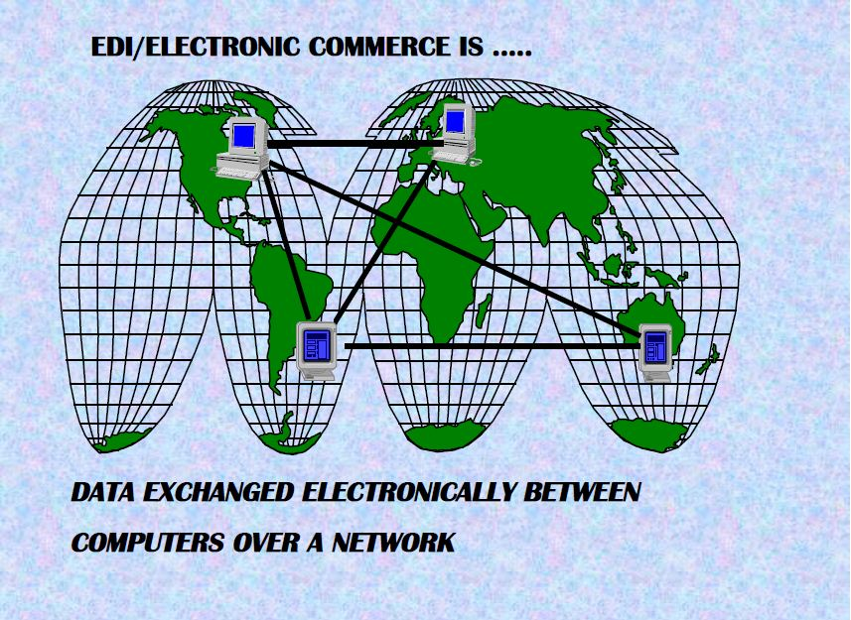
Introduction of EDI

Slide 4
DEFINITION
“The Transfer Of Structured Data , By Agreed Message Standards, From One Computer System To Another , By Electronic means ” Is Called EDI.
GIVEN BY:-
(International Data Exchange Association )

Slide 5
Structured Data- “EDI transaction are composed of code and value.” Agreed Message Standards- “The EDI has to have a standard format.”
From One Computer System To Another- “The EDI Message sent is between two computer System.”
By Electronic Means- “ Usually this is by data communication , often network specially designed for EDI will be used.”
Partner A
Internal
System
Partner B
Internal
System
VAN
EDI Software
VAN
EDI Software

Slide 6
The Main Requirements of EDI
Computer Systems
EDI Standard
EDI Software
Network for Communication (VAN)

Slide 7
Implementation of EDI
Steps to implement EDI:-
Step 1:- develop the organizational structure for
managing EDI.
Step 2:- undertake the strategic review of the business.
Step 3:-developing an EDI solution to meet the need of
business.
Step 4:-integrating with other business Systems across
the company or out side the company.

Slide 8
Step 5:- Undertake mapping/data analysis of internal business process.
Step 6:- establishing a pilot project with selected trading
partners.
Step 7:- deployment of the EDI system amongst trading
partners.

Slide 9
How does EDI work?
Order is sent by customer organization to the supplier organization.
Electronic contract approved over network via acknowledgement.
Supplier manufacturer packages and goods , attaching shipping data recorded in a bar code.
Quantities shipped and invoices transmitted to purchasing organization.

Slide 10
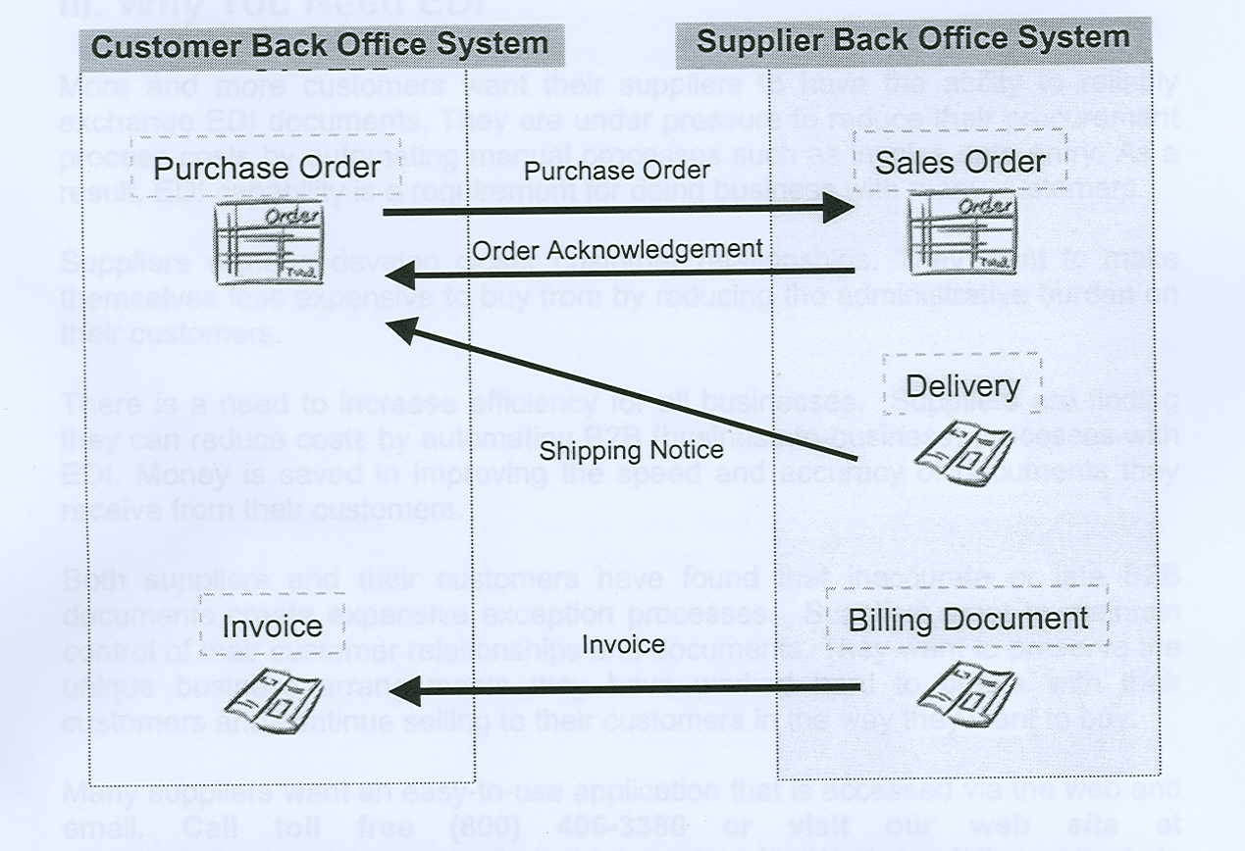
Below is a graphic demonstration of the typical flow between suppliers and customers

Slide 11
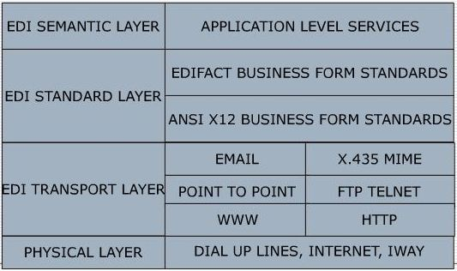
LAYERED ARCHITECTURE OF EDI

Slide 12
Semantic/Application layer
Consist of actual business applications that are going to be connected through the EDI systems.
These applications may use their own electronic record formats and document formats for processing the information.
For EDI to operate documents of internal company need’s to convert to a format that can be understood by the system used by trading partner.

Slide 13
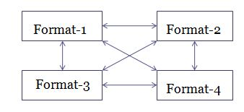
Semantic/Application layer

Slide 14
Standard Formats Layer
The important and critical block of the EDI system is standard for business documents.
EDI forms standards are basically data standards for data exchange.
For instance, a purchase order name field in an
x12 standard might be specified to hold a max. of 50 characters.

Slide 15
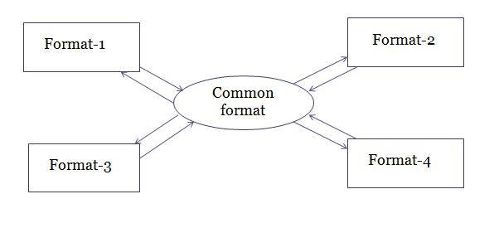
Standard Formats Layer
Common Formats Approach

Slide 16
Data Transport Layer
Consist of services that automate the task of electronic transfer of messages.
After preparing the order dispatch it using transport/carrier mechanism.
Utilizes any of the available network transport services such as e-mail , HTTP , FTP etc.

Slide 17
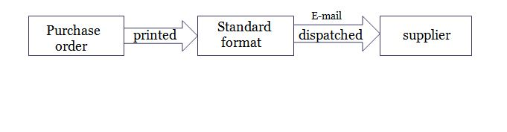
Data Transport Layer
Processing-

Slide 18
Physical/Interconnection Layer
Refers to the network infrastructure that is used for the exchange of information between trading partners.
It may consist of dial-up lines , internet or any reliable connection.
Through interconnection , EDI partners are able to achieve document exchange between themselves.

Slide 19

Network routes and pathways
Dial-up
Connection
network
Dial-up
Wide area interconnection

Slide 20
Features of EDI
Exchange of structured business information in standard formats between computers.
It has reduced data entry link, eliminates the need for a paper bases system and improved business cycle.
EDI transfer structured business documents internally among groups of departments or externally with its suppliers, customers and subsidiaries.
In EDI, information transferred over a network will not have to read, retyped or printed but must have predefine structure agreed between the two company's which send and receive data.

Slide 21
Applications
The ability to exchange business document electronically has been found to facilitate coordination between the partners , reduce lead time and thus reduce inventory.
Below given four different scenarios in industry that use EDI extensively –
International Trade
Reduce transaction expenditure.
Quicker movement of import and exported goods.
Improved customer service.

Slide 22
Electronic Fund Transfer
EFT are credit transfer between banks where fund flow directly from payers bank to the payee’s bank.
EFT is one of the earliest example of payment systems that use online transaction

Slide 23
Manufacturing/Retail Procurement using EDI
IN manufacture , EDI is used to support
Just–In-Time.
In manufacturing JIT means transfer of data or fund among manufacturing department quickly,
IN retailing , EDI is used to support quick response.
For the customer , QR means service and availability of wider range of product.
For retailer , QR means survival in a competitive market.

Slide 24
Security and Privacy issues Regarding EDI
Typical security issues involved between communicating parties in EDI include –
-Authentication
- Access control.
- Confidentiality.
- Data Integrity and Non-repudiation.

Slide 25
Advantages of EDI
The Advantages of EDI are two types-
Tangible OR Direct Advantages
Intangible OR Indirect Advantages
Tangible Advantages-
Reduced costs
Minimized paper use and storage
Elimination of errors
Improved accuracy

Slide 26
Intangible Advantages-
Cash flow
Improved business relationships
Increase Business Opportunity

Slide 27
Disadvantages of EDI
Network unreliability
Too Many Standards
EDI is Too Expensive
Limit Your Trading Partners

Slide 28
Conclusion
Getting into EDI is a major business decision.
It is easy to use.
Beneficial to the business.
Do not assume you can fall back to a paper-based system

