Slide 1

BIG DATA SPARK AND NO SQL ASSIGNMENT
By Pawan Thakur (A21020)

Slide 2

CONTENTS
INTRODUCTION…………………………………………………. 3-4
BUSINESS PROBLEM…………………………………………............5-6
DATASET…………………………………………………………….7-8
PROPOSED SOLUTION……………………………………………9-10
TOOLS USED………………………………………………………..11-12
RESULTS OBTAINED…………………………………………….......13
VISUALIZATIONS……………………………………………………14-18
CONCLUSION……………………………………………………......19

Slide 3
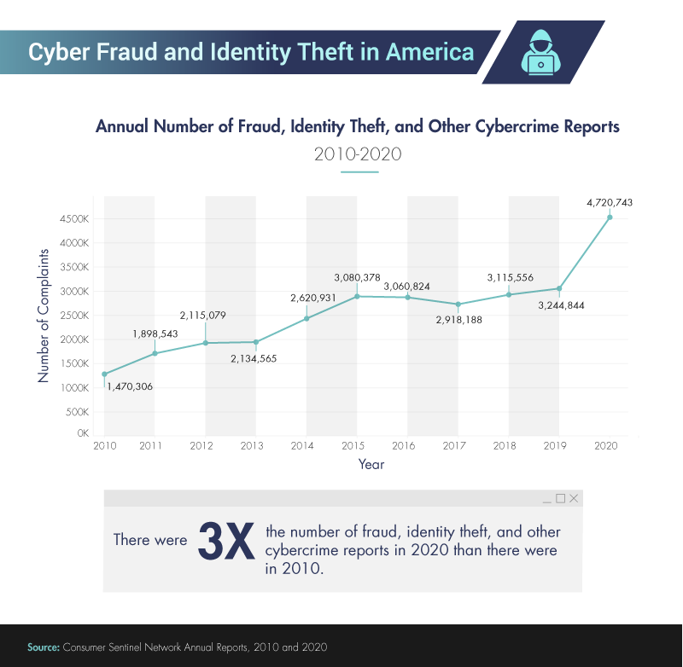
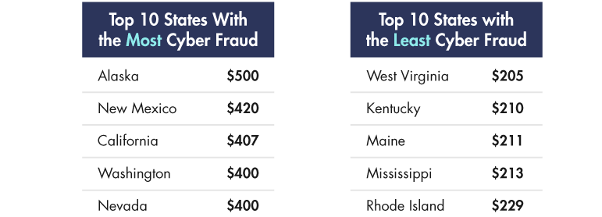
INTRODUCTION Growth
Cybercrime is a crime that involves a Computer and network. The computer may have been used in the commission of a crime, or it may be the target. Cybercrime may harm someone's security and financial health.
Cybercrime reports have exploded in the past decade, with over 4.7 million reports in the U.S. in 2020. This represents an increase of over 300% in 2020 relative to a 2010 baseline, costing the global economy trillions of dollars in the process. California is one of the top 3 states to be affected.

Slide 4
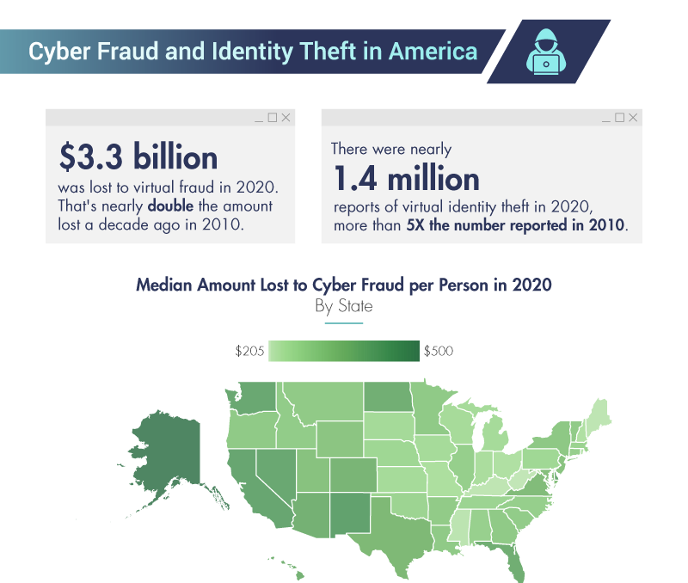
Most computer crimes are motivated by money. This includes types of computer fraud or theft. Common computer crimes can include the following:
Identity Theft
Credit Card Fraud
Insurance Fraud
Hacking
Phishing
Stealing financial data
Denial of Service (DOS) attacks
Use of Malware
Most computer crimes involve fraud or theft. However, computers can also be used for unlawfully spying on someone, online harassment etc.
Applications of Machine Learning can identify sources and potential vulnerabilities in the IT infrastructure of an organization so that future attacks are prevented and detected in a timely manner.

Slide 5
BUSINESS PROBLEM
A technology Start-up in San- Francisco, California have been recently attacked and need help in finding out about hackers
The forensic engineers in the start-up have grabbed valuable information about the hacks, including information like session time, locations, Words per minute typing speed etc
The forensic engineer have been able to grab meta data of each session that the hackers have used to connect to their servers
The firm is certain that there are 3 potential hackers that perpetrated the attack

Slide 6
BUSINESS PROBLEM
The engineers are certain about 2 hackers being involved but they aren’t sure that if there was any 3rd person involved
Can we as data professionals help to figure out whether any 3rd person was involved in perpetrating the attack?
One last thing the forensic engineer helped us with is knowing that the hackers trade-off attacks
This means that they should have same attacks roughly. For example if there are 100 attacks if there are two attackers each will have roughly 50 attacks and if there are 3 attackers each will have 33 attacks approximately

Slide 7
DATASET
These are the features of the data provided to us by the forensic engineers
‘Session_Connection_Time’: How long the session lasted in miniutes
Bytes Transferred: Number of MB transferred during the session
Kali_Trace_Used: Indicates if the hacker was using Kali Linux
Servers_Corrupted: Number of Servers corrupted during the attack
Pages_Corrputed: Number of Pages illegally accessed
Location:- Location of the attack (Probably useless as hackers might have used VPNs)

Slide 8
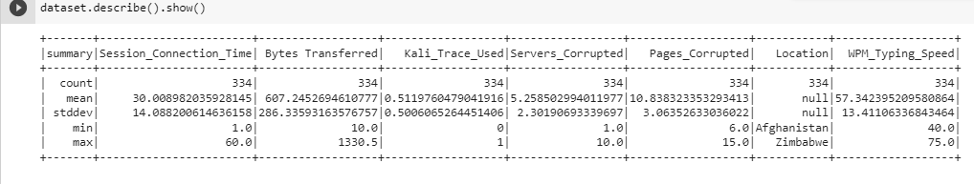
DATASET
WPM_typing_speed: The hackers estimated typing speed based on session logs
The dataset given to us was in CSV format
The dataset has 334 rows and 7 columns

Slide 9
PROPOSED SOLUTION
We use Spark and Python to do clustering with the features available to find the number of attackers
We used the KMeans Clustering technique to form clusters of Hackers by assigning the K=2 or 3
We first start by importing the latest version of Spark and creating a spark session
We then Read CSV by spark’s spark.read.csv function
We then transform the data using Vector Assembler

Slide 10
PROPOSED SOLUTION
We then standardize the data using the Standard Scaler so the datapoints are on the same scale
We then find the optimal Value for K either 2 or 3 using the trainingCost function in Spark
Although 3 cluster had a lower score we first modelled using K=3 but it was unevenly spread unlike the information provided to us by the domain experts i.e Forensic engineers
So we take K= 2 and we find the attack are evenly traded off. So we do the clustering by take K=2 and make 2 clusters

Slide 11
TOOLS USED
We used Python and Spark to solve the above problem
We used read.csv function to read the data
We used pyspark.ml.clustering to import Kmeans
We used printSchema to check the structure of the dataframe
pyspark.ml.feature import VectorAssembler to perform feature transformations
We use StandardScaler to scale the data

Slide 12


TOOLS USED
We used trainingCost feature of Spark to calculate cost for optimum value of K
We used Tableau as well to create visualizations

Slide 13
RESULTS OBTAINED
We tested for 3 cluster and 2 clusters and found that the cost decreased for 3 clusters so ideally it should have been the optimum K value but since domain expertise requires that clusters to be evenly split so we tested for both 2 and 3
We first tried 3 clusters we saw it was not evenly split
We then performed clustering with 2 clusters and found it was evenly split so we go with 2 clusters

Slide 14
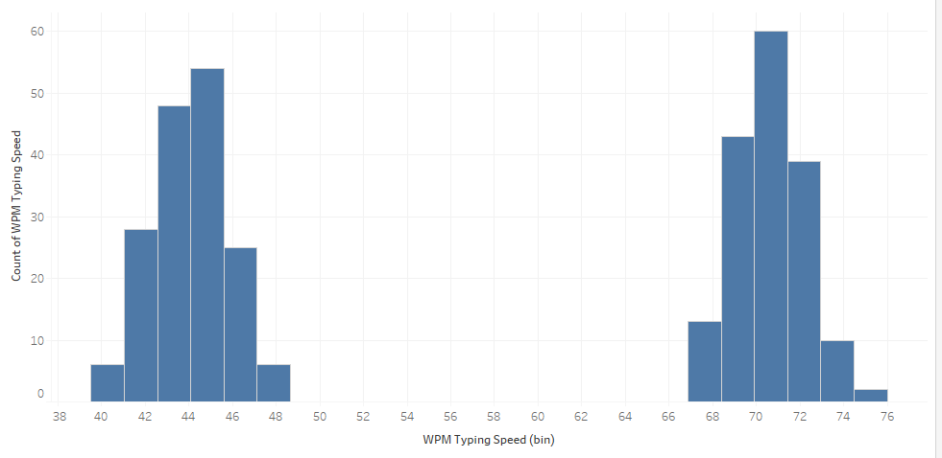
VISUALIZATIONS
The visualizations also give an idea that there might be 2 hackers

Slide 15
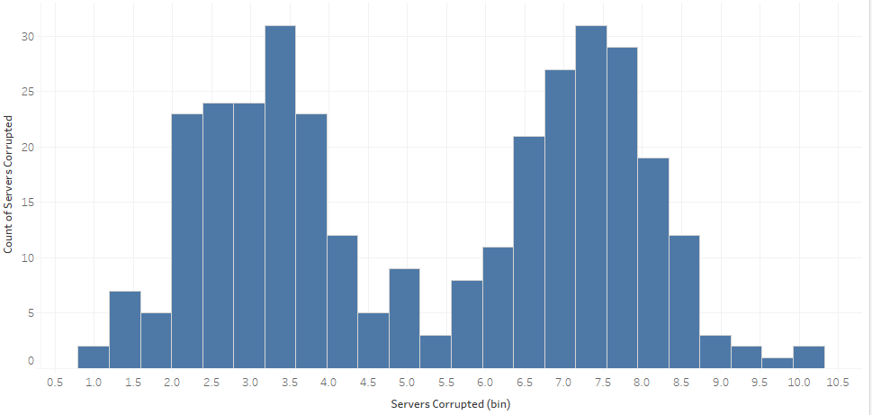
VISUALIZATIONS

Slide 16
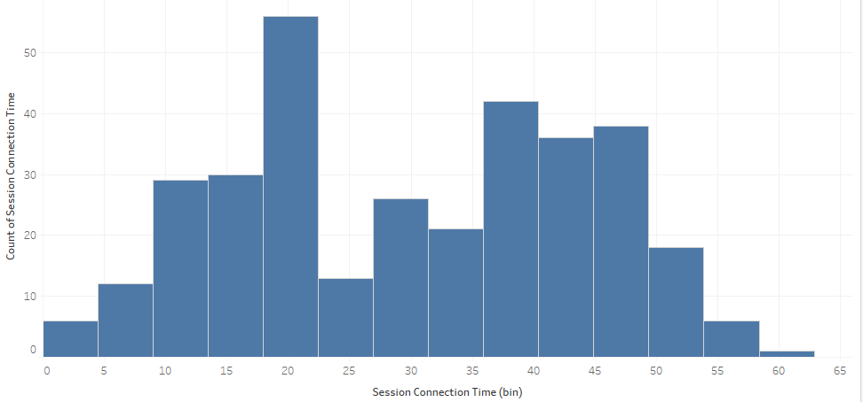
VISUALIZATIONS

Slide 17
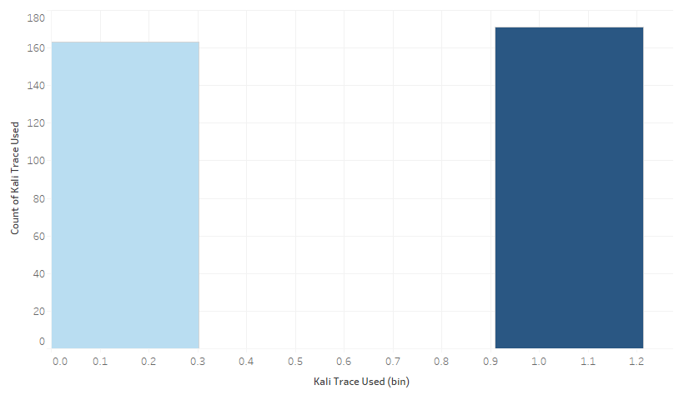
VISUALIZATIONS

Slide 18
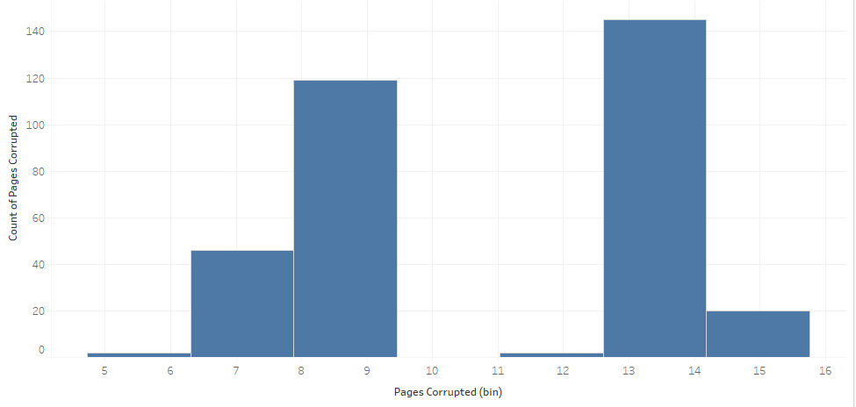
VISUALIZATION

Slide 19
CONCLUSION
From the assignment we conclude that Machine Learning and Data Analytics can be a powerful tools to reduce crimes in the cyberworld
Cybercrime is a thing for concern as everyone today has a digital footprint and therefore could be vulnerable to attacks
We should also educate the masses about cybercrimes to prevent it
Integrating Machine Learning an Cybersecurity can reduce the trivial tasks so that more knowledge could be applied to prevent powerful and well planned attacks

Slide 20

Thank you

