Slide 2
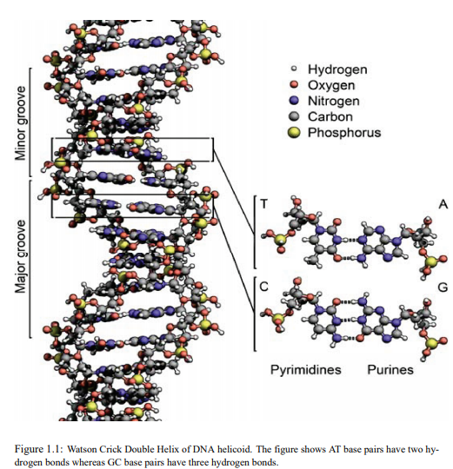
Introduction
Basics
1.1 DNA and it’s structure
Deoxyribonucleic Acid
Component sugar, phosphate and Nitrogen bases
Two strands are complementary to each other start from 5’ to 3’
Bases are paired as AT and GC
Function carrier of genetic information.
Stability
Covalent bond
Hydrogen bond
Stacking interaction hydrophobic effect
Van der Waals interaction
dipole-dipole interaction

Slide 3
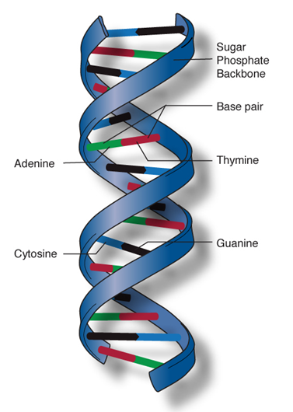
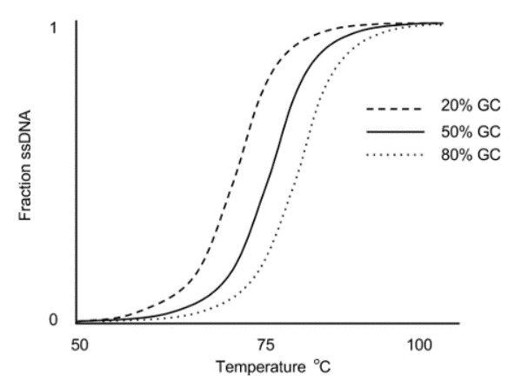
1.2 DNA denaturations by heating and stretching
A. thermal DNA melting
M. Peyrard and A. R. Bishop, PRL 62, 2755 (1989)
T. Dauxois, M. Peyrard, and A. R. Bishop, PRE 47, 684 (1992)
DNA melting curves for three strands of DNA with different levels of GC content.
The y-axis indicates the fraction of DNA molecules that are single-stranded.
Observation: GC-rich DNA melts at higher temperatures.

Slide 4
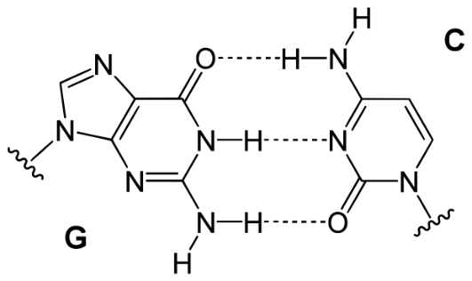
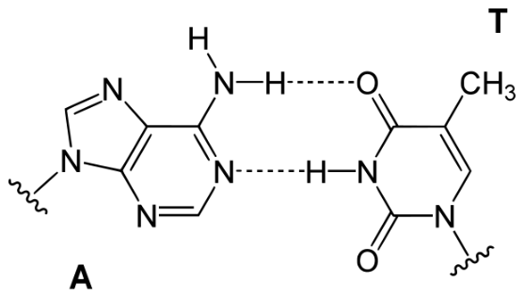
Observation: GC-rich DNA melts at higher temperatures.
Reason: GC base pairs are stronger bound than AT base pairs:
GC: 3 H-bonds
AT: 2 H-bonds
Goal: Obtain coarse-grained model to quantitatively predict DNA melting curves
for short DNA (10-100 pbs) with given sequence of base pairs
S. Ares, N. K. Voulgarakis, K. O. Rasmussen, and A. R. Bishop, PRL 94, 035504 (2005)

Slide 5
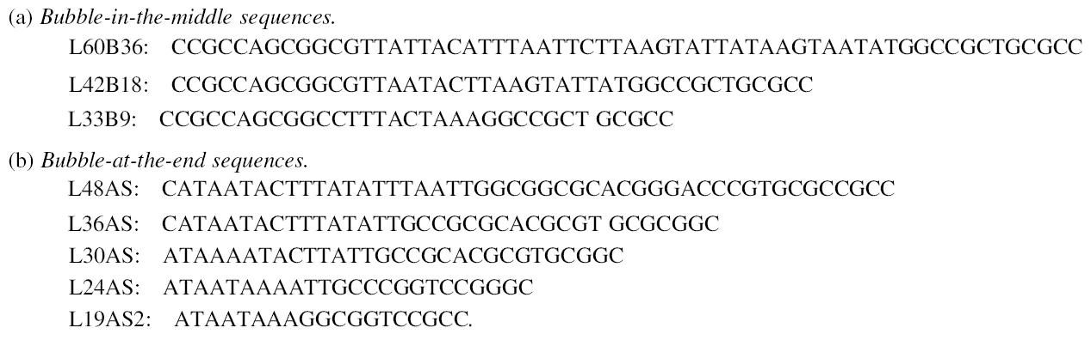
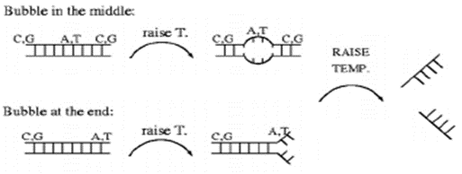
completely denatured
Ares et al. PRL (2005)

Slide 6
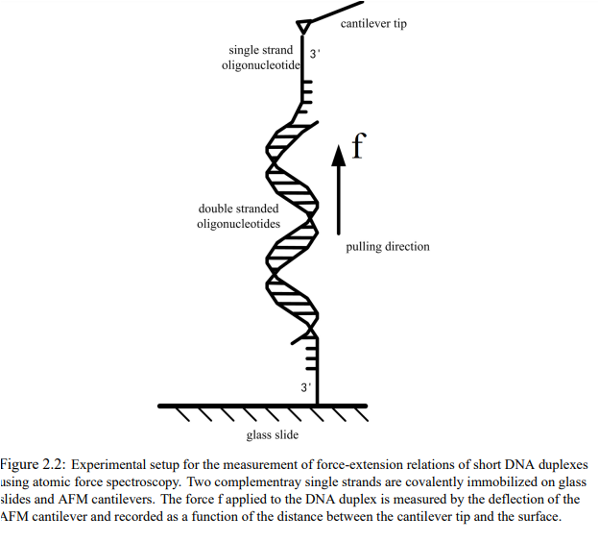
B. Denaturations by stretching

Slide 7
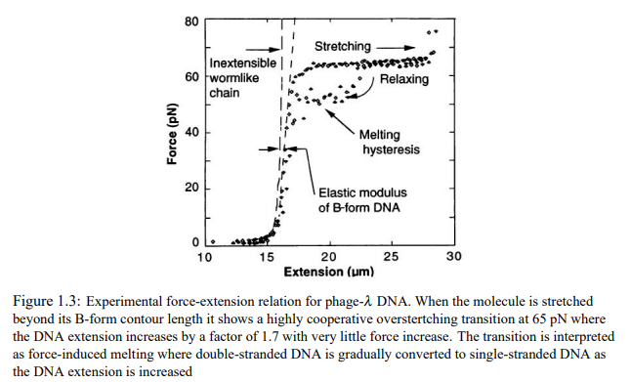
Force versus extension curve

Slide 8
Method
Peyrard Bishop model for helicoidal DNA

Slide 9
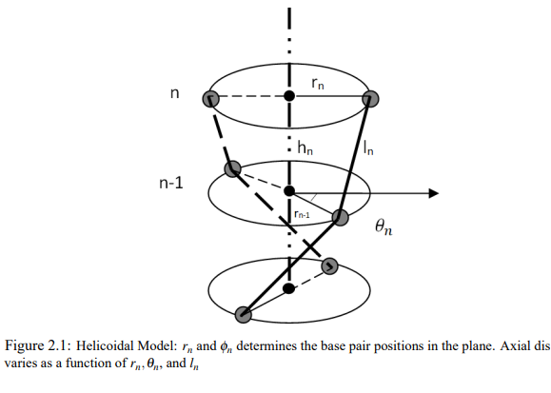
Helicoidal
F

Slide 11
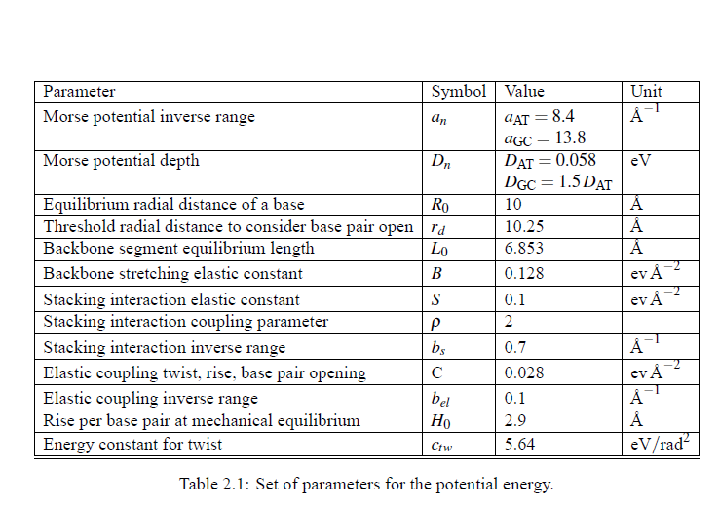

Slide 12
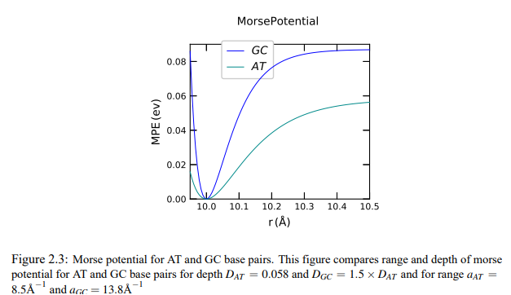
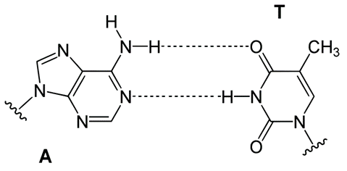
Binding energy b/w bases in base pair n
Ares et al. PRL (2005)

Slide 13
Stacking energy b/w base pairs
Switch function: stacking interaction b/w closed bps is stronger
Ares et al. PRL (2005)

Slide 14

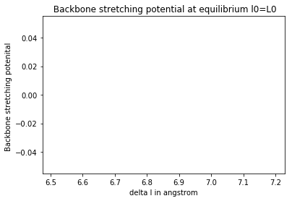
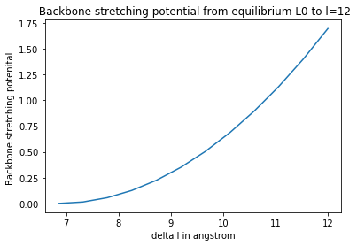
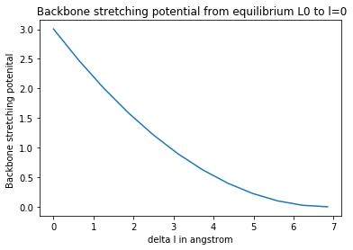
Backbone stretching energy b/w n-1,n bases

Slide 15
Coupling Between helical twist, rise, and base pair opening
Describe cross over from closed to open

Slide 16
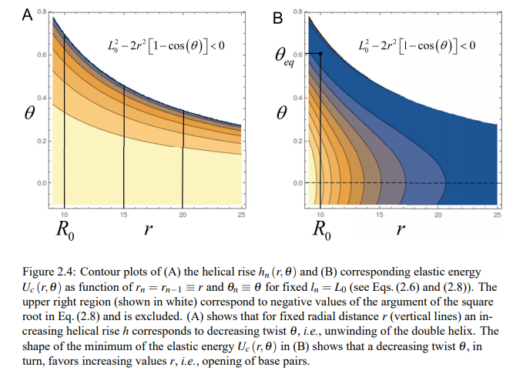
Contour plot h and U_{c}

Slide 17
External stretching force between n and n-1.

Slide 18
2.2 Monte Carlo Simulation
Ares et al. PRL (2005)

Slide 19
Base-pair opening move

Slide 20
Twisting move

Slide 21
Stretching Move

Slide 22
Double stranded ensemble

Slide 23
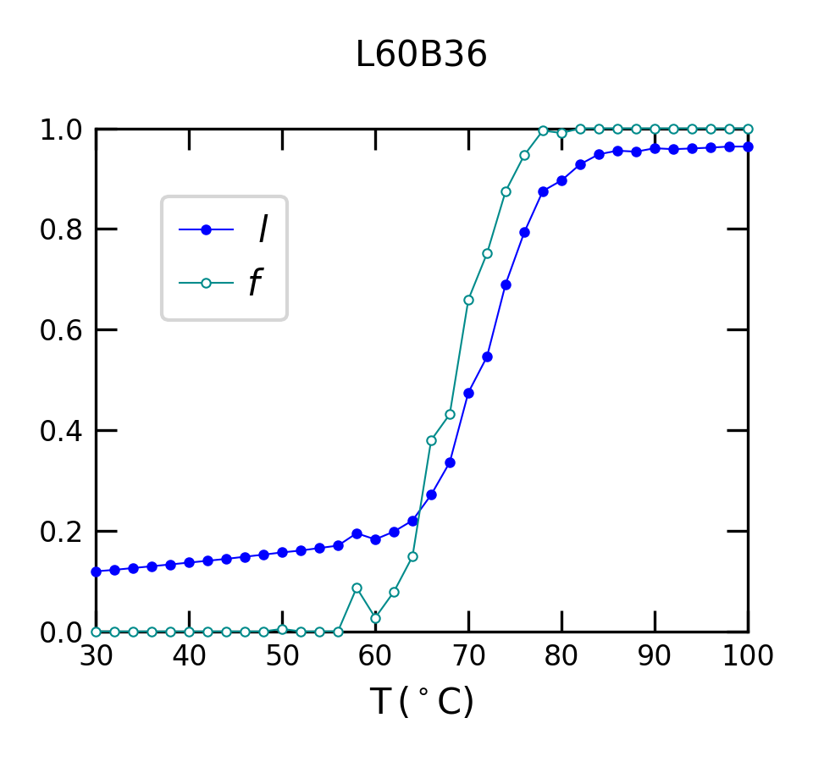
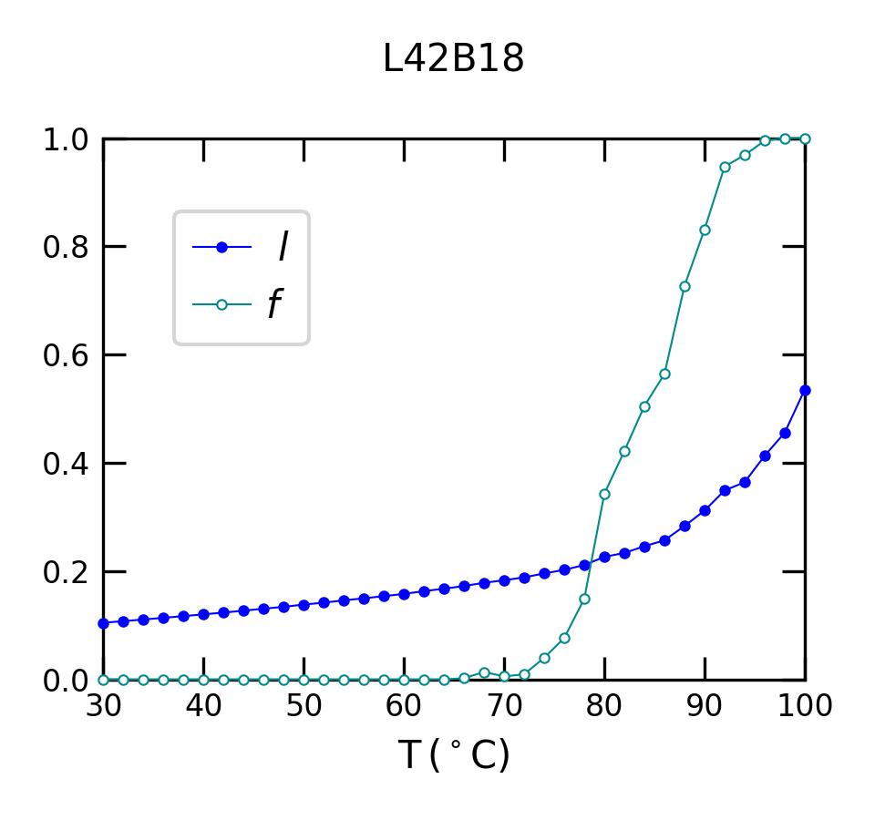
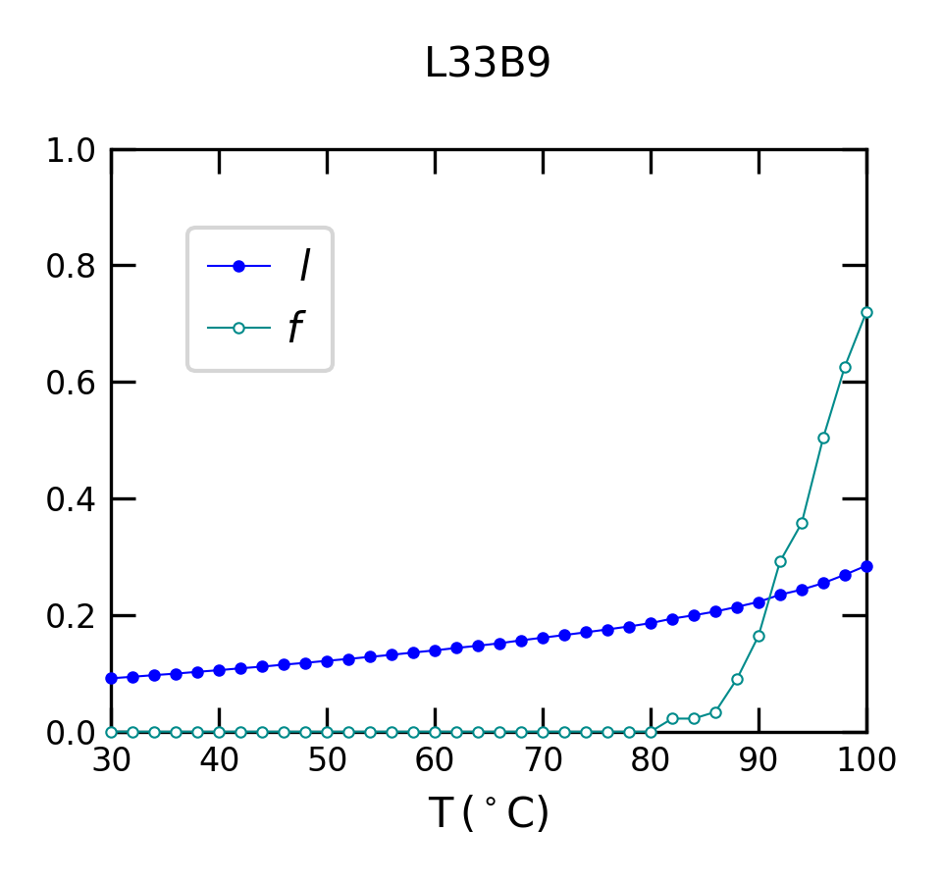
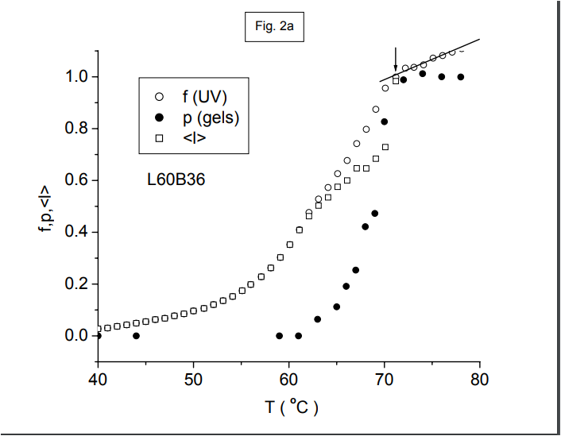
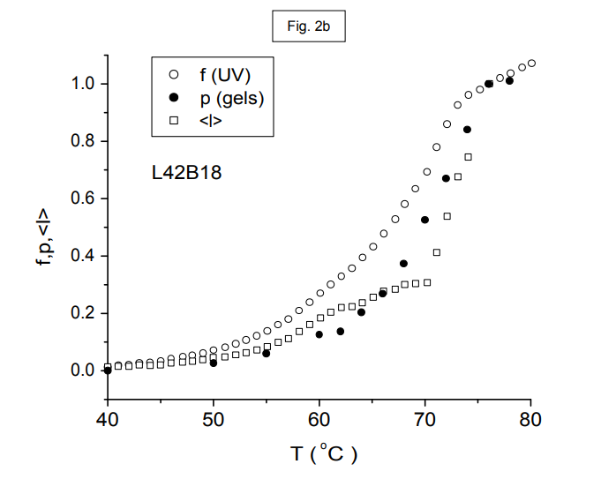
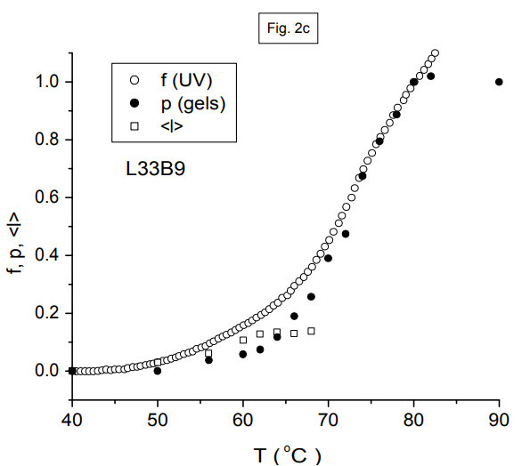
Result
Thermal denaturations

Slide 24
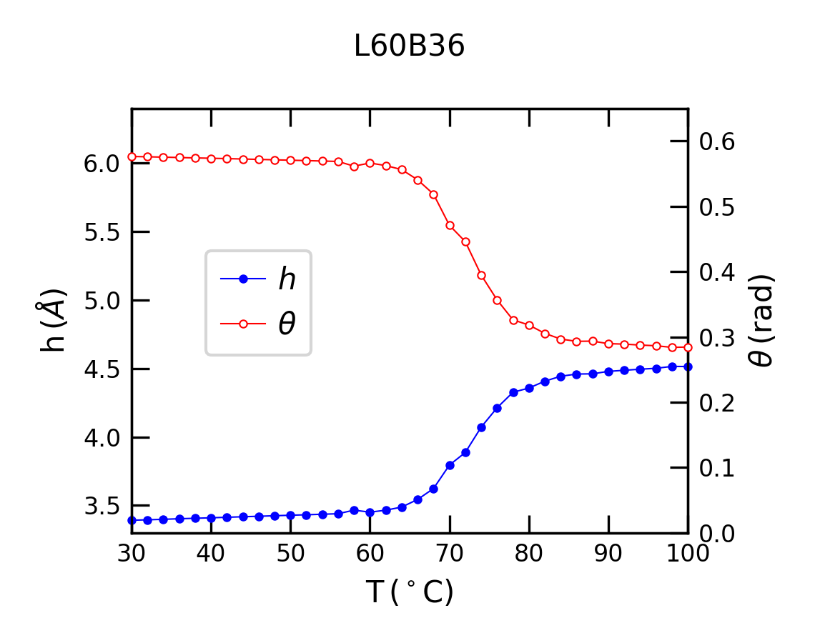
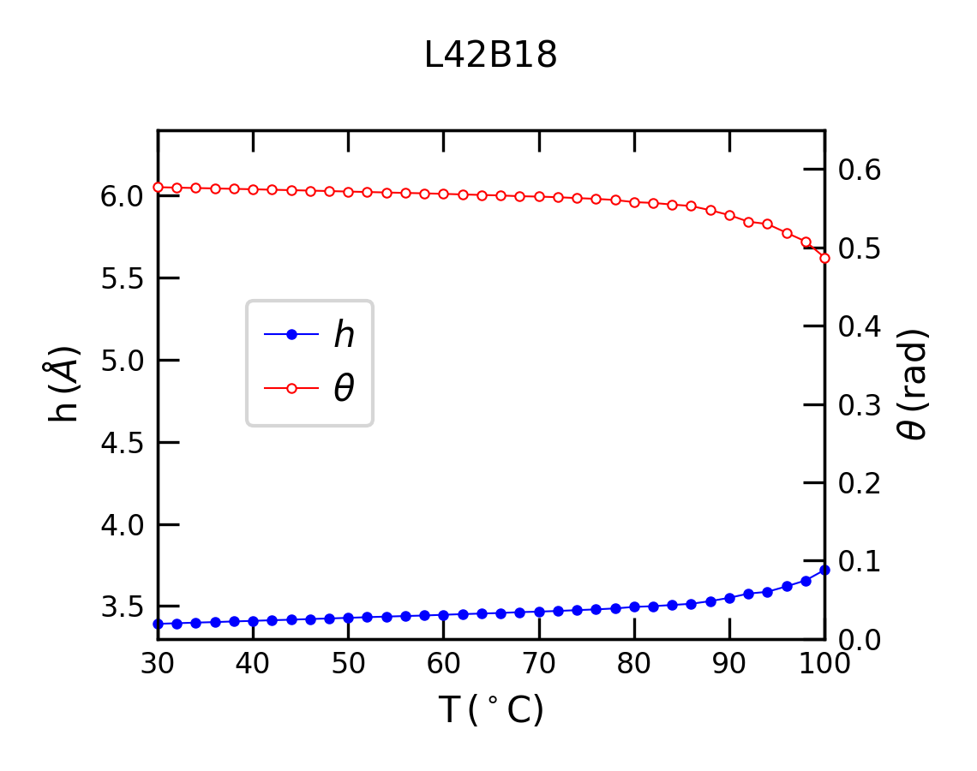
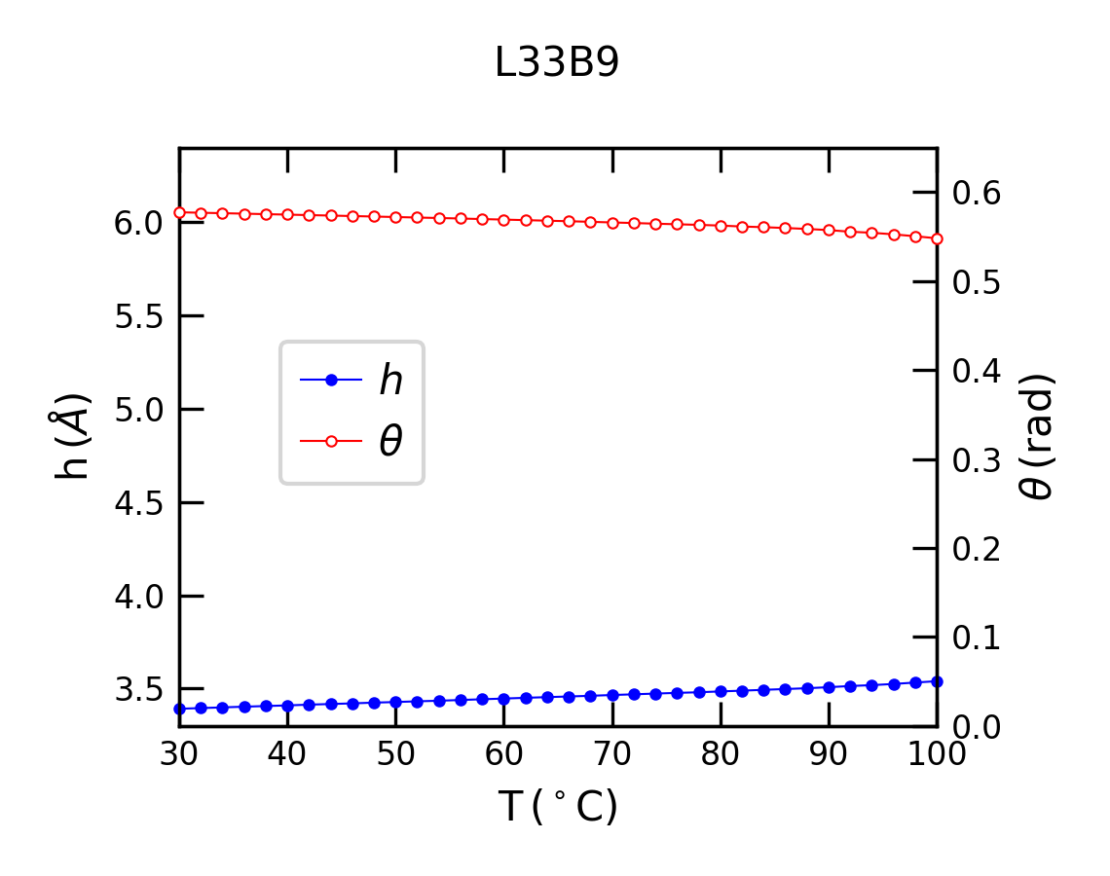
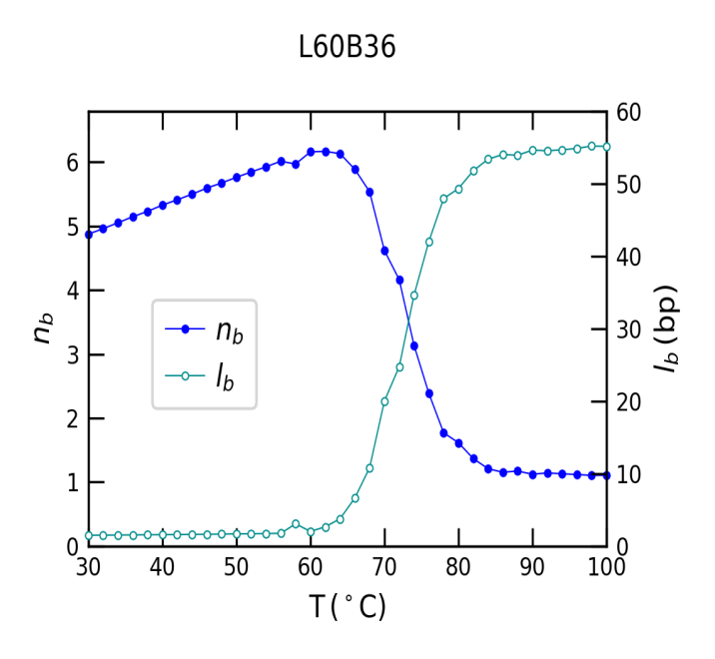
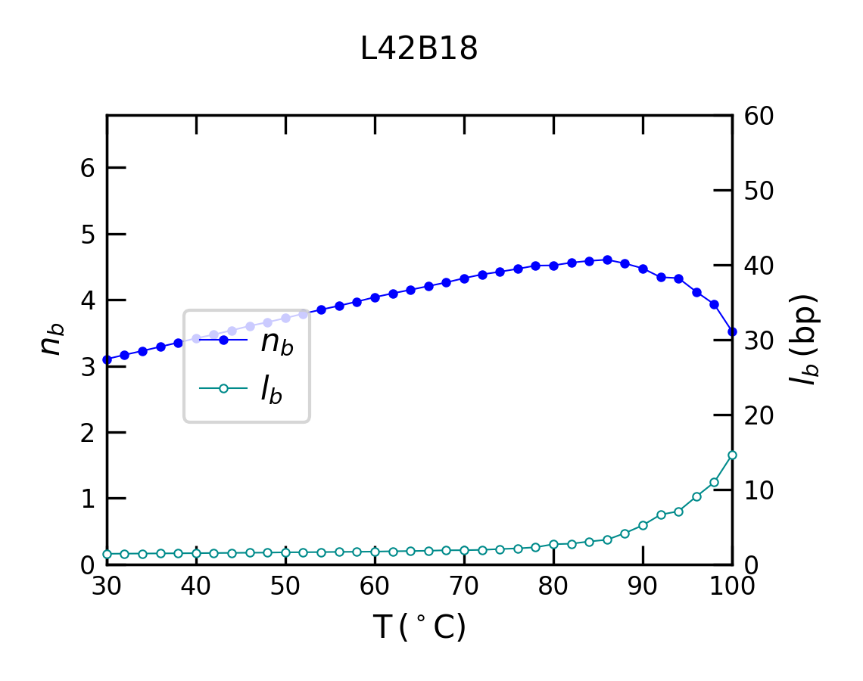
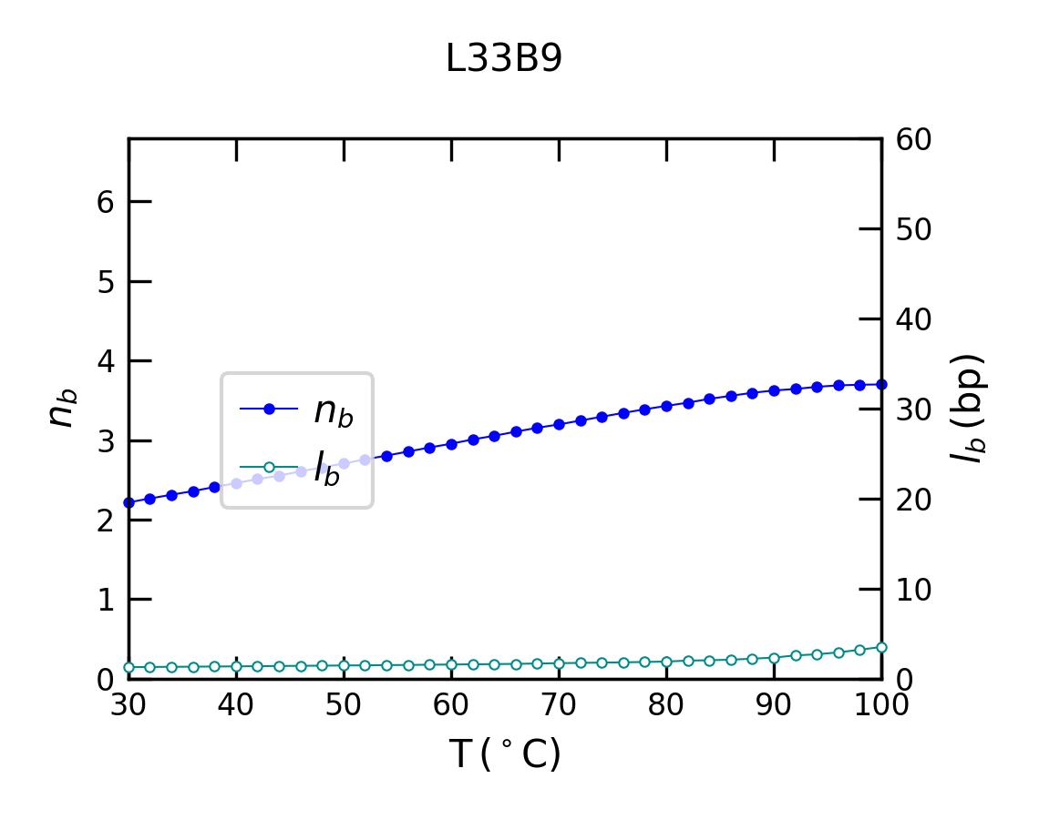

Slide 25
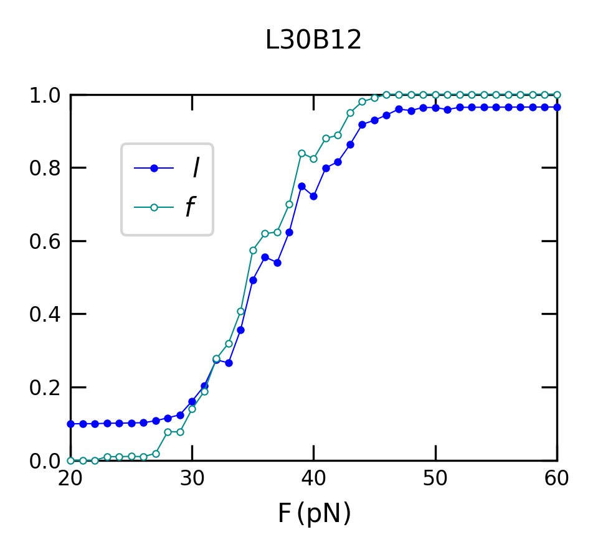
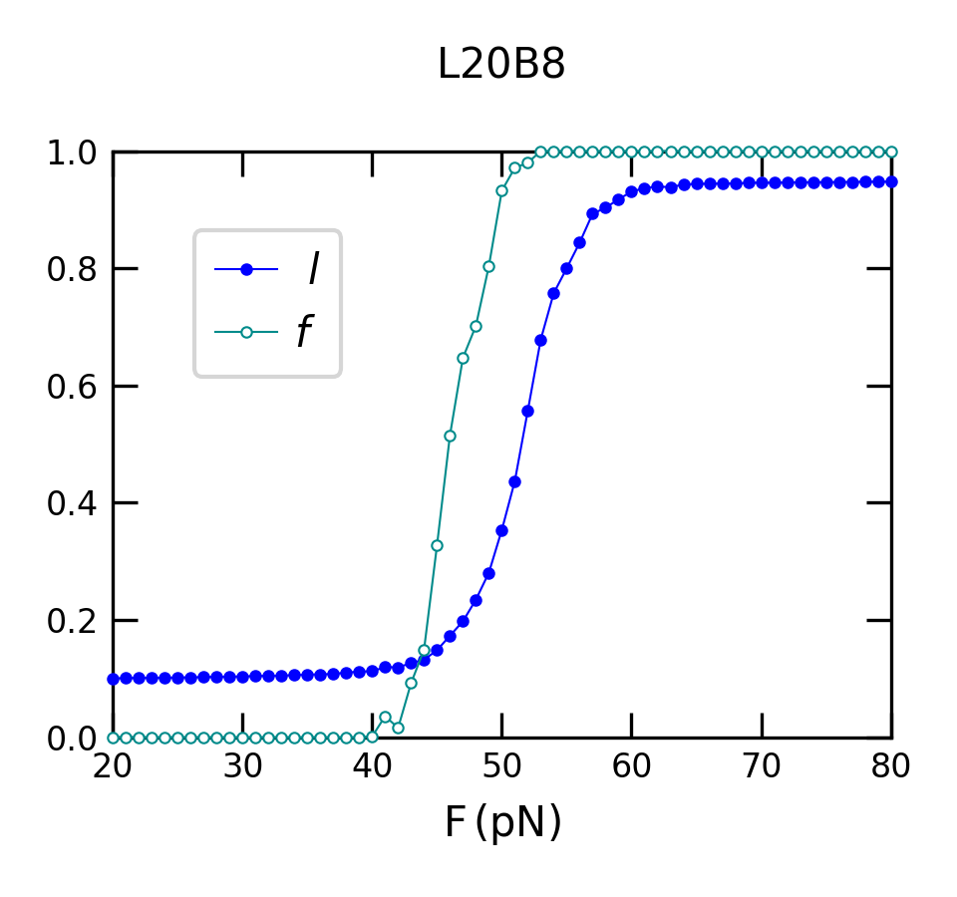
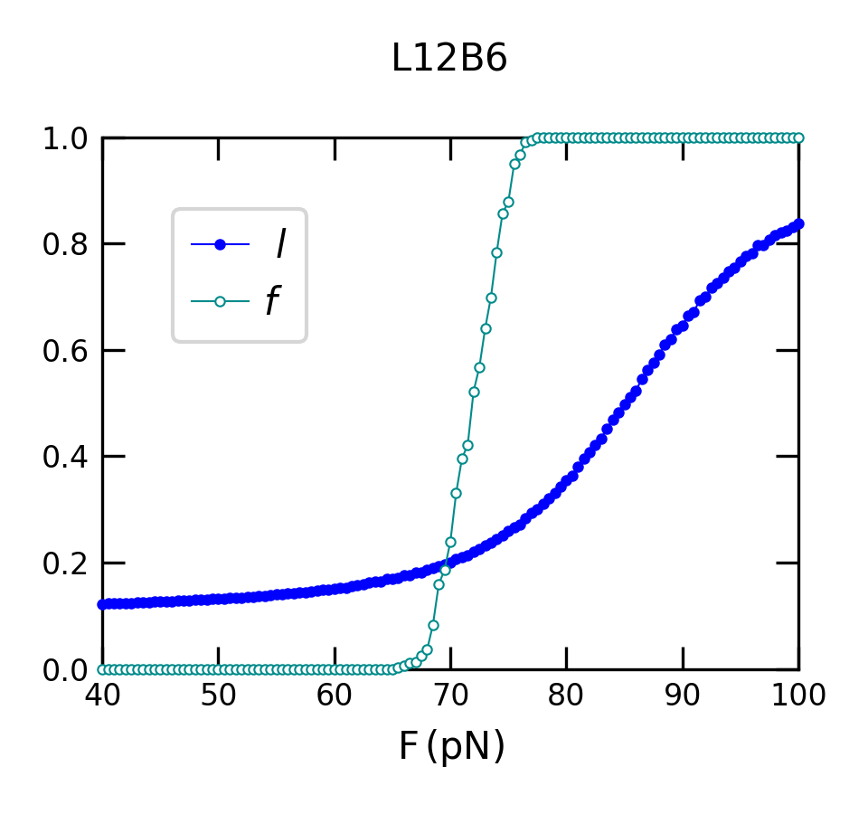
Force-induced denaturations

Slide 26
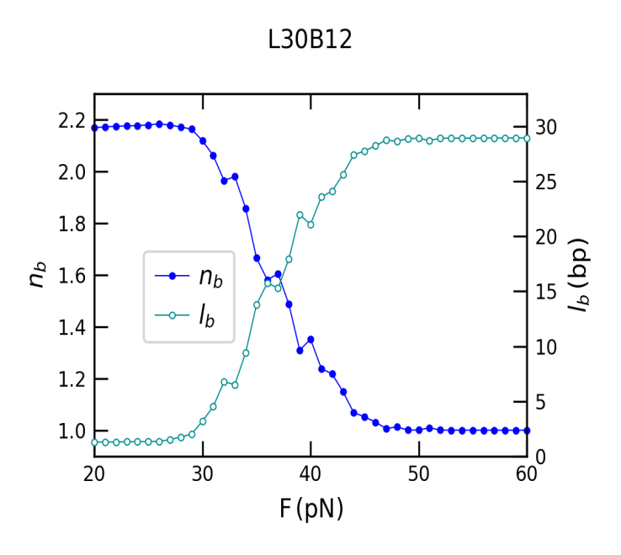
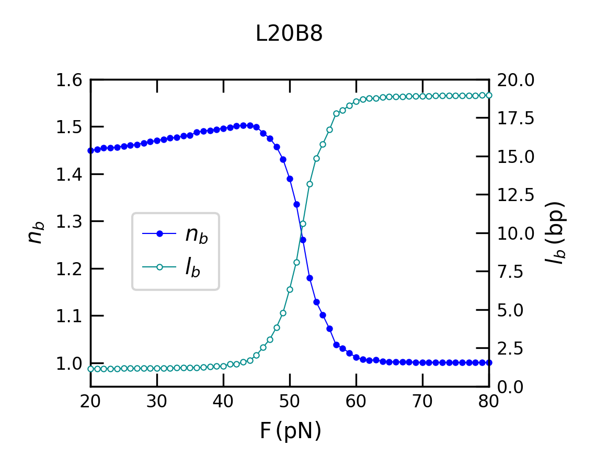
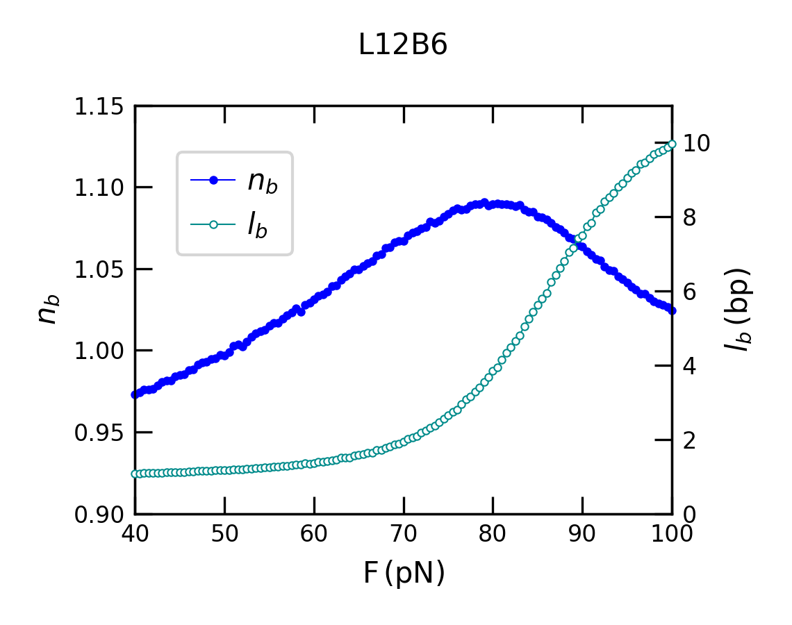
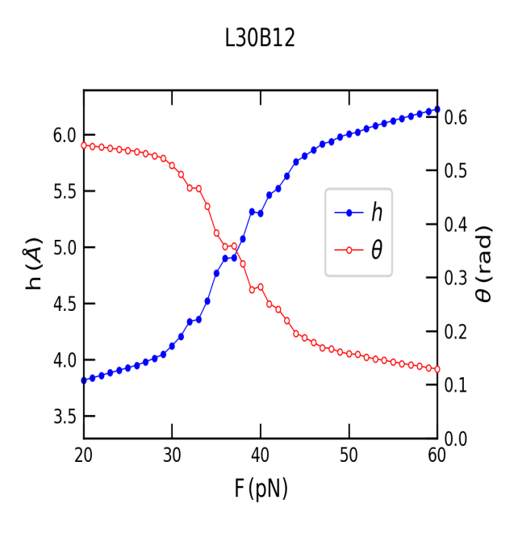
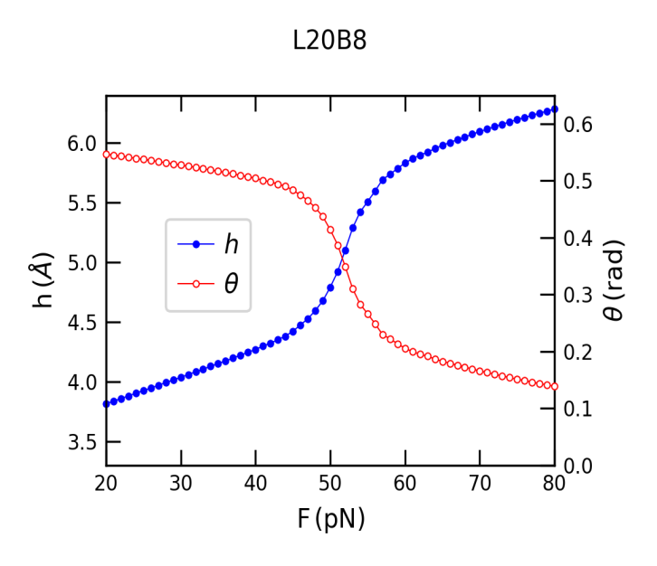
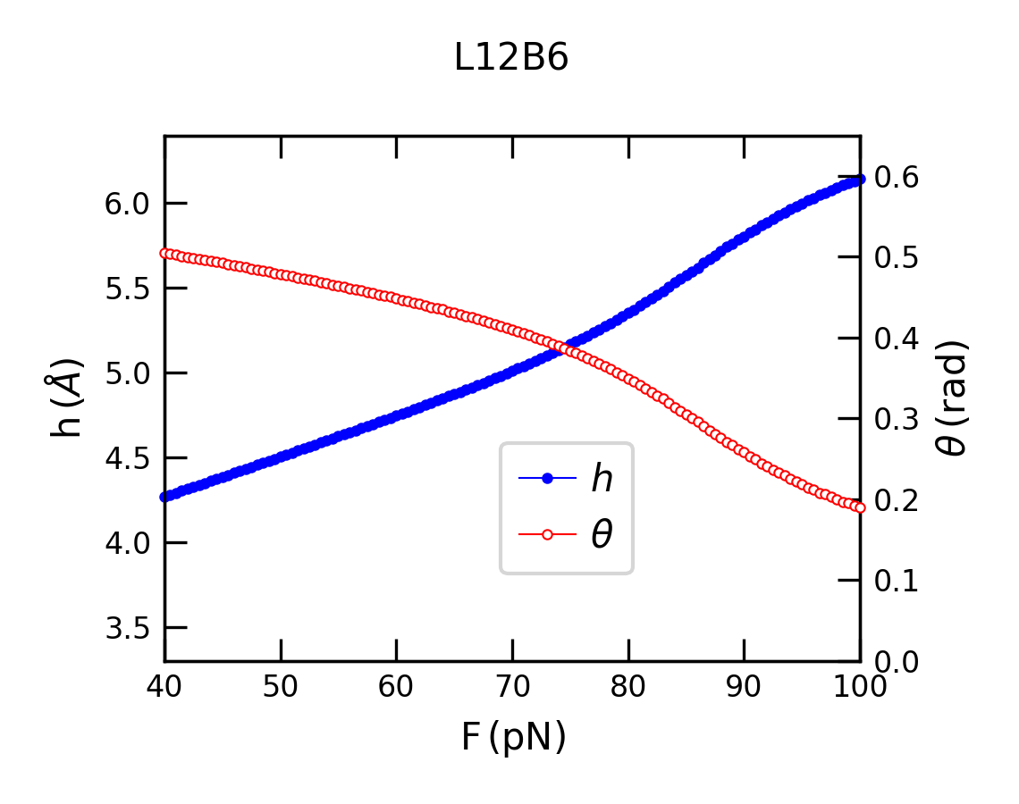

Slide 27
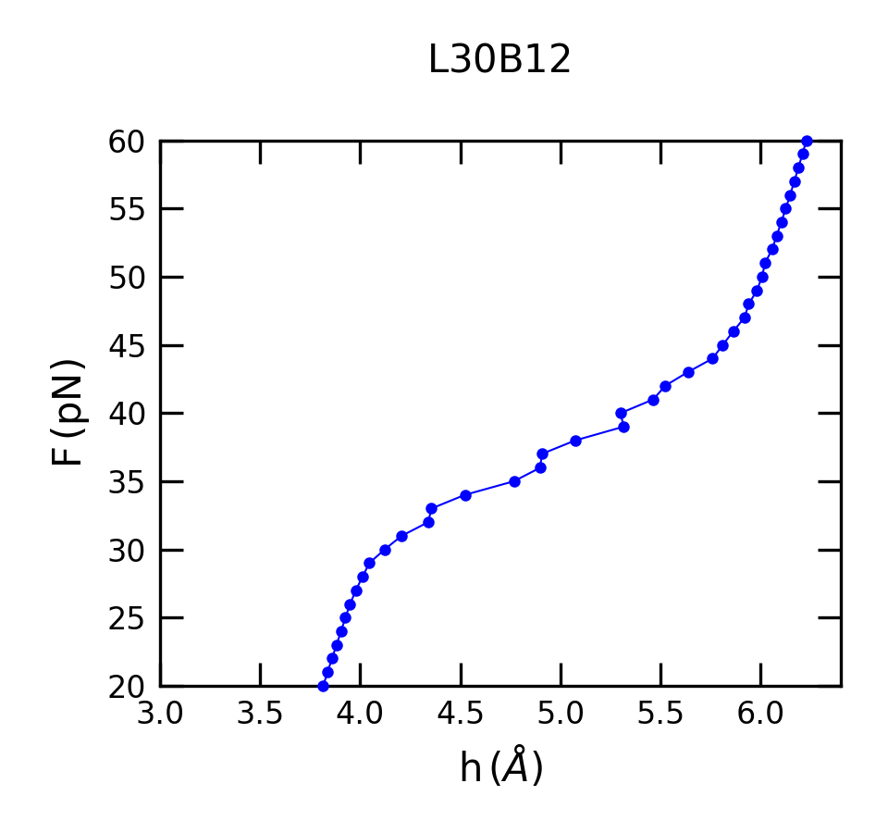
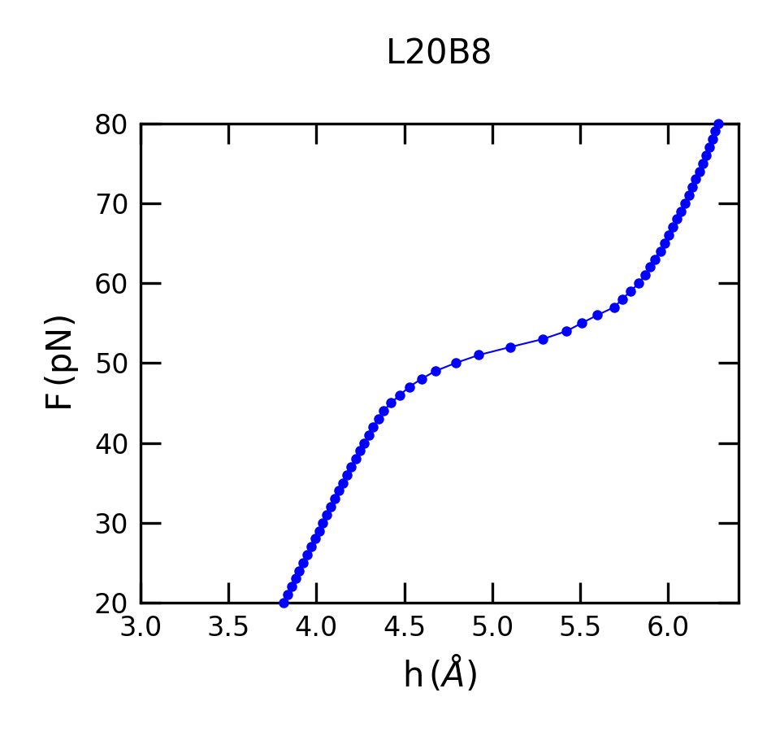
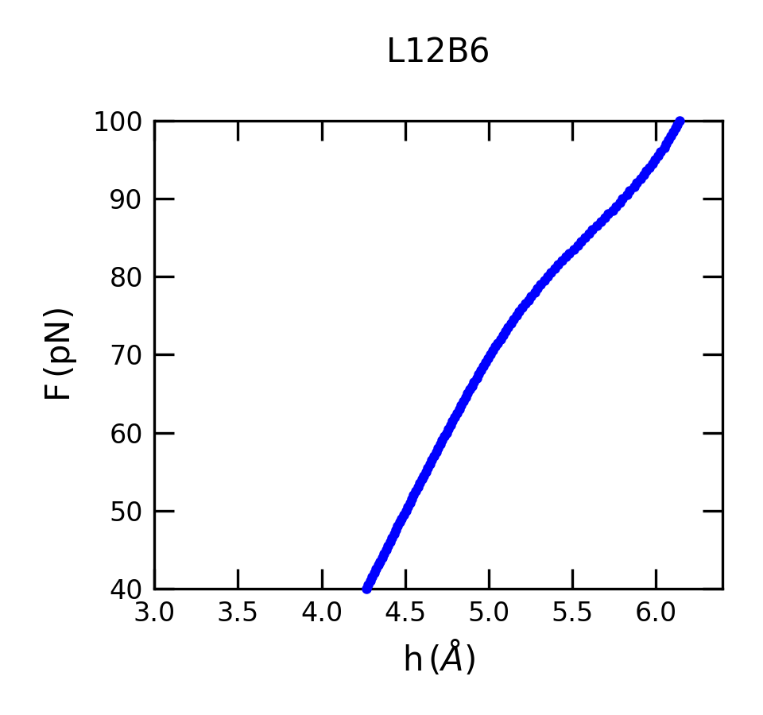
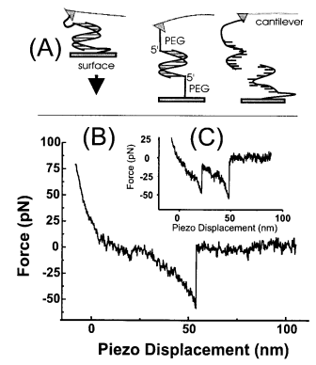
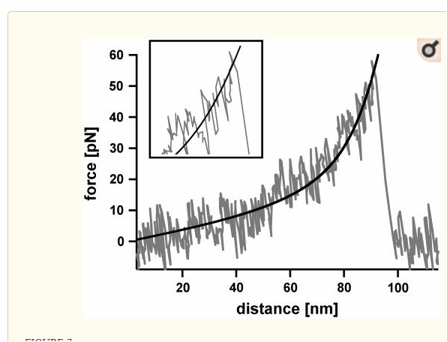
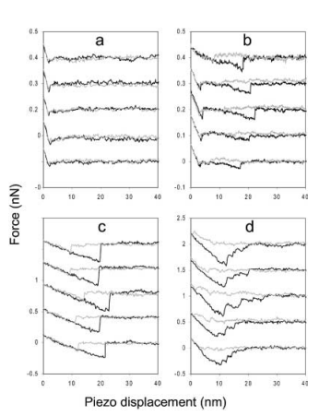
Force vs. extension

Slide 28
Conclusion

Slide 29
Thank you

