Slide 1
Dashboard on US States Covid19 Daily Reports on Tableau
By : Pawan V. Walke
Batch : Mar '21 Batch 1

Slide 2
OBJECTIVE
To create Dashboard based on US States Covid19 Daily Reports on Tebleau

Slide 3
INTRODUCTION
Coronaviruses are a large family of viruses which may cause illness in animals or humans. In humans, several coronaviruses are known to cause respiratory infections ranging from the common cold to more severe diseases such as Middle East Respiratory Syndrome (MERS) and Severe Acute Respiratory Syndrome (SARS). The most recently discovered coronavirus causes coronavirus disease COVID-19 - World Health Organization
The number of new cases are increasing day by day around the world. This dataset has information from 50 US states and the District of Columbia at daily level.

Slide 4
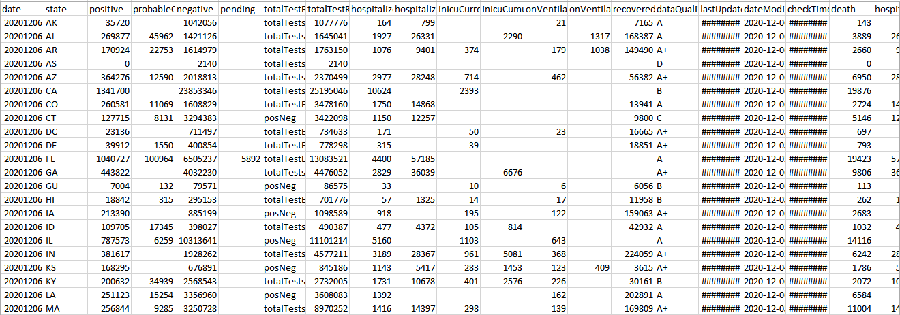
Dataset
DATASET contains 55 columns and 15634 rows.

Slide 5
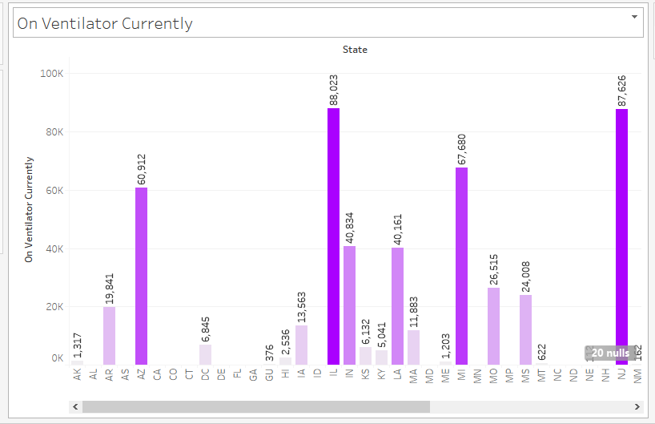
Chart No. 1
Problem statement:
How Many Patients are on the Ventilator Currently According to State Wise ?
.

Slide 6
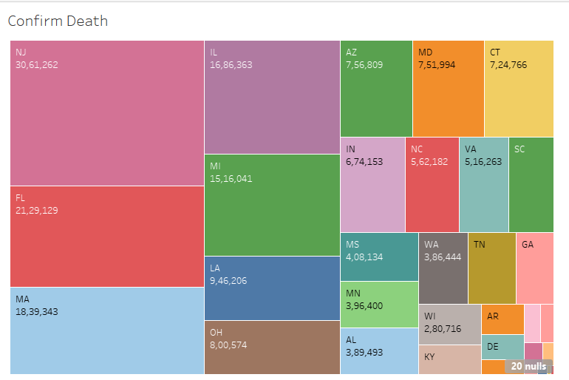
Chart No. 2
Problem statement:
To find how many patients are death ?

Slide 7
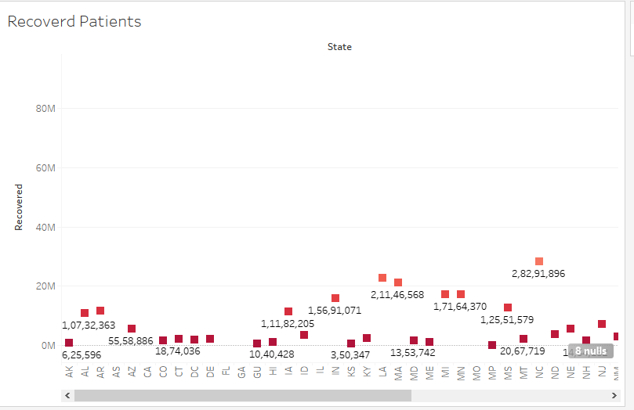
Chart No. 3
Problem statement:
To find How many Patients Recovered According to State wise .

Slide 8
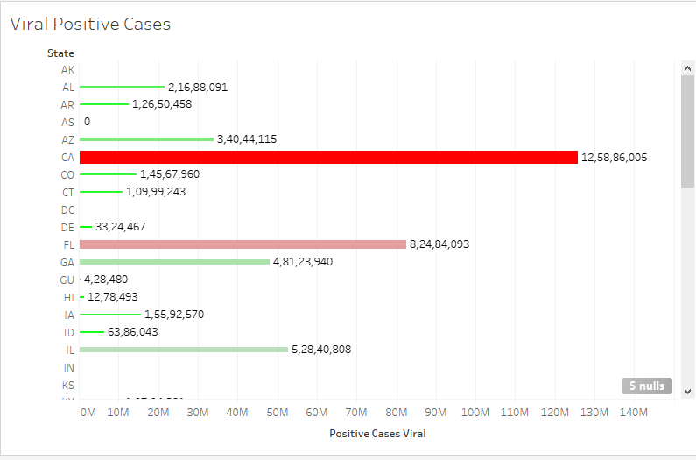
Chart No. 4
Problem statement:
State Wise the Viral Positive Cases .

Slide 9
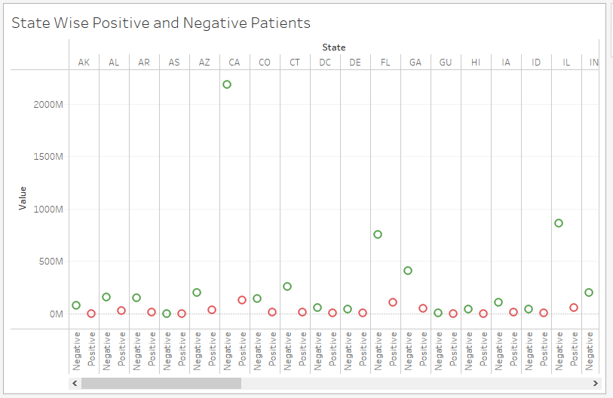
Chart No. 5
Problem statement:
To Find State wise Positive and Negative Patients.

Slide 10
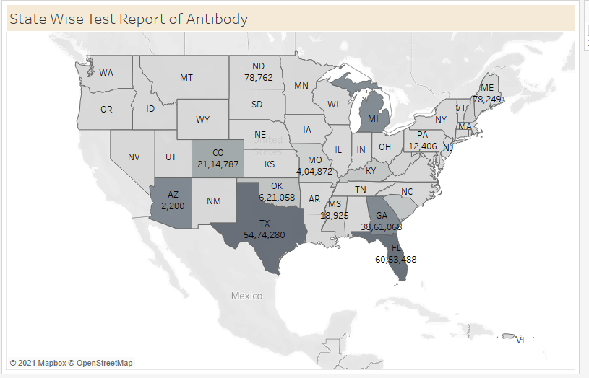
Chart No. 6
Problem statement:
To Find Positive state wise report of Antibody.

Slide 11
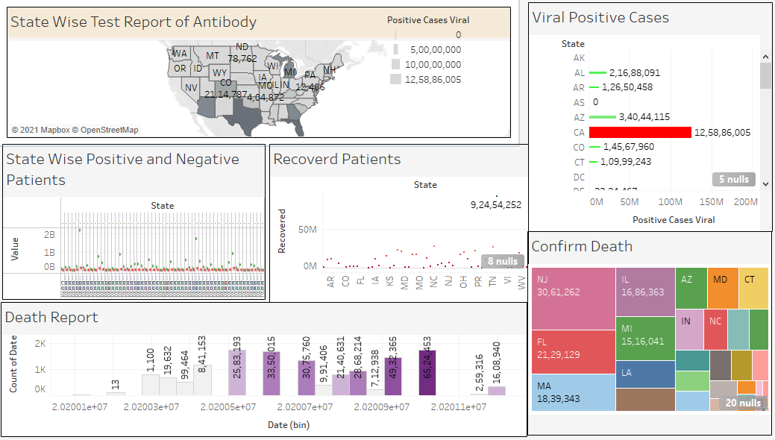
Dashboard

Slide 12
Conclusion
As Comparative other state Illinois (il) have maximum patients on ventilator.
Most of the people are confirm death in New Jersey (nj) state.
Most of the people recovered from Texas (TX) .
Most of the viral positive cases found in California (ca).
Most of the positive test antibody cases have in Texas (TX) .

Slide 13
Video Link
https://drive.google.com/file/d/17jJZiECAeN35jBm04-ccSNDbkWVi_gEv/view?usp=sharing

Slide 14
Thank You

