Slide 1
Info 5100
Business Case Study
The Structure and Operations of a University System

Slide 2
Objectives
How to read a complex domain model
How to abstract a social environment into a model with strong focus on people and subjects and users
Design management and control structure into the model
Understand the full potential of a digital domain model
  The whys:
    Strategic such as
      how to improve the educational systems (more competitive graduates) through learning and feedback
      new educational systems by passing existing systems
    Operational: Improved service delivery
Kal Bugrara, Ph.D
Application Engineering Information Systems

Slide 3
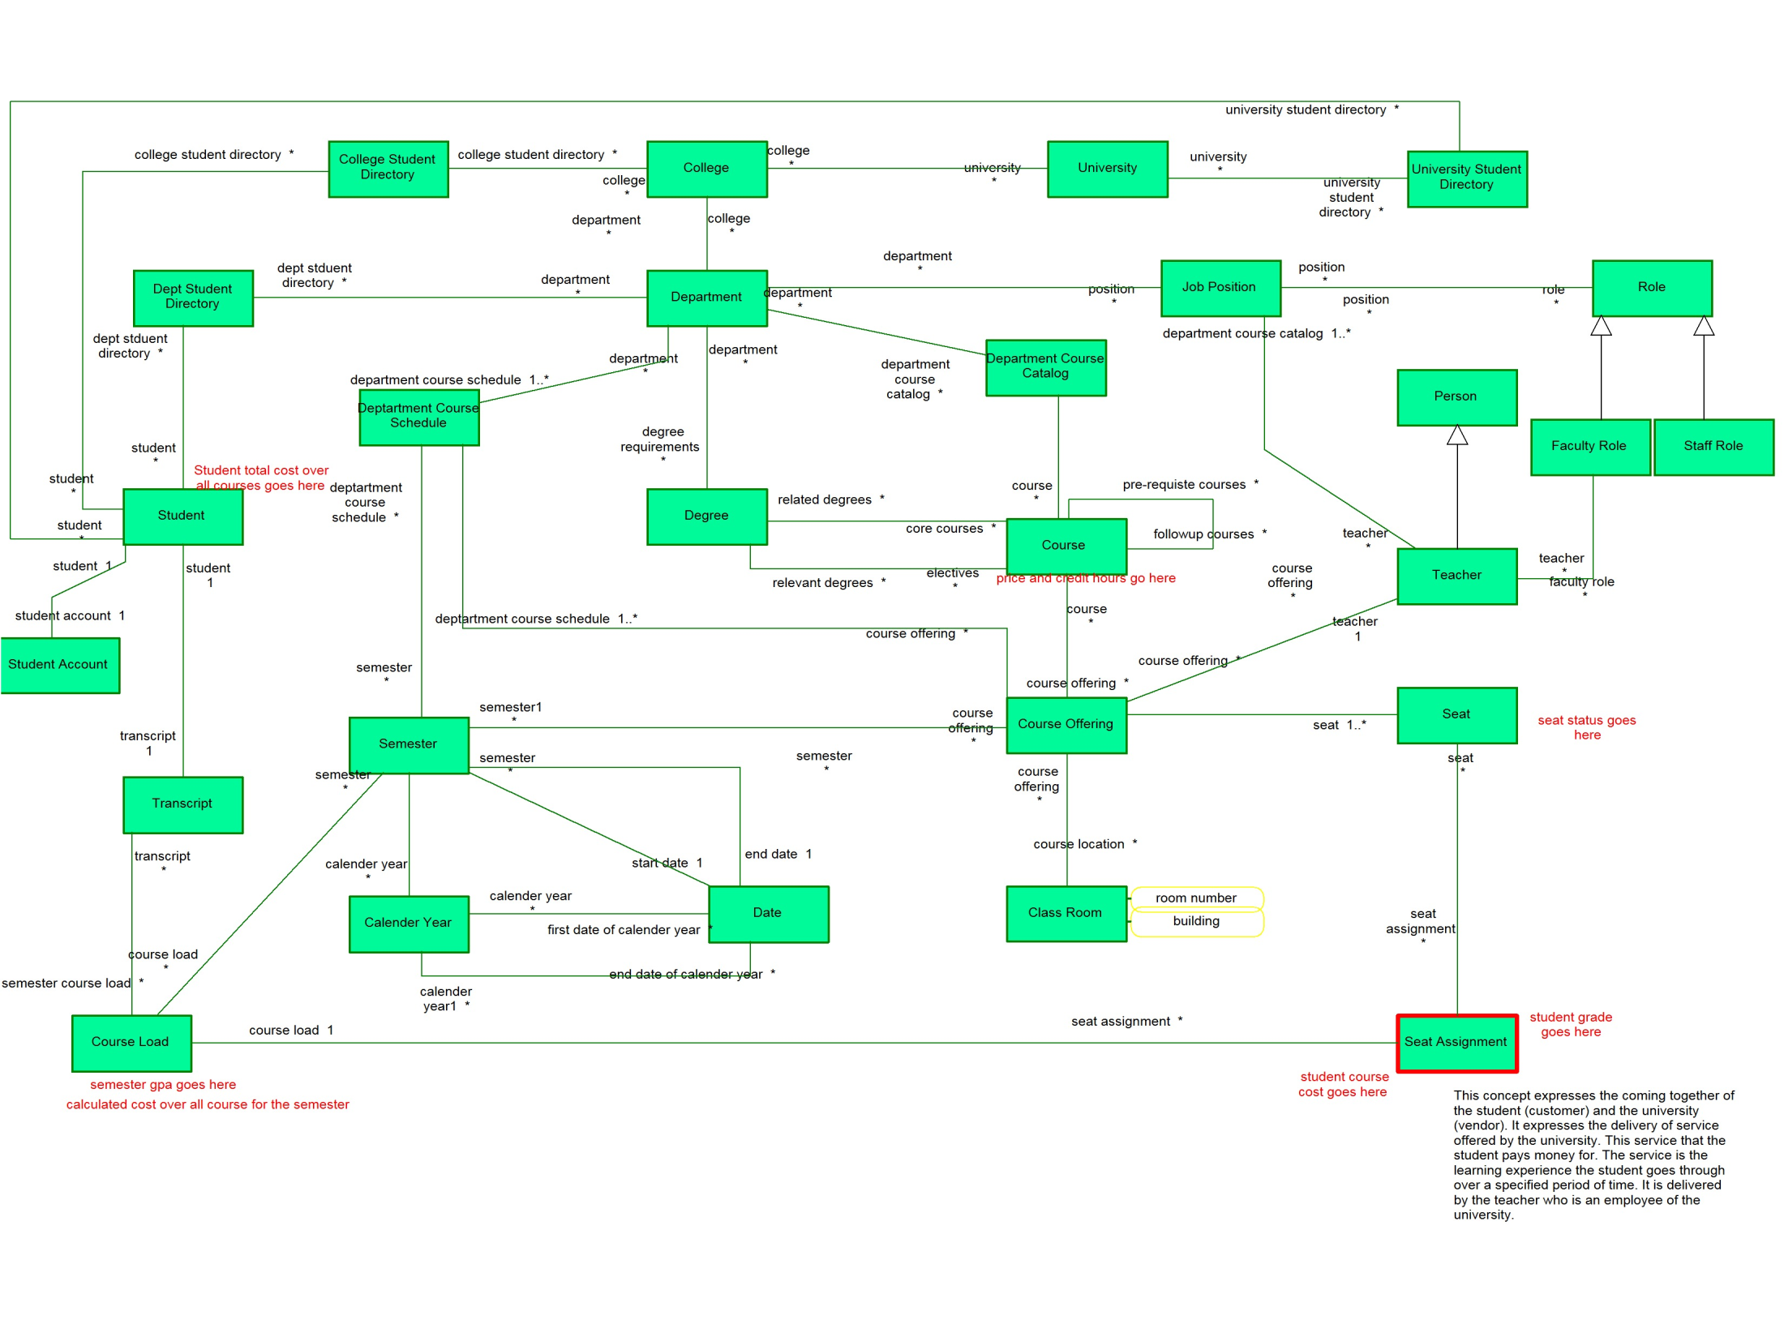

Slide 4
The Problem Statement
Build a university-wide student registration and management system. The system must enable the university to manage its operations at the student, department, and college levels. This will allow the university to devise more effective ways of: measuring unit performance, control costs, forecast enrollments, and implementing marketing plans.
Kal Bugrara, Ph.D
Application Engineering Information Systems

Slide 5
Dept
      Responsible for
      Academic matters such as students and courses
      Business matters such as staff, faculty, etc.
      Maintain course catalog and schedule courses
Issues important at this level
What are the courses we teach?
What are the courses we offer at any given semester?
Which courses are core and which ones are electives? What are the course requirements?
What are the degree requirements?
What is our current capacity? How many seats are empty?
What is our faculty/student ratio per class? How do we compare with other depts in the college?
What is the average number of students per class? Largest class? Smallest class?
What is the current student enrollment in our department?
What is the administrative staff to faculty ratio?
What is the ratio of full time faculty vs part-time?
What is the percentage of faculty with Ph.Ds?
Kal Bugrara, Ph.D
Application Engineering INFO 5001 Information Systems

Slide 6
University:
      Responsible for
      academic matters such as colleges and students
      Business matters such as marketing, financials, course pricing, etc.
      Administrative matters such as Human Resources
Issues important at this level
Are we profitable?
What is the faculty/student ratio per class broken down by college? What is the current student enrollment in our university broken down by college?
Kal Bugrara, Ph.D
Application Engineering INFO 5001 Information Systems

Slide 7
College:
      Responsible for
      Academic matters such as departments and students
      Business matters such as staff, faculty, etc.
Issues important at this level
What is the faculty/student ratio per class broken down by Department? How do we compare with other colleges?
What is the average number of students per class? Largest class? Smallest class?
What is the current student enrollment in our college broken down by department?
What is the administrative staff to faculty ratio?
What is the ratio of full time faculty vs part-time?
What is the percentage of faculty with Ph.Ds?
Kal Bugrara, Ph.D
Application Engineering INFO 5001 Information Systems

Slide 8
Department Stakeholders and Users
Students
  Needs: Review courses offered, Register for courses, Review Teacher profiles, Graduation Requirements, Review Academic Status, Departmental student portal, etc
Teachers
  Student profiles, Grade submission, Contact Info
Departmental Staff
  Maintain course catalog, Manage course schedule, Student grade submission, course enrollment numbers, student status, Manage Teachers and their profiles
College Administrators
  Department enrollment numbers, Department performance evaluation
Parents
  Real-time access to student class standing?
Kal Bugrara, Ph.D
Application Engineering INFO 5001 Information Systems

Slide 9
Department
Has products and services
Has Demand for its products and services
  Customers and course offerings
Has a service delivery process of how these products and services will be delivered to its customers.
  Instructors, instructors teaching classes, evaluating student performance, assigning grades
Has a way of measuring how it is performing through management and feedback
Kal Bugrara, Ph.D
Application Engineering INFO 5001 Information Systems

Slide 10
Department
Department
Department Staff
Student Directory
Course Schedule
Course Catalog
Faculty Directory
Job Position
Degree
Kal Bugrara, Ph.D
Application Engineering INFO 5001 Information Systems

Slide 11
An Object Model
Department
Department Staff
Student Directory
Course Schedule
Course Catalog
Faculty Directory
Job Position
Employer
Assigned Individual
Course Offering
Faculty Member
Student
Course
Person
Employment
Kal Bugrara, Ph.D
Application Engineering INFO 5001 Information Systems

Slide 12
Course Offering vs Course
Course Offering
Course
Models a specific offering of course
An actual class
Time bound: month and year
Has a teacher
Class room
Course description
Exists in course catalog only
Independent of teacher
Kal Bugrara, Ph.D
Application Engineering INFO 5001 Information Systems

Slide 13
Course Offering vs Course
Course Offering
Course offerings 0..*
Course
The course 1..1
Kal Bugrara, Ph.D
Application Engineering INFO 5001 Information Systems

Slide 14
Department Manages Course Catalog
Manage the department course catalog which represent all the courses the department has to offer or the courses the department is capable of teaching (Capability)
Course catalogs are updated once a year (if at all); so course catalogs are independent of time but we keep track of last time the catalog was updated
Example of cc responsibilities:
  Find course given the course name
  Find course given course number
  List all courses
  Update course
Department
Course Catalog
Course
Attributes:
name, Number, description
Kal Bugrara, Ph.D
Application Engineering INFO 5001 Information Systems

Slide 15
Department Manages Course Schedule
Department
Manage the department course schedule which represent all the courses the department is scheduled (committed) to teach in a given semester
Course schedules are created every semester. Course schedules are time dependent
Example of CS responsibilities:
  Which courses are taught in a given semester
  Add a course to the course schedule
  Assign a teacher to teach a scheduled course
Course Schedule
Course Offering
Attributes:
name, Number, description
Kal Bugrara, Ph.D
Application Engineering INFO 5001 Information Systems

Slide 16
Course Offering vs Course
Department
Course Schedule
Course Catalog
Course Offering
Course
Kal Bugrara, Ph.D
Application Engineering INFO 5001 Information Systems

Slide 17
What is a course offering
Course Offering
It is the actual class being taught at some point in time. It answers questions such as:
What is the course being offering?
Who is teaching the course
When is it offered?
Where is it offered
Who are the students signed up for the class?
Kal Bugrara, Ph.D
Application Engineering INFO 5001 Information Systems

Slide 18
What is a course offering
Course Schedule
Semester
Att: Number
Course Offering
Room
Course
Teacher
Building
Person
Kal Bugrara, Ph.D
Application Engineering INFO 5001 Information Systems

Slide 19
Courses students must take to qualify for degree
Degree this course is part of 1..*
Core *
Degree
Course
Degree this course is part of 1..*
Courses that count as electives this degree 1..*
Kal Bugrara, Ph.D
Application Engineering INFO 5001 Information Systems

Slide 20
Department-Course-Degree Connection
Degree issued by department *
Department
Course Catalog
Degrees offered by department *
Degree this course is part of 1..*
Core *
Degree
Course
Degree this course is part of 1..*
Courses that count as electives this degree 1..*
Kal Bugrara, Ph.D
Application Engineering INFO 5001 Information Systems

Slide 21
The Student Dimension
Department
Student Directory
Student
Kal Bugrara, Ph.D
Application Engineering INFO 5001 Information Systems

Slide 22
Split the student into two concepts
Financial matters
Such as credit and debt
Personal/academic achievement information
Student Account
Student
Kal Bugrara, Ph.D
Application Engineering INFO 5001 Information Systems

Slide 23
Student carries a course load each semester (a number of courses
Student
Course grade goes here
Course Load
Seat Assignment
Course Offering
Semester
Kal Bugrara, Ph.D
Application Engineering INFO 5001 Information Systems

Slide 24
Student
Semester grade average goes here
Course Load
Seat Assignment
The Course Load class is responsible for the student courses in any given semester. It is the set or collection of courses the student took in a semester. It answers the question “What courses did the student complete in a given semester. Without the Course Load it will very difficult to answer such a reasonable question.
Semester
Kal Bugrara, Ph.D
Application Engineering INFO 5001 Information Systems

Slide 25
What is a transcript then?
Student
Transcript
Course Load
Semester
Kal Bugrara, Ph.D
Application Engineering INFO 5001 Information Systems

Slide 26
What is a transcript then?
Student
Transcript
Course Offering
Course Load
Seat Assignment
Semester
Kal Bugrara, Ph.D
Application Engineering INFO 5001 Information Systems

Slide 27
Transcript
Student GPA goes here. It is a calculated attribute (operation).
The Transcript class is a historical record of all the courses the student took during their stay at the university. The transcript class knows who the student is. It knows the student course load for any given semester.
To find the GPA. retrieve all the course load objects. For each course load object, get all the seat assignments. Iterate over all the seat assignments. For a given seat assignment get the course grade. Total them up grades. Take the average.
Kal Bugrara, Ph.D
Application Engineering INFO 5001 Information Systems

Slide 28
getGPA() goes here
A reference to the transcript instance is part of the student class
Student
The question is usually something like what is Jim’s GPA?
Therefore we need to define an operation of the student class that returns the student GPA. We need to define getGPA() operation on the student class.
The student class has a reference to the transcript instance. The getGPA() operation on the student class calls the operation
transcript.CalculateGPA() which calculates the student GPA when requested. The logic is as follows:
Transcript
CalculateGPA() operation goes here.
The CalculateGPA() operation retrieves all the course load objects. For each course load object, get all the seat assignments. Iterate over all the seat assignments. For a given seat assignment get the course grade. Total them up grades. Take the average.
Kal Bugrara, Ph.D
Application Engineering INFO 5001 Information Systems

Slide 29
How to determine student GPA?
Start her (find student)
Must iterate over all instances. For example, the transcript class has a list of course loads over a number of semesters. So we need to consider all instances of course load.
Student Directory
Student
Transcript
Course Load
Seat Assignment
The order of search or navigation
Kal Bugrara, Ph.D
Application Engineering INFO 5001 Information Systems

Slide 30
How to determine if a student fulfilled the degree requirements?
Start her
Must iterate over all instances. For example, the transcript class has a list of course loads over a number of semesters. So we need to consider all instances of course load.
Student Directory
Department
Student
Transcript
Course Load
Seat Assignment
Course Offer
isCoreCourse()
isElective()
The order of search or navigation or access
Course
Degree
Kal Bugrara, Ph.D
Application Engineering INFO 5001 Information Systems

Slide 31
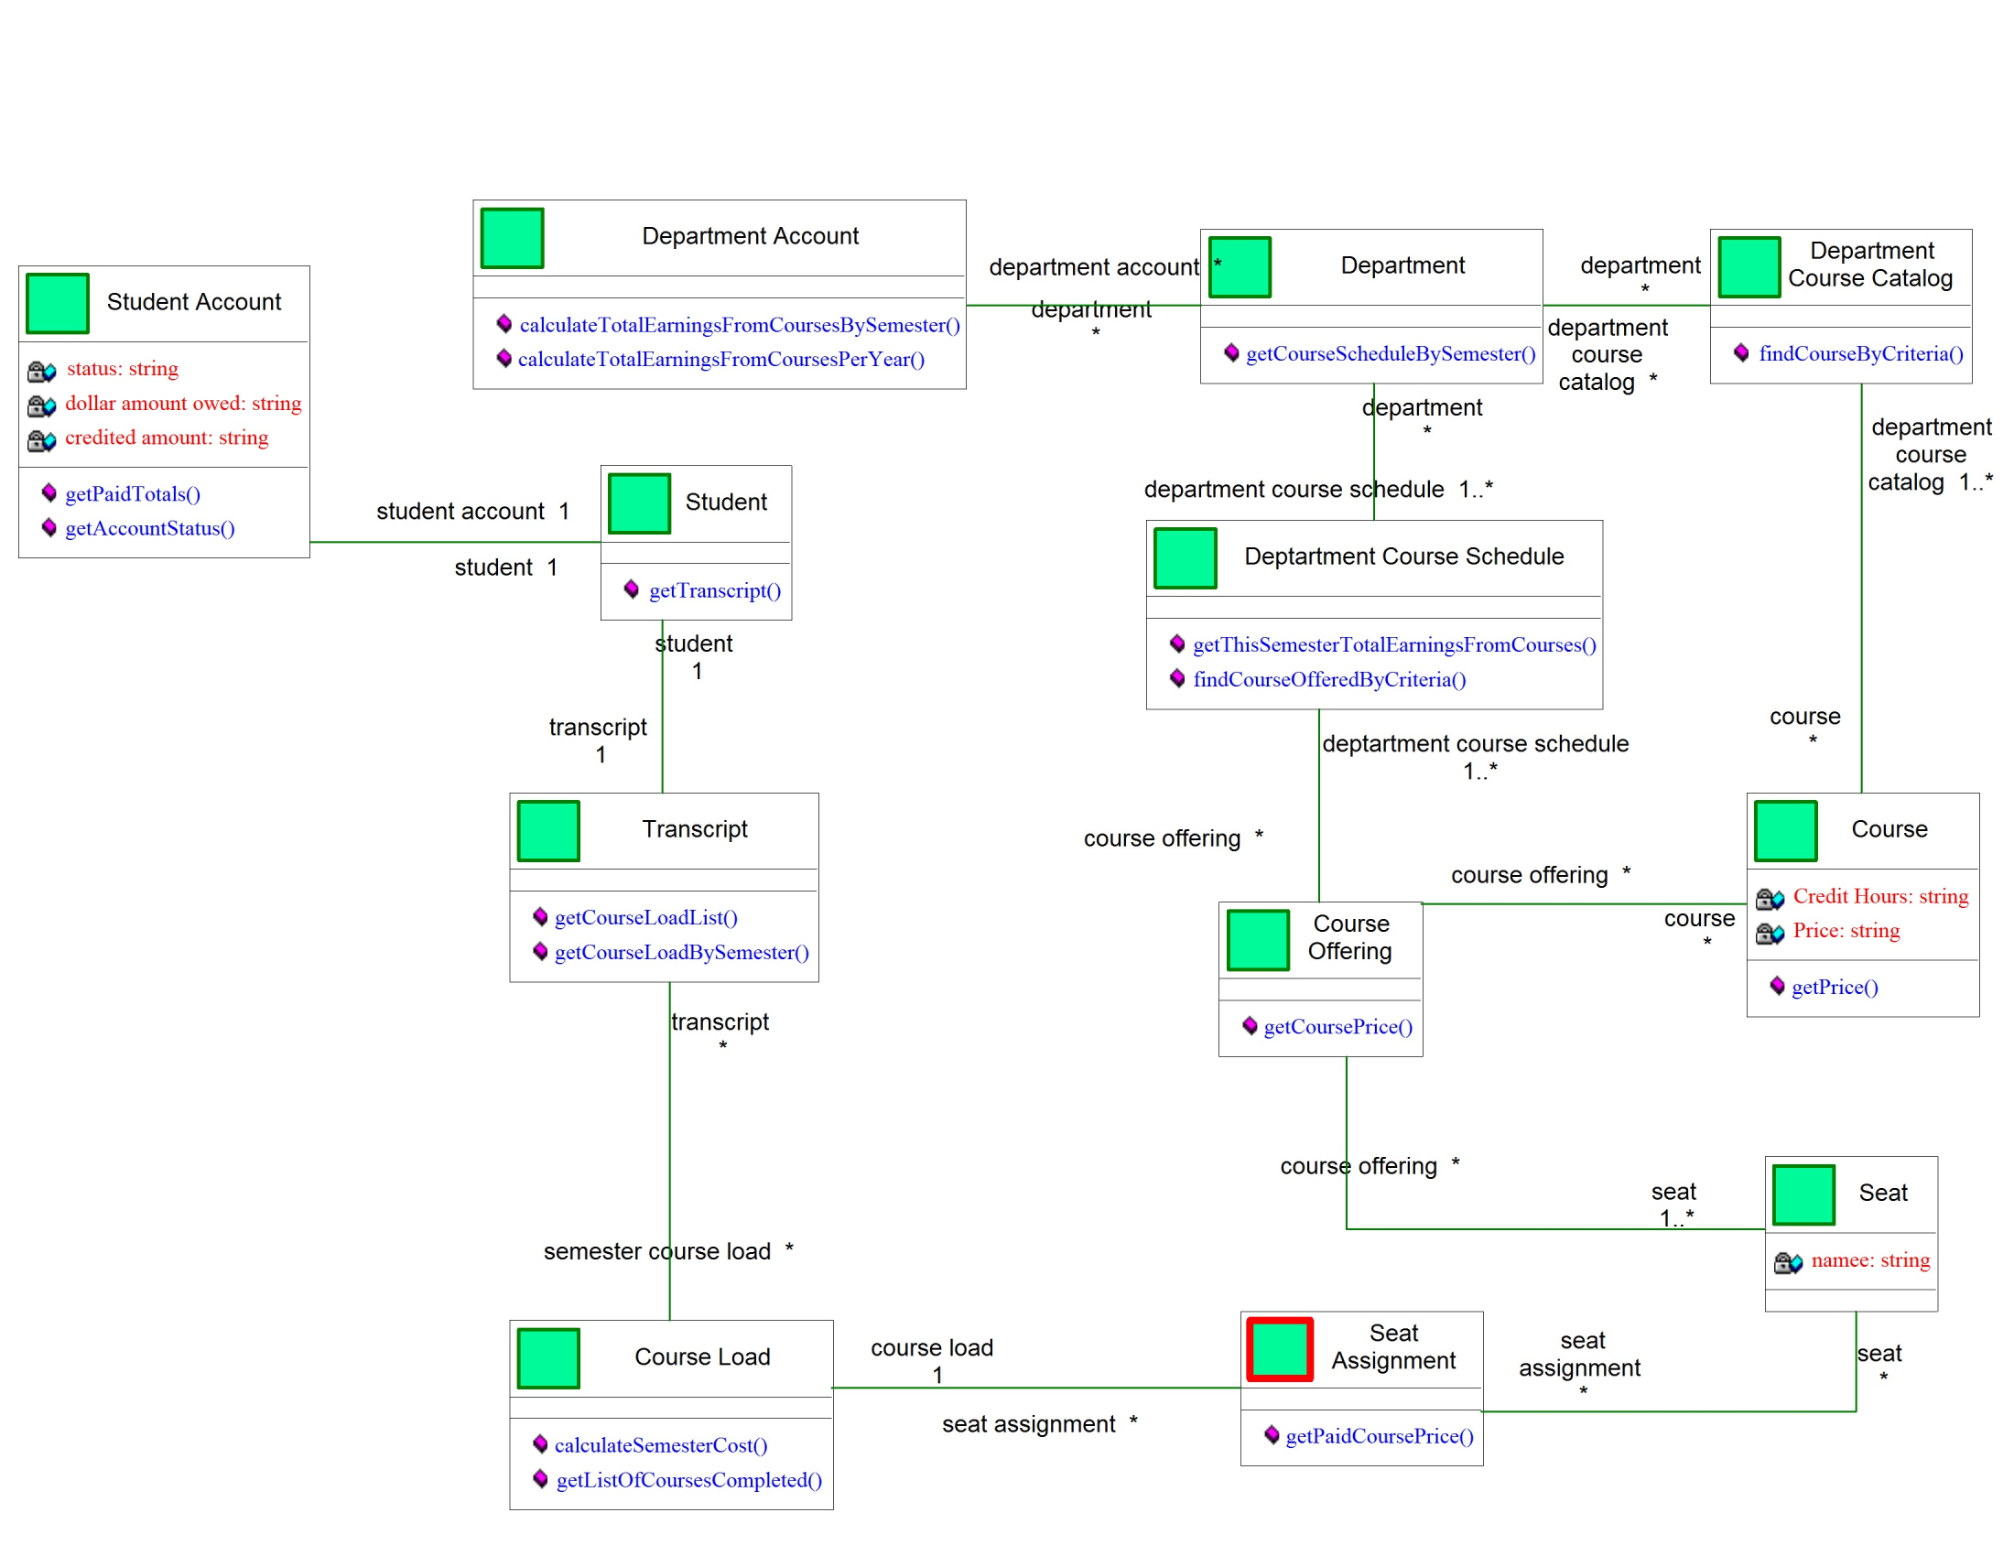
We extracted the following classes from the original model.
The focus is on classes to do with revenues.
For a more modular design financial matters are separated from the student class. The result is the addition of a Student Account class.

Slide 32
Operations and Strategy for answering quiz question
Student related questions start here
Department related questions start here

