Slide 1
Fundamentals Of Software Engineering Java Coding Patterns

Slide 2

Department
Next
Course Schedule
Course Catalog
Course Offer
Course

Slide 3
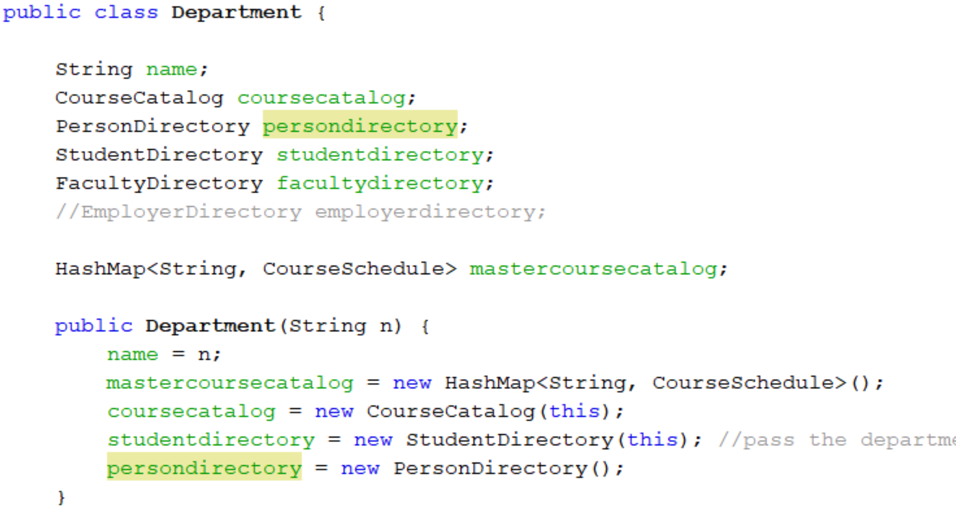
Department

Slide 4
1
2
1
Course Offer
Course

Slide 5
1
2
1
Patient
Person

Slide 6
1
2
1
Person
Course
Offer

Slide 7
1
1
2
1
Course Load
Seat Assignment
Seat

Slide 8
1
1. Create Course First 2. Link CourseOffer to course
2
1
Course Offer
Course
CourseOffer
Course
public class CourseOffer {
Course course;
public CourseOffer(Course c){
course =c;
}
public String getCourseNumber(){
return course.getCOurseNumber();
}
Course c = coursecatalog.getCourseByNumber(n);
CourseOffer co = new CourseOffer(c);
schedule.add(co);

Slide 9
1. Create Person First 2. Link Link StudentProfile next
2
1
Student Profile
Person
StudenProfile
person
public class StudentProfile {
Person person;
public StudentProfile(Person p) {
person = p;
}
PersonDirectory pd = department.getPersonDirectory();
Person person = pd.newPerson("0112303");
StudentDirectory sd = department.getStudentDirectory();
StudentProfile student = sd.newStudentProfile(person);

Slide 10
1. Create Person First 2. Link Link User Account next
2
1
User Account
Person
User Account
person
public class UserAccount {
Person person;
```String username;
public UserAccount(Person p) {
person = p;
}
PersonDirectory pd = department.getPersonDirectory();
Person person = pd.newPerson("0112303");
UserADirectory ud = department.getUserADirectory();
UserAccount student = ud.newUserAccount(person);

Slide 11
1. Create Person First 2. Link Link StudentProfile next
2
1
Patient
Person
Patient
person
public class Patient {
Person person;
public Patient(Person p) {
person = p;
}
Person person = new Person("0112303");
Patient patient = new Patient(person);

Slide 12
1. Create Course Offer First 2. Link Seat next
2
1
Seat
Course Offer
Seat
Course Offer
public class Seat {
Boolean occupied;
int number;
CourseOffer courseoffer;
public Seat (CourseOffer co, int n){
courseoffer = co;
Number = n;
}
Course course = new Course(‘info 5100”,,)
CourseOffer co = new CourseOffer(course);
Seat seat = new Seat(co, 1); //seat numner 1

Slide 13
public class CourseOffer {
Course course;
ArrayList<Seat> seatlist;
public CourseOffer(Course c){
course =c;
seatlist = new ArrayList();
}
public String getCourseNumber(){
return course.getCOurseNumber();
}
public void generatSeats(int n){
for (int i=0; i<n; i++){
seatlist.add(new Seat(this, i));
}
}
public Seat getEmptySeat(){
for(Seat s: seatlist){
if(s.isOccupied()) return s;
}
return null;
}
public int getTotalCourseRevenues(){
int sum = 0;
for(Seat s: seatlist){
if(s.isOccupied()==true) sum = sum + course.getCoursePrice();
}
return sum;
}
}
Course Offer
Seat
Course
offer
This means Current courseoffer
Seats

Slide 14
Two ways of registering students
Registering a student
(student side)
Assigning student to a class (Schedule Side)
Student
Course Schedule
Transcript
Course Offer
Student is registered for a class (a fact)
Must find an empty seat
Course Load
Seat Assignment
Seat

Slide 15
Transcript
Course Offer
Seat seat = co.getEmptySeat();
1
3
Course Load
Seat Assignment
Seat
SeatAssignment sa= seat.newSeatAssignment();
seatassignments.add(sa);
2
public SeatAssignment newSeatAssignment(CourseOffer co){
Seat seat = co.getEmptySeat(); // seat linked to courseoffer
if (seat==null) return null;
SeatAssignment sa = seat.newSeatAssignment();
seatassignments.add(sa); //add to students course load
return sa;
}

Slide 16
How to assign a teacher to a class
1
2
1
Person
Faculty Assignment
Course Offer

Slide 17
How to assign a teacher to a class
1
2
3
2
Person
Faculty Profile
Faculty Assignment
Course Offer

Slide 18
How to assign a teacher to a class
Person Directory
Faculty Directory
Course Schedule
Person
Faculty Profile
Faculty Assignment
Course Offer

Slide 19
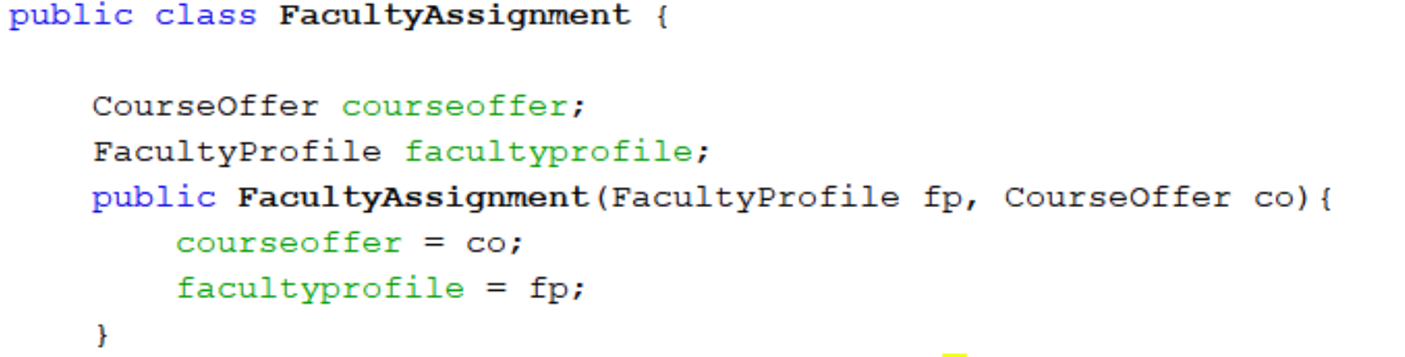
The binding object is shared by both. The faculty assignment knows the teacher and the course
Faculty Profile
Faculty Assignment
Course Offer

Slide 20
the teacher for the class
Faculty Directory
2
Course Schedule
1
1
Faculty Profile
Faculty Assignment
Course Offer
Find teacher => faculty profile
Find course offer => course offer
From Course offer assign teacher “course offer has faculty assignment attribute
Courseoffer.assignteacher(teacher profile)

Slide 21
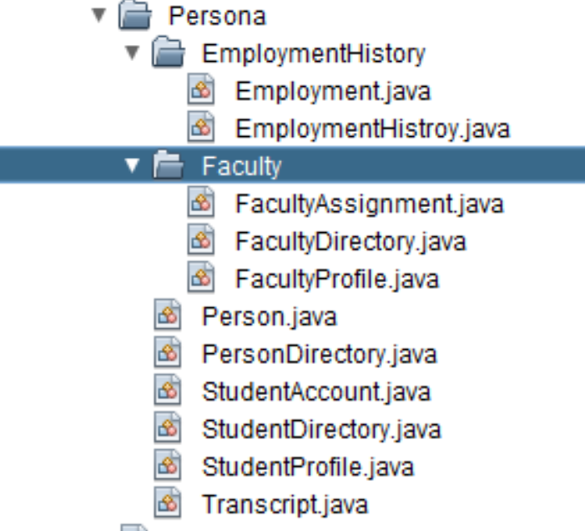
Faculty Directory
Course Schedule
2
1
1
Faculty Profile
Faculty Assignment
Course Offer

Slide 22
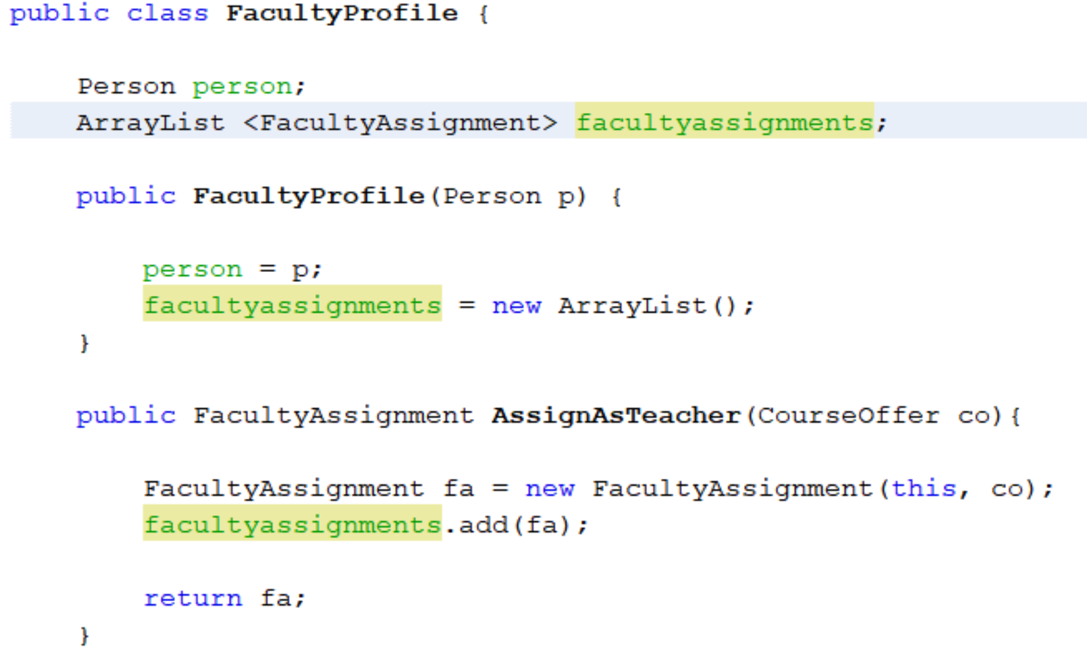
Faculty Directory
Course Schedule
2
1
1
Faculty Profile
Faculty Assignment
Course Offer

Slide 23
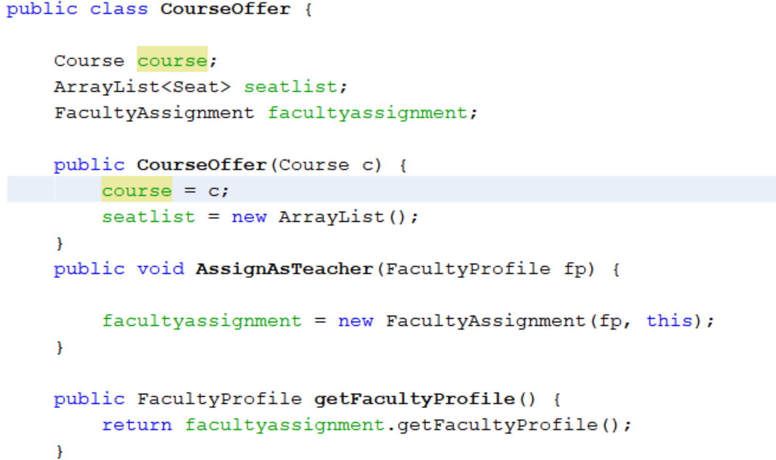
Faculty Directory
2
Course Schedule
1
1
Faculty Profile
Faculty Assignment
Course Offer

Slide 24
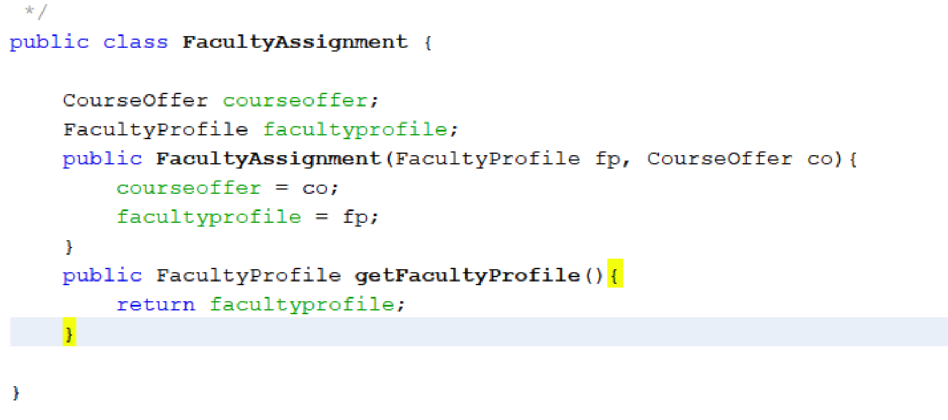
Faculty Directory
Course Schedule
2
1
1
Faculty Profile
Faculty Assignment
Course Offer

Slide 25
How to model a person role – step 1
Person Directory
University
Student Directory
Department
Person
Student Profile
Transcript
Financial Account
Degree reqs
Legal Identity

Slide 26
How to model a person role – step 1
Person Directory
University
Faculty Directory
Student Directory
Faculty Profile
Student Profile
Person
Department
Classes
Performance evaluations
Transcript
Financial Account
Degree reqs

Slide 27
How to model a person role – step 1
Corporate Partners
University
Employer Directory
Department
Employer Organization
Employer Profile
Legal Identity

Slide 28
Goal is to define the java code for this component of the department
Department
Course Schedule
Course Catalog
Course Offer
Course

Slide 29
Course is the first building block
public class Course {
String number;
String name;
int credits;
int price = 1250; //per credit hour
public Course(String n, String numb, int ch, int p){
name = n;
number = numb;
credits = ch;
price = p;
}
public String getCOurseNumber(){
return number;
}
public int getCoursePrice(){
return price*credits;
}
}
Course

Slide 30
public class CourseCatalog {
String lastupdated;
ArrayList<Course> courselist;
public CourseCatalog(){
courselist = new ArrayList();
}
public ArrayList<Course> getCourseList(){
return courselist;
}
public Course newCourse(String n, String nm, int cr){
Course c = new Course(n, nm, cr);
courselist.add(c);
lastupdated = todaysdate();
return c;
}
public Course getCourseByNumber(String n){
for( Course c: courselist){
if(c.getCOurseNumber().equals(n)) return c;
}
return null;
}
}
Course Catalog
Course

Slide 31
Order of generating the data
Course offerings
0
Course | Fall 2020 | Spring 2021 | Summer 2021 | Fall 2021
Info 5001
Info 5100
Info 6210
Info 6101
1
2
2

Slide 32
Every Semester there is a schedule
Course offerings
0
Course | Fall 2020 | Spring 2021 | Summer 2021 | Fall 2021
Info 5001
Info 5100
Info 6210
Info 6101

Slide 33
public class CourseOffer {
Course course;
ArrayList<Seat> seatlist;
public CourseOffer(Course c){
course =c;
seatlist = new ArrayList();
}
public String getCourseNumber(){
return course.getCOurseNumber();
}
public void generatSeats(int n){
for (int i=0; i<n; i++){
seatlist.add(new Seat(this, i));
}
}
public Seat getEmptySeat(){
for(Seat s: seatlist){
if(s.isOccupied()) return s;
}
return null;
}
public int getTotalCourseRevenues(){
int sum = 0;
for(Seat s: seatlist){
if(s.isOccupied()==true) sum = sum + course.getCoursePrice();
}
return sum;
}
}
Course Offer
Seat

Slide 34
public class CourseOffer {
Course course;
ArrayList<Seat> seatlist;
public CourseOffer(Course c){
course =c;
seatlist = new ArrayList();
}
public String getCourseNumber(){
return course.getCOurseNumber();
}
public void generatSeats(int n){
for (int i=0; i<n; i++){
seatlist.add(new Seat(this, i));
}
}
public Seat getEmptySeat(){
for(Seat s: seatlist){
if(s.isOccupied()) return s;
}
return null;
}
public int getTotalCourseRevenues(){
int sum = 0;
for(Seat s: seatlist){
if(s.isOccupied()==true) sum = sum + course.getCoursePrice();
}
return sum;
}
}
Course Offer
Seat
Course
offer
This means Current courseoffer
Seats

Slide 35
Course
Course Offer
Seat
public class CourseOffer {
Course course;
ArrayList<Seat> seatlist;
public CourseOffer(Course c){
course =c;
seatlist = new ArrayList();
}
public String getCourseNumber(){
return course.getCOurseNumber();
}
public void generatSeats(int n){
for (int i=0; i<n; i++){
seatlist.add(new Seat(this, i));
}
}
public Seat getEmptySeat(){
for(Seat s: seatlist){
if(s.isOccupied()) return s;
}
return null;
}
public int getTotalCourseRevenues(){
int sum = 0;
for(Seat s: seatlist){
if(s.isOccupied()==true) sum = sum + course.getCoursePrice();
}
return sum;
}
}
Course Offer
Course Offer
Course
Seat

Slide 36
Student Directory
Student Profile
Student. getTranscript()
Get The student transcript
Transcript
Transcript.getCourseLoadList()
Retrieve student course loads
For each courseload from the list
for(Courseload cl: coursloadlist)
Course Load 1
Course Load 2
Course Load 3
next
Course Load 4
Fall 2021
Spring 2022
Fall 2022
Spring 2023
For each seat assignment from the list of seat assignment
Seat Assignment 1
Seat Assignment 2
Seat Assignment 3

Slide 37
For each seat assignment from the list of seat assignments
Seat Assignment 1
Seat Assignment 2
Seat Assignment 3
Semester GPA
Course grade
Seat 1
Seat 2
Seat 3
Course seat availability
Course offer 1
Course offer 2
Course offer 3
Course
Teacher, location
Course
Course
Course
Course
Core/elective
Credit hours

