Slide 1
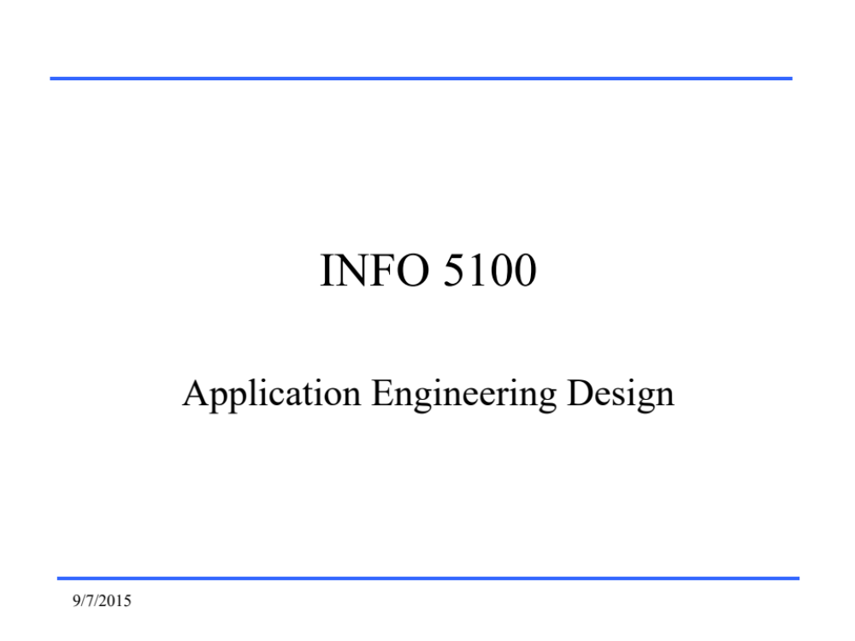
CSYE 6200
Concepts of Object Oriented Design
9/10/2016
Notes:
1.00.2

Slide 2
Java Memory Management
Daniel Peters
d.peters@neu.edu
9/21/2016

Slide 3
Lecture:
  Java JVM Memory Management
  Heap and Nursery
  Thread Stack
  Object Allocation
  Automatic Garbage Collection (AGC)
2/27/2022

Slide 4
Lecture
  Operating System and platform resources
  Java Memory Management
    Java Stack Memory Management
    Java Heap Memory Management
11/8/2020

Slide 5
Java Memory management
Oracle: Understanding Memory Management
https://docs.oracle.com/cd/E13150_01/jrockit_jvm/jrockit/geninfo/diagnos/garbage_collect.html
11/8/2020

Slide 6
Operating System
Software manager
  Share platform resources
    Volatile Memory: memory management
      Double Data Rate Synchronous Dynamic Random Access Memory (DDR4 SDRAM)
    Non-Volatile Memory: filesystem
      Disk
      Solid State Drive (PCIe SSD)
      Flash
    Input/Output devices
      Networking interfaces (Wifi, Ethernet)
      USB (keyboard, mouse, display, etc.)
11/8/2020

Slide 7
Java Memory management
Heap memory
  Long lifetime storage
  Dynamically allocated
    Java language heap allocation
      New
      Deleted by JVM AGC
  Stack memory
    Originally allocated from heap
  Java class methods
    Java Code
11/8/2020

Slide 8
JVM Heap
“The Java Virtual Machine has a heap that is shared among all Java Virtual Machine threads. The heap is the run-time data area from which memory for all class instances and arrays is allocated. ”
  -- Oracle Java SE JVM Specification: https://docs.oracle.com/javase/specs/jvms/se7/html/jvms-2.html#jvms-2.5.2
2/27/2022

Slide 9
JVM Heap
“The heap is created on virtual machine start-up. Heap storage for objects is reclaimed by an automatic storage management system (known as a garbage collector); objects are never explicitly deallocated. ”
  -- Oracle Java SE JVM Specification: https://docs.oracle.com/javase/specs/jvms/se7/html/jvms-2.html#jvms-2.5.2
2/27/2022

Slide 10
Heap
“The heap is created when the JVM starts up and may increase in size while the application runs.”
  -- Oracle Diagnostics Guide: Understanding Memory Management
https://docs.oracle.com/cd/E13150_01/jrockit_jvm/jrockit/geninfo/diagnos/garbage_collect.html
2/7/2022

Slide 11
Heap
“Java Objects reside in an area called the heap.”
  -- Oracle Diagnostics Guide: Understanding Memory Management
https://docs.oracle.com/cd/E13150_01/jrockit_jvm/jrockit/geninfo/diagnos/garbage_collect.html
Java uses “new” to instantiate objects from classes
  Objects are allocated from heap memory
    constructor identifies the class and performs object initialization
2/7/2022

Slide 12
Nursery
“The heap is sometimes divided into two areas (or generations) called the nursery (or young space) and the old space.”
  -- Oracle Diagnostics Guide: Understanding Memory Management
https://docs.oracle.com/cd/E13150_01/jrockit_jvm/jrockit/geninfo/diagnos/garbage_collect.html
Large objects greater than Limit (between 2 and 128 KB) go in Old Space;
Small objects in TLAs
2/7/2022

Slide 13
Nursery
“JRocket JVM distinguishes between small and large objects.”
  -- Oracle Diagnostics Guide: Understanding Memory Management
https://docs.oracle.com/cd/E13150_01/jrockit_jvm/jrockit/geninfo/diagnos/garbage_collect.html
Small objects go in TLAs
Large objects greater than Set Limit (between 2 and 128 KB) go in Old Space;
2/7/2022

Slide 14
TLA
“The Thread Local Areas (TLAs) are free chunks reserved from the heap and given to a Java thread for exclusive use.”
  -- Oracle Diagnostics Guide: Understanding Memory Management
https://docs.oracle.com/cd/E13150_01/jrockit_jvm/jrockit/geninfo/diagnos/garbage_collect.html
Java application executes in the JVM, a process which consists of threads executing the java code.
12/4/2022

Slide 15
JVM Memory
“A running application is made up of one process with its own memory space.
… a process consists of many concurrently running threads. When you run a Java application, a new JVM process is started.”
  -- Oracle Diagnostics Guide: Understanding Memory Management
https://docs.oracle.com/cd/E13150_01/jrockit_jvm/jrockit/geninfo/diagnos/garbage_collect.html
12/4/2022

Slide 16
JVM Memory
JVM process with memory
Heap
Methods
Thread stacks
  Default size typically 512k
12/4/2022

Slide 17
Java Memory management
Stack memory
  Thread execution storage
  Last In First Out (LIFO) Block allocated
    Method code block
  Short lifespan (only within a code block)
11/8/2020

Slide 18
JVM Thread Stack
“ Each Java Virtual Machine thread has a private Java Virtual Machine stack, created at the same time as the thread. ”
  -- Oracle Java SE JVM Specification: https://docs.oracle.com/javase/specs/jvms/se7/html/jvms-2.html#jvms-2.5.2
2/27/2022

Slide 19
JVM Thread Stack
“A Java Virtual Machine stack stores frames.”
  -- Oracle Java SE JVM Specification: https://docs.oracle.com/javase/specs/jvms/se7/html/jvms-2.html#jvms-2.5.2
2/27/2022

Slide 20
JVM Thread Stack
“A Java Virtual Machine stack is analogous to the stack of a conventional language such as C: it holds local variables and partial results, and plays a part in method invocation and return.”
  -- Oracle Java SE JVM Specification: https://docs.oracle.com/javase/specs/jvms/se7/html/jvms-2.html#jvms-2.5.2
2/27/2022

Slide 21
JVM Thread Stack
“ Because the Java Virtual Machine stack is never manipulated directly except to push and pop frames, frames may be heap allocated. The memory for a Java Virtual Machine stack does not need to be contiguous. ”
  -- Oracle Java SE JVM Specification: https://docs.oracle.com/javase/specs/jvms/se7/html/jvms-2.html#jvms-2.5.2
2/27/2022

Slide 22
Java Stack Memory management
LIFO Stack for each thread
  Stack frame pushed for each method called
    Stack frame pushed for each code block in method
Thread execution storage
  Primitive data types
    Variables like int a, double d, char c
  Object reference variables
    Variable ‘s’ contains reference to String object
      String s = “Dan”; // s contains address of “Dan” on heap
11/8/2020

Slide 23
Java Stack Memory
LIFO Stack for each thread
Thread1 Thread2 … Threadn
[--------] [--------] … [--------]
[--------] [--------] … [--------]
. . .
[--------] [--------] … [--------]
11/8/2020

Slide 24
Java Stack Memory
LIFO Stack for each thread
  Stack frame pushed for each method called
Thread1 Thread2 … Threadn
[method] [method] … [method]
[method] [method] … [method]
. . .
[method] [method] … [method]
11/8/2020

Slide 25
Java Stack Memory
LIFO Stack for each thread
  Stack frame pushed for each method called
    Stack frame pushed for each code block in method
Thread1 Thread2 … Threadn
[ block ] [ block ] … [ block ]
[ block ] [ block ] … [ block ]
. . .
[ block ] [ block ] … [ block ]
11/8/2020

Slide 26
Java Stack Memory
LIFO Stack for code block
  {
    int n;
    double d;
    char c;
  }
[char c]
[double d]
[int n]
11/8/2020

Slide 27
Java Memory management
public class Driver {
public static void main(String[] args) {
MyClass1.demo();
MyClass2.demo();
}
}
New LIFO stack frame for each code block
  Method main() code block calls static method MyClass.demo()
11/8/2020

Slide 28
Java Thread Stack Memory
Thread LIFO Stack after main method called
[ main ]
When execution of main method begins, stack frame for main method is pushed on Thread stack
11/8/2020

Slide 29
Java Thread Stack Memory
public class MyClass1 {
public static void demo() {
int a = 6;
int b = 3;
int sum = a + b;
System.out.println(sum);
}
}
Stack allocated variables a, b, sum
11/8/2020

Slide 30
Java Thread Stack Memory
Thread LIFO Stack after MyClass1.demo method called
[int sum=9]
[ int b=3 ]
[ int a=6 ]
[ main ]
New stack frame pushed on top of main method stack frame on stack bottom
11/8/2020

Slide 31
Java Thread Stack Memory
public class MyClass2 {
public static void demo() {
MyClass2 obj = new MyClass2();
System.out.println(obj);
}
}
Stack allocated variable obj
Heap allocated object MyClass2
  Reference variable points to object on heap
11/8/2020

Slide 32
Java Thread Stack Memory
Thread LIFO Stack after MyClass2.demo method called
[ obj ]
[ main ]
Stack frame is popped off stack when MyClass1.demo method returns
New stack frame is pushed on stack when MyClass2.demo method is called
11/8/2020

Slide 33
Java Stack Memory
Java does NOT use Stack memory for created objects
  Java uses Heap allocated memory for objects
Object reference variable is on the stack
  Contain address which points to object
    Object is created from Heap allocated memory
11/8/2020

Slide 34
Java Thread Stack Memory
Thread LIFO Stack after System.out.println method called
[ obj ]
[ obj ]
[ main ]
Parameters passed to methods are also pushed on Thread stack
11/8/2020

Slide 35
Java Heap Memory management
Heap memory
  Dynamically allocated explicitly: ‘new”
  Long lifespan (until deleted *)
  Used for all object allocations
* JVM AGC deletes unused objects
11/8/2020

Slide 36
Java Heap Memory management
Java Development Kit (JDK)
  Java Class Libraries
  Java Runtime Environment (JRE)
Java Runtime Environment (JRE)
  Java Virtual Machine (JVM)
    Automatic Garbage Collection (AGC)
11/8/2020

Slide 37
Java SE Documentation
Java SE Documentation
  https://docs.oracle.com/javase/specs/
Java Virtual Machine (JVM)
  https://docs.oracle.com/javase/specs/jvms/se19/jvms19.pdf
10/22/2022

