Slide 1

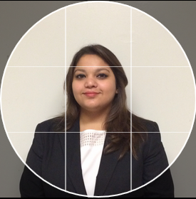

Allstate Insurance Predictor Final Project Presentation
Sumit Deo
Priyanjna sharma
Gautam pawar
YouTube Link: https://youtu.be/3dQqIstlNRc

Slide 2
Problem Statement
Allstate auto insurance provides customized insurance policies to the customers with personal attention and service.
When a car owner inquires about the car-insurance plan, insurance agents propose several quotes with different coverage options with its cost. After considering all the possible options, car owner settles with a plan and purchases it.
Customers on average consider reviewing 6-8 quotes before making any decision making and that involves time involvement and agent engagement.
Allstate provides 7-plan coverage policy to customer with each plan having different sub – types.

Slide 3
Proposed Solution
Analyzing from marketing perspective , we came up with the idea of an application that provides the best insurance quote to the customer in the first attempt. We will achieve following :
1) eventual purchase can be predicted sooner in the shopping
2) the quoting process is shortened
3) issuer is less likely to lose the customer’s business
We will allow customer to manually choose plans in case he’s not satisfied with our predicted policy.

Slide 4
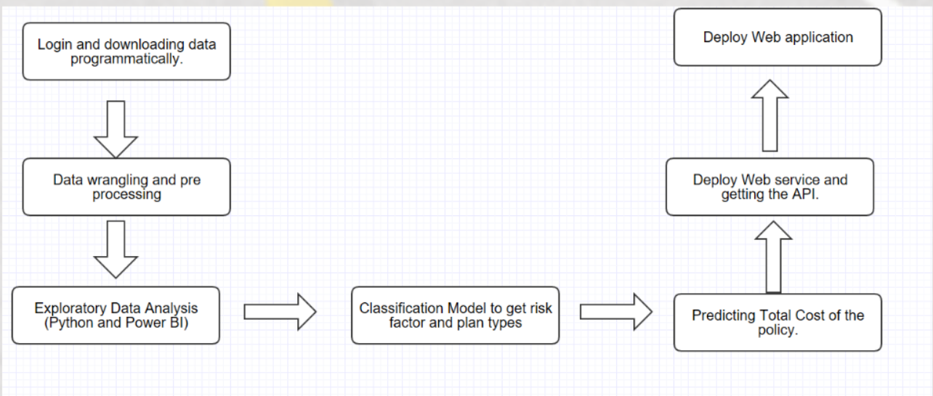
High Level Architecture

Slide 5
Exploratory Data Analysis
Power BI: https://app.powerbi.com/groups/me/dashboards/4e12d7e1-113c-412b-80a6-b0cab098aaca
Jupyter Notebook https://github.com/sumit91188/ADSSpring2017/blob/master/FinalPr oject/EDA.ipynb

Slide 6
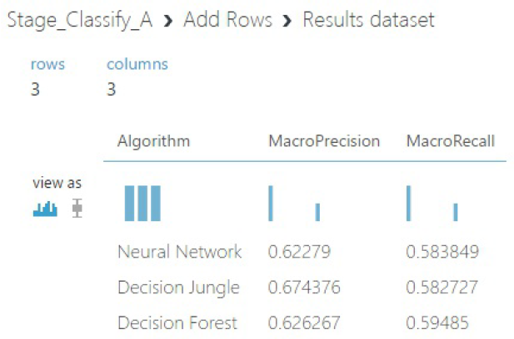
Classify Coverage Plans
We have compared the following models performance using Azure ML studio using a single API to classifying the individual coverage plans type.
Multiclass Neural Network
Multiclass Decision Jungle
Multiclass Decision Forest
Based on the below results we have decided to deploy the Multiclass decision jungle create an API.

Slide 7
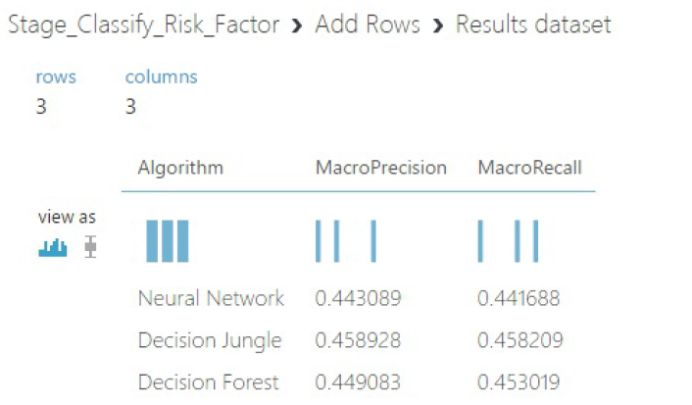
Classify Risk Factor
We have compared the following models to classify the Risk Facto r missing in the dataset.
Multiclass Neural Network
Multiclass Decision
Jungle & Multiclass Decision Forest
Based on the above results we have decided to deploy the Random
Forest model and create an API.

Slide 8
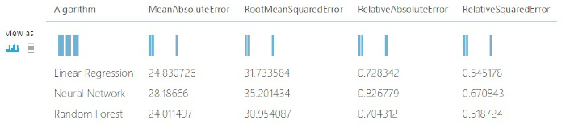
Predictive Analysis
To predict the Total cost of the policy selected for the coverage , we have implemented and compared following models
Neural Network
Linear Regression
Decision Forest
Based on the above results we have decided to deploy the decision forest regression and create an API.

Slide 9
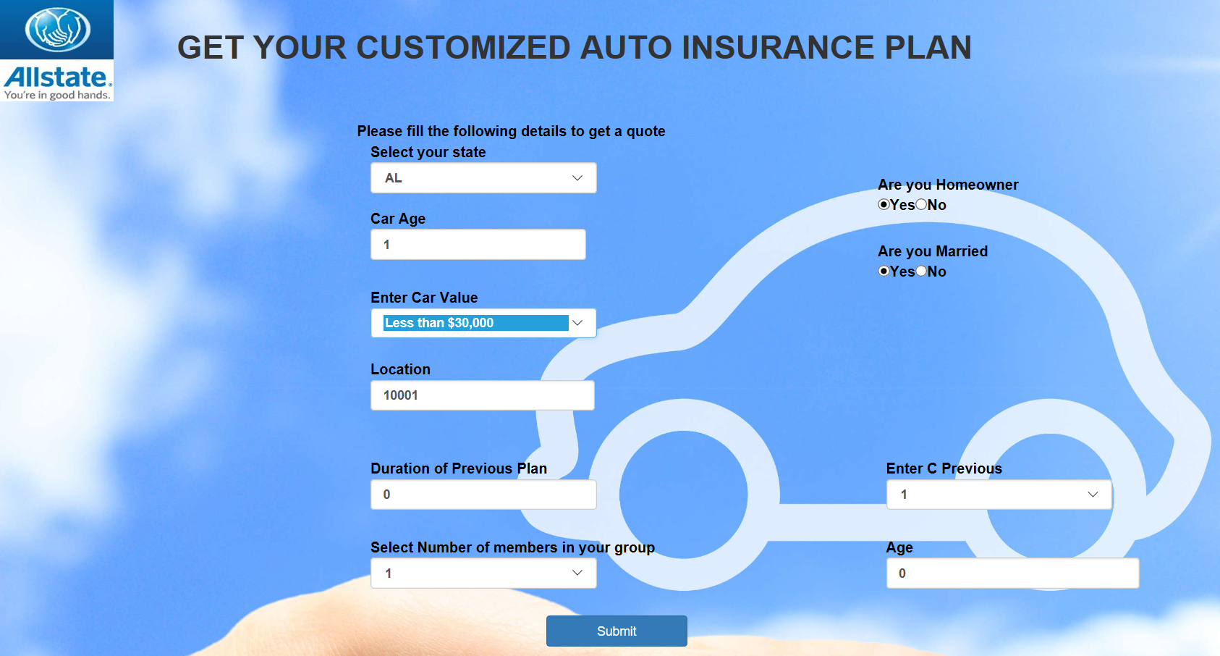
Web Application
We have deployed the web application using Dot net on Microsoft Visual Studio.
Link : http://allstateapplication.azurewebsites.net/

Slide 10
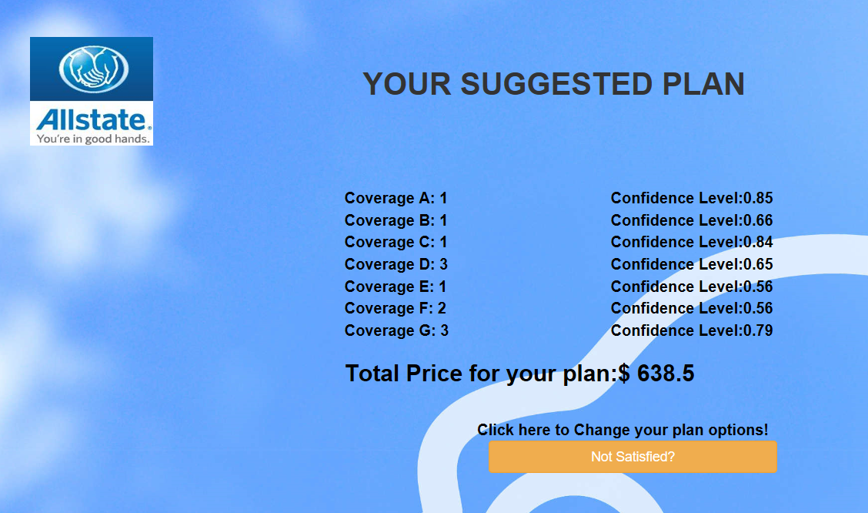
Web Application(Contd.)
Once user has entered all the information, he will be redirected to another page stating the proposed quote.
If he is not satisfied, he can enter his own preferable quotes by clicking on Not Satisfied? button.

Slide 11
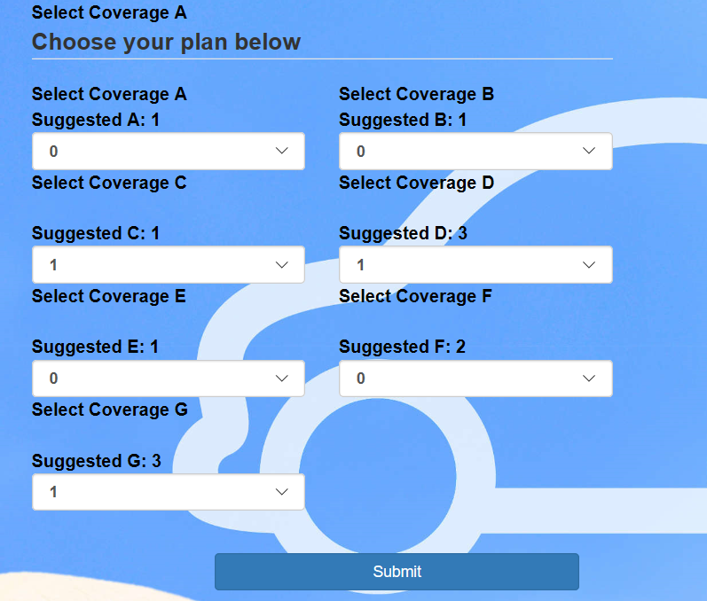
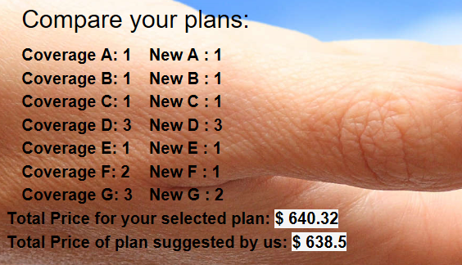
Application will process the selected coverages and will predict the price for the new plan selected.

Slide 12
Questions?

