Slide 1

SMART INDIA HACKATHON 2026
TITLE PAGE
Problem Statement ID – 26132
Problem Statement Title - Strengthening market linkages and price discovery for farmers
Theme - Agriculture, FoodTech & Rural Development
PS Category- Software/Hardware: Software
Team ID-
Team Name:Conquerors

Slide 2


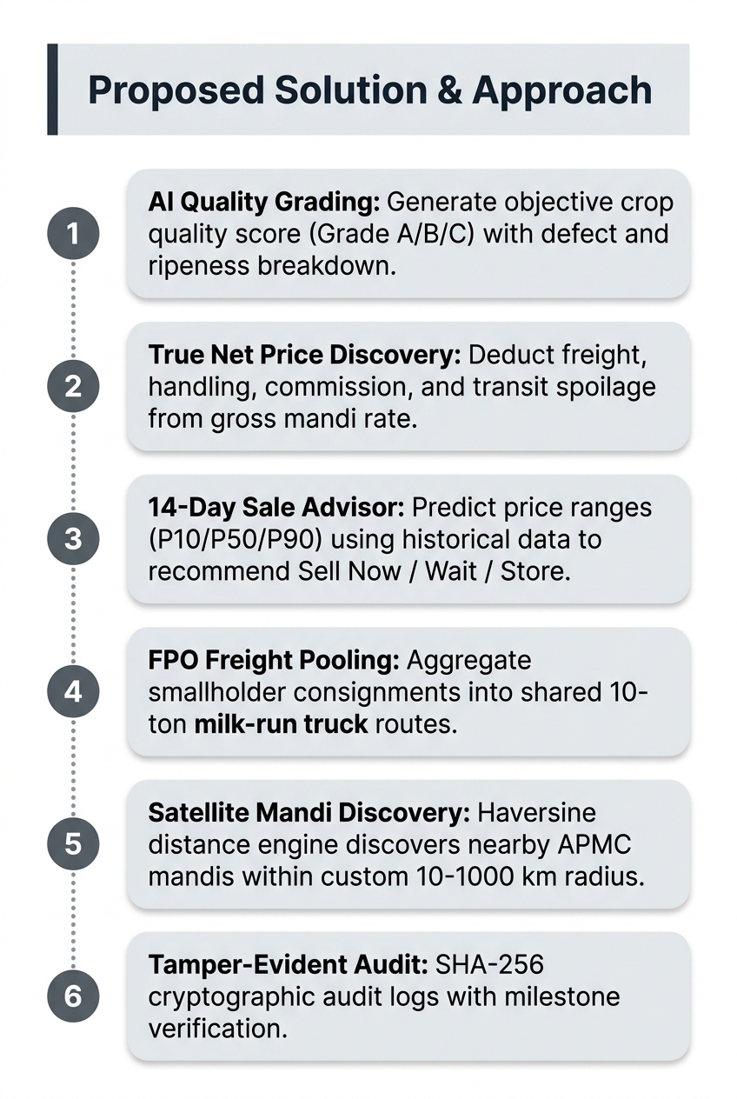
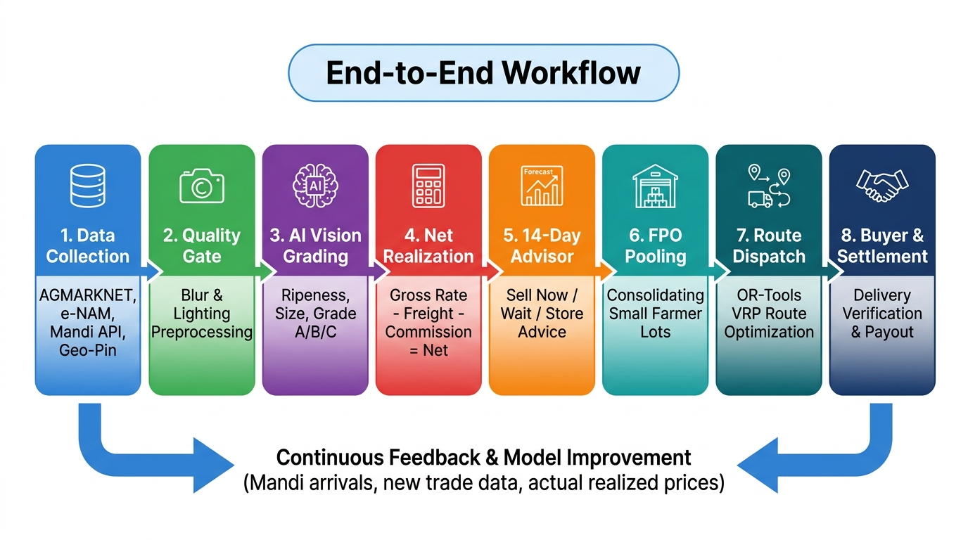

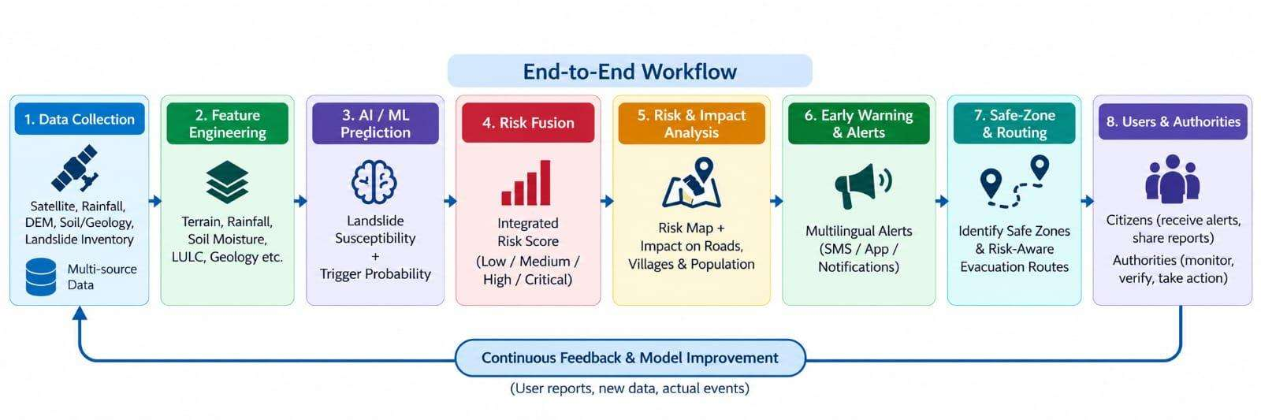
KrishiSetu AI
Bridging Farm Gate to True Net Income
🌾
1. Harvest
Smallholder farmer
harvests crop
📱
2. Vision AI
Camera scan for
Grade A/B/C report
🏭
3. FPO Hub
Consignment weighed
& aggregated
🚛
4. Pooled Route
Milk-run truck
cuts freight 32%
🤝
5. Fair Sale
Verified gate receipt
& direct payout
➔
➔
➔
➔
Hosted Website
Click here
GitHub
Click Here
SMART INDIA HACKATHON 2026

Slide 3
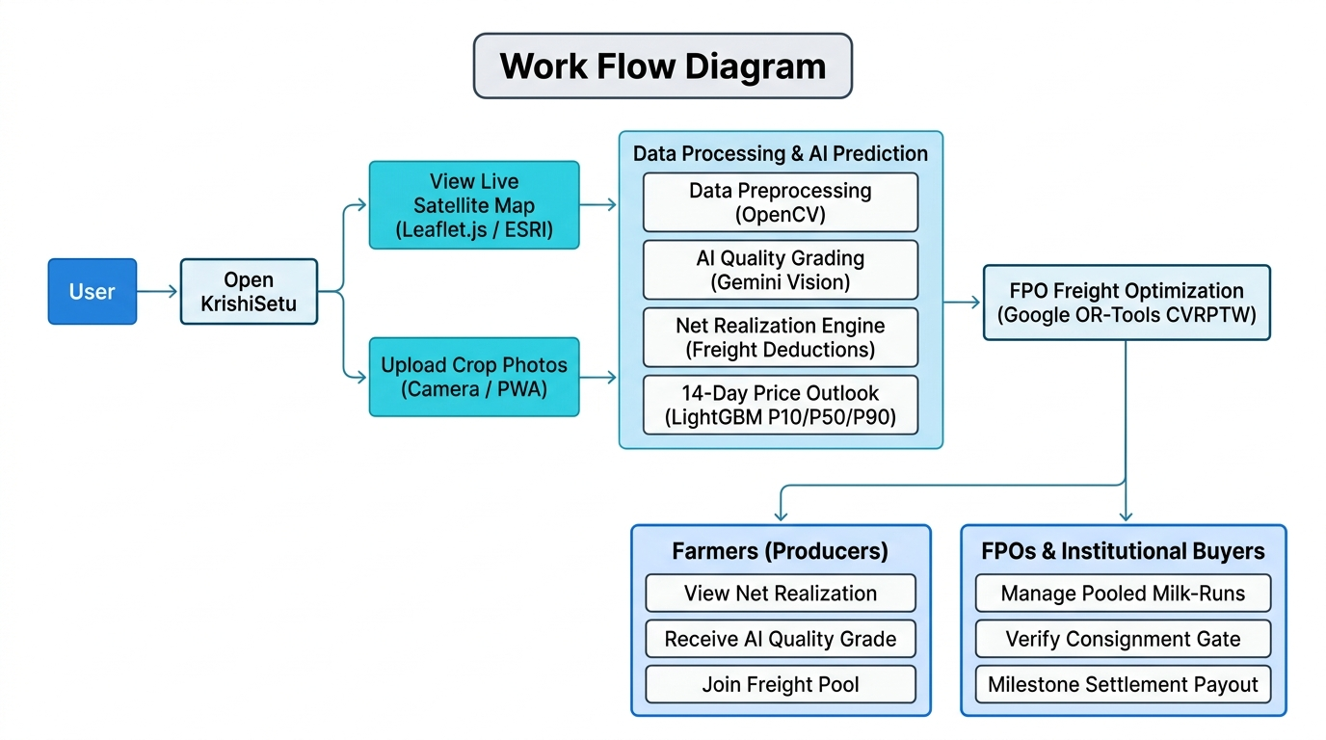
TECHNICAL APPROACH
Technology Used
Data Sources
-AGMARKNET API
-e-NAM Mandi Portal
-MSAMB Live Feeds
Data Processing
-Python 3.11
-FastAPI REST Backend
-NumPy / Pandas
-OpenCV Quality Gate
AI/ML Model
-Gemini 2.5 Flash (Vision)
-LightGBM Quantile Reg.
-OR-Tools (CVRPTW)
Database
-SQLite Local Fallback
-PostgreSQL Target
-IndexedDB (Offline PWA)
Maps & Routing
-Leaflet.js + GeoJSON
-ESRI World Imagery
-Haversine Engine
User Interface
-Next.js 16 (React 19)
-TypeScript + Tailwind CSS
-shadcn/ui + Recharts
Deployment
-Docker Container
-Vercel Edge CDN
-SHA-256 Audit Trail
SMART INDIA HACKATHON 2026
3

Slide 4
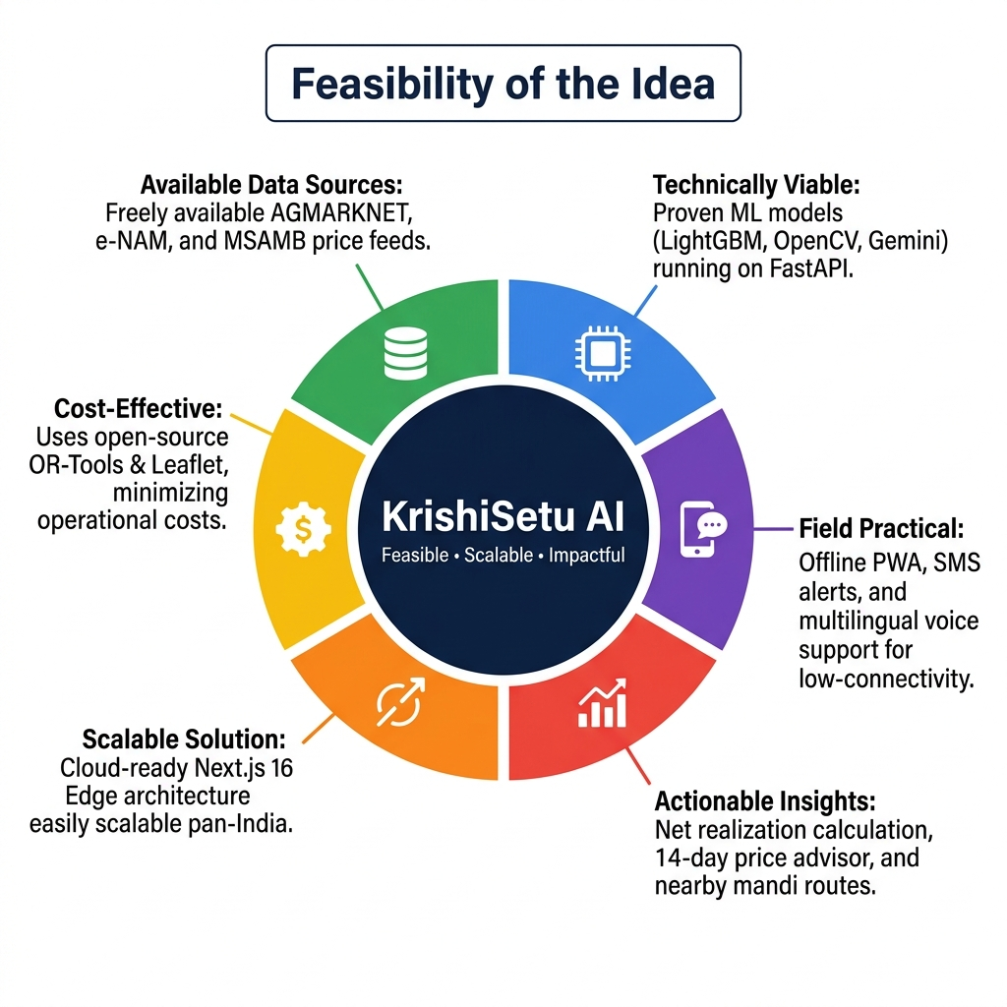
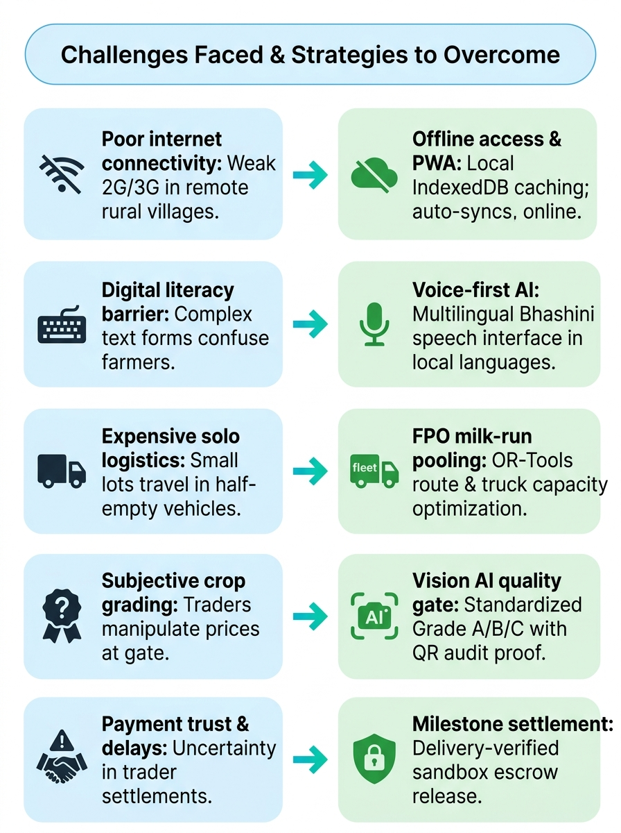
FEASIBILITY AND VIABILITY
SMART INDIA HACKATHON 2026
4

Slide 5
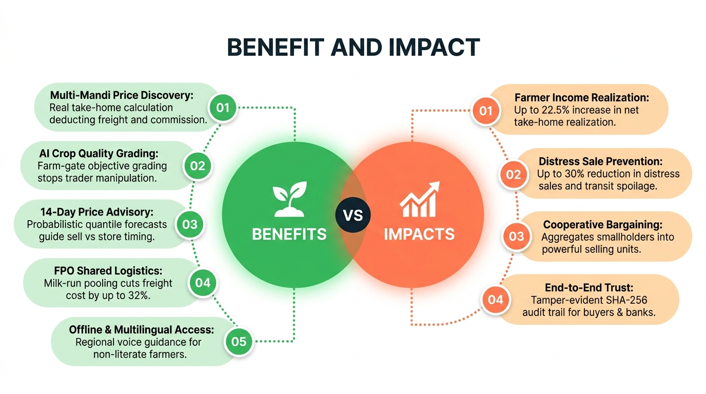
BENEFIT AND IMPACT
SMART INDIA HACKATHON 2026
5

Slide 6

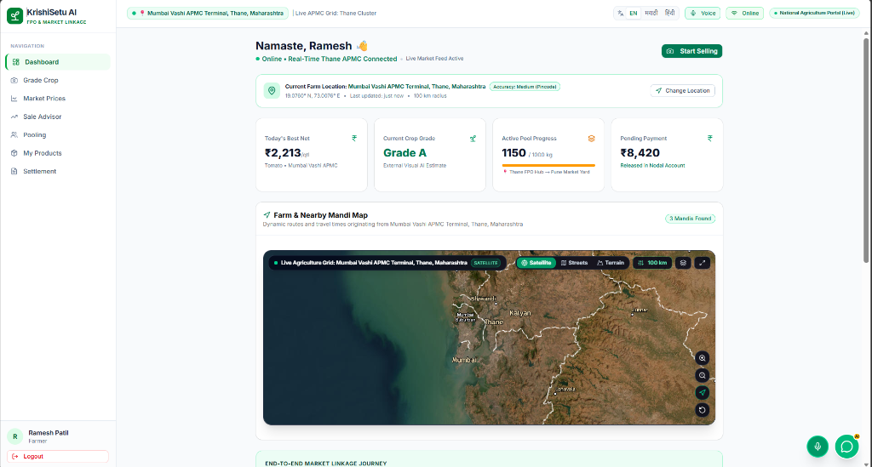
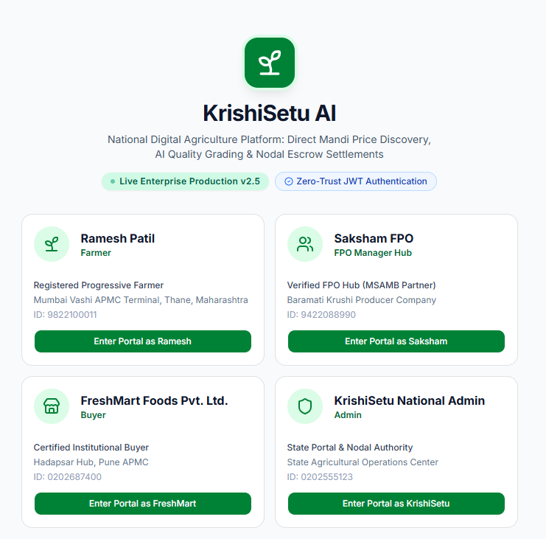
RESEARCH AND REFERENCES
• National Agriculture Market (e-NAM) Portal
https://enam.gov.in/web/
• Unified national electronic trading market connecting 1,361+ mandis.
• Directorate of Marketing & Inspection (AGMARKNET)
https://agmarknet.gov.in/
• Official daily agricultural commodity prices and arrivals bulletins.
• Bhashini: National Language Translation Mission (MeitY)
https://bhashini.gov.in/
• Voice-first Indic AI speech models for regional rural accessibility.
• Google OR-Tools: Capacitated Vehicle Routing Problem (CVRPTW)
https://developers.google.com/optimization/routing/cvrptw
• Algorithmic formulation for multi-depot milk-run pickup & route scheduling.
• LightGBM: A Highly Efficient Gradient Boosting Decision Tree
https://lightgbm.readthedocs.io/
• Fast quantile regression generating probabilistic P10 / P50 / P90 price ranges.
• SHA-256 Cryptographic Standards (NIST FIPS 180-4)
https://csrc.nist.gov/publications/detail/fips/180-4/final
• Tamper-evident audit trail logging every lot status and payment transition.
• Ministry of Agriculture & Farmers Welfare Benchmarks (2024-26)
https://agricoop.nic.in/
• Empirical data on post-harvest leakages, commissions, and FPO aggregation.
🌾 Farmer Dashboard: Real Take-Home Net & Mandi Radius Map
D
A
S
H
B
O
A
R
D
⚡ Multi-Role Enterprise Portal: Farmer • FPO Hub • Buyer • Admin
SMART INDIA HACKATHON 2026
6

