Slide 1


A
Seminar On
“Deep learning model for plant disease detection and diagnosis”.
Presented by: (GROUP 90)
1. Amit Anil Pawar B150363255
2. Mitali Dipak Pawaskar B150363259
3. Sonali Subhash Ghodake B150363114
Guided By:
Prof . A.V. Padgavhankar
DEPARTMENT OF ELECTRONICS &TELECOMMUNICATION ENGINEERING
SMT. KASHIBAI NAVALE COLLEGE OF ENGINEERING, PUNE – 41.

Slide 2
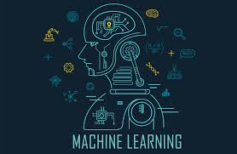
PROJECT DOMAIN
MACHINE LEARNING

Slide 3
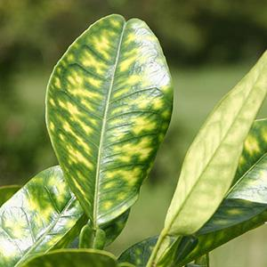
Problem Statement
Real time identification of crops, weeds, disease and pest damage and nutrient deficiency symptoms.

Slide 4
Objectives
Developing a model that can be used by developer to create smartphones application to detect plant diseases.
Accurate and instant diagnosis of particular disease.
To provide remedy for disease that is detected.

Slide 5
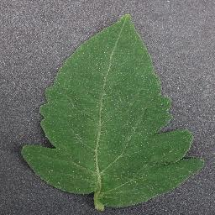
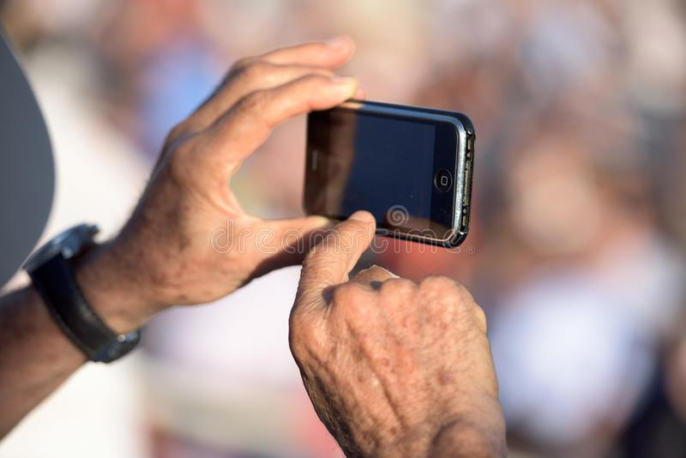
Proposed Solution
An android application that facilitates farmers, scientists and botanists to detect the type of plant or crops, detect pests and any other kind of diseases in them.
The app sends the image of the plant to the server where it is analysed using CNN classifier model.
Once detected, the disease and its solutions are displayed to the user. Also the closest pesticides selling centers are suggested.

Slide 6
Literature survey
Ref No. | Title | Technology/ Algorithm | Details | Limitations/Future Scope
[1] | Identification of Maize Leaf Diseases Using Improved Deep Convolutional Neural Networks | Deep learning, convolutional neural networks,image processing | GoogLeNet and Cifar10 models are used to train and test maize leaf images achieves 98.9% and 98.8% accuracy respectively. | More complex. For quick and reasonable judgment trained model can be combined with mobile devices.
[2] | Diagnosis of Diseases on Cotton Leaves Using Principal Component Analysis Classifier | Principle Component Analysis (PCA), Nearest Neighbourhood Classifier (KNN) | PCA will provide best results to detect various diseases on cotton leaves. The frequency of detected diseases on cotton leaves are 28% . | Some diseases are having similar colour pattern due to which KNN can not classify them well. More robust classifier.

Slide 7
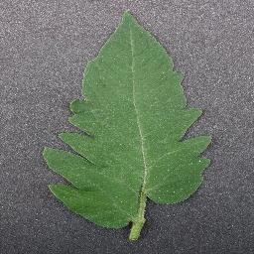
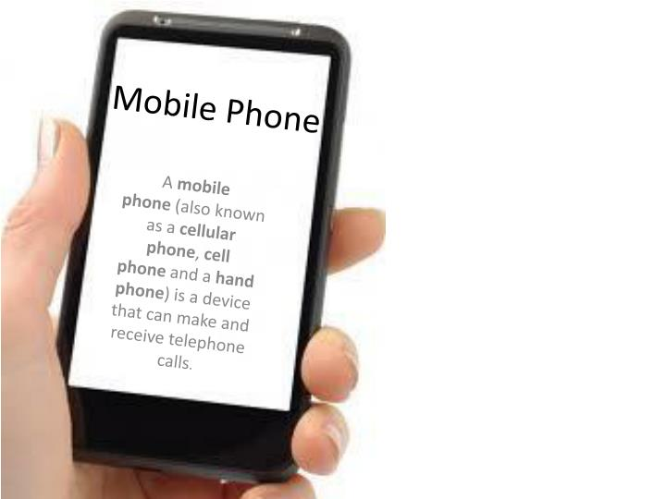

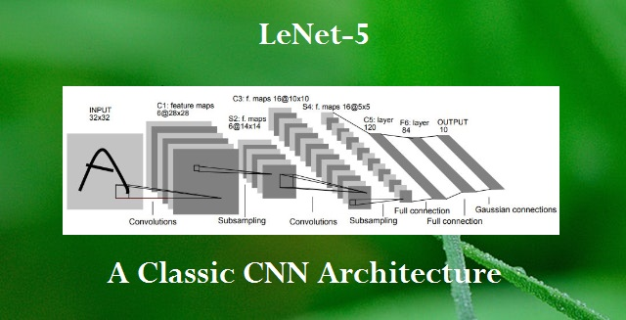
Fig. Flow Diagram

Slide 8
Convolutional Neural Network (CNN) models were developed to perform plant disease detection and diagnosis using simple leaves images of healthy and diseased plants,through deep learning methodologies. It detects the plant disease from the snapshot of the plant leaf.All farmer/User has to do is capture the plant leaf image from app in his mobile. The app will send this image to our AI system. Our AI will detect the disease form the image and send back the disease name,remedies, and precautions to the user.

Slide 9
The Problem Is
Solved In 4
Phases:
PHASE 1. COLLECTION OF DATASET
PHASE 2. TRAINING
PHASE 3. USER INTERFACE
PHASE 4. TESTING

Slide 10
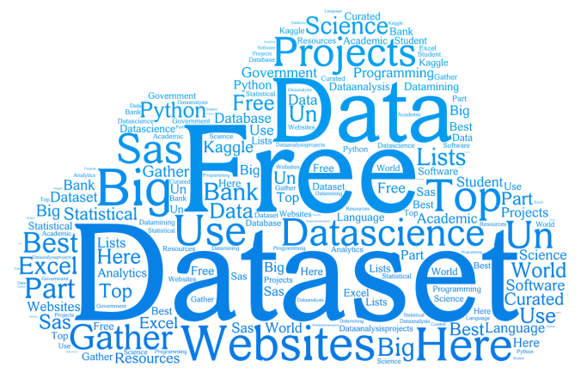
PHASE 1. COLLECTION OF DATASET
Publicly available datasets​:
We collect different datasets each for plant type, weeds, disease, pests etc that are publicly available.
Resizing images for efficient storage and prediction
Disease categories:
• 1 healthy set for tomato crop
• 9 diseases set for tomato crop

Slide 11
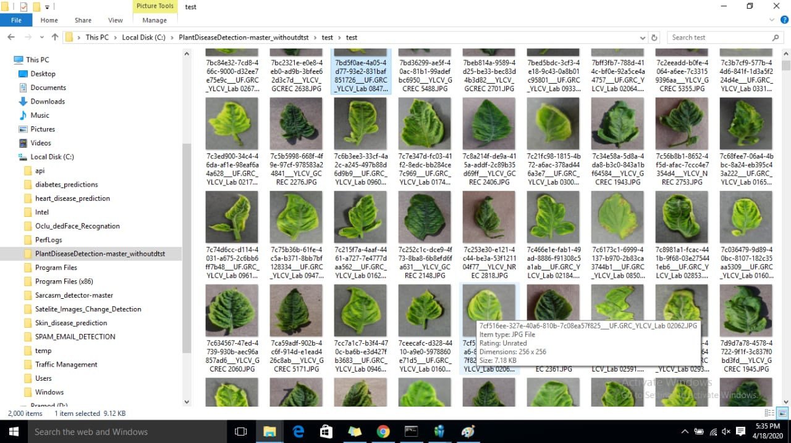
PHASE 2 . TRAINING

Slide 12
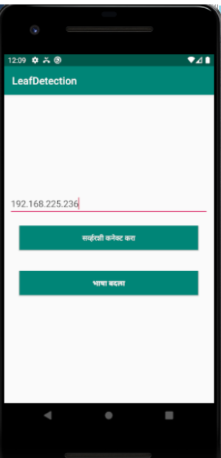
PHASE 3. USER INTERFERENCE
Fig : FRONT PAGE OF APP
Fig : SELECTION OF LANGUAGE

Slide 13
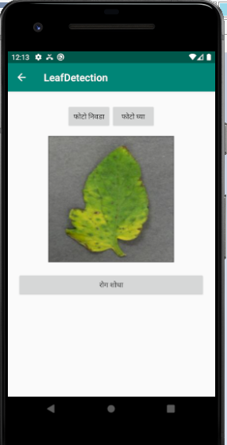
PHASE 4. TESTING
In our Android application anyone can click the picture
of leaf using device’s camera or may use already
existing tomato leaves images in the device.
Fig : LEAF SELECTION

Slide 14
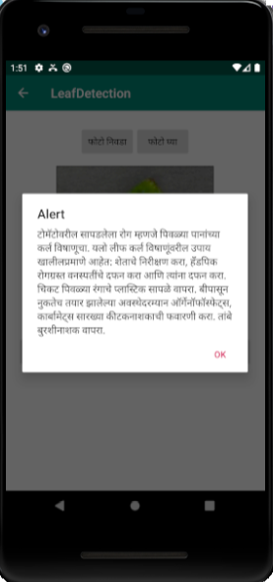
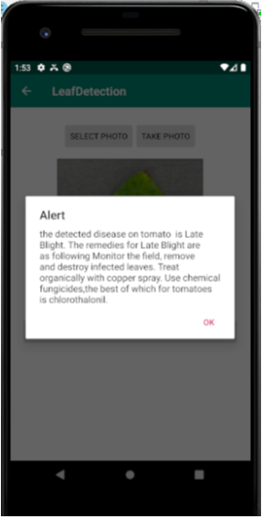
LEAF DISEASE DETECTION & SUGGESTION OF PESTICIDES
Fig : DISEASE DETECTION(MARATHI)
Fig : DISEASE DETECTION(ENGLISH)

Slide 15
Result
We have selected 4000 tomato leaves images for training purpose and 2000 images for testing purpose. In image classification, CNNs outperform traditional image processing methods in several applications. According to the results, the recognition rate of our system was above 94% when using the CNN, even when 30% of the leaf was damaged. Our system therefore improves upon previous studies, which achieved a recognition rate of approximately 90%

Slide 16
Future Scope
Extending the product for other horticulture plants
system will be feed into Drone so it will useful for larger farm areas.
Using Reinforcement learning through time to time feedbacks to improve accuracy of product.
Using Reinforcement learning through time to time feedbacks to improve the accuracy of our pr

Slide 17
THANK YOU

