Slide 1
AI Usage Insights
AI Usage & Impact on Students and Professionals
Project by Aniket Pawar

Slide 2
Source Data — “data” Sheet
Sample rows
Range
User ID | Country | User Type | AI Tool | Time Saved | Satisfaction
U0001 | Kenya | Professional | ChatGPT | 4.9 hrs | 5 / 10
U0002 | Pakistan | Professional | ChatGPT | 1.7 hrs | 4 / 10
U0003 | Australia | Student | ChatGPT | 0.5 hrs | 6 / 10
U0004 | India | Student | ChatGPT | 5.6 hrs | 7 / 10
U0005 | India | Professional | Meta AI | 10.7 hrs | 6 / 10
... | ... | ... | ... | ... | ...
data!A1:S289
Columns
User ID • Age • Gender • Country • User Type • Education • AI Tool • AI Purpose • Usage Hrs/Day • Monthly AI Cost • Productivity • Satisfaction • Time Saved • Would Recommend
▸ This flat table is the source for every pivot, chart, and dashboard visual that follows.
288 user responses
One row per user across 12 countries, covering students and professionals who use tools like ChatGPT, Gemini, and Copilot.
Quick Stats
Total Time Saved: 1,615 hrs/wk Avg Satisfaction: 6.13 / 10
Users: 288 Avg Productivity: 5.24 / 10

Slide 3
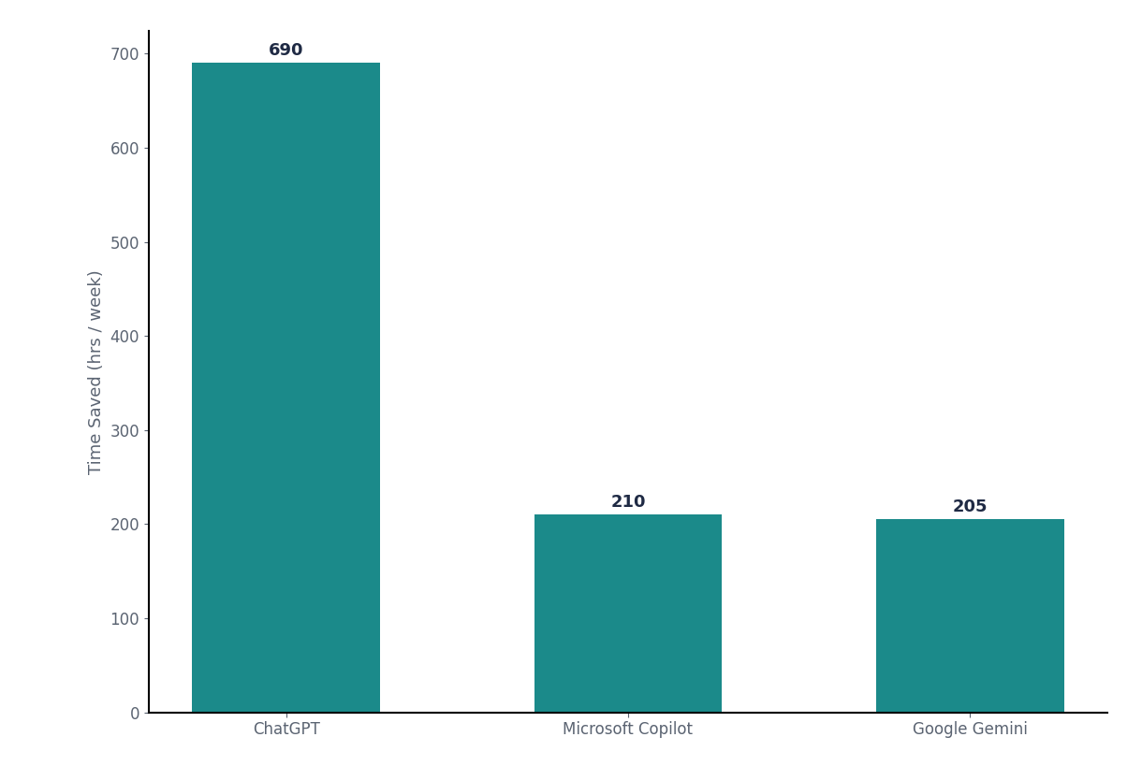
Time Saved by AI Tool
ChatGPT leads time saved by a wide margin, far ahead of Copilot and Gemini.
Ranking
AI Tool | Hrs Saved / Wk
ChatGPT | 690
Microsoft Copilot | 210
Google Gemini | 205
Avg Satisfaction: ChatGPT 6.3 · Copilot 6.3 · Gemini 5.7
▸ ChatGPT’s lead comes from volume (119 users vs 33–39), while Copilot saves the most per user at 6.6 hrs a week.

Slide 4
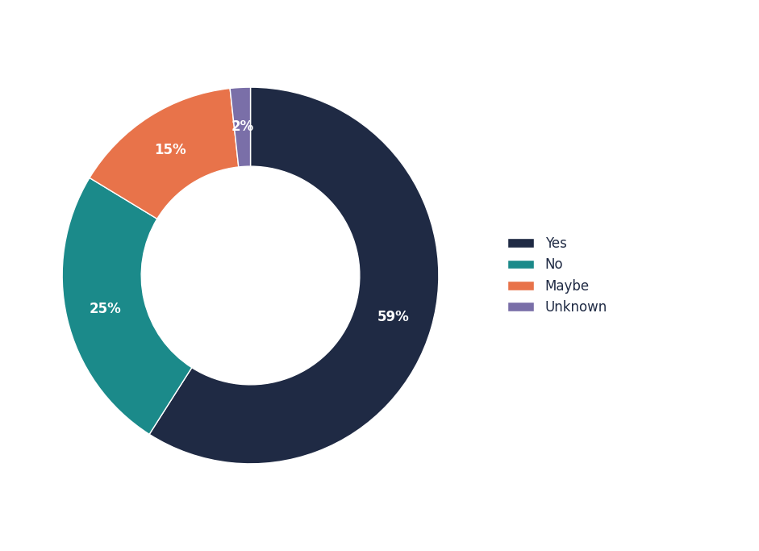
Users by Recommendation
How the 288 users split on whether they would recommend their AI tool.
Breakdown
Response | Users
Yes | 170
No | 71
Maybe | 42
Unknown | 5
▸ 59% of users would recommend their tool, and recommenders report the best results: 6.7 satisfaction and 6.5 hrs saved a week, vs 5.0 and 4.7 for “No”.

Slide 5
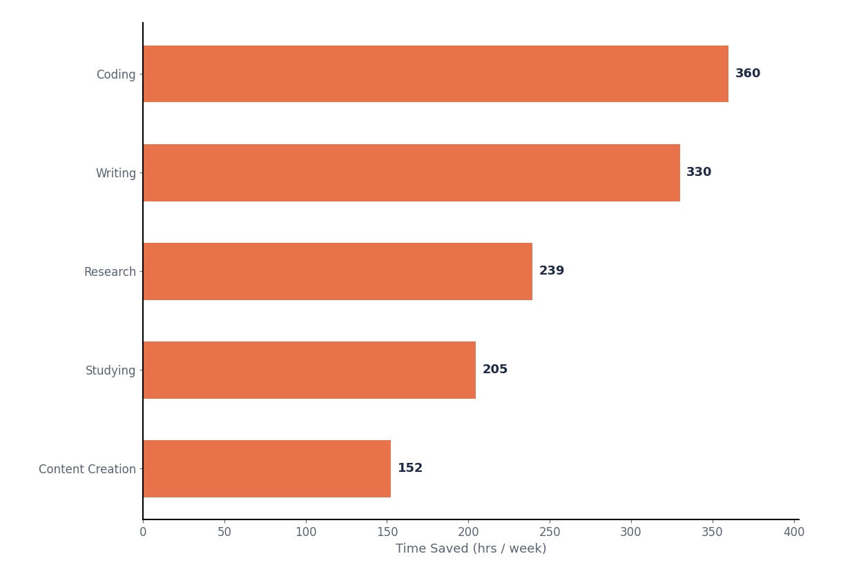
Top 5 AI Purposes by Time Saved
Coding and Writing are the two strongest purposes, each over 300 hrs saved a week.
Totals
AI Purpose | Hrs Saved / Wk
Coding | 360
Writing | 330
Research | 239
Studying | 205
Content Creation | 152
▸ These top 5 purposes alone account for roughly 80% of all weekly hours saved.

Slide 6
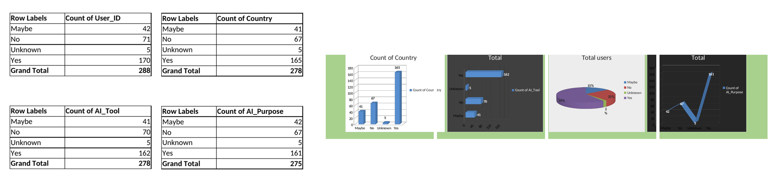
Pivot Table vs Pivot Chart
What is a Pivot Table?
What is a Pivot Chart?
A Pivot Table summarizes large amounts of raw data into a compact grid. It lets you group, filter, count, and sum rows (e.g. data!A1:S289) by fields like Would Recommend, AI Tool, or Purpose — without writing formulas.
A Pivot Chart is a visual (bar, pie, column, etc.) built directly on top of a Pivot Table's output. It updates automatically whenever the Pivot Table refreshes, giving a live picture of the same summarized data — like the charts on this dashboard.
Pivot table screenshot

Slide 7
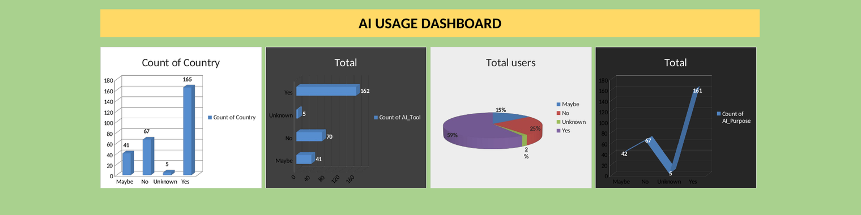
Dashboard
AI Usage Dashboard — user counts and totals by Recommendation, built entirely from Pivot Table + Pivot Chart output.

Slide 8



