Slide 1
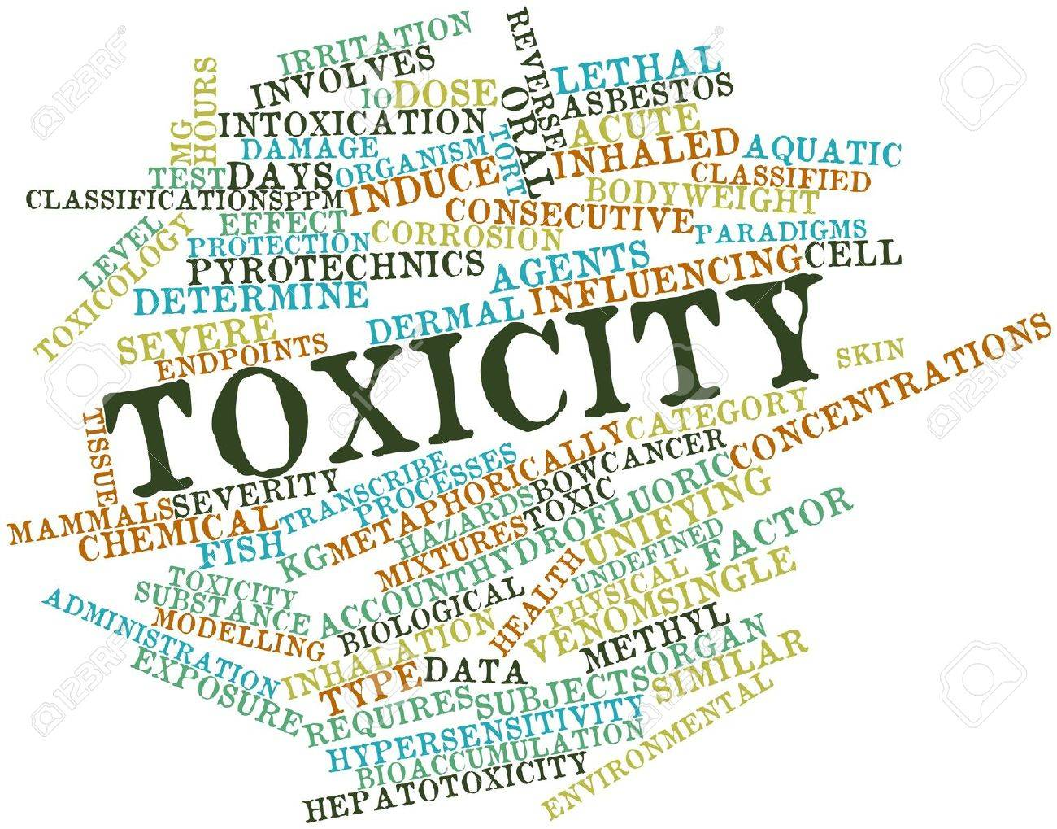
Revealing Toxicity
https://www.kaggle.com/c/jigsaw-toxic-comment-classification-challenge/overview/description

Slide 2







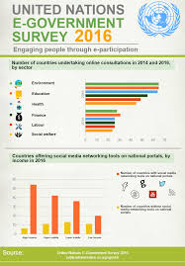

Is it worth our time?
Educational
Government
Personal Space
Social Networks

Slide 3
Forms
Toxic
Severe Toxic
Threatening
Insulting
Bye! Don't look, come or think of coming back! Tosser.
fisrt, ANYONE WHO BELEIVES THIS CRAP IS A FOOL
Fuck You! Go fuck yourself fuckin' bitch! Narrow-minded asshole!
Stupid peace of shit stop deleting my stuff asshole go die and fall in a hole go to hell!
Hi! I am back again! Last warning! Stop undoing my edits or die!
Why are you still here? Can you not find anything more important to do, like killing yourself?
Fuck you faggot, I don't care if i get blocked, as long as everyone knows you are a dumb cunt.
Stupid peace of shit stop deleting my stuff asshole go die and fall in a hole go to hell!
Identity Hate
Obscene
Kill all niggers. I have hard, that others have said this.. should this be included? That racists sometimes say these.
u r a tw@ fuck off u gay boy.U r smelly.Fuck ur mum poopie
this user is such a worthless goddamn faggot fuck you faggot
Stupid peace of shit stop deleting my stuff asshole go die and fall in a hole go to hell!

Slide 4
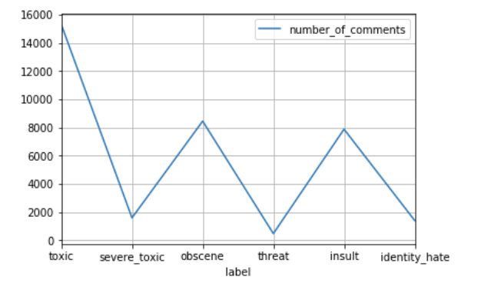
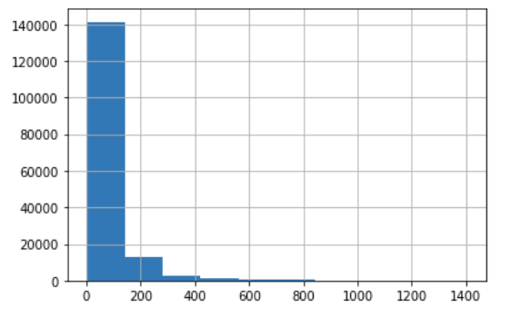
Observed Data : What and How?
X: Labels
Y: No Of Comments
X: No of comments
Y: No of words

Slide 5
Architecture
Toxic
Severe toxic
Insult
Obscene
Threat
Identity Hate
Deep
Neural
N/w
Vectorized Input Sequence
LSTM Layer
Embedding Layer
w1
w2
w100

Slide 6
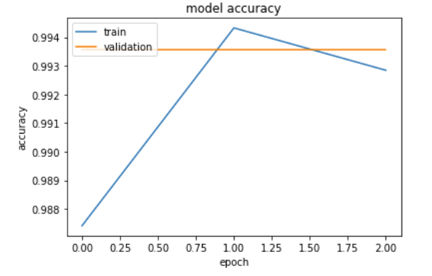
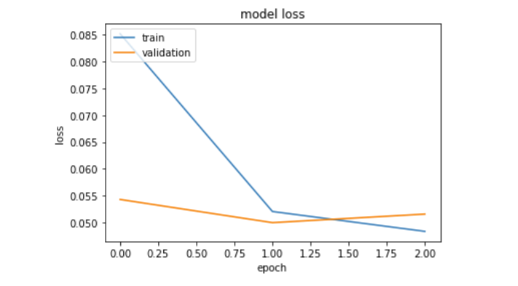
Train-Validation stats

Slide 7
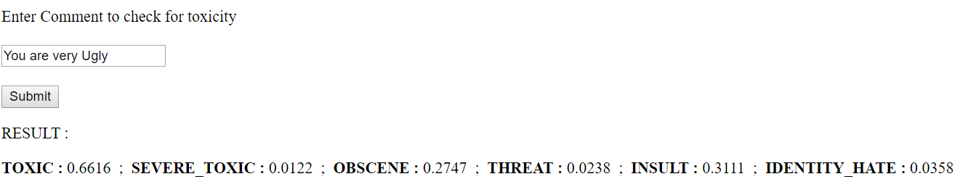
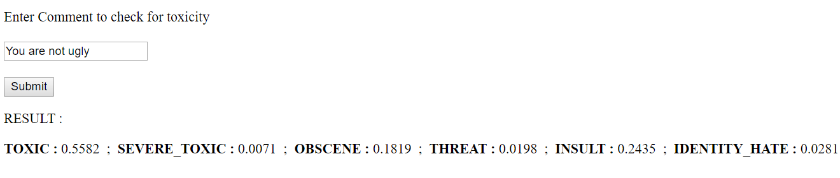
Interesting Results

Slide 8
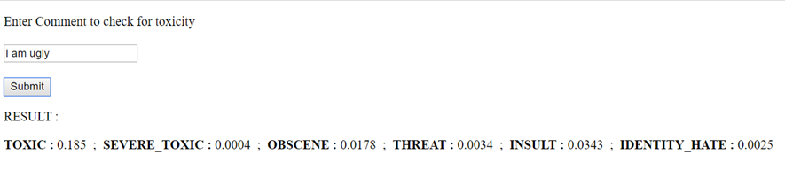
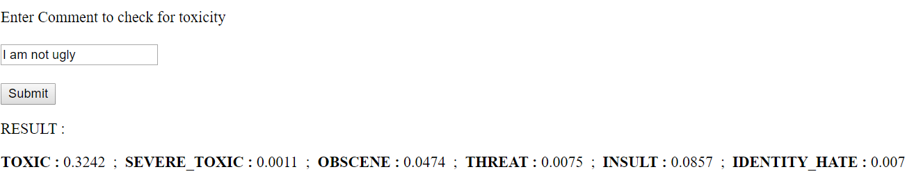
Interesting Results- Contd…
Still there is lot of scope ☺

Slide 9
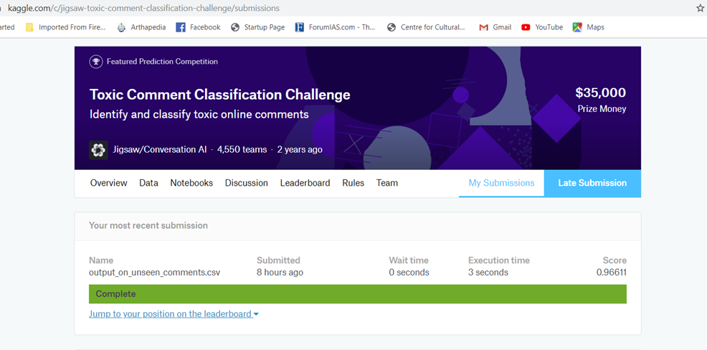
How system performed according to
Kaggle evaluation script

