Slide 1
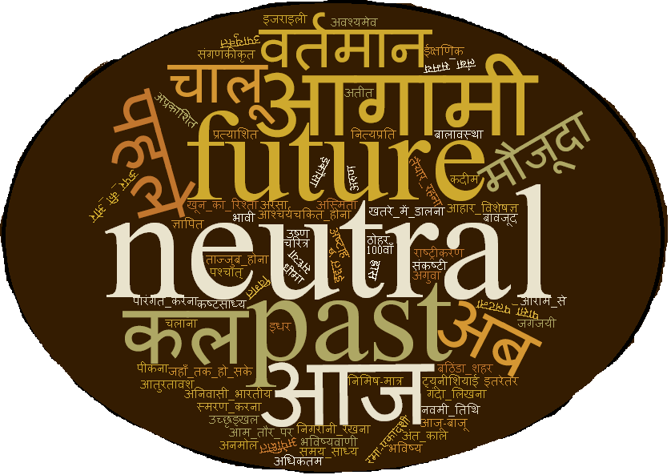

Building Tempo-HindiWordNet: A Temporal Resource for Hindi
Dipawesh Pawar
(1411CS04)
Under the guidance of
Dr. Asif Ekbal
IIT Patna
5/18/2016

Slide 2
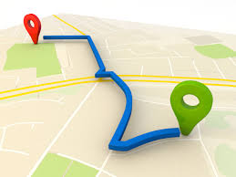
Roadmap
Task Definition
Motivation
Structure of Tempo-HindiWordNet
Methdology
Propagation Strategies
Results over gold standard set
Setence Temporality Detection
Conclusion and Future Work
IIT Patna
5/18/2016

Slide 3
Task Definition
Detect inherent temporal orientation of each synset in Hindi WordNet
Temporal Orientations : past, present, Future, Neutral, Atemporal
E.g.
Synset : भविष्य, भविष्य काल, आगामी समय, उत्तरकाल, उत्तर-काल, उत्तर काल, भावी समय, आने वाला समय, अगत, अप्राप्तकाल, कल, अवर्त्तमान, अवर्तमान, आगम, आगाह
Transliteration : bhaviShya, bhaviShya kaal, AAgaamee samaya, Uttarakaal, Uttara-kaal, Uttara kaal, bhaavee samaya, AAne vaalaa samaya, Agat, Apraaptakaal, kal, Avarttamaan, Avartamaan, AAgam, AAgaaha
Gloss : आने वाला काल या समय
Transliteration : AAne vaalaa kaal yaa samaya
Example sentence : भविष्य में क्या होगा कोई नहीं जानता । / कल किसने देखा है ।
Transliteration : bhaviShya meN kyaa hogaa koEE naheeN jaanataa ;; / kal kisane dekhaa hai ;;
Temporal Orientation : Future
IIT Patna
5/18/2016

Slide 4
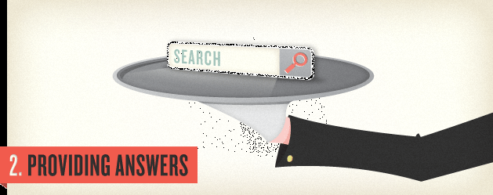
Motivation
Importance of retrieving and ranking search results wrt time
Temporal aspects in user information needs
Importance of time in assessing credibility
Importance of Linking words to their temporal orientation
IIT Patna
5/18/2016

Slide 5
Importance of retrieving and ranking
search results wrt time
7 % of search queries : temporal[Metzler et al. 2009]
Query Types : Explicitly temporal & Implicitly temporal
Explicitly Temporal
Implicitly Temporal
WorldCup 2011
Indian Prime Minister 2000
1990’s Bollywood songs
Newton’s childhood
World-war II
Recent Bollywood songs
1.5% of queries : explicitly temporal (re-estimated to 1.21% -removing false positives e.g. Windows 2000) [Nunes et. al. 08]
Implicit queries : Rate unmeasured
IIT Patna
5/18/2016

Slide 6
Temporal aspects of user information needs
“temporal web search experience” Survey’s claim
“ most of the time user queries needs to be addressed with recent information though sometimes it also needs to be addressed with past or future related information” [Joho et. al. 2013]
E.g. आज कौन जिता (AAj kaon jitaa ) ? ( Recency related)
फॅन कब प्रकाशित होगा (phaen kab prakaashit hogaa) ? (Future related)
शिवाजींका इतिहास (shivaajeeNchaa Itihaas) ? ( Past related )
NTCIR-11 workshop Temporal Query Intent Classification(TQIC) task – classify search queries among past, recency, future, atemporal classes
Tempo-WordNet [Hasazauman et. al. 2012]
IIT Patna
5/18/2016

Slide 7

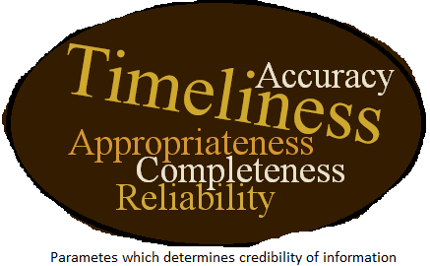
Importance of time in assessing
credibility
Information is increasing at an
exponential rate
Need to assess credibility of information
Time : key component to assessing
credibility of information
-[Metzger 2007]
IIT Patna
5/18/2016

Slide 8

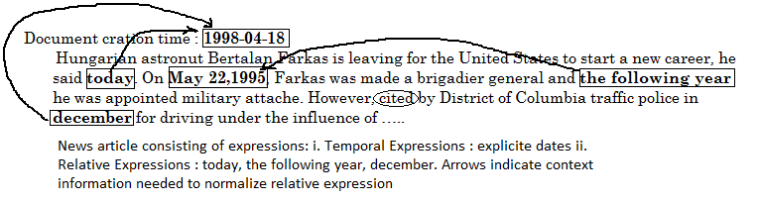
Importance of Linking words to their
temporal orientation
Reliance on explicit timexes
Rare presence of timexes
Absence of temporal lexical resource
IIT Patna
5/18/2016

Slide 9
Structure Of the Tempo-HindiWordNet
Synset_Offset, Word, PoS, Sense number, Gloss, Class, Confidence_Value
9234, अतरसों (AtarasoN), NOUN, 2, गत परसों से पहले का दिन या आज से पहले का तीसरा दिन (gat parasoN se pahale kaa din yaa AAj se pahale kaa teesaraa din), past, 1
2688, अद्यतन (Adyatan), ADJECTIVE, 1, जिस पर इस समय की बातों या विशेषताओं की पूरी छाप हो (jis para Is samaya kee baatoN yaa visheShataaON kee pooree chhaap ho), present, 1
23772, आइन्दा (AAIndaa), ADVERB, 1, इस समय के बाद से (Is samaya ke baad se), future, 0.295
IIT Patna
5/18/2016

Slide 10
Methodology
One step classification
ii. Two step classification
Past, present, future, neutral, atemporal
classification
Step 1 : Temporal-Atemporal classification
Step 2 : Past, present, future, neutral classification
IIT Patna
5/18/2016

Slide 11
Algorithm
START
Learn the classifier
On current seed set
Apply the learned classifier on test set
Expand training set using CBES
Yes
If Accuracy Improve-s
Learn the classifier on new training set
STOP
No
IIT Patna
5/18/2016

Slide 12
Key Steps of Algorithm
Creation of seed word set
Seed word set (multi-rater kappa agreement=0.73)
: past (12), present(12), Future(12), Neutral(12),
Atemporal(37)
Checkpoints to create Seed word set
- Prevent bias towards any temporal class
- Prevent bias towards any POS category
- Hindi WordNet subtree of the word समय (samaya) biased towards noun POS category
IIT Patna
5/18/2016

Slide 13
Example seed words
Past | POS | Present | POS | Future | POS
कल (kal) (1) | adv | मौजूदा (maojoodaa) (3) | adj | आगामी (Aagaamee) (1) | adj
गुज़रा (guZara) (2) | adj | वतमान (vartamaan) (2) | n | कल (kala) (2) | adv
अतीत (Ateeta)(1) | n | आजकल (AAjkal))(1) | adv | कल (kala) (2) | n
Neutral | POS | Atemporal | POS
धीमा (dheemaa) (1) | adv | राष्ट्रीकरण (raaShTreekaraNNa) (1) | n
ठोहर (Thohara) (1) | n | अस्मिता (Asmitaa) (4) | n
अरसा (Arasaa) (1) | n | अनिवासी_भारतीय (Anivaasee_bhaarateeya) (1) | n
IIT Patna
5/18/2016

Slide 14
Confidence based Expansion Strategy (CBES)
(Accepted in LREC-16)
Word | POS | Sense no | Class
जर्मन | noun | 2 | ?
साल | noun | 3 | ?
अगला | adj | 3 | ?
Learn the classifier
Apply it
On Test set
Word | POS | Sense no | Class
कल | adv | 1 | past
धीमा | adv | 1 | neutral
Obtain
Predictions
Instance no | Predicted class | Confidence Value
जर्मन | Atemporal | 0.98
साल | Atemporal | 0.4
अगला | Future | 0.99
Expand current seed set
With retrieved samples
Instance no | Predicted class | Confidence Value
जर्मन | Atemporal | 0.98
अगला | Atemporal | 0.99
Retrieve threshold no of most
informative samples
(Max confidence value)
Of each class
IIT Patna

Slide 15
Experiments
Feature: Gloss of the synset
E.g.
भविष्य काल .n. 3
GLOSS : आने वाला काल या समय (AAne vaalaa kaal yaa samaya )
Feature: Word Embedding(WE) and gloss of the synset
E.g.
भविष्यवाणी.1.n -
GLOSS : आगे चलकर होने वाली वह बात जो पहले से ही किसी ने कह दी हो (AAge chalakara hone vaalee vah baat jo pahale se hee kisee ne kah dee ho)
WE : -0.111895, -0.143482, 0.113252, -0.150294, …….., - 0.291205 , 0.007565, 0.19466, 0.041686
IIT Patna
5/18/2016

Slide 16

Word Embedding(WE)
Trained using word2vec tool [Tomas Mikolov et. al. 2013]
Trained over Bojar corpus ( 44 million Hindi sentences)
[Bojar et. al. 2014]
Tool provides two broad techniques to train word embedding
- Continuous bag of word model (CBOW)
- skip-gram model
WE of synset –
Where,
m= no of content words in gloss, synonymous set , hypernymy gloss and hyponym gloss of the synset
W_{m} = m^{th} content word
Content words
Gloss : आने वाला काल या समय
IIT Patna
5/18/2016

Slide 17
Multi-rater agreement results of
4 raters ( 3 humans and 1 machine)
Feature :Gloss of the synset
One Step Classification |  |  | Two Step Classification
 | General Gold Set | Easy Cases |  | General Gold Set | Easy Cases
J48 | 0.547 | 0.83 | J48 | 0.356 | 0.747
Naive Bayes | 0.479 | 0.724 | Naïve Bayes | 0.371 | 0.673
SVM | 0.514 | 0.781 | SVM | 0.348 | 0.747
IIT Patna
5/18/2016

Slide 18
Feature : Word Embedding(WE) and gloss of the synset
One Step Classification |  |  | Two Step Classification
 | General Gold Set | Easy Cases |  | General Gold Set | Easy Cases
J48 | 0.562 | 0.876 | J48 | 0.384 | 0.751
Naive Bayes | 0.393 | 0.611 | Naïve Bayes | 0.354 | 0.728
SVM | 0.31 | 0.353 | SVM | 0.478 | 0.879
IIT Patna
5/18/2016

Slide 19
Improvement Achieved
in agreement with WE
One Step Classification |  | Two Step Classification
General gold set | Easy cases | General gold set | Easy cases
2.74 % | 4.6% | 28.84 % | 17.67 %
IIT Patna
5/18/2016

Slide 20
Results over gold standard
test set
Gold Test set :
Manually annotated : multi-rater kappa agreement = 0.58 (moderate)
composed of 180 instances : 100 Atemporal and 20 of each
temporal class
One Step Classification Approach | Gloss as feature |  | Gloss & WE as feature
 | General Gold Set A=77.7 % | Easy cases A=86 % | General Gold Set A=80 % | Easy cases A=90 %
precision | 0.494 | 0.514 | 0.644 | 0.739
recall | 0.502 | 0.521 | 0.601 | 0.644
F-measure | 0.498 | 0.518 | 0.622 | 0.700
When only gloss is used as feature One Step approach fails to predict temporal class
Future
IIT Patna
5/18/2016

Slide 21
Two Step Classification Approach | Gloss as feature |  | Gloss & WE as feature
 | General Gold Set A=49.1 % | Easy cases A=65.5 % | General Gold Set A=66.1% | Easy cases A=82.7%
precision | NAN | NAN | 0.665 | 0.793
recall | 0.382 | 0.562 | 0.636 | 0.839
F-measure | NAN | NAN | 0.650 | 0.816
Gloss oriented Two Step approach fails to predict
temporal class Present
IIT Patna
5/18/2016

Slide 22

Word Embedding based expansion
strategy
Test Set
Train Set
Cosine Similarity
Word | POS | Sense no | Cosine Similarit-y
जर्मन | noun | 2 | 0.4
साल | noun | 3 | 0. 6
अगला | adj | 3 | 0.5
Word | POS | Sense no | Class
कल | adv | 1 | past
धीमा | adv | 1 | neutral
0.3
0.6
Retrieve threshold no of most
informative samples
(Max cosine similarity)
Of each class and add them to
Current seed set
Cosine Similarity
IIT Patna
5/18/2016

Slide 23
Multi-rater agreement results of
4 raters ( three humans and 1 machine)
One Step Classification |  |  | Two Step Classification
 | General Gold Set | Easy Cases |  | General Gold Set | Easy Cases
J48 | 0.491 | 0.74 | J48 | 0.419 | 0.827
Naive Bayes | 0.57 | 0.889 | Naïve Bayes | 0.44 | 0.827
SVM | 0.272 | 0.378 | SVM | 0.462 | 0.855
Improvement Achieved in agreement with WEBE wrt CBES( gloss oriented)
One Step Classification |  | Two Step Classification
General gold set | Easy cases | General gold set | Easy cases
4.20 % | 7.10% | 24.52 % | 14.45 %
IIT Patna
5/18/2016

Slide 24
Results over gold standard
test set
One Step Classifica-tion | General Gold Set A=81.1% |  |  | Easy cases A=90.9%
 | Precision | Recall | Fmeasure | Precision | Recall | Fmeasure
 | 0.792 | 0.736 | 0.763 | 0.812 | 0.821 | 0.816
Improved Precision, recall and F-measure wrt both experiments employing CBE.
Two Step Classific-ation | General Gold Set A=62.7 |  |  | Easy cases A=75.8
 | Precision | Recall | Fmeasure | Precision | Recall | Fmeasure
 | 0.65 | 0.581 | 0.613 | 0.738 | 0.712 | 0.725
Improved Precision, recall and F-measure wrt gloss oriented CBE but shows
improvement only for classes Present and Neutral wrt WE oriented CBE
IIT Patna
5/18/2016

Slide 25
Algorithm
No
Stop
If
current CV accuracy
is grater than
previous one
Select seed words
representing classes
Prepare test set by dividing
all synsets in HindiWordNet
in 10 folds
1
Yes
Yes
Learn classifier on current
set of seed words
All folds of
HW are
traversed
Start
No
1111
1. Test learned classifier on i^{th}
fold of test set & obtain
predictions
1
Select threshold no. of instances of
Each class which are predicted
with highest confidence to expand
Current train set

Slide 26
Sentence Temporality Detection
Manually annotated corpora
Contains Sentences : ILTIMEX corpus (281 Past, 533 Present, 126 Future) [Ramrakhiyani et. al. 2015]
Multi-rater Kappa agreement( 3 annotator) : 0.78( Substantial)
Corpora disambiguation : Unsupervised MFS algorithm[ Sudha et. al 2015]
Example sentences :
1. दो साल पहले निर्माता जवाहर एल जयरथ ने इस प्रॉजेक्ट पर काम शुरू किया - Past
2. इसी साल इन दोनों परियोजनाओं का काम देखने के लिए मूंदड़ा पोर्ट एंड स्पेशल इकनॉमिक जोन लिमिटेड का गठन हुआ - Present
3. यह कमिटी अगले 6 महीने में बदले हुए हालात को देखते हुए दिल्ली नगर निगम के नए ऐक्ट का ड्राफ्ट तैयार करेगी - Future
IIT Patna
5/18/2016

Slide 27
Rule based approach for Sentence
Temporality Detection
Only one temporal class – annotate respective class
Two temporal classes t1, t2
- t1=past & t2=present, annotate Present
- t1=present & t2=future, annotate Future
- t1=past & t2=future, annotate Future
All temporal classes – annotate future
No temporal class – annotate randomly
Rules :
Sentence consists of
IIT Patna
5/18/2016
5/18/2016

Slide 28
Results
Confidence Based Expansion
Gloss as feature |  |  | WE & gloss as feature
 | One Step Classification | Two Step Classification | One Step Classification | Two Step Classification
J48 | 65.3 % | 14.4 % | 49 % | 59.7 %
Naïve Bayes | 32.4 % | 56.5 % | 51.2 % | 61.2 %
SVM | 40.7 % | 16.4 % | 24 % | 51.9 %
Word Embedding Based Expansion
 | One Step Classification | Two Step Classification
J48 | 39.6 % | 44 %
Naïve Bayes | 44.5 % | 72.2 %
SVM | 44.8 % | 59.4 %
IIT Patna
IIT Patna
5/18/2016

Slide 29
SentiWordNet vs TempoWordNet
Hyponymy relation plays important role in propagating opinions
But hyponymy of words which are not detonating temporality but
their connotation indeed, are mostly seen not to denote or
connote temporality.
e.g.
IIT Patna

Slide 30
Conclusion
Developed and tested CBES and WEBE
Developed Temporal corpora : 940 sentences
Sentence Temporality Detection : An application of Tempo-HindiWordNet
Future Work
Deep learning
Combination of WEBE and CBES
Facilitate research in Temporal IR .
IIT Patna
5/18/2016

Slide 31
Acknowledgement
I would like to thank Phd scholar Sabysachi Kamila & M.Tech. student Vikram Singh for assisting me in manual annotation of training data, gold standard data & sentence classification corpora.
IIT Patna
5/18/2016

Slide 32
References
Tomas Mikolov, Chen Kai, Corrado Greg and Dean Jeffrey. 2013. Efficient Estimation of Word Representations in Vector Space. In Proceedings of Workshop at ICLR, 2013.
Nitin Ramrakhiyani and Prasenjit Majumder. Approaches to temporal expression recognition in hindi. ACM Transactions on Asian and Low-Resource Language Information Processing, 14(1):2, 2015.
Mohammed Hasanuzzaman, Gaël Dias, Stéphane Ferrari, and Yann Mathet. Propagation strategies for building temporal ontologies. In 14th Conference of the European Chapter of the Association for Computational Linguistics (EACL), pages 6–11, 2014.
Ondrej Bojar, Vojtech Diatka, Pavel Rychlỳ, Pavel Stranák, Vít Suchomel, Ales Tamchyna, and Daniel Zeman. Hindencorp-hindi-english and hindi-only corpus for machine translation. In LREC, pages 3550–3555, 2014
Hideo Joho, Adam Jatowt, and Blanco Roi. A survey of temporal web search
experience. In Proceedings of the 22nd international conference on World Wide
55Web companion, pages 1101–1108. International World Wide Web Conferences
Steering Committee, 2013.
IIT Patna
5/18/2016

Slide 33
THANK YOU ANY QUESTIONS ?
IIT Patna
5/18/2016

