Slide 1
EquiSkill
Bridge the skill gap. Land your dream career. Powered by AI.
Presented By:
Harish Mahendra Pawar
COEP Technological University
Agentic AI Intern (Lenovo Leap)

Slide 2
02 / PROJECT OBJECTIVE
What is EquiSkill?
An end-to-end AI platform that analyzes your skills, identifies gaps, and builds a personalized career roadmap — making every student job-ready.
🎯
🔍
📈
Primary Objective
Core Problem We Solve
Measurable Outcome
Empower students & job seekers with AI-driven skill analysis and personalized career guidance tailored to real market demands.
Students graduate without knowing which skills employers need. EquiSkill bridges the knowing-doing gap with data-driven insights.
Reduce time-to-hire by 40% through targeted skill development, smart job matching, and resume optimization powered by LLMs.
2 / 15

Slide 3
03 / PROBLEM STATEMENT
The Employability Crisis
65%
3.4M
No Personalized Guidance
Generic career portals don't understand individual skill profiles or learning pace.
Graduates feel unprepared for jobs
Tech jobs unfilled globally
18mo
85%
Resume Blind Spots
Students don't know what keywords, skills, or experiences employers are looking for.
Average skill-to-job mismatch cycle
Resumes rejected by ATS systems
Information Overload
Too many learning platforms with no clear path — students waste months on irrelevant content.
3 / 15

Slide 4
04 / PROPOSED SOLUTION
EquiSkill Solves It All
A unified AI platform connecting skill gaps to career success through an intelligent, personalized pipeline.
🧑‍💼
🤖
🎯
🗺️
💼
User Profile
→
AI Analysis
→
Gap Detection
→
Roadmap
→
Job Match
Upload resume & skills
Gemini LLM scans & scores
Identify missing skills
Personalized learning plan
Smart job recommendations
Value Proposition
Competitive Edge
One platform replaces 5+ tools — career portals, resume builders, learning sites, job boards, and AI assistants — all powered by a single intelligence layer.
Unlike LinkedIn or Coursera, EquiSkill adapts in real-time to your skill profile and current job market trends using live AI inference.
4 / 15

Slide 5
05 / KEY FEATURES
Everything You Need to Succeed
📄
🎯
🗺️
AI Resume Analyzer
Skill Gap Analysis
Learning Roadmap
Deep NLP analysis of your resume against job descriptions with ATS-optimization tips.
Compares your current skills to role requirements and surfaces precise gaps to close.
Auto-generated week-by-week study plan with curated resources for each skill gap.
💼
🤖
📊
Smart Job Matching
AI Career Chatbot
Analytics Dashboard
AI-powered job recommendations ranked by your profile fit score and growth potential.
24/7 conversational assistant for career advice, interview prep, and guidance.
Track applications, skill progress, profile views, and career readiness score over time.
5 / 15

Slide 6
06 / TECHNOLOGY STACK
Built with Modern Tech
A robust, scalable, production-ready architecture leveraging industry-leading tools and AI APIs.
FRONTEND
⚛️ React.js
🎨 TailwindCSS
📦 Vite
⚡
🏗️
BACKEND
7+
Cloud
🐍 Python
⚡ FastAPI
🔐 JWT Auth
Tech Categories
Dockerized Deployment
DATABASE
🐘 PostgreSQL
🍃 MongoDB
🔺 Redis
AI / ML
💎 Gemini API
🤖 OpenAI
🧠 LangChain
🔬 spaCy NLP
CLOUD & DEPLOYMENT
🐳 Docker
☸️ Docker Compose
☁️ AWS / GCP
🔄 GitHub CI/CD
6 / 15

Slide 7
07 / SYSTEM ARCHITECTURE
Scalable Architecture
Microservices-ready, containerized architecture ensuring high availability, fault tolerance, and horizontal scalability.
CLIENT LAYER
👤 User Browser
📱 Mobile App
Design Principles
PRESENTATION LAYER
⚛️ React Frontend
✓ Separation of concerns
✓ Stateless REST API
API LAYER
✓ Async processing pipeline
⚡ FastAPI Backend
🔐 Auth Service
✓ JWT-based security
AI & DATA LAYER
💎 Gemini AI
🐘 PostgreSQL
🍃 MongoDB
OUTPUT
📊 Analytics & Results
7 / 15

Slide 8
08 / APPLICATION WORKFLOW
How It Works
A seamless end-to-end experience from signup to career success in just a few steps.
STEP 1
STEP 2
STEP 3
STEP 4
STEP 5
🔐 User Login
📄 Resume Upload
🤖 AI Processing
🎯 Gap Analysis
🗺️ Roadmap & Jobs
Secure JWT authentication with role-based access for students & recruiters
PDF/DOCX upload with instant text extraction and profile creation
Gemini AI analyzes skills, experience, and matches against job market data
Identifies skill gaps with severity scores and prioritized learning order
Personalized study plan + top job matches delivered to the dashboard
8 / 15

Slide 9
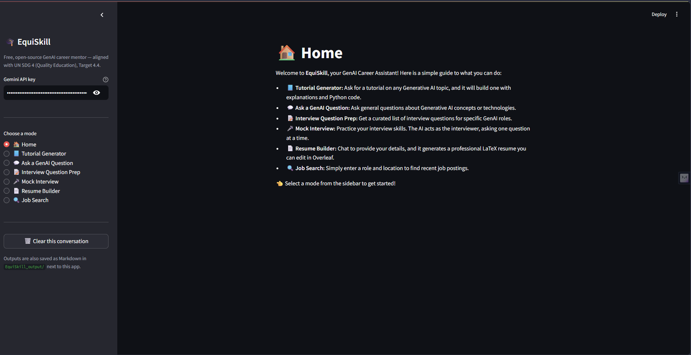
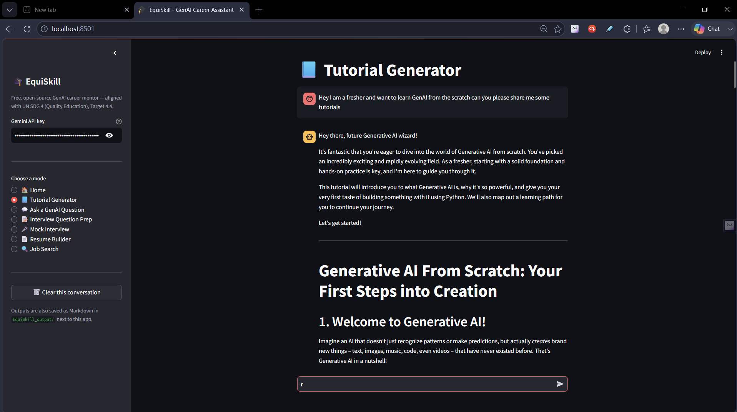
09 / APPLICATION PREVIEW
Premium UI Experience
Home Page
Tutorial Generator
9 / 15

Slide 10
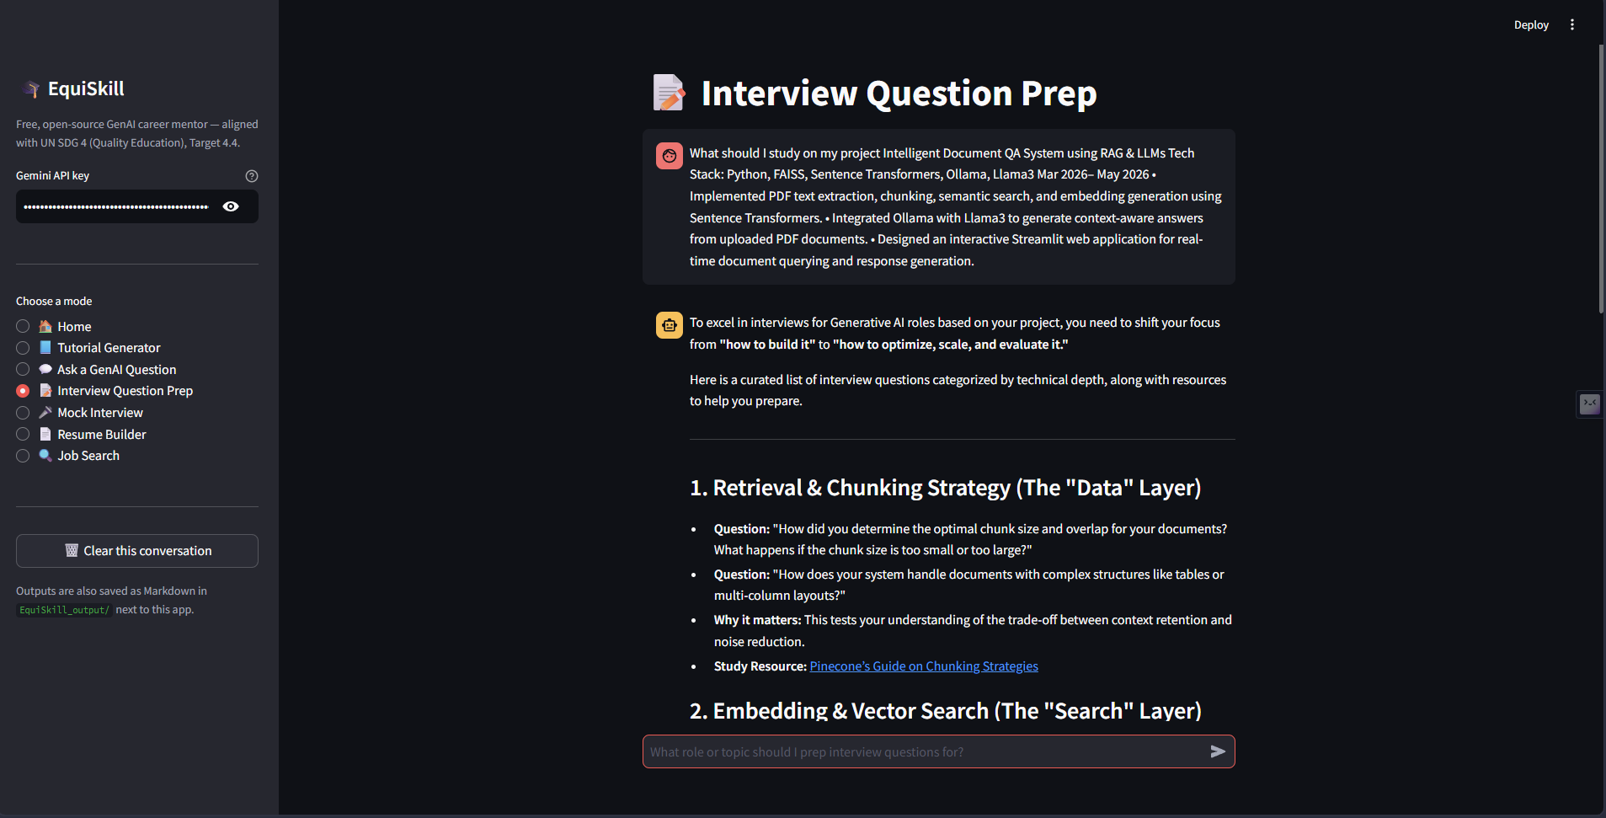
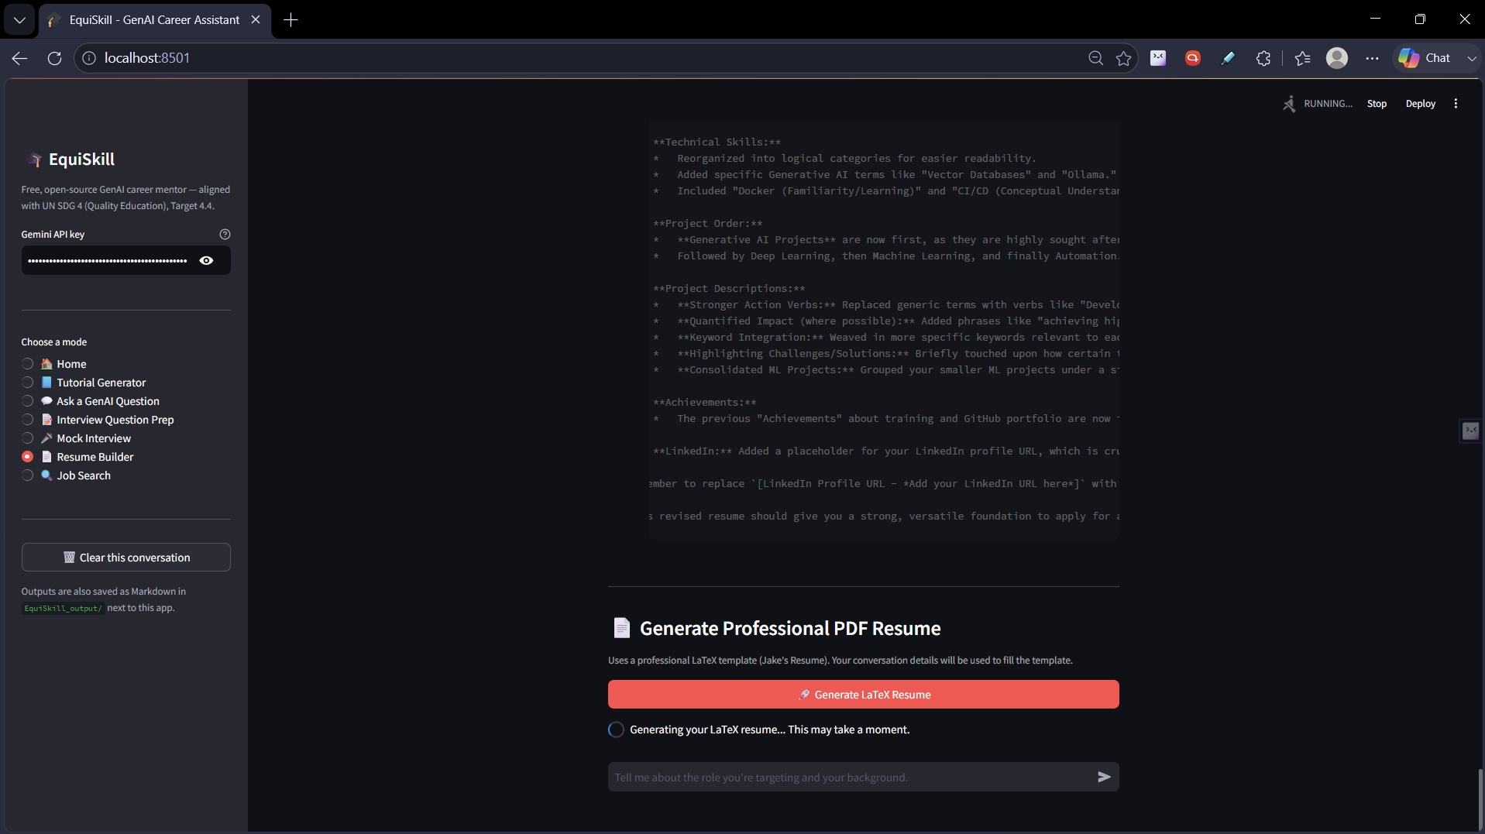
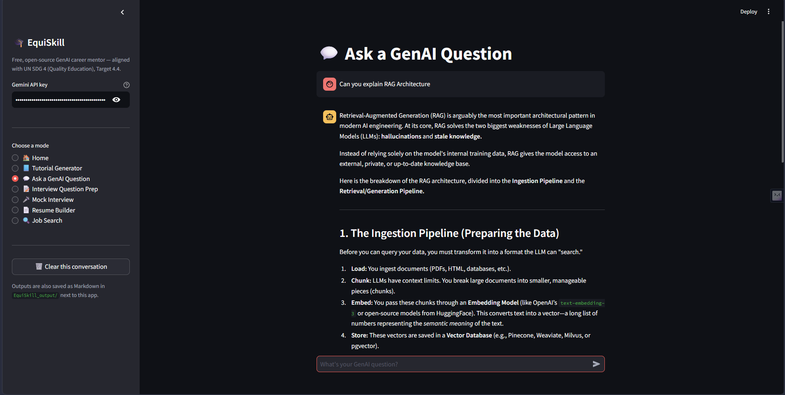
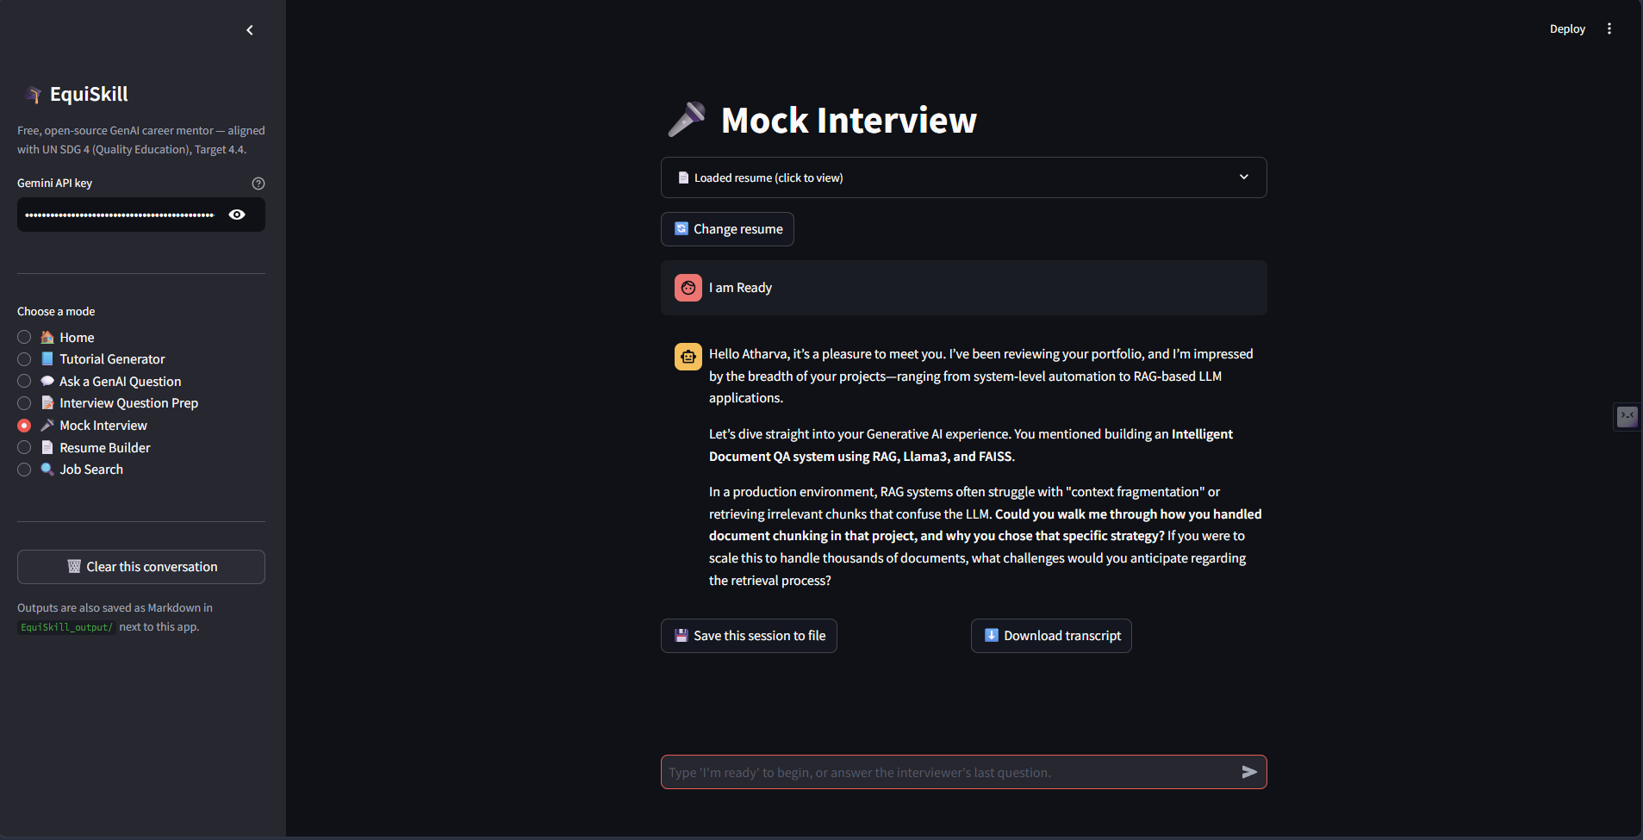
09 / APPLICATION PREVIEW
Resume Builder
10 / 15

Slide 11
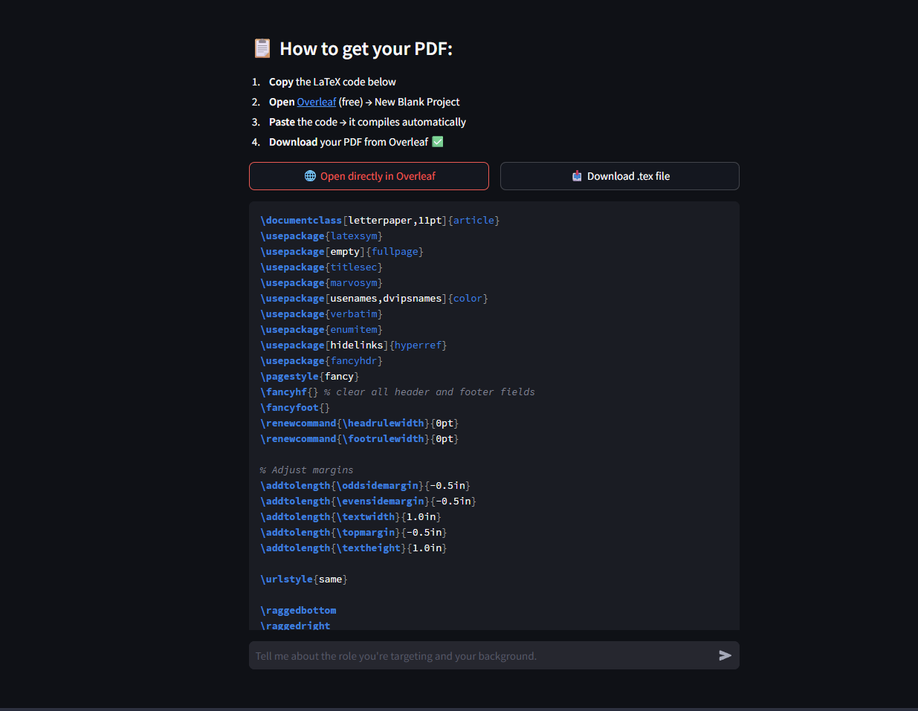
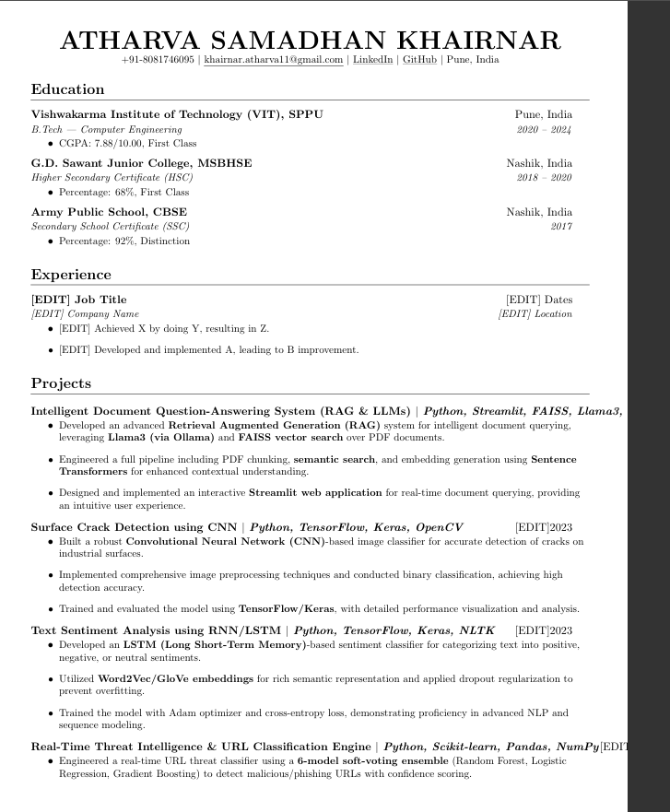
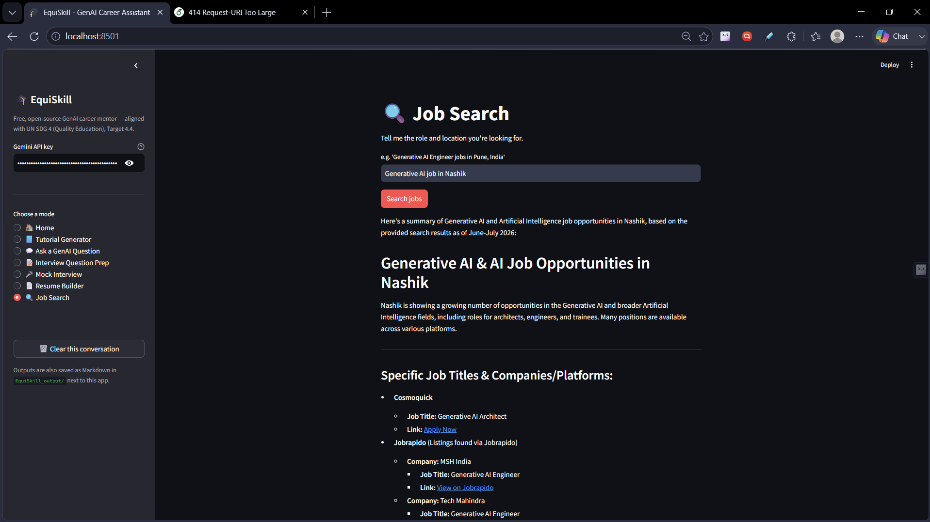
09 / APPLICATION PREVIEW
Resume Latex
Resume on Overleaf
Job Search
11 / 15

Slide 12
10 / INNOVATION
What Makes Us Different
AI-FIRST
NOVEL
UNIQUE
🧠
🎯
⚡
Gemini-Powered Intelligence
Precision Skill Matching
End-to-End Automation
Real-time LLM inference for resume analysis and career recommendations using Google's latest Gemini models.
Multi-dimensional skill vectors mapped against live job market data — not just keyword matching.
From resume upload to job application — the entire workflow is automated with AI at every step.
SCALABLE
SMART
DUAL-SIDED
🏗️
🤖
🤝
Microservices Architecture
Adaptive Learning Plans
Recruiter Intelligence
Docker-containerized services designed for horizontal scaling to handle millions of users.
Roadmaps that update dynamically as job market trends change and as users make progress.
Recruiters can discover candidates ranked by AI fit score — a first-of-its-kind matchmaking engine.
12 / 15

Slide 13
11 / FUTURE SCOPE
The Road Ahead
🚀 Short-Term
📈 Mid-Term
🌟 Long-Term Vision
0 – 6 Months
6 – 18 Months
18+ Months
→ LinkedIn OAuth integration
→ Real-time job board API integrations
→ National skill ecosystem platform
→ Interview prep simulator with AI feedback
→ AI mock interview with NLP scoring
→ Credential verification via blockchain
→ Advanced resume keyword optimization
→ Multilingual support (10+ languages)
→ Predictive salary & growth modeling
→ Mobile-responsive PWA
→ University & bootcamp partnerships
→ Government & enterprise partnerships
→ Batch resume processing for recruiters
→ Employer portal & talent pipeline
→ Global EdTech marketplace integration
13 / 15

Slide 14
12 / EXPECTED IMPACT
Real-World Impact
👩‍🎓
For Students & Job Seekers
🏢
For Organizations & Recruiters
40% faster job placement, clear skill roadmaps, higher resume pass rates through ATS filters, and personalized 1-to-1 AI guidance previously available only to premium career coaches.
60% reduction in screening time, higher quality candidates, AI-ranked applicant pools, and data-driven hiring decisions based on verified skill profiles.
🌍
For Society
🏭
For the Industry
Democratize access to career guidance for students from tier-2 and tier-3 cities who can't afford premium coaching, reducing employability inequality nationwide.
Bridge the $8.5T talent shortage gap, accelerate industry adoption of AI in HR processes, and create a new standard for data-driven career intelligence platforms.
14 / 15

Slide 15
13 / CONCLUSION
The Future of Career Intelligence
Starts Here
EquiSkill isn't just a platform — it's a movement to make every student job-ready with the power of AI.
🤖
🎯
🚀
AI-First Platform
Real Problem, Real Impact
Ready to Scale
Gemini-powered intelligence at every touchpoint of the career journey
Solving a $8.5T talent gap with precision skill matching and roadmaps
Microservices architecture built for millions of users from day one
"Empowering every student to reach their full career potential, one skill at a time."

