Slide 1
CRICKET LEAGUE MANAGEMENT SYSTEM USING JAVA
UID | NAME
120IT1108A | Pawar Herschel Pravin
120IT1210A | Prabhu Yash Rathod
120IT1144A | Gajakosh Devdatta Ashok
120IT1034A | Mourya Ayush Dilip

Slide 2
Content
Introduction
Literature survey
Motivation
Objective
System architecture
Proposed work with methodology
Software and hardware requirements

Slide 3
Introduction
Managing a tournament can be a very hard task so this software makes it simpler and faster

Slide 4
Literature survey
TITLE | AUTHOR | AIM OF THE PAPER
Design and Development of Management System for Reserve Talents of Competitive Sports | S. Qing and Y. Tianchao, "Design and Development of Management System for Reserve Talents of Competitive Sports," 2010 Second International Conference on Computer Modeling and Simulation, 2010, pp. 491-493, doi: 10.1109/ICCMS.2010.472. | This paper develops a kind of management system and analysis management for reserve talents of competitive sports based on network. The system possesses such features as convenient to use, strong expandability, and comprehensive functions.
Designing database for a football league: A case study of Thai football league | Chaloemchai Trisuwannawat, Chirasil Chayawan and Nithinant Thammakoranonta, "Designing database for a football league: A case study of Thai football league," 2010 3rd International Conference on Computer Science and Information Technology, 2010, pp. 359-363, doi: 10.1109/ICCSIT.2010.5564970. | In this paper , a database for a football league has been designed by classifying and representing those data in categories. The app is used to design a database for football league which help to analyze and store beneficial information.

Slide 5
Motivation
Managing a tournament can be a very hard task, you need to:
Create committee and get volunteers
Organize them so work is done efficiently
Plan out dates in advance and select venue
Promote the tournaments
Handle scores
etc
our software avoid manual labor by automating some of the process
Increase the security by avoiding paperwork and using login credentials

Slide 6
Objective
Develop a system that provides a convenient way to manage tournaments and register for them
Develop a database which stores team and tournament details and player stats

Slide 7
System Architecture / User Types
Admin
Create Tournaments
Team Manager
Invite Players
Register For Tournament
Score Keeper
Update
Match Result
Player Stats
Edit Tournament Details
Verify Player Details
Player
View Match Details
View Lifetime Stats

Slide 8
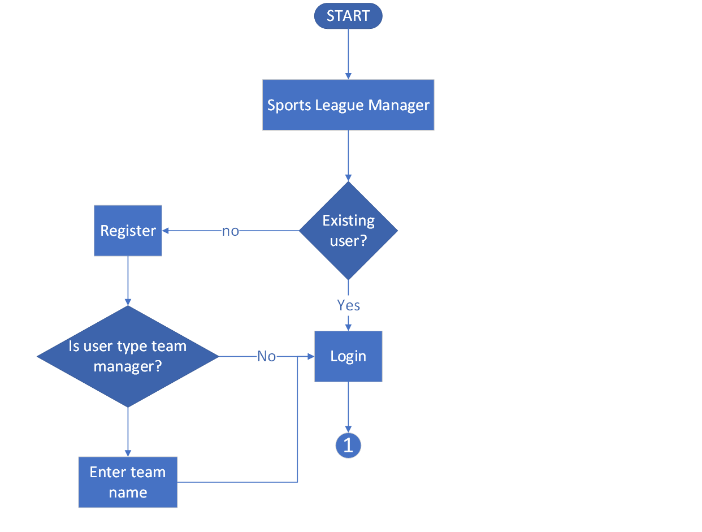
System Architecture / Flow Chart / 1

Slide 9
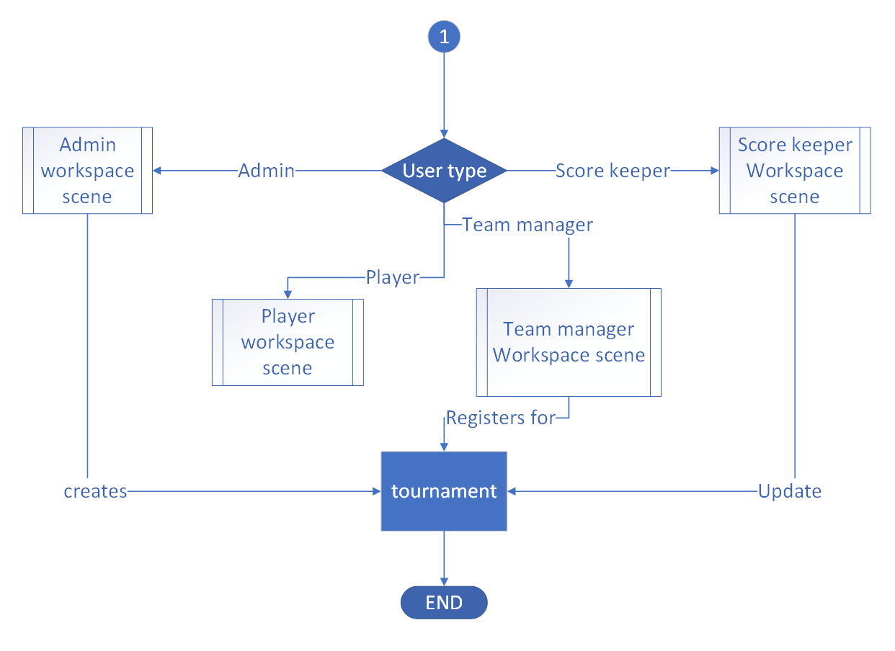
System Architecture / Flow Chart / 2

Slide 10
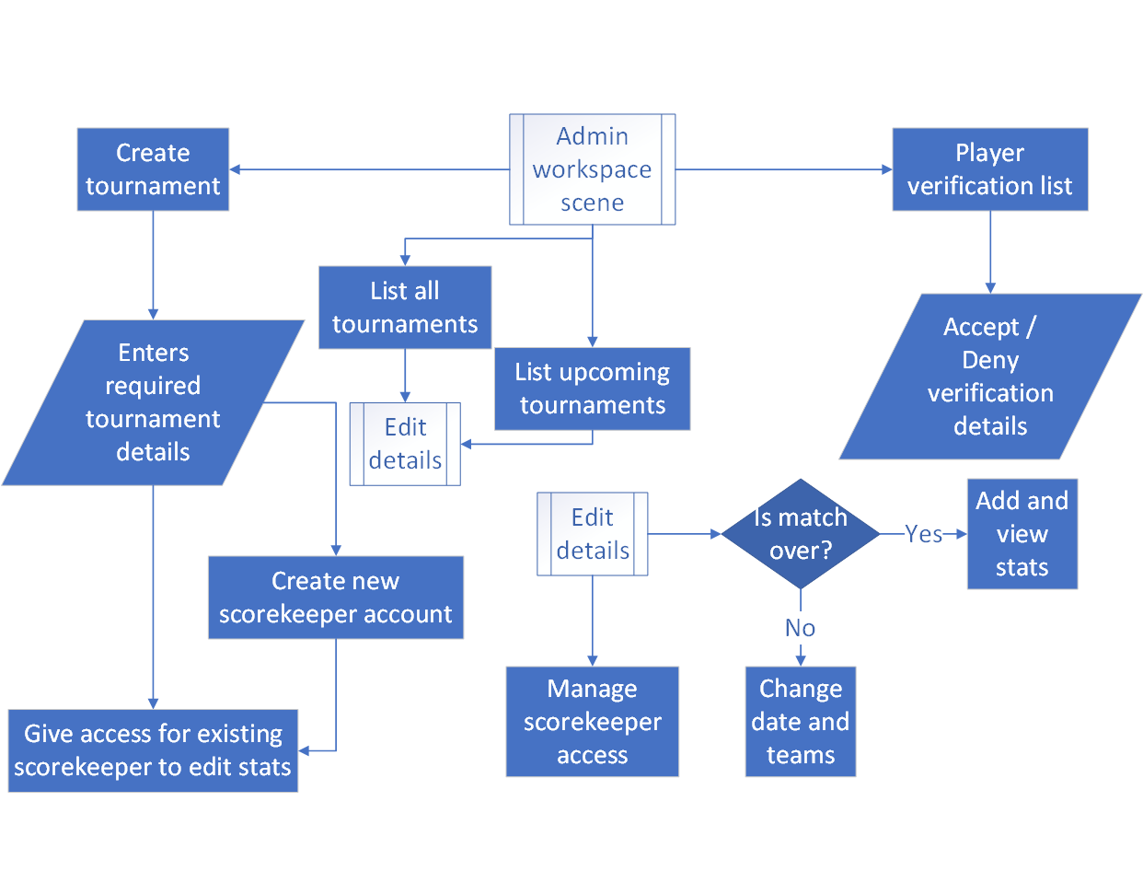
System Architecture / Flow Chart / 3

Slide 11
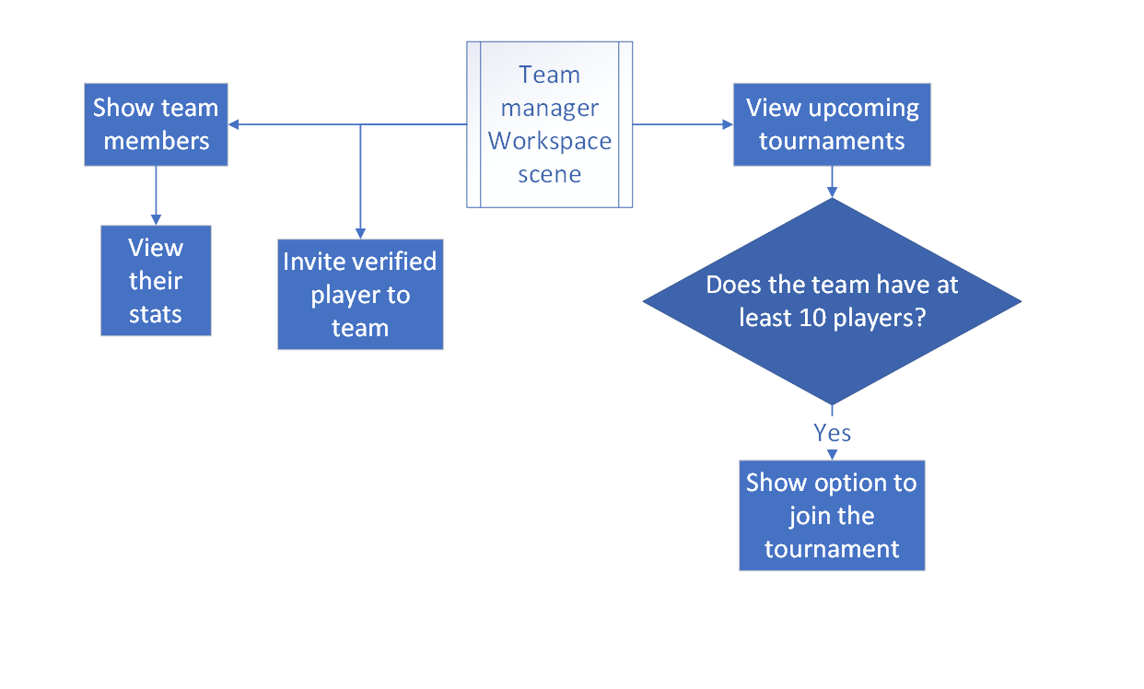
System Architecture / Flow Chart / 4

Slide 12
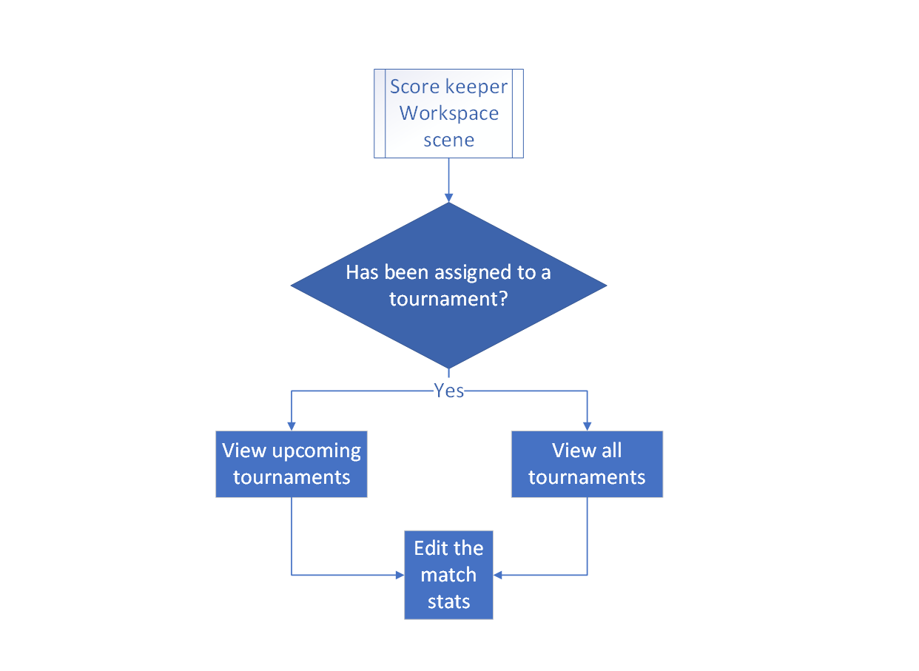
System Architecture / Flow Chart / 5

Slide 13
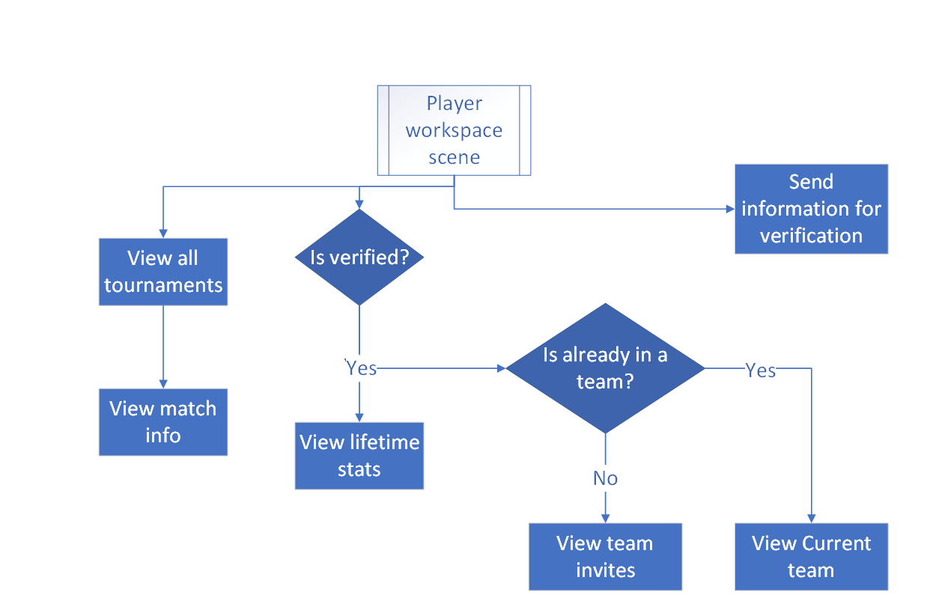
System Architecture / Flow Chart / 6

Slide 14
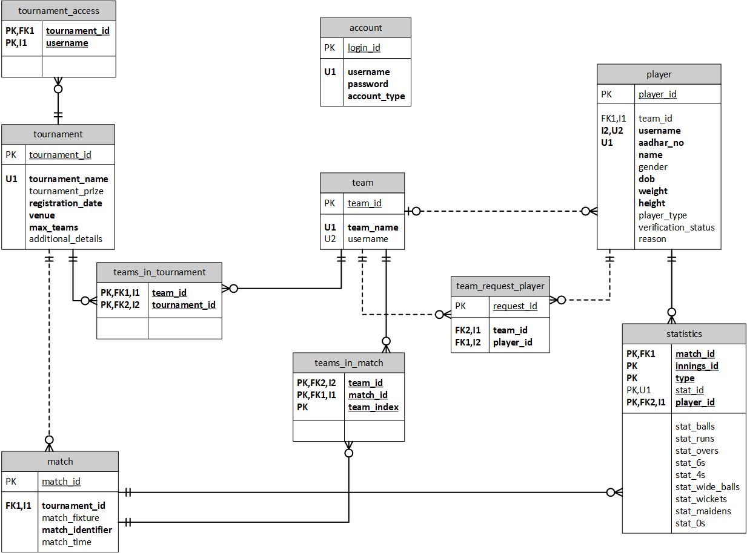
System Architecture / ER Diagram

Slide 15
Proposed work with methodology
Make it easy to make and manage a sports league by handling
Scheduling tournament
Managing a tournament can be a very hard task so this software makes it simpler and faster
Registering players
Makes it easier to keep track of team & its player’s performance
Using sql
Checking availability
Shows the team manager the upcoming tournament
Recording history & player stats
Allows the team and the players to improve themselves by showing them the areas they can improve upon
Handling security
Admins verify players, create tournaments, assign accounts for score keeper

Slide 16
Software and hardware requirements
To use the software, the minimum requirements are
Software Requirement:
JDK 17
MySql
Hardware requirements:
Windows 7
1 gigahertz (GHz) or faster 32-bit (x86) or 64-bit (x64) processor.
4 GB RAM
20 GB diskspace

