Slide 1
Artificial Face Recognition using Wavelet Transform & SVM
Pawar Manojkumar
(11IT18F)
Under the guidance of
Prof. G.R.M. Reddy

Slide 2
Table Of Contents
Introduction
SecondLife
Need Of Face Recognition in Virtual World
Architecture Of Face Recognition
Wavelet Transform
SVM
Implementation
Demo
Result & Conclusion

Slide 3
Introduction
Multiplayer games like second word, Avatar is an identity of each user.
As many users invest their money in such gamming there are more chances of fraud over there.
So this face recognition technique can be used to avoid such frauds.

Slide 4
Second Life
Second Life online virtual world developed by Linden Lab.
A number of free client programs, or Viewers, enable Second Life users, called Residents, to interact with each other through avatars.
Residents can explore the world ,meet other residents, socialize, participate in individual and group activities, and create and trade virtual property and services with one another.

Slide 5
Second Life
Economy : internal currency, the Linden dollar (L$).
L$ can be used to buy, sell, rent or trade land or goods and services with other users.
Virtual goods include buildings, vehicles, devices of all kinds, animations, clothing, skin, hair, jewellery, flora and fauna, and works of art.
The Linden can be exchanged for US dollars or other currencies .
Applications: Education, Art, Science, Business.

Slide 6
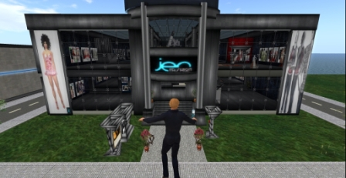
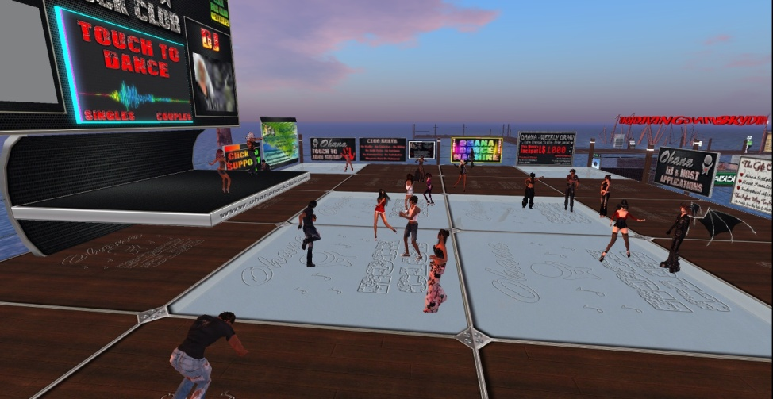
Second Life

Slide 7
Need of Face Recognition in Virtual World
Virtual crimes will become more common as we venture more and more into virtual worlds.
Limitations on username based tracking.
Not all avatars are human looking, and even with those that are humanoid there is a huge diversity of colour
Matching a human face to an avatar generated from owner face.

Slide 8
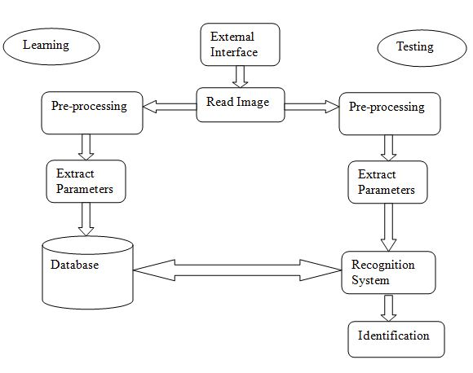
Architecture of Face Recognition

Slide 9
Feature Extraction
Feature extraction involves simplifying the amount of resources required to describe a large set of data accurately.
Less coefficients but still describing the data with sufficient accuracy.
Methods: Principal component analysis(PCA) Multi-factor dimensionality reduction Wavelet transform

Slide 10
Wavelet Transform
Disadvantage of Fourier transform- only frequency and not the time resolution.
Cut the signal into several parts and analyze them separately.
The scalable window is moved along the signal, and the spectrum for each position is calculated.
Ultimately, the result is a set of time-frequency representation signals with different resolutions (multi resolution)

Slide 11
Wavelet Transform
Low-frequency content- Identity of signal, most important part.
Wavelet analysis- Approximations and Details.
The approximations - high-scale, low-frequency components of the signal.
The details - low-scale, high-frequency components.
The detail coefficients cD are small and consist mainly of a high-frequency noise, while the approximation coefficients cA contain much less noise than does the original signal.

Slide 12
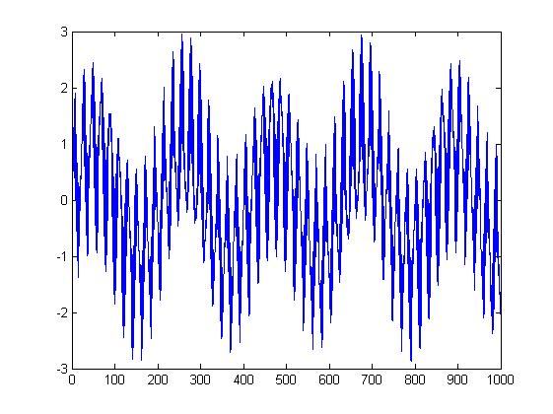
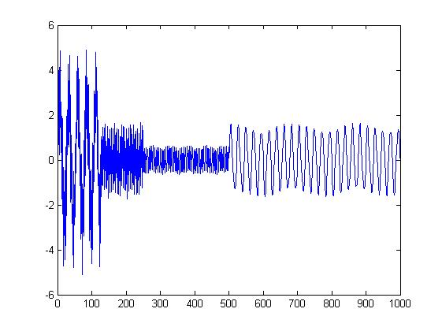
Wavelet Transform

Slide 13
SVM
Support Vector Machines:- supervised learning models that analyze data and recognize patterns.
The basic SVM takes a set of input data and predicts, for each given input, which of two possible classes input belongs.
SVM types Linear Nonlinear Multi-class classification.

Slide 14
SVM
The goal of the SVM is to find a classifier for two classes of data, to separate copies of this data, and to maximize the distance between these two classes.
SVM has to be an optimal hyper plane, which means the hyper plane needs to pass through the centre points of two classes of examples.
The goal is to find the maximum hyper plane that maximizes the distance to the training examples or margin.

Slide 15
Linear SVM
Simpler Using maximum margin classifiers.
The margin between the positive and negative is defined by two hyper planes (w•x)+b=±1 .
None of the points is lying between these hyper planes and has a margin width of z / ||w||.
Maximize the margin by minimizing ||w|| to achieve an optimal solution with a maximum spread.
Support vectors- Data points on the separating hyper planes

Slide 16
SVM
Optimal Hyper plane
Support Vectors

Slide 17
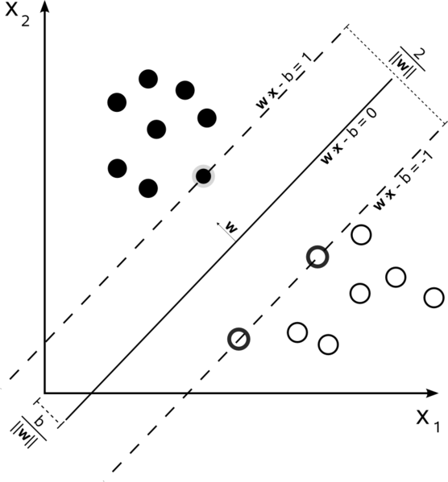
SVM

Slide 18
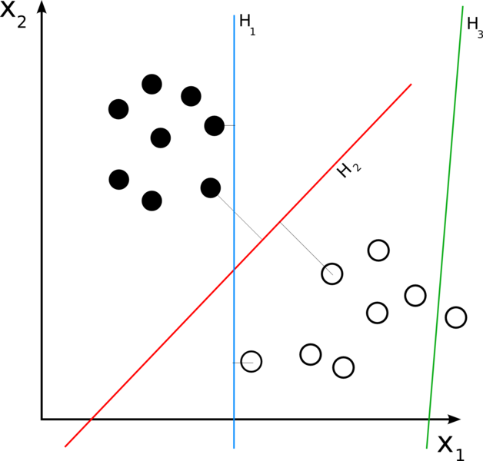
SVM

Slide 19
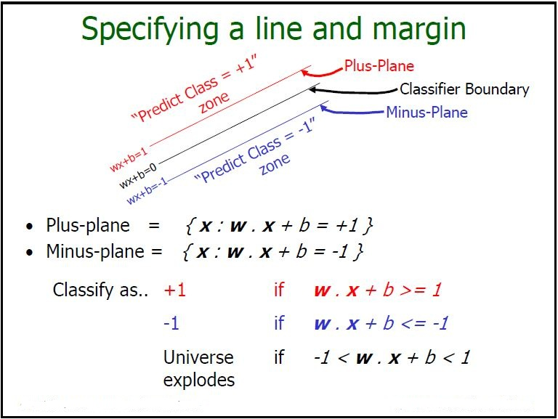
SVM

Slide 20
Multi Class SVM
Reduce single multi class problem into multiple binary classification problem
One vs All
One vs One

Slide 21
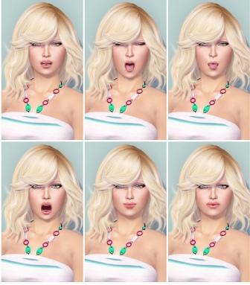
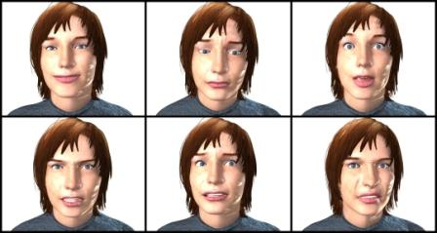
Implementation
Image Data Set

Slide 22
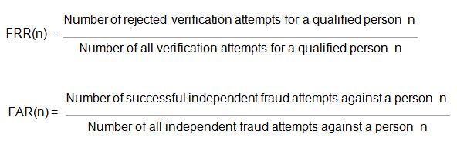
Results

Slide 23
Demo

Slide 24
Conclusion
The work was presented in " Artificial Human Face Recognition via Daubechies Wavelet Transform and SVM" , and after implementing it, it shows that results are almost matching.
The wavelet transformation along with SVM (Support Vector Machine ) gives better results.
Skin color and intensity of light is doing much effect on performance. System performance can be improved by adding more images with different poses and lightning conditions.

Slide 25
Future Work
parallelize algorithm at following stages.
Learning Phase
Each node can read image parallelly apply wavelet transformation and store characterized parameters in database, which will be used for training system.
Recognition Phase
As current implementation of recognition, work serially on SVM network . It is possible to apply recognition part parallelly on different different group .

