Slide 1
Capstone
Final Presentation
Information Systems Development and Design Capstone Course (IS-5303)
Presented by Poonam Pawar
1429329
Trine University
Presented on May 02, 2019

Slide 2

INTRODUCTION
Serve on Door (SOD)
Serve on Door (SOD) is a Warsaw-based, family-owned business.
SOD will target all towns within Kosciusko county.
SOD will provide better business opportunity to many local vendors and service providers.
SOD is the unique and singular place for all local vendors to advertise and lure more customers.
It is cost-effective and quick for the customers and vendors.
Special people like elders, physically-challenged, or busy personals can benefit from SOD, as they can get easy and quick service by few clicks on www.serveondoor.com.
Accessible via internet globally.
E-commerce business.

Slide 3
COMPANY OVERVIEW
COMPANY NAME
Serve on Door Pvt. LTD
WEBSITE
www.serveondoor.com
TITLE
Serve on Door Pvt. LTD
LOCATIONS
Kosciusko County
BUSINESS TYPE
E-commerce business
SPONSOR(S)
Poonam Pawar. CEO, Serve on Door Pvt. LTD
ESTABLISHED ON
15 Dec, 2018
TARGET MARKET
SOD will target to lure all vendors and customers, from Warsaw and nearby Kosciusko county towns.
MOTTO
We are here to serve you.
MISSION STATEMENT
To develop and deliver an e-commerce organization that provides all local business and an opportunity to join us in boosting the local economy by bringing the services to the door of the customers with ease.
VISION STATEMENT
To bring all the nearby business close to the consumers so that we can reach our common goal of proving quick and effective services.

Slide 4

HISTORY OF COMPANY
ESTABLISHED ON
15 Dec, 2018
SPONSOR(S)
Poonam Pawar. CEO, Serve on Door Pvt. LTD
LOCATIONS
Warsaw, Kosciusko County
HISTORY
Serve on Door (SOD) is a Warsaw-based e-commerce company established in Dec' 2018.
Warsaw's weekend farmer's market was the inspiration behind the inception of SOD.
There are many small and local vendors whose business is limited to fewer customers.
The products were very good yet only few customers were there.
Family owned business has potential to grow as everyone in the town knows everyone else.
Trust between the customers and vendors are already existing.
SOD will give all the vendors/ sellers/ service providers a common platform to expand their business.
Initial prototype was built and shared with the vendors by Feb 2019.

Slide 5

BUSINESS PROBLEMS
Local business is not performing to its full potential.
No online grocery deliver system.
Expensive services.
Local vendors find it tough to lure maximum potential customers.
No quick and on-demand service providers for household chores.
Trust on unknown vendors and suppliers.
Labor and time required to maintain house.
Customers don’t have a place to check and search for all vendors.
Transport facilities to nearby major airports, destinations, and bus stations..
Vehicle repair at any hour of clock.
Special people like elders, physically-challenged, or busy personals can benefit from SOD, as they can get easy and quick service by few clicks on www.serveondoor.com.

Slide 6









PROPOSED SOLUTION
Vendors
Customers
Administrator
Notes:
All Vendors, Customers will call www.serveondoor.com to request for various services like transportation, grocery, house maintenance, car repair, and house repairs.

Slide 7
PROPOSED SOLUTION
CONTINUE…
www.serveondoor.com
SOD will have multiple options to request for services based on service type which will include grocery delivery, transport request, and household services.
The website will also have options to book services for future dates and specific time.
Unique and singular place from where customers can request for a service.
Vendors can advertise their products and lure more customers.
All the vendors are local and trusted.
Many services are family owned.
Easy and quick service on door.
Any vendor can join the company with easy registration process.
New business opportunity.
Low cost service.
Business value
The intention of the business is also to provide services on optimal rates.
The business is estimated to bring a 30% rise in the local business sales, plus at least 15% profit to the company for every service request.
SOD will also get additional profit by advertisement requested by local vendors and companies to list them in the website.
Notes:
SOD will help in improving the business and user-experience because:
SOD will simplify the user-experience as none of the users has to physically go to the vendor, rather www.serveondoor.com will be there shopping place.
SOD can help vendors reach out to especially challenged customers, like elder people, physically challenged persons, or even customers from busy-working class.
The service will be cost effective and quick as the customers and vendors are geographically close to each other.
Local business and service providers can reach to the customers easily.
Customers will have more options to choose from.
Scope for growing the business is limitless.

Slide 8

BUSINESS REQUIRMENTS
With the inception of SOD, all customers need to visit www.serveondoor.com to find the solutions for most of the required services.
Domain for hosting www.serveondoor.com website and company.
A simple process for vendor registration, service request form, and advertisement.
Web service development and Amazon account to manage the services.
All local vendors to advertise their services in www.serveondoor.com.
A communication channel between the consumer and the service provider.
Service tracking and billing service mechanism.
Services to give feedback to the vendors and the consumers.
Airport and bus station transport facility.
Provide on-demand services for house cleaning, carpet cleaning, lawn maintenance, ice cleaning, and other household services.
Grocery delivery services from the nearby stores to home.

Slide 9
BUSINESS REQUIRMENTS
CONTINUE…
Below are the services that Serve on Door (SOD) will provide with this RELEASE :
Grocery delivery services
Transportation services
House cleaning services
Vehicle repair services
House maintenance service

Slide 10
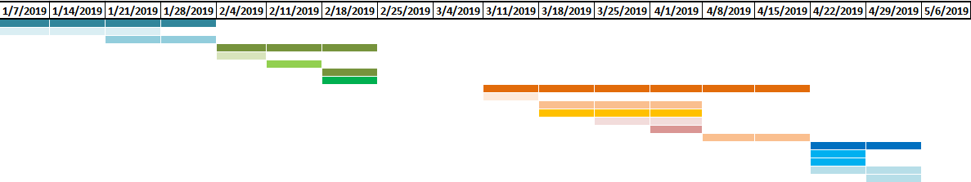
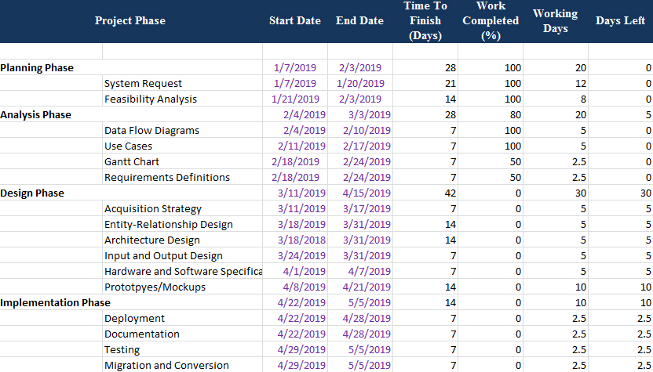
GANTT CHART

Slide 11




FEASIBILITY ANALYSIS
Operational Feasibility
Economic Feasibility
All the operations in the e-commerce business will be handled by me and my husband.
The services are directly provided by the local vendors/ sellers.
SOD will be responsible for providing an easy platform for sellers to sell their service, and users to request for service.
24x7 supports to all the customers for any issues with the e-commerce website.
In case of any issues with the service, the users can directly connect with the vendors or sellers.
The project implementation and maintenance are very cost-effective and economically feasible.
The duration of the project implementation is 16 weeks.
AWS services are paid based on the usage with no contracts.
All configurations are available on AWS with pay-per-use basis.
The estimated cost can be calculated from https://calculator.s3.amazonaws.com/index.html service.
Technical Feasibility
Schedule Feasibility
The project is highly feasible technically.
The pre-requirements for the development of the e-commerce website is very minimal.
The e-commerce website will need a domain name and website www.serveondoor.com which is currently available to purchase.
AWS as the platform, there is no overhead of physical hardware, software, or network infrastructure.
The services will be developed in the cloud and will be maintained online.
16 weeks Project.
Completely feasible.
The team has already built the architecture and a prototype for the project.
The e-commerce domain and the website can be purchased immediately from goDaddy.com.
And we already have the AWS account set up and ready for use.

Slide 12


REQUIREMENTS DEFINITION STATEMENT
Output Requirements
The website must provide vendors with registration and login capabilities.
With a valid vendor login, the website should give options to submit an advertisement for review.
Provide vendors the capability to update the advertisement.
Provide customers with proper payment gateway options.
The website must have dynamic web pages. All the web pages must be integrated with each other.
Properly designed for the simple user interface.
Notification system.
The system must provide customers with updated rates, and available services.
Input Requirements
The system must provide vendors with an advertisement template and form, which should be submitted for review.
All the service request must have a standard application form.
A feedback form will be provided to the customer after
each service request is completed.
Backend database will save all information including:
Advertisement details,
Service request
User details
Feedback
Invoices.
Notes:
Output requirements
The website must provide vendors with registration and login capabilities.
With a valid vendor login, the website should give options to submit an advertisement for review.
The website must provide vendors the capability to update the advertisement.
The website must provide customers with proper payment gateway options.
The e-commerce site must present various options to the potential customers to make their choice of services and vendors.
The website must have dynamic web pages. All the web pages must be integrated with each other.
The website must be properly designed for the simple user interface.
The website should be able to send notifications to the users or vendors about their service request, queries, or payment.
The system must provide customers with updated rates, and available services.
Input requirements
The system must provide vendors with an advertisement template and form, which should be submitted for review.
All the service request must have a standard application form.
Every information in the system must be stored in a database, which will be maintained by the system administrators.
Each advertisement request must be stored in the backend database.
All service request details must be stored in the backend database.
All invoices must be stored in a backend database.
A feedback form will be provided to the customer after each service request is completed.

Slide 13


REQUIREMENTS DEFINITION STATEMENT
CONTINUE…
Process Requirements
All registration request must be validated for duplicity.
Business contract between a vendor and SOD system is pre-determined.
All logins will be validated against the database records of the registration details.
All service request must be directly sent to the selected vendors. The system will keep a track of the service request from the backend.
The payment must be done directly to the payment gateway, from where Serve on Door will pay the vendors and keep the profits.
For any concern and coordination, the customer and vendors will directly interact.
All communications will be done via email between vendors and customers.
All the service request details, vendor details, advertisement details will be verified and handled by the system administrators.
Control Requirements
The system must save all the audit logs about user logins, service requests, payments transactions, invoices, and advertisements.
All transactions must have audit trails.
Server On Door's system administrator will be the part of all email communication between customers and vendors.
The system must generate error details which will include error type, severity, error description, and time stamp.
Notes:
Process Requirements
All registration request must be validated for duplicity.
Business contract between a vendor and SOD system is pre-determined.
All logins will be validated against the database records of the registration details.
All service request must be directly sent to the selected vendors. The system will keep a track of the service request from the backend.
The payment must be done directly to the payment gateway, from where Serve on Door will pay the vendors and keep the profits.
For any concern and coordination, the customer and vendors will directly interact.
All communications will be done via email between vendors and customers.
All the service request details, vendor details, advertisement details will be verified and handled by the system administrators.
Control Requirements
The system must save all the audit logs about user logins, service requests, payments transactions, invoices, and advertisements.
All transactions must have audit trails.
Server On Door's system administrator will be the part of all email communication between customer and vendors.
The system must generate error details which will include error type, severity, error description, and time stamp.

Slide 14

REQUIREMENTS DEFINITION STATEMENT
CONTINUE…
Performance Requirements
Serve on Door must be available via internet with no downtime seven days a week, 365 days a year.
The system must support any number of concurrent users.
All processes are synchronous in nature.
The user details, service request details, advertisement details, and other transactional details must be stored in the backend with 99.99% availability.
Serve on Door e-commerce website must be hosted in North-America AWS region with at least 2 backend servers.
There must be no impact to the customer when the system is upgraded or maintained.
Notes:
Performance requirements
Serve on Door must be available via internet with no downtime seven days a week, 365 days a year.
The system must support any number of concurrent users.
All processes are synchronous in nature.
The user details, service request details, advertisement details, and other transactional details must be stored in the backend with 99.99% availability.
Serve on Door e-commerce website must be hosted in North-America AWS region with at least 2 backend servers.
There must be no impact to the customer when the system is upgraded or maintained.

Slide 15
SYSTEM CHANGEOVER STRATEGY
Serve on Door is built using Amazon Web Services (AWS) applications, which is hosted on the cloud.
All the interfaces and services will be released in batches to the users.
The cloud infrastructure is the most optimal and economically effective solution for the business.
System changeover plan is as below:
Re-analyses all the functional requirements and business use cases to determine the impact on the current project.
Determine the phases and release scope for system changeover.
Define the dependencies and expected cost for upgrades and maintenance.
To maintain business continuity, the best possible approach has to be taken to make the necessary changes.
We have opted for the Pilot method for system changeover plan.
The pilot method is low in cost
Medium risk
Lengthy changeover duration.
Note: Since all the applications in the project are cloud-based we can reduce the time required for infrastructure change, network update, or even software changes.

Slide 16

TRAINING PLAN
Training plan for new developers/ system architects/designers: Serve on Door is built using AWS services which are cloud-based. All the AWS application's training material is available online globally, and anyone interested in that can use it.
Training vendors/ sellers about Serve on Door website: The project management team will send the company's representatives to the local business and express the idea behind the e-commerce website. The presentation or interaction will include the impact, benefits, and user interfaces details so that the end users can comprehend the system easily.
Training for real-world users/customers: There will be no formal training for real world users. But the website will have easy forms and web pages designed for the effective user interface.
Mode of training plans
Notes:
Mode of training plans
All the formal trainings will have standard documents explaining the details about the subject in hand. Apart from that project management team will have presentations, videos, conferences, meetings, and WebEx to accommodate the maximum number of audiences. All the training material will be documented and kept in storage for future use.

Slide 17



SUPPORT/ MAINTENANCE PLAN
Maintenance plan
Support system
The business will share the support with the vendors and sellers who can directly interact with the users.
The entire service request will contain direct contact details of the sellers or vendors that a user can directly use.
Contact us at support.admin@sod.com
We are also available at 574-XXX-XXXX on office hours.
Our office hours are :
Monday : 09:00 EST -17:00 EST
Tuesday : 09:00 EST -17:00 EST
Wednesday : 09:00 EST -17:00 EST
Thursday : 09:00 EST -17:00 EST
Friday : 08:00 EST -19:00 EST
Saturday : 08:00 EST -19:00 EST
Sunday : 09:00 EST -12:00 EST
Technical Issues
All technical issues related to the e-commerce website will be managed by the project management team and developers.
Upgrades/ downtime
The development team will coordinate the changes and other details directly with the vendors and on the website.
User queries
For all the user queries about any service, the users can directly contact the vendors or sellers using their contact details that will be present in the service request acknowledgment form.

Slide 18


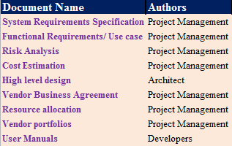
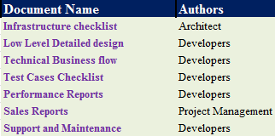
DOCUMENTATION PLAN
Functional Documents
Technical Documents
Notes:
Functional Documents:
System Requirements Specification -->AUTHOR : Project Management-->Detailed business requirement document.
Functional Requirements/ Use case -->AUTHOR : Project Management-->Use case document listing all the functional details.
Risk Analysis -->AUTHOR : Project Management-->Risk analysis document defining the RACI matrix
Cost Estimation -->AUTHOR : Project Management-->Document defining resource and infrastructure requirement to determine the estimated project cost.
High level design -->AUTHOR : Architect-->High level graphical document representing all actors and actions.
Vendor Business Agreement -->AUTHOR : Project Management-->Individual business agreement between Serve on Door and the vendors.
Resource allocation-->AUTHOR : Project Management-->Resource allocation document.
Vendor portfolios-->AUTHOR : Project Management-->Individual vendor profiles with advertisement, services, and access details.
User Manuals-->AUTHOR : Developers-->Detailed document for users (vendors, customers, or sellers)
Technical Documents
Infrastructure checklist -->AUTHOR : Architect-->Document representing all the infrastructure required for project implementation.
Low Level Detailed design -->AUTHOR : Developers-->Detailed technical design document, representing all the aspects of project implementation.
Technical Business flow -->AUTHOR : Developers-->Document representing how the technical components will interact with each other.
Test Cases Checklist -->AUTHOR : Developers-->List of pre-defined test cases.
Performance Reports -->AUTHOR : Developers-->Weekly or monthly report for performance analysis.
Sales Reports -->AUTHOR : Project Management-->Weekly or monthly report for sales analysis.
Support and Maintenance -->AUTHOR : Developers-->Business agreement document for entire company to provide best possible support to the end users.

Slide 19
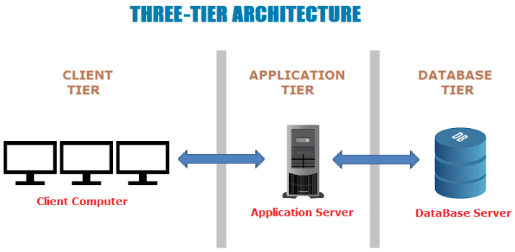
ARCHITECTURE DESIGN
THIN CLIENT TECHNOLOGY
No physical server
No hardware required
No physical database
All services are on cloud
Robust system
Easy scalable
Easy maintenance
TIER | Applications used
Client Layer | AWS VPC and ROUTE 53
Application Layer | Java Servlet and Java Server Pages (JSP)
Database layer | MY SQL
Notes:
Serve on Door (SOD) e-commerce website is a three-tier architecture system. The three layers are as below:
Presentation layer/client layer: The presentation/ client layer will be responsible for the user interface or the website. The websites/ user interface/ web portal are hosted over the internet. All the web calls will reach the system via the AWS VPC and ROUTE 53 services. All the services are hosted on port 443 (https services) using REST API transport.
Application layer: This layer is responsible to integrate the front end to the backend of the system. The integration layer is built on Java Servlet and Java Server Pages (JSP). The servers are Apache Tomcat Servers. All the user interface pages are developed in the AWS developer tool.
Database layer: This is the backend of the system where all the user information, advertisement details, legal documents, logs, transaction details, and service request details are available. We are using MYSQL database as the backend, and all the data are encrypted.
The architecture of the product will have thin client technology. There is no physical server, desktop, network, database, or hardware which was required to develop the e-commerce website. With AWS service all the applications and tools are available on the cloud for use. This all architecture points make the system very robust. The future of the company is very prominent due to easy maintenance and scalability.

Slide 20
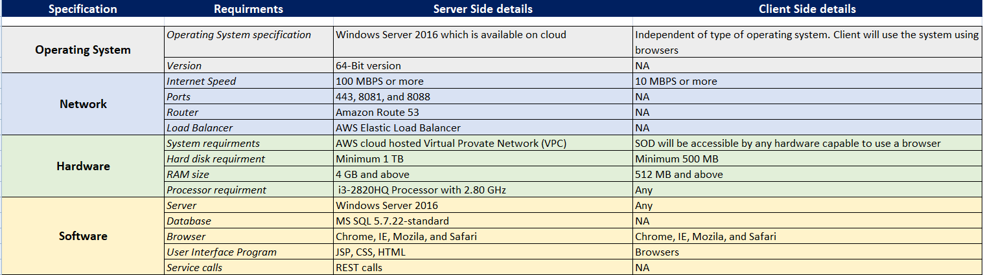
HARDWARE/ SOFTWARE SPECIFICATIONS

Slide 21

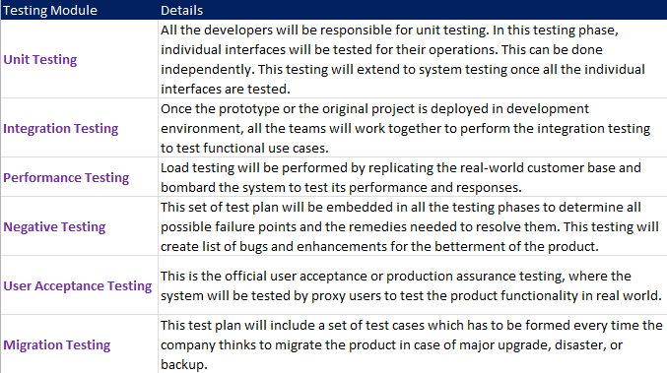
TESTING PLAN

Slide 22
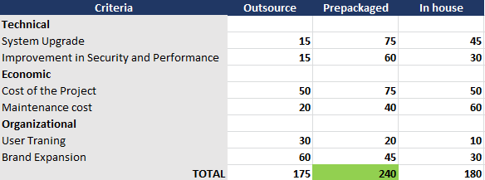
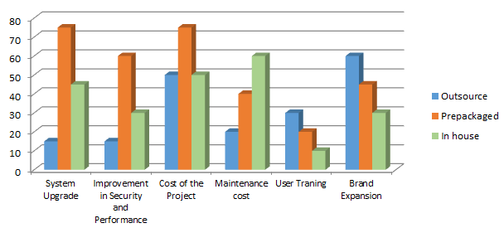
ACQUISITION STRATEGY
Point Estimated
Score Weightages
Serve on Door is built using Amazon Web Services (AWS) applications, which is hosted on the cloud.
We have chosen Pre-packaged option as acquisition strategy, because :
Easy system upgrade.
No infrastructure required.
Cost is low.
Pay per use with no contractual limitations.
Globally accessible.
Notes:
Technical Criteria
System Upgrade: System upgrade has many aspects like infrastructure, hardware, software, and servers. We have opted for a prepackaged option. All the various aspects come in the package with AWS which make it easy for Serve on Door to upgrade. Also, there is no overhead of cost, the company has to pay per use. There is no impact on the end user as there will be no downtime.
Improvement in Security and Performance: System improvements in security in performance is essential for any company. The knowledge about system usage and possible security threads can be vast and often unknown. We have opted for a prepackaged option. With the pre-packaged AWS application, performance and security are well handled. As a company, with the pre-packaged option, there is less cost involved.
Economical Criteria
Cost of the Project: We have opted for prepackaged option as the cost is pay per use. There is no agreement for AWS service usage and the development effort is quick, which reduces the project cost. Along with that, AWS services can scale up or down automatically. The cost of the project will remain constant throughout the project life cycle with pay per use basis. There is no capital required for infrastructure as everything is hosted on the cloud.
Maintenance cost: We opted for the in-house option. This option will be fit for the company. Most of the services given to the customer like transport, cleaning, and grocery needs in-house monitoring and maintenance for better customer satisfaction.
Organizational Criteria
User Training: A maximum number of the users of Serve on Door will be common people who may not be groomed to use e-commerce site. User training will become an essential part of the success of the business. We have opted for outsourcing the user training, so that company's representative can meet with the vendors and explain them the system UI and usage.
Brand Expansion: We have opted for Outsourcing option. As most of the users like vendors, sellers, and customers are the local population, we have opted for outsourcing to increase the brand value of Serve On Door company. Being a local business, most of the customers, vendors, and sellers are directly influenced by advertisement and word of mouth. The inception of the company is limited to Kosciusko county, where the company is trying to lure vendors by meeting them and requesting them to join the venture. As the brand value increases, we will need more people to connect with local businesses and bring them to Serve On Door.

Slide 23

INTERFACE MOCKUPS

Slide 24
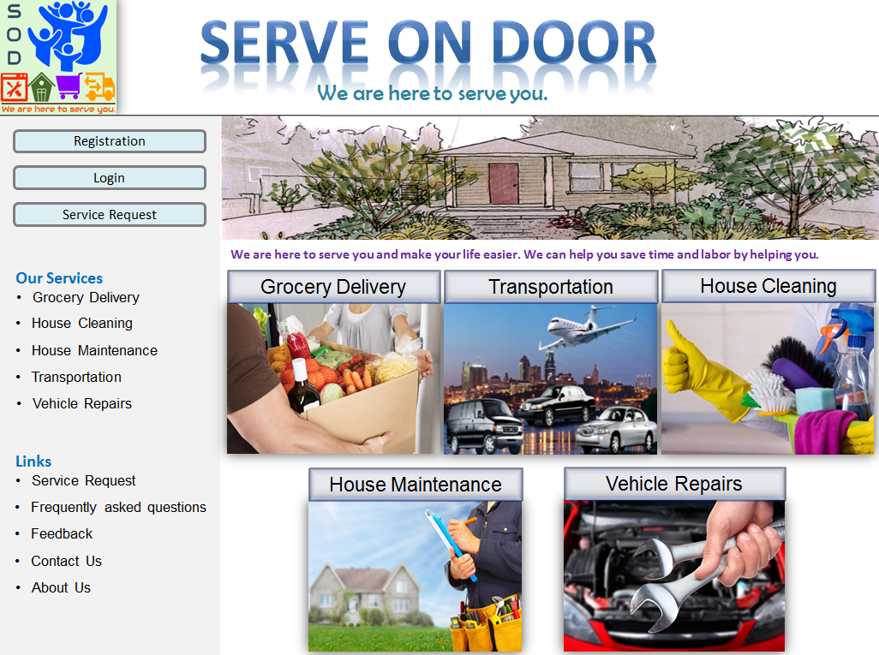
INTERFACE MOCKUPS
MAIN PAGE
Main page website will have the layout with all hyperlinks active. Users (vendor/ customers) can choose the next steps.

Slide 25
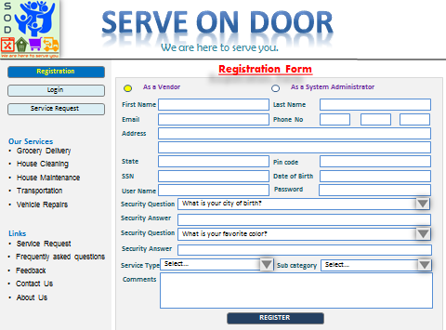
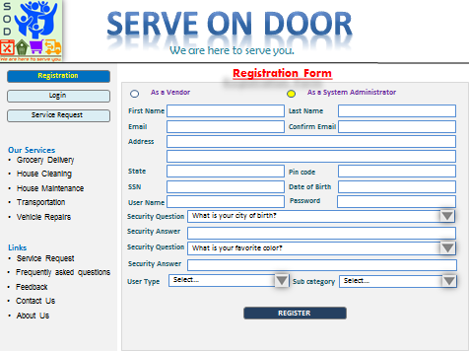
INTERFACE MOCKUPS
REGISTRATION PROCESS
Vendor Registration Form
Administrator Registration Form
Any vendor or administrator will have to register to the system before they can login.
Vendors can comment their information, service details in Comments section.
All registration goes to the system administrator for validation and acceptance.
Email notification is sent after registration with Confirmation details and login link.

Slide 26
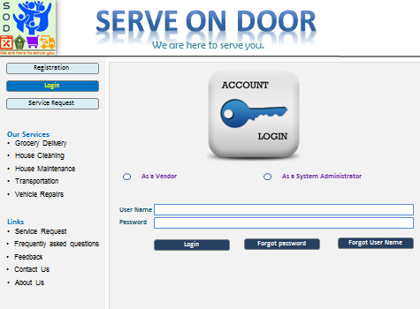
INTERFACE MOCKUPS
LOGIN PROCESS
Vendor or system administrator can login to the Serve On Door using their credentials.
All user details are encrypted and saved in backend database.

Slide 27
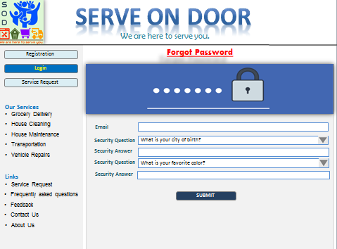
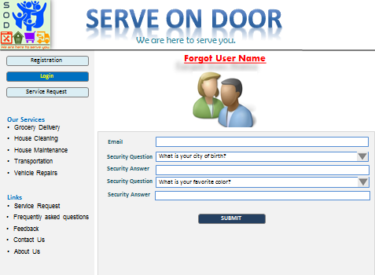
INTERFACE MOCKUPS
FORGET LOGIN PROCESS
Forgot Password Form
Forgot Username Form
Any vendor or administrator can use the links to reset their password or remember their username.
An email will be sent with next steps.

Slide 28
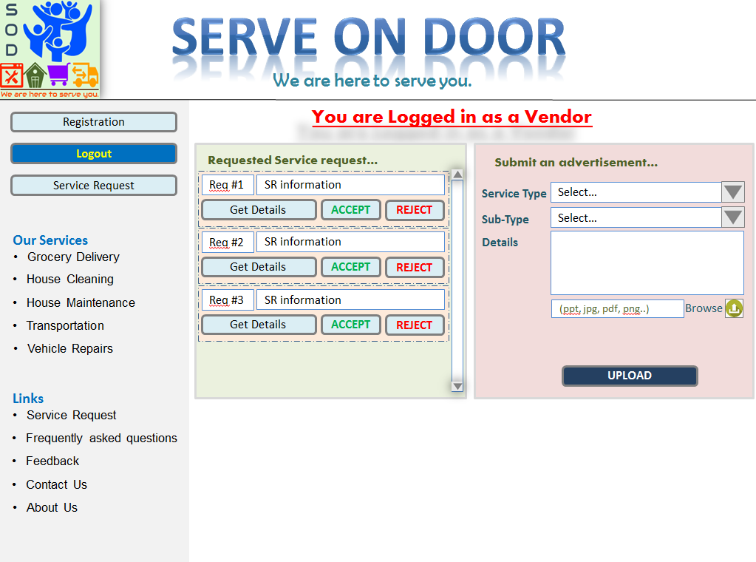
INTERFACE MOCKUPS
VENDOR LOGIN
Vendor login provides two options:
Vendor can upload advertisement about their services and offers using .ppt. .pdf, .png, .doc files. All advertisement details will go to system administrator for validation and acceptance.
List of all pending Service Request will be displayed for the vendors to accept or reject. Vendors can also go inside the Service request to find details about the request.

Slide 29
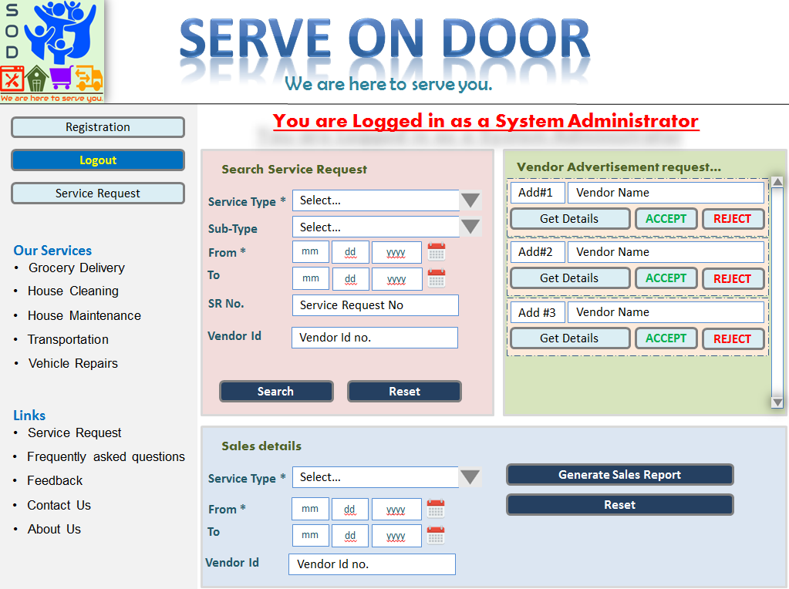
INTERFACE MOCKUPS
ADMINISTRATOR LOGIN
Administrator login provides below options:
List of all pending advertisement request will be displayed for the vendors to accept or reject. Administrator can also go inside the advertisement request to find details about the request.
Administrator can search Service request details based on service type, sub-type, dates, Service Request number, Vendor id.
Administrator can also generate sales report based on dates and Service type.

Slide 30
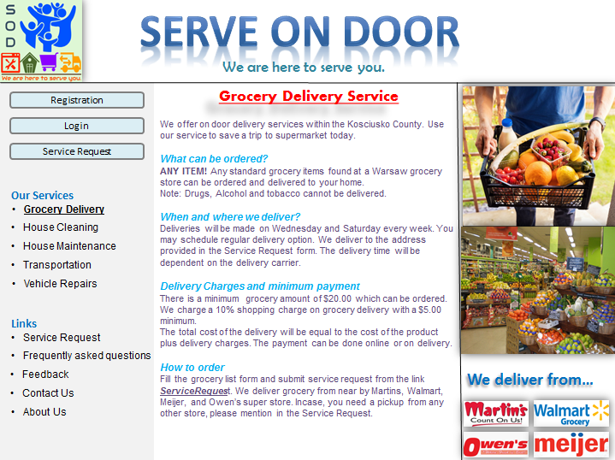
INTERFACE MOCKUPS
GROCERY DELIVERY SERVICE
Grocery Delivery Service Page:
The page will explain the process of grocery delivery service, which includes:
What can be ordered?
When order can be placed?
Where can we deliver?
Minimum payment
Cancelation policies.
User can go to ServiceRequest link to request for grocery delivery service.
Information about special delivery and local shops are mentioned in the page.

Slide 31
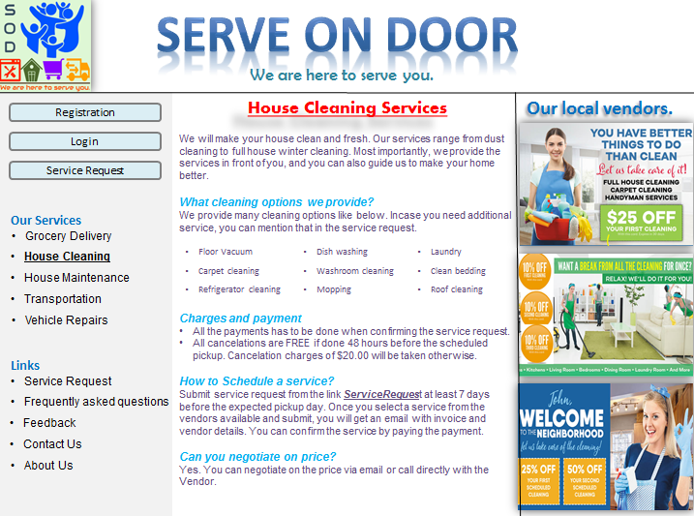
INTERFACE MOCKUPS
HOUSE CLEANING SERVICES
House Cleaning Service Page:
The page will explain the process of House cleaning service, which includes:
List of cleaning services provided.
Cleaning charges.
Payment process.
How to schedule a service?
Price negotiation.
User can go to ServiceRequest link to request for home cleaning service.
List of all advertisement by our local vendors.

Slide 32
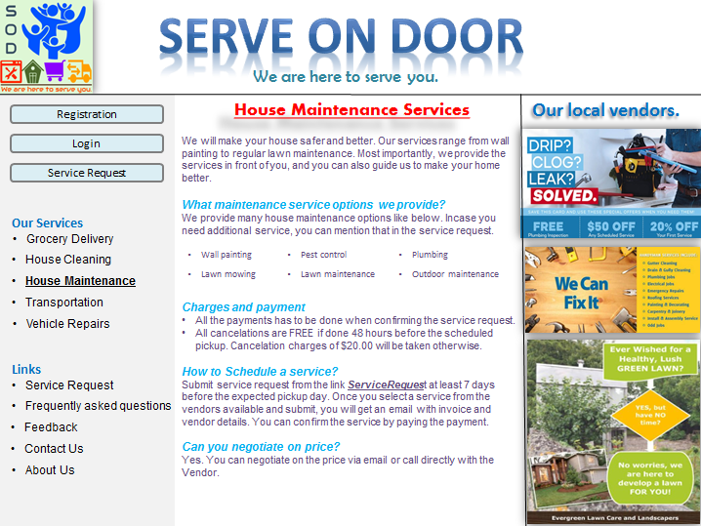
INTERFACE MOCKUPS
HOUSE MAINTENANCE SERVICE
House Maintenance Service Page:
The page will explain the process of House Maintenance service, which includes:
List of maintenance services provided.
Details about charges.
Payment process.
How to schedule a service?
Price negotiation.
User can go to ServiceRequest link to request for house maintenance service.
List of all advertisement by our local vendors.

Slide 33
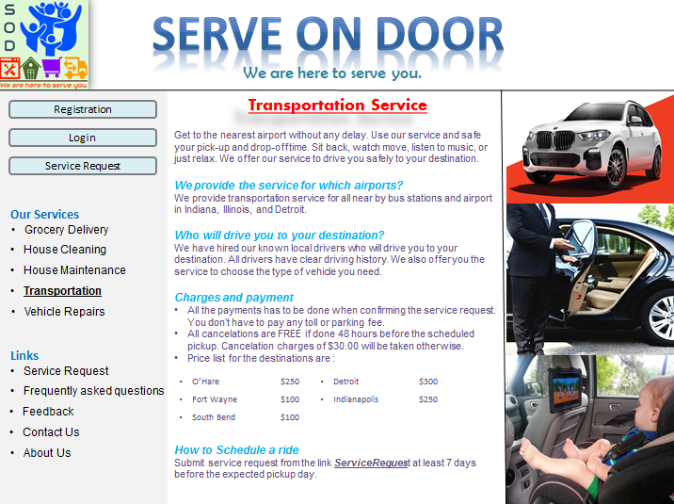
INTERFACE MOCKUPS
TRANSPORTATION SERVICE
Transportation Service Page:
The page will explain the process of Transportation service, which includes:
List of destination we provide transport service.
Charges details.
Who will drive?
How to schedule a pickup?
Cancelation policies.
User can go to ServiceRequest link to request for transportation service.

Slide 34
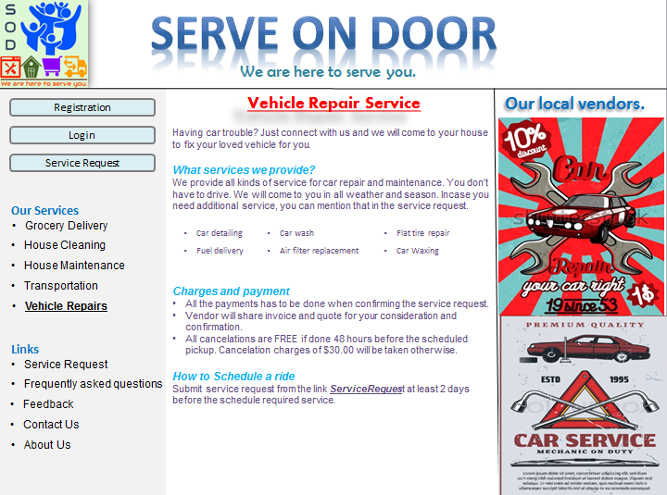
INTERFACE MOCKUPS
VEHICLE REPAIR SERVICE
Vehicle Repair Service Page:
The page will explain the process of Vehicle Repair service, which includes:
List of repair services provided.
Details about charges.
Payment process.
How to schedule a service?
Price negotiation.
User can go to ServiceRequest link to request for vehicle repair service.
List of all advertisement by our local vendors.

Slide 35
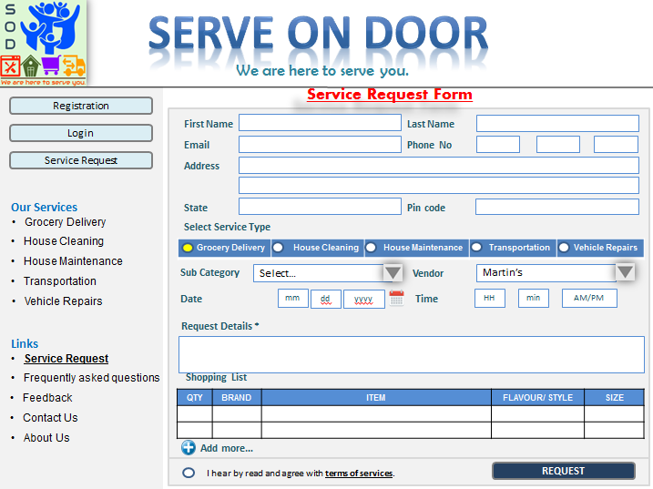
INTERFACE MOCKUPS
SERVICE REQUEST FORM
Service Request Form:
All the Service request from various services link come to this page.
This page will require all the details about the service required, which will include:
Requestor details.
Service details.
Special request details.
Schedule information.
In case of grocery request, shopping list will appear.
Agreement accept option.

Slide 36
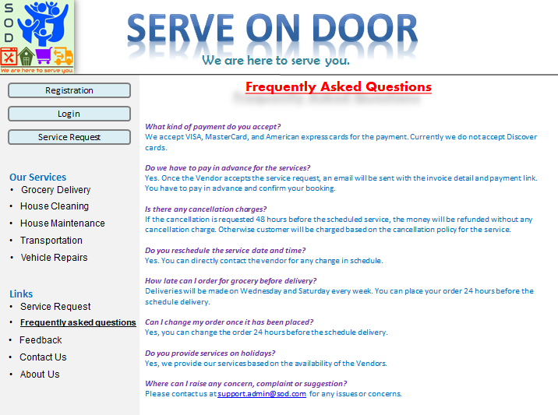
INTERFACE MOCKUPS
FAQ PAGE
Frequently Asked Question Page:
This page will list all the common questions with their answers.
The details in this page are subjected to increase as we get more feedback and user queries.

Slide 37
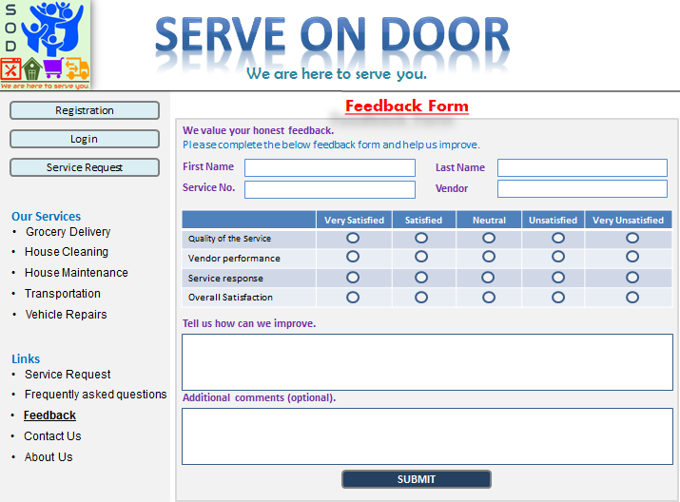
INTERFACE MOCKUPS
FEEDBACK FORM
Feedback form Page:
This page is accessible by all customers.
Customers can provide their feedback to any service request they requested for.
The feedback is directly sent to the vendor and service provide.

Slide 38
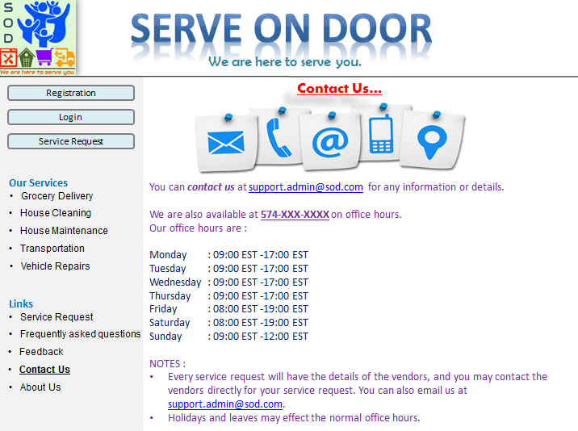
INTERFACE MOCKUPS
CONTACT US PAGE
Contact Us Page:
This page will have all the details about the support system. Which will include:
Support email details.
Office hours.
Direct contact number.

Slide 39
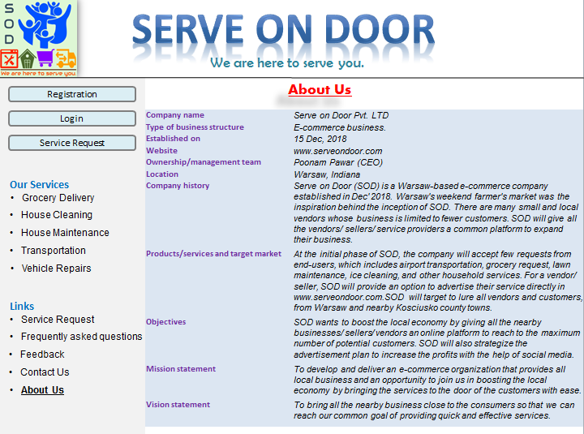
INTERFACE MOCKUPS
ABOUT US PAGE
About us Page:
This page will list basic details about the company, which includes:
Company profiles.
Ownership details.
Company history.
Mission statement
Vision statement.
Objective.
Target market

Slide 40
CONCLUSION
Serve on Door will provide an opportunity for all the local vendors and sellers from Kosciusko Country to advertise their business and lure more customers.
The system is robust and highly scalable.
The e-commerce website is available via the internet and anyone can access it at their leisure.
Special customers like our loved elderly population, physically challenged people, and busy personals can opt for a easy solution to make their life easy.
The implementation and maintenance cost of the system is very low.
Everything is on cloud which gives the company high scalability, accessibility, integrity and reliability.
All the information is encrypted and secure.
“Serve on door is a family owned company created to make your life easy by serving you when you want.”
Remember, WE ARE HERE TO SERVE YOU !

Slide 41
REFERENCES
https://thenextweb.com/creativity/2015/04/27/user-testing-explained/
https://www.licor.com/env/products/eddy_covariance/support.html
https://www.iconexperience.com/o_collection/icons/?icon=folder_document
https://www.softwaretestingmaterial.com/software-architecture/
https://www.tourismsoutheast.com/services-and-support/skills-and-training/training-options.html
https://www.stenhousemuirfc.com/2018/06/20/office-technical-issues/
https://www.numinix.com/shop-by-ecommerce-platforms-zen-cart-installs-upgrades-c-179_250_360/zen-cart-upgrade-sv-781
http://www.pack2go-europe.com/en/operational-standards/auf/
http://www.buyhome-turkey.com/technical-services/
https://play.google.com/store/apps/details?id=com.google.android.deskclock&hl=en_US
https://www.iconexperience.com/v_collection/icons/?icon=element_into_input
https://www.iconexperience.com/v_collection/icons/?icon=element_next
https://www.iconexperience.com/v_collection/icons/?icon=atom
https://www.iconexperience.com/v_collection/icons/?icon=control_panel
https://www.iconexperience.com/v_collection/icons/?icon=window_oscillograph
https://icons8.com/icons/set/history
https://www.flaticon.com/free-icon/problem_1066371
https://pngimage.net/vendor-icon-png-3/
https://pngtree.com/free-icon/vendor_822884
https://www.shareicon.net/tag/customers
http://www.iconarchive.com/show/free-large-boss-icons-by-aha-soft/Admin-icon.html
https://www.cleanstartbc.ca/icon-requirements/

Slide 42


