Slide 1





EMOTESTYLE
“EXPERIENCE SHOPPING THAT UNDERSTANDS YOU”

Slide 2




At EmoteStyle, we're transforming online shopping by combining virtual try-ons with personalized recommendations that reflect your mood, while highlighting sustainable products—all in one seamless experience.
VALUE PROPOSITION
EmoteStyle transforms online shopping by combining virtual try-ons with an assistant that understands and responds to your emotions. You can virtually try on clothing, accessories, furniture, and cosmetics while receiving personalized recommendations that match your mood. Plus, the platform highlights sustainable products, helping you make environmentally conscious choices.
DESCRIPTION

Slide 3

FEATURES
1
VIRTUAL TRY-ON EXPERIENCE
5
PERSONALIZED RECOMMENDATIONS
2
EMOTIONALLY INTELLIGENT ASSISTANT
6
TRANSPARENCY AND CONTROL
3
SUSTAINABILITY HIGHLIGHT
4
DATA PRIVACY AND ETHICAL AI

Slide 4

Finalize product concept and specifications.
Conduct comprehensive market research.
Assemble a skilled development team.
Establish key partnerships.
Develop Minimum Viable Product (MVP) prototype.
Validate core functionalities.
Gather initial user feedback.
PRODUCT ROADMAP
RESEARCH AND PLANNING
PROTOTYPE DEVELOPMENT
Test the product in a real-world environment.
Collect extensive user data and feedback.
Refine features based on insights.
Enhance features and fix issues identified during pilot testing.
Prepare for full-scale launch.
PILOT TESTING AND BETA LAUNCH
PRODUCT REFINEMENT

Slide 5

USE CASES
ENHANCED VIRTUAL SHOPPING EXPERIENCE
EMOTION-AWARE PERSONALIZATION
SUSTAINABLE PRODUCT DISCOVERY
REDUCED RETURN RATES
CUSTOMER SUPPORT ENHANCEMENT
DATA PRIVACY ASSURANCE

Slide 6
TRADE OFFS
Balancing advanced features with a user-friendly interface
Ensuring emotional data is used ethically, with explicit consent and robust privacy safeguards.
COMPLEXITY VS. USABILITY
PERSONALIZATION VS. PRIVACY
Advanced AI and AR technologies may require significant investment
Users may be hesitant to adopt emotion-recognition features.
COST OF IMPLEMENTATION
TECHNOLOGY ADOPTION

Slide 7
WHY IT STANDS OUT
Adds a unique layer of personalization that competitors may not offer.
Emotionally responsive interactions can significantly enhance user experience and satisfaction
DIFFERENTIATION
CUSTOMER ENGAGEMENT
The assistant can adjust recommendations in real-time, catering to the customer's current mood and preferences
Combines the convenience of online shopping with the personalized attention of in-store experiences
ADAPTIVE EXPERIENCE
VALUE ADDITION

Slide 8

MOBILE SHOPPING TRENDS
Mobile shopping continues to grow, driven by the increasing use of smartphones and mobile apps. Businesses need to optimize their online presence for mobile users to capitalize on this trend. Mobile-Optimized Websites, Mobile Apps , Mobile Payments And Location-Based Marketing

Slide 9
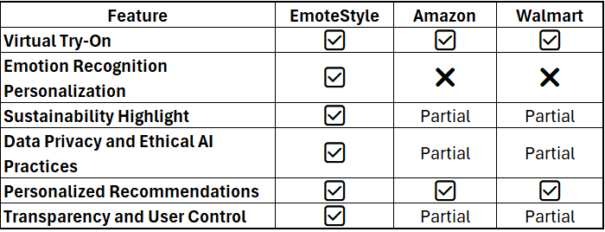
COMPETITIVE ANALYSIS

Slide 10


EMERGING
E-COMMERCE TRENDS
The e-commerce landscape is constantly evolving, with several trends poised to shape the future of online shopping. Staying ahead of these trends is crucial for businesses aiming to maintain competitiveness. Several trends are poised to shape the future of online shopping in the e-commerce landscape that is constantly evolving.

Slide 11


THANK YOU
FOR JOINING ME TODAY TO EXPLORE THE EXCITING TRENDS SHAPING THE FUTURE OF E-COMMERCE.

