Slide 1
Company Financial Analysis and Visualization
An End-to-End Data Analysis & Visualization Project
Prepared by: Prerna Pawar
UNID:UMIP24851

Slide 2
Project Overview
Objective: Analyze company financial data and derive insights using Python and Tableau.
Tools Used: Jupyter Notebook (Python), Tableau, Kaggle.
Workflow: Data acquisition → Cleaning → Analysis → Visualization.

Slide 3

Dataset Overview
Original Dataset: 'Company Finance.csv' downloaded from Kaggle. https://www.kaggle.com/datasets/atharvaarya25/financials
Structure: Financial metrics for multiple companies over time.
Key Attributes: Revenue, Profit, Operating Costs, Growth Rates, etc.

Slide 4
Data Cleaning & Preprocessing
Tool: Jupyter Notebook using Python libraries like pandas and numpy.
Steps performed:
- Removed null or missing values.
- Converted columns to appropriate data types.
- Filtered, renamed columns, and created new structured dataset.
Result: 'Cleaned_Company_Finance.csv'

Slide 5
Python-based Analysis
Explored trends and outliers using descriptive statistics.
Grouped data by company and year for comparative analysis.
Used correlation matrix and visual inspection to understand variable relationships.

Slide 6
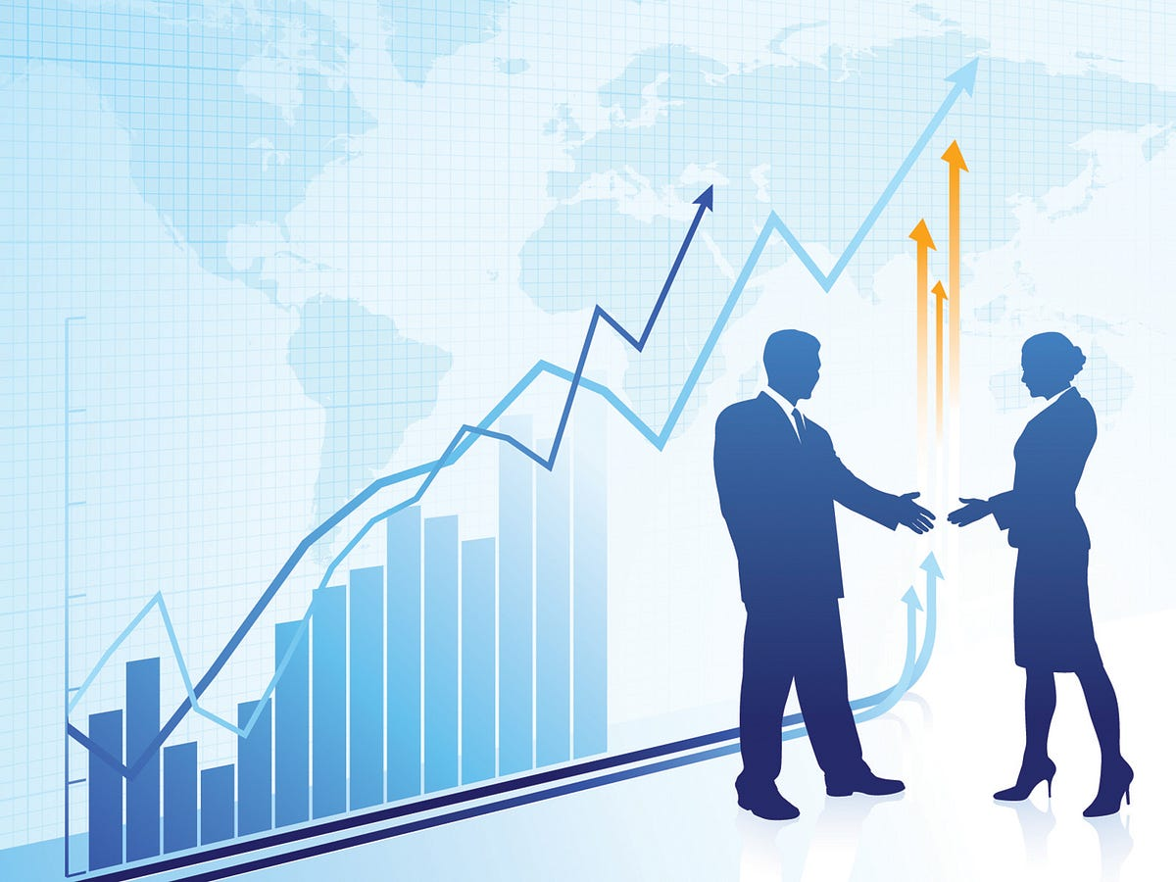
Exporting Structured Data
Final structured dataset saved as 'Cleaned_Company_Finance.csv'.
Used as input for visualization in Tableau.

Slide 7
Data Visualization in Tableau
Loaded cleaned data into Tableau for interactive visual analysis.
Created bar charts, line graphs, and KPIs to highlight financial performance.
Focused on revenue trends, profitability, and growth insights across companies.

Slide 8
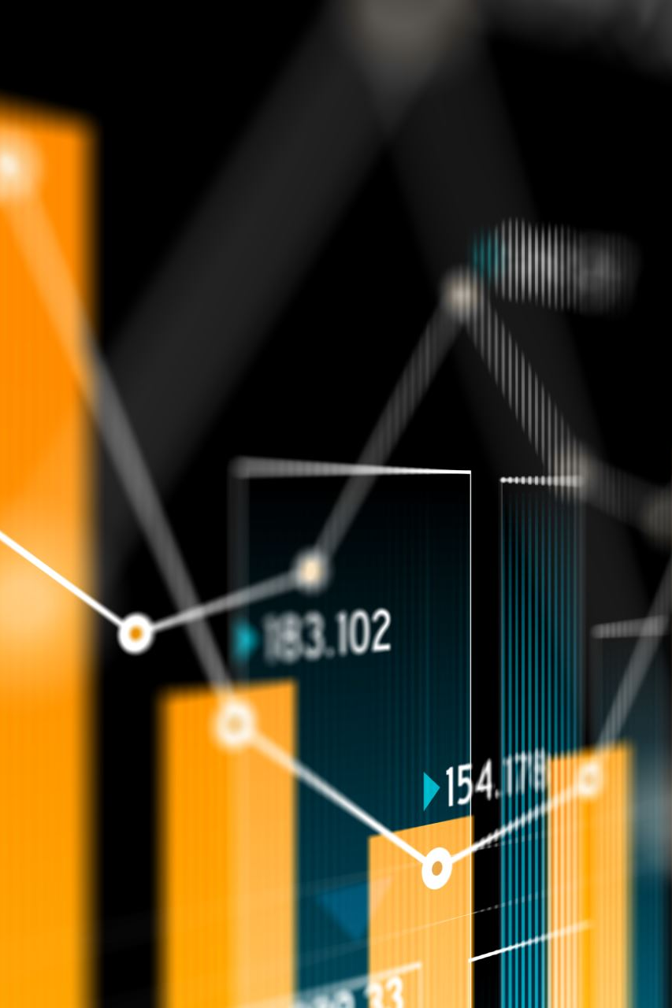
Dashboard Creation
Developed a dynamic dashboard named 'Tableau Financial Dashboard'.
Included filters for Year and Company.
Dashboard showcases key business metrics in a user-friendly layout.

Slide 9
Key Insights
Identified top-performing companies by revenue and profit.
Detected seasonal patterns and trends over years.
Exposed cost inefficiencies and growth opportunities.

Slide 10
Conclusion
Successfully integrated Python and Tableau for financial data analysis.
Streamlined messy dataset into a meaningful, visual story.
Project demonstrates strong data handling and visualization skills.

Slide 11
Future Enhancements
Automate data updates and dashboard refresh.
Integrate additional data sources like stock prices or market indicators.
Enhance Tableau interactivity with drill-downs and custom metrics.

