Slide 1

Stock Price Prediction Project Report
An in-depth overview of the end-to-end process
Prepared by: Prerna Pawar
UNID:UMIP24851

Slide 2
Introduction
Goal: Predict future stock prices using historical data.
Approach: Use machine learning models to learn patterns from stock data.
Significance: Helps in financial decision-making and investment planning.

Slide 3

Dataset Overview
Source: https://www.kaggle.com/datasets/mattiuzc/stock-exchange-data
Features: Date, Open, High, Low, Close, Volume.
Target: Predict 'Close' price based on historical features.

Slide 4
Data Preprocessing
Parsed 'Date' column to datetime format and sorted records.
Handled missing or null values (if any).
Normalized features to improve model performance.

Slide 5
Exploratory Data Analysis (EDA)
Visualized stock price trends over time.
Plotted correlations between features.
Identified trends, seasonality, and potential outliers.

Slide 6
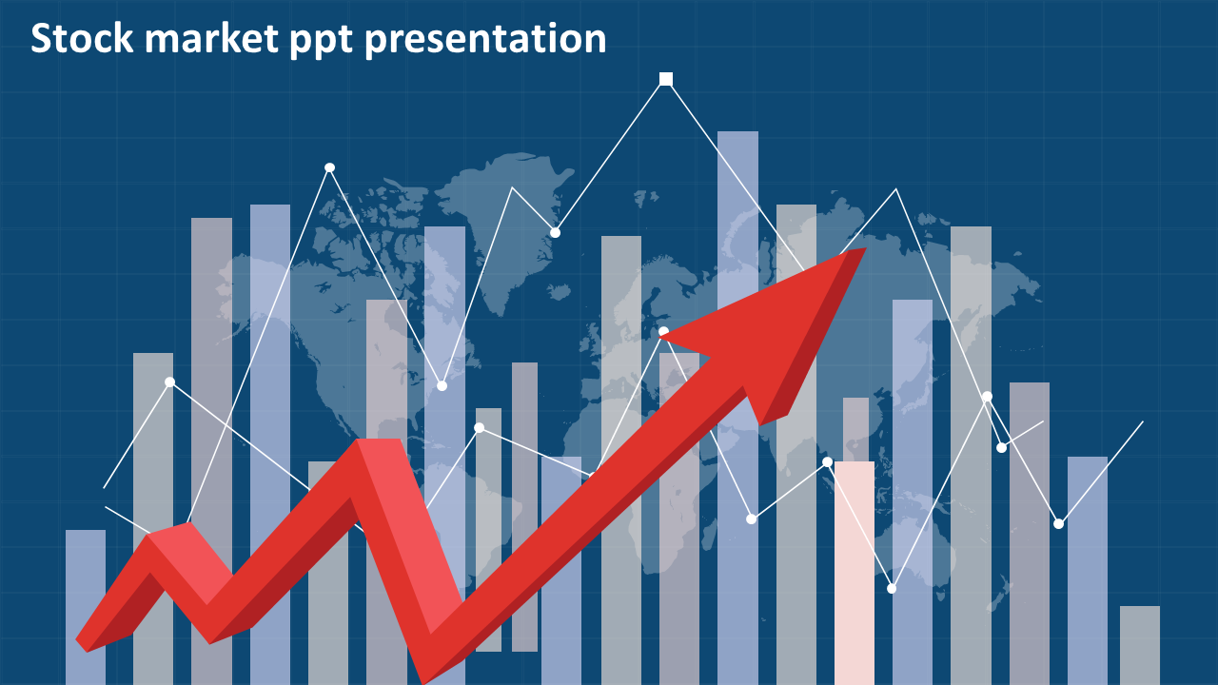
Feature Engineering
Created new features like moving averages.
Generated lag features to capture previous day prices.
Selected relevant features for model training.

Slide 7

Model Building
Split data into training and test sets (e.g., 80/20).
Implemented models: Linear Regression, Random Forest.
Trained models using training data and validated on test set.

Slide 8

Model Evaluation
Metrics: RMSE (Root Mean Square Error), MAE (Mean Absolute Error), R² Score.
Compared predicted vs actual prices on test data.
Random Forest outperformed simpler models with lower prediction error.

Slide 9

Visualization of Predictions
Line plots comparing predicted vs actual prices.
Scatter plots for residual analysis.
Helped evaluate how well the model generalized.

Slide 10

Conclusion
ML models can capture stock price trends with reasonable accuracy.
Project demonstrated end-to-end data science workflow.
Can be extended with more advanced models like LSTM, sentiment analysis.

Slide 11
Future Work
Incorporate news sentiment analysis for more context.
Use LSTM or GRU models for sequential data prediction.
Automate model retraining with new data.

