Slide 1
Autonomous-Object-Training-and-Detection-System-with-Convolutional-Neural-Networks Discussion 30.01.23
Supervisor : Prof. Dr. Andreas Pech
By student : Paween Pongsomboon
Frankfurt University of Applied Sciences

Slide 2
Concepts
Apply Transfer learning with pretrained CNN models to be able to classify new data
Conventional Method
Transfer learning
Retrain the whole model
Model
Old Data
New Data
New Data
Retrain some layers
** Require less computational resources

Slide 3
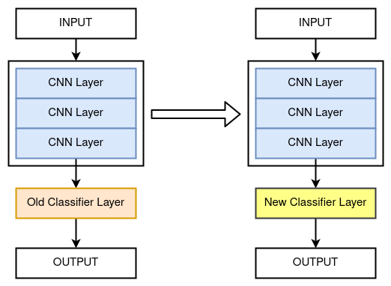
Transfer learning
Transfer learning requires removing the classifier layer, and freezing the
Pretrained model
Retrained and can classify new data

Slide 4







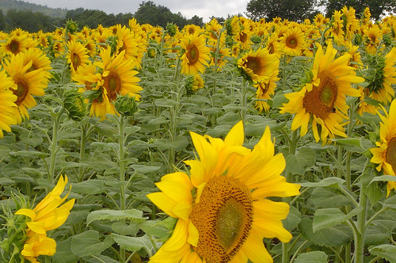



Implementation
Implemented with EfficientNet_B0
New Data
Modified model
Daisy
Otto
new Input Layer
EfficientNet_B0
(pretrained model)
Save model
Dandelion
Rose
Linear classifier Layer
train
Sunflower
Tulip

Slide 5
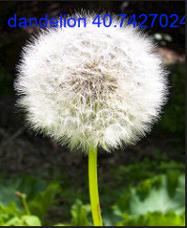

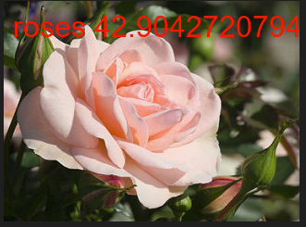
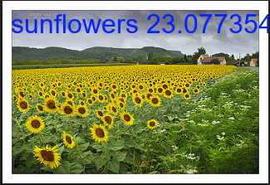
Implementation
Implementation with EfficientNet_B0
Classified outputs
Save model
New Data

Slide 6
Problems
The accuracy of classification is low
The saved model cannot classify the old data, it forgets what it holded before

