Slide 1

Classification of time signals by CNN using STFT
Subject : Computational Intelligence
By : Prof. Dr. Andreas Pech
Group : T3
Member
Paween Pongsomboon
Mahdieh Pirmoradian

Slide 2
Overview
Project Description
Experiment Design
Experiment Result
Conclusion

Slide 3
Project Description
The fundamental aim of this paper is to show how we can use CNNs to categorize a long-sampled time domain signal.
At first, we had an amplitude representation of the signal over time. Therefore, we used spectrogram, as it is a visual representation of all the frequencies over time.
Then we reviewed what adjustments needed to be made to our Conv Net’s design in order to achieve a better result in the accuracy of model classifying, as well as what aspects we should consider while testing our program. Furthermore, in the process of creating spectrograms, selecting the window type, size, and speed of movement was critical for obtaining an accurate picture of the sound.

Slide 4
Experiment Design
Extract 1D data from 3 Objects
Convert 1D data to 2D data
Performing Short-Time Fourier Transform (STFT) on 2D data
Downsampling the output
Preprocessing
Construct the Convolutional Neural Network (CNN) model
Train model with spectrogram images from Preprocessing
Evaluate the CNN model
Training and Testing
Classification
Classify the unlearned data with the trained CNN model

Slide 5
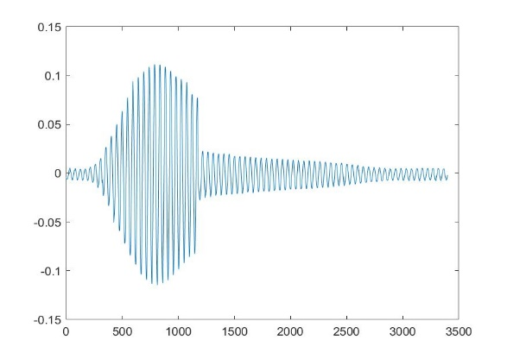
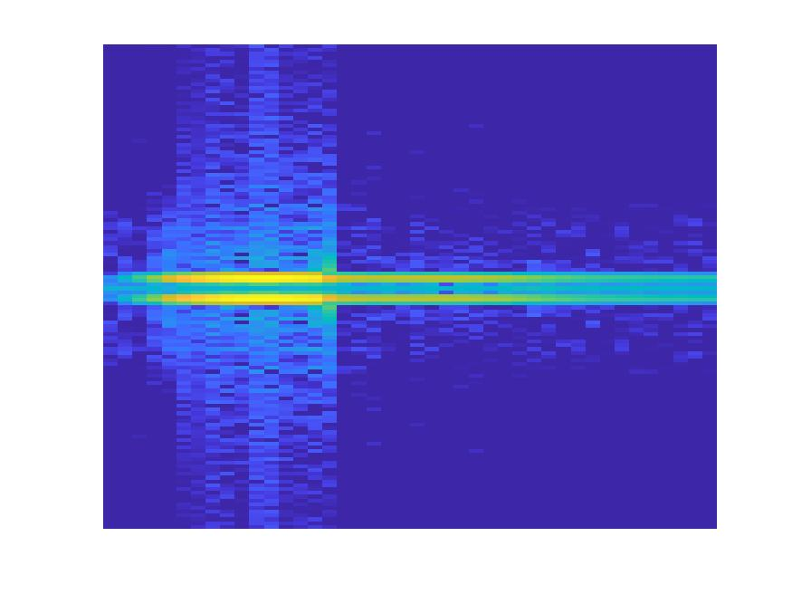

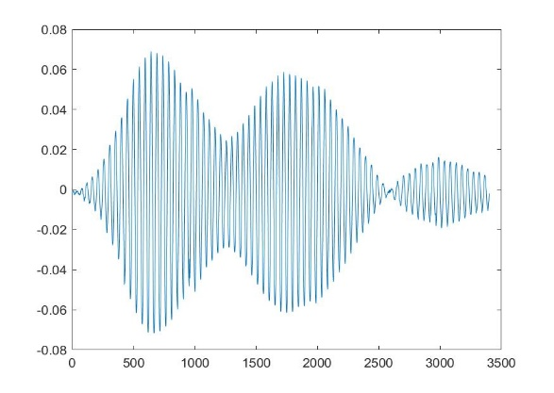
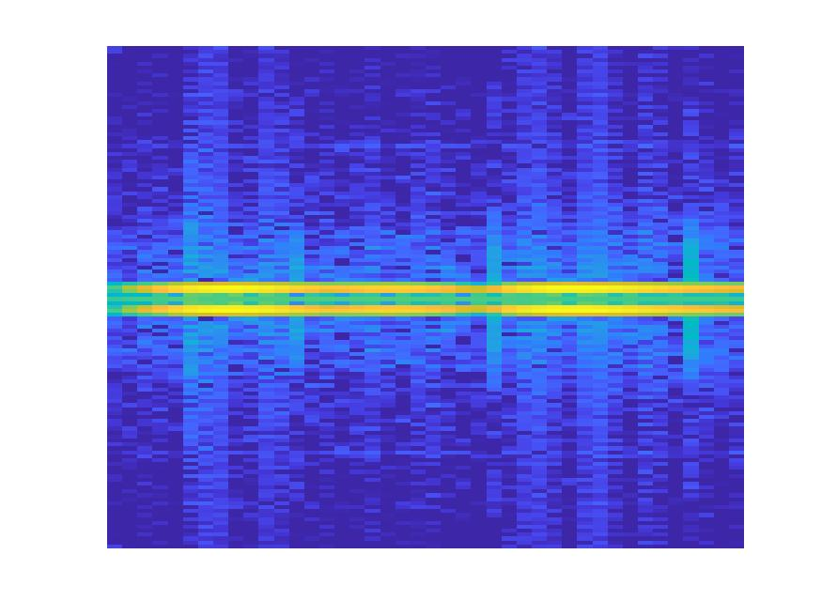
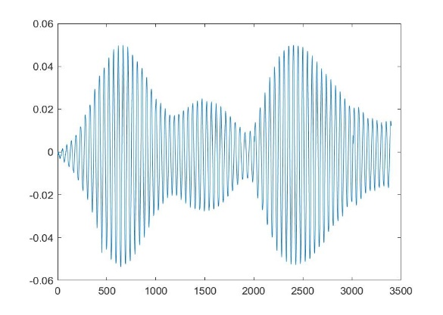
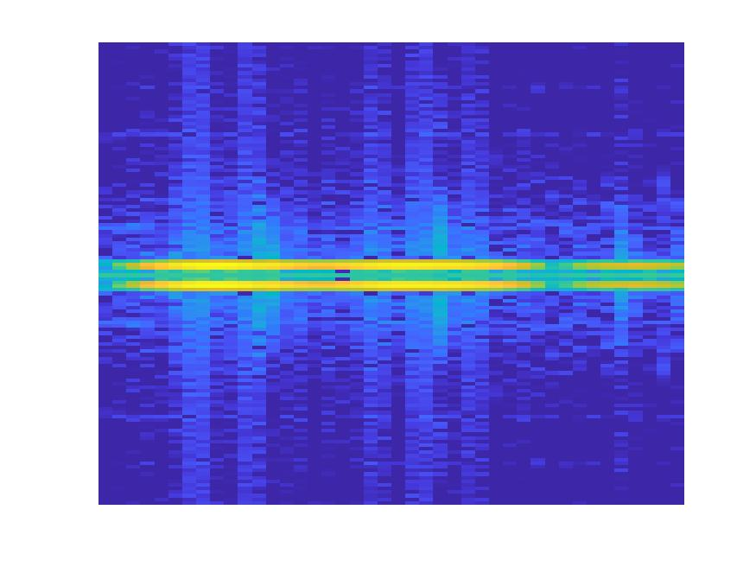
Preprocessing
Extract Data
1D Data
1D-to-2D Conversion
2D Data
Spectrogram
STFT
Downsampling
Add X-Axis to data and plot
Perform STFT
and get Spectrogram
Reduce dimensions to
20 % of original to preserve computation cost
Object 1 – 315 samples
Object 2 – 200 samples
Object 3 – 400 samples
※Each object has 3400 amplitude values
875 × 656 × 3
175 × 132 × 3
875 × 656 × 3
175 × 132 × 3
…
…
…
875 × 656 × 3
175 × 132 × 3

Slide 6
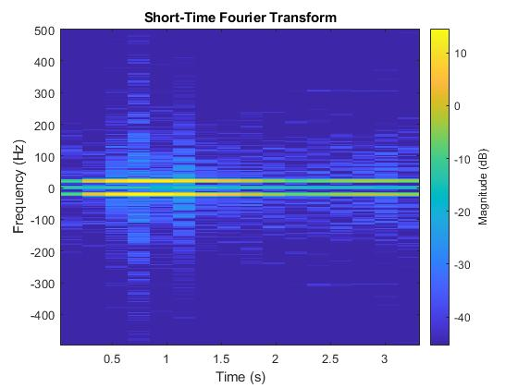

Preprocessing
STFT process
We perform STFT on input using the following algorithm.
$$X(f,t)=\int_{−∞}^{∞}{w\left(t−τ\right)x\left(τ\right)e^{−i2πfτ}}dτ$$
Where$X(f,t)$is the spectrogram, $t$ is the time variable, $w\left(t−τ\right)$ is the shifted hamming window, $x\left(τ\right)$ is the input signal, and $e^{jπfτ}$is the complex exponential.
Fig. 1 Conversion from 2D Time signal to spectrogram using STFT

Slide 7
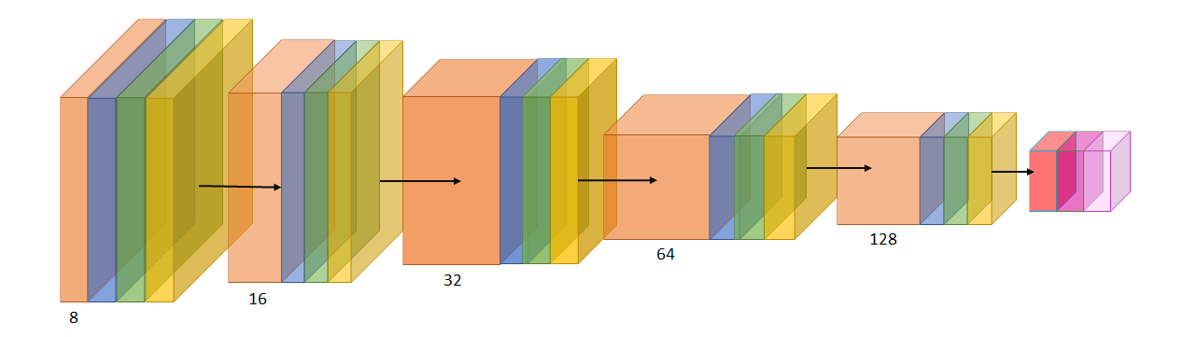
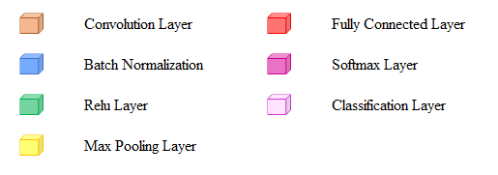
Training and Testing
build CNN model
Convolution 8 filters with 3×3×3 convolutions with stride 1 × 1 and padding 'same'
Batch Normalization Batch normalization with 8 channels
ReLU Rectified Linear Unit
Max Pooling 2×2 max pooling with stride 2 × 2 and padding with 0

Slide 8
Training and Testing
Training and Testing
In the model training and testing process, we train the CNN model with 80 % data and test it with another 20 % data.
Remarks : Numbers represent the amount of spectrogram images in each data set.

Slide 9
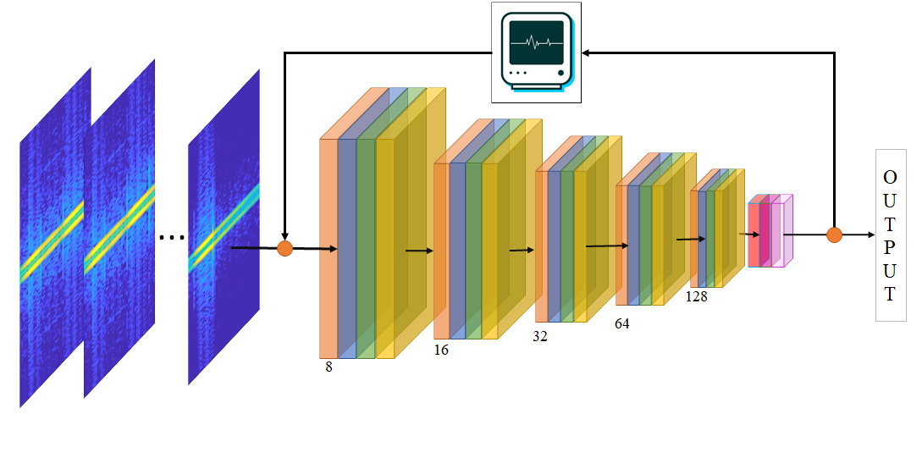
Training and Testing
Training and Testing
We labeled the input and then feed them to the CNN model. The process will then adjust weights accordingly. We trained the CNN model with 30 epochs.
Fig. 2 Training and Testing Process

Slide 10
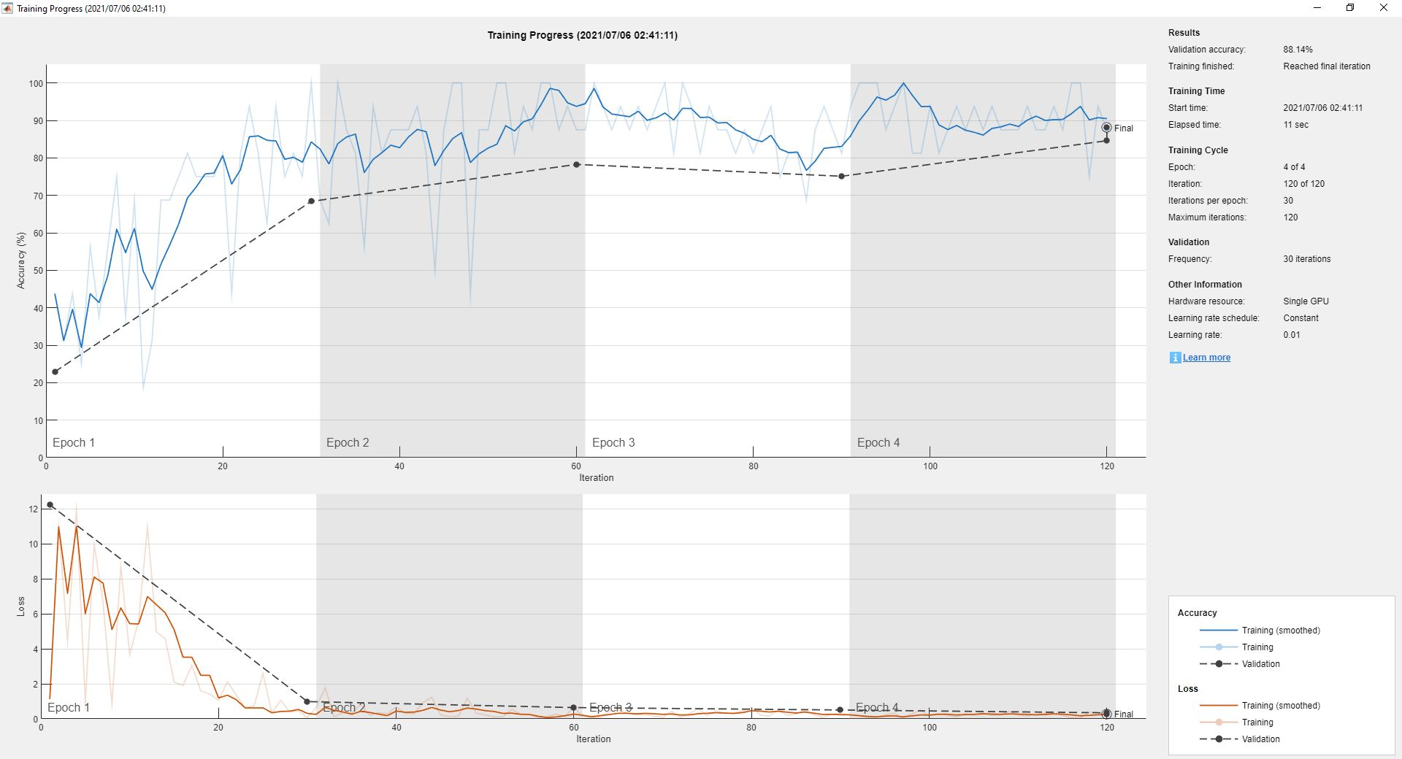
Training and Testing
Training and Testing
We used the Stochastic Gradient Descent with Momentum (SGDM) optimizer to adjusting weights in the CNN model by minimizing the loss function.

Slide 11
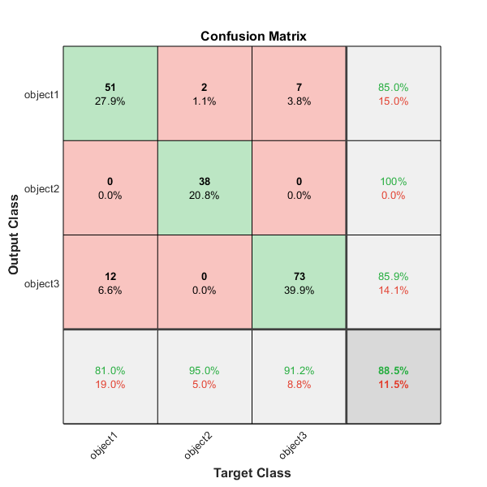
Training and Testing
Evaluation
There are four evaluation measurements we used in this experiment, which derived from confusion matrix.
Accuracy
Precision
Recall
F1-Score

Slide 12
Classification
We used the CNN model from Training and Testing to classify the unlearned data.
T1
T2
1D data
Spectrogram
Preprocessing
Classification
Classification Result
…
T12
Classify using trained model
1D to 2D conversion
+
STFT

Slide 13
Experiment Result
There are two parts in experiment results.
Evaluation of trained CNN model
Table 1: Measurement of trained CNN model
Measurement | Average Value
Accuracy | 0.879
Precision | 0.906
Recall | 0.890
F1-Score | 0.901
Remarks : we conducted the experiment 100 times and find the average value.

Slide 14
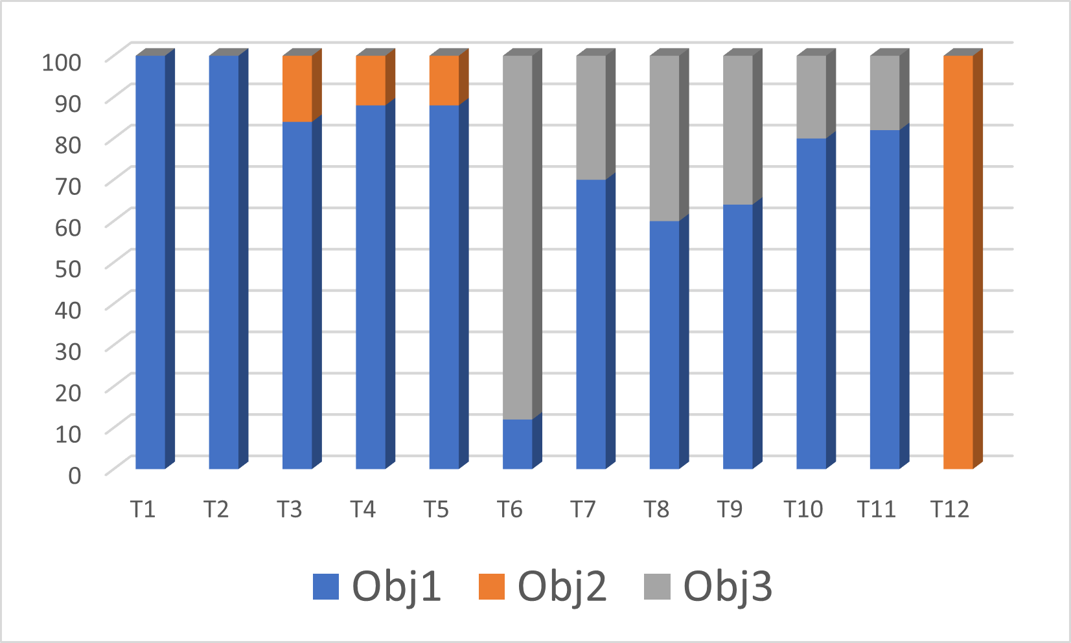
Experiment Result
Table 2: Classification result
Classification result
Object | Classified as Obj 1 | Classified as Obj 2 | Classified as Obj 3
T1 | 100 | 0 | 0
T2 | 100 | 0 | 0
T3 | 84 | 16 | 0
T4 | 88 | 12 | 0
T5 | 88 | 12 | 0
T6 | 12 | 0 | 88
T7 | 70 | 0 | 30
T8 | 60 | 0 | 40
T9 | 64 | 0 | 36
T10 | 80 | 0 | 20
T11 | 82 | 0 | 18
T12 | 0 | 100 | 0
Fig. 3: Classification result in bar graph

Slide 15
Conclusion
Using CNN for classifying sound signals works helpful However It is better that we train our model with enough steps to have a more accurate result.
In Our experiment after training our CNN model for 100 times we reached the F1 score of 90%, but still when we want to use it for classifying of the unlabeled sound signal for 25% of signals the percentage of accurate classifying is 60%.
We also assume that since the data from training dataset is selected randomly, seldom the process selects poor samples for training and resulting in low adjusting in weights and biases

