Slide 1

Classification of time signals by CNN using STFT
Subject : Computational Intelligence
By : Prof. Dr. Andreas Pech
Group : T3
Member
Paween Pongsomboon
Mahdieh Pirmoradian

Slide 2
Overview
Project Description
Experiment Design
Experiment Result
Conclusion
Encounter Problem

Slide 3


Project Description
The project goal is to classify 1D time signals with Convolutional Neural Network with the preprocessing method of Short-time Fourier Transform.
Obj 2
Time Signals
Process
Classification result
Obj 1
sensor
Obj 3
Fig. 1 Project description

Slide 4
Experiment Design
Extract 1D data from 3 Objects
Convert 1D data to 2D data
Performing Short-Time Fourier Transform (STFT) on 2D data
Downsampling the output
Preprocessing
Construct the Convolutional Neural Network (CNN) model
Train model with spectrogram images from Preprocessing
Evaluate the CNN model
Training and Testing
Classification
Classify the unlearned data with the trained CNN model

Slide 5
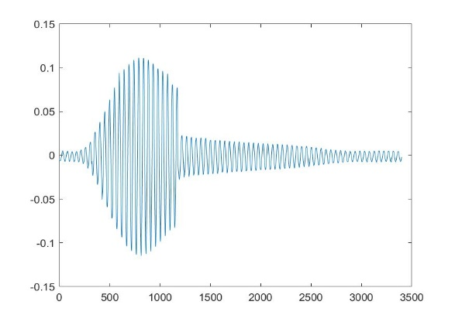
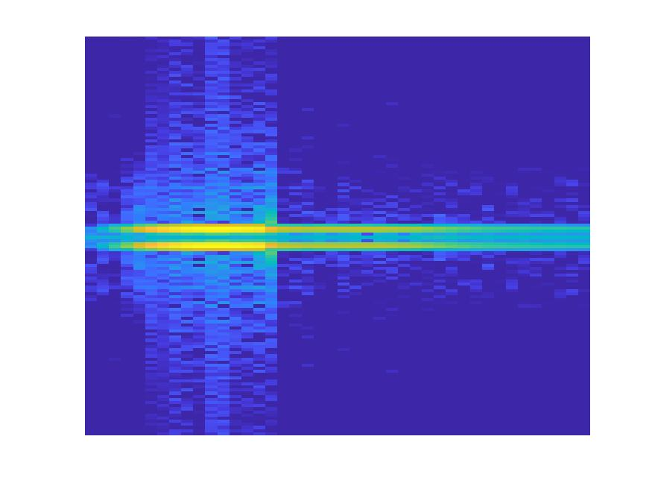

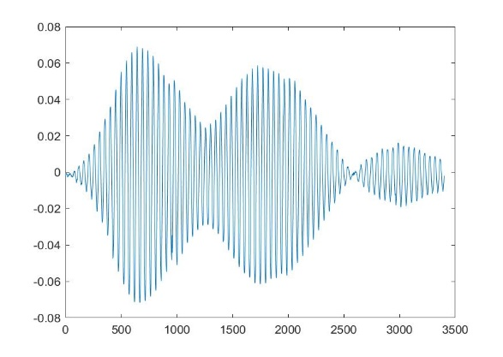
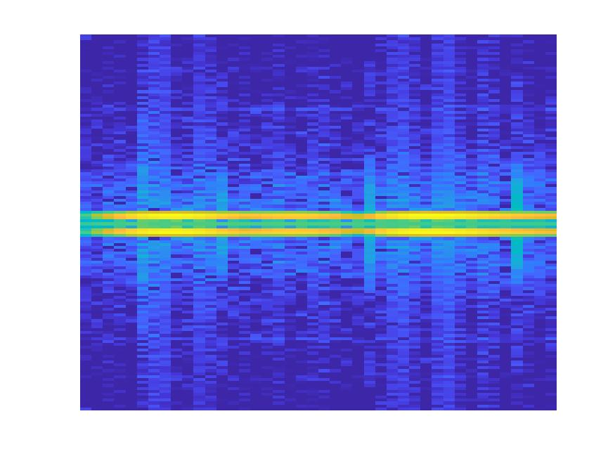
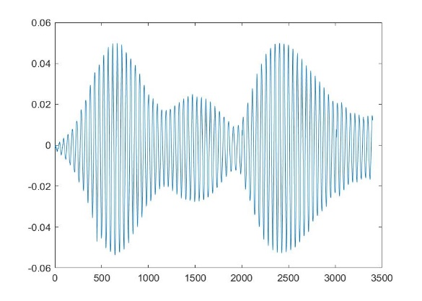
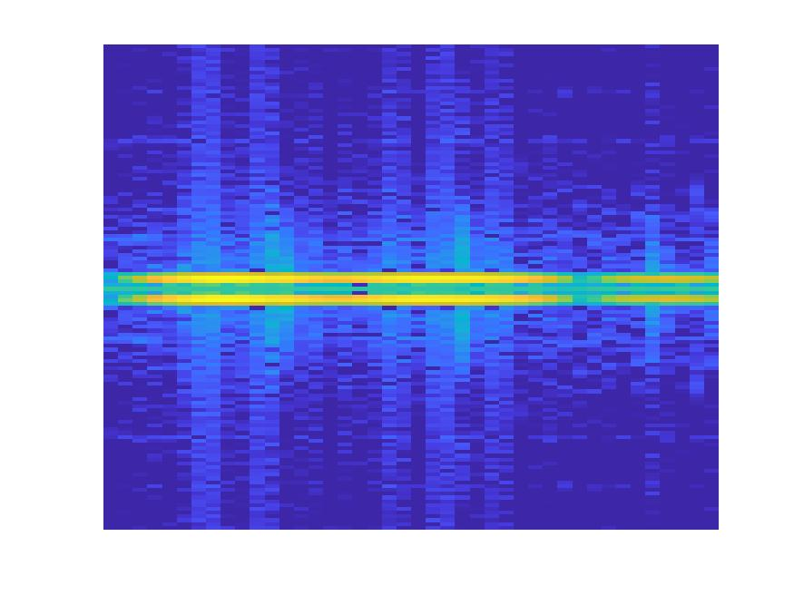
Preprocessing
Extract Data
1D Data
1D-to-2D Conversion
2D Data
Spectrogram
STFT
Downsampling
Add X-Axis to data and plot
Perform STFT
and get Spectrogram
Reduce dimensions to
20 % of original to preserve computation cost
Object 1 – 315 samples
Object 2 – 200 samples
Object 3 – 400 samples
※Each object has 3400 amplitude values
875 × 656 × 3
175 × 132 × 3
875 × 656 × 3
175 × 132 × 3
…
…
…
875 × 656 × 3
175 × 132 × 3

Slide 6
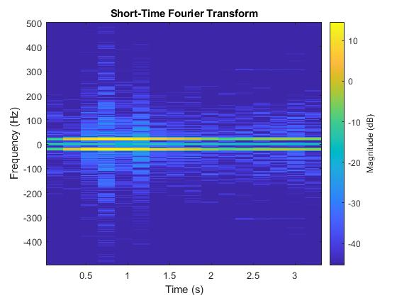

Preprocessing
STFT process
We perform STFT on input using the following algorithm.
$$X(f,t)=\int_{−∞}^{∞}{w\left(t−τ\right)x\left(τ\right)e^{−i2πfτ}}dτ$$
Where$X(f,t)$is the spectrogram, $t$ is the time variable, $w\left(t−τ\right)$ is the shifted hamming window, $x\left(τ\right)$ is the input signal, and $e^{jπfτ}$is the complex exponential.
Fig. 2 Conversion from 2D Time signal to spectrogram using STFT

Slide 7
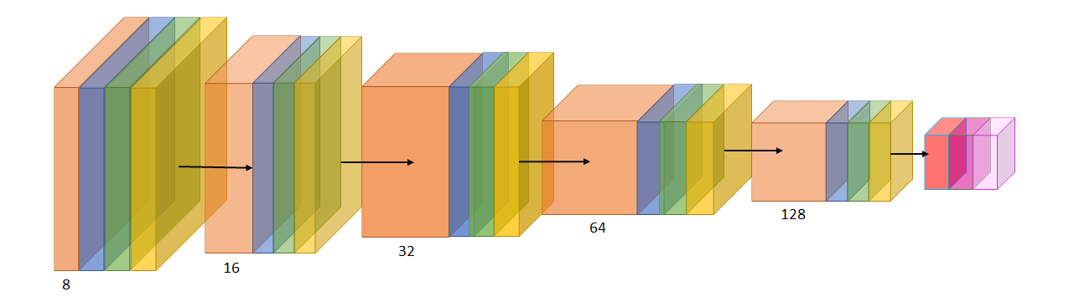
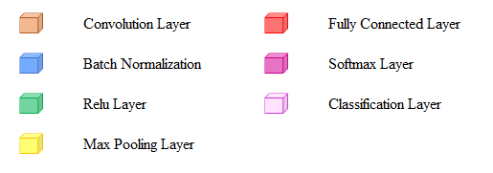
Training and Testing
build CNN model
Convolution 8 filters with 3×3×3 convolutions with stride 1 × 1 and padding 'same'
Batch Normalization Batch normalization with 8 channels
ReLU Rectified Linear Unit
Max Pooling 2×2 max pooling with stride 2 × 2 and padding with 0

Slide 8
Training and Testing
Training and Testing
In the model training and testing process, we train the CNN model with 80 % data and test it with another 20 % data.
Remarks : Numbers represent the amount of spectrogram images in each data set.

Slide 9
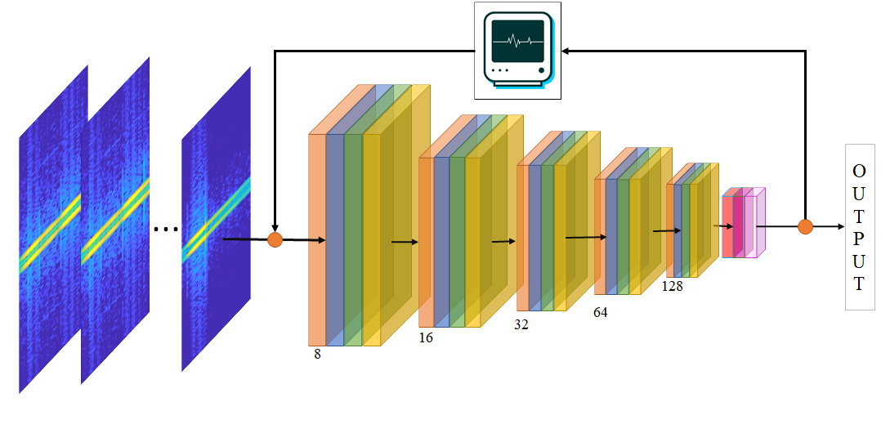
Training and Testing
Training and Testing
We labeled the input and then feed them to the CNN model. The process will then adjust weights accordingly. We trained the CNN model with 30 epochs.
Fig. 3 Training and Testing Process

Slide 10
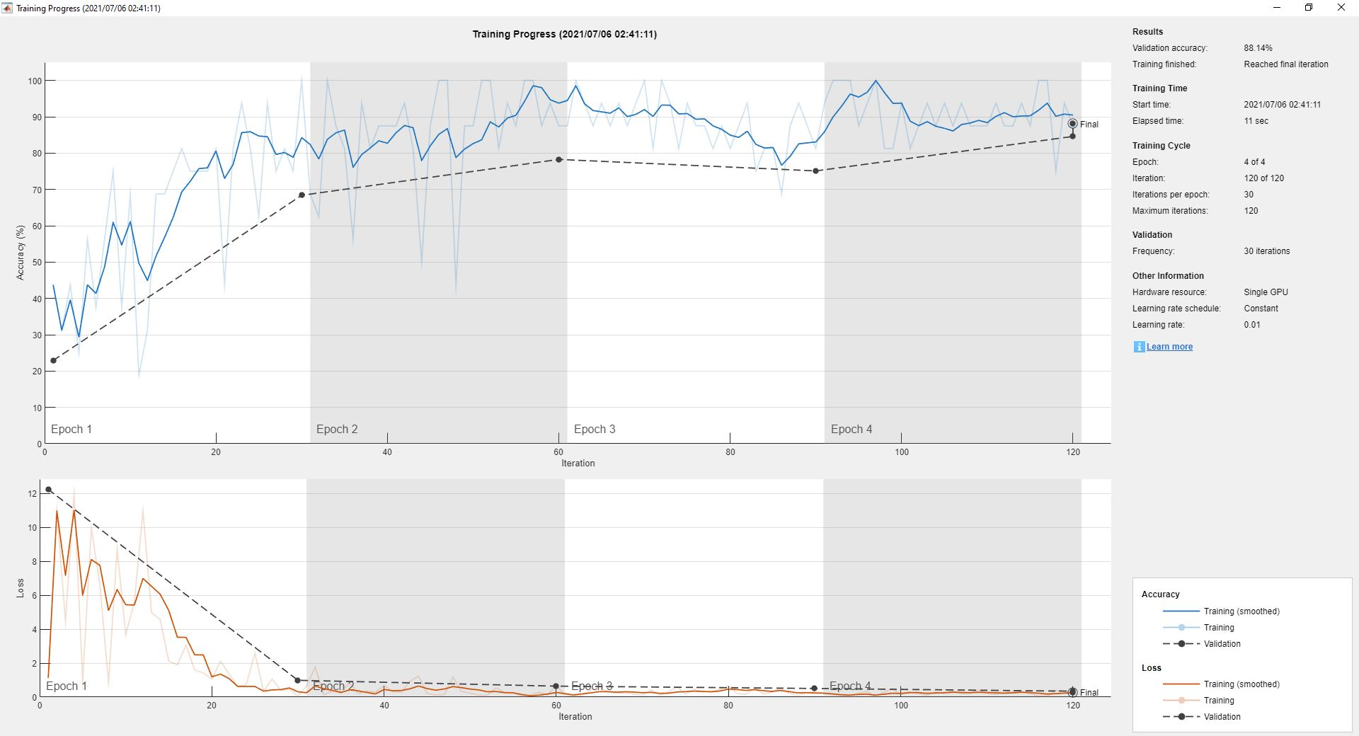
Training and Testing
Training and Testing
We used the Stochastic Gradient Descent with Momentum (SGDM) optimizer to adjusting weights in the CNN model by minimizing the loss function.

Slide 11
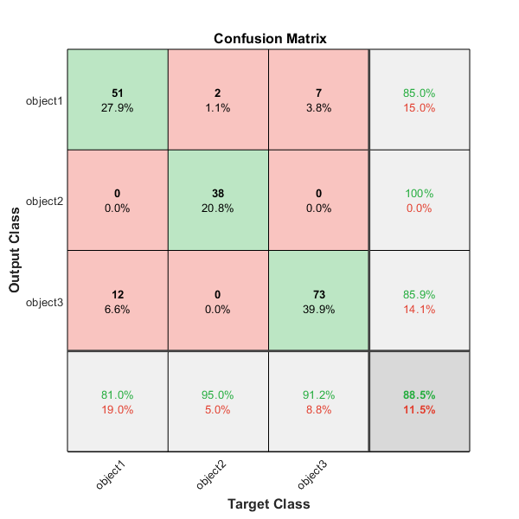
Training and Testing
Evaluation
There are four evaluation measurements we used in this experiment, which derived from confusion matrix.
Accuracy
Precision
Recall
F1-Score

Slide 12
Classification
We used the CNN model from Training and Testing to classify the unlearned data.
T1
T2
1D data
Spectrogram
Preprocessing
Classification
Classification Result
…
T12
Classify using trained model
1D to 2D conversion
+
STFT

Slide 13
Experiment Result
There are two parts in experiment results.
Evaluation of trained CNN model
Table 1: Measurement of trained CNN model
Measurement | Average Value
Accuracy | 0.879
Precision | 0.906
Recall | 0.890
F1-Score | 0.901
Remarks : we conducted the experiment 100 times and find the average value.

Slide 14
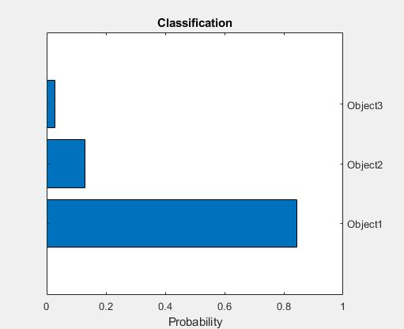
Experiment Result
Classification result
We used trained CNN model from training and testing process to classify the untrained objects
T object Signal
Convert to Spectrogram
Classification Process
Classification Result

Slide 15
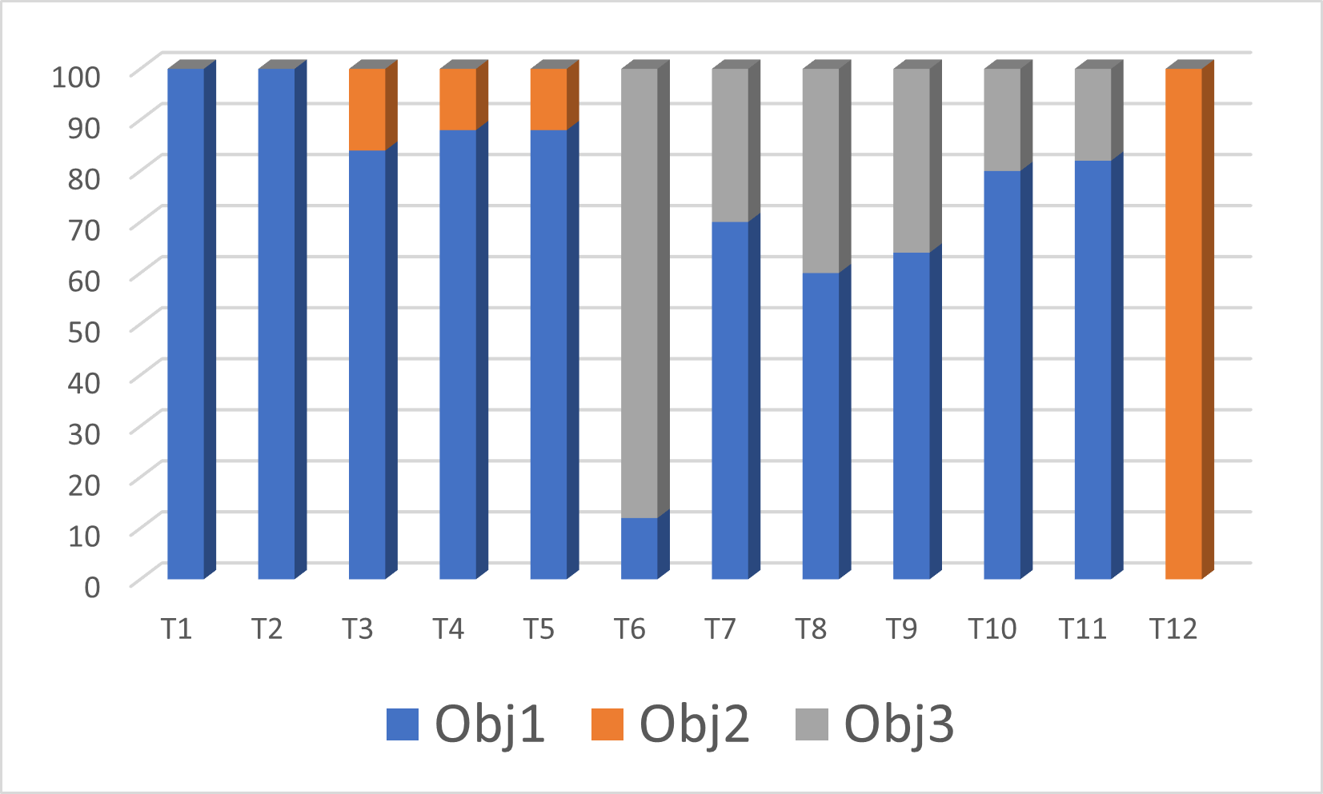
Experiment Result
Table 2: Classification result
Classification result
Object | Classified as Obj 1 | Classified as Obj 2 | Classified as Obj 3
T1 | 100 | 0 | 0
T2 | 100 | 0 | 0
T3 | 84 | 16 | 0
T4 | 88 | 12 | 0
T5 | 88 | 12 | 0
T6 | 12 | 0 | 88
T7 | 70 | 0 | 30
T8 | 60 | 0 | 40
T9 | 64 | 0 | 36
T10 | 80 | 0 | 20
T11 | 82 | 0 | 18
T12 | 0 | 100 | 0
Fig. 3: Classification result in bar graph

Slide 16
Conclusion
Time signals can be classified by CNN model with STFT.
Trained CNN model yields good evaluation results.
The process can classify time signals from untrained objects.

Slide 17
Encountered problem
Since the selection of data for training and testing process is random, and we conducted the experiment for 100 times. We found low evaluation score of CNN model in 1 out of 100 experiment result sets. We guess that some training data are too poor to train. So, it yields a very bad weighting in CNN model training, which then results as a low evaluation.
Experiment Round | Accuracy | Precision | Recall | F1-Score
29 | 0.852 | 0.874 | 0.867 | 0.846
30 | 0.437 | Undefined | 0.333 | Undefined
31 | 0.902 | 0.917 | 0.908 | 0.913

Slide 18
Q & A

