Slide 1
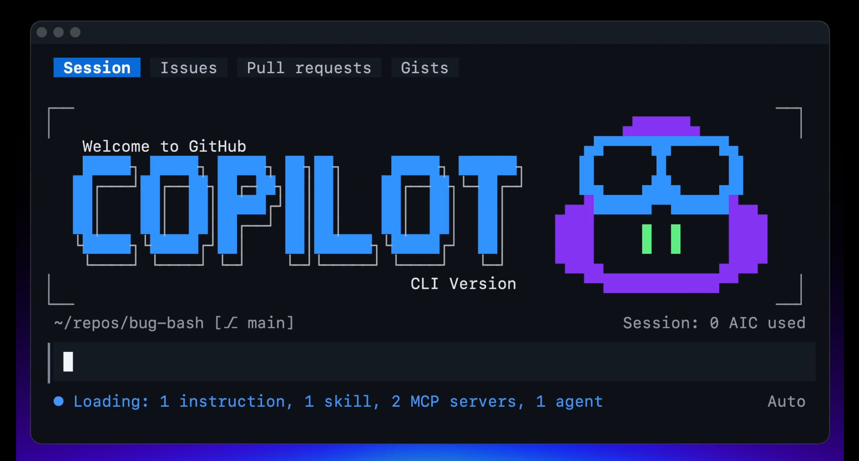
Dev Days – GitHub Copilot CLI
Notes:
OK let's talk about the terminal and GitHub copilot CLI which is your AI terminal companion that gives you all of the powers of GitHub copilot directly in your terminal and so much more

Slide 2




















Riding the waves
Today
Wave 1
Wave 2
Wave 3
Pair programmer
Beyond pair programmers
Teams + agents
Code completion
(2021-2023)
Agentic SDLC
(2024-2025)
Hybrid teams
(2026+)
Notes:
Riding the waves – where we are today
Four years ago, GenAI began to fundamentally change software development. That shift has come in three waves – and today we're living in the transition where agents eventually become full-fledged team-members.
Wave 1 – it rode along and helped you write code faster, but the developer did all the driving.
Wave 2 – Agents moved from assisting to participating as peers – planning, building, and reviewing across the lifecycle. Some teams are still dipping their toes in; many businesses are already rolling out at scale.
Wave 3 – Teams and agents work in tandem, with the developer at the center directing the work. That's where the world is rapidly heading.
So today we're squarely in the shift from Wave 2 to Wave 3 – the pair programmer becoming a true peer and teammate, with developers at the center.

Slide 3

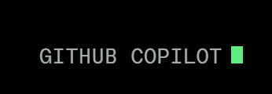
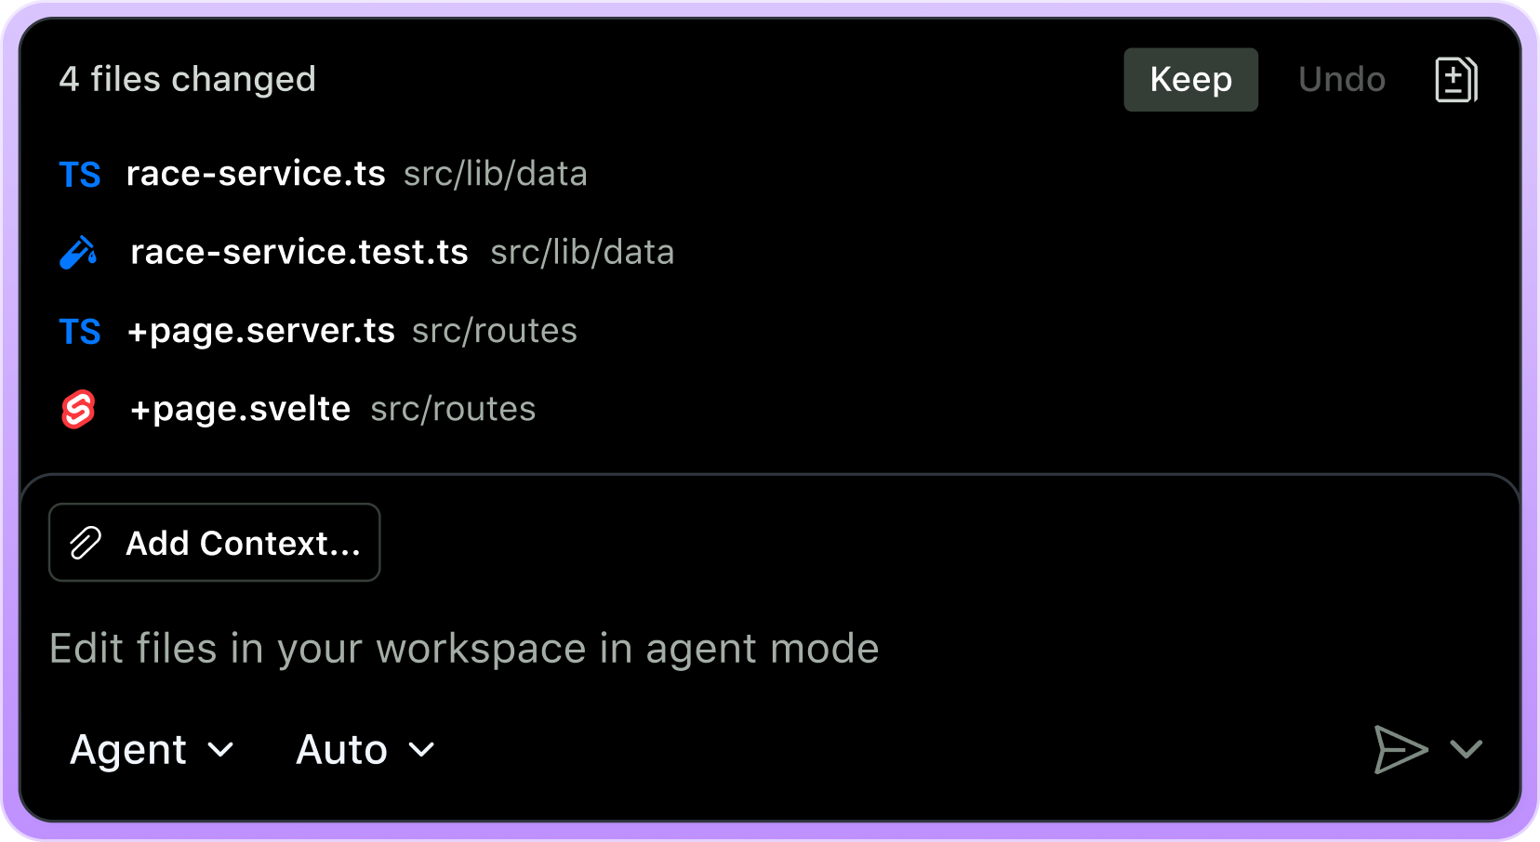
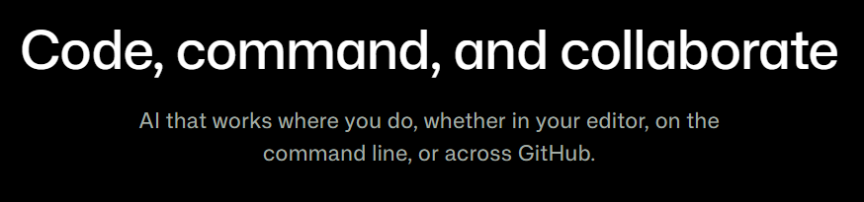
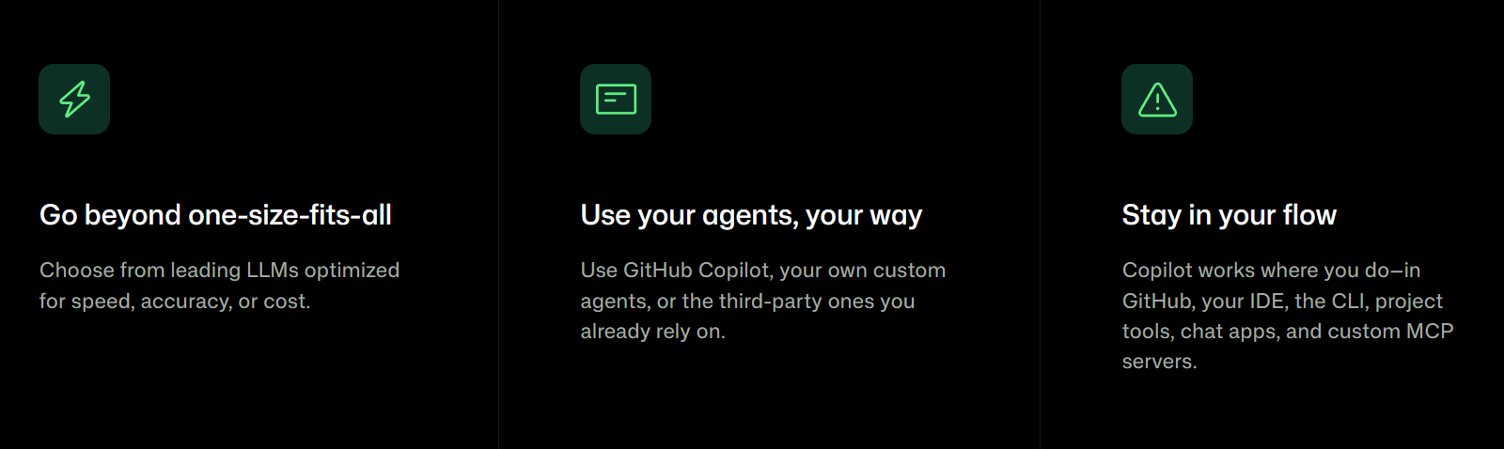
Notes:
This is where GitHub Copilot has been expanding: not just one tool in one place, but AI that works where developers already are.
The core idea is: code, command, and collaborate.
Copilot is designed to support different needs — whether you care most about speed, accuracy, cost, or flexibility.
It also supports different ways of working: GitHub Copilot agents, custom agents, third-party agents, and integrations across the tools developers already use.
So instead of thinking about Copilot as “just autocomplete,” we should think about it as a broader AI platform across the developer workflow.

Slide 4
One GitHub Copilot, everywhere you code
Notes:
GitHub Copilot and is available everywhere that you code and for any programming language that you're coding in

Slide 5
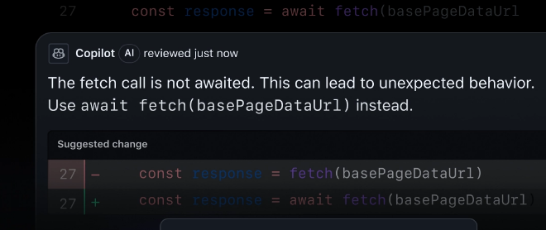
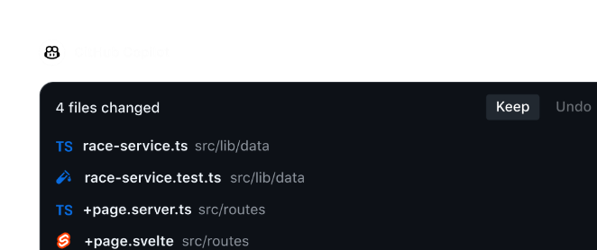

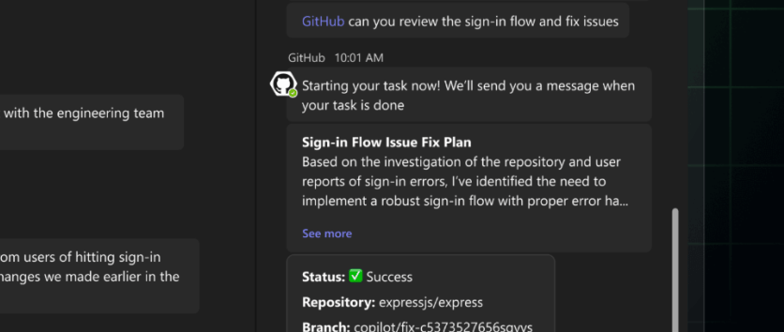
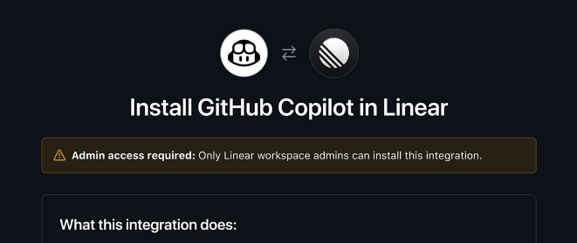
GitHub Copilot is available across IDEs, web, and mobile
GitHub.com & GitHub mobile apps
VS Code
JetBrains IDEs, Eclipse,
Vim, Visual Studio, Xcode
Slack & Teams
Azure DevOps Boards, Linear, Jira
Terminal (Copilot CLI)
Notes:
Copilot is where you work.
If you're storing your code on GitHub dot com as deeply integrated there but it's also available anywhere else you don't have to be using GitHub at all to use GitHub copilot.
It’s deeply integrated into VS code which is the premiere code editor for GitHub copilot but it’s available in many other ides as well including Visual Studio Jetbrains, Eclipse Xcode and so many more
Integrate it into the mobile app, there’s a GitHub copilot CLI (our focus today), and you can even delegate tasks directly from slack and teams or popular board of management software like Azure DevOps or Linear

Slide 6
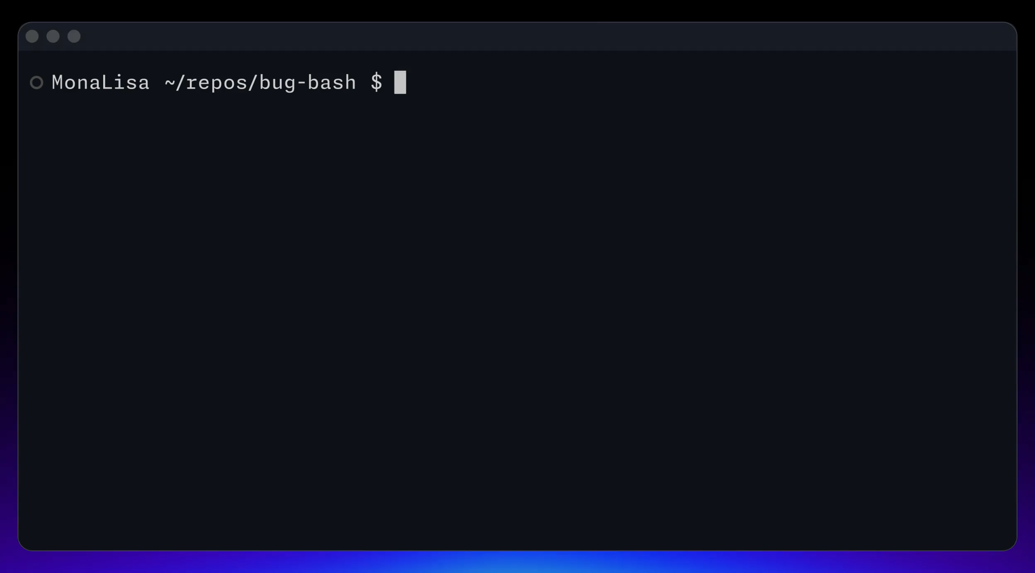
Less // TODO: more done
GitHub Copilot CLI
Notes:
This all brings us to today's topic: the GitHub Copilot CLI, the command-line interface (CLI) for GitHub Copilot that allows you to use Copilot directly from your terminal.
Note: GitHub Copilot CLI is available with all Copilot plans. If you receive Copilot from an organization, the Copilot CLI policy must be enabled in the organization's settings.

Slide 7
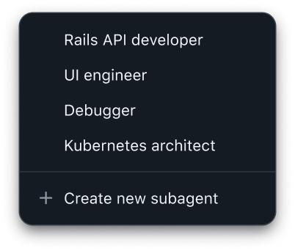
Core Features
What’s in the box
Interactive
Assistance
Headless
Automation
Code Generation
& Modification
Tool Execution
& Shell Commands
Multi-file
context awareness
BYOK/ Custom Providers
Skills, Tools, Hooks, MCP
Modes for
multiple situations
Plan/Autopilot/et
Streaming
Remote Sessions
Permissions
OpenTelemetry
Notes:
As you may expect the GitHub copilot CLI is packed full of features obviously including interactive but also headless automation and assistance code generation modification tools execution and script and shell commands it can understand your entire code base and it’s multi file contacts where there’s lifecycle hooks multiple modes for any different situation and of course skill and MCP server integration as well

Slide 8
Slash commands
/agent
/model
/cwd or /cd
Switch to a custom agent
View all available models and choose which to use
Change working directory mid-session
/plan
/mcp
/fork
Plan out an implementation before writing any code
Manage your MCP servers
Fork the current session into a new session
/every & /after
/yolo
/context
Schedule a prompt or skill within the current CLI session
Enable all permissions
Info on token usage & context window
/diff
/review
/rubber-duck
Review changes made in directory
Run a code review to analyze changes
Get a second opinion from a different agent
/skills
/sandbox
/remote
Manage & call skills
Configure sandbox settings
Start in the terminal, then monitor, steer, and merge from GitHub.com or your phone
/delegate
/fleet
Push the task to Copilot cloud agent on GitHub
Coordinate subagents
Notes:
One thing that you'll use all the time inside of the CLI are slash commands these are things such as switching the agent or model that you want to use going into and out of plan mode or review agent and loading up skills or doing a diff for example. This is just a subset of them there are so many being added all the time to handle different scenarios when working in the CLI.
Let's dive deeper into some things you will use every day.

Slide 9
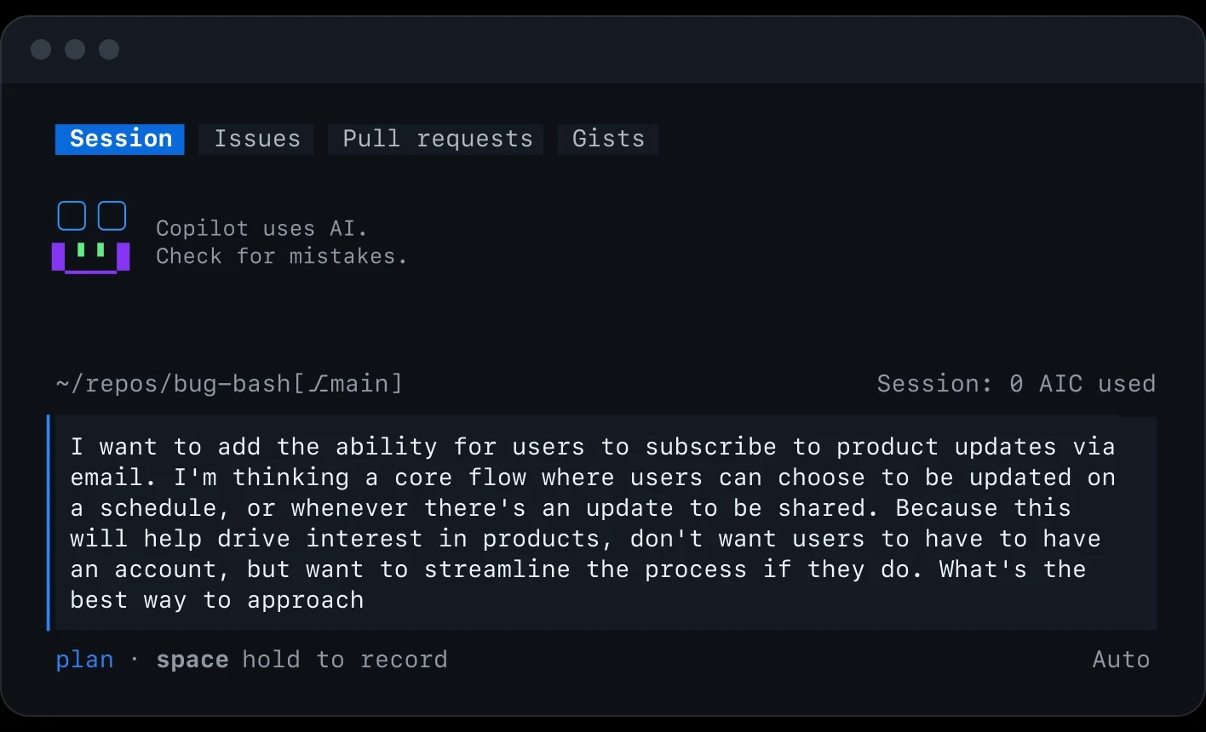
outline the work, use /model to compare approaches, and then use autopilot mode to implement without step-by-step approval.
/plan with a team of agents
Notes:
When you first get into GitHub Copilot you’ll be in an interactive mode which allows you to work alongside the Agent to iterate on your work when you need to make changes or call a tool for example to grab information from the web or from GitHub it will ask you for your approvals and then it will continue on the work and make edits But there are other modes that are built in such as Plan and Autopilot mode enables you to work directly with a team of agents to clarify questions about the work before getting to implementation.
You can use Shift+Tab to rotate between these modes or use /plan to change and work on an outline for the work.
* Use /plan to create an implementation strategy before writing code.
Let Copilot analyze requirements, dependencies, and potential approaches.
Use /model to compare approaches and model capabilities.
Switch into autopilot when you're ready for Copilot to execute work with less manual interaction.
The developer defines the goal while Copilot helps plan and execute the implementation.
And when ready you can return to Interactive mode with Shift+Tab or go into autopilot mode when you want Copilot to carry the task forward without step-by-step approval.

Slide 10
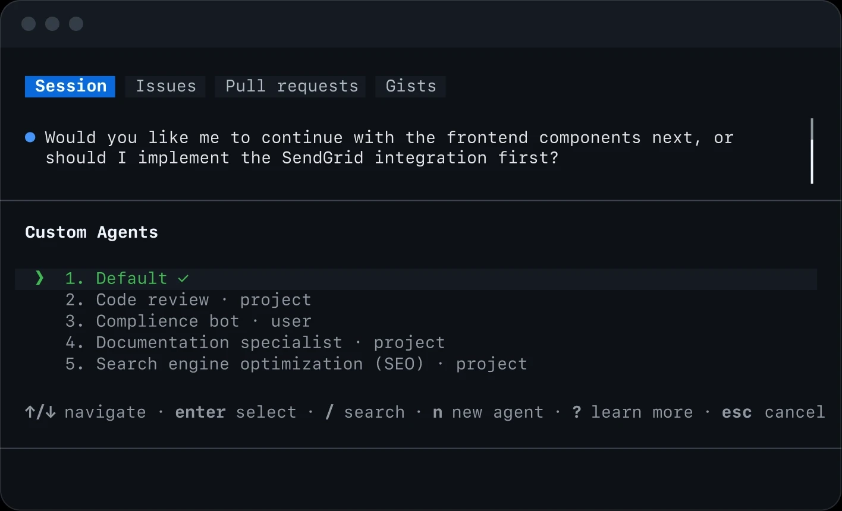
define custom instructions and tool access, so behavior stays consistent across models, sessions, and delegated work.
Shape behavior with /agent and /skills
Notes:
Now that we know about modes, let’s talk about shaping the behavior of how the agent works.
The industry standards of AGENTS.md and custom instructions allow you to define best practices and coding conventions that the agent will use with every request.
Use Agent Skills to define custom instructions and tool access that get called on demand to do specific work, like frontend design or accessibility, this way behavior stays consistent across models, sessions, and delegated work.
In addition, you can create and specialized agents for exploration, code reviews, task execution, or complex reasoning.
This means you can create custom agents tailored to your team's workflows, standards, and processes.

Slide 11
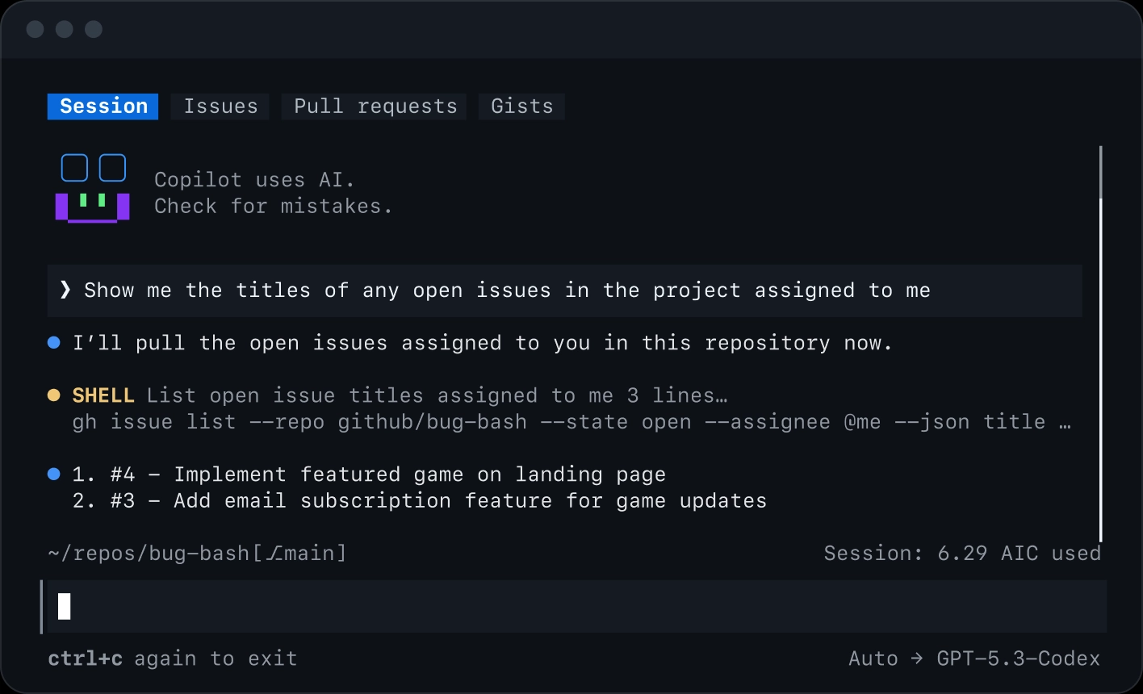
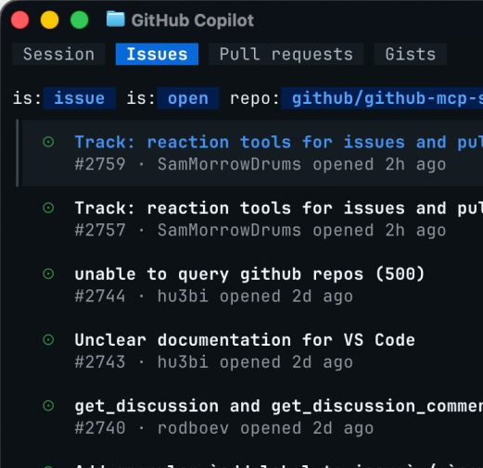
move from backlog to implementation without context hunting.
Work with your issues, PRs, and more
Notes:
Built on GitHub’s native integration, Copilot can search issues, analyze labels and activity, and summarize scope so you can move from backlog to implementation without context hunting.
Access GitHub issues and project context directly from the terminal.
Move from backlog to implementation without switching between GitHub, the browser, and your IDE.
Stay in flow by bringing issue context directly into the coding experience.
This is powered by the GitHub MCP (Model Context Protocol) server built in, but you can always extend Copilot with your own MCP servers such as Azure, Supabase, Microsoft Learn, and more to add more tools to your toolbox.
For an easier way to view your sessions, gists, issues, and PRs, simply use the tabs at the top of your screen. Press Tab to move between the tabs. Highlight an issue or pull request and press c to drop a reference to it into your prompt, then ask Copilot to investigate, fix, comment on, or review it. Press o to open the highlighted item on GitHub in your browser, or press / on the Issues or Pull requests tab to search GitHub with your own query.
You can also click a tab with your mouse to switch to it. From your settings, you can reorder, hide, or turn off the tab bar entirely.

Slide 12
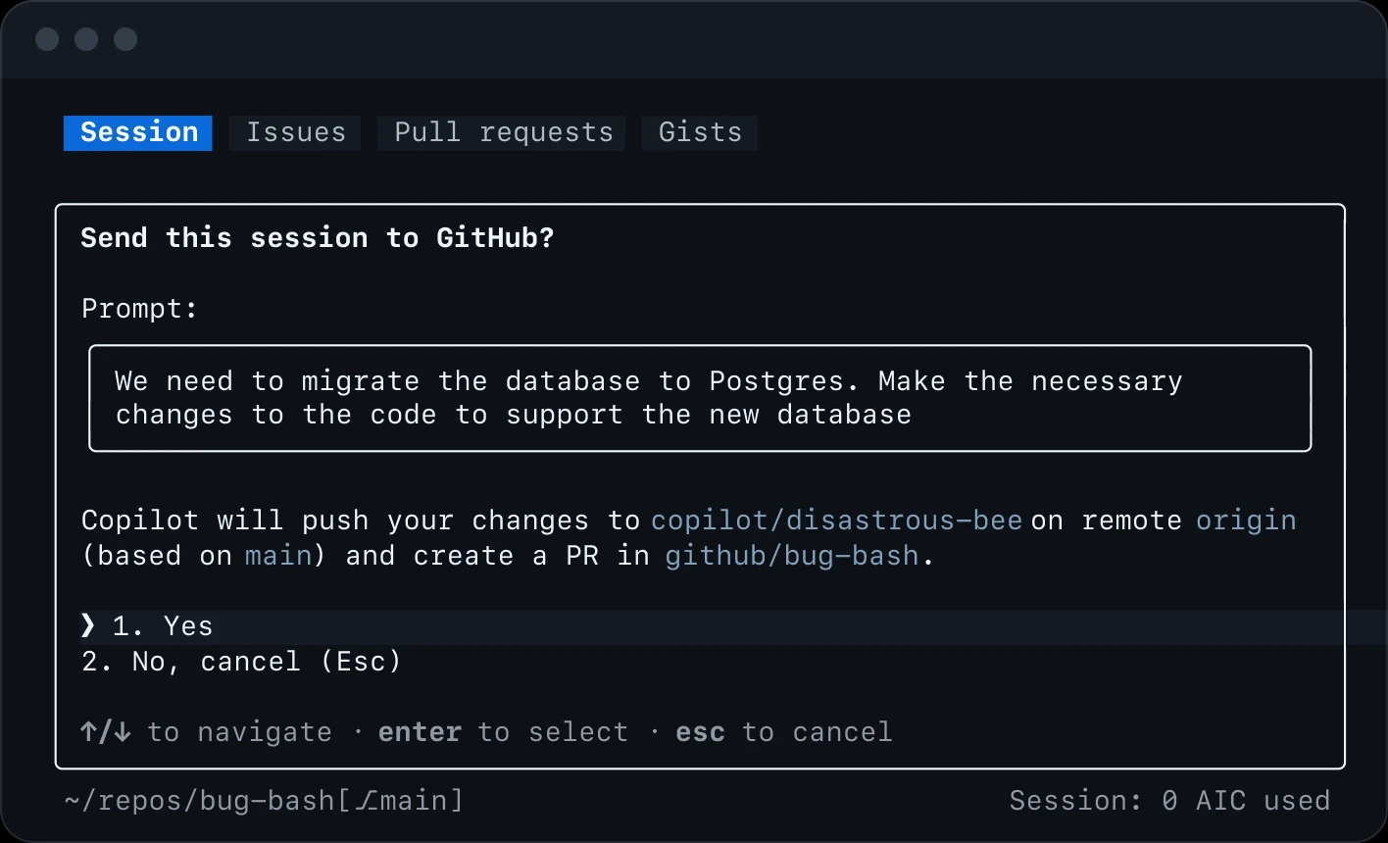
Create a branch, implement a change, and open a pull request with a single command.
/delegate work to the cloud
Notes:
Want to have work done remotely in the cloud? The GitHub Copilot cloud agent integration with /delegate has you covered.
Delegate engineering work at any time directly to the Copilot cloud agent.
Copilot can create a branch, implement changes, and open a draft pull request in the cloud for you.
Continue working while the agent completes tasks in the background.
And at any time, you can use /diff and PR reviews to inspect and validate generated changes.

Slide 13
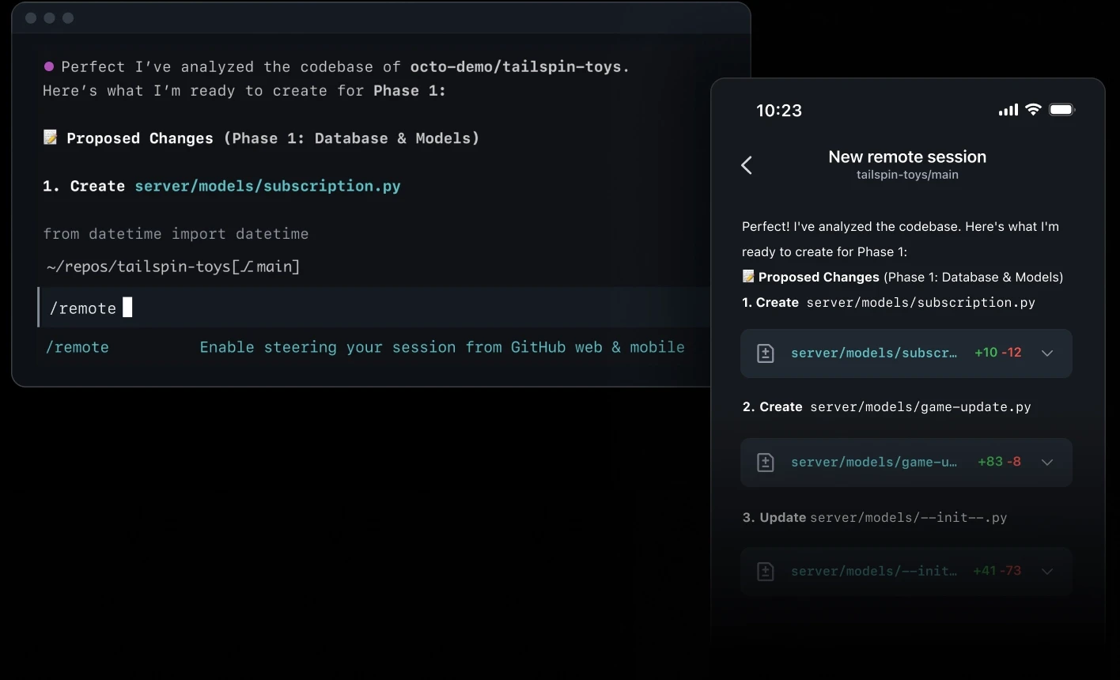
Start in the terminal, then monitor, steer, and merge from GitHub.com or your phone.
/remote to any device
Notes:
Need access to the CLI and your machine from ANYWHERE in the world? /remote has you covered.
Start in the terminal, then monitor, steer, and merge from GitHub.com or your phone.
Start a Copilot CLI session on your workstation and monitor it from anywhere.
Use /remote to access and steer a running session from GitHub.com or GitHub Mobile.
Review output, respond to prompts, and approve permissions remotely.
Ideal for long-running tasks when you're away from your machine.
The work continues on the original machine while you interact through a remote control interface.

Slide 14
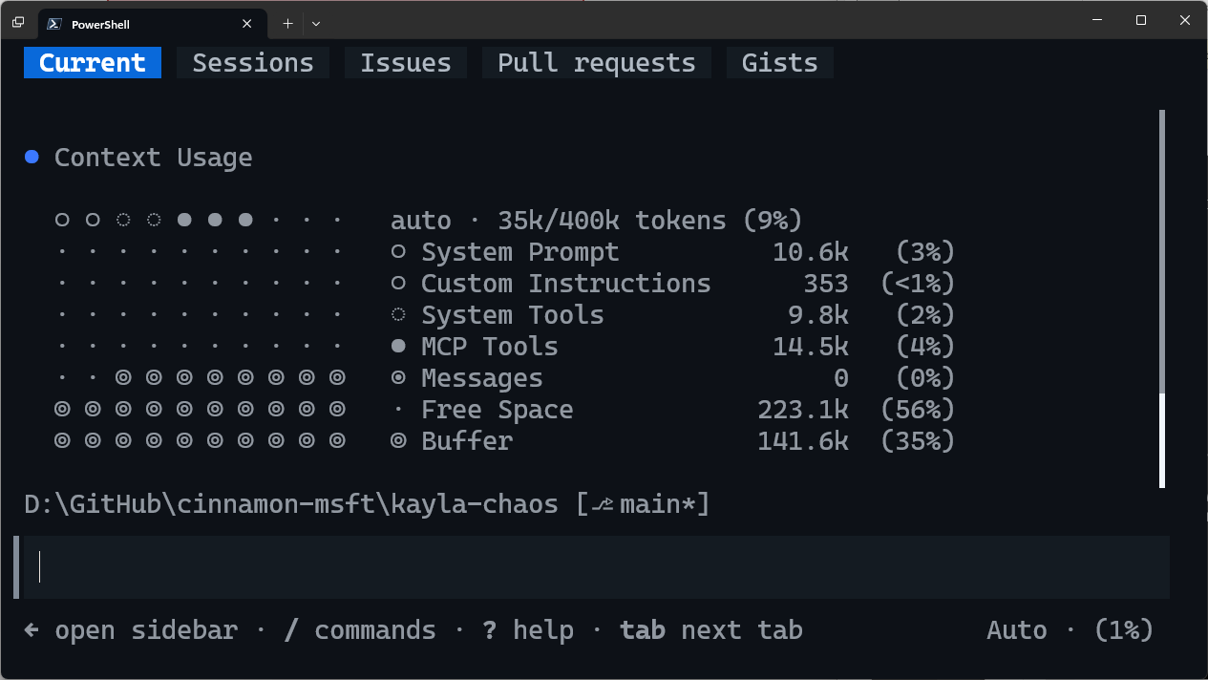
Context
GitHub Copilot CLI
Infinite Sessions (a CLI exclusive) means you likely never have to worry about these, but when you want to manage your context more directly, you can:
/context
/compact
Visualize what is in your context window.
Summarizes current context and compacts to smaller size.
Notes:
The CLI also has powerful context awareness it has this concept of infinite sessions which means you never really have to worry about the context it automatically managed it for you at anytime you can say slash context to visualize the current context and where things are at or do you compact to automatically compact and summarize the current context but because of infinite sessions it does it for you automatically

Slide 15
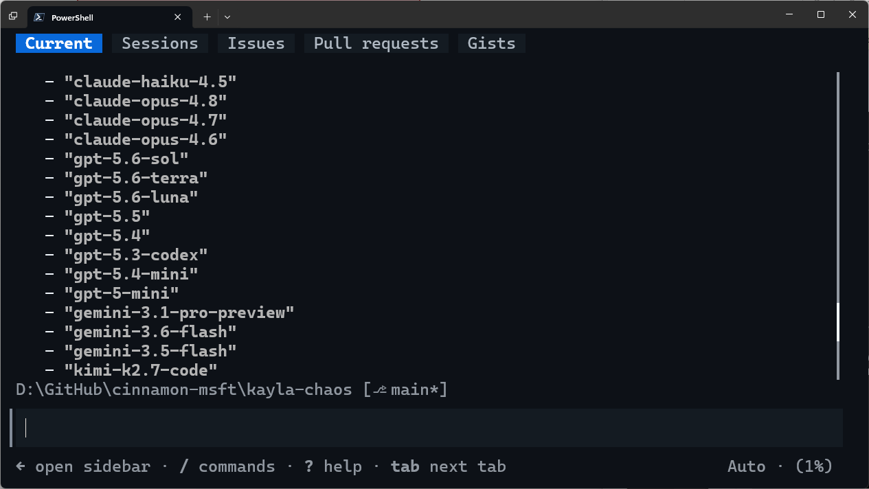
Models!
GitHub Copilot CLI
Models available from all kinds of providers like Microsoft, Anthropic, OpenAI, Google, and Moonshot AI. Plus you can use your own with Bring Your Own Key!
/model
/rubber-duck
Search through and select which model you want to use.
Run a code review leveraging a different AI model.
Notes:
Copilot CLI also gives you flexibility in which AI model powers your session. Use slash model to browse and select from models across Microsoft, Anthropic, OpenAI, Google, Moonshot AI, and other providers. If you have a preferred provider or model, you can also bring your own key. And slash rubber-duck is a useful way to get a fresh second opinion: it runs a code review with a different AI model rather than asking the same model to review its own work.
Note: different Copilot subscriptions have access to different models.

Slide 16
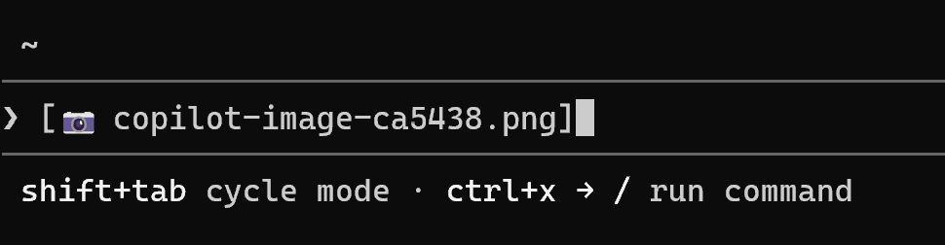
@ to mention files
GitHub Copilot CLI
Provide Copilot context by @-mentioning files directly in your prompt
@-mention multiple files at once, including images
Alternatively drag and drop or paste the file or image to provide context
ALT+V / CMD+V to paste images into CLI
Notes:
Another thing that you can do is specifically mention code files that you may want to be working on directly inside of a specific prompt and you can even give it images by dragging and dropping it or pasting it in directly into the CLI and then it can use vision API to understand that image and of course it can read those files directly it’s a nice way to guide the agent into what you need to have done

Slide 17
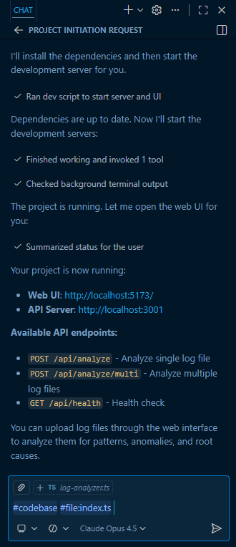
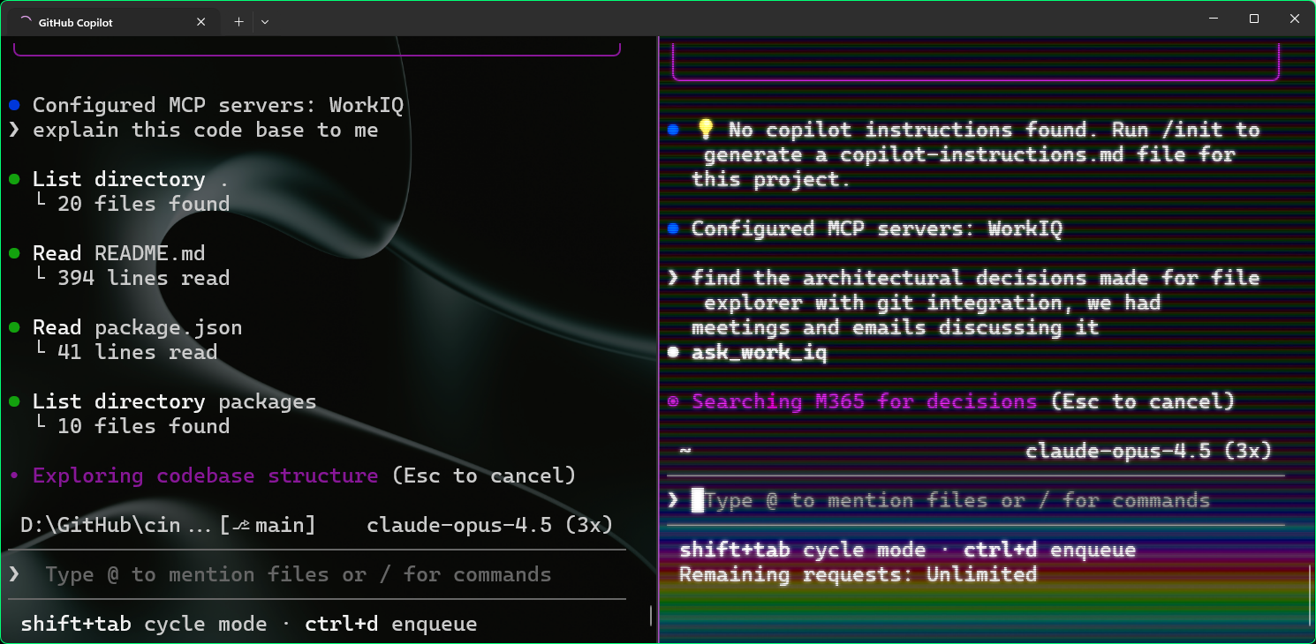
Parallel Copilot
Two projects in terminal split panes
VS Code agent chat
Notes:
The last thing I want to talk about too is that you can be running multiple parallel copilot sessions all at the same time you can have multiple slit tabs for example multiple terminals open you could be running in background task agents inside of VS Code either interactively or in the background or in any other IDE as well you can run all of these at the same time across multiple code bases and this is just scratching the surface of the CLI.

Slide 18
Installation
GitHub Copilot CLI
Windows (WinGet)
macOS / Linux (Homebrew)
Any OS (npm, Node.js ≥ 22)
winget install GitHub.Copilot
brew install copilot-cli
npm install –g @github/copilot
Notes:
The Copilot CLI is available across Windows, Mac, and Linux. You can install it with common tools like winget or homebrew and of course you can install it with NPM as well. Once you have it installed the CLI will automatically update or you can run copilot update and check for updates manually

Slide 19
Demo
GitHub Copilot Dev Days
GitHub Copilot CLI
Notes:
Let's go ahead and see it in action.

Slide 20

gh.io/dev-days/feedback
Notes:
Encourage your attendees to provide their feedback on the event.

Slide 21
As a Dev Days attendee, you're eligible for 10% off an in-person pass to GitHub Universe 2026 in San Francisco on October 28-29.
Use discount code UNIV26DVDY at registration.

Slide 22
Thank you
Notes:
Alright let's open it up for Q&A.

