Slide 1
Message Broker Pattern – RabbitMQ
25-06-2020, Garbacik, Paweł

Slide 2
Agenda
Integrations
AMQP
What is a Message Broker?
RabbitMQ
RabbitMQ vs Apache Kafka
Demo

Slide 3
Microservices Architecture
Every single service is:
Highly maintainable and testable - enables rapid and frequent development and deployment
Loosely coupled with other services - enables a team to work independently the majority of time on their service(s) without being impacted by changes to other services and without affecting other services
Independently deployable - enables a team to deploy their service without having to coordinate with other teams
Capable of being developed by a small team - essential for high productivity by avoiding the high communication head of large teams

Slide 4
Microservices communication
Synchronous
Asynchronous
Protocols such as well known HTTP/REST
Protocols such as AMQP

Slide 5
AMQP
Advanced Message Queuing Protocol - open standard for passing business messages between applications or organizations. Enables communication between confirming client applications and messaging middleware brokers.
Message broker receive messages from publisher and route them to consumers
Queue is a buffer for messages storing
Producers and consumers are user applications
Producers and consumers are technologically independent and can be located on different machines

Slide 6
Message Broker
It mediates communication among applications, minimizing the mutual awareness that applications should have of each other in order to be able to exchange messages, effectively implementing decoupling.
Route messages to one or more destinations
Interact with an external repository to augment a message or store it
Provide content and topic-based message routing using the publish - subscribe pattern

Slide 7
RabbitMQ
RabbitMQ is a message broker: it accepts and forwards messages.
RabbitMQ is lightweight and easy to deploy on premises and in the cloud. It supports multiple messaging protocols. RabbitMQ can be deployed in distributed and federated configurations to meet high-scale, high-availability requirements.

Slide 8
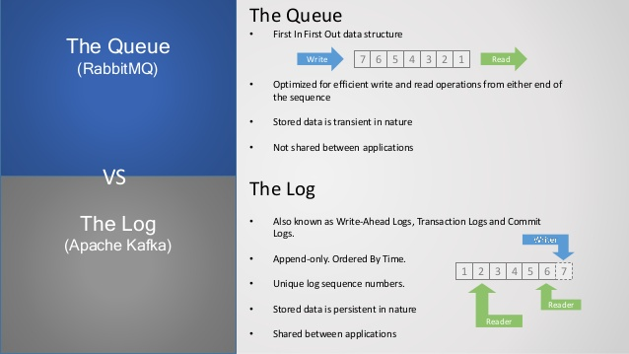
RabbitMQ vs Apache Kafka

Slide 9
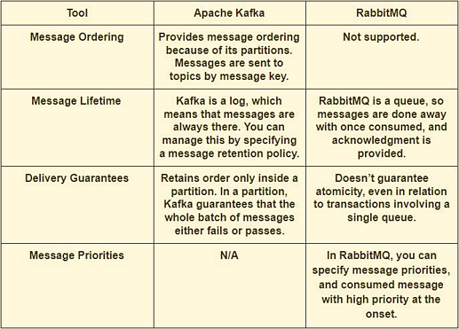
Rabbit / Kafka – Messaging Handle

Slide 10
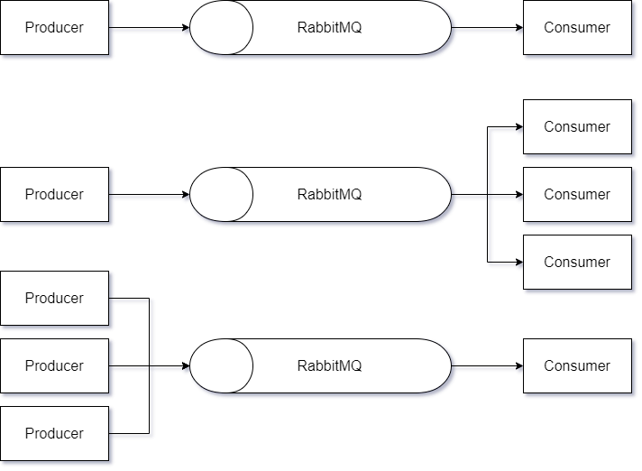
Scenario 1 – Producer - Consumer

Slide 11
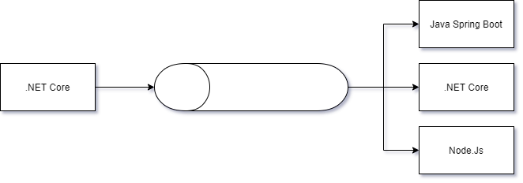
Scenario 2 -Events broadcasting to multiplatform clients

Slide 12
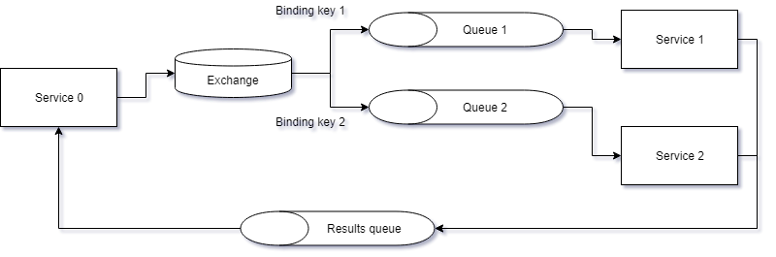
Scenario 3 – Async communication with routing

Slide 13

https://github.com/pawel90g

