Slide 2
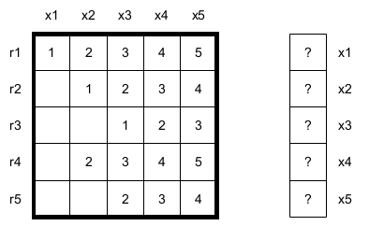
General information
The solver works as a black box – it only expects a square matrix and a RHS vector; it does not require information about the problem which is represented in the matrix.
It's only output is a vector containing the solution or – in the case of unsolvable systems – an exception.

Slide 3
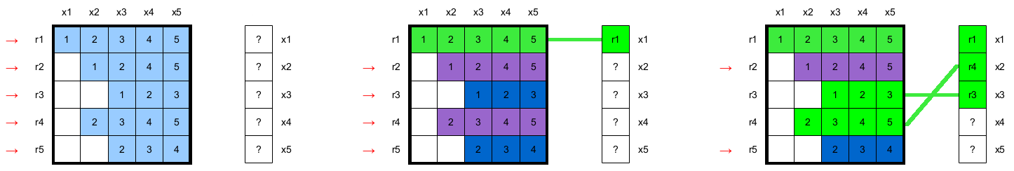
Forward substitution phase¹
Ideally, a separate thread would be used for every row in the matrix; in the sequential prototype, this behavior is mimicked by a for loop.
For every row, it is established which of the functions (x_{n}) it describes
In the above example, row 1 describes x₁, row 3 describes x₃ and row 4 describes x₂.
The other functions are left as „not yet found” for the time being.
These information are stored in a separate vector, which serves as a map of described function to row ID.

Slide 4
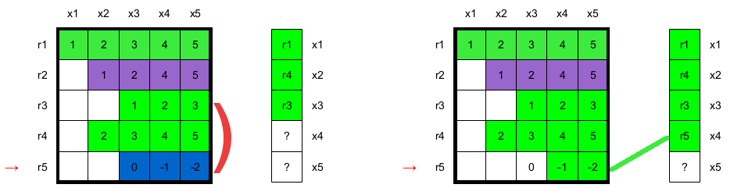
Forward substitution phase²
As in the typical Gauss approach, two rows cannot describe the same function.
If a thread checks the function to row map and the function in the row is already mapped to a row, a reduction will be performed on the „conflicting” (not found in the map) row – by adding the original row to the conflicting row times an appropriate multiplier.
In the above example row 5 is reduced using the data in row 3 (since row 3 was the first to „claim” ownership of function x₃).

Slide 5
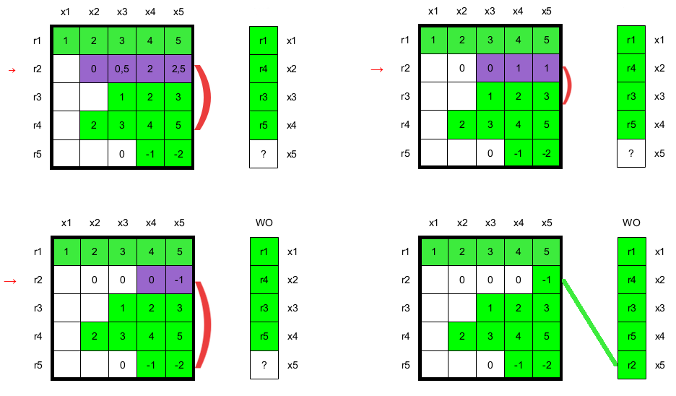
Forward substitution phase³
In this example, for row 5 a single round of reduction was required.
However reducing row 2 from x₂ to x₅ requires three rounds of reduction.
In the prototype this is achieved by stepping the for loop back by one upon reduction, in a thread this could be achieved with a while loop.
While every thread will have to perform at most N-1 reductions in an N x N matrix, I still consider this a bottleneck, possibly solvable with preemptive matrix reordering.

Slide 6
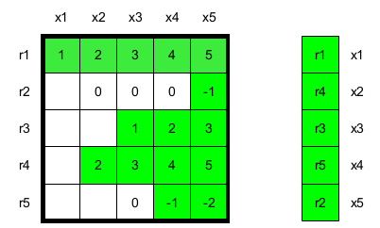
Backward substitution phase
Typical approach to Gauss elimination method produces a matrix in echelon form.
This method produces a so-called „mapped echelon form”, where backward substitution cannot be performed by walking the matrix in bottom-up order, but it must be performed by walking the function to row map bottom-up.
The backward substitution phase cannot be easily paralellized, so it is performed in sequence.

Slide 7
Paralellization for a GPU platform
From the GPU paralellism standpoint, the requirement of locking parts of the function to row map is a major bottleneck (since not only hitting the device memory is very time ineffective, but also has the threads sleeping for significant amounts of time).
The solution I'm currently exploring involves reordering the matrix, then slicing it into independent parts (workgroups) that will be processed by different streaming multiprocessors.
This way, locking, waiting and reduction only happens in a particular multiprocessor's memory, which is much cheaper than hitting (and locking on) the global device's memory.
The steps of reordering and performing parts of the solution in slices will be performed as many times as necessary; this will work well (in a few steps of repetition) for banded matrices, slightly worse for block and dense matrices.
Reordering the matrix directly on the GPU is time-costly, but allows avoiding repeatedly downloading and reuploading data over PCI-Express connections, which is one of the most costly steps in the overall solution.

