Slide 1
Plantuml
Paweł Tarkowski

Slide 2
plantuml – what iS IT ?
This is tool which combine coding and creating diagrams.
Without drawing you can easliy create diagrams like:
sequence, class, component, activity
additional non-UML diagrams like: archimate, wireframe graphical interface

Slide 3
Other advantages
Possibility to create/update diagrams directly on web page
Simple structure of code
Readability of created diagrams
Integration with popular IDEs like Idea, VisualCode,…

Slide 4
Disadantages
Need to get familiar with plantuml code structure
Flexibility appearance is limited

Slide 5
Before start
Documentation: http://plantuml.com/PlantUML_Language_Reference_Guide.pdf
Check examples on web page http://plantuml.com/
You can create diagrams directly on: http://www.plantuml.com/plantuml
Download plugin for your favourite IDE
Additional software is needed to install: https://www.graphviz.org/download/

Slide 6
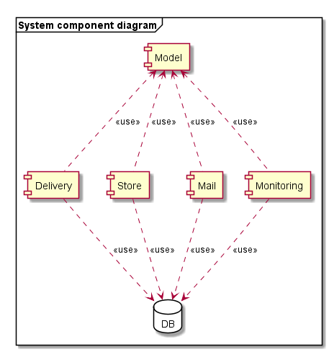
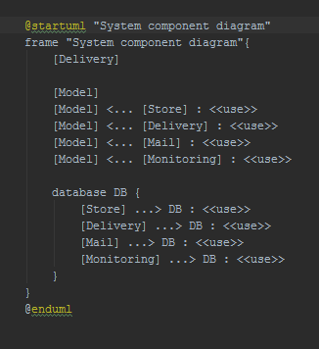
Component diagram

Slide 7
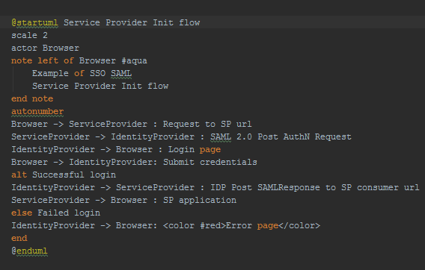
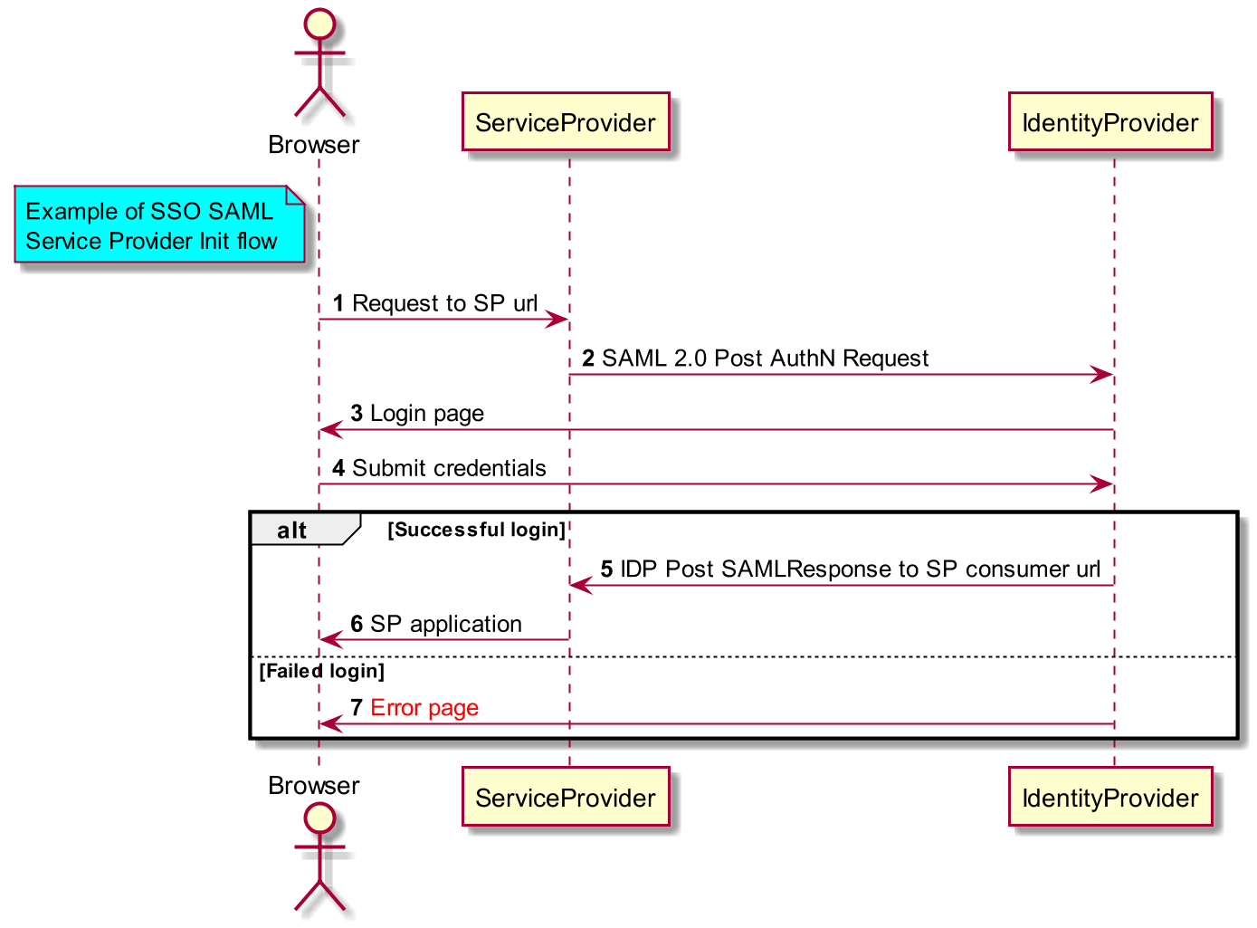
Sequence diagram

Slide 8
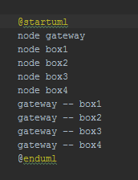
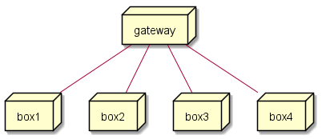
Deployment diagram

Slide 9
Examples
All examples are available on github:
https://github.com/paweltarkowski/plantuml-examples

Slide 10
Questions ?

Slide 11
Thank you

