Slide 1


SRM VALLIAMMAI ENGINEERING COLLEGE
(An Autonomous Institution)
SRM Nagar, Kattankulathur-603203
Department of Electronics & Communication Engineering
1906709 – Project work – Phase I
RAILGUARD: INTELLIGENT DETECTION OF TRACK MISALIGNMENTS DUE TO THERMAL STRESS
Presented By
142222106100-PAVITHRA D
142222106104-PRANAY SENDHILKUMAR
142222106110-PRIYADARSINI S
142222106120-REHAN AHAMED E.
Under the Supervision of
Dr. S. R. Preethi,
Associate Professor,
ECE Department.

Slide 2
PRESENTATION OUTLINE
Aim
Objectives
Literature Survey
Summary of Literature Survey
Base Paper Details
Flow Diagram
Hardware and Software Components
Base Setup of the project
Base Output of the project
Initial calibration readings and test results
Configuration File Preparation
Final Configuration File Code
Breakdown of the Configuration File code
Work Plan
References

Slide 3
AIM
Considering the growing volume and frequency of train traffic, railway safety is crucial. Track misalignments brought on by thermal stress are one of the main dangers to rail infrastructure. Temperature-induced expansion or contraction of continuously welded rails (CWR), which are not flexible enough to withstand such changes, causes these misalignments. As temperatures change, the accumulated stresses could cause rails to buckle in extreme heat or fracture in cold, which would be extremely dangerous for both public safety and train operation.
The necessity of non-destructive, real-time monitoring technologies has been highlighted by recent research and industry events. Conventional techniques for determining rail stress and neutral temperature (NRT), such as strain gauges and rail cutting, are either labour-intensive, destructive, or necessitate a large amount of downtime. As a result, there is an increasing need for intelligent systems that can provide precise, contactless, and real-time data to support preventive maintenance.

Slide 4
OBJECTIVE
Our proposed system, RAILGUARD, aims to bridge this gap. It utilizes mmWave radar technology to detect track misalignments remotely and accurately, even in harsh environments. Coupled with a configurable architecture and a user-friendly Graphical User Interface (GUI), RAILGUARD offers flexibility for field engineers and ensures operational safety through efficient monitoring and reporting.
We set the groundwork for a reliable and scalable intelligent railway track monitoring solution in this Phase I project by presenting the RAILGUARD system design, basic technologies, and rationale.

Slide 5
LITERATURE SURVEY
S.No | Paper details (Author name, Title of the paper, Journal name, Volume & Issue number, Year) | Contribution by Authors | Inference
1 | Gary Nicholas et al., “A Review of Techniques for Measurement of Forces and Neutral Temperatures in Railway Track,” Proc IMechE Part F: J Rail and Rapid Transit, Vol. 239(4), 2025. | Comprehensive review of destructive and non-destructive methods for rail stress and NRT measurement. | Identified mmWave and vibration-based methods as promising non-contact solutions for real-time monitoring.
2 | Liu et al., “Bi-directional strain method for NRT monitoring,” Sensors, 2023. | Proposed strain-based sensors using an H-shaped steel plate. | Offers high accuracy (~±1.7 MPa), but requires installation during unstressed conditions.

Slide 6
LITERATURE SURVEY
S.No | Paper details (Author name, Title of the paper, Journal name, Volume & Issue number, Year) | Contribution by Authors | Inference
3 | Knopf et al., “Non-contacting DIC method for NRT,” Journal of Structural Health Monitoring, 2022. | Used stereo-DIC to estimate rail deformation and curvature for thermal stress analysis. | Promising accuracy (~2.7– 4.4°C); not yet field validated.
4 | Pandrol Ltd., “VERSE Method for Rail Stress Measurement,” Company White Paper, 2020. | Standard industry tool using vertical deflection and stress-strain principles. | Accurate but requires track unclipping; limited in hot weather.

Slide 7
SUMMARY OF LITERATURE SURVEY
Although accurate, the majority of conventional methods (such as rail cutting and VERSE) are intrusive or necessitate track closure.
More non-invasive monitoring is available with recent methods that include strain gauges, digital photography, and vibrational response.
However, dependability is constrained by field conditions, calibration requirements, and sensitivity to outside influences.
Real-time, non-contact, scalable, and programmable rail stress sensing devices are not readily available.
These gaps serve as the basis for the RAILGUARD system, which uses mmWave radar to identify anomalies accurately and in real time.

Slide 8
BASE PAPER DETAILS
Title: “A Review of Techniques for Measurement of Forces and Neutral Temperatures in Railway Track”
Authors: Gary Nicholas, William Gray, Michael Poulter, Rob S. Dwyer-Joyce, Roger Lewis
Journal Details:
Proceedings of the IMechE, Part F: Journal of Rail and Rapid Transit
DOI: 10.1177/09544097251314907
Publication Date:
Volume 239, Issue 4, April 2025

Slide 9
BASE PAPER DETAILS
Key Takeaways:
Offers a thorough analysis of NRT (Neutral Rail Temperature) and rail stress testing methods.
draws attention to the shortcomings of the existing approaches, such as their lack of real-time data, low scalability, and requirement for track closure.
highlights the rising need for precise, adjustable, and non-contact monitoring solutions.
By combining mmWave radar, real-time monitoring, and a graphical user interface (GUI)-based alert system, RAILGUARD fills this gap.

Slide 10
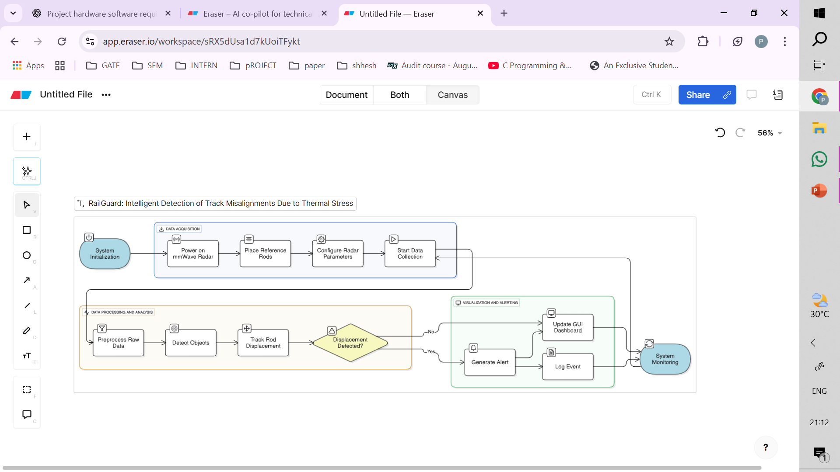
FLOW DIAGRAM

Slide 11
HARDWARE AND SOFTWARE COMPONENTS
HARDWARE REQUIREMENTS
TI IWR6843ISK - mmWave radar sensor for rod/track displacement detection
Tripod / Fixed Mount - To position radar accurately near rails or testbed
Metal Rods/Reflectors - Act as proxy targets for displacement detection
5V Power Supply / USB - Power the radar (via USB or external supply)
Laptop/PC - For visualization, flashing, debugging
3D-Printed Casing - Custom-designed enclosure to securely house the IWR6843ISK.
SOFTWARE REQUIREMENTS
TI mmWave SDK 3.6 - Core software framework for 6843ISK (includes mmw demo firmware)
TI UniFlash - Flash firmware to the IWR6843ISK
mmWave Demo Visualizer - Visualize point cloud and rod movement detection
Teraterm / PuTTY - Monitor UART output (optional debugging/logging)
TI mmWave Industrial Toolbox - Prebuilt examples, config templates, MATLAB tools
SolidWorks - Design 3D-printed enclosure for radar + stable mounting
Custom .cfg File - Define range profile, clutter removal, etc. tuned to your setup

Slide 12
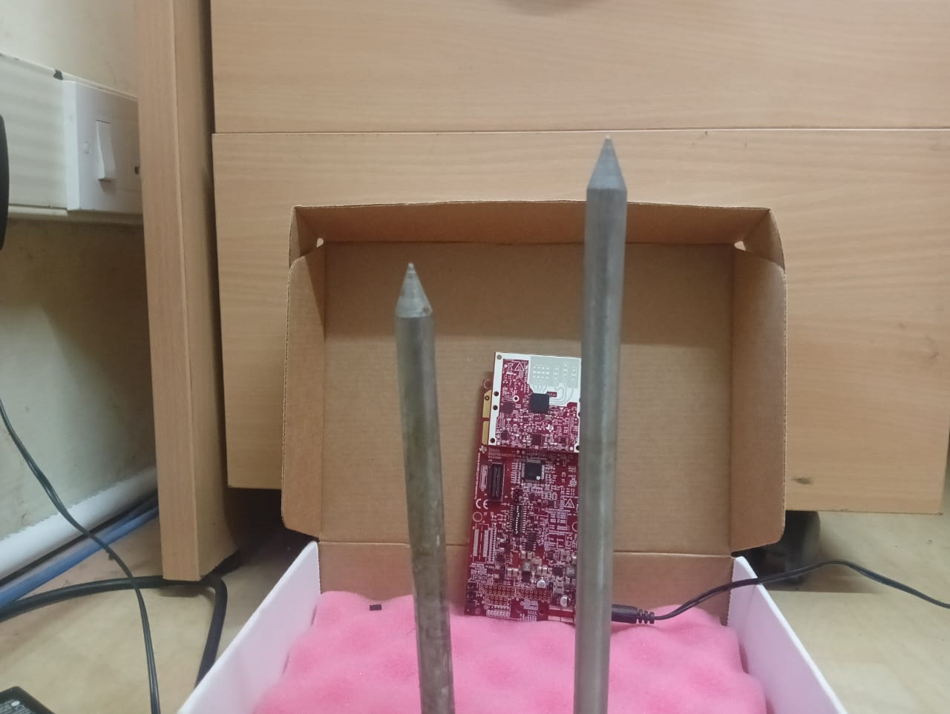
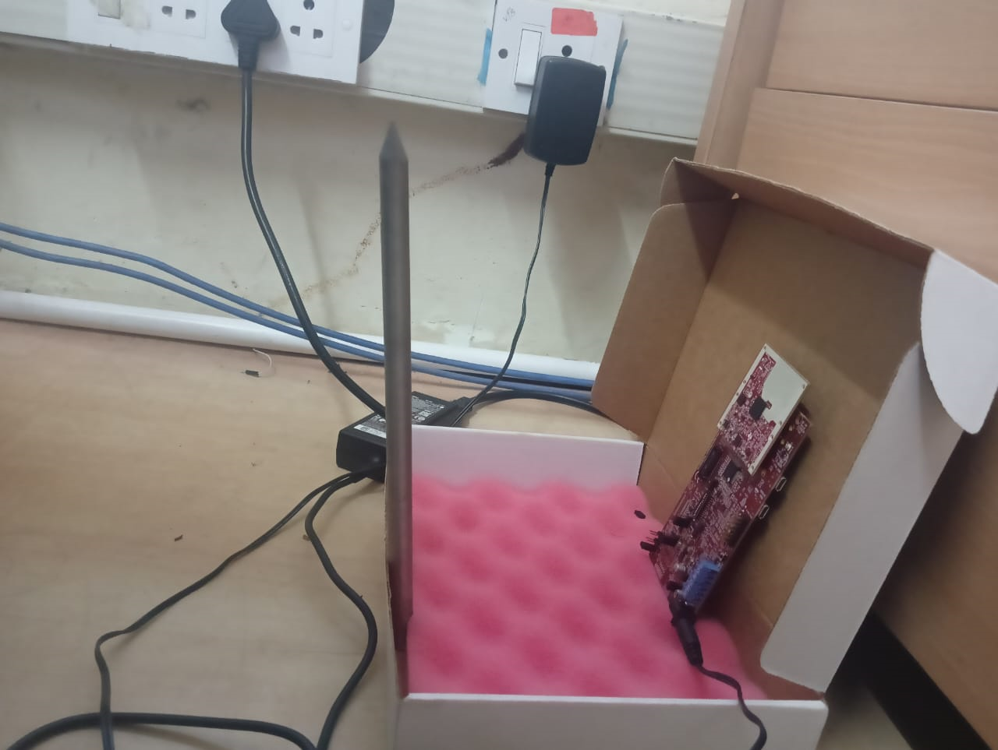
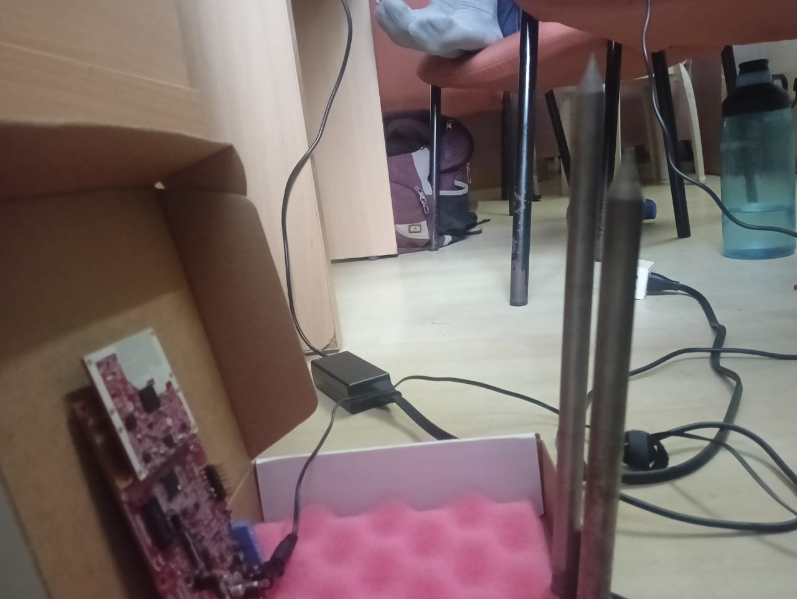
BASE SETUP OF THE PROJECT
The end goal of the project is to detect the amount of displacement that the railway tracks go through due to thermal effects. For that, a base setup will require DETECTION OF RODS by the IWR6843ISK. The below pictures are when the setup is done in accordance with initial calibration readings (18 cm from the board and 5 cm in between the rods).

Slide 13
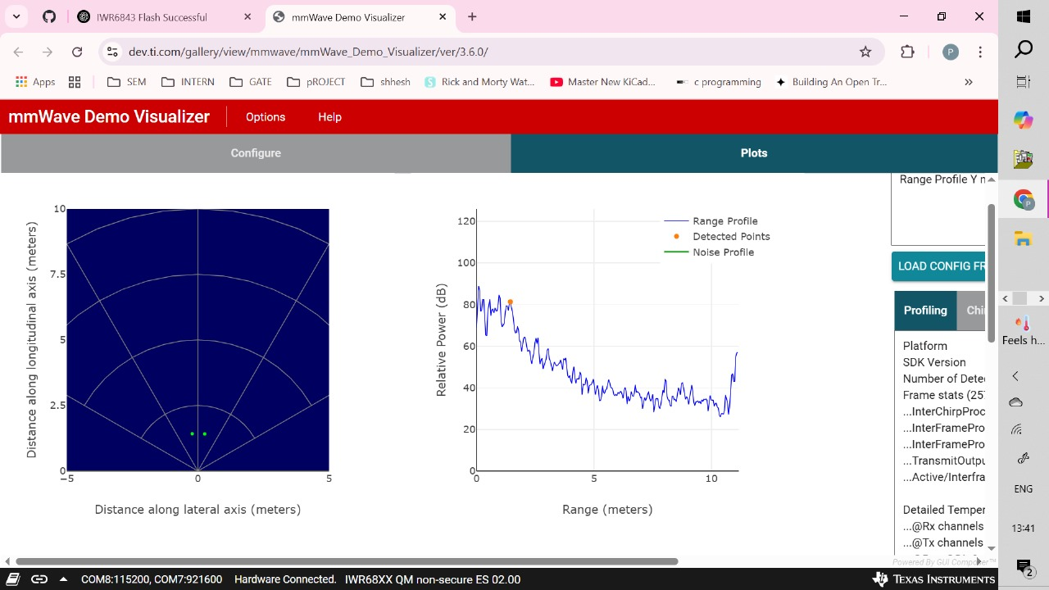
BASE OUTPUT OF THE PROJECT

Slide 14
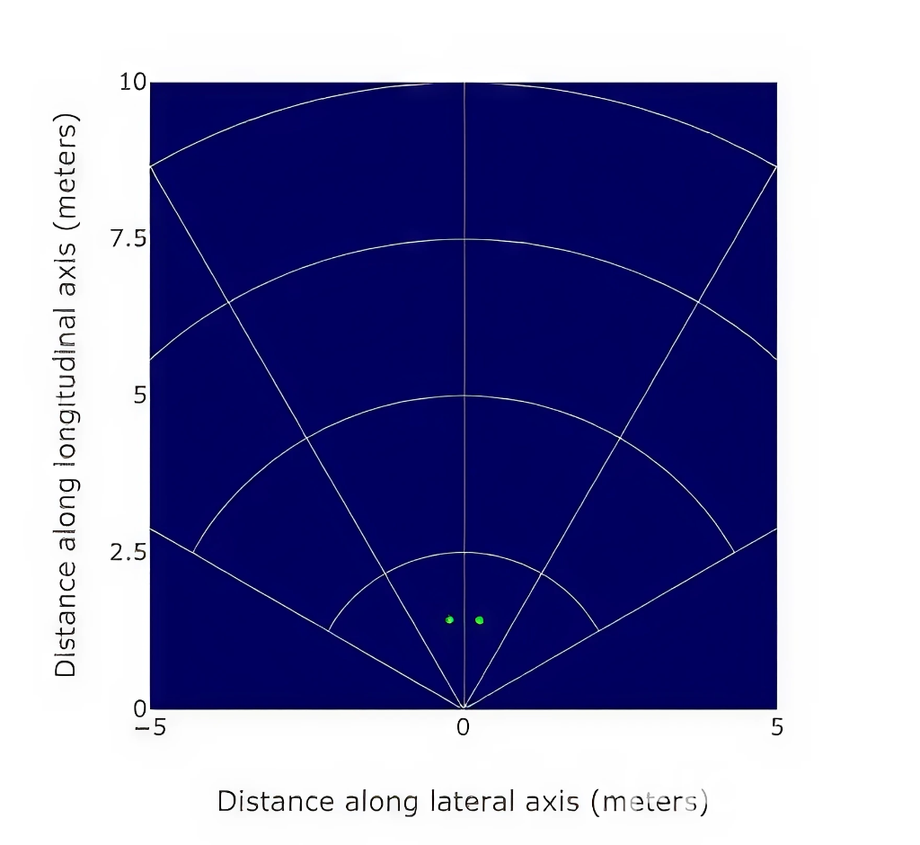
BASE OUTPUT OF THE PROJECT
The mmWave visualizer successfully detects the rods placed during the setup.
Range Profile Graph: Peaks indicate reflections from rods at the calibrated distance (18 cm from board, 5 cm separation).
Scatter/Detection Plot: Shows the rods as distinct points, confirming correct positioning.
The output validates that the radar can differentiate multiple static metallic objects.
This proves the feasibility of using the setup to monitor displacement in railway tracks.

Slide 15
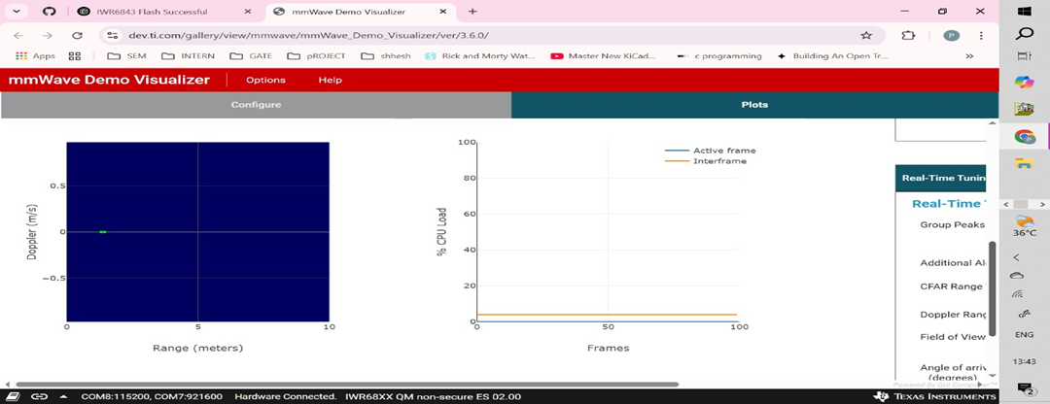
BASE OUTPUT OF THE PROJECT

Slide 16
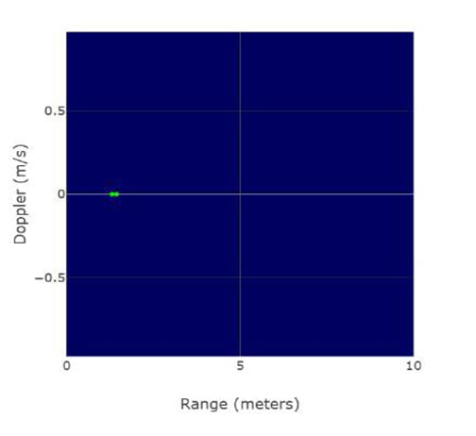
BASE OUTPUT OF THE PROJECT
The Range-Doppler plot confirms that the detected rods are sttic objects (no Doppler shift observed).
The scatter plot shows accurate positioning of rods at the calibrated distance.
Output remains stable across frames, validating consistency of detection.
Confirms the radar’s capability to detect multiple stationary metallic objects in real-time.
These results strengthen the feasibility of extending the setup to monitor railway track displacement.

Slide 17
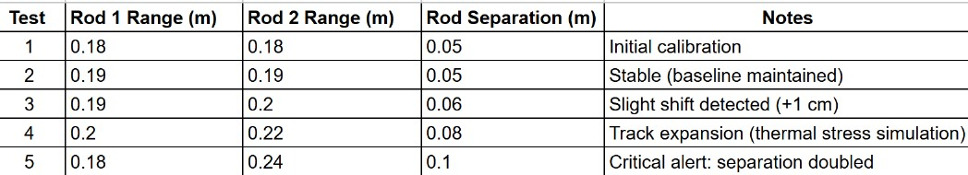
INITIAL CALIBRATION READINGS AND TEST RESULTS
This data table illustrates the system's ability to accurately detect and measure changes in the separation between the rods. The initial calibration (Test 1 & 2) establishes a stable baseline, while subsequent tests (3-5) demonstrate the system's sensitivity to minor displacements and its ability to identify critical-level expansion.
Advanced Data Acquisition and Noise Mitigation
The IWR6843ISK board features an integrated FFT accelerator and digital signal processor (DSP), which provide powerful, inbuilt filtering capabilities to resist external noise and improve data quality. However, to achieve the high accuracy and range required for subtle thermal displacement detection, relying on default hardware alone is not enough. A configuration file is used to precisely customize the sensor's performance. This allows us to modify key radar parameters like chirp and frame settings to optimize range, resolution, and signal-to-noise ratio. By tailoring these settings, we can ensure the system maintains reliable and accurate data acquisition, which is essential for the long-term integrity of a track displacement monitoring system.

Slide 18
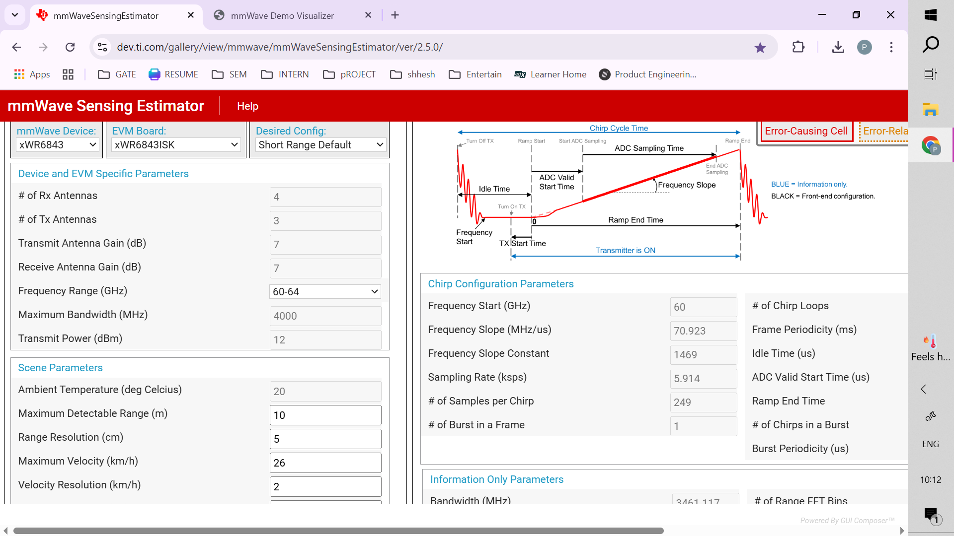
CONFIGURATION FILE PREPARATION
The mmWave Sensing Estimator (TI Tool) was used to design the configuration file for the IWR6843ISK.
Parameters such as frequency range (60–64 GHz), bandwidth (4 GHz), and transmit power (12 dBm) were set to achieve higher accuracy.
Scene parameters were tuned to optimize for short-range, high-resolution detection (range resolution ~5 cm, max detectable range ~10 m).
Adjusted chirp configuration (frequency slope, number of samples per chirp, and frame periodicity) to balance accuracy and real-time processing.
This configuration ensures improved target separation and reduces noise in the detection outputs.
The file generated here will be uploaded into the mmWave demo visualizer for testing.

Slide 19
FINAL CONFIGURATION FILE CODE
The final configuration of the IWR6843ISK mm Wave radar was generated using the TI mm Wave Sensing Estimator and validated through the mm Wave Demo Visualizer. It defines optimized parameters for precise, short-range displacement detection in railway tracks.
Key Parameters:
Operating Frequency: 60–64 GHz
Bandwidth: 4 GHz (≈ 5 cm range resolution)
Maximum Range: 10 m
Transmit Power: 12 dBm
Frame Rate: Continuous monitoring
Detection Mode: CFAR-based adaptive thresholding
Static Target Detection: Enabled for rail surfaces
Configuration Snippet:
cfarCfg -1 0 2 8 4 3 0 8 0
cfarCfg -1 1 0 4 2 3 1 8 0
staticDetectionCfg 1 1 4 16 256 0
Outcome: Enhanced detection stability, improved SNR, and reliable sub-centimeter displacement measurement.

Slide 20
BREAKDOWN OF CONFIGURATION FILE CODE
The configuration file defines radar processing parameters for target detection, classification, and signal optimization.
1. CFAR Configuration (cfarCfg)
Purpose: Adaptive thresholding to detect valid reflections while minimizing noise. Commands:
cfarCfg -1 0 2 8 4 3 0 8 0
cfarCfg -1 1 0 4 2 3 1 8 0
Key Parameters:
Domain (0 = Range, 1 = Doppler): Sets where CFAR operates.
Window & Guard Cells: Define the neighbourhood for noise estimation.
Threshold Scaling: Adjusts sensitivity for strong vs weak reflections. Effect: Ensures stable target detection by suppressing clutter and multipath reflections.
2. Static Detection Configuration (staticDetectionCfg)
Purpose: Enables identification of stationary metallic targets (rail surfaces). Command:
staticDetectionCfg 1 1 4 16 256 0
Key Parameters:
FFT Sizes (4, 16, 256): Control signal resolution and range bin classification.
Enable Flags: Activate static object detection and filtering logic. Effect: Retains static reflection points critical for long-term displacement tracking.
3. System-Level Impact
Enhanced SNR (Signal-to-Noise Ratio) for clearer target separation.
Consistent phase stability for precise displacement estimation.
Real-time operation with minimal computational load.
Outcome: Reliable, repeatable detection of multiple static metallic targets enabling continuous, non-contact railway track displacement monitoring.

Slide 21
WORK PLAN
S. No | Month | Works to be completed
1 | July | Aim, Objectives, Work Plan, References.
2 | August | Literature Survey, Proposed Block Diagram, Hardware and Software Components,
3 | September | Technical content – High level Design of the project, Simulation Output and Presentation.
4 | October | Project demonstration, Publication, Project Report Submission, Project Work Plan Submission.

Slide 22
REFERENCES
[1] J. R. Wang, D. I. Lee and C. Liu,"Rail track monitoring using mmWave radar and deep learning,"IEEE Sensors Letters, vol. 5, no. 6, pp. 1–4, Jun. 2021,doi: 10.1109/LSENS.2021.3077778.
[2] Y. Wang, Q. Luo, Z. Chen and H. Guan,"Bridge displacement monitoring using FMCW mmWave radar sensor,"IEEE Sensors Journal, vol. 21, no. 12, pp. 13728–13736, Jun. 2021,doi: 10.1109/JSEN.2021.3071333.
[3] G. Ollier, P. V. Orlik, T. Y. Al-Naffouri and S. Subramanian,"Infrastructure-free railway track condition monitoring using 60 GHz mmWave radar,"IEEE Access, vol. 10, pp. 112892–112902, 2022,doi: 10.1109/ACCESS.2022.3204630.
[4] T. La, H. Moon, M. Shin and K. Kim,"A mmWave radar-based method for detecting small vibrations and displacements of railway tracks,"in Proc. 2020 IEEE Sensors, Rotterdam, Netherlands, 2020, pp. 1–4,doi: 10.1109/SENSORS47125.2020.9278737.
[5] S. Liu, M. Ritchie and L. Peterson,"Thermal stress-induced rail deformation detection using low-cost mmWave radar sensors,"in Proc. 2022 IEEE International Conference on Intelligent Transportation Engineering (ICITE), Beijing, China, 2022, pp. 230–235,doi: 10.1109/ICITE54927.2022.00045.
[6] Texas Instruments,"Tracking multiple objects using mmWave radar with the IWR6843,"Application Note, Texas Instruments, Oct. 2020. [Online]. Available:https://www.ti.com/lit/pdf/swra574

Slide 23
THANK YOU

