Slide 1

Javascript Training
Case 7: Ajax requests

Slide 2
Case 7
Ajax requests
Ajax
XMLHttpRequest
JQuery
Get, Post

Slide 3

Case 7
Ajax requests
Ajax
Asynchronous JavaScript and XML
Dynamisch
Geen refresh nodig
JSON
Notes:
Geen programeer taal

Slide 4
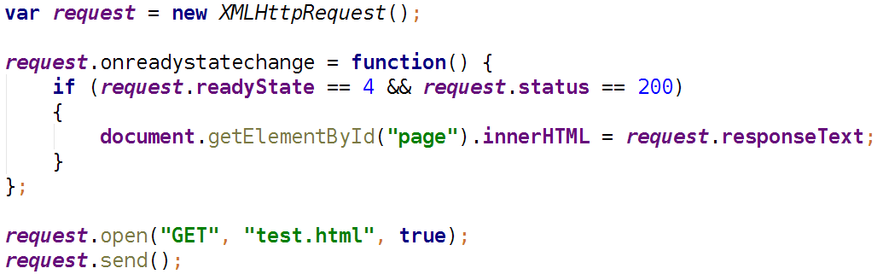
Case 7
Ajax requests
XMLHttpRequest
Notes:
request.responseText

Slide 5
Case 7
Ajax requests
XMLHttpRequest
ReadyState
  0: request not initialized
  1: server connection established
  2: request received
  3: processing request
  4: request finished and response is ready
Status
  200: "OK"
  404: Page not found
Notes:
Geen programeer taal

Slide 6

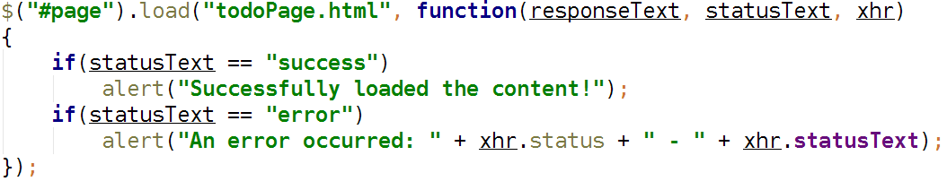
Case 7
Ajax requests
Jquery load
Notes:
Geen programeer taal

Slide 7
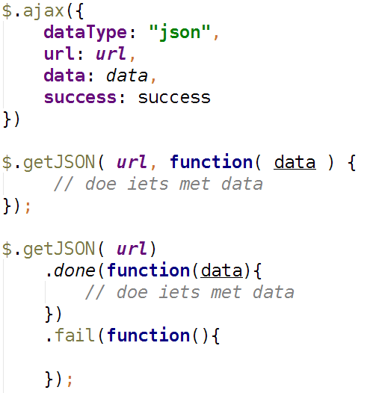
Case 7
Ajax requests
Ajax get
Notes:
Geen programeer taal

Slide 8
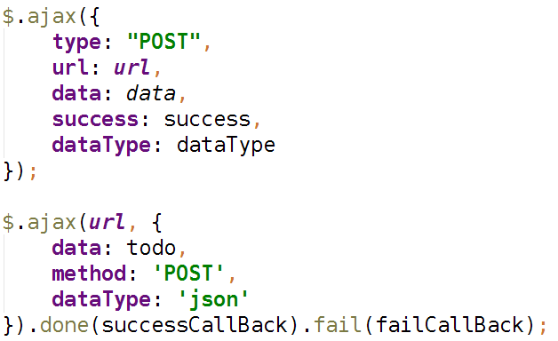
Case 7
Ajax requests
Ajax post
Notes:
Geen programeer taal

