Slide 1

Javascript Training
Case 9: Jasmine

Slide 2
Case 9
Jasmine
Makkelijke syntax
Standalone
Grunt
1.3 → 2.0

Slide 3
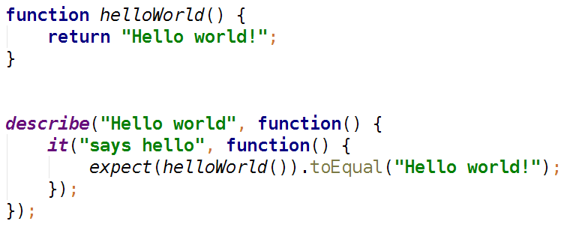
Case 9
Jasmine

Slide 4
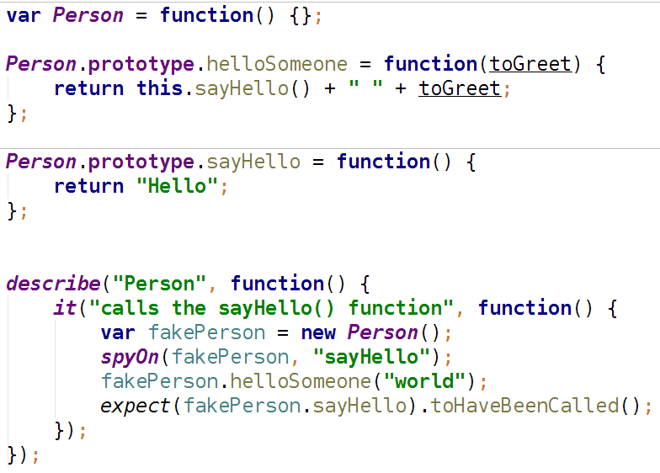
Case 9
Jasmine

Slide 5
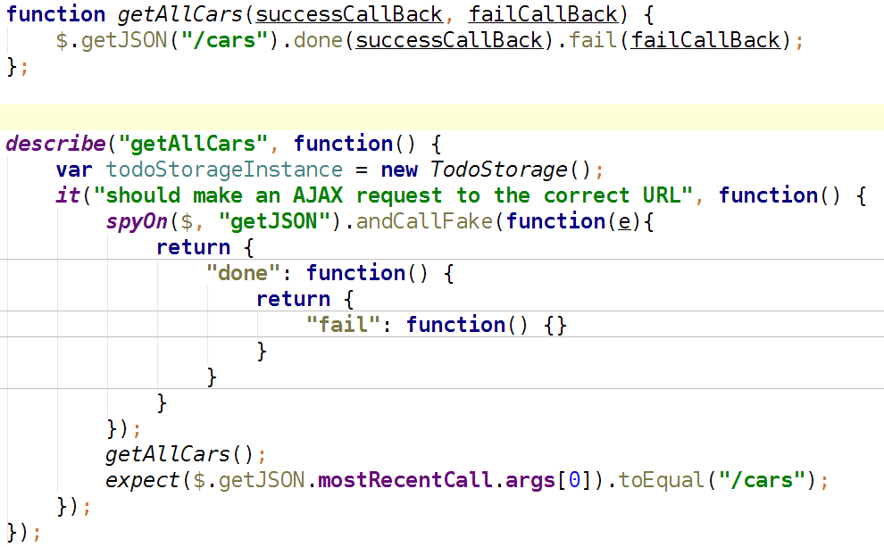
Case 9
Jasmine

