Slide 1

Javascript Training
Case 5: Advanced dom manipulatie

Slide 2
Case 5
Advanced dom manipulatie
JQuery
JQuery UI

Slide 3

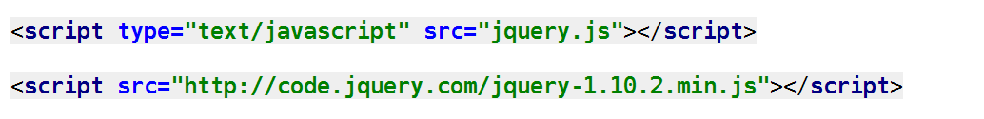
Case 5
Advanced dom manipulatie
JQuery
32kb
DOM navigatie
Cross browser
CSS3
Ajax
Notes:
65% van alle sites

Slide 4
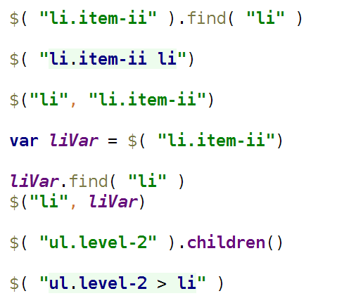
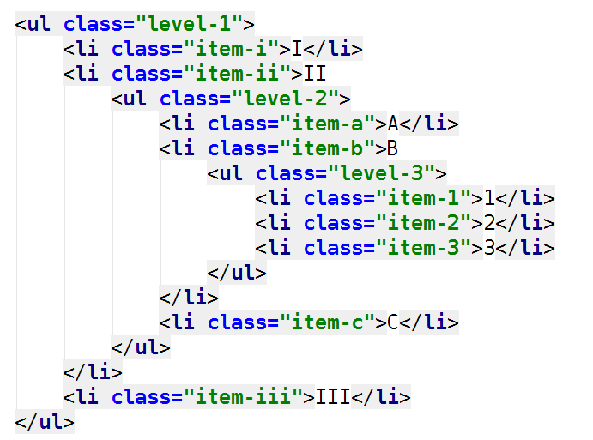
Case 5
Advanced dom manipulatie

Slide 5
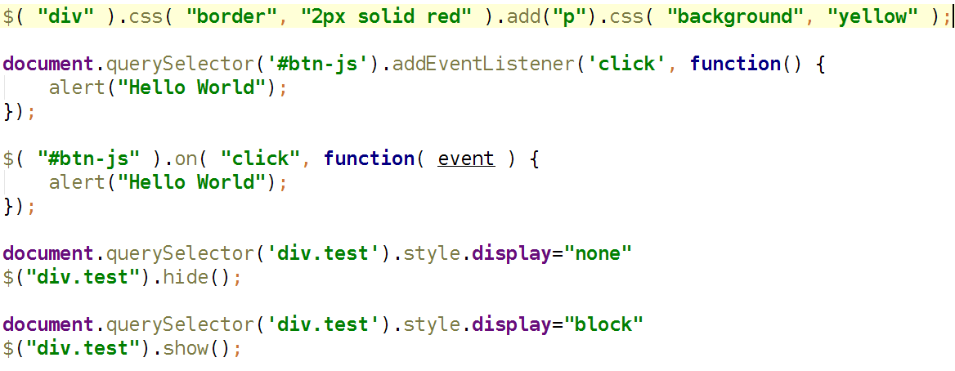
Case 5
Advanced dom manipulatie

Slide 6

Case 5
Advanced dom manipulatie
JQuery UI
Draggable
Droppable
Resizable
Selectable
Sortable

Slide 7
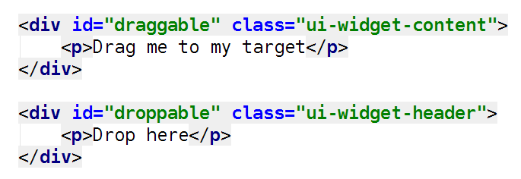
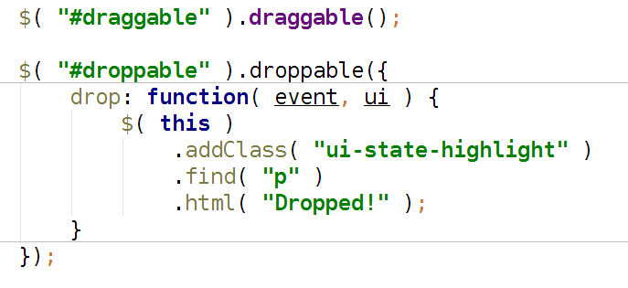
Case 5
Advanced dom manipulatie
Drag & Drop
Notes:
AddClass
revert: true
SnapMode
Containment: “#test”

Slide 8
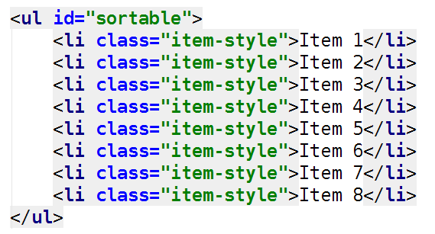
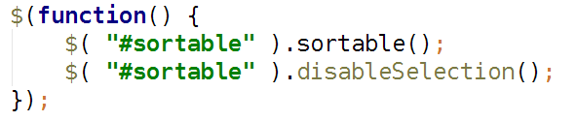
Case 5
Advanced dom manipulatie
Sortable
Notes:
DisableSelection niet gebruiken buiten dit. Nie handig

