Slide 1


Slide 2
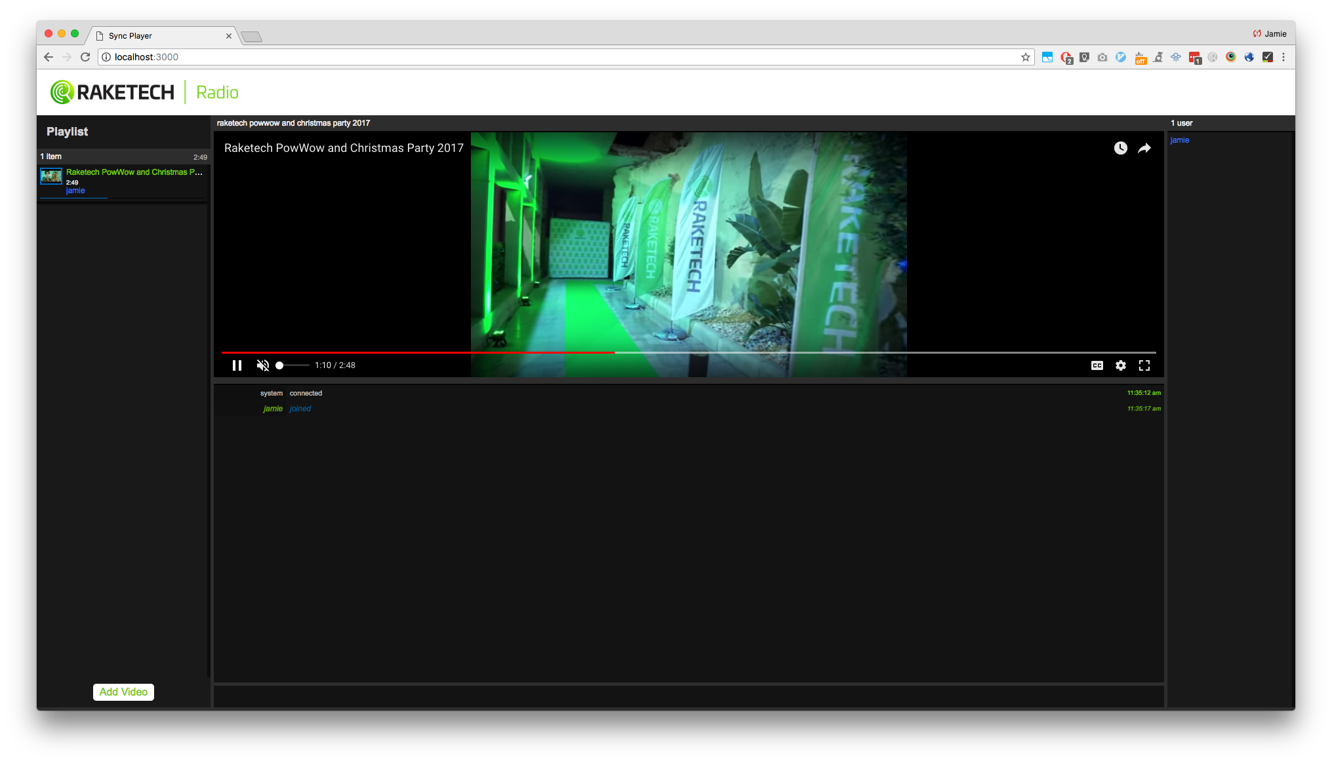

Slide 3




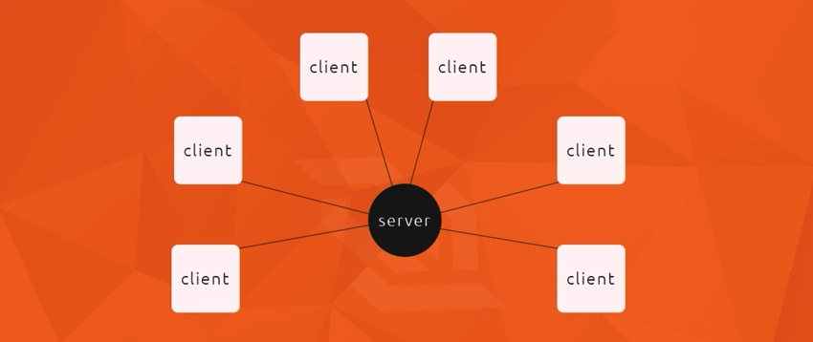

Slide 4
Future functionality:
Video like button
Video archive, sorted by tags
Different channels
Flagging
Video commenting section
Signing in with Raketech credentials
Improve UI
Mobile support

