Slide 1




HELIX NAKE
Deniz ALBAYRAK 2017510007
Gaye SÜNER 2017510070
Rona CIDA 2017510022
IZMIR

Slide 2


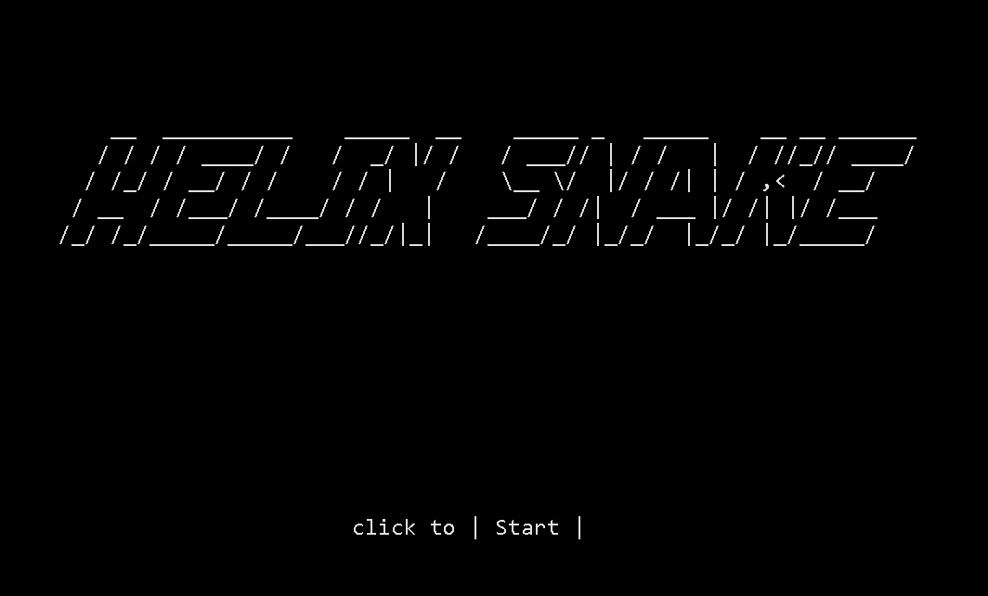
OUTLINE
INTRODUCTION
PROGRESS SUMMARY
Changes in Requirements
Tasks Sharing and Scheduling
Completed Tasks
Incomplete Tasks: Reasonsi Explanations
Additional Improvements
PROBLEMS ENCOUNTERED
ALGORITHMS ANDSOLUTION STRATEGIES
SCREENSHOTS
CONCLUSION
REFERENCES

Slide 3

INTRODUCTION
The goal of the project is to develop a snake game.
The snake starts with 3 letters assigned randomly out of four letter (A, C, G, T).
When the snake eats a letter, the player earns 5 points. The player will also earn extra from codons.

Slide 4
PROGRESS SUMMARY Changes In Requirements
firstly the task was moving the snake with right and left key.
Then using four direction keys is allowed

Slide 5
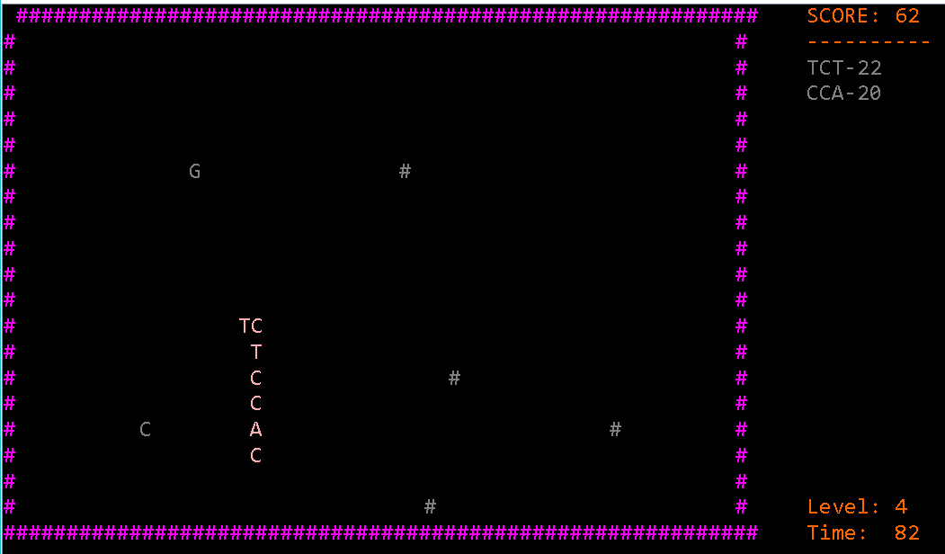
PROGRESS SUMMARY Tasks Sharing and Scheduling
We usually studied separately.
We told each other the codes during the course hours.
#

Slide 6
PROGRESS SUMMARY Tasks Sharing and Scheduling
In the first week we tried to understand project and we planned it. Then we installed Enigma. We designed our game screen and we create a snake with random letters.
In second week and third, we tried to moving, eating and growing part of snake. This made us hard and we lose time in that part.
In the end of the third week first two weeks’ job and top-10 score list were done.
When we reach the fourth week we realize some deficiencies in top-10 score list and snake. We tried to fix it.
In the last week we finished the Multi Linked List part and we check errors.

Slide 7
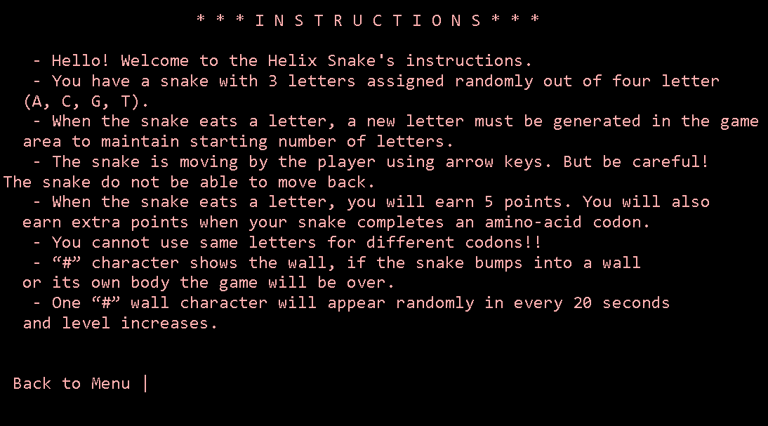
PROGRESS SUMMARY Completed Tasks
We finished all tasks. Our game can do more tasks what requested from us.
#

Slide 8
PROGRESS SUMMARY Additional Improvements
We added sound to some parts of the game as effects.
We added some color in our game.
We wrote a instruction part.

Slide 9
PROGRESS SUMMARY Additional Improvements
Mouse clicking method.
Rescoring with same name
whoseIsThisProtein method.

Slide 10
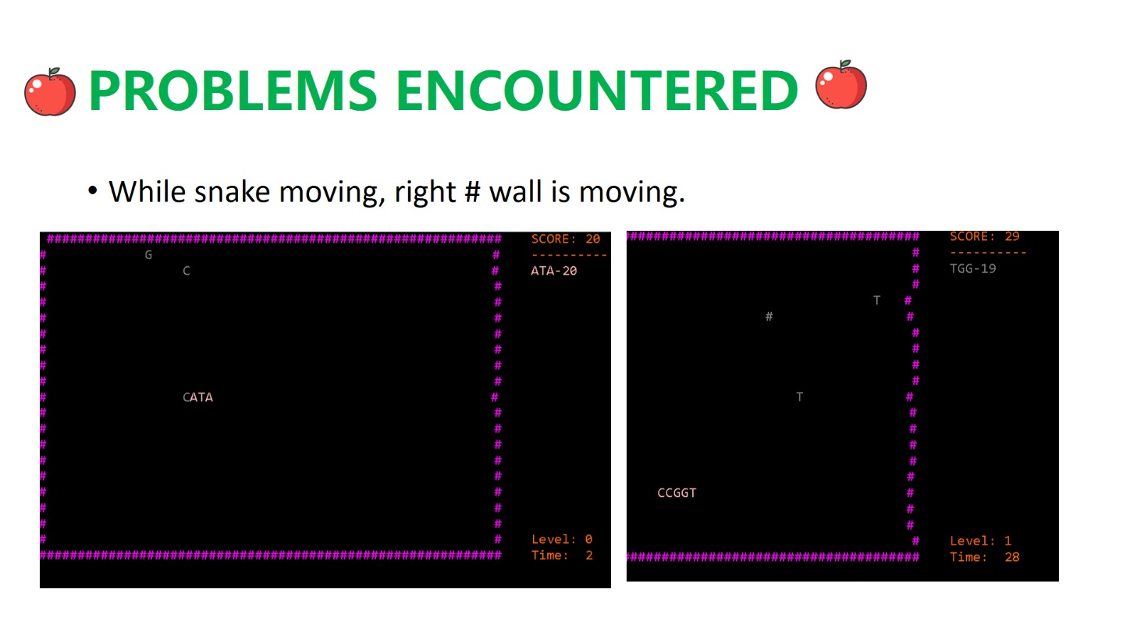

Slide 11

ALGORITHMS AND SOLUTION STRATEGIES SCREENSHOTS

Slide 13
CONCLUSION
We practied and developed our algorithmic skill while trying to understand how classes logic works. We learned methods, classes, things about object logic and so on.
We finished the project efficiently.

Slide 14
REFERENCES
https://www.geeksforgeeks.org/data-structures/linked-list/
https://www.techiedelight.com/reverse-arraylist-java/
https://docs.oracle.com/javase/7/docs/api/java/awt/Color.html

Slide 15

ANY QUESTION?

