Slide 1








Event Proposal
24-Hour AI Game Jam · Fall 2026
Unnatural Intelligence × Game Development Club
Godot 4 · paid Ziva Basic · 24 hours · doors Sat 9:00
Saitsa Clubs Portal · portal.hellorubric.com
Primary Event Organizer — VP, Unnatural Intelligence (Pierre Tchio)
Signature: ____________________ Date: ______________
01

Slide 2
24-Hour AI Game Jam Overview
Description
Overnight Saturday–Sunday jam co-hosted with the Game Development Club. Doors Saturday 9:00. Theme, teams, Godot 4, and Ziva Basic before 10:30. Official build is 24 hours (Sat 10:30 – Sun 10:30). Teams of 2–5 ship a playable Godot prototype. Food is five drops from the attached Curated Catering campus menu only — no Event Palette items. Not a sleepover: leave-and-return allowed; a named exec is on site all night. No alcohol.
Time and Date
Saturday 14 November – Sunday 15 November 2026. Doors Sat 9:00 AM. Official jam Sat 10:30 AM – Sun 10:30 AM. Judging then teardown to ~1:00 PM Sunday. Pending SECC, Campus Security, and the 5 October grant intake.
Proposed Location
Indoor computer-friendly classroom or lab with projector, power, and Wi-Fi (Stan Grad / Heritage Hall). Weekend and after-hours booking by SECC only. Overflow if RSVPs exceed ~40.
Expected Attendance
30 recommended (fully fed, Philippines dinner) / 50 ceiling (pizza dinner). Engine: Godot 4 (free). AI: Ziva Basic at CAD $28/attendee. Cursor is BYO only. PEO: VP, Unnatural Intelligence (Pierre Tchio). Game Dev Club is logistics lead and overnight deputy. Equal budget split.
Primary Event Organizer — [NAME AND EXECUTIVE ROLE]
Signature: ____________________ Date: ______________
02

Slide 3
Agenda — Saturday 9:00 to Sunday afternoon
24 hours of game dev is fixed. Official clock Sat 10:30 – Sun 10:30. Quiet hours 01:00–06:00.
Clock | Segment
Sat 09:00–09:15 | Doors, attendance, power map, both-club sign-ups
Sat 09:15–10:00 | Welcome, rules, secret theme, teams (2–5)
Sat 09:30 | Continental Lite kickoff ($10) — coffee included
Sat 10:00–10:30 | Setup lab: Godot 4 + Ziva Basic redeem
Sat 10:30 | Official start. 24-hour clock begins.
Sat 12:30 | Lunch boxes drop ($16). Eat at desks.
Sat 18:30 | Philippines dinner ($29) · pizza ($6) if 50-person ceiling
Sun 00:00 | Energy bars & bites ($6) midnight drop
Sun 01:00–06:00 | Quiet hours. Leave-and-return. Two-person exec minimum
Sun 08:00 | Signature Breakfast Lite ($12)
Sun 10:30 | Submissions freeze. Godot export + 60-second playable
Sun 10:30–13:00 | Judging, results, send-home, exec teardown
Primary Event Organizer — [NAME AND EXECUTIVE ROLE]
Signature: ____________________ Date: ______________
03

Slide 4
Objectives & labour split
1
Ship a playable Godot game in 24 hours — every team leaves with a running scene.
2
Use paid Ziva Basic as a Godot teammate, not as the designer — human finish.
3
Cross-club recruitment — both clubs sign people up; beginners pair with shippers.
4
Foundations: untapped (AI in Godot overnight), workflow (a real jam), human finish.
Who does what
Unnatural Intelligence | Game Development Club
Files proposal + grant; 50% of cost | Coordinates logistics via SECC; 50% of cost
Ziva Basic redeem + setup lab | Godot install, template, export
First draft of judging rubric | Reviews rubric; co-judges
Named exec on overnight roster | Named exec on overnight roster
Theme together (secret until Sat 9:15) | Theme together
Primary Event Organizer — [NAME AND EXECUTIVE ROLE]
Signature: ____________________ Date: ______________
04

Slide 5
Campus menu only — attached cards
Food quotes are the attached Curated Catering cards, not the Hotel Arts Event Palette. Order via SECC. SAITevents@hotelarts.ca · 403-210-5774. Fees card: +18% service + 5% GST (× 1.239). 20% / 50% deposits after grant approval. Additional staff $30/hr not budgeted. No statutory-holiday surcharge on 14–15 Nov 2026.
Menu card | Base | Loaded | This jam
Continental Lite | $10.00 | $12.39 | Sat 9:30 kickoff
Lunch boxes | $16.00 | $19.82 | Sat 12:30 lunch
Taste of the Philippines | $29.00 | $35.93 | Sat dinner (30 rec.)
Taste of Morocco | $30.00 | $37.17 | Dinner swap (~+$37 / 30)
Pizza, 2 slices | $6.00 | $7.43 | Sat dinner (50 ceiling)
Energy bars & bites | $6.00 | $7.43 | Sun 00:00 midnight
Signature Breakfast Lite | $12.00 | $14.87 | Sun 8:00 breakfast
Sides & add-ons | $1–$6 | — | Not used
Paid Ziva Basic — Cursor is not a grant line
Hobby ($3 usage) will not last 24 hours. Basic is $20 USD/mo = CAD $28.00 (BoC USD/CAD 1.4002 on 18 Sep 2026) with $20 weekly / $60 monthly usage. 30 × $28 = $840. 50 × $28 = $1,400. Cancel after the jam. Stay under the weekly cap with Ziva’s free model plus any attendee’s own Claude Code / Codex. Cursor Pro is the same $20 USD — do not buy 30–50 seats.
Headcount | Ziva Basic @ $28 | Five food drops loaded
30 | $840 | $2,714 (Philippines dinner)
50 | $1,400 | $3,098 (pizza dinner)
Primary Event Organizer — [NAME AND EXECUTIVE ROLE]
Signature: ____________________ Date: ______________
05

Slide 6
Budget A — $4,100 for 30 people
Recommended. Five campus-menu drops including Philippines dinner, Ziva Basic for 30, overnight security placeholder. Split $2,050 / $2,050.
Item | Details | Estimated cost
Posters | Tabloid 11×17, unaltered Saitsa Clubs logo | $10.00
Misc | Tape, markers, unexpected small costs | $5.00
Continental Lite (30) | Sat kickoff @ $10 pp + 18% + GST | $372.00
Lunch boxes (30) | Sat lunch @ $16 pp loaded | $595.00
Philippines (30) | Sat dinner @ $29 pp loaded | $1,078.00
Energy bars (30) | Midnight @ $6 pp loaded | $223.00
Signature Breakfast (30) | Sun @ $12 pp loaded | $446.00
Ziva Basic (30) | CAD $28 / attendee, one month then cancel | $840.00
After-hours security | Placeholder until Security quote | $350.00
Name tags | Printed club templates | $30.00
Power strips | Overnight laptop load | $50.00
First aid + buffer | Overnight kit + dietary / minimums | $101.00
TOTAL | UI $2,050 + Game Dev $2,050. Do not spend before approval. | $4,100.00
Primary Event Organizer — [NAME AND EXECUTIVE ROLE]
Signature: ____________________ Date: ______________
06

Slide 7
Budget B — $5,000 for 50 people
Ceiling. Same five drops but pizza dinner ($6) instead of Philippines ($29) — the $29 buffet at 50 people is $1,797 loaded and does not fit with Ziva Basic. Split $2,500 / $2,500. Do not go above 50.
Item | Details | Estimated cost
Posters | Tabloid 11×17, unaltered Saitsa Clubs logo | $10.00
Misc | Tape, markers, unexpected small costs | $5.00
Continental Lite (50) | Sat kickoff @ $10 pp loaded | $620.00
Lunch boxes (50) | Sat lunch @ $16 pp loaded | $991.00
Pizza (50) | Sat dinner @ $6 pp loaded (2 slices) | $372.00
Energy bars (50) | Midnight @ $6 pp loaded | $372.00
Signature Breakfast (50) | Sun @ $12 pp loaded | $743.00
Ziva Basic (50) | CAD $28 / attendee, one month then cancel | $1,400.00
After-hours security | Placeholder until Security quote | $250.00
Name tags | Printed club templates | $50.00
Power strips | Higher laptop load | $60.00
First aid + buffer | Overnight kit + dietary / minimums | $127.00
TOTAL | UI $2,500 + Game Dev $2,500. Do not spend before approval. | $5,000.00
Primary Event Organizer — [NAME AND EXECUTIVE ROLE]
Signature: ____________________ Date: ______________
07

Slide 8
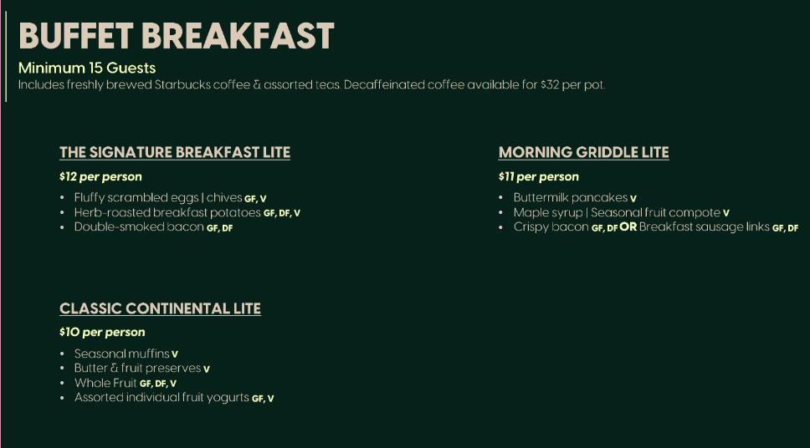
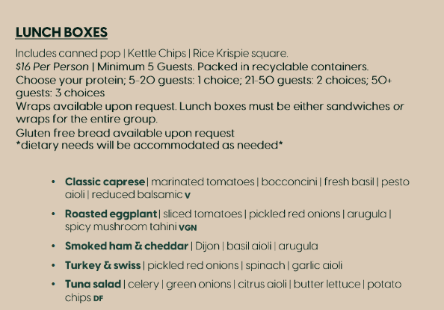
Quoted menu — breakfast & lunch
Attached Curated Catering cards. Base prices; add 18% + GST (× 1.239).
Continental Lite $10 (Sat kickoff) · Signature Breakfast Lite $12 (Sun 8:00). Min 15. Coffee included.
Lunch boxes $16. Min 5. 21–50 guests = 2 protein choices. Sat 12:30.
Primary Event Organizer — [NAME AND EXECUTIVE ROLE]
Signature: ____________________ Date: ______________
08

Slide 9
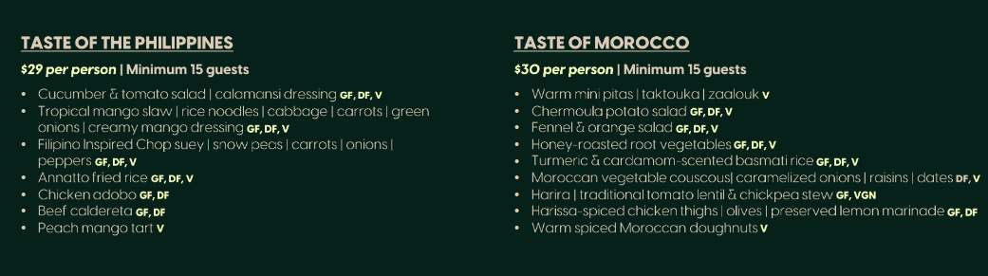
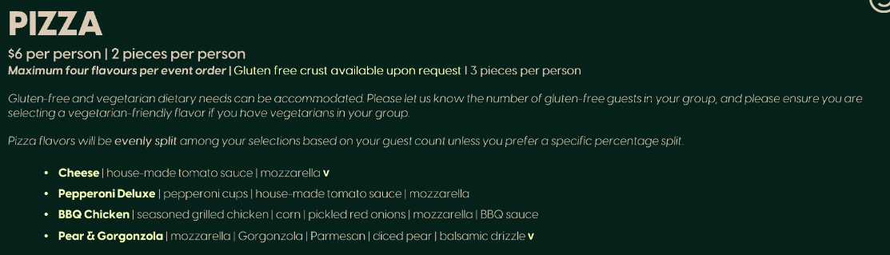
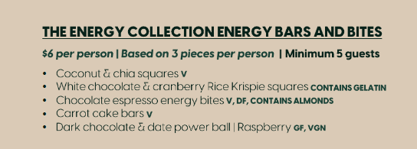
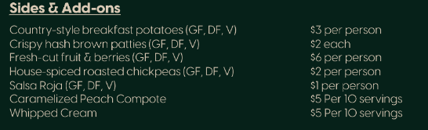
Quoted menu — dinner & midnight
Philippines $29 (30-person dinner) · Morocco $30 (swap). Min 15 guests.
Pizza $6 / 2 slices. 50-person ceiling dinner. Max four flavours.
Energy bars & bites $6 / 3 pieces. Midnight drop. Min 5 guests.
Sides & add-ons — not used in these budgets.
Primary Event Organizer — [NAME AND EXECUTIVE ROLE]
Signature: ____________________ Date: ______________
09

Slide 10
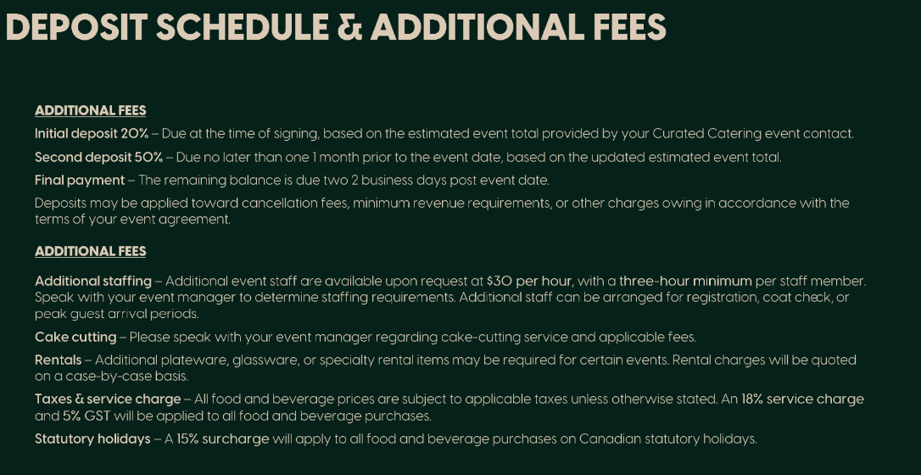
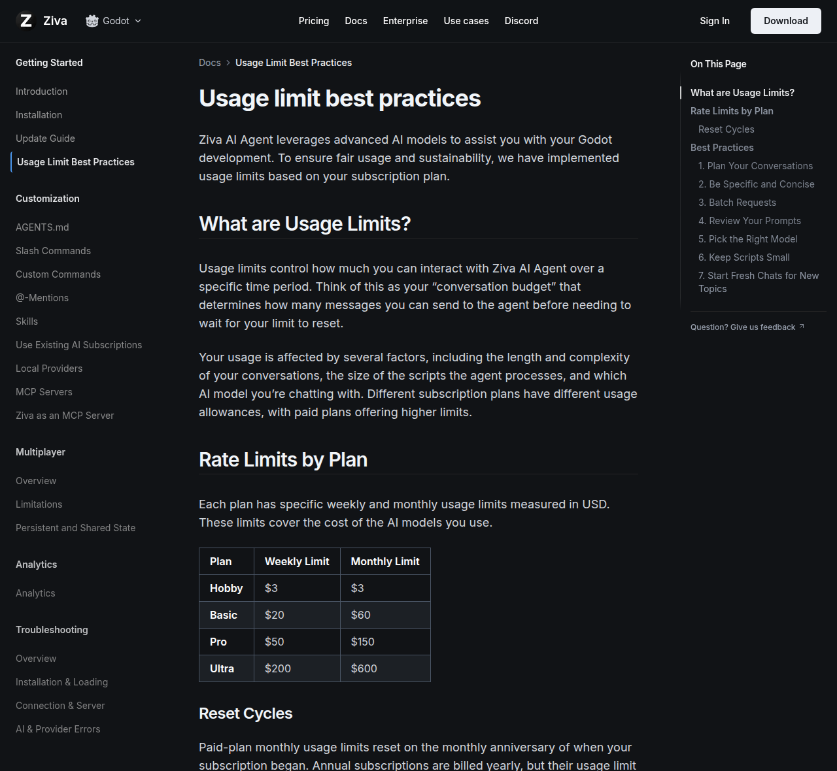
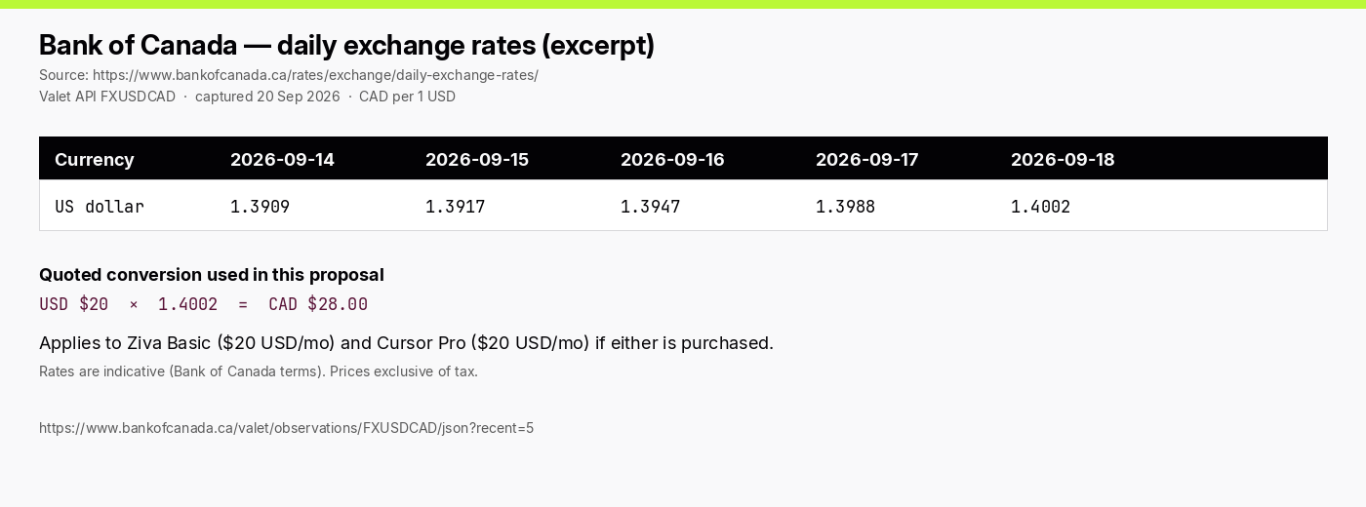
Quoted fees, Ziva, FX
18% service + 5% GST on all food. 20% / 50% deposits after grant approval. Staff $30/hr not budgeted.
Ziva Basic $20 USD / $60 usage — the paid SKU for every attendee. Hobby $3 is too small for 24 hours.
BoC FXUSDCAD 18 Sep 2026 = 1.4002 → USD $20 = CAD $28.00.
Primary Event Organizer — [NAME AND EXECUTIVE ROLE]
Signature: ____________________ Date: ______________
10

Slide 11

Logistics, Risk & Compliance
• Room booking coordinated exclusively by the SECC. Game Dev logistics lead files through them.
• Risk: medium. Indoor, no alcohol, no sport — after-hours, fatigue, food, laptops. Written exec roster; PEO or deputy always on site.
• After-hours with SECC and Campus Security. Occupants staying after facility hours listed. Booked work session, not an unsanctioned sleepover. Quiet hours 01:00–06:00.
• Food only through Curated Catering via SECC, using the attached campus menu cards. Dietary needs on RSVP. Drops 9:30, 12:30, 18:30, 00:00, 08:00.
• A/V returned after Sunday teardown (~13:00). Attendance list signed. Posters tabloid 11×17, Saitsa Clubs logo unaltered, $10 built-in.
• Disclose the 50/50 sister-club contribution. No spend before approval. Unused grant (including unspent security) is reclaimed.
• Ziva Basic is one month of event access, then cancelled — not a member gift. Do not buy Cursor for the room.
Promotion Plan
• Posters on Saitsa General Poster Boards (approved submission first).
• Both clubs’ Discord, Instagram, Teams, and Rubric RSVP. Cap 50; waitlist after that.
• Clubs Fall Expo / Showcase (13–14 October 2026) if the jam is after it.
• Pitch: Godot + Ziva Basic, 24 hours, doors Saturday 9:00, meals included, beginners welcome.
Primary Event Organizer — VP, Unnatural Intelligence (Pierre Tchio)
Signature: ____________________ Date: ______________
11

