Slide 1
Understanding the Nature of Environmental Science
Lesson 1

Slide 2
Understanding the Nature of Environmental Science
Environmental Principles
Environmental Ethics
Ecological Concept

Slide 3
Learning Objectives
At the end of this lesson, students should be able to:
Define environmental science and explain its importance.
Identify key environmental principles.
Understand environmental ethics and their role in decision-making.
Apply concepts to real-life environmental issues.
Identify key ecological concepts.

Slide 4
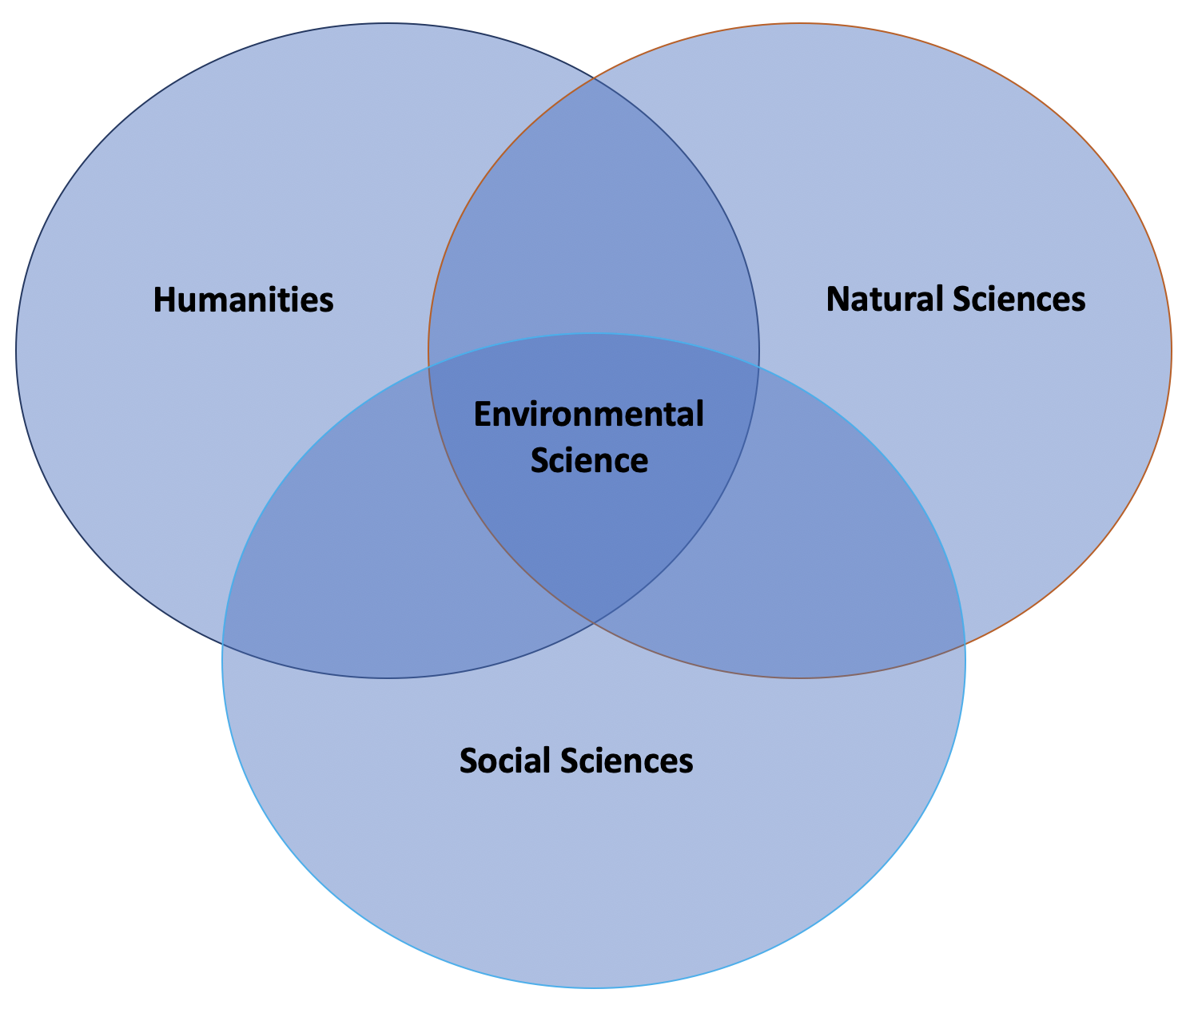
Environmental Science
Environmental science is the dynamic, interdisciplinary study of the interaction of living and non-living parts of the environment, with special focus on the impact of humans on the environment.
Environmental science includes disciplines in the physical sciences (like geology, soil science, physical geography, chemistry, and atmospheric sciences), life sciences (like ecology, conservation biology, restoration biology, and population biology), social sciences (like human geography, economics, law, political science, and anthropology), and humanities (philosophy, ethics).

Slide 5
Environmental Principles
To understand how the world works, we follow several core ecological principles. These serve as the "ground rules" for nature.

Slide 6
Environmental Principles
Everything is connected to everything else (Interdependence).
All forms of life are important (Diversity).
Nature knows best.
Ours is a finite earth (Resource Management).
Nature is beautiful, and we are stewards of God’s creation.
Everything changes.
Everything must go somewhere

Slide 7
Environmental Principles
1. Everything is connected to everything else (Interdependence)
Nature is a complex web. If you change one part of an ecosystem (e.g., removing a predator), it creates a ripple effect that impacts all other parts (e.g., overpopulation of prey and depletion of vegetation).
2. All forms of life are important (Diversity)
Biodiversity is the backbone of ecosystem resilience. A variety of species ensures that an ecosystem can survive diseases, climate shifts, or disasters.

Slide 8
Environmental Principles
3. Nature knows best
Nature has evolved self-regulating mechanisms over billions of years. When humans attempt to "improve" nature, it often leads to unforeseen negative consequences.
4. Ours is a finite earth (Resource Management)
Earth’s resources, water, minerals, and space, are not infinite. We must live within the "carrying capacity" of our planet.

Slide 9
Environmental Principles
5. Nature is beautiful and we are stewards of God’s creation
This principle bridges science and morality. It suggests that humans have a responsibility (Stewardship) to protect the environment not just for its utility, but for its intrinsic value.
6. Everything changes
Nature is dynamic, not static. Ecosystems go through succession, and species evolve. Human-induced change, however, often happens too fast for nature to adapt.
7. Everything must go somewhere
Waste does not disappear; it accumulates in land, air, or water.

Slide 10
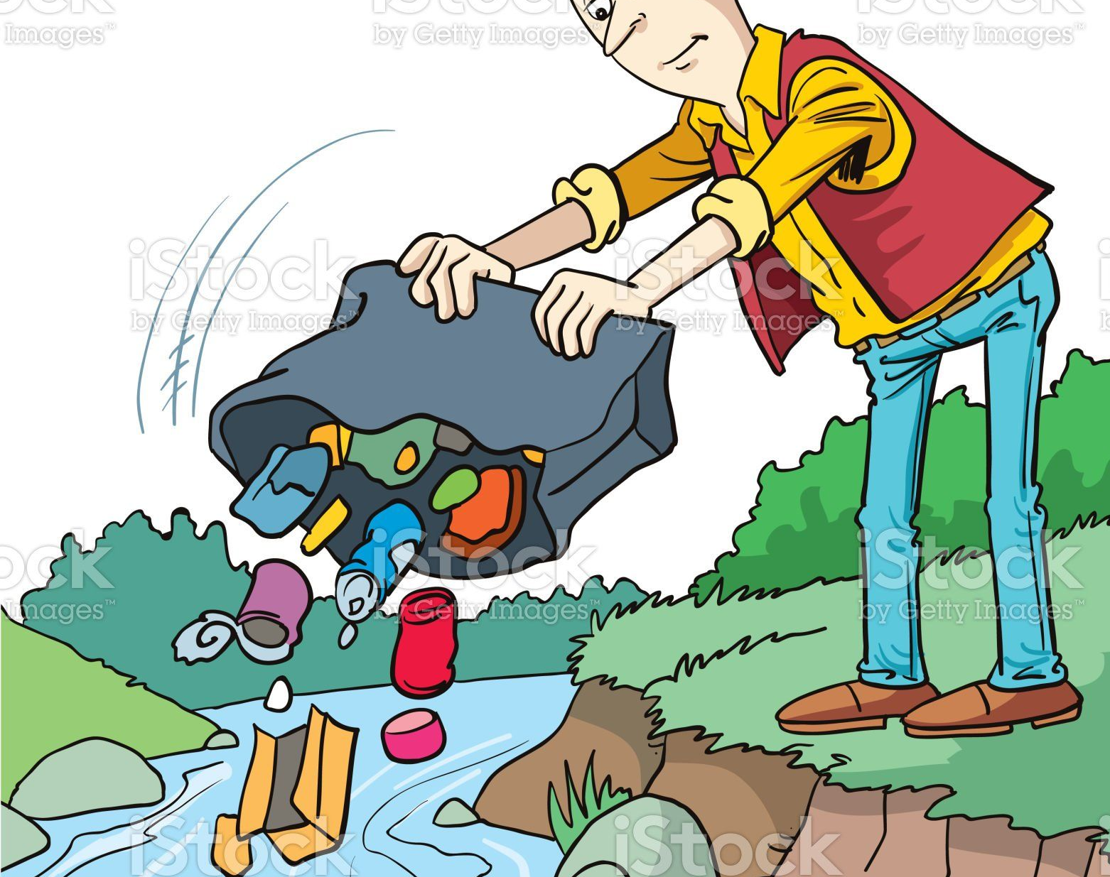
How does throwing plastic affect the environment?

Slide 11
Environmental Ethics
What is the right thing to do for nature?

Slide 12
Environmental Ethics
Environmental ethics is the branch of philosophy that studies the moral relationship of human beings to the environment.
It is the study of how humans should treat the environment.

Slide 13
Three Primary Worldviews
1. Anthropocentrism (Human-Centered)
2. Biocentrism (Life-Centered)
3. Ecocentrism (System-Centered)

Slide 14
1. Anthropocentrism (Human-Centered)
Humans are the most significant entity in the universe.
Nature is used for human benefit.
Perspective: Nature has value only in how it serves human needs (economic, recreational, or medical).
Example
Protecting a forest only because it provides timber or clean water for a city.
Cutting forests for development.

Slide 15
2. Biocentrism (Life-Centered)
All living things have intrinsic value, regardless of their usefulness to humans.
Humans are not superior.
Perspective: Every individual organism, from a whale to a blade of grass, has a "right to exist.“
Example
Opposing a dam because it would destroy a unique species of fish, even if the dam provides electricity.

Slide 16
3. Ecocentrism (Nature-Centered)
The entire ecosystem (including non-living components like soil and water) is the focus of moral concern.
Entire ecosystems are valuable.
Focus on balance and sustainability.
Perspective: It is not just about individuals, but about the integrity of the whole system.
Example:
  A community stops building resorts near a coral reef to preserve marine life and ecosystem health.
  A government decides to protect a forest from logging, even if it could generate profit, because the forest is important for wildlife habitats, clean air and water, and ecological balance.

Slide 17
Core Ethical Principles
Stewardship – Humans must care for the Earth.
Sustainability – Use resources without harming future generations.
Responsibility – Be accountable for environmental actions.
Justice – Fair sharing of resources.

Slide 18
Preservation versus Conservation
Conservation (The Wise-Use Approach)
Championed by Gifford Pinchot.
It argues that we should use resources sustainably "for the greatest good for the greatest number for the longest time.“
Preservation (The Hands-Off Approach)
Championed by John Muir.
It argues that nature should be protected in its pristine state, untouched by human development.

Slide 19
Questions for Reflection
Which of the three worldviews (Anthropocentrism, Biocentrism, or Ecocentrism) best describes your own view?

Slide 20
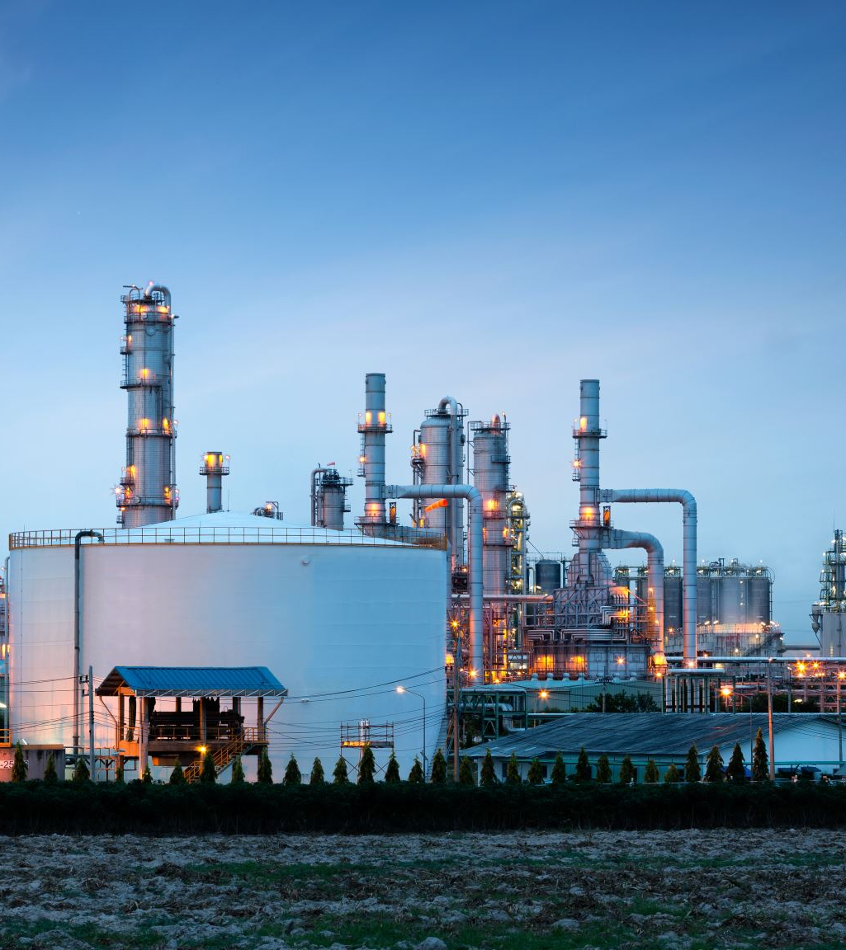
Case Study
A company plans to build a factory near a river.
Is this ethical?
What environmental impacts may occur?
Which ethical view supports or opposes it?

Slide 21

Importance of Environmental Science
Environmental science helps:
Protect natural resources.
Prevent environmental damage.
Promote sustainable living.
Improve human health.

Slide 22
Ecological Concepts

Slide 23
What is Ecology?
Ecology is the study of interactions between organisms and their environment.

Slide 24
Levels of Organization in Ecology
From smallest to largest:
Organism – a single living individual.
Population – a group of the same species living in one area.
Community – different species living together
Ecosystem – living (biotic) + non-living (abiotic) components
Biome – large area with similar climate (e.g., desert, forest)
Biosphere – all ecosystems on Earth

Slide 25
Biotic and Abiotic Factors
Biotic factors – living components (plants, animals, bacteria)
Abiotic factors – non-living components (sunlight, water, temperature, soil)
Organisms depend on:
  Temperature
  Water
  Light
  Soil nutrients
If these change, organisms may:
Adapt
Migrate
Become extinct

Slide 26
Habitat versus Niche
Habitat – where an organism lives.
Niche – the role or function of an organism in its environment.
Example:
A frog’s habitat = pond
Its niche = predator of insects and prey for snakes

Slide 27
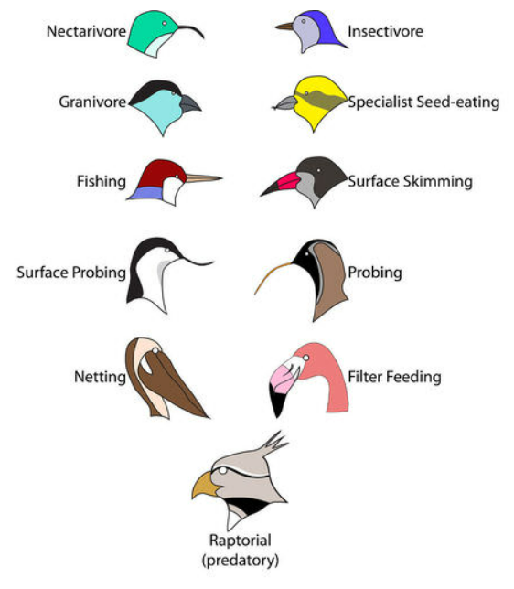
Bird Niches.
Each of these species of birds has a beak that suits it for its niche.
The long, slender beak of the nectarivore allows it to sip liquid nectar from flowers.
The short, sturdy beak of the granivore allows it to crush hard, tough grains.

Slide 28
Next Meeting

Slide 29
Advance Study Task
Before our next meeting, review and familiarize yourself with the organisms that I will provide.
You do NOT need to write anything, just be ready to recognize and understand them.
Be prepared to use this knowledge in our next activity.

Slide 30
Organisms
Wheat
Deer
Fly maggot
Pine tree
Algae
Bear
Hawk
Rabbit
Millipede
Bacteria
Sparrow
Mouse
Frog
Snake

Slide 31
Organisms
Bacteria & Human intestines
Spanish moss & Trees
Dogs & Fleas
Squirrels & Trees
Whales & Barnacles
Butterfly & Flower
Figs & Fig wasps
Remora & Sharks
Tawny owl & Mice
Field digger wasp & Fly
Clown fish & Sea anemone
Venus fly trap & Insects
Rafflesia plant & Vine
Ants & Acacia trees
Tapeworm & Mammal
Trees & Orchids
Human head & Lice
Trees & Mistletoe
Yucca moth & Yucca plant
Eagle & Rabbit

