Slide 1

Population Ecology
Lesson 2

Slide 2
Population Ecology
Population Dynamics
Human Populations

Slide 3
Learning objectives
At the end of this lesson, students should be able to:
Describe how ecologists measure population size and density.
Describe three different patterns of population distribution.
Explain how the carrying capacity of a habitat may change.
Describe human population patterns and trends.

Slide 4
POPULATION ECOLOGY
Population Ecology is the study of how populations of organisms interact with their environment over time.

Slide 5
Key Population Characteristics
Population Size (N)
Population Density
Population Distribution
Clumped
Uniform
Random

Slide 6
POPULATION SIZE (N)
Population size refers to the total number of individuals of a species in each area at a specific time.
It gives a basic idea of how large or small a population is.
Examples:
A forest has 200 deer → Population size = 200
A classroom has 40 students → Population size = 40
A city has 1 million people → Population size = 1,000,000

Slide 7
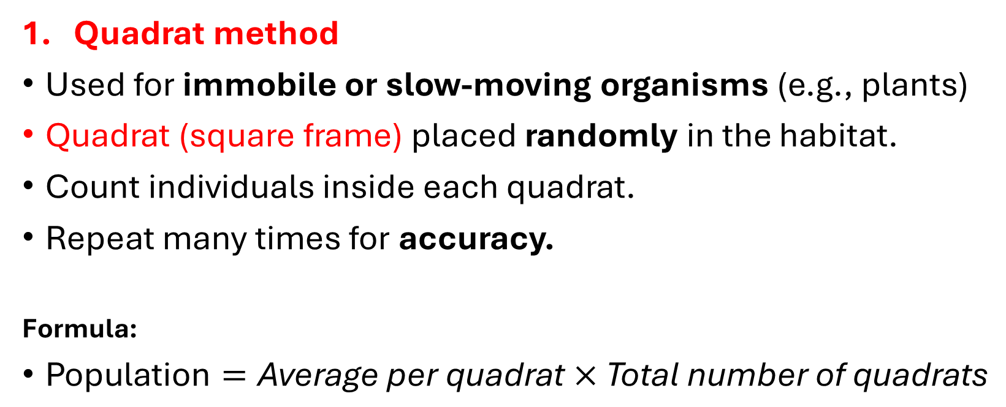
Estimating population size
Quadrat method
Used for immobile or slow-moving organisms (e.g., plants)
Quadrat (square frame) placed randomly in the habitat.
Count individuals inside each quadrat.
Repeat many times for accuracy.
Formula:
$\text{Population}=\text{Average} \text{per} \text{quadrat}×\text{Total} \text{number} \text{of} \text{quadrats}$

Slide 8
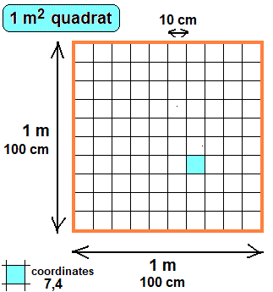
Quadrat method

Slide 9
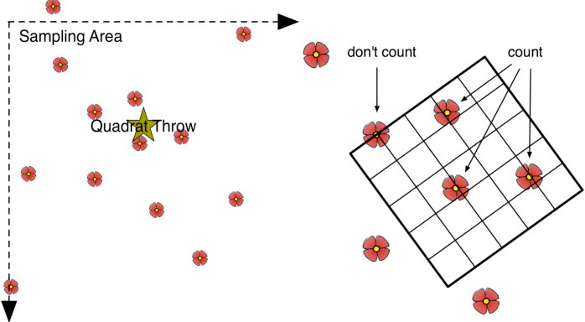
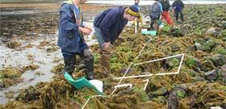

Slide 10
Example:
A researcher wants to estimate the number of grass plants in a field.
A 1 m × 1 m quadrat is placed randomly on the ground 10 times.
The number of plants counted in each quadrat:
12, 15, 10, 13, 14, 11, 16, 12, 13, 14
Step 1: Find the average
Total = 130 plants
Average = 130 ÷ 10
= 13 plants per m²
Step 2: Estimate total population
If the field is 100 m²:
Estimated population = 13 × 100 = 1300 plants
About 1300 plants are estimated in the whole field based on the sample.

Slide 11
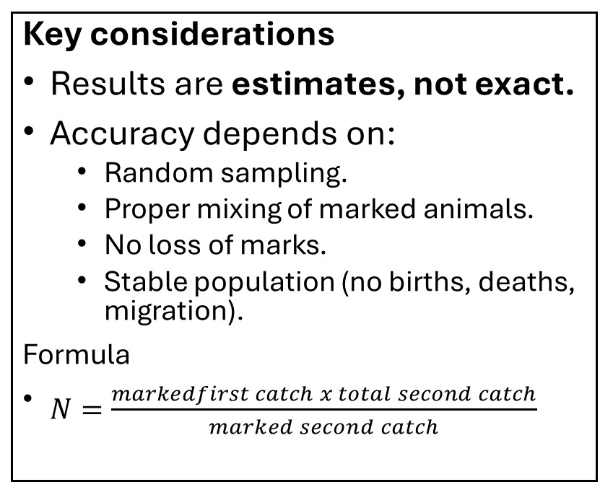
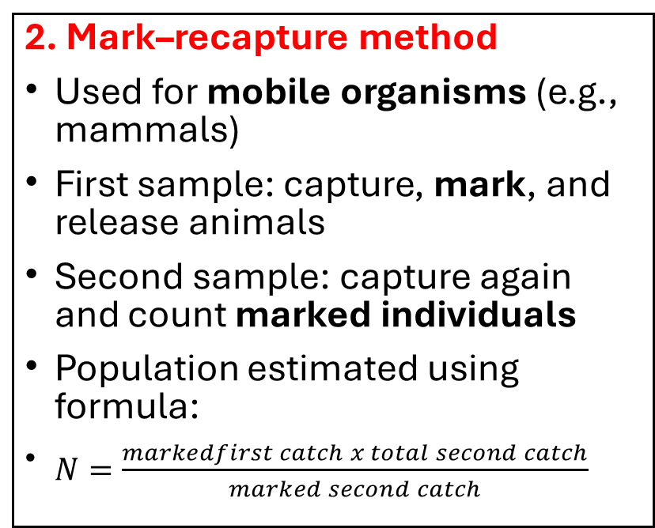
Cont.
2. Mark–recapture method
Used for mobile organisms (e.g., mammals)
First sample: capture, mark, and release animals
Second sample: capture again and count marked individuals
Population estimated using formula:
$N=\frac{markedfirst catch x total second catch}{marked second catch}$
Key considerations
Results are estimates, not exact.
Accuracy depends on:
  Random sampling.
  Proper mixing of marked animals.
  No loss of marks.
  Stable population (no births, deaths, migration).
Formula
$N=\frac{markedfirst catch x total second catch}{marked second catch}$

Slide 12
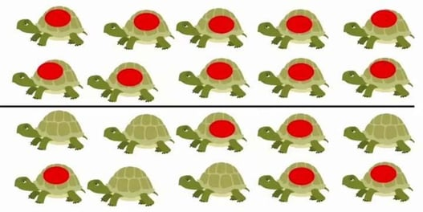
Mark–recapture method

Slide 13
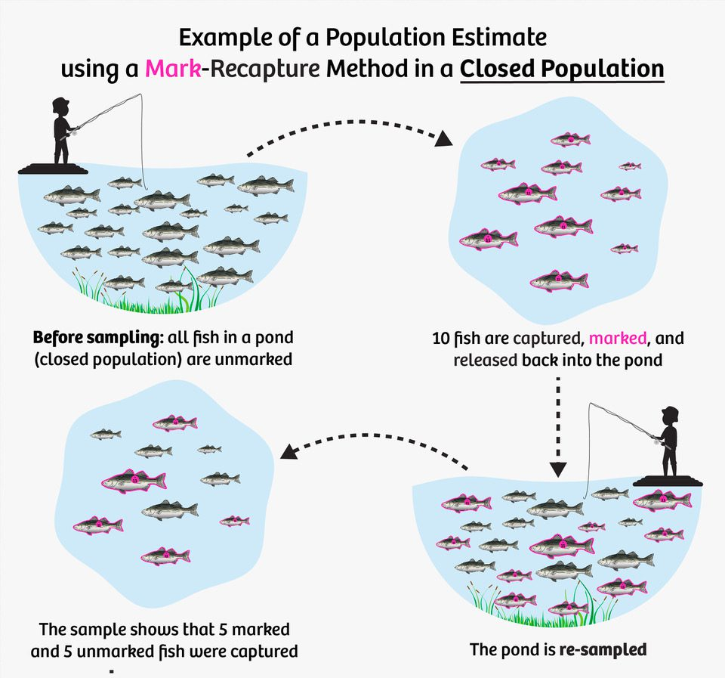
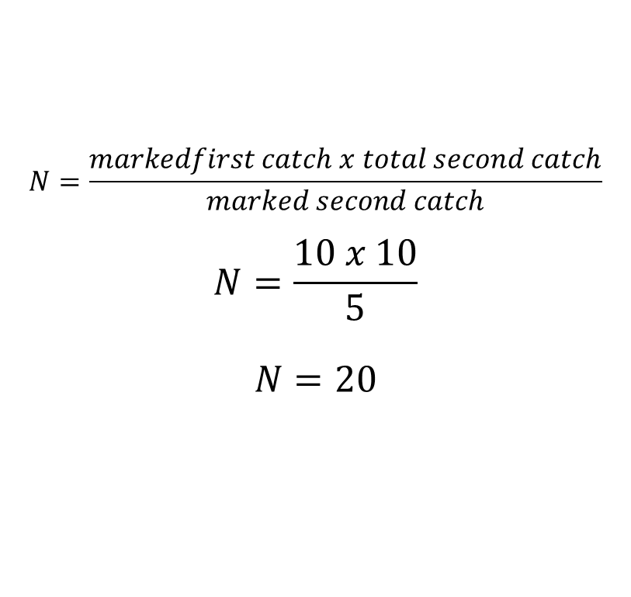
$$N=\frac{markedfirst catch x total second catch}{marked second catch}$$
$$N=\frac{10 x 10}{5}$$
$$N=20$$

Slide 14
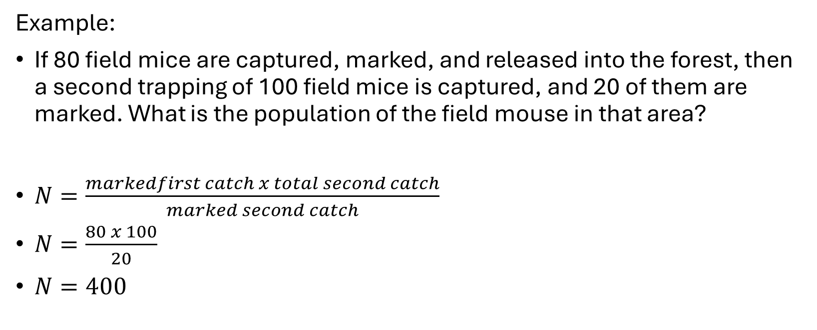
Try this!
Example:
If 80 field mice are captured, marked, and released into the forest, then a second trapping of 100 field mice is captured, and 20 of them are marked. What is the population of the field mouse in that area?
$N=\frac{markedfirst catch x total second catch}{marked second catch}$
$N=\frac{80 x 100}{20}$
$N=400$

Slide 15
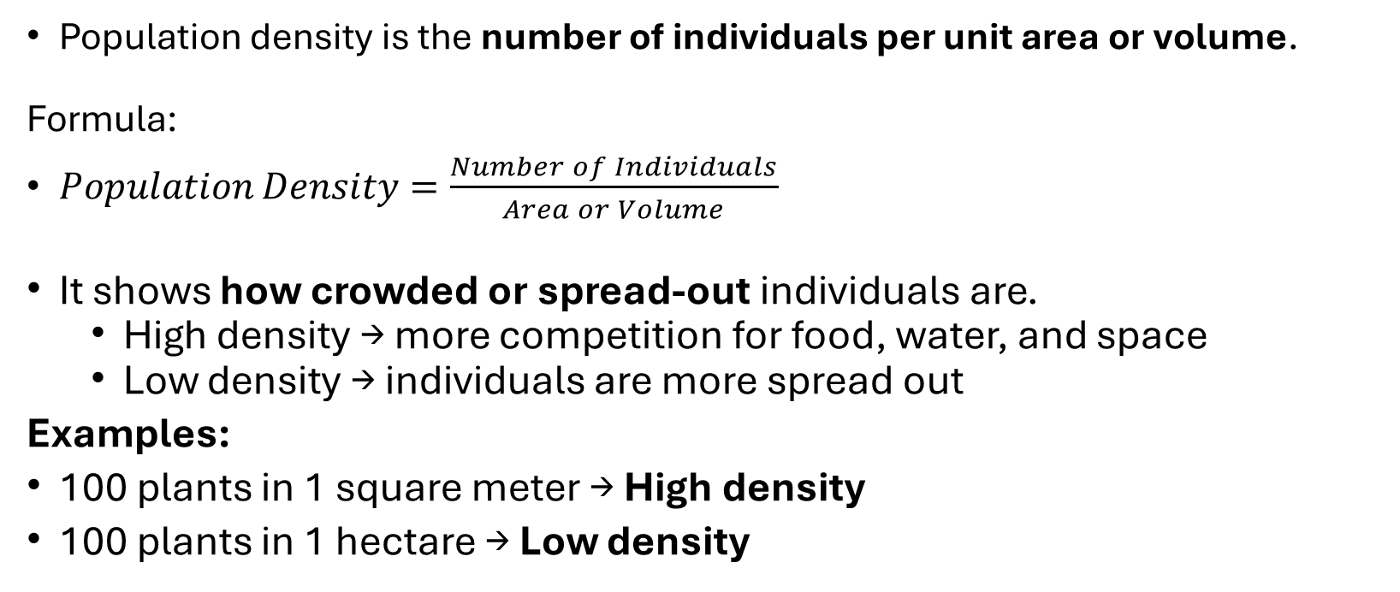
POPULATION DENSITY
Population density is the number of individuals per unit area or volume.
Formula:
$Population Density=\frac{Number of Individuals}{Area or Volume}$
It shows how crowded or spread-out individuals are.
  High density → more competition for food, water, and space
  Low density → individuals are more spread out
Examples:
100 plants in 1 square meter → High density
100 plants in 1 hectare → Low density

Slide 16
Examples:
Urban areas (cities) → high population density.
Deserts → low population density
Why it matters:
High density can lead to
  Disease spread
  Competition
Low density can make
  Finding mates difficult.

Slide 17
POPULATION DISTRIBUTION (DISPERSION)
Population distribution refers to how individuals are spaced within a given area.
Three main types:
Clumped Distribution
Uniform Distribution
Random Distribution

Slide 18
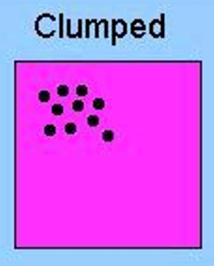
1. Clumped Distribution
Individuals are grouped in patches.
Why did it happen?
  Resources are concentrated in certain areas.
  Protection from predators.
  Social behavior (living in groups).
The most common type of distribution in nature.

Slide 19
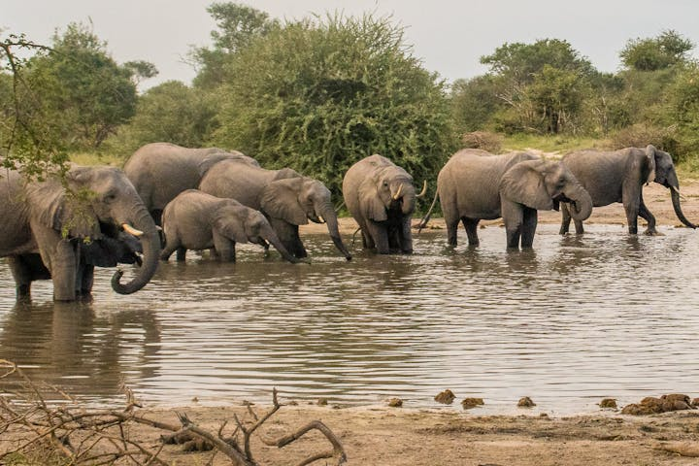
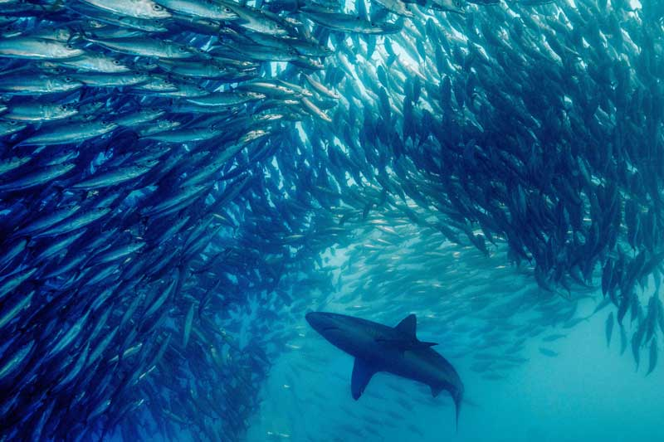
Examples
1. African Elephants
Elephants gather in groups around rivers and watering holes, especially during dry seasons.
Reason:
  Water is limited and found only in certain places.
2. Schools of Fish
Fish such as sardines or tuna move in large groups in the ocean.
Reason:
  Protection from predators.
  Easier to find food.

Slide 20
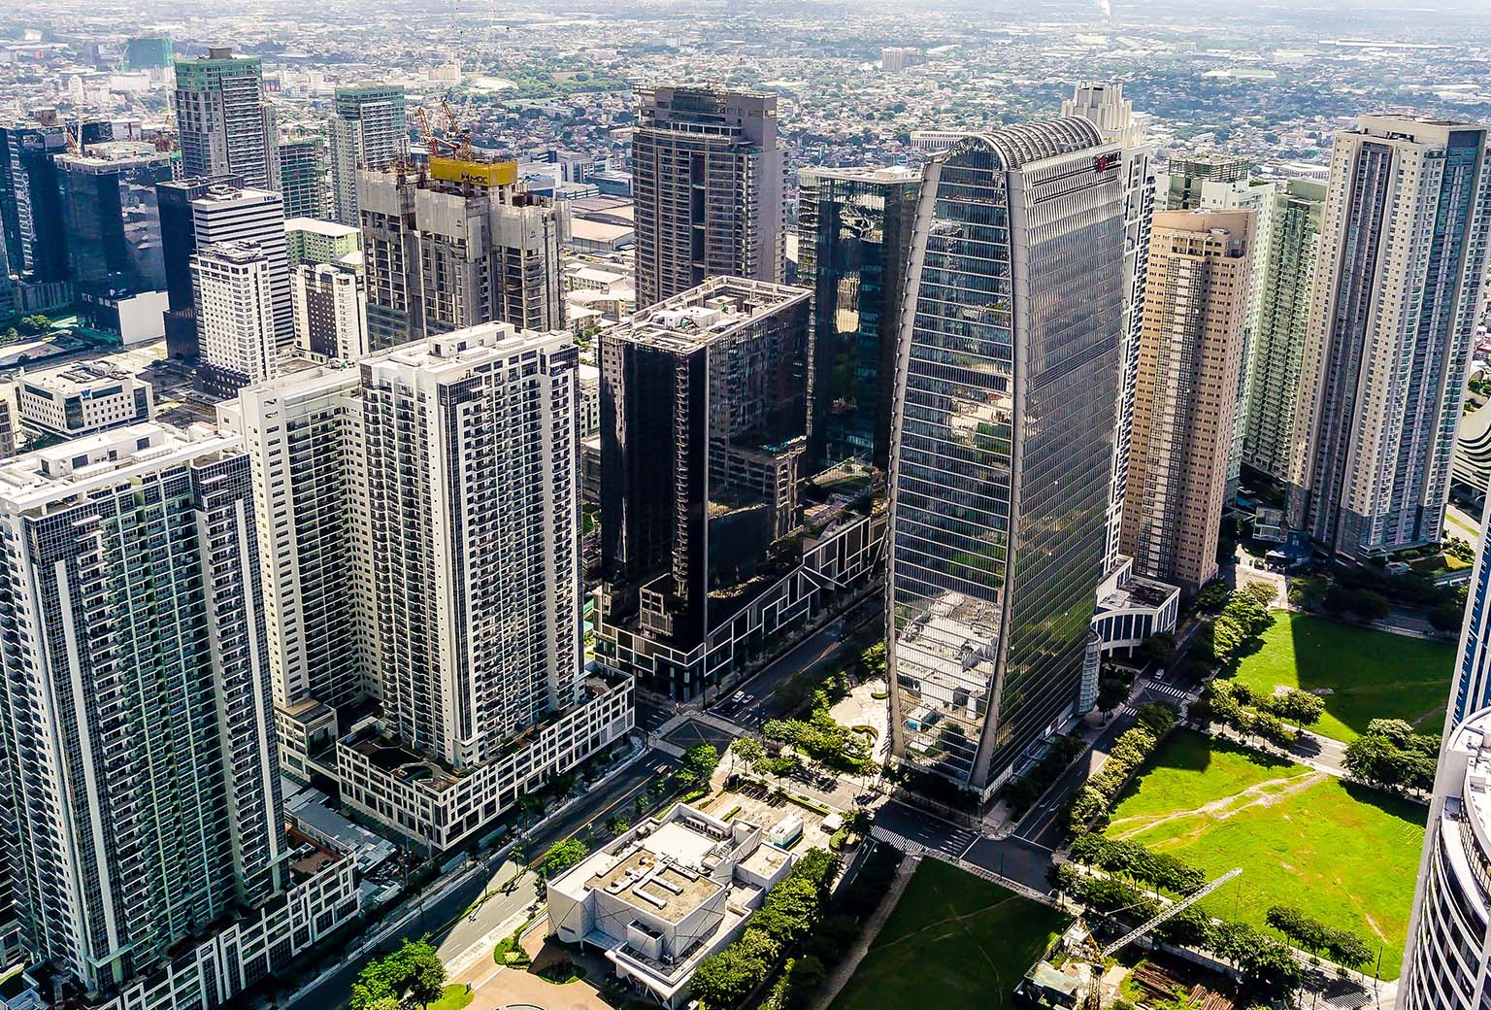
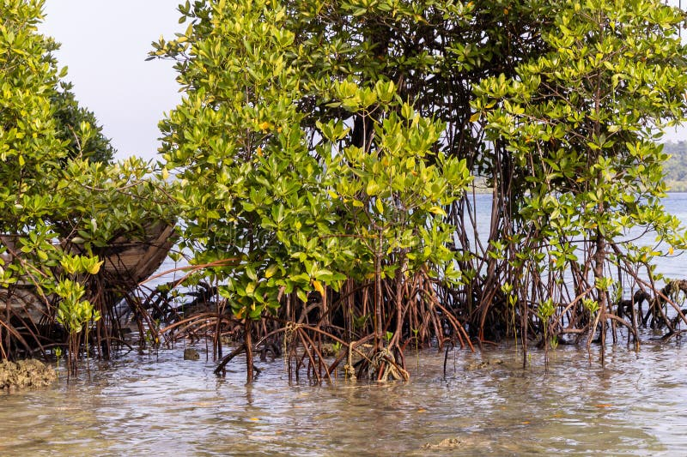
Examples
3. Human Populations (Cities)
People live close together in cities like Manila, Tokyo, or New York.
Reason:
  Jobs
  Access to services (schools, hospitals)
  Transportation
4. Trees in Fertile Areas
Trees often grow in clusters where soil and water are favorable.
Example: Mangrove forests along coastal areas.
Reason:
  Suitable environmental conditions exist only in certain places.

Slide 21
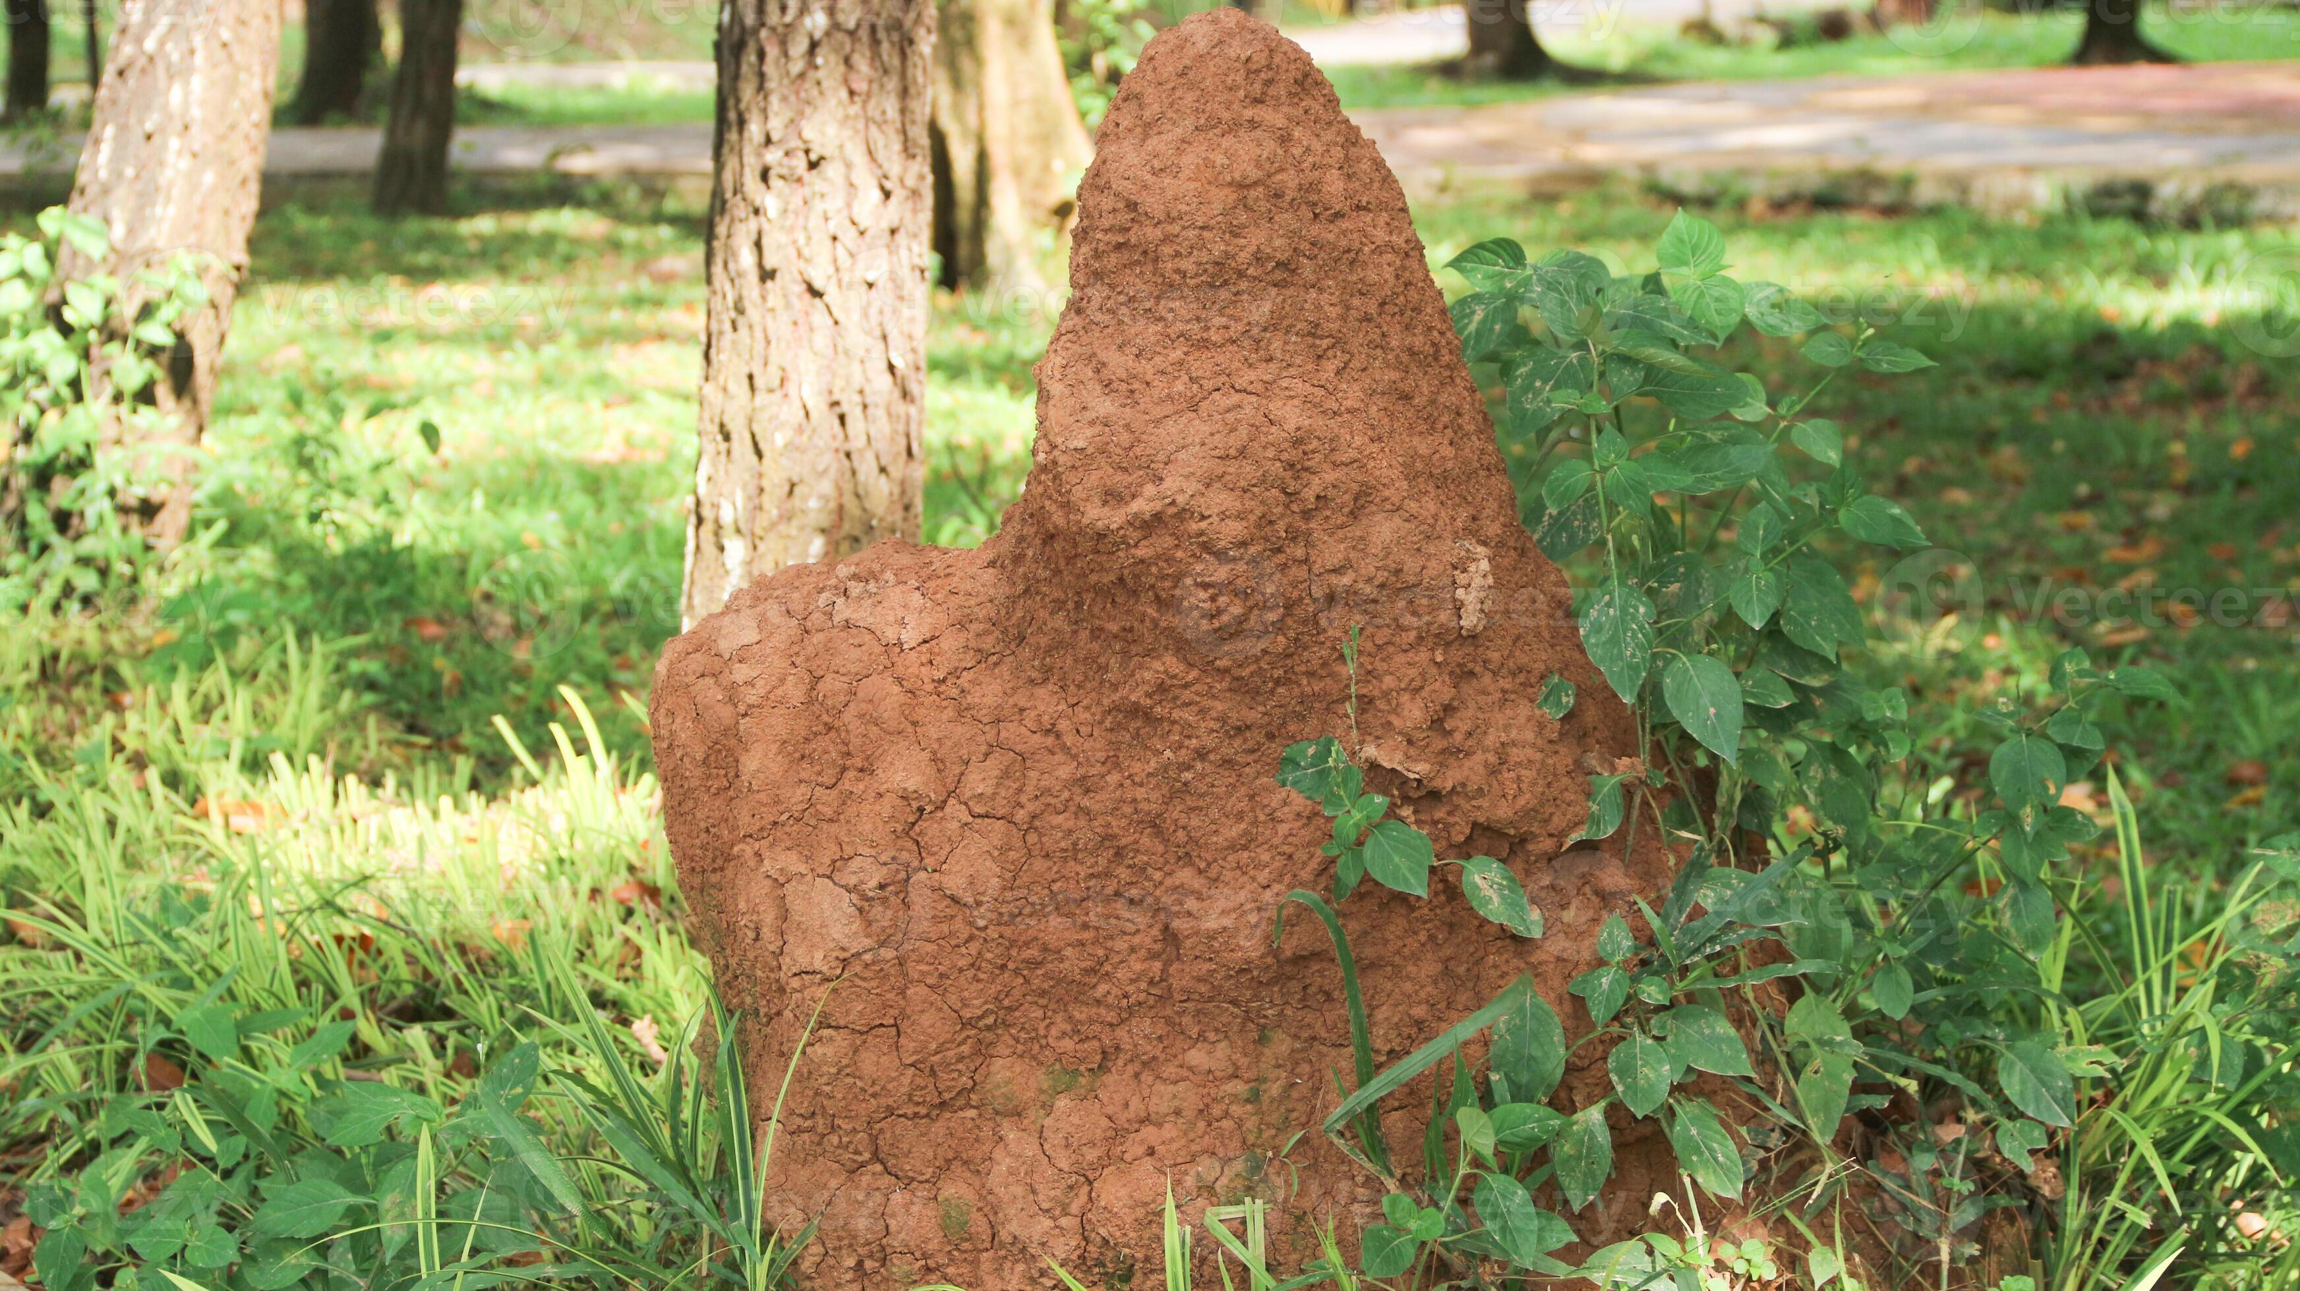
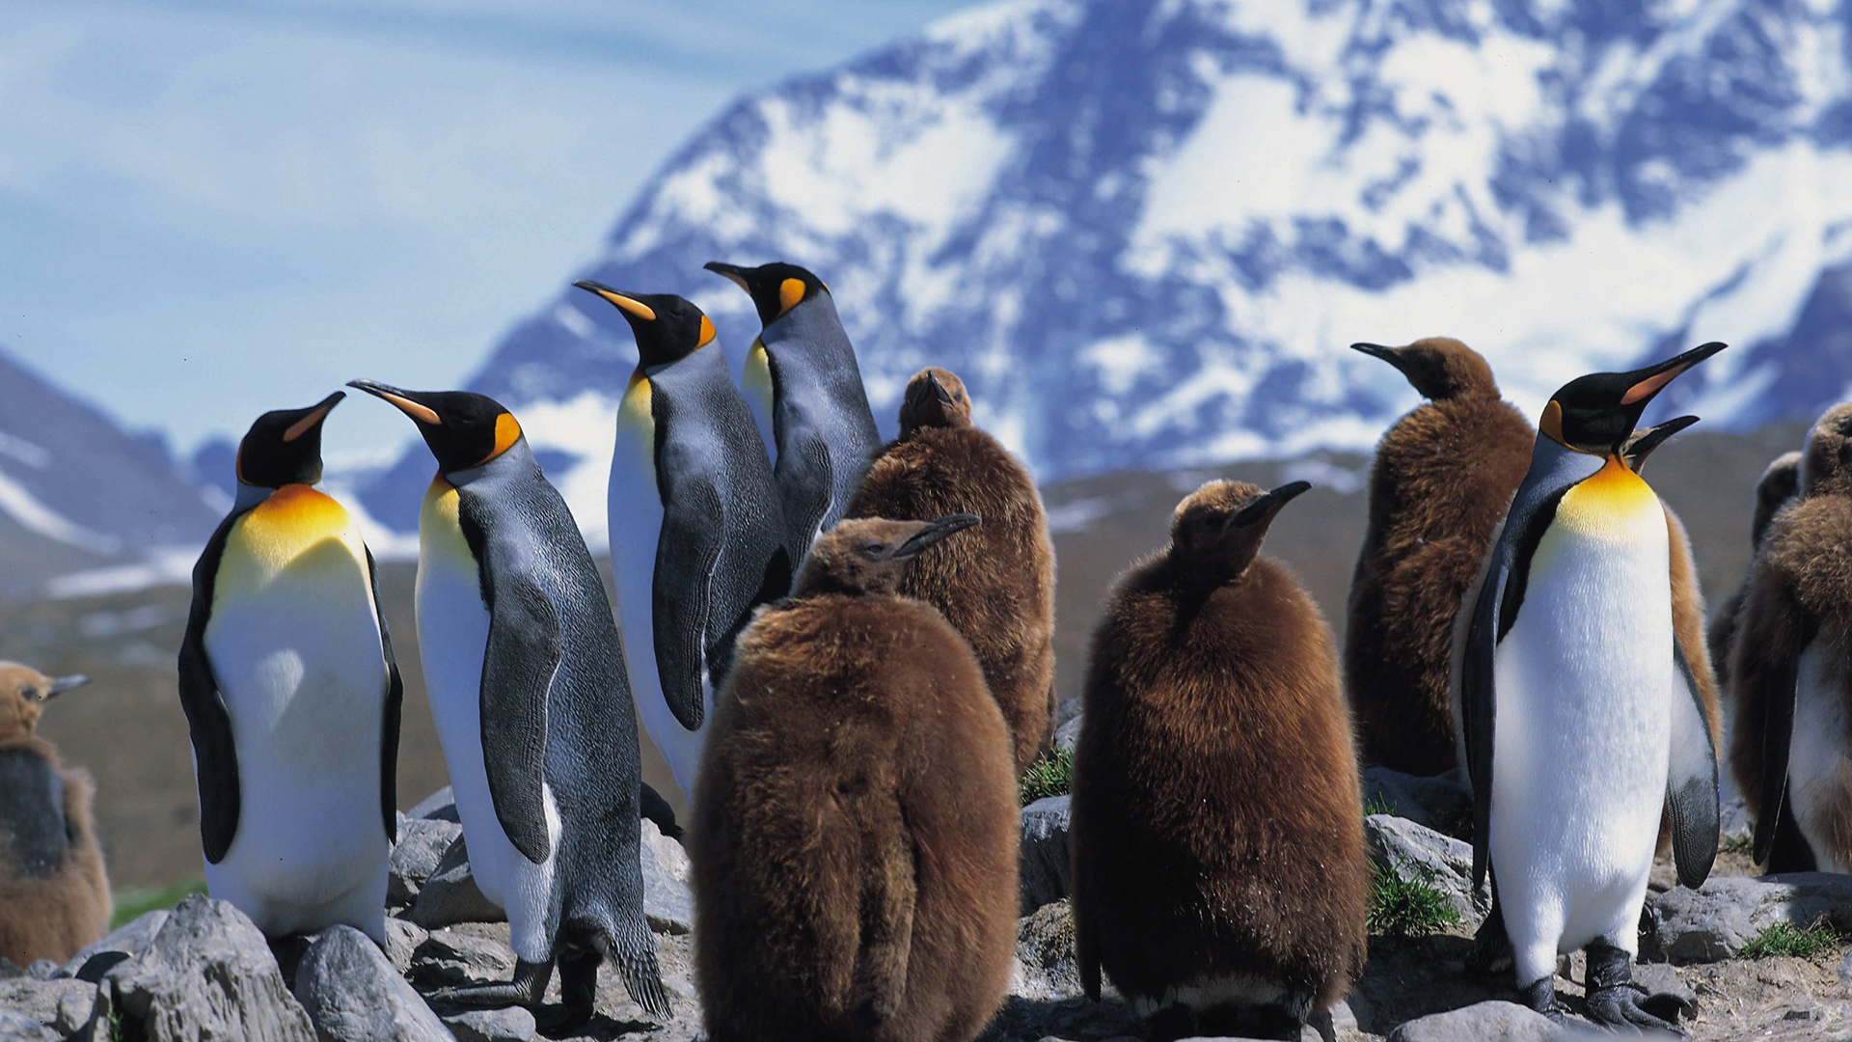
Examples
5. Ant Colonies
Ants live together in colonies or nests.
Reason:
  Social behavior and cooperation
Example: Anthills found in yards or forests.
6. Penguin Colonies
Penguins gather in large groups during breeding season.
Reason:
  Protection against predators.
  Warmth in cold environments.
Example: Emperor penguins in Antarctica.

Slide 22
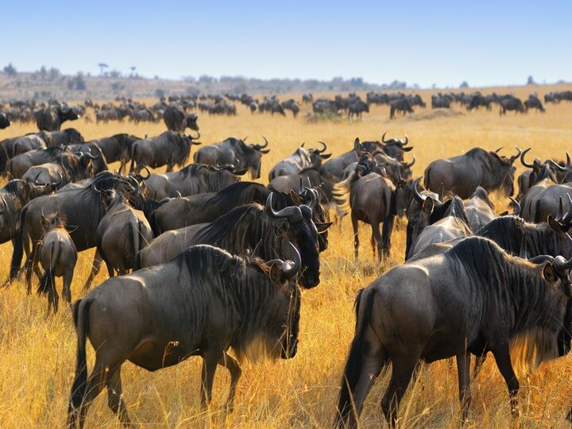

Examples
7. Grazing Animals (Cows, Zebras, Wildebeest)
Herbivores gather in herds in grasslands.
Reason:
  Safety in numbers
  Availability of grass
Example: Wildebeest migration in Africa
8. Bird Nesting Colonies
Birds like herons or seagulls nest close together.
Reason:
  Protection and breeding advantage
Example: Seagulls nesting on cliffs

Slide 23
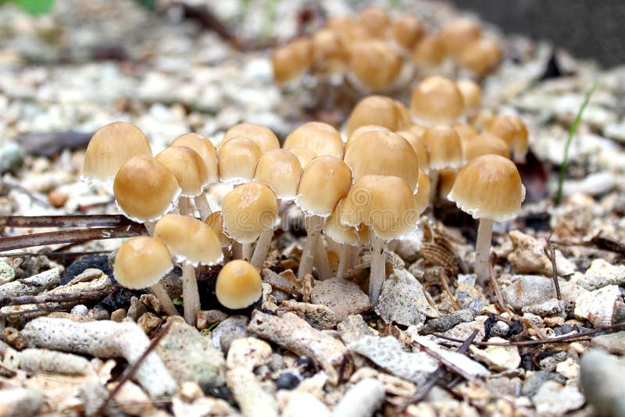
Example
9. Mushrooms After Rain
Mushrooms often grow in clusters in moist areas.
Reason:
  Favorable conditions (moisture, organic matter)

Slide 24
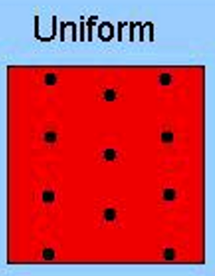
2. Uniform Distribution
Individuals are evenly spaced from each other.
Why did it happen?
  Competition for resources.
  Territorial behavior.
Spacing is regular because individuals repel each other.

Slide 25
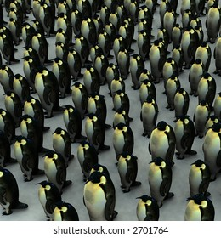
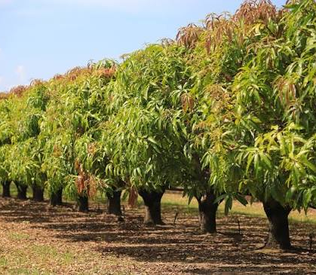
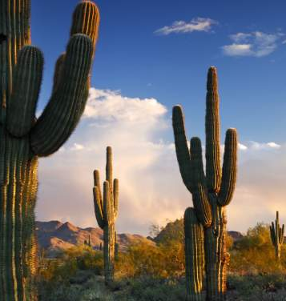
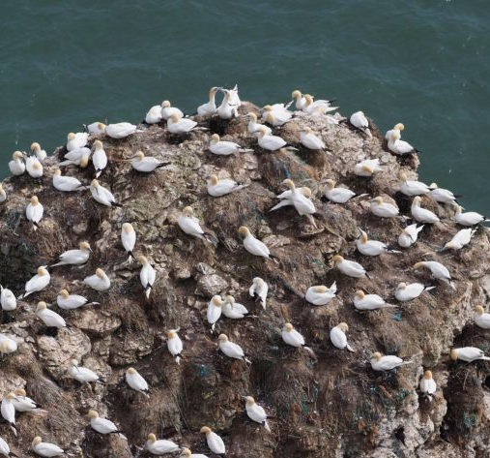
Examples:
Penguins nesting at equal distances.
Birds defending territories.
Trees in an orchard plantation (planted by humans in rows).
Desert plants (like cacti) are spaced apart to avoid competition for water.

Slide 26
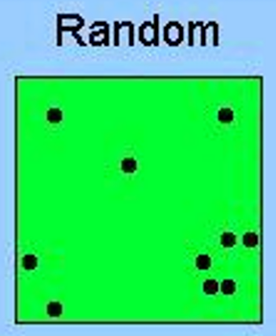
3. Random Distribution
Individuals are spread randomly with no predictable pattern.
Why did it happen?
  Environment is uniform.
  Individuals do not strongly attract or repel each other.
The least common type in nature.

Slide 27
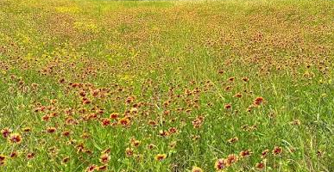
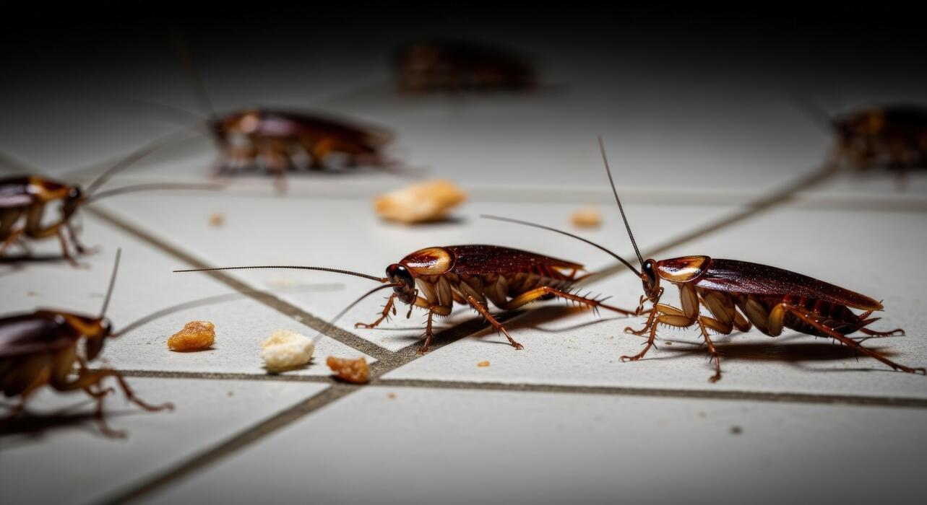
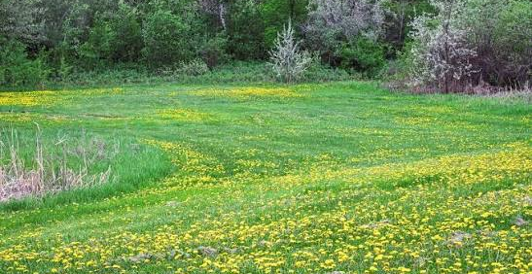
Examples
Dandelions scattered by the wind.
Some insects are in a habitat with evenly distributed resources.
Wildflowers growing randomly in a field.

Slide 28
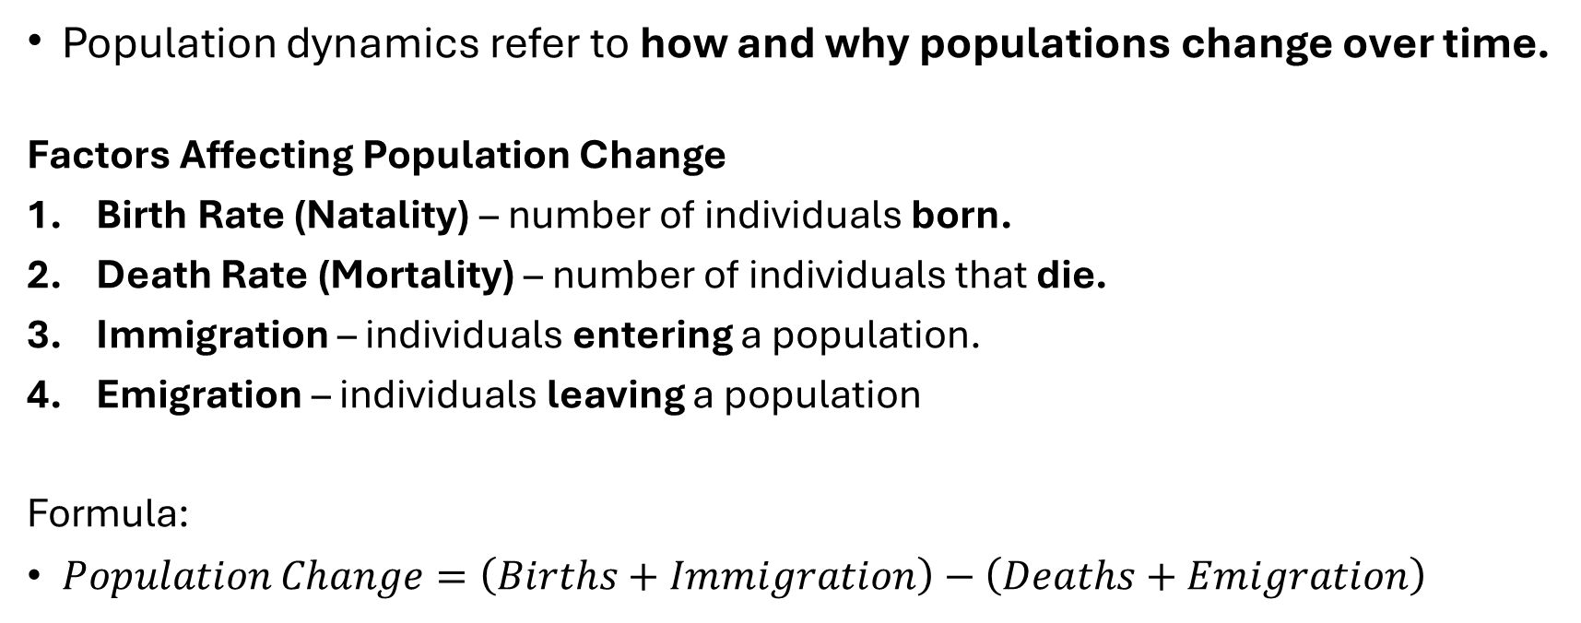
Population Dynamics
Population dynamics refer to how and why populations change over time.
Factors Affecting Population Change
Birth Rate (Natality) – number of individuals born.
Death Rate (Mortality) – number of individuals that die.
Immigration – individuals entering a population.
Emigration – individuals leaving a population
Formula:
$Population Change=\left(Births+Immigration\right)−\left(Deaths+Emigration\right)$

Slide 29
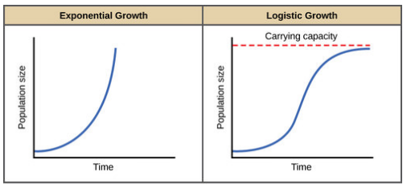
Patterns of Population Growth
1. Exponential Growth
Occurs when resources are unlimited.
Population grows rapidly.
Graph: J-shaped curve.
Example: Bacterial reproduction
  A bacterial population doubles every hour under ideal conditions.

Slide 30
Patterns of Population Growth
2. Logistic Growth
Growth slows as resources become limited.
  When a population is small, resources are abundant → rapid growth.
  As population increases, resources become scarce → growth slows.
  Eventually, the population stabilizes at carrying capacity (K).
Graph: S-shaped curve.
Example: Deer population in a forest
  Growth slows when food, water, and space become scarce.

Slide 31

Carrying Capacity (K)
Carrying capacity refers to the maximum number of individuals of a species that an environment can sustainably support over time.
It depends on the availability of:
  Food
  Water
  Shelter
  Space
stable level = Carrying Capacity (K)

Slide 32
Examples
1. Elephants in a Safari Park
A park can only support 200 elephants due to food and water.
If elephants increase to 300 → food shortage occurs → some die or migrate.
Carrying Capacity = 200
2. Fish in a Pond
A pond can support 500 fish.
If fish exceed this number → oxygen decreases → fish die.
Carrying Capacity = 500

Slide 33
What Happens When K is Exceeded?
If a population goes beyond its carrying capacity:
1. Resource depletion occurs
  Food and water become insufficient.
2. Increased competition
  Organisms fight for limited resources.
3. Population crash
  Sudden decrease due to death, disease, or migration.

Slide 34
Limiting factors
Limiting factors are conditions or resources that restrict the growth, size, or distribution of a population.
They prevent populations from growing indefinitely and help maintain balance in ecosystems.
No population can grow forever because:
Resources are limited
The environment can only support a certain number of individuals.
Limiting factors are what control population size and lead to the carrying capacity (K).

Slide 35
Types of Limiting Factors
Density-Dependent Factors
These factors depend on population density.
The more crowded the population → the stronger the effect.
As the population increases:
  Disease spreads faster.
    Flu spreading in crowded classrooms.
  Competition increases.
    Plants competing for sunlight in a forest.
  Predators find prey more easily.
    Wolves hunting large herds of deer.

Slide 36
Types of Limiting Factors
2. Density-Independent Factors
Affect populations regardless of density.
They can impact small or large populations equally.
Examples:
a. Natural Disasters
  Typhoons, earthquakes, floods, and volcanic eruptions
b. Climate / Weather
  Extreme heat, drought, cold temperatures
c. Human Activities
  Pollution, deforestation, urbanization

Slide 37
SUMMARY TABLE
 | Meaning | Example
Population Size | Total number of individuals. | 500 fish in a pond
Population Density | Number per unit area. | 50 trees per hectare
Population Distribution | How individuals are spaced.
Clumped | Grouped together. | Herds of animals
Uniform | Evenly spaced. | Penguins nesting
Random | No pattern. | Wildflowers

Slide 38
Summary
Exponential Growth: Rapid growth that increases continuously because resources are unlimited.
Logistic Growth: Growth that starts rapidly but slows and stabilizes as resources become limited.
Carrying Capacity (K) : maximum sustainable population.
  Determined by limited resources.
  Leads to a stable population size.
  Can change over time.
  Exceeding K causes population decline.
Limiting factors: anything that slows or stops population growth
  Two types:
  Density-dependent (depends on crowding)
  Density-independent (does not depend on crowding)
  They help determine carrying capacity (K)

Slide 39

HUMAN POPULATIONS

Slide 40
Human Population Growth
The human population has grown rapidly due to:
Advances in medicine.
Improved sanitation.
Increased food production.
Result: Population explosion

Slide 41
AGE STRUCTURE
Age structure refers to the distribution of individuals in a population according to different age groups.
It shows how many people fall into each age category.

Slide 42
Age Groups
1. Pre-reproductive (0–14 years)
Too young to reproduce.
Future potential parents.
Example: children and teenagers.
2. Reproductive (15–44 years)
Capable of having offspring.
Main contributors to population growth.
Example: young adults and middle-aged individuals.
3. Post-reproductive (45+ years)
Older individuals, typically past reproductive age.
Example: senior citizens.

Slide 43
Age structure diagrams
Age structure is often shown using population pyramids.
Expanding Population (Pyramid Shape)
Stable Population (Rectangular Shape)
Declining Population (Inverted Pyramid)

Slide 44
Expanding Population (Pyramid Shape)
The population will continue to grow quickly.
Characteristics:
Wide base (many young people)
High birth rate
Rapid population growth
Examples: Philippines, Many developing countries

Slide 45
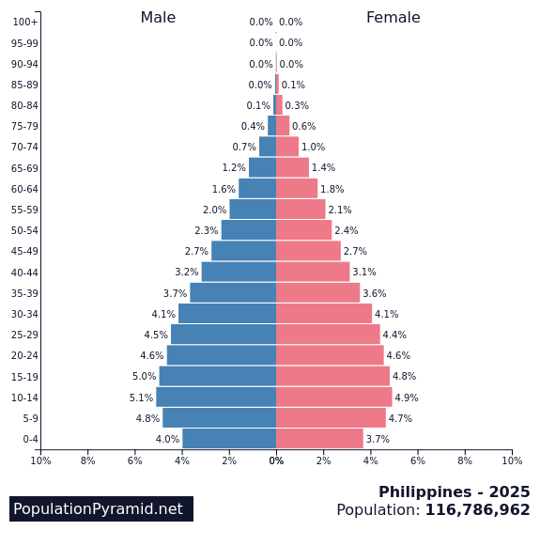
Philippines
Wide base population pyramid.
Many young people
Result: Rapid population growth

Slide 46
2. Stable Population (Rectangular Shape)
Population remains steady.
Characteristics:
Nearly equal numbers in all age groups
Low birth and death rates
Slow or no growth
Examples: USA, France

Slide 47
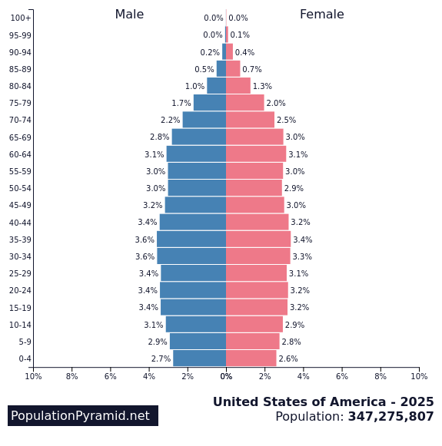
United States (USA)
Nearly rectangular population pyramid.
A moderate number of young people and adults.
Result:
  Relatively stable population growth.
  Balanced working-age population.
  Gradual aging trend (increasing elderly population).

Slide 48
3. Declining Population (Inverted Pyramid)
Population may shrink over time.
Characteristics:
Narrow base (few young people)
Low birth rate
Aging population
Examples: Japan, Germany

Slide 49
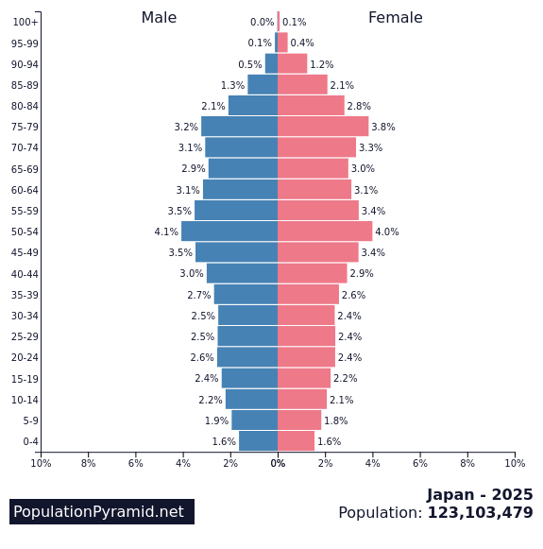
Japan
Narrow base, more elderly
Result:
  Aging society
  Labor shortage

Slide 50
Why age structure is important?
1. Predicts Future Growth
  Many young people → population will grow
  Few young people → population may decline
2. Helps Government Planning
  More children → need more schools
  More elderly → need more healthcare services
3. Shows Economic Impact
  Large working population → strong economy
  Aging population → fewer workers

Slide 51
Factors affecting age structure
Birth rate
Death rate
Health care
Culture and traditions
Government policies

Slide 52
LIFE EXPECTANCY
Life expectancy is the average number of years a person is expected to live in a population.
It reflects the overall health and living conditions of a country.
It is influenced by:
  Healthcare quality
  Nutrition
  Sanitation
  Lifestyle
High life expectancy → better quality of life.
Low life expectancy → possible health or economic problems.
Philippines
Around low to moderate life expectancy.
roughly 72.04 years. about 66.89 years for men and 72.82 years for women.
Reason: Improving healthcare but still limited in some areas.
Japan
Very high life expectancy (among the highest in the world).
85.0 years
Reason:
Healthy diet (fish, vegetables)
Strong healthcare system
USA
High but slightly lower than Japan
79.4 years
Reason: Advanced healthcare, but lifestyle diseases affect longevity.

Slide 53
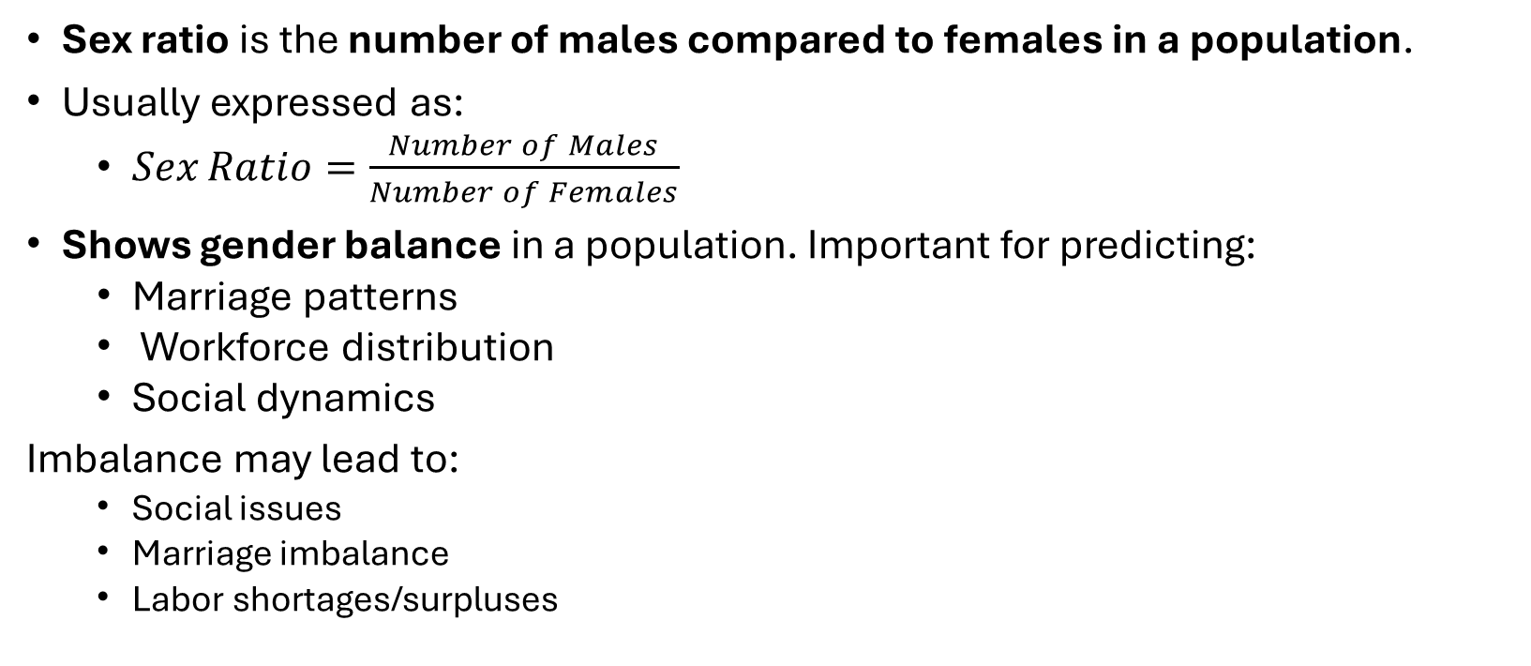
SEX RATIO
Sex ratio is the number of males compared to females in a population.
Usually expressed as:
  $Sex Ratio=\frac{Number of Males}{Number of Females}$
Shows gender balance in a population. Important for predicting:
  Marriage patterns
  Workforce distribution
  Social dynamics
Imbalance may lead to:
  Social issues
  Marriage imbalance
  Labor shortages/surpluses

Slide 54
Cont.
Global Average
  About 105 males for every 100 females at birth.
Philippines
  Almost balanced sex ratio (99 to 102 males per 100 females).
USA
  Slightly more females than males.
  Reason: Females generally live longer.
India / China (some regions)
  More males than females.
  Reason: cultural preferences (historically).

Slide 55
FERTILITY RATE
Total Fertility Rate (TFR) is the average number of children a woman would have by the end of her childbearing years if she were to bear children at the current age-speciﬁc fertility rates.
Replacement level = about 2.1 children per woman.
  meaning the population can replace itself from one generation to the next.
  Above 2.1 → population grows
  Below 2.1 → population declines
The Philippines’ TFR dropped to 1.7 children per woman in 2025.

Slide 56
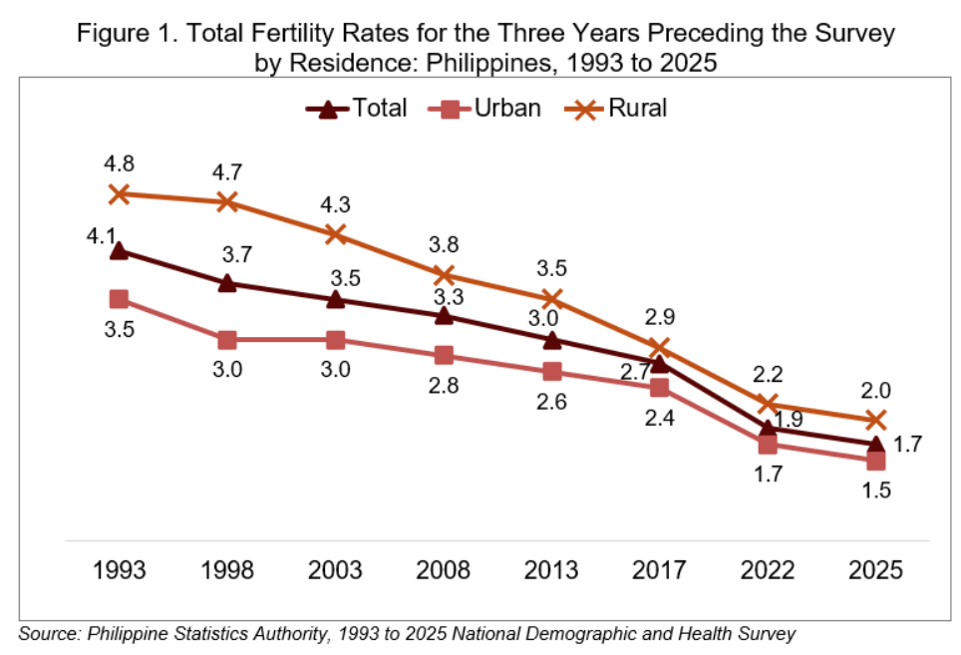

Slide 57
Factors Affecting Fertility Rate
Education (especially of women).
Access to family planning.
Economic status.
Cultural beliefs.
Government policies.

Slide 58
Impacts of Human Population Growth
Positive Effects
Economic development.
Technological advancement.
Negative Effects
Environmental degradation
Resource depletion
Pollution
Climate change

Slide 59
Population and the Environment
Population growth affects ecosystems through:
Overuse of natural resources
Habitat destruction
Loss of biodiversity

Slide 60
Summary
Age structure = age distribution of a population.
Three groups:
  Pre-reproductive
  Reproductive
  Post-reproductive
Shapes tell:
  Growing population → pyramid
  Stable population → rectangular
  Declining population → inverted

Slide 61
Summary
 | Meaning | High Value Means | Low Value Means
Life Expectancy | Average lifespan | Better health, longer life | Poor health conditions
Sex Ratio | Males vs females | Possible imbalance | Balanced population
Fertility Rate | Average number of children per woman. | Population growth | Population decline

Slide 62
Summary
Age structure
Life expectancy
Sex ratio
Fertility rate
These help us understand:
Population growth
Aging society
Future population trends

