Slide 1
Community and Ecosystem Ecology
Lesson 3

Slide 2
Community and Ecosystem Ecology
Community Ecology
Community Structures
Community Dynamics
Species Interaction
Ecosystem Ecology
Energy Flow Through Ecosystems

Slide 3
Learning objectives
At the end of the lesson, students should be able to:
Describe community structure and its components.
Explain factors that influence community dynamics.
Distinguish between succession types.
Identify different types of interactions among organisms.
Illustrate the flow of energy and matter in ecosystems.

Slide 4
Community Structure
Community structure refers to the organization and composition of species in a community.

Slide 5
Species Richness
Species richness is the number of different species present in each area or ecosystem.
It focuses only on the count, not how many individuals each species has.
Higher richness = more variety of species.
Example:
If a forest has:
5 species of trees → Species richness = 5
Importance:
Species richness tells us how diverse an ecosystem is.
Helps assess ecosystem health (more species often = more stable ecosystem).

Slide 6
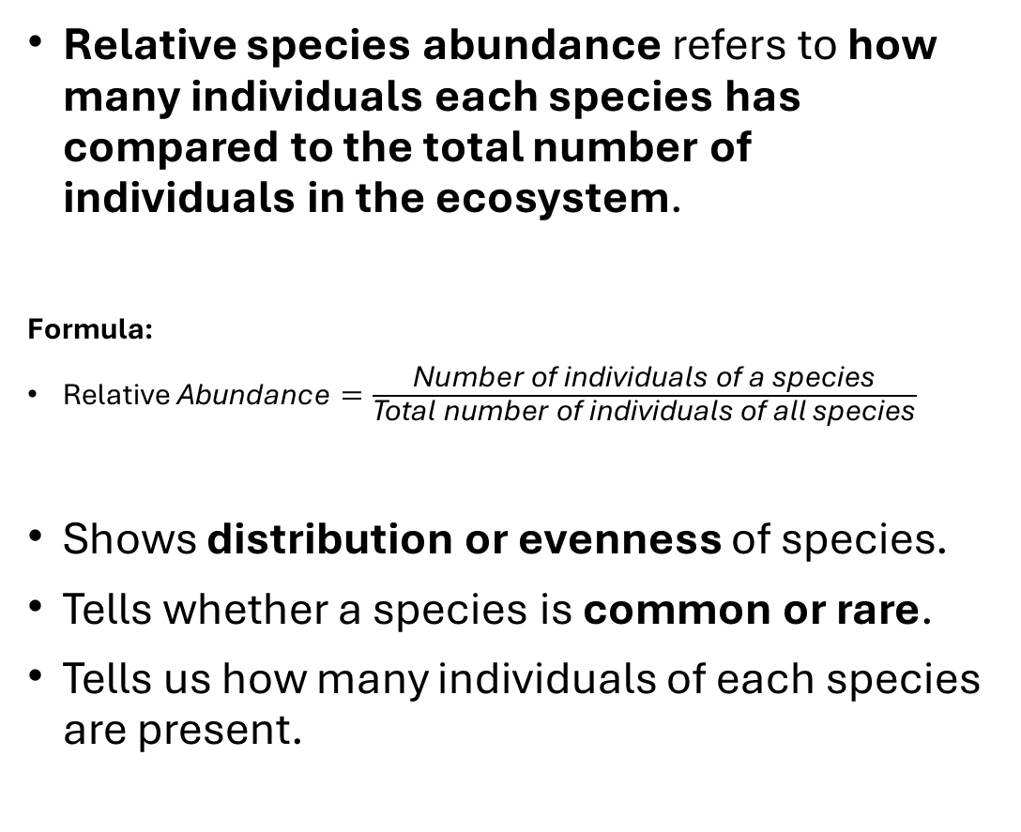
Relative Species Abundance
Relative species abundance refers to how many individuals each species has compared to the total number of individuals in the ecosystem.
Formula:
$\text{Relative} \text{Abundance}=\frac{\text{Number} \text{of} \text{individuals} \text{of} \text{a} \text{species}}{\text{Total} \text{number} \text{of} \text{individuals} \text{of} \text{all} \text{species}}$
Shows distribution or evenness of species.
Tells whether a species is common or rare.
Tells us how many individuals of each species are present.

Slide 7
Example:
In a sample with 100 organisms:
Species A = 70 individuals → 70%
Species B = 20 individuals → 20%
Species C = 10 individuals → 10%
Species richness = 3 (there are 3 different species).
Species abundance is uneven:
  Species A = 70%
  Species B = 20%
  Species C = 10%
Although the sample has a species richness of 3, the uneven abundance shows low species evenness, meaning one species is much more common than the others.
This suggests lower overall biodiversity compared to a community where all three species have similar abundances.

Slide 8
DOMINANT SPECIES
Species with the highest abundance or biomass.
Strong influence on the environment and other species.
  Dominant species affect:
    Resource availability (light, water, nutrients)
    Habitat structure
    Other species’ survival and distribution

Slide 9
How Dominant Species Shape Communities
1. Resource Control
  Dominant species often monopolize important resources:
    Light (tall trees block sunlight)
    Water (deep-rooted plants access more water)
    Nutrients (fast-growing plants absorb more nutrients)
Result: Limits the growth of other species
2. Habitat Formation
  They create physical environments where other organisms live.
Example:
  Trees provide shelter, nesting areas, and shade.
  Corals create reefs where fish live.

Slide 10
How Dominant Species Shape Communities
3. Food Web Influence
  They often serve as a primary food source.
  Affect energy flow in the ecosystem.
Example:
  Grass → eaten by herbivores → supports predators
4. Community Stability
  Their presence helps maintain balance.
  Removing them may cause major changes.

Slide 11
Examples of Dominant Species
 | Dominant Species | Role
Forest | Oak or pine trees | Control light, provide habitat.
Grassland | Grasses | Main food source for herbivores.
Coral reef | Corals | Form physical structure of ecosystem.
Marine | Phytoplankton | Base of food chain

Slide 12
FOUNDATION SPECIES
A foundation species is a species that creates, shapes, or maintains the habitat for other organisms.
Key Characteristics:
Usually abundant and dominant in the ecosystem.
Physically shapes the environment.
Creates habitat or shelter for other species.
Influences biodiversity indirectly.

Slide 13
Examples
1. Trees in a Forest
Example: Oak or pine trees
Provide:
  Shelter for animals
  Shade controlling temperature
  Nutrients through leaf litter
Without them → forest ecosystem would collapse
2. Coral in Coral Reefs
Coral builds the reef structure
Provides habitat for:
  Fish
  Invertebrates
  Algae

Slide 14
Examples
3. Seagrass in Marine Ecosystems
Provides nursery grounds for fish.
Stabilizes ocean floor sediments.
Supports marine food webs.
4. Mangrove Trees
Serve as breeding grounds for aquatic species.
Found in coastal areas.
Protect shorelines from erosion.

Slide 15
KEYSTONE SPECIES
A keystone species is a species that has a very large impact on its ecosystem relative to its abundance.
Even if it is not the most common species, its presence helps maintain the balance of the ecosystem.
Importance
Controls populations of other species.
Maintains biodiversity.
Prevents one species from dominating the ecosystem.
Supports ecosystem stability.

Slide 16
Examples:
Sea Otters
  Eat sea urchins.
  Prevent sea urchins from destroying kelp forests.
Wolves (Yellowstone National Park)
  Control deer and elk populations.
  Allow vegetation and other animal populations to recover.
Bees
  Pollinate many flowering plants and crops.
  Support plant reproduction and food webs.
Starfish (Pisaster)
  Control mussel populations.
  Allow many other species to coexist.

Slide 17
What happens if a keystone species is removed?
One species may become overly abundant.
Biodiversity decreases.
Food webs become disrupted.
The ecosystem may partially or completely collapse.

Slide 18
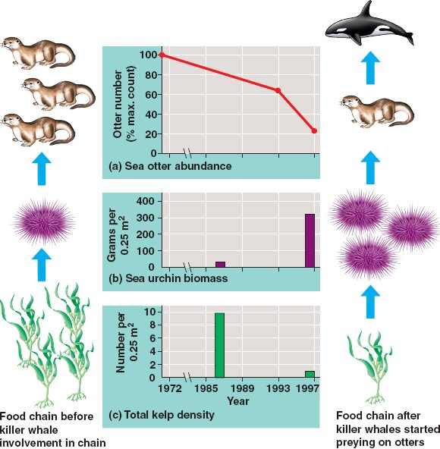

Slide 19
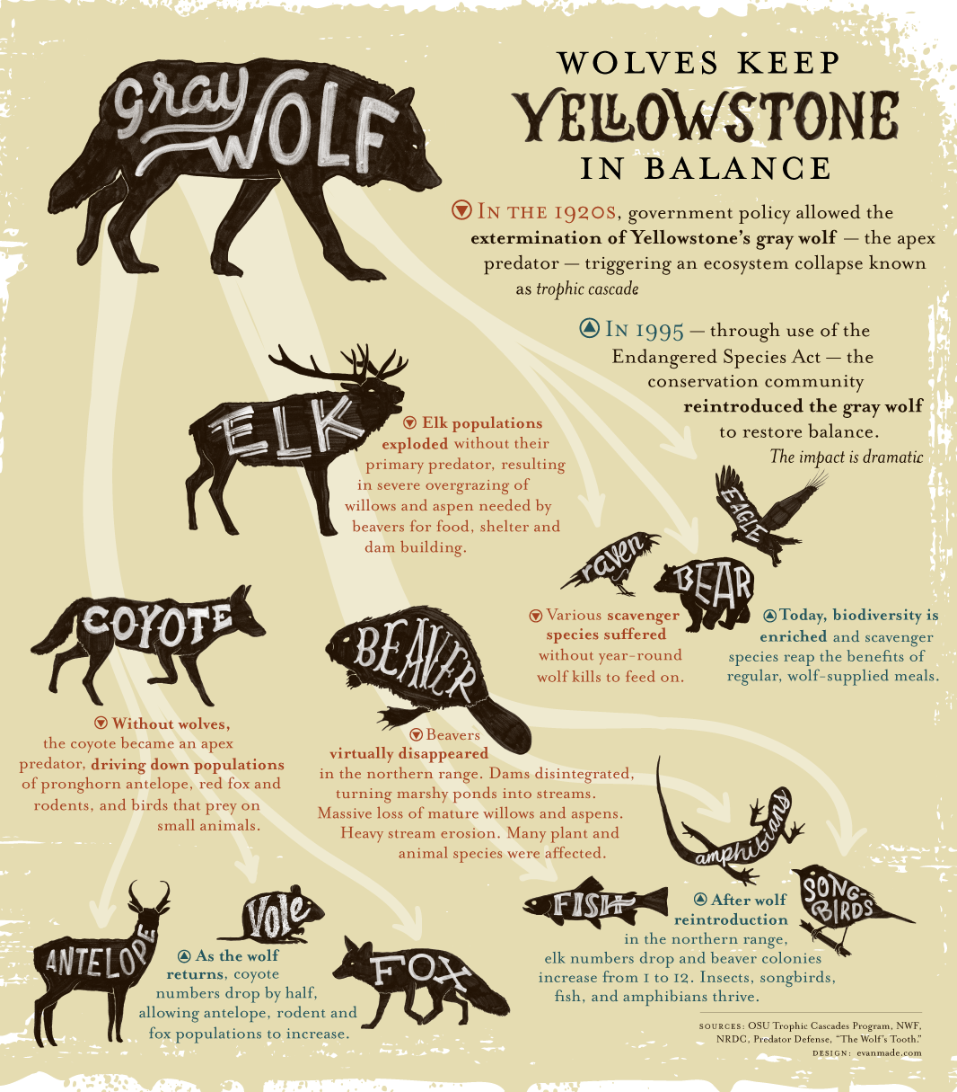
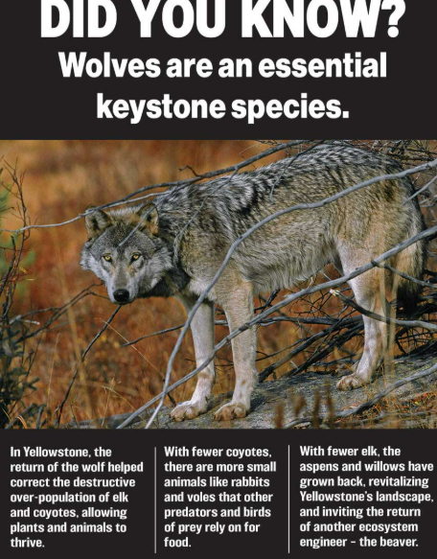

Slide 20
Summary of Ecological terms
Species Richness
  The number of different species present in an ecosystem.
Relative Species Abundance
  The proportion or percentage of individuals belonging to each species compared to the total population.
Dominant Species
  The species with the highest abundance or biomass, exerting the greatest influence on the community due to its large numbers.
  Most numerous but not always ecosystem-shaping.
Foundation Species
  A species that creates, structures, or maintains a habitat that supports many other organisms.
  Creates or defines habitat
    Example: Corals in coral reefs, mangroves in coastal ecosystems.
Keystone Species
  A species whose impact on the ecosystem is much greater than its abundance. Removing it can cause major changes in ecosystem structure and biodiversity.
  Has a large impact despite low abundance.
    Example: Wolves, sea otters, starfish.

Slide 21
Community Dynamics
Community dynamics refers to changes in community structure over time.

Slide 22
Ecological Succession
Ecological succession is the process by which ecosystems recover, change, and reach stability over time after a disturbance.
Disturbance
Any event that disrupts an ecosystem (natural or human-made).
  Examples: wildfire, typhoon, deforestation.
Disturbances often restart succession.

Slide 23
Ecological Succession
Pioneer species
Pioneer species (like moss and lichens) are the first to grow.
These organisms help form soil, allowing larger plants to grow later.
Climax Community
The final, stable stage of succession.
The ecosystem becomes balanced, with mature plants and animals.

Slide 24
Types of Ecological Succession
1. Primary Succession
Primary succession is the process by which a community of organisms develops in an area where no soil and no life previously existed.
Examples
New volcanic islands
Land exposed after glaciers melt
Areas covered by lava flows
How it Happens?
Bare rock is exposed (e.g., after a volcanic eruption or retreating glacier).
Pioneer species, such as lichens and mosses, colonize the area.
These organisms break down rock and help form soil.
Grasses, shrubs, and small plants begin to grow.
Trees and larger organisms establish themselves.
A stable climax community eventually develops.

Slide 25
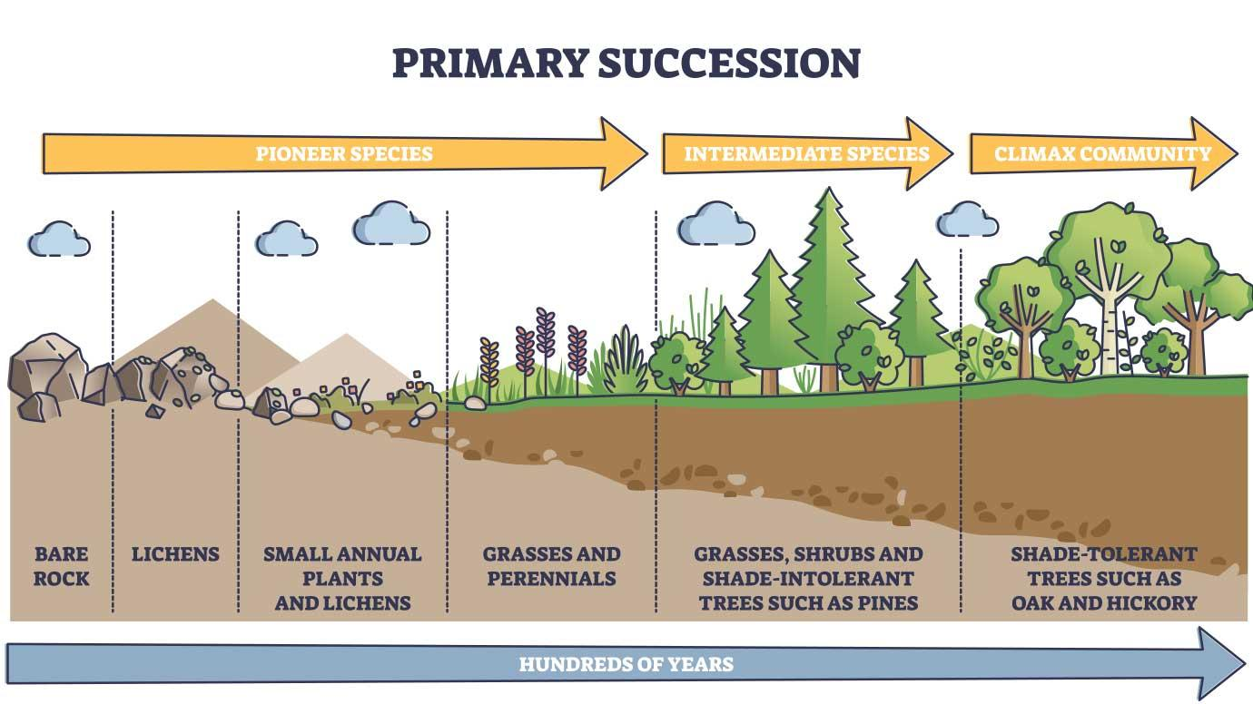

Slide 26
Types of Ecological Succession
2. Secondary Succession
Secondary succession is the process by which an ecosystem recovers after a disturbance that destroys a community but leaves the soil intact.
Examples
Forest regrowth after a wildfire.
Abandoned farmland returning to forest.
Recovery after a flood or hurricane.
How it Happens
A disturbance occurs (fire, flood, farming, logging, hurricane).
Soil remains in place.
Grasses and small plants grow first.
Shrubs and young trees appear.
Larger trees and animals return.
A stable ecosystem is re-established.

Slide 27
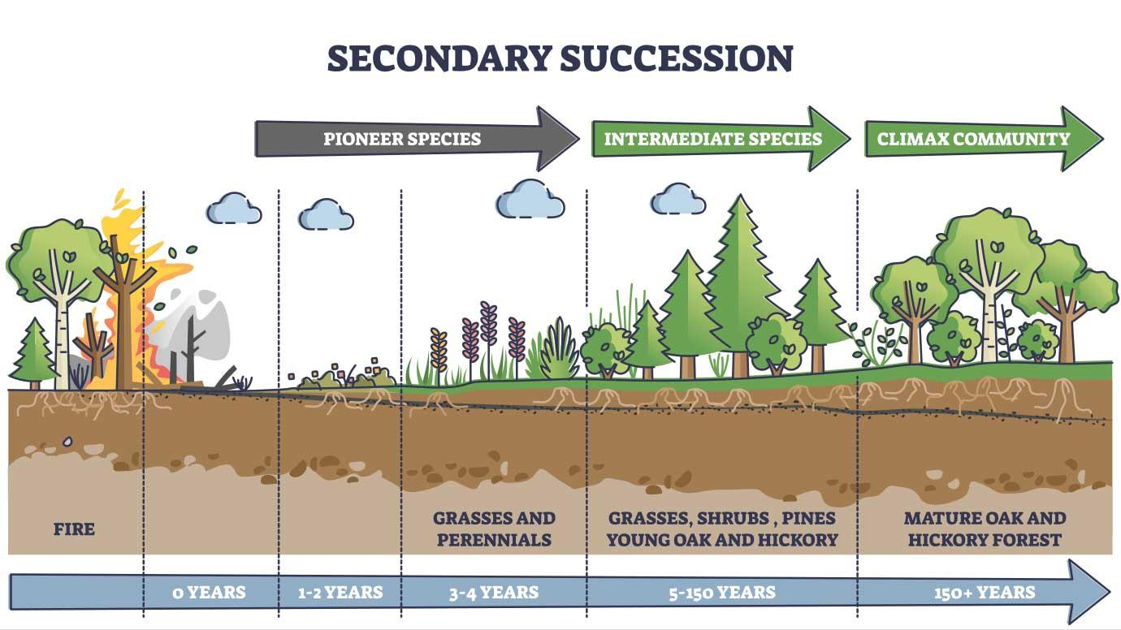

Slide 28
Primary versus Secondary Succession
 | Primary Succession | Secondary Succession
Soil present? | No | Yes
Starts with | Bare rock | Existing soil
Pioneer species | Lichens and mosses | Grasses and herbs
Speed | Slow | Faster
Example | New volcanic island | Forest after a fire

Slide 29
Species Interactions
Species interactions refer to the relationships between different species that coexist in the same ecosystem.
These interactions affect the survival, growth, and population of the species involved.

Slide 30
Types of Species Interactions
A. Competition
Intraspecific competition
Interspecific competition
B. Predation
C. Symbiosis (Closed Relationship)
Mutualism
Commensalism
Parasitism
C. Herbivory

Slide 31
A. COMPETITION
(-/-)
Competition happens when organisms fight for the same limited resources (like food, space, water, or mates).
Both species are negatively affected.
1. Intraspecific competition occurs between members of the SAME species
  Two dogs fighting for food.
  Trees of the same species competing for sunlight.
  Deer competing for mates
2. Interspecific competition occurs between DIFFERENT species.
  Lions and hyenas hunting the same prey.
  Plants of different species competing for water .
  Birds and squirrels competing for seeds.

Slide 32
Cont.
Competitive exclusion principle
  Competitive exclusion principle states that two species cannot occupy the same niche in a habitat indefinitely.
  Species competing for the same resources cannot coexist forever.
  One species will eventually outcompete or replace the other.
This exclusion may be avoided.
Resource partitioning
  Resource partitioning is when species divide resources to reduce competition.
  Each species uses the resources in a different way, time, or place.
  This allows species to coexist in the same habitat without outcompeting each other.

Slide 33
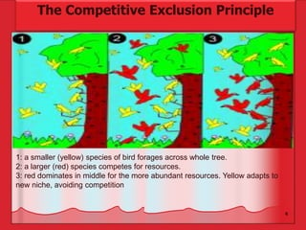
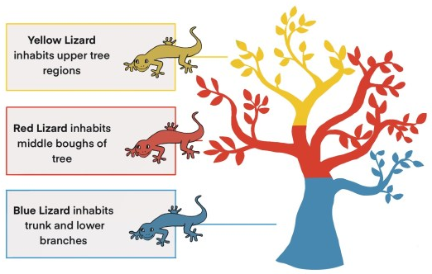
Resource partitioning

Slide 34
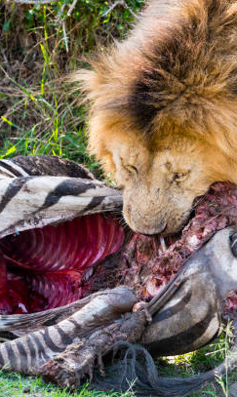
B. Predation (+/-)
One species (predator) kills and eats another species (prey).
Predator benefits; prey is harmed.
Examples
    Lion → eats zebra
    Snake → eats mouse
    Bird → eats insect

Slide 35
Defense Mechanisms Against Predation
Defense Mechanism | Description | Example | How It Helps Survival
Camouflage | Blends with environment. | Stick insect, chameleon | Avoids being seen by predators.
Warning Coloration | Bright colors warn predators of danger. | Poison dart frog | Predators avoid eating them.
Mimicry | Harmless species copies harmful one. | King snake (looks venomous) | Tricks predators into staying away.
Physical Defenses | Body parts protect the organism. | Turtle (shell), porcupine(spikes), plants (thorn) | Makes it hard to attack or eat.
Speed/Escape | Moves quickly to escape. | Deer running fast | Helps avoid being caught.
Chemical Defenses | Produces toxins or bad smells. | Skunk spraying foul odor | Repels or harms predators.
Behavioral Defenses | Actions to avoid danger. | Playing dead (opossum) | Confuses or discourages predators.

Slide 36
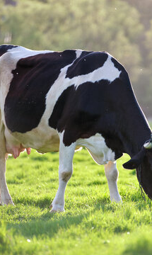
C. Herbivory (+/-)
An animal feeds on plants or algae.
Herbivore benefits; the plant is harmed.
Example: Cow grazing on grass.

Slide 37
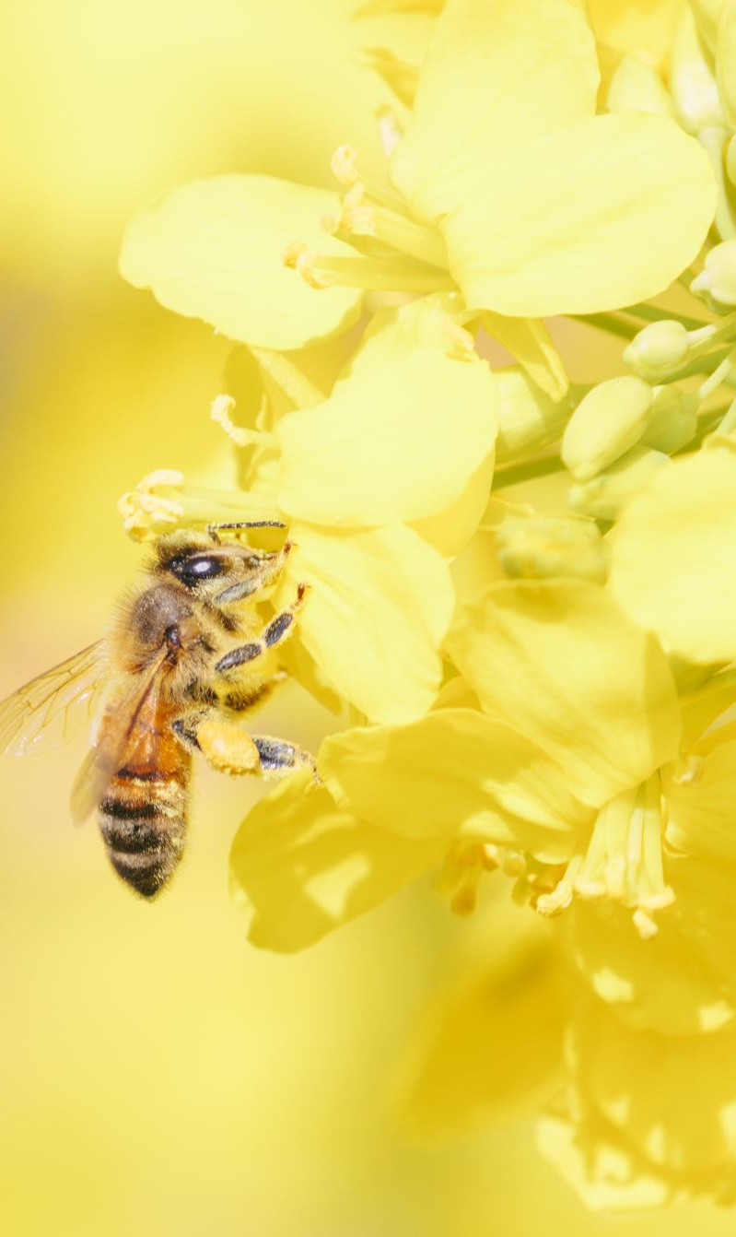
D. Symbiosis
Mutualism (+/+)
Mutualism (+/+)
Both organisms benefit.
Example: Bees get nectar from flowers while helping pollinate them.

Slide 38
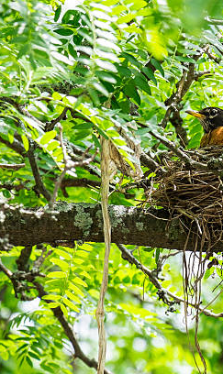
D. Symbiosis
Commensalism (+/0)
Commensalism
One benefits, the other is unaffected (neither helped nor harmed).
Example:
  Birds nesting in trees

Slide 39
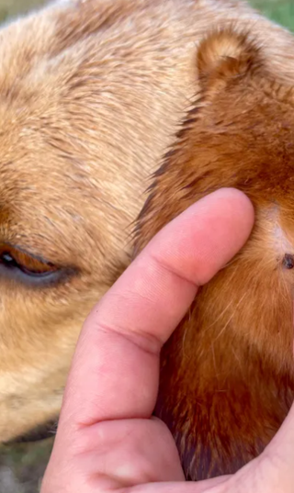
D. Symbiosis
Parasitism (+/-)
Parasitism
A parasite lives on or in a host and obtains nutrients from it.
Parasite benefits; the host is harmed.
Example: Ticks on dogs

Slide 40
Interaction | Effect on Species 1 | Effect on Species 2 | Example
Competition | - | - | Lions and hyenas
Predation | + | - | Snake and mouse
Herbivory | + | - | Cow and grass
Mutualism | + | + | Bee and flower
Commensalism | + | 0 | Barnacle and whale
Parasitism | + | - | Tick and dog

Slide 41
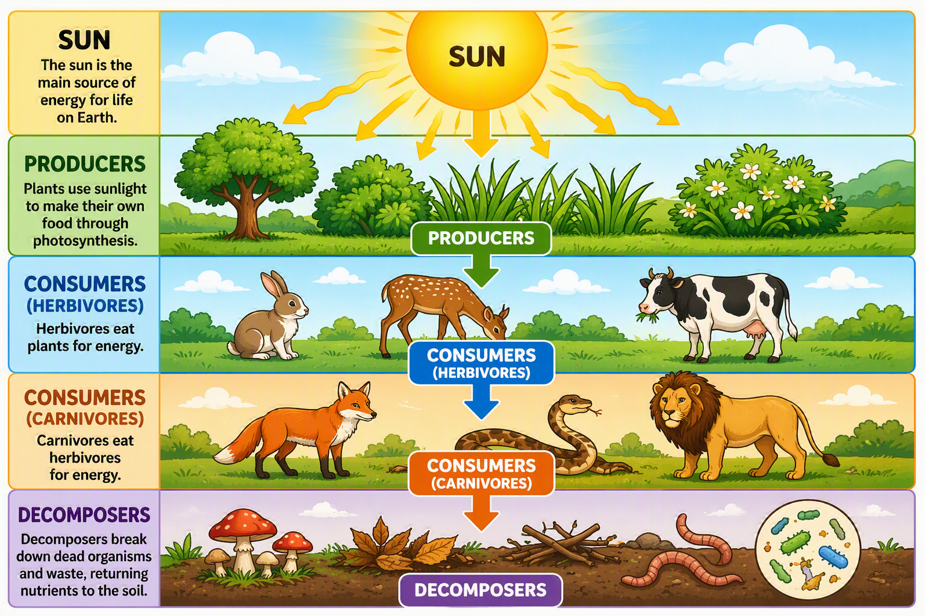
Energy Flow in the Ecosystem

Slide 42
Energy comes mainly from the Sun.
Passed through organisms through food chains and food webs.

Slide 43
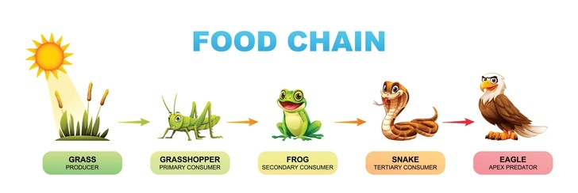
Food Chains
A food chain is a linear sequence of organisms through which nutrients and energy pass as one organism eats another.
There is a single path through a food chain.

Slide 44
Trophic level
Each organism in a food chain occupies a specific trophic level (energy level), its position in the food chain.
Producers (1st Level)
  Plants and algae
  Make their own food using sunlight (photosynthesis)
Primary Consumers (2nd Level)
  Herbivores (eat plants)
  Examples: rabbit, deer, grasshopper
Secondary Consumers (3rd Level)
  Carnivores that eat herbivores
  Examples: snake, fox
Tertiary Consumers (4th Level)
  Top predators
  Examples: eagle, lion
Higher Trophic Levels: Some ecosystems have quaternary consumers and other top predators
Decomposers break down dead and decaying organisms from any trophic level.

Slide 45
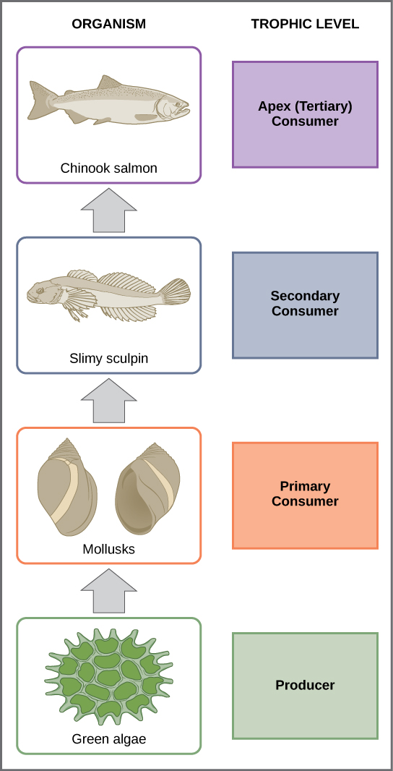
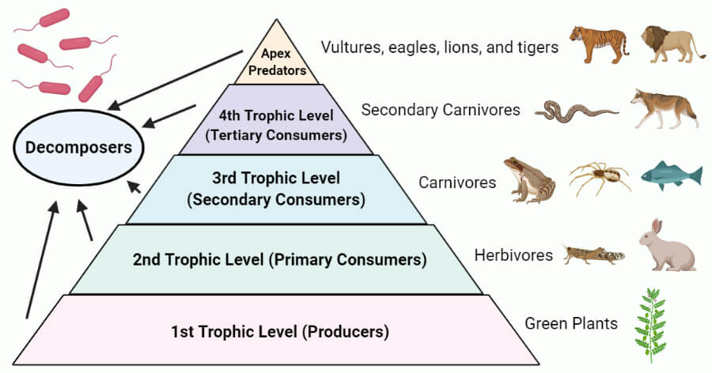
Trophic levels of a food chain

Slide 46
10% Energy Rule
The 10% energy rule states that only about 10% of the energy at one trophic level is transferred to the next trophic level.
The remaining 90% is lost as heat, movement, growth, and other life processes.
Example
Producers (Grass) = 10,000 units of energy
Primary Consumers (Rabbit) = 1,000 units
Secondary Consumers (Snake) = 100 units
Tertiary Consumers (Hawk) = 10 units
Why is it important?
Explains why food chains are usually short.
Shows why there are fewer top predators than producers.
Demonstrates the flow and loss of energy in ecosystems.

Slide 47
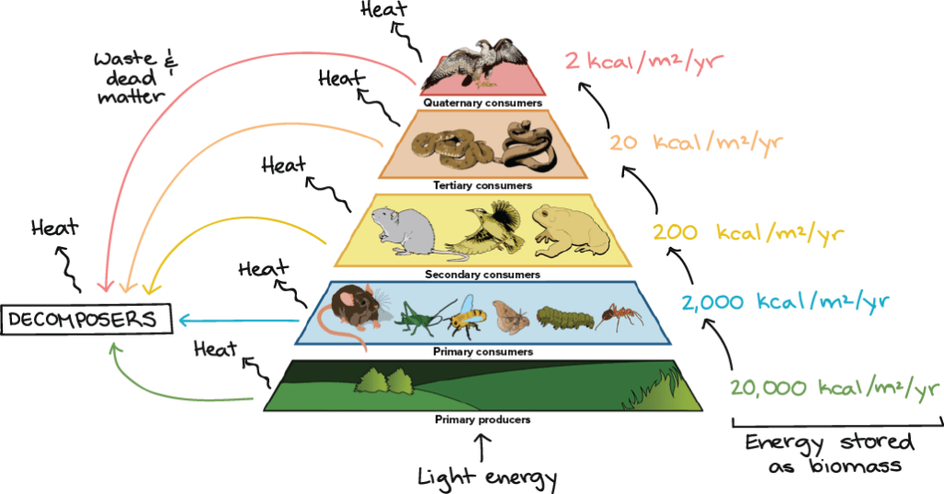

Slide 48
Biomagnification
Certain environmental toxins can become more concentrated as they move up the food chain, with the highest concentrations occurring in the top consumers, a process called biomagnification.
Essentially, a top consumer ingests all the toxins that had previously accumulated in the bodies of the organisms at the lower trophic levels.
This explains why frequently eating certain fish, like tuna or swordfish, increases mercury exposure, a toxic heavy metal.

Slide 49
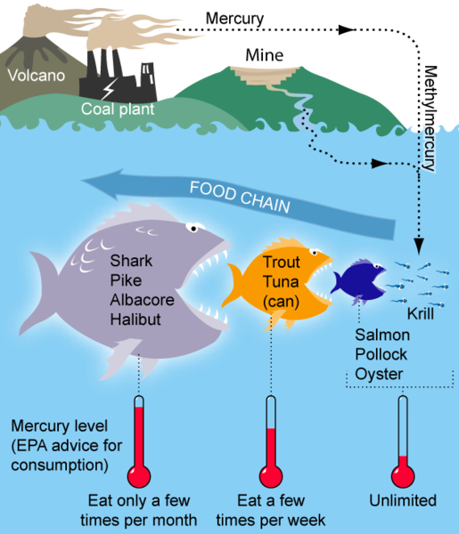
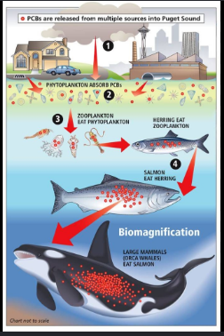

Slide 50
Food Web
Food webs are networks of interconnected food chains that show how energy and nutrients move through an ecosystem.
Consists of multiple interconnected food chains.
Show that organisms often have more than one food source.
Illustrate the feeding relationships among different organisms.
Demonstrate how energy flows through an ecosystem.
Help explain how changes in one species can affect many others.
Importance of Food Webs
Show ecosystem complexity.
Help maintain ecosystem stability.
Reveal the impact of losing or adding a species.

Slide 51
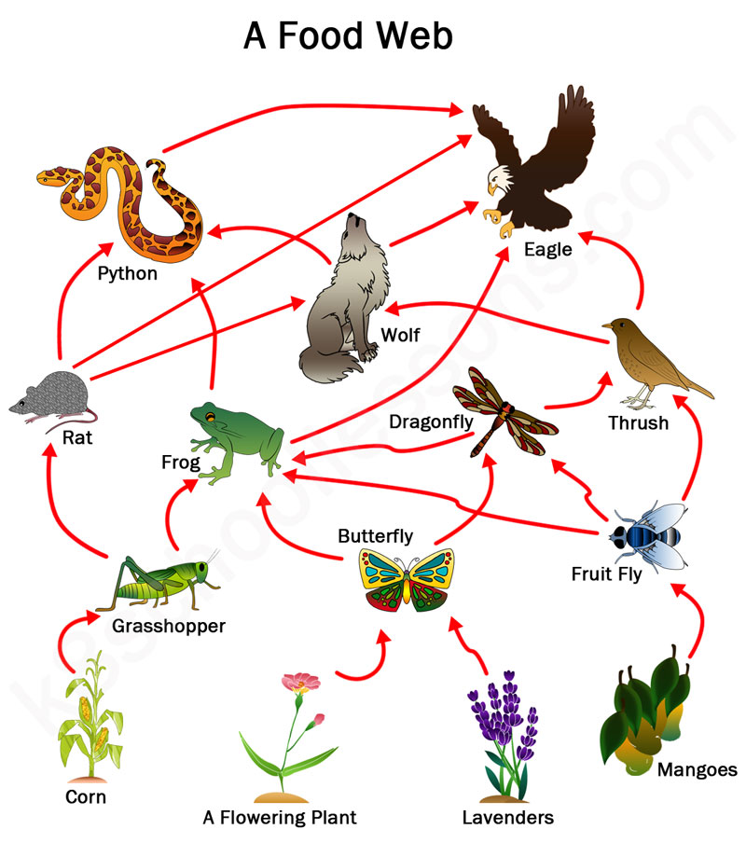

Slide 52
Ecosystem Concepts Summary
Ecosystem Concepts Summary
Flow of Energy – Energy moves in one direction through an ecosystem: Sun → Producers → Consumers → Decomposers.
Food Chain – A simple pathway showing how energy and nutrients pass from one organism to another through feeding relationships.
Trophic Level – The feeding position an organism occupies in a food chain.
  1st: Producers
  2nd: Primary Consumers
  3rd: Secondary Consumers
  4th: Tertiary Consumers
10% Energy Rule – Only about 10% of the energy at one trophic level is transferred to the next; about 90% is lost as heat and life processes.
Biomagnification – The process by which harmful substances (e.g., pesticides, mercury) become more concentrated at higher trophic levels in a food chain.
Food Web – A network of interconnected food chains showing multiple feeding relationships within an ecosystem.
These concepts help us understand how energy flows through ecosystems, how organisms depend on one another, and why biodiversity and environmental protection are important for maintaining a balanced and healthy ecosystem

Slide 53
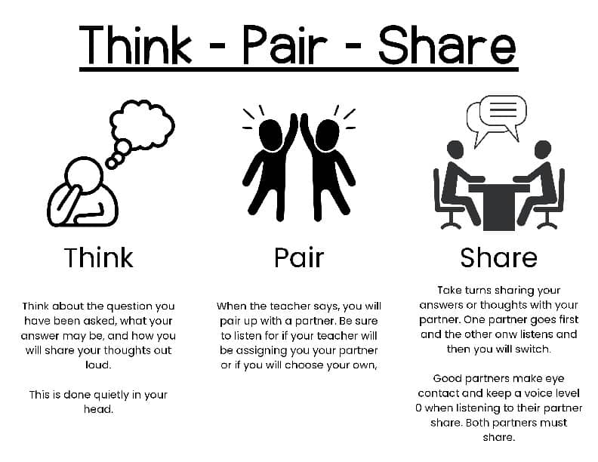
Activity Time!

