Slide 1

Biogeochemical Cycles
Lesson 4

Slide 2
Objectives
Understand how Biogeochemical Cycles are interconnected and their importance to ecosystem health.
Analyze and explain diagrams or models of the cycles of matter, identifying key processes.
Develop an appreciation for the delicate balance of ecosystems and the role that the cycles of matter play in maintaining this balance.

Slide 3
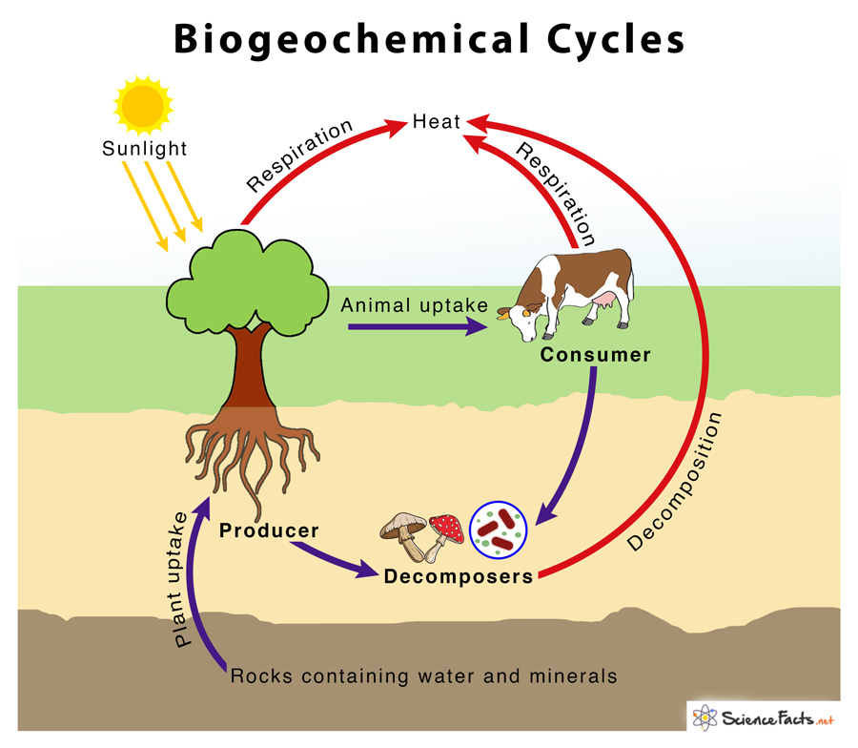
Biogeochemical Cycles
Biogeochemical Cycles are the pathways through which chemical elements and compounds move through the biotic (living) and abiotic (non-living) components of an ecosystem.
These cycles are essential for life as they ensure the continuous recycling of nutrients and other elements necessary for organisms to survive and thrive.
Major Biogeochemical Cycles
Water Cycle (Hydrologic Cycle)
Carbon Cycle
Nitrogen cycle
Phosphorus Cycle
Sulfur Cycle

Slide 4
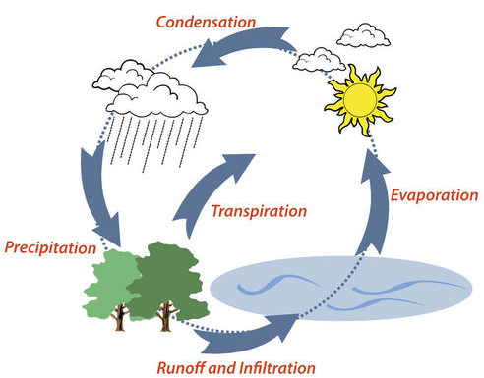
Water Cycle (Hydrologic Cycle)
The water cycle describes the continuous movement of water in its various forms (liquid, solid, gas) through the Earth's atmosphere, oceans, and land.
Essential for all life; influences climate, weather patterns, and the distribution of other elements.
Key Processes: Evaporation, transpiration, condensation, precipitation, infiltration, runoff.

Slide 5
Water Cycle (Hydrologic Cycle)
Evaporation: The process by which water transforms from a liquid state to a vapor, rising into the atmosphere due to heat from the sun.
Transpiration: The process of water movement through a plant and its evaporation from aerial parts, such as leaves, stems, and flowers. It is like the plant "sweating" out water vapor.
Condensation: The transformation of water vapor back into liquid water droplets, forming clouds as the vapor cools and loses energy.
Precipitation: The release of water from clouds in the form of rain, snow, sleet, or hail that falls back to the Earth's surface.
Infiltration: The process by which water penetrates the soil surface and moves downward into the groundwater supply.
Runoff: The flow of water, often from rain or melting snow, that travels across the land surface and eventually enters rivers, lakes, or oceans.

Slide 6
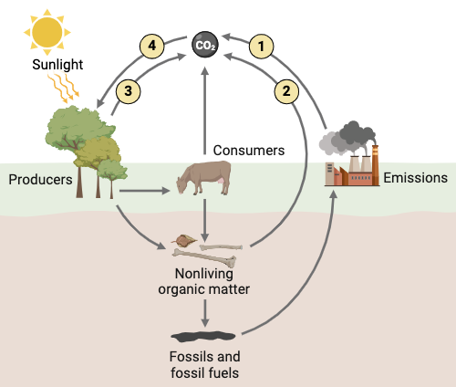
Carbon Cycle
The carbon cycle involves the movement of carbon through the atmosphere, oceans, land, and living organisms.
Carbon is the backbone of all organic molecules; regulates Earth's temperature and is a key component of fossil fuels.
Key Processes: Photosynthesis, respiration, decomposition, combustion, fossilization.

Slide 7
Carbon Cycle
Photosynthesis: This is how plants (and some other organisms) use sunlight, water, and carbon dioxide in the atmosphere to create sugars (glucose) for energy and release oxygen as a byproduct.
Aerobic Respiration: This is the process by which organisms (plants, animals, fungi, bacteria) break down sugars (like glucose) to release energy. This process consumes oxygen and releases carbon dioxide back into the atmosphere.
Decomposition: When organisms die, their remains are broken down by decomposers (bacteria and fungi). This process releases carbon back into the soil and, as carbon dioxide, into the atmosphere.
Combustion: Burning organic material (wood, fossil fuels) rapidly combines the carbon in the material with oxygen, producing carbon dioxide and releasing energy (heat and light).
Fossilization: Over long periods of time, under specific conditions, the remains of dead organisms can be transformed into fossil fuels (coal, oil, natural gas). This process stores carbon in the Earth's crus

Slide 8
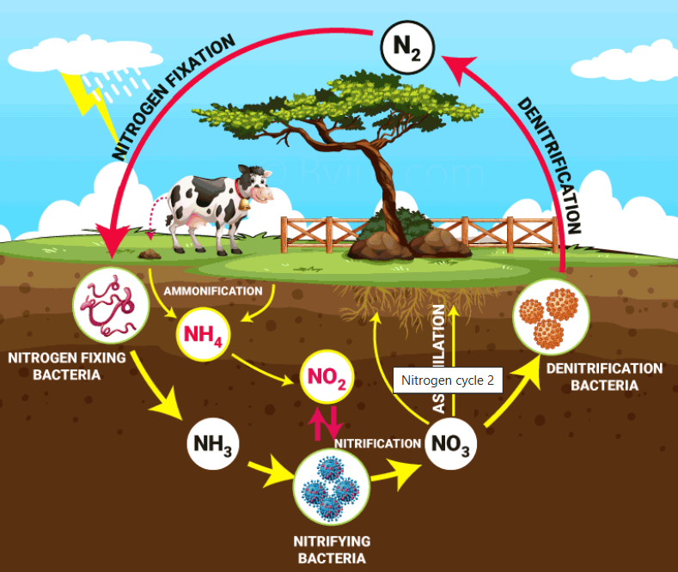
Nitrogen Cycle
The nitrogen cycle is the process by which nitrogen is converted into various forms and cycled through the atmosphere, soil, and living organisms.
Nitrogen is a crucial component of proteins and nucleic acids; often a limiting nutrient for plant growth.
Key Processes: Nitrogen fixation, nitrification, denitrification, assimilation, ammonification.

Slide 9
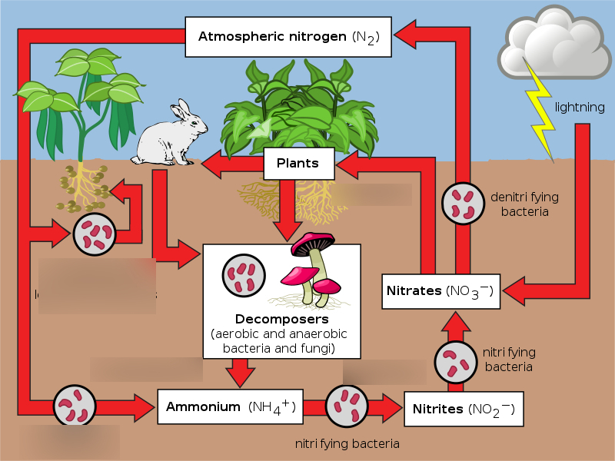

Slide 10
Nitrogen Cycle
Nitrogen Fixation: This is the process where atmospheric nitrogen (N₂), which is unusable by most organisms, is converted into ammonia (NH₃) or other usable nitrogen compounds. This is primarily done by certain bacteria in the soil or in the roots of some plants (like legumes).
Nitrification: Ammonia (NH₃) is converted into nitrites (NO²⁻) and then nitrates (NO³⁻) by bacteria in the soil. Nitrates are a form of nitrogen that plants can readily absorb.
Denitrification: Nitrates (NO³⁻) are converted back into atmospheric nitrogen gas (N₂) by certain bacteria in oxygen-poor environments (like waterlogged soils). This process returns nitrogen to the atmosphere.
Assimilation: Plants absorb nitrogen (in the form of nitrates or ammonia) through their roots and incorporate it into organic molecules like proteins and nucleic acids. Animals then assimilate nitrogen by eating plants (or other animals that have eaten plants).
Ammonification: When organisms die or produce waste, the organic nitrogen in their remains is converted back into ammonia (NH₃) by decomposers (bacteria and fungi). This ammonia can then be used by plants or go through nitrification again.

Slide 11
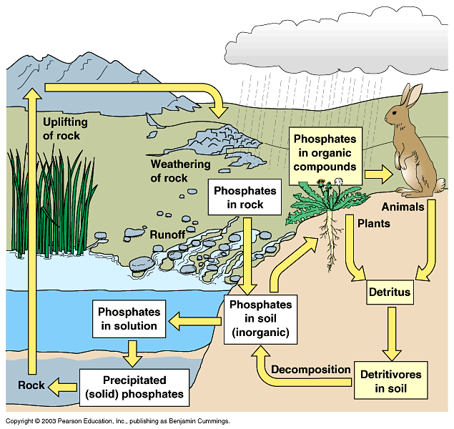
Phosphorus Cycle
The phosphorus cycle describes the movement of phosphorus through the Earth's ecosystems. Unlike other cycles, it does not have a significant atmospheric component.
Phosphorus exists in nature as a phosphate ion (PO₄³⁻).
Phosphorus is essential for DNA, RNA, and ATP (the energy currency of cells); often a limiting nutrient for plant growth.
Key Processes: Weathering, erosion, assimilation, decomposition, sedimentation.

Slide 12
Phosphorus Cycle
Weathering: This is the breakdown of rocks and minerals at the Earth's surface through physical, chemical, and biological processes. Weathering releases phosphorus (and other minerals) from rocks into the soil and water.
Erosion: This is the movement of weathered material (soil, rock fragments) from one place to another by natural forces like wind, water, and ice. Erosion can transport phosphorus-containing particles to new locations, including bodies of water.
Assimilation: This is the process by which living organisms incorporate nutrients, like phosphorus, into their cells and tissues. Plants assimilate phosphorus from the soil through their roots, and animals assimilate it by eating plants (or other animals).
Decomposition: This is the breakdown of dead organisms and organic matter by decomposers (bacteria and fungi). Decomposition releases phosphorus (and other nutrients) back into the soil, where it can be used by plants again.
Sedimentation: This is the process by which particles of sediment (including phosphorus-containing minerals) settle out of water or air and accumulate over time, forming layers of sediment. Over long periods, these sediments can become rock, trapping the phosphorus within them until weathering releases it.

Slide 13
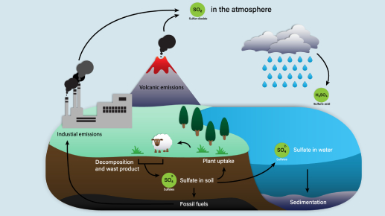
Sulfur Cycle
The sulfur cycle involves the movement of sulfur through the atmosphere, oceans, land, and living organisms.
Sulfur is a component of some amino acids and proteins; plays a role in enzyme activity and protein structure.
Sulfur exists in the atmosphere as sulfur dioxide (SO₂).
Key Processes: Weathering, volcanic activity, assimilation, decomposition, oxidation, reduction.

Slide 14
Sulfur Cycle
Volcanic Activity: Volcanoes release large amounts of sulfur dioxide (SO₂) into the atmosphere, which can then be converted into sulfuric acid (H₂SO₄) and return to Earth as acid rain.
Assimilation: Plants absorb sulfur from the soil and incorporate it into proteins and other organic molecules. Animals then assimilate sulfur by eating plants (or other animals).
Decomposition: When organisms die, decomposers break down their remains, releasing sulfur back into the soil in various forms.
Oxidation: This is a chemical process where sulfur reacts with oxygen, changing its form.
  Example: Hydrogen sulfide (H₂S) can be oxidized to sulfur dioxide (SO₂).
Reduction: This is the opposite of oxidation, where sulfur gains electrons and changes to a less oxidized form.
  Example: Sulfates (SO₄²⁻) can be reduced to sulfides (S²⁻) by certain bacteria in anaerobic (oxygen-poor) environments.

