Slide 1

Biomes of the Earth
Lesson 5

Slide 2
Learning Objectives
By the end of this lesson, students should be able to:
Explain what a biome is and describe its key characteristics.
Explain how climate, soil, sunlight, and water influence the distribution and characteristics of biomes.
Discuss how human activities affect both terrestrial and aquatic ecosystems.

Slide 3
Biomes
Biomes: Large ecological areas with distinct climate, flora, and fauna.
Two Main Types:
Terrestrial Biomes (land-based)
Aquatic Biomes (water-based)

Slide 4
Terrestrial Biomes

Slide 5
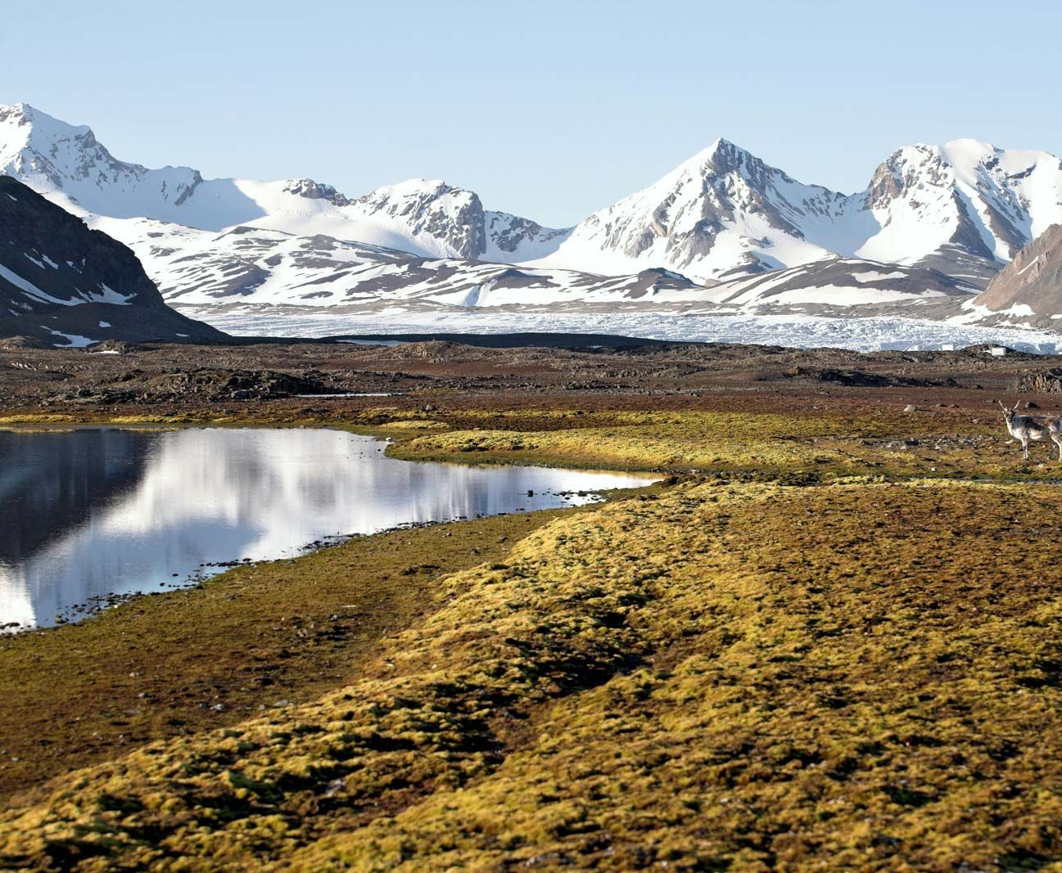
Tundra
Cold
Treeless
Permafrost soil

Slide 6
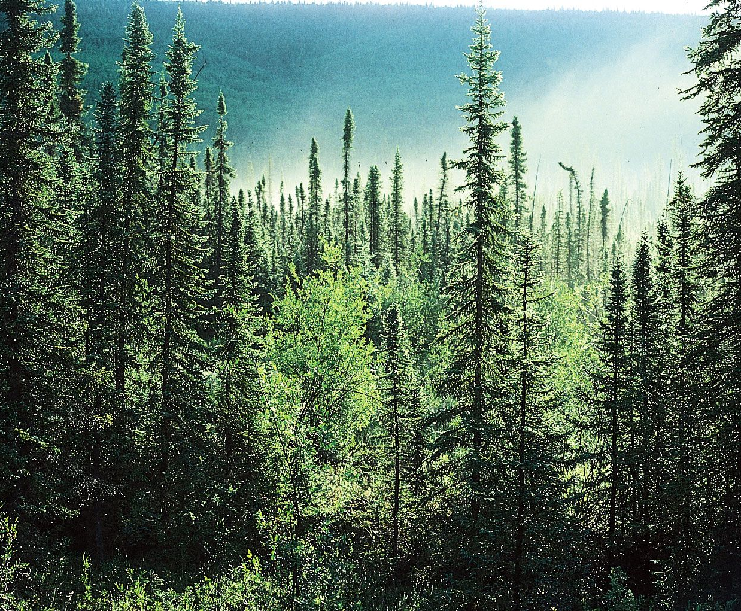
Taiga/boreal forest
Coniferous forests
Long winters
Coniferous trees: cone-bearing trees with needle-like leaves, staying green throughout the year.

Slide 7
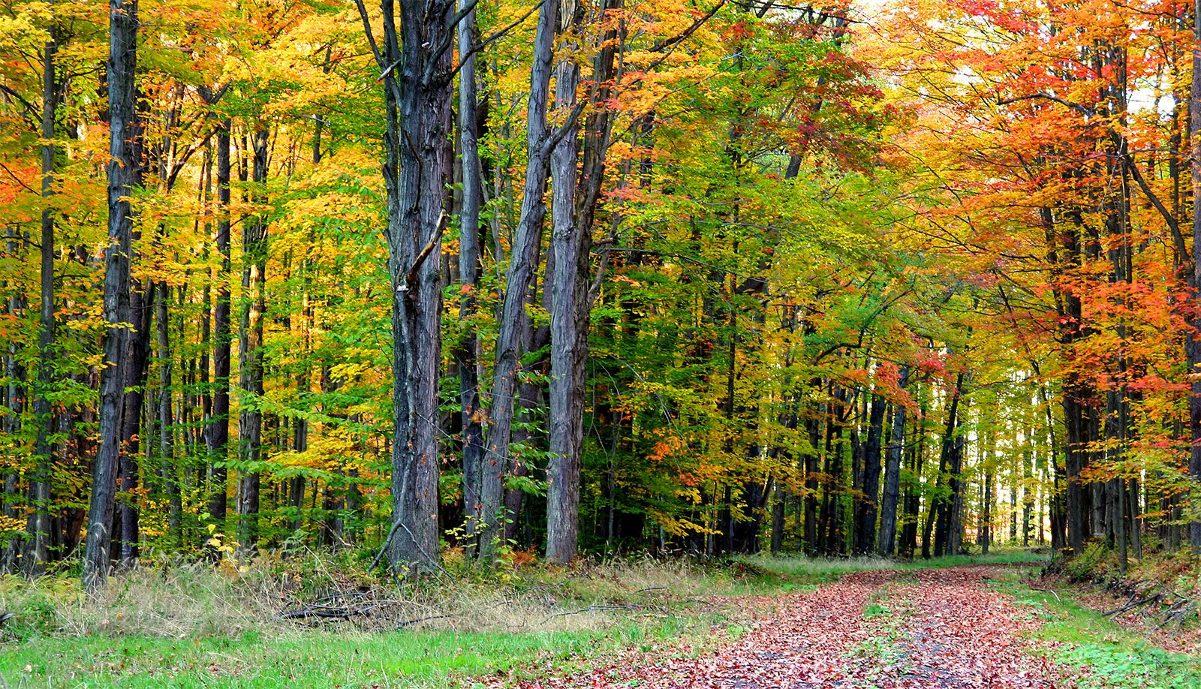
Temperate Forest
Four seasons
Deciduous trees
Deciduous trees: Trees with broad leaves that change color and fall off in autumn, regrowing in spring.

Slide 8
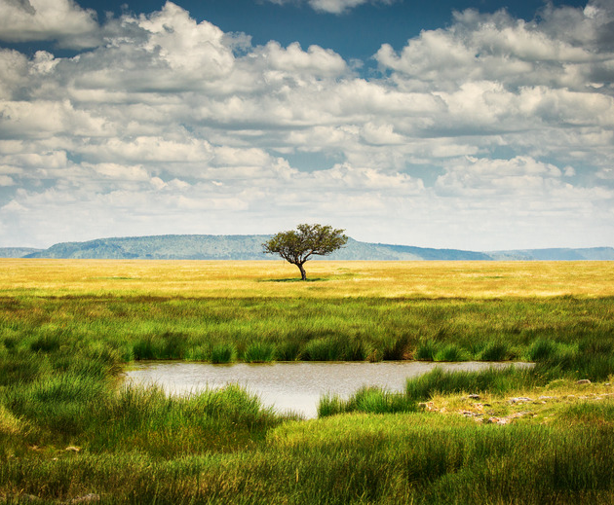
Grassland
Dominated by grasses
Few trees.

Slide 9
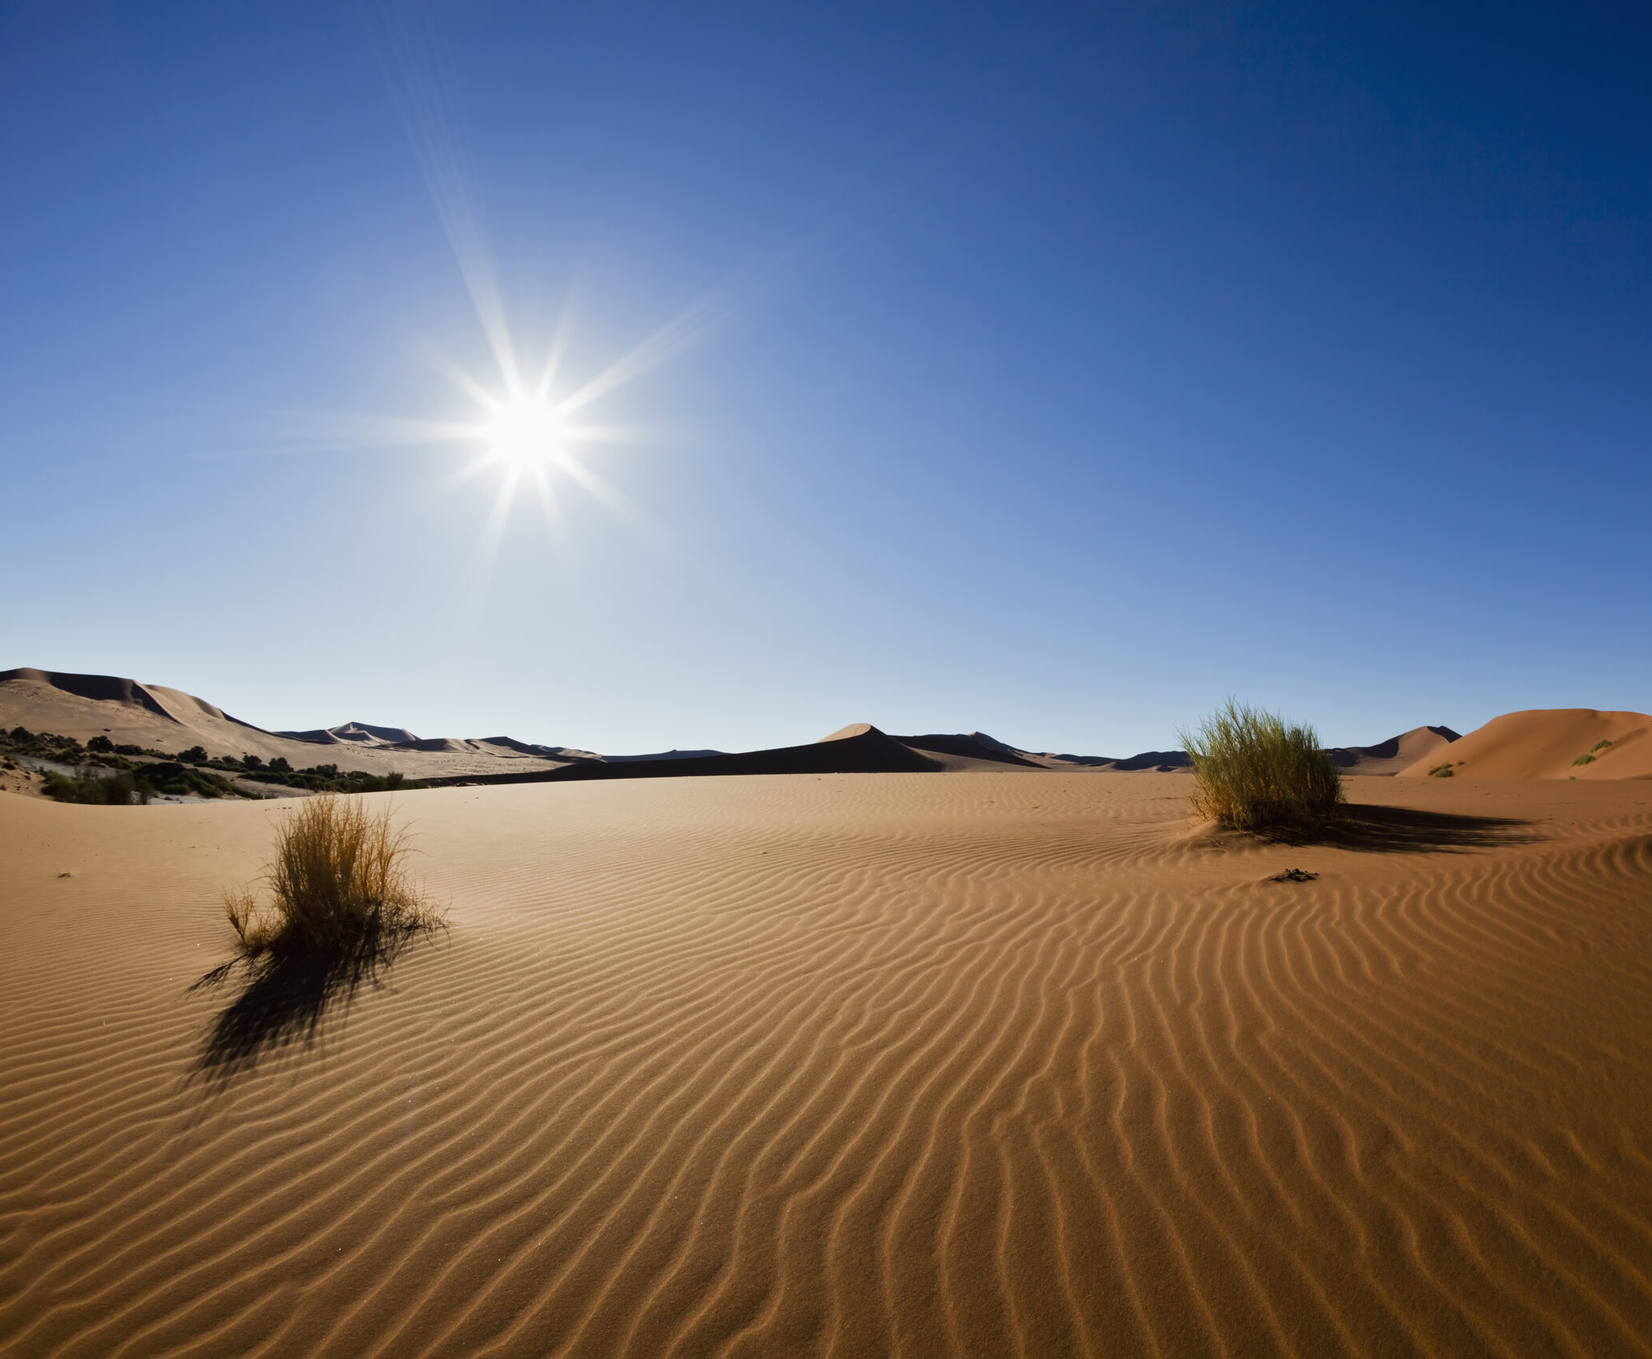
Desert
Very dry
Extreme temperatures.

Slide 10
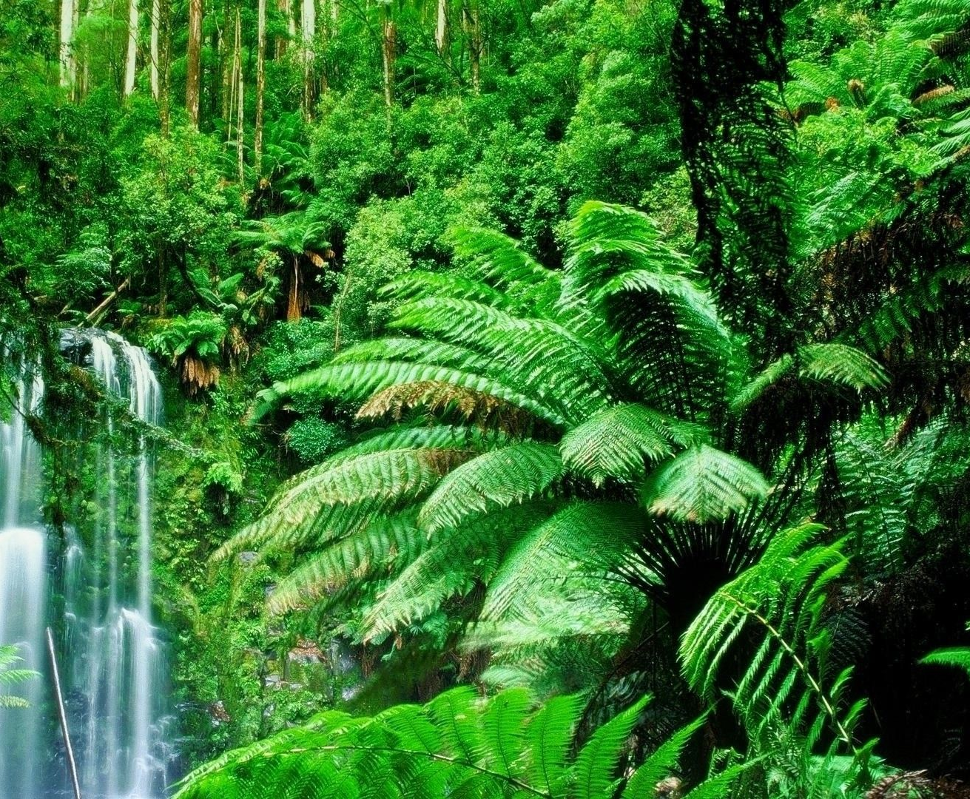
Tropical Rainforest
Warm
Wet
High biodiversity

Slide 11
Terrestrial Biomes: Flora & Fauna
Terrestrial Biome | Flora (Plants) | Fauna (Animals)
Tundra | Mosses, lichens, grasses | Arctic fox, caribou, polar bear, snowy owl
Taiga/Boreal Forest | Conifers (pine, spruce, fir), mosses | Moose, lynx, bears, wolves, squirrels
Temperate Forest | Deciduous trees (oak, maple, beech), shrubs, ferns | Deer, foxes, raccoons, black bears, songbirds
Grassland | Grasses, wildflowers, few trees | Bison, antelope, zebras, lions, prairie dogs
Desert | Cacti, succulents, drought-resistant shrubs | Camels, lizards, snakes, scorpions, fennec fox
Tropical Rainforest | Orchids, ferns, broadleaf trees, vines | Jaguars, toucans, monkeys, frogs, insects

Slide 12
Aquatic Biomes
Freshwater
Marine

Slide 13
Freshwater
Low salinity, supporting diverse plants and animals adapted to non-salty environments.
Rivers: Flowing bodies of freshwater.
Lakes: Large, still freshwater basins.
Wetlands: Water-saturated ecosystems with high biodiversity.

Slide 14
Freshwater : Flora & Fauna
Ecosystem | Flora (Plants) | Fauna (Animals)
Rivers | Algae, water grasses, willow trees along banks | Trout, salmon, otters, frogs, kingfishers
Lakes | Water lilies, cattails, reeds, phytoplankton | Ducks, turtles, fish (bass, perch), snails
Wetlands | Mangroves, sedges, bulrushes, mosses | Frogs, herons, dragonflies, beavers, alligators

Slide 15
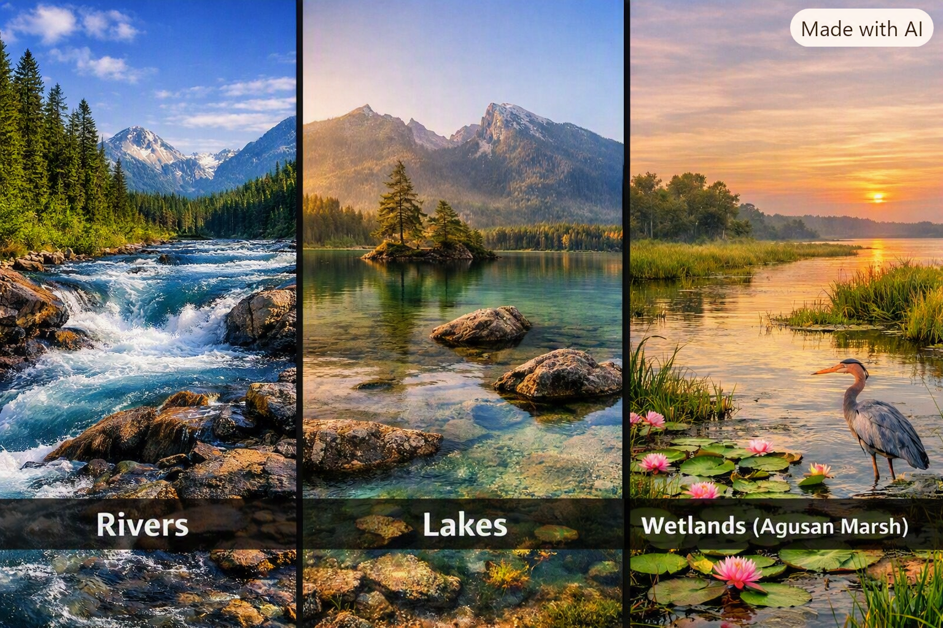

Slide 16
Marine
Oceans: Vast saltwater ecosystem covering most of Earth’s surface, regulating climate and supporting diverse life from plankton to whales.
Coral Reefs: High biodiversity ecosystems in shallow, warm waters, built by corals and home to countless fish and invertebrates.
Estuaries: Transition zones between rivers and seas, mixing freshwater and saltwater, serving as nurseries for many marine species.
      Water is brackish — a mix of salt and fresh water.

Slide 17
marine: Flora & Fauna
Biome | Flora (Plants & Producers) | Fauna (Animals)
Ocean | Phytoplankton, seaweed, kelp forests, algae | Whales, dolphins, sharks, jellyfish, sea turtles, plankton
Coral Reefs | Zooxanthellae (symbiotic algae), sea grasses, algae | Clownfish, parrotfish, sea stars, reef sharks, sea urchins, corals (animals)
Estuaries | Mangroves, salt marsh grasses, algae | Crabs, oysters, shrimps, herons, egrets, fish fry (young fish)

Slide 18
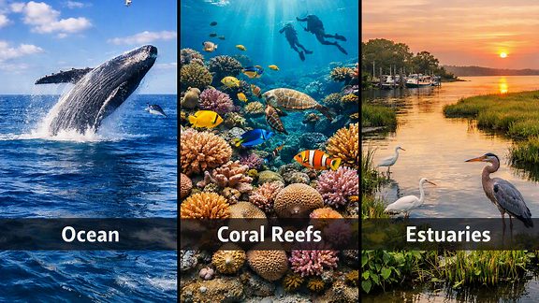

Slide 19
Environmental Factors Shaping Biomes
Climate
      Temperature and rainfall determine vegetation.
Soil
      Nutrient availability affects plant growth.
Sunlight
      Energy source for photosynthesis.
Water
      Availability and salinity.

Slide 20
Summary
Biomes are shaped by environmental factors.
Terrestrial biomes depend on climate and soil.
Aquatic biomes depend on water properties.
Understanding biomes helps us protect biodiversity.

Slide 21
Terrestrial Biomes
Tundra: Cold, treeless, permafrost soil.
Taiga: Coniferous forests, long winters.
Temperate Forest: Four seasons, deciduous trees.
Grassland: Dominated by grasses, few trees.
Desert: Very dry, extreme temperatures.
Tropical Rainforest: Warm, wet, high biodiversity.

Slide 22
Aquatic biome
Freshwater
Low salinity, supporting diverse plants and animals adapted to non-salty environments.
Rivers: Flowing bodies of freshwater.
Lakes: Large, still freshwater basins.
Wetlands: Water-saturated ecosystems with high biodiversity.
Marine
Oceans: Vast saltwater ecosystem covering most of Earth’s surface, regulating climate and supporting diverse life from plankton to whales.
Coral Reefs: High biodiversity ecosystems in shallow, warm waters, built by corals and home to countless fish and invertebrates.
Estuaries: Transition zones between rivers and seas, mixing freshwater and saltwater, serving as nurseries for many marine species.

Slide 23
Discussion Question
How do human activities (deforestation, pollution, climate change) impact both terrestrial and aquatic biomes?

Slide 24
assignment
Title: Biomes of the World – Digital Infographic
Objective: Students will design a digital infographic that explains one or more world biomes.
Content Requirements
Title & Subtitle – Creative and clear.
Definition – Concise description of the chosen biome.
Climate – Temperature, precipitation, and seasonal patterns.
Flora & Fauna – Representative plants and animals.
Human Impact – Positive or negative effects. .
Visuals – Icons, images, or diagrams to enhance understanding.
Sources – Cite references for accuracy.
Format
Digital layout (Canva, PowerPoint, or similar).
Orientation: Landscape or Portrait.
Size: A4 or Letter.
Export format: PNG or PDF.

Slide 25
Rubric
Criteria | Excellent (10 pts) | Good (8 pts) | Fair (6 pts) | Needs Improvement (4 pts)
Content Accuracy | All biome info correct, complete, and relevant. | Minor inaccuracies or missing details. | Several inaccuracies or incomplete data. | Major errors or missing key concepts.
Visual Design | Creative, balanced, visually appealing layout. | Clear design with minor clutter. | Acceptable design but lacks harmony. | Poor layout or distracting visuals.
Organization & Clarity | Logical flow; easy to read and understand. | Mostly organized; minor confusion. | Some disorganization or unclear sections. | Hard to follow; lacks structure.
Creativity | Original, engaging, innovative presentation. | Some creative elements; moderately engaging. | Limited creativity; basic design. | Minimal effort; lacks originality.
Sources & Citations | All sources properly cited. | Some sources cited. | Few sources cited. | No citations provided.

