Slide 1

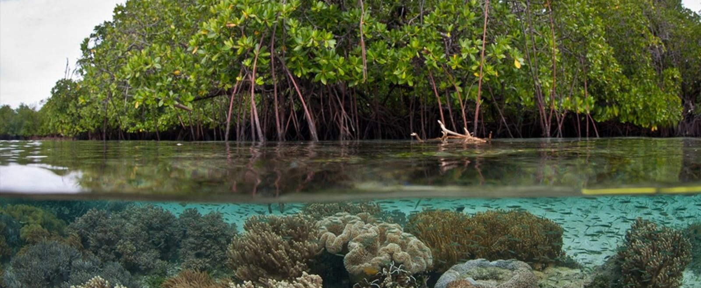
Biodiversity
Lesson 6

Slide 2
Objectives
At the end of the lesson, students should be able to:
Explain the different levels of biodiversity.
Discuss the ecological, economic, social, and scientific importance of biodiversity.
Identify and analyze major threats to biodiversity.
Describe and evaluate strategies for conserving biodiversity.

Slide 3
What is Biodiversity?
The term biodiversity comes from the words biological and diversity.
Biodiversity is the variety and variability of living organisms and the ecosystems in which they occur.

Slide 4
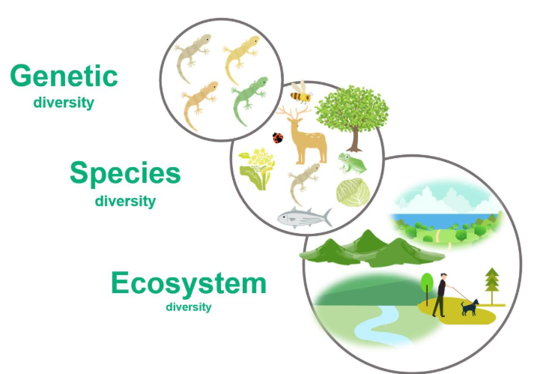
Levels of Biodiversity
Biodiversity can be studied at three major levels:
Genetic diversity
Species diversity
Ecosystem diversity

Slide 5
Genetic Diversity
Genetic diversity refers to the differences in genetic characteristics among individuals of the same species.
Individuals belonging to the same species are not necessarily genetically identical.
Example
Rice varieties can differ in:
  Grain size
  Color
  Taste
  Resistance to pests
  Tolerance to drought
  Growth period

Slide 6
Why is genetic diversity important?
Genetic diversity allows populations to adapt to:
  Diseases
  Climate change
  Environmental changes
  Pests
  Other environmental pressures
A population with greater genetic diversity generally has a greater range of characteristics that may help some individuals survive changing conditions.

Slide 7
Species Diversity
Species diversity refers to the variety of species present in a particular area.
It involves two related ideas:
1. Species richness
The number of different species in an area.
Example:
Forest A contains 50 different species, while Forest B contains 20 species.
Forest A has greater species richness.
2. Species evenness
The relative abundance of different species in an ecosystem.
Example:
Two forests may contain the same number of species, but one may be dominated by only one species while the other has relatively balanced populations.

Slide 8
Example
A coral reef may contain:
  Hundreds of fish species
  Corals
  Sea stars
  Sea urchins
  Mollusks
  Crustaceans
  Algae
  Microorganisms
This represents high species diversity.

Slide 9
Ecosystem Diversity
Ecosystem diversity refers to the variety of ecosystems, habitats, and ecological communities within a geographic area.
Examples:
Tropical rainforests
Mangrove forests
Coral reefs
Seagrass beds
Lakes
Wetlands
Grasslands
Agricultural ecosystems

Slide 10
Level | Meaning | Example
Genetic diversity | Variation within a species | Different varieties of rice.
Species diversity | Variety of species in an area | Different species in a forest.
Ecosystem diversity | Variety of ecosystems in a region | Forests, mangroves, coral reefs.

Slide 11
Importance of Biodiversity
Biodiversity is essential for both ecosystem functioning and human well-being.
A. Ecological Importance
B. Economic Importance
C. Food Security
D. Medicinal and Scientific Importance
E. Ecosystem Services
F. Cultural and Social Importance

Slide 12
A. Ecological Importance
Biodiversity helps ecosystems function properly.
Different organisms perform different ecological roles.
Example:
  Plants produce oxygen and organic matter.
  Pollinators help plants reproduce.
  Decomposers recycle nutrients.
  Predators regulate populations.
  Soil organisms help maintain soil fertility.

Slide 13
B. Economic Importance
Biodiversity provides resources that support economic activities.
Examples:
  Agriculture
  Fisheries
  Forestry
  Ecotourism
  Pharmaceuticals
  Food production
Many products used by humans originate from biological resources.

Slide 14
Example
Fish populations support:
  Fisherfolk
  Fish vendors
  Food processors
  Restaurants
  Consumers
Biodiversity can contribute directly to livelihoods and economic development.

Slide 15
C. Food Security
Biodiversity contributes to food security by providing a variety of:
  Crops
  Livestock
  Fish
  Fruits
  Vegetables
  Wild food resources
Genetic diversity in crops is particularly important because it can provide varieties that are resistant to diseases, pests, drought, or other environmental stresses.

Slide 16
D. Medicinal and Scientific Importance
Many organisms contain compounds that can be used in medicine and scientific research.
Plants, fungi, bacteria, and marine organisms have contributed to the discovery of biologically active substances.
Biodiversity therefore provides a large natural resource for scientific discovery.

Slide 17
E. Ecosystem Services
Ecosystem Service | Example
Provisioning | Food, freshwater, timber, medicines
Regulating | Climate regulation, flood control, pollination.
Cultural | Recreation, tourism, spiritual and cultural values.
Supporting | Nutrient cycling, soil formation, primary production.

Slide 18
F. Cultural and Social Importance
Biodiversity is closely connected to human culture.
Plants, animals, landscapes, forests, rivers, and coastal ecosystems may have:
  Cultural significance (Philippine eagle)
  Traditional uses (Bamboo)
  Recreational value (Coral reefs)
  Educational value (Mangrove forests)
  Aesthetic value (The Banaue Rice Terraces)
For many communities, natural resources are also connected to traditional knowledge and livelihoods.

Slide 19
Threats to Biodiversity
Biodiversity is declining because of both human activities and natural environmental changes.
Major threats
H – Habitat loss
I – Invasive species
P – Pollution
P – Population/human pressure
O – Overexploitation
C – Climate change

Slide 20
Habitat Loss and Destruction
Habitat loss occurs when natural habitats are destroyed or converted into areas used for human activities.
Examples:
  Deforestation
  Urbanization
  Mining
  Agricultural expansion
  Road construction
  Coastal development

Slide 21
Example
When a forest is cleared for agriculture, organisms that depend on the forest may lose:
  Food
  Shelter
  Breeding sites
  Protection
Some species may be forced to move, while others may decline or disappear.

Slide 22
2. Invasive Species
An invasive species is a non-native organism that establishes itself and causes ecological, economic, or other harm.
Such species may:
  Compete with native species
  Consume native organisms
  Introduce diseases
  Alter habitats
  Disrupt food webs
Example
The introduction of non-native species into an ecosystem can change relationships among native organisms and reduce native biodiversity.

Slide 23
3. Pollution
Pollution can damage organisms and their habitats.
Air pollution
  Can affect plants, animals, and atmospheric processes.
Water pollution can result from
  Sewage
  Agricultural runoff
  Industrial waste
  Plastics
  Oil

Slide 24
Cont.
Soil pollution can result from:
  Pesticides
  Heavy metals
  Improper waste disposal
Plastic pollution
  Plastic waste can enter rivers and oceans and harm marine organisms through ingestion or entanglement.

Slide 25
4. Overexploitation
Overexploitation occurs when organisms or natural resources are harvested faster than they can naturally reproduce or recover.
Examples:
  Overfishing
  Illegal logging
  Excessive hunting
  Collection of wild plants
  Wildlife trafficking
Example
If fish are caught faster than they reproduce, the fish population can decline.

Slide 26
6. Climate Change
Climate change can alter environmental conditions such as:
  Temperature
  Rainfall
  Sea level
  Ocean temperature
  Ocean chemistry
Species may need to:
  Adapt
  Move to new habitats
  Change their behavior
Species that cannot adapt or move quickly enough may experience population decline.
Example
Coral reefs are particularly vulnerable to increasing ocean temperatures because prolonged heat stress can cause coral bleaching.

Slide 27
Conservation of Biodiversity
Biodiversity conservation refers to the protection, management, and sustainable use of biological diversity.
Major approaches:
  In-situ conservation
  Ex-situ conservation
  Sustainable use
  Habitat restoration
  Laws and policies
  Community participation
  Education and awareness

Slide 28
A. In-Situ Conservation
In-situ conservation means conserving organisms in their natural habitats.
Examples:
  National parks
  Wildlife sanctuaries
  Marine protected areas
  Forest reserves
  Protected landscapes and seascapes
Example
Protecting a coral reef through a marine protected area allows organisms to remain within their natural ecosystem.

Slide 29
B. Ex-Situ Conservation
Ex-situ conservation means conserving organisms outside their natural habitats.
Examples:
  Zoos
  Botanical gardens
  Seed banks
  Gene banks
  Aquariums
  Captive breeding facilities
Example
A rare plant may be cultivated in a botanical garden when its natural population is threatened.

Slide 30
C. Sustainable Use of Biological Resources
Sustainable use means using biological resources at a rate that allows them to remain available for future generations.
Examples:
Sustainable fishing
Sustainable forestry
Responsible wildlife management
Sustainable agriculture
Ecotourism
Example
Instead of catching unlimited fish, fishing regulations can establish:
Catch limits
Fishing seasons
Minimum size limits
Protected areas
Restrictions on destructive fishing methods

Slide 31
D. Habitat Restoration
Habitat restoration involves repairing or improving ecosystems that have been degraded or damaged.
Examples:
  Reforestation
  Mangrove restoration
  Coral reef rehabilitation
  Wetland restoration
  River rehabilitation
Example
Planting mangroves in degraded coastal areas can help restore habitat for fish, crabs, birds, and other organisms while also helping protect coastlines.

Slide 32
E. Laws and Policies
Governments establish laws and policies to protect biodiversity.
Republic Act No. 9147
  Wildlife Resources Conservation and Protection Act
  It provides for the conservation and protection of wildlife resources and their habitats.
Republic Act No. 7586
  National Integrated Protected Areas System (NIPAS) Act of 1992
  It established a system for identifying and managing protected areas.
  It was strengthened by:
Republic Act No. 11038
  Expanded NIPAS Act of 2018
  It expanded the country's protected-area system and strengthened protection and management provisions.

Slide 33
Biodiversity in the Philippines
The Philippines is recognized as a megadiverse country because of its high biological diversity and high level of endemism.
A megadiverse country is a country that has an exceptionally large variety of living organisms (biodiversity) and contains a high number of species that are found nowhere else in the world (endemic species).
Example: the Philippine eagle is endemic to the Philippines.
Endemic species are particularly vulnerable because if their limited habitat is destroyed, they may have nowhere else to naturally occur.

Slide 34
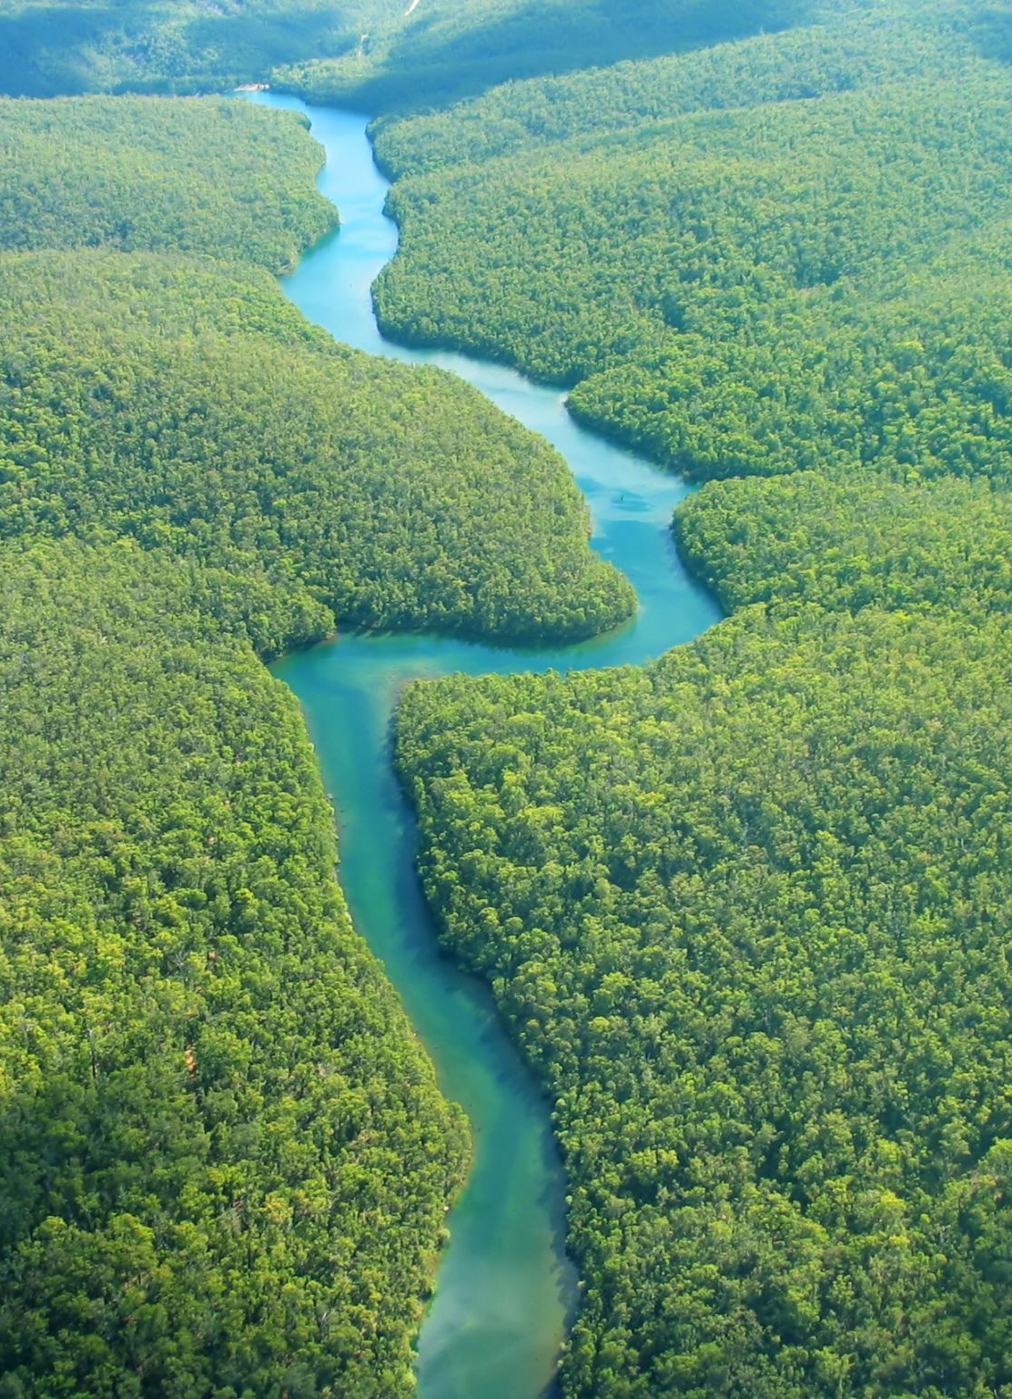
Class Discussion
What would happen to human life if biodiversity continued to decline?
A community plans to convert a mangrove forest into a commercial development.
  What biodiversity-related consequences might occur?
  What alternatives could allow the community to achieve economic development while protecting biodiversity?

Slide 35




Key Concepts to Remember
Biodiversity | Variety of life and ecological systems
Genetic diversity | Variation within a species
Species diversity | Variety of species in an area
Ecosystem diversity | Variety of ecosystems
Species richness | Number of species in an area
Species evenness | Relative abundance of species
Endemic species | Naturally occurs only in a particular area
Habitat loss | Destruction or conversion of natural habitat
Habitat fragmentation | Division of continuous habitat into smaller patches
Overexploitation | Excessive use or harvesting of organisms
Invasive species | Non-native species that causes harm
Pollution | Introduction of harmful substances or energy
Climate change | Long-term changes in climate conditions
In-situ conservation | Conservation in the natural habitat
Ex-situ conservation | Conservation outside the natural habitat
Sustainable use | Using resources without preventing future availability
Habitat restoration | Repairing degraded ecosystems

Slide 36
Topic | Summary
Levels of Biodiversity | Biodiversity occurs at genetic, species, and ecosystem levels.
Importance | Biodiversity supports ecosystem functions, food production, livelihoods, medicine, culture, and ecosystem services.
Threats | Habitat loss, invasive species, pollution, overexploitation, and climate change threaten biodiversity.
Conservation | Biodiversity can be protected through in-situ and ex-situ conservation, sustainable use, habitat restoration, laws, community participation, and education.

