Slide 1
Air Quality and Supervision
Lesson 7

Slide 2
INTRODUCTION
Air quality refers to the condition of the air in a particular place based on the amount and type of pollutants present.
  Good air quality supports human health and ecosystems,
  Poor air quality can cause respiratory diseases, environmental damage, and climate-related problems.
This lesson discusses the Earth's atmosphere, air pollution, air quality management, and methods of controlling air pollution.

Slide 3
Learning Objectives
At the end of the lesson, students should be able to:
Describe the structure and composition of the Earth's atmosphere.
Identify and explain major sources, types, and effects of air pollution.
Explain the principles and practices of air quality management.
Evaluate appropriate methods for preventing and controlling air pollution.

Slide 4
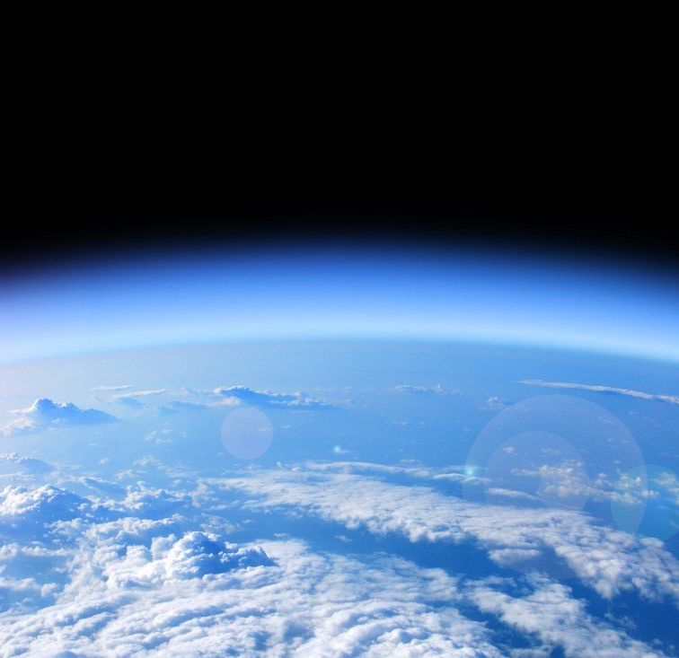
The Earth's Atmosphere
The atmosphere is the layer of gases surrounding Earth. It provides the conditions necessary for life.
This Photo by Unknown Author is licensed under CC BY-SA-NC

Slide 5
Composition of the Atmosphere
Gas | Approximate Proportion | Importance
Nitrogen (N₂) | 78% | Important in the nitrogen cycle and production of proteins.
Oxygen (O₂) | 21% | Required for respiration and combustion.
Argon (Ar) | 0.93% | Inert gas with limited biological activity.
Carbon dioxide (CO₂) | ~0.04% | Used by plants in photosynthesis; Greenhouse gas.
Other gases | Small amounts | Include neon, helium, methane, ozone, and others.
Water vapor | Variable | Important in weather, clouds, and the water cycle.

Slide 6
Layers of the Earth's Atmosphere
The atmosphere is divided into several layers according to changes in temperature and other characteristics.
Layer | Temperature trend | Important Characteristics
Troposphere | ↓ Decreases | Weather occurs here.
Stratosphere | ↑ Increases | Contains the ozone layer.
Mesosphere | ↓ Decreases | Many meteoroids burn up here.
Thermosphere | ↑ Increases | Very high temperatures; auroras occur here
Exosphere | Gradually transitions | Outermost layer; gradually transitions into space

Slide 7
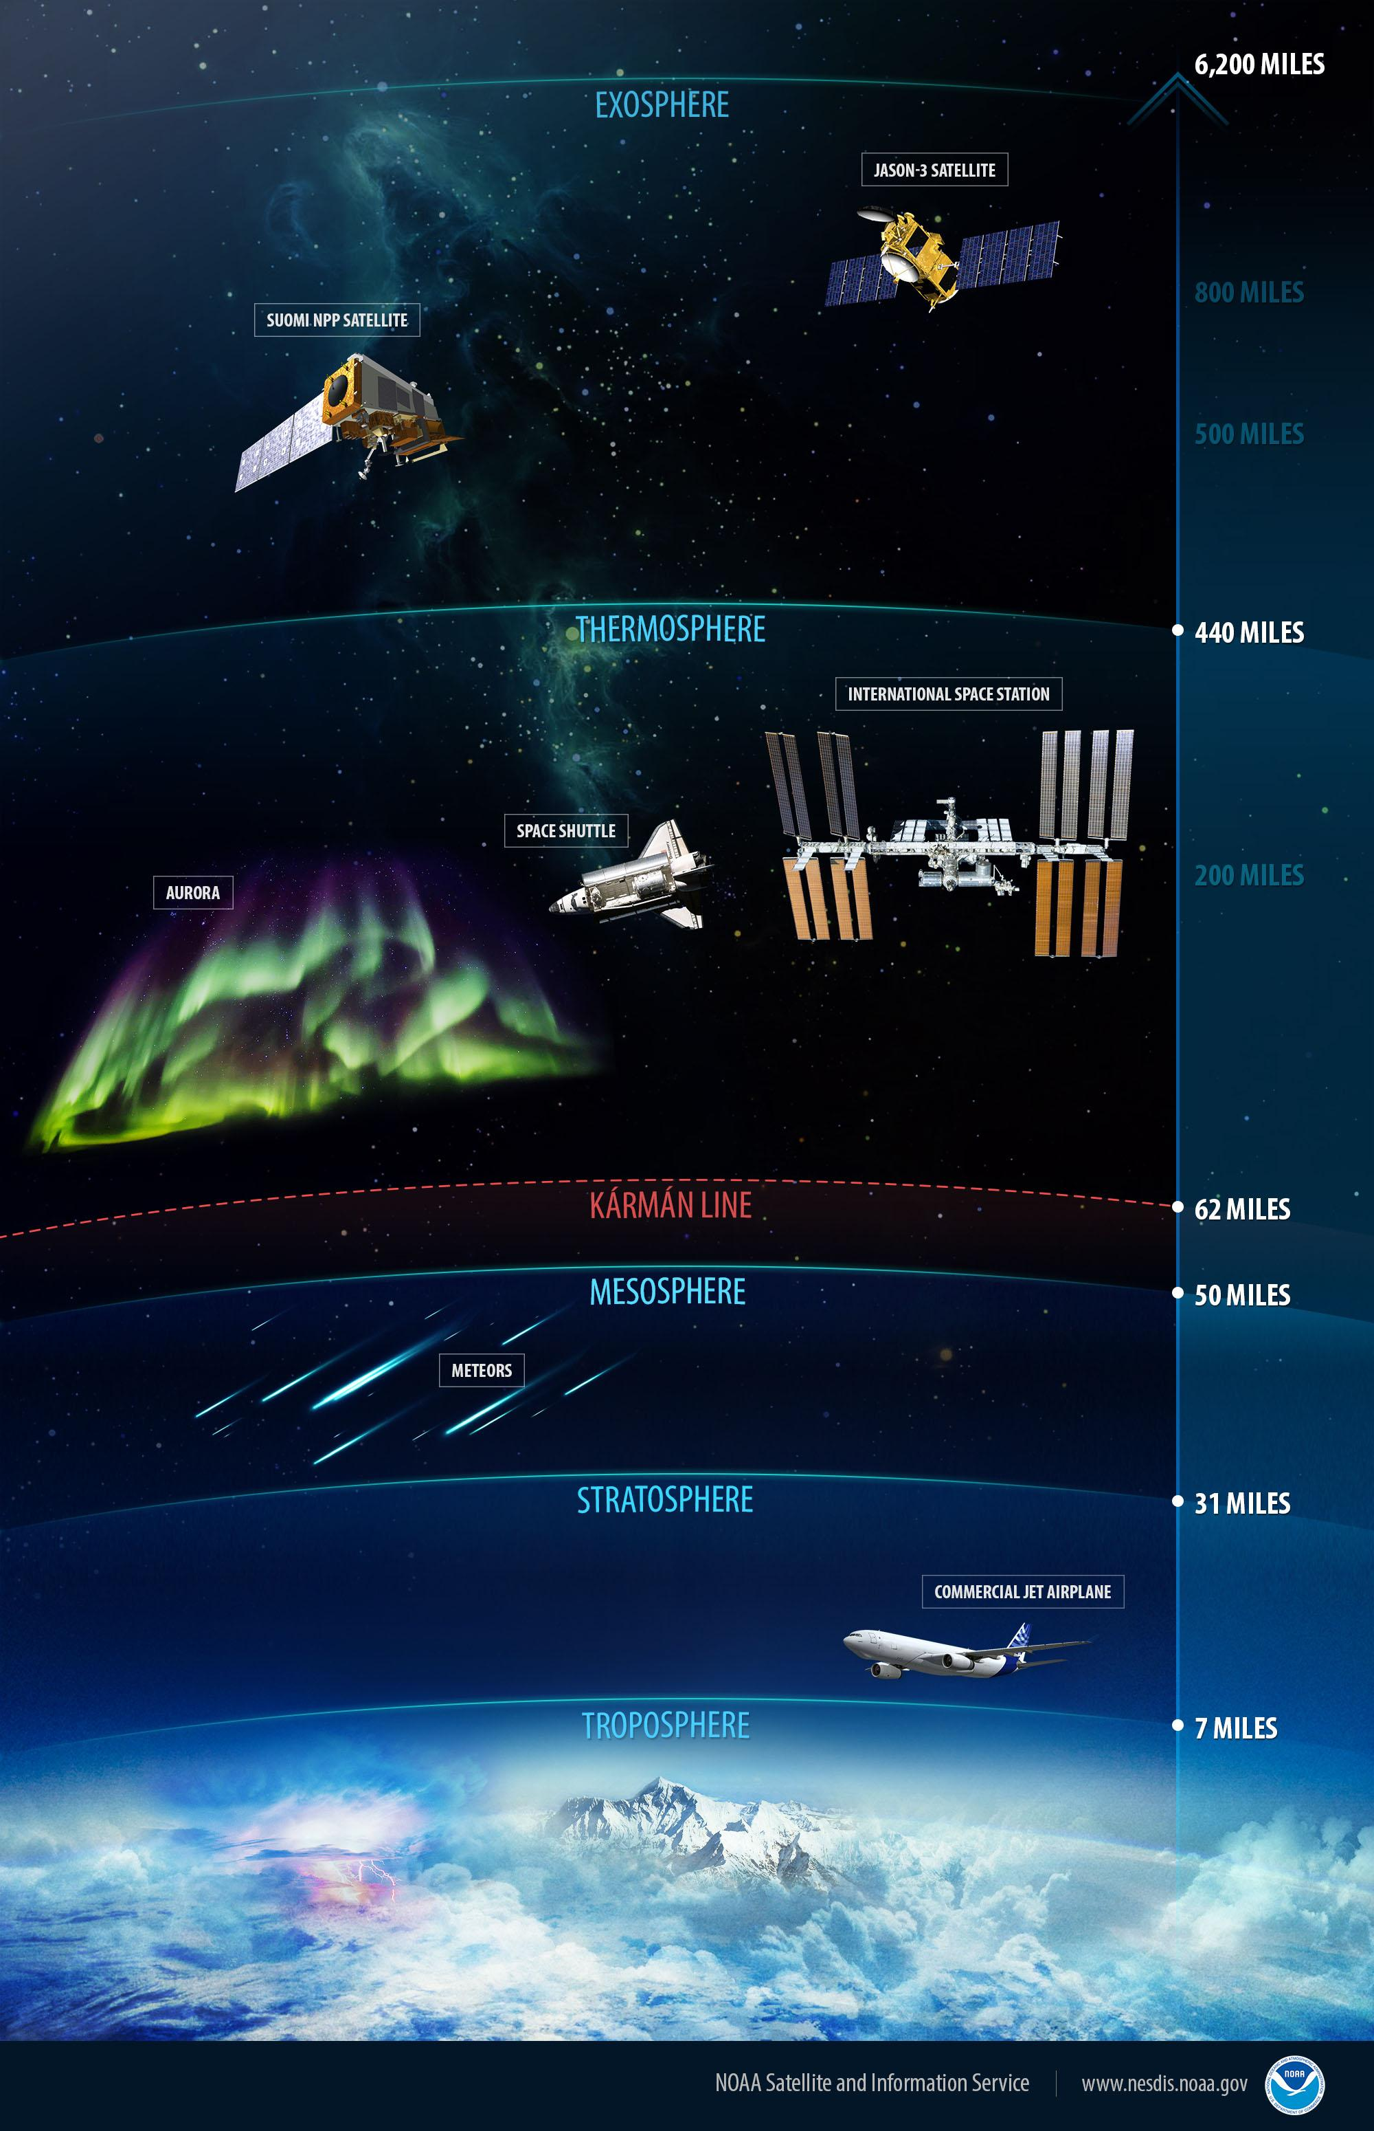
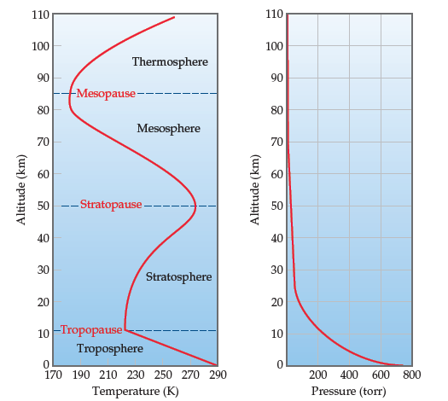

Slide 8
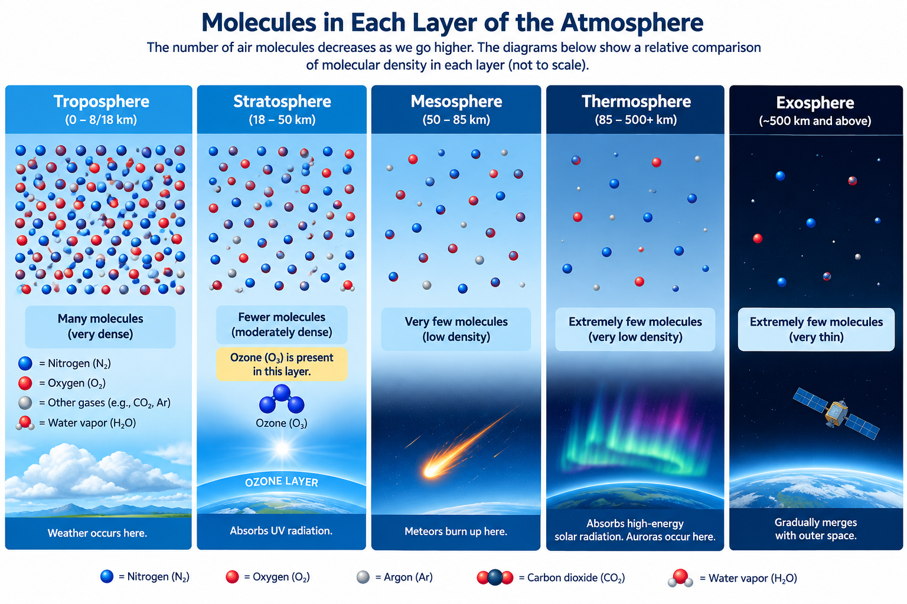

Slide 9
1. Troposphere
The troposphere is the lowest atmospheric layer and the layer in which people live.
It contains most of the atmosphere's water vapor and is where:
  clouds form
  rain occurs
  winds develop and
  most weather takes place.
Air pollution that directly affects human health is primarily concentrated in the troposphere.

Slide 10
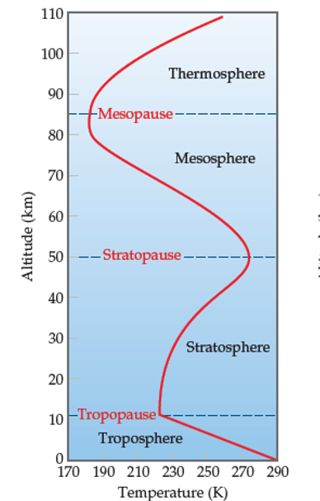
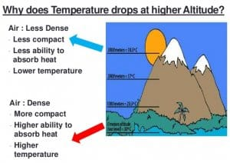
Cont.
As altitude increases, temperature generally decreases.
This happens because the Earth's surface is the main source of heat for the lower atmosphere. Air farther from the surface receives less heat.
Example: Mountain areas are generally cooler than areas near sea level.

Slide 11
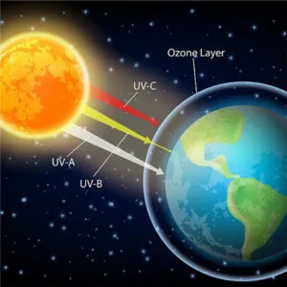
2. Stratosphere
The stratosphere lies above the troposphere. It contains the ozone layer, which absorbs much of the Sun's harmful ultraviolet (UV) radiation.
Temperature increases as altitude increases.
The major reason is the presence of ozone (O₃), which absorbs ultraviolet (UV) radiation from the Sun and converts some of that energy into heat.
UV radiation → absorbed by ozone → heat → temperature increase

Slide 12
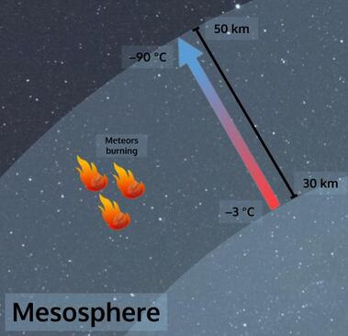
3. Mesosphere
The mesosphere is the layer where many meteoroids entering Earth's atmosphere burn (producing what we commonly call shooting stars) because of friction with atmospheric gases.
Temperature decreases as altitude increases. The mesosphere is one of the coldest regions of Earth's atmosphere.
Mesosphere = little ozone → less absorption → cools upward

Slide 13
Why is the mesosphere cold even though it is closer to the Sun?
Atmospheric temperature depends more on how much solar energy is absorbed than simply on distance from the Sun.
  The air becomes much thinner.
  There is less ozone available to absorb UV radiation. Less solar energy is converted into heat.
What about meteors?
The fact that meteors burn in the mesosphere does not mean the entire mesosphere is hot. The meteor is heated mainly because of its extremely high-speed interaction with atmospheric gases.

Slide 14
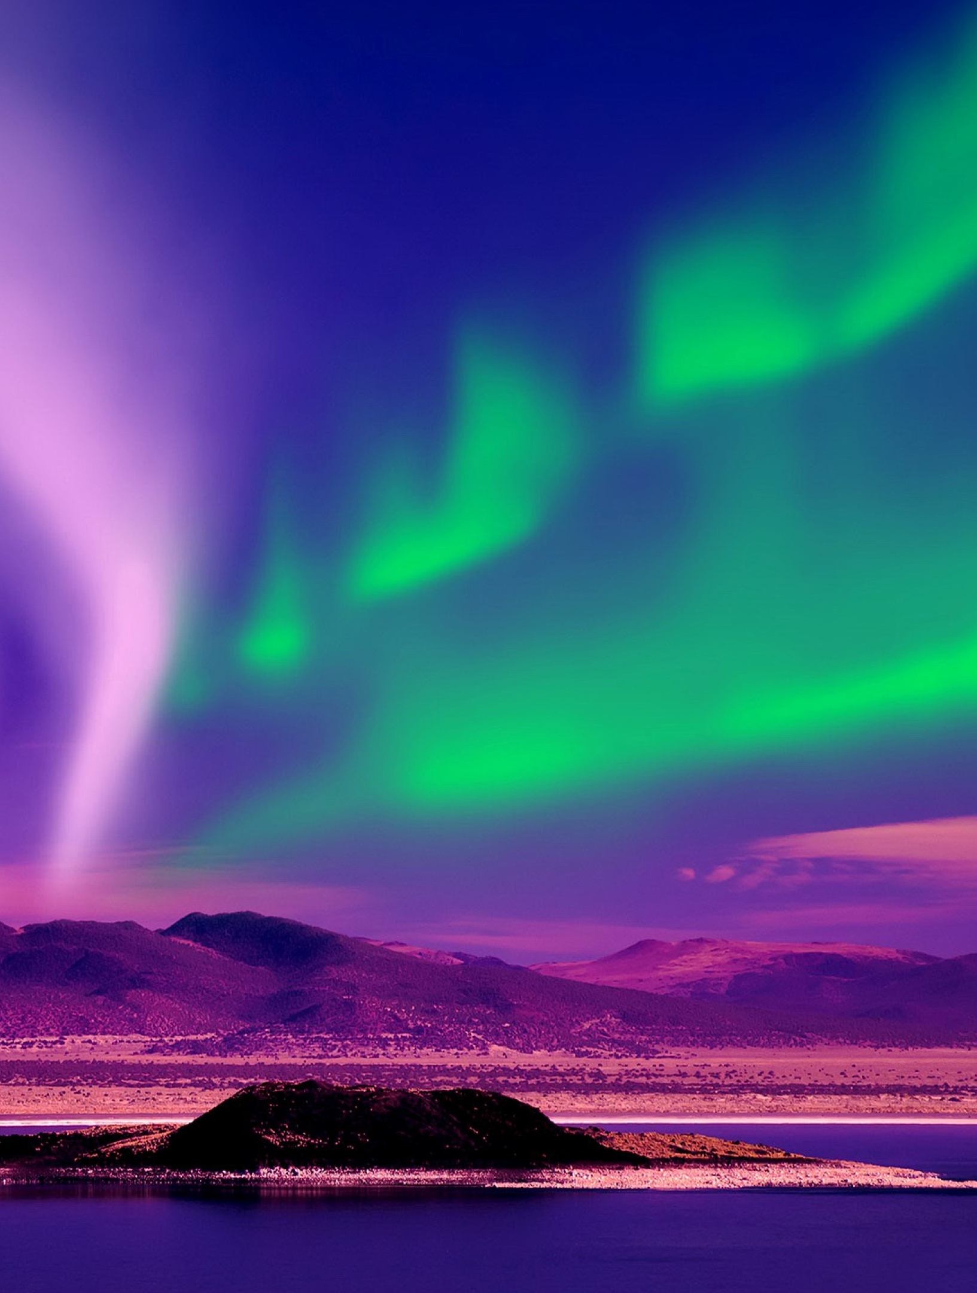
4. Thermosphere
Auroras occur in this region.
    Borealis – North
    Australis - South
  Collision with oxygen
    Green and red emission
  Collision with Nitrogen
    Low level red and very high blue/violet

Slide 15
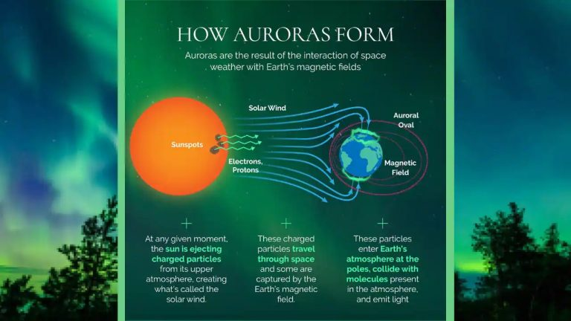

Slide 16
Cont.
The thermosphere contains very thin air and can reach extremely high temperatures.
Temperature increases as altitude increases.
  The temperature of the thermosphere increases with altitude because the gases in this layer absorb high-energy solar radiation, particularly extreme ultraviolet radiation and X-rays. This energy makes the gas particles move very rapidly, resulting in very high temperatures.
  However, the thermosphere is extremely thin, so there are very few particles to transfer heat. Therefore, although the measured temperature is very high, the thermosphere would not feel like a very hot atmosphere on Earth.

Slide 17
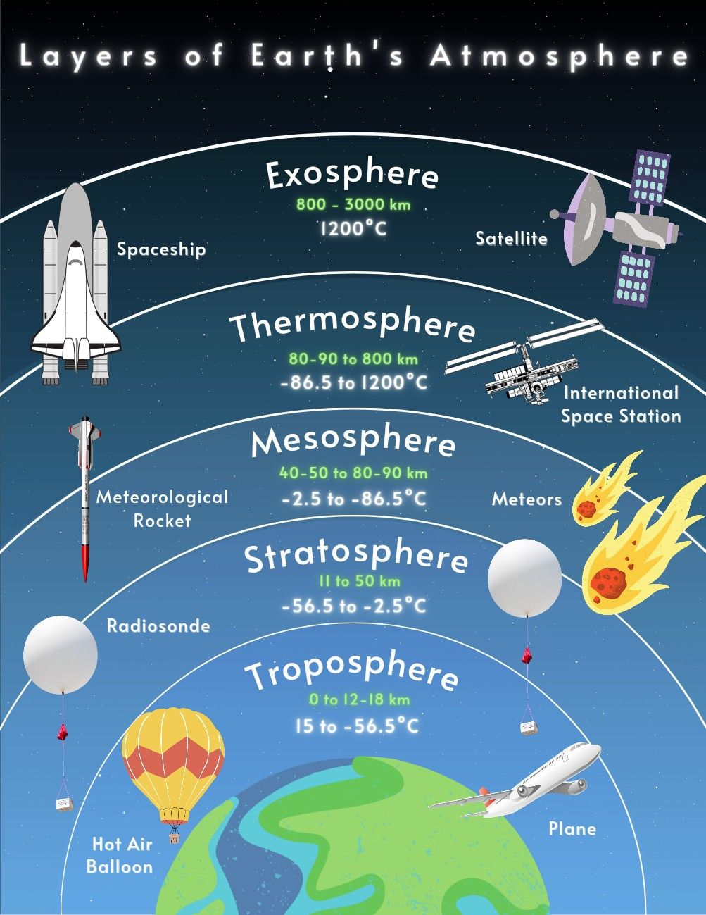
Cont.
Some spacecraft and satellites orbit within or pass through this region.
Many satellites, especially those in Low Earth Orbit, are in the thermosphere or above it. The ISS, for example, orbits within the thermosphere at about 400 km altitude. Higher-orbit satellites are far above the main layers of Earth's atmosphere.
Although the thermosphere can have temperatures of hundreds or thousands of degrees Celsius, the ISS does not experience ordinary atmospheric heating like an aircraft flying through dense air because there are extremely few molecules there.

Slide 18
5. Exosphere
The exosphere is the outermost region of Earth's atmosphere.
The gases are extremely sparse, and there is no sharp boundary where the atmosphere suddenly ends. Instead, the exosphere gradually becomes outer space.
Some satellites in higher orbits are located well above the exosphere

Slide 19
Atmosphere
The atmosphere:
  provides oxygen for respiration.
  provides carbon dioxide needed by plants for photosynthesis.
  protects Earth from harmful solar radiation.
  regulates Earth's temperature.
  supports the water cycle.
  allows weather and climate processes to occur and
  burns up many small meteoroids before they reach Earth's surface.

Slide 20
Air Pollution
Air pollution can come from natural and human-made (anthropogenic) sources.

Slide 21
A. Natural Sources
Volcanic eruptions
Forest fires caused by natural events
Dust storms
Pollen and plant materials
Decomposition of organic matter
Sea spray

Slide 22
B. Human-Made Sources
Motor vehicles
Factories and power plants
Burning of coal, oil, and other fuels
Open burning of waste
Construction activities
Agricultural activities
Household fuel combustion.

Slide 23
Pollutants
Air pollutants can also be classified according to how they are formed.
Primary Pollutants
Primary pollutants are released directly into the atmosphere from a source.
Pollutant | Common Source
Carbon monoxide (CO) | Incomplete combustion of fuels.
Sulfur dioxide (SO₂) | Burning sulfur-containing fuels.
Nitrogen oxides (NOₓ) | Fuel combustion and vehicles.
Particulate matter (PM) | Combustion, construction, dust.
Volatile organic compounds (VOCs) | Fuel evaporation and industrial processes.

