Slide 1

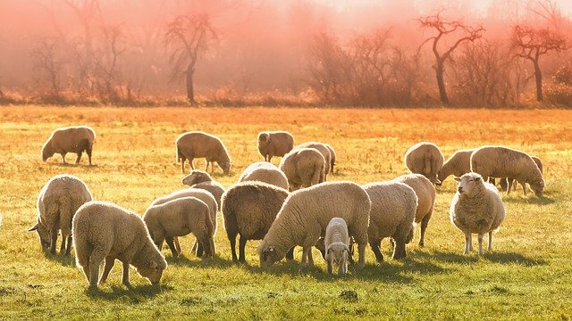
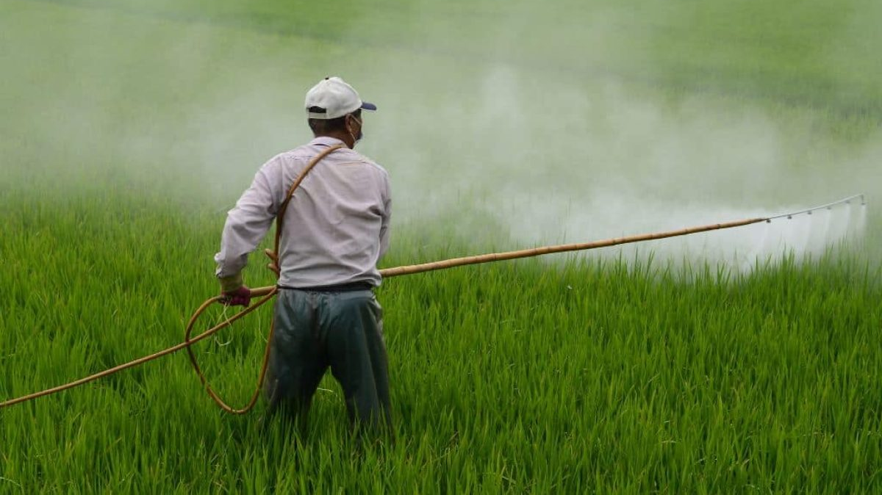
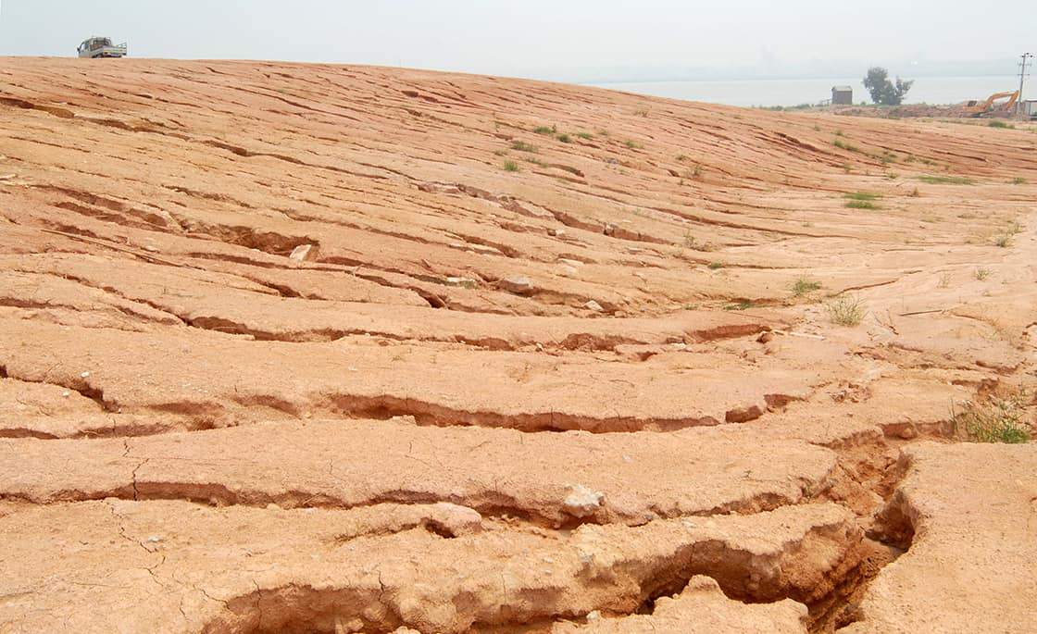
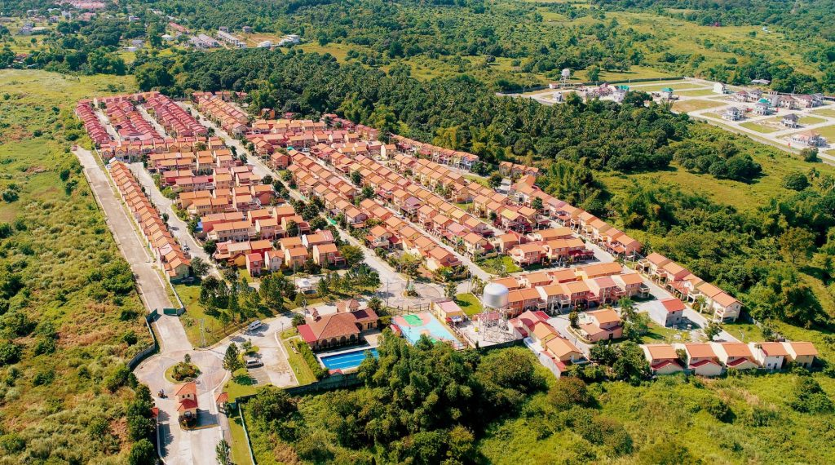
Land Use and Management
Lesson 9

Slide 2
Objectives
Identify and describe the different types of land use.
Explain the importance of land.
Analyze issues in land use and suggest possible solutions.
Discuss sustainable land management practices.
Explain RA 9003 and its role in managing waste and protecting the environment.

Slide 3
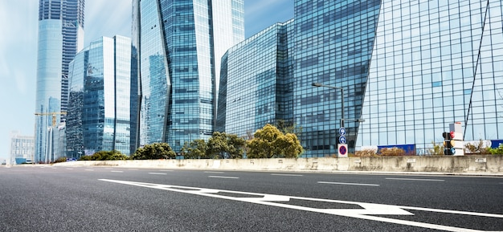
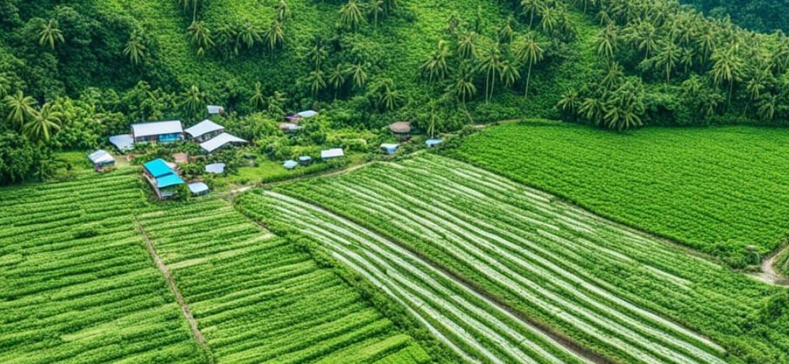
Have you ever wondered why some places are filled with farms and trees, while others are full of buildings and roads?

Slide 4

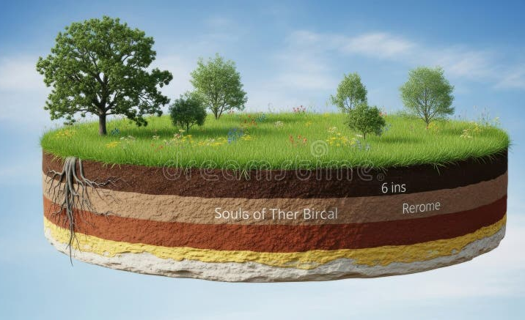
The Land
Land is the solid, dry surface of the Earth, making up about 29.2% of the planet's surface.
It includes soil, rocks, and minerals, and is where natural resources are found on and beneath the surface.

Slide 5
Importance of Land
Habitat – Provides living space for humans, animals, and plants.
Agriculture – Supplies the soil and nutrients necessary for growing crops and raising livestock.
Natural Resources – Contains valuable minerals, fossil fuels, and construction materials.
Infrastructure – Serves as the foundation for homes, roads, industries, and other human structures.
Ecological Balance – Supports ecosystems and maintains biodiversity.

Slide 6
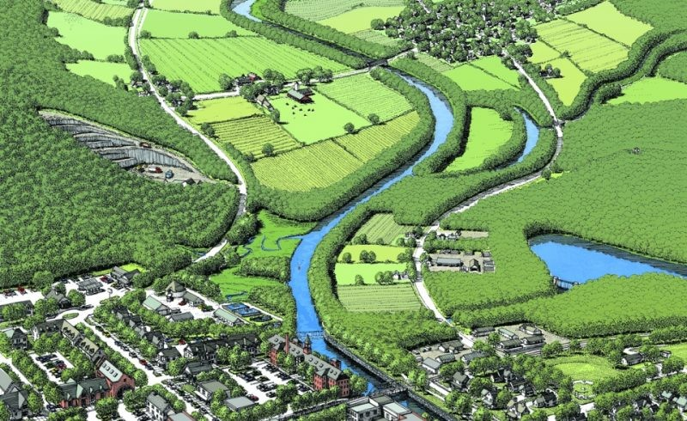
Land Use
Land Use describes the purpose or activity for which a piece of land is utilized.

Slide 7
Types of Land Use
Agricultural Land – Used for farming, livestock, and other food production.
Residential Land – Areas for housing and communities.
Commercial Land – Used for businesses, trade, and services.
Industrial Land – For factories, manufacturing, and processing plants.
Institutional/Public land - For municipal facilities, hospitals, museums, religious buildings, and schools.

Slide 8
cont.
6. Recreational Land – Parks, playgrounds, sports fields, and tourism sites.
7. Transport Land – Roads, railways, airports, and seaports.
8. Forest Land – Covered with trees and vegetation that support wildlife and prevent erosion.
9. Protected Areas – conservation zones for wildlife and natural habitats.

Slide 9
Issues in Land Use
Deforestation
Soil erosion and degradation
Urban sprawl
Land conversion

Slide 10
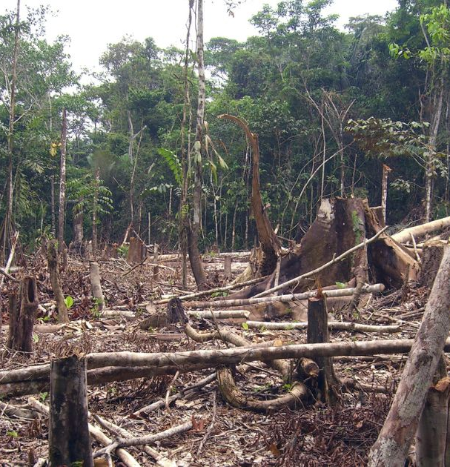
Deforestation
Deforestation is the large-scale removal of trees and forests for human activities such as logging, agriculture, or urban development.
Effects
  Loss of habitat for wildlife.
  Increased carbon dioxide in the atmosphere (since fewer trees absorb CO₂).
  Disruption of the water cycle.
  Contribution to soil erosion and climate change.

Slide 11
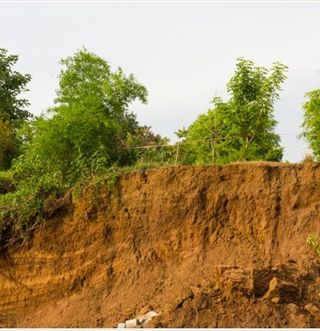
Soil Erosion and Degradation
Soil erosion is the wearing away of the top layer of soil due to wind, water, or human activities such as over-farming and deforestation.
Effects
  Loss of fertile soil, reducing crop productivity.
  Sedimentation in rivers and lakes, leading to flooding.
  Difficulty in plant growth due to loss of nutrients.
  Desertification in extreme cases.

Slide 12
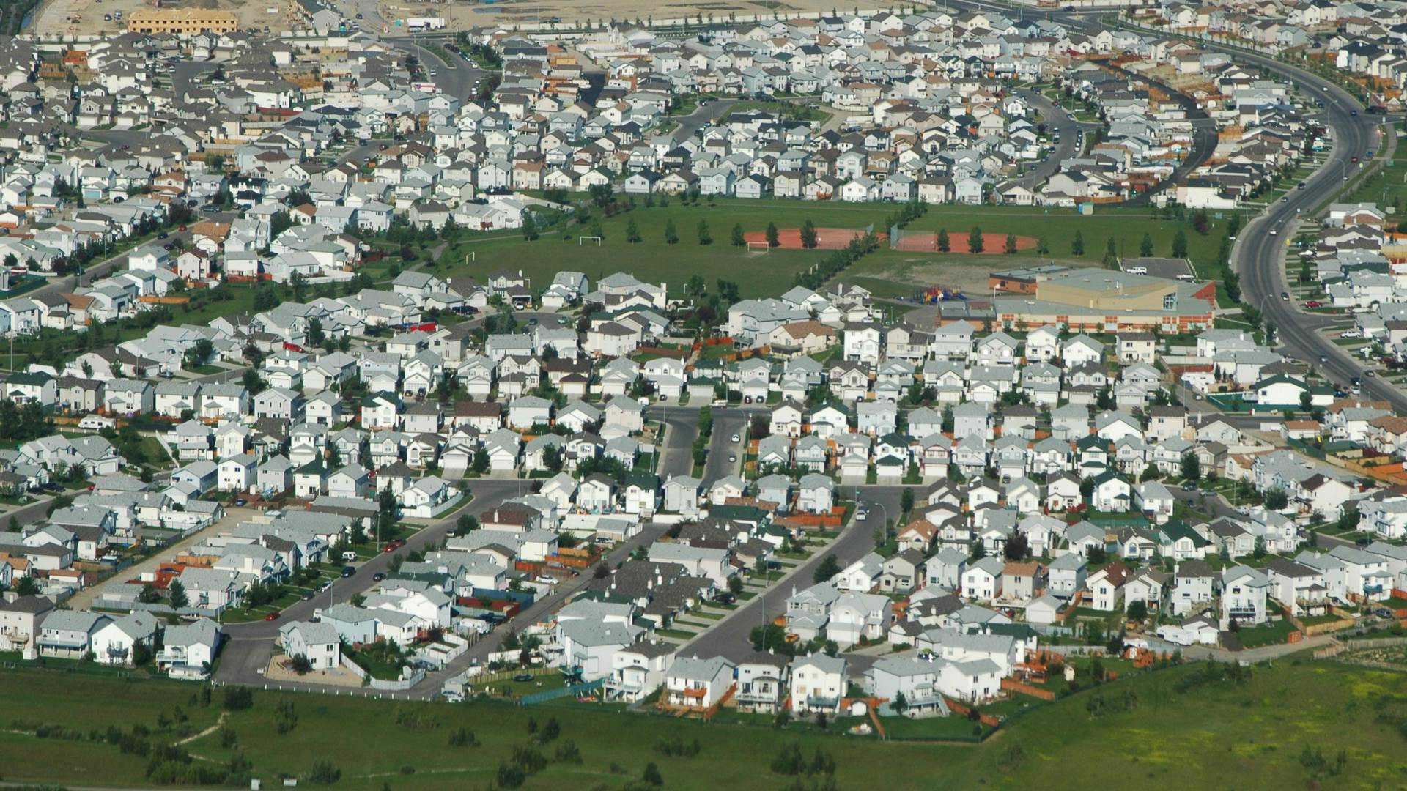
Urban Sprawl
Urban sprawl refers to the spread of cities into the countryside or rural areas.
This occurs when more houses, roads, malls, and buildings are constructed outside the city, causing cities to expand and cover a larger area of land.
Effects
  Loss of agricultural and forest lands.
  Increased traffic and pollution.
  Higher demand for water, energy, and other resources.
  Demands on infrastructure such as roads, schools, and hospitals.

Slide 13

Land Conversion
(from Agricultural to Industrial/Residential Use)
Land conversion happens when farmland is turned into areas for housing, factories, or commercial establishments.
Effects
  Reduction in available land for food production.
  Increased risk of flooding due to loss of soil and vegetation.
  Displacement of farming communities.
  Greater dependency on imported food supplies.

Slide 14
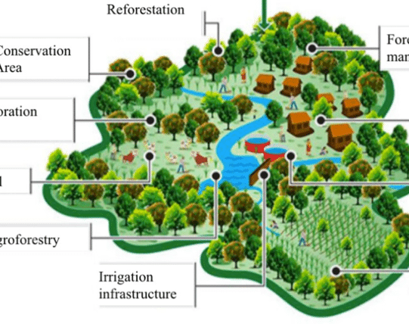
LAND MANAGEMENT
Land Management refers to the methods, policies, and practices to use land resources wisely and sustainably.

Slide 15
Sustainable Land Management Practices
Reforestation and Afforestation
Contour Plowing and Terracing
Organic and Conservation Farming
Agroforestry (trees + crops)
Land Zoning and Protected Areas
Use of Green Infrastructure
Proper Waste Disposal

Slide 16
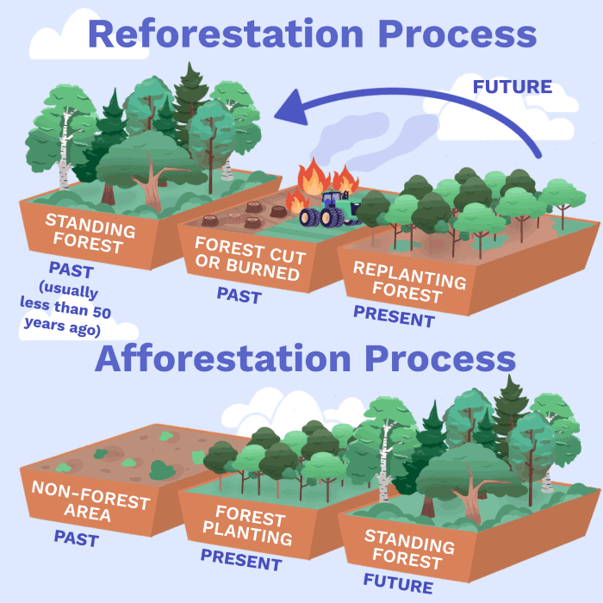
Reforestation and Afforestation
Reforestation means replanting trees in areas where forests were cut down or destroyed.
Afforestation means planting trees in areas that were not previously forested.
Purpose
  Prevents soil erosion
  Improves air quality
  Restores habitats for wildlife
  Helps absorb carbon dioxide and combat climate change

Slide 17
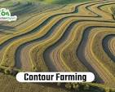
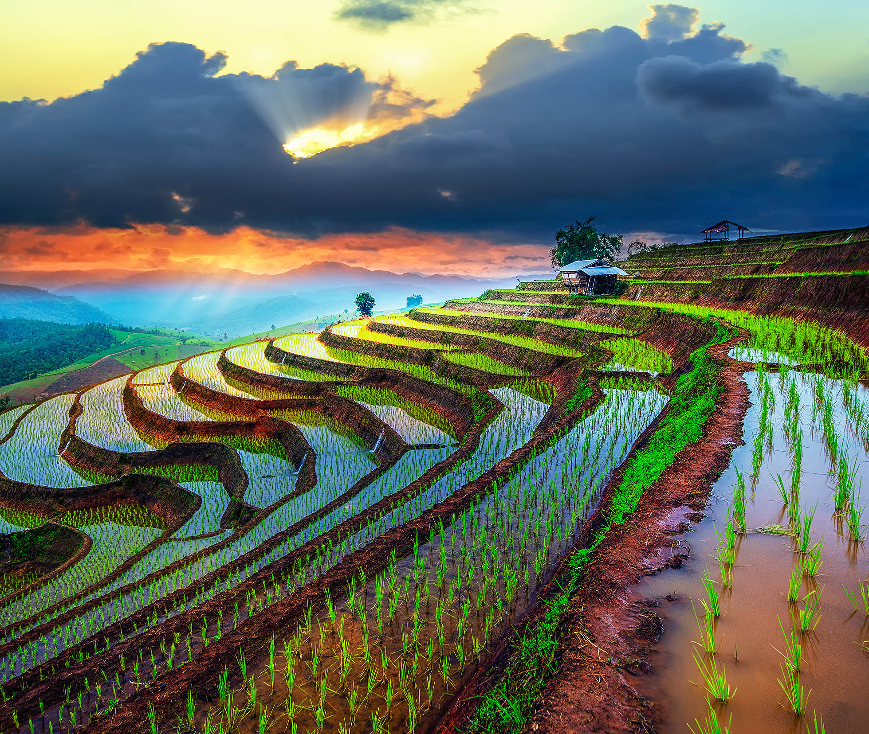
Contour Plowing and Terracing
Contour Plowing: Plowing along the natural curves or contours of the land to slow down water runoff.
Terracing: Creating step-like flat areas on slopes to prevent soil erosion and make hilly land suitable for farming.
Purpose
  Reduces water loss and soil erosion
  Improves water absorption by the soil
  Increases crop productivity on slopes

Slide 18
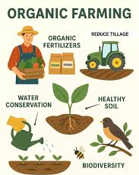
Organic and Conservation Farming
Organic Farming: Avoids synthetic fertilizers and pesticides, instead using compost, crop rotation, and natural pest control.
Conservation Farming: Minimizes soil disturbance, maintains crop cover, and rotates crops to keep the soil healthy.
Purpose
  Maintains soil fertility and biodiversity
  Protects groundwater from chemical pollution
  Promotes long-term agricultural sustainability

Slide 19
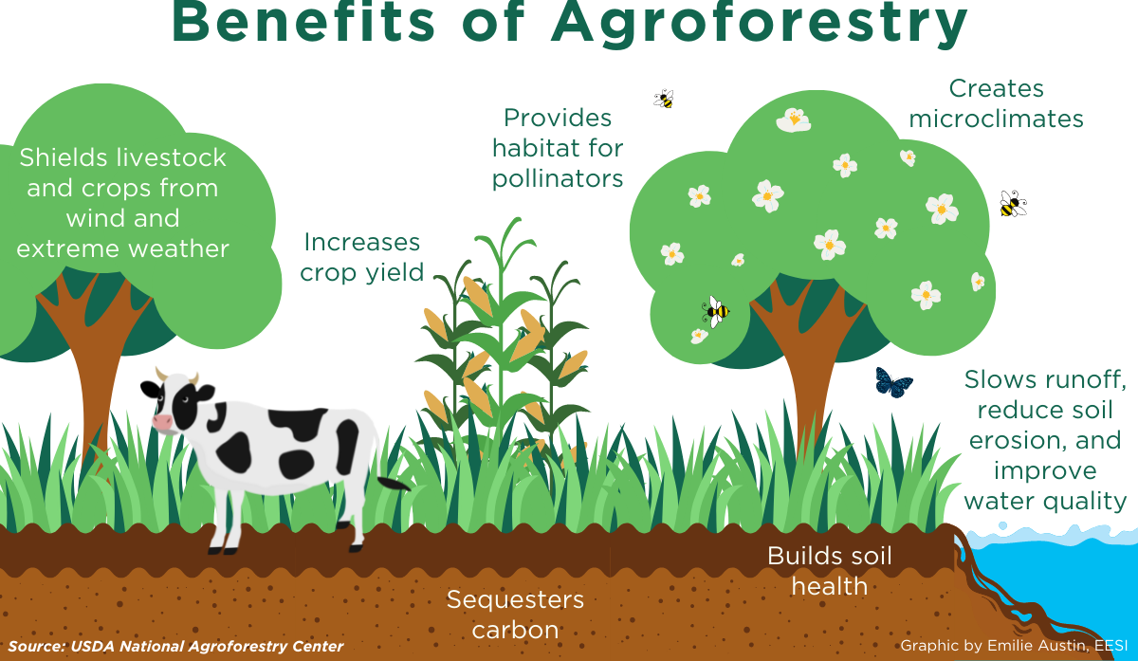
Agroforestry (Trees + Crops)
The practice of growing trees and crops together on the same land.
Purpose
  Prevents erosion and improves soil fertility.
  Provides shade, fruits, and additional income.
  Enhances biodiversity and reduces the need for chemical inputs.

Slide 20
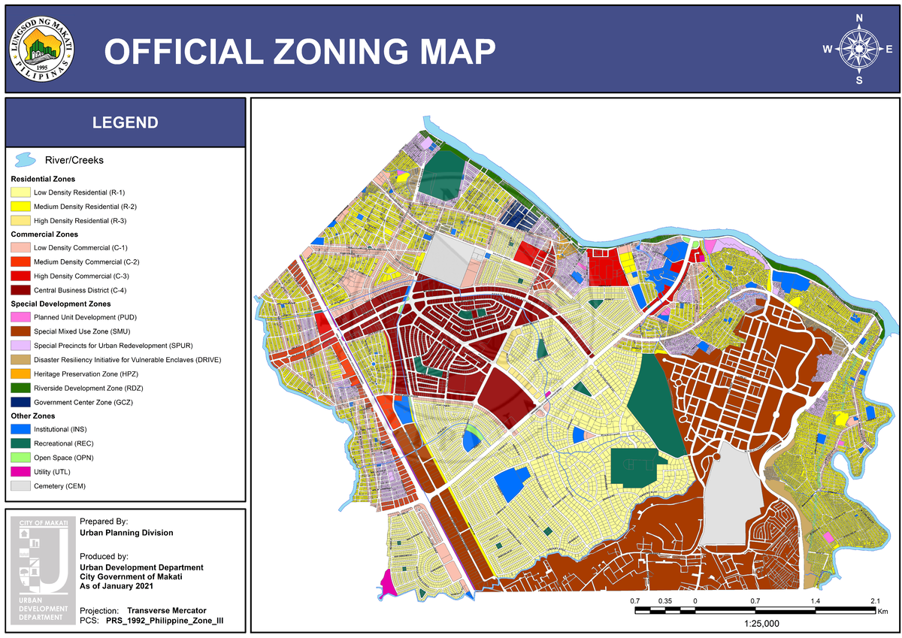
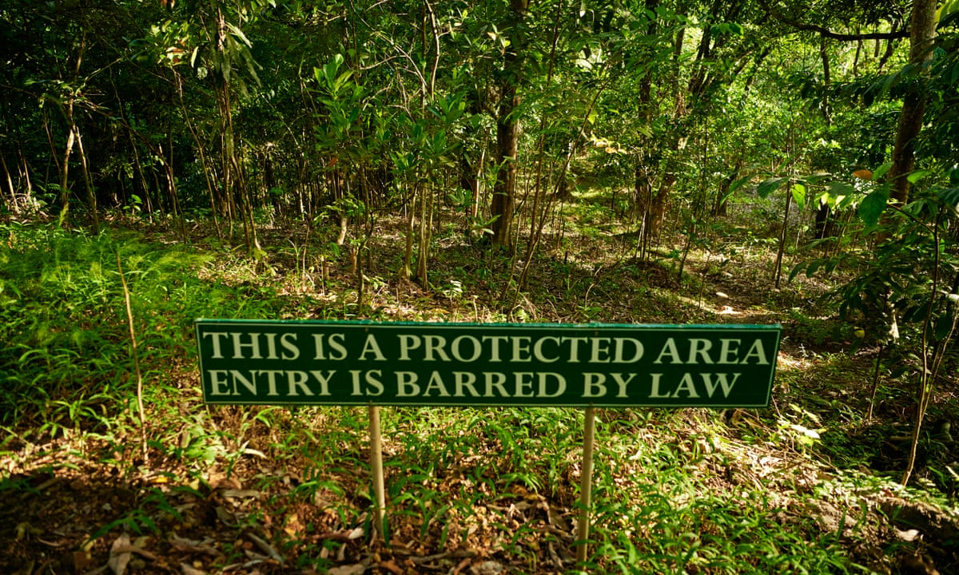
Land Zoning and Protected Areas
Land Zoning: Dividing land into zones (residential, agricultural, industrial, etc.) to guide proper land use.
Protected Areas: Declaring forests, watersheds, and ecosystems as protected zones.
Purpose
  Prevents land-use conflicts and overdevelopment
  Conserves natural habitats and biodiversity
  Ensures sustainable land allocation for different needs

Slide 21
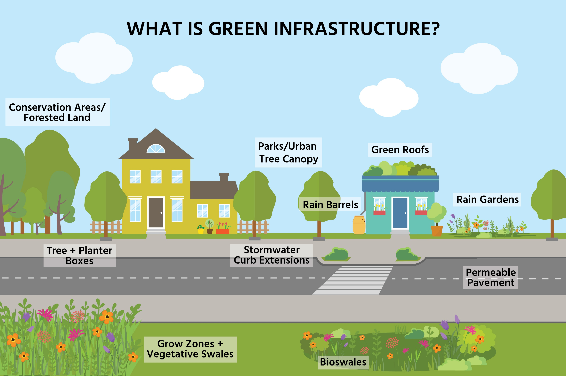
Use of Green Infrastructure
Designing cities and communities with nature-based solutions like parks, green roofs, buffer zones, and rain gardens.
Purpose
  Reduces flooding and improves air quality
  Enhances urban biodiversity
  Provides recreation and improves quality of life

Slide 22
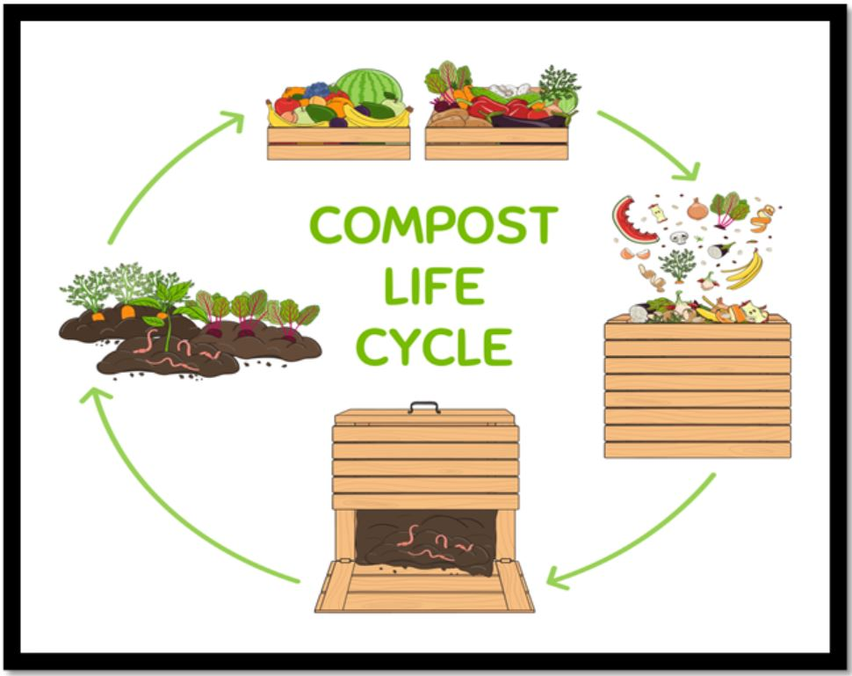
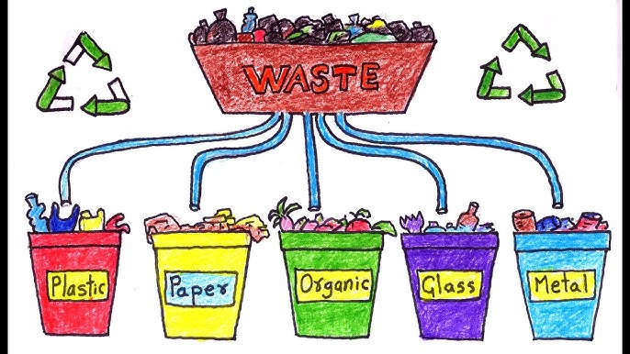
Proper Waste Disposal
Proper Waste Disposal means managing household, agricultural, and industrial waste properly to prevent pollution and land contamination.
Practices:
  Waste segregation and recycling
  Composting of biodegradable materials
  Safe disposal of hazardous waste
Purpose
  Keeps land and water sources clean
  Reduces greenhouse gas emissions from dumpsites

Slide 23
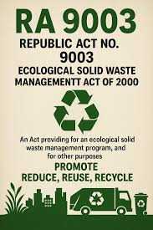
RA 9003
The Ecological Solid Waste Management Act of 2000 (Republic Act No. 9003) is a law that provides a comprehensive framework for proper solid waste management.
It emphasizes reducing, reusing, recycling, and proper disposal of solid waste.

Slide 24
Key Provisions
Waste Segregation
  Households, commercial establishments, and institutions must segregate waste into biodegradable, non-biodegradable, and recyclable materials.
Collection and Transport
  Local government units (LGUs) are responsible for collecting and transporting waste efficiently and sustainably.
Recycling and Composting
  Encourages resource recovery facilities to process recyclables and biodegradable waste.
Establishment of Materials Recovery Facility (MRF)
  LGUs must establish MRF in every barangay to sort, recycle, and compost waste.

Slide 25
Key Provisions
5. Prohibition of Open Dumping and Burning
  Open dumping of waste and burning of garbage are illegal to prevent pollution and health hazards.
6. Solid Waste Management Planning
  LGUs must prepare and implement a 10-year solid waste management plan, reviewed annually.
7. Public Education and Participation
  Programs to educate citizens on proper waste handling and encourage active participation.
8. Funding and Incentives
  LGUs can receive funds and incentives to support sustainable waste management programs.

Slide 26
Bioremediation
Bioremediation is the use of living organisms—such as bacteria, fungi, or plants to break down, detoxify, or remove pollutants from contaminated soil, water, or air.
Key Types
Microbial bioremediation – bacteria degrade oil, pesticides, or sewage.
Phytoremediation – plants absorb or stabilize heavy metals and toxins.
Mycoremediation – fungi decompose complex pollutants like petroleum products.

Slide 27
Type of Soil Contamination | Organism Used | Bioremediation Method |  | Example
Oil-contaminated soil | Bacteria (e.g., Pseudomonas spp.) | Microbial bioremediation | Bacteria degrade petroleum hydrocarbons into less harmful substances. | Soil cleanup after oil leaks near ports and fuel depots in Manila Bay.
Heavy metal–contaminated soil | Plants (sunflower, vetiver grass) | Phytoremediation | Plants absorb metals like lead and cadmium, which are removed during harvesting. | Mine-affected areas in Benguet and Nueva Vizcaya.
Pesticide-contaminated soil | Fungi (white-rot fungi) | Mycoremediation | Fungal enzymes break down persistent pesticide residues. | Intensive vegetable farming areas in Benguet and Laguna.

